Slide 1
FORM 5
GEOGRAPHY
Lesson 28
Basic Notions on Population
Notes:
Good morning, class, and welcome to our geography lesson. I am your geography teacher, Mr Kamdem. Today we are starting Lesson 28: Basic Notions on Population.

Slide 2
CLASS INFO
Class, Chapter and Duration
Class | Form 5
Chapter | Module III: Management of Population Growth and Space Colonisation
Duration | 2 periods (2 × 50 minutes)
Notes:
This lesson is for Form 5. It belongs to Module III: Management of Population Growth and Space Colonisation. We shall need 2 periods to cover it.

Slide 3
IDENTIFICATION
Lesson Identification
Topic | The Dynamics of Population and Implications
Sub-topic | Population and Population Distribution
Lesson | Lesson 28: Basic Notions on Population
Notions / Concepts | Population, demography, census, world population.
Syllabus focus | Definition; evolution of world's population.
Competence | Learners are able to define population and describe the evolution of the world population.
Notes:
Our topic is The Dynamics of Population and Implications, and the sub-topic is Population and Population Distribution. The key notions we shall use today are: population, demography, census, world population. At the end, you should be able to do this: learners are able to define population and describe the evolution of the world population.

Slide 4

HOMEWORK CORRECTION
Correction of the Homework
Question (Lesson 27: Pollution):
Identify two types of pollution in your town, their sources and one solution for each.
Notes:
Before we start the new lesson, let us correct the homework I gave you at the end of Lesson 27: Pollution. The question was: Identify two types of pollution in your town, their sources and one solution for each. Take out your exercise books.

Slide 5
HOMEWORK CORRECTION
Correction: Possible Answer
Example: air pollution from old cars and burning waste (inspect vehicles, stop burning); water pollution from waste in the river (bins and sanitation).
Notes:
Here is a good answer. Example: air pollution from old cars and burning waste (inspect vehicles, stop burning); water pollution from waste in the river (bins and sanitation). Compare it with your own answer and correct your work in red.

Slide 6
LESSON PLAN
Lesson Plan
Correction of the homework
Objectives and recall
Real-life situation and action to take
Learning activities
Board summary
Evaluation, remediation and homework
Notes:
Here is the plan of our lesson today. First, we shall correct the homework. Then we shall look at the objectives and recall what you already know. After that, we shall study a situation from real life and the action to take, and do the learning activities. Finally, we shall copy the board summary, do the evaluation and the remediation, and I will give you the homework.

Slide 7
OBJECTIVES
Objectives
By the end of this lesson, you should be able to:
Define population and demography.
Describe the evolution of the world population.
Notes:
Take your time to copy this part; we will continue together.

Slide 8
OBJECTIVES
Objectives (continued)
Explain the causes of rapid growth since 1950.
Notes:
By the end of this lesson, you should be able to do three things. Number 1: define population and demography. Number 2: describe the evolution of the world population. Number 3: explain the causes of rapid growth since 1950.

Slide 9
PREVIOUS KNOWLEDGE
Previous Knowledge
Cameroon has about 28 million people.
Many children are born in Africa.
Some regions are crowded.
Notes:
Let us first remember what you already know. Cameroon has about 28 million people. Many children are born in Africa. Some regions are crowded. Keep this in mind, because we shall build on it today.

Slide 10
REAL-LIFE SITUATION
Situation in Real Life
In 1950 the world had about 2.5 billion people, but today it has more than 8 billion. A pupil wonders why the population grew so fast.
Notes:
Listen carefully to this situation from real life. In 1950 the world had about 2.5 billion people, but today it has more than 8 billion. A pupil wonders why the population grew so fast. Think about it, because I am going to ask you some questions.

Slide 11
REAL-LIFE SITUATION
Situation: Question 1
What is the problem in the situation?
Notes:
Question 1: What is the problem in the situation? Think for a moment, then raise your hand to answer.

Slide 12
REAL-LIFE SITUATION
Answer
We want to understand the growth of the world population.
Notes:
Good. We want to understand the growth of the world population.

Slide 13
REAL-LIFE SITUATION
Situation: Question 2
What was the world population in 1950?
Notes:
Question 2: What was the world population in 1950? Think for a moment, then raise your hand to answer.

Slide 14
REAL-LIFE SITUATION
Answer
About 2.5 billion.
Notes:
Good. About 2.5 billion.

Slide 15
REAL-LIFE SITUATION
Situation: Question 3
What is it today?
Notes:
Question 3: What is it today? Think for a moment, then raise your hand to answer.

Slide 16
REAL-LIFE SITUATION
Possible Answer
More than 8 billion.
Notes:
Good. More than 8 billion.

Slide 17
ACTION TO TAKE
Action to Take
Take part in census operations and give correct information.
Notes:
From this situation, the action we are working towards in this lesson is the following: take part in census operations and give correct information.

Slide 18
JUSTIFICATION
Justification of the Lesson
This lesson introduces the study of population and its challenges.
Notes:
Why is this lesson important for you? This lesson introduces the study of population and its challenges.

Slide 19

1. DEFINITION
Activity 1
A crowd.
Notes:
Activity 1. Look carefully at this picture: a crowd. Observe every detail before I ask the question.

Slide 20
1. DEFINITION
Activity 1: Question
What is population?
Notes:
Here is the question for Activity 1: What is population? Take one minute to think and write your answer in your rough notebook.

Slide 21
1. DEFINITION
Activity 1: Answer
The total number of people living in an area at a given time.
Notes:
Let us check the answer together. The total number of people living in an area at a given time.

Slide 22
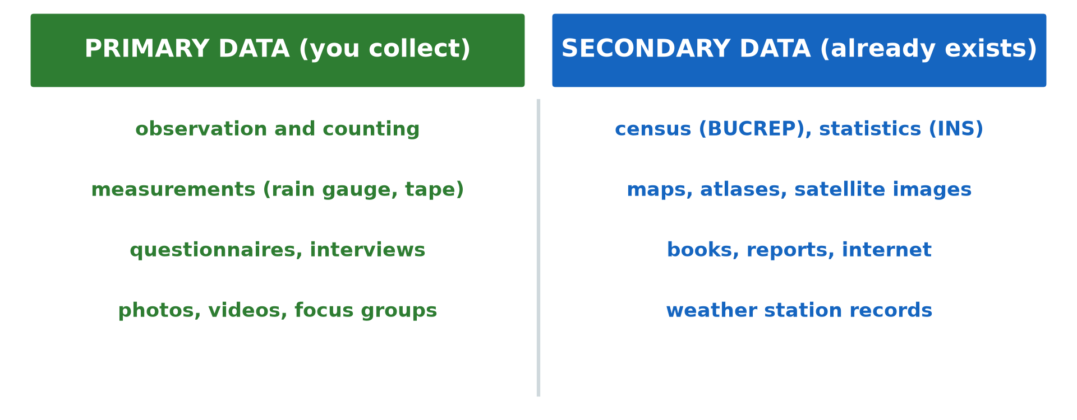
1. DEFINITION
Activity 2
Sources of data.
Notes:
Activity 2. Look carefully at this diagram: sources of data. Observe every detail before I ask the question.

Slide 23
1. DEFINITION
Activity 2: Question
What is demography?
Notes:
Here is the question for Activity 2: What is demography? Take one minute to think and write your answer in your rough notebook.

Slide 24
1. DEFINITION
Activity 2: Answer
The scientific study of human population.
Notes:
Let us check the answer together. The scientific study of human population.

Slide 25
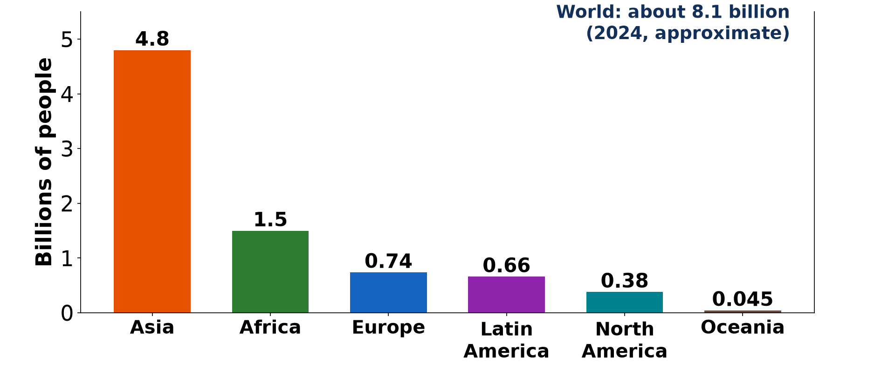
2. EVOLUTION: SLOW GROWTH
Activity 3
Growth of the world population.
Notes:
Activity 3. Look carefully at this diagram: growth of the world population. Observe every detail before I ask the question.

Slide 26
2. EVOLUTION: SLOW GROWTH
Activity 3: Question
Describe world population growth before 1800.
Notes:
Here is the question for Activity 3: Describe world population growth before 1800. Take one minute to think and write your answer in your rough notebook.

Slide 27
2. EVOLUTION: SLOW GROWTH
Activity 3: Answer
It was very slow because of high death rates from famine, disease and wars.
Notes:
Let us check the answer together. It was very slow because of high death rates from famine, disease and wars.

Slide 28
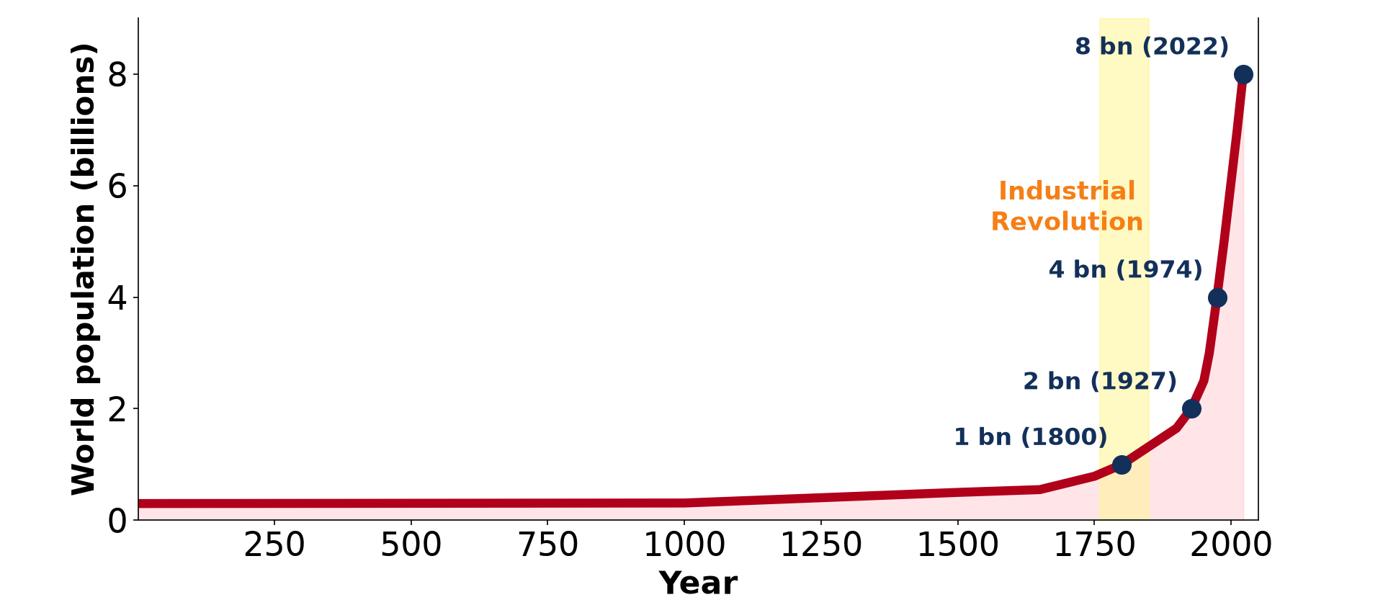
2. EVOLUTION: RAPID GROWTH
Activity 4
World population growth.
Notes:
Activity 4. Look carefully at this diagram: world population growth. Observe every detail before I ask the question.

Slide 29
2. EVOLUTION: RAPID GROWTH
Activity 4: Question
Describe world population growth since 1950.
Notes:
Here is the question for Activity 4: Describe world population growth since 1950. Take one minute to think and write your answer in your rough notebook.

Slide 30
2. EVOLUTION: RAPID GROWTH
Activity 4: Answer
It is very rapid, from 2.5 billion in 1950 to more than 8 billion today.
Notes:
Let us check the answer together. It is very rapid, from 2.5 billion in 1950 to more than 8 billion today.

Slide 31

3. CAUSES
Activity 5
Vaccination.
Notes:
Activity 5. Look carefully at this picture: vaccination. Observe every detail before I ask the question.

Slide 32
3. CAUSES
Activity 5: Question
Why did the population grow fast after 1950?
Notes:
Here is the question for Activity 5: Why did the population grow fast after 1950? Take one minute to think and write your answer in your rough notebook.

Slide 33
3. CAUSES
Activity 5: Answer
Death rates fell with medicine and food, while birth rates stayed high in LICs.
Notes:
Let us check the answer together. Death rates fell with medicine and food, while birth rates stayed high in LICs.

Slide 34
BOARD SUMMARY
Board Summary
Topic: The Dynamics of Population and Implications
Sub-topic: Population and Population Distribution
Lesson 28: Basic Notions on Population
Notes:
Now we are going to copy the board summary. Write the title and the headings neatly in your notebooks. I will give you enough time for each slide, so do not rush.

Slide 35
BOARD SUMMARY
DEFINITIONS
The key terms of this lesson are defined as follows:
Population: It is the total number of people living in an area at a given time.
Demography: It is the scientific study of human population.
Notes:
Let us copy the definitions. The key terms of this lesson are defined as follows. On this slide we have Population and Demography. Write each point on a new line, with the key term first, and explain it in your own words when we revise.

Slide 36
BOARD SUMMARY
1. Evolution of the World Population
The world population evolved as follows:
Before 1800: Growth was slow because of famine, diseases and wars.
1800 to 1950: Growth increased with the Industrial Revolution in Europe.
Notes:
Let us copy Evolution of the World Population. The world population evolved as follows. On this slide we have Before 1800 and 1800 to 1950. Write each point on a new line, with the key term first, and explain it in your own words when we revise. When you finish, we go to the next slide.

Slide 37
BOARD SUMMARY
1. Evolution of the World Population (continued)
Since 1950: Growth is very fast, reaching more than 8 billion people today.
Causes: Medicine, vaccines and more food reduced death rates.
Notes:
We continue with Evolution of the World Population. On this slide we have Since 1950 and Causes. Write each point on a new line, with the key term first, and explain it in your own words when we revise.

Slide 38
BOARD SUMMARY
1. Evolution of the World Population
Illustration: growth of the world population
Notes:
Now draw this illustration in your notebook: growth of the world population. Give it a title and label it clearly.

Slide 39
FORMATIVE EVALUATION
Evaluation 1
Define population.
Notes:
Now let us check what you have understood. Question 1: Define population. Answer in your exercise book.

Slide 40
FORMATIVE EVALUATION
Expected Answer
The total number of people in an area at a given time.
Notes:
The expected answer is: the total number of people in an area at a given time. If you got it right, well done.

Slide 41
FORMATIVE EVALUATION
Evaluation 2
Give one cause of rapid growth since 1950.
Notes:
Now let us check what you have understood. Question 2: Give one cause of rapid growth since 1950. Answer in your exercise book.

Slide 42
FORMATIVE EVALUATION
Expected Answer
Falling death rates due to medicine.
Notes:
The expected answer is: falling death rates due to medicine. If you got it right, well done.

Slide 43
REMEDIATION
Remediation
Fill in the blanks:
The study of population is ______.
The world population passed ______ billion in 2022.
Vaccines reduced the ______ rate.
Notes:
For those who need more practice, fill in the blanks in your exercise book. The answers are: number 1, demography; number 2, eight (8); number 3, death.

Slide 44
HOMEWORK
Homework
Find the population of Cameroon in the censuses of 1976, 1987 and 2005.
Notes:
For your homework: Find the population of Cameroon in the censuses of 1976, 1987 and 2005. We shall correct it at the beginning of our next lesson.

Slide 45
NEXT LESSON
Next Lesson
Our next lesson will be on:
Further Study 3: Sources of Population Data
Notes:
Our next lesson will be on Further Study 3: Sources of Population Data. Thank you for your attention, and see you next time.

Slide 46
BILINGUAL GAME
Bilingual Game (Jeu Bilingue)
English | Français
Population | La population
Demography | La démographie
Census | Le recensement
Growth | La croissance
Billion | Le milliard
Death rate | Le taux de mortalité
Notes:
Let us play the bilingual game. I say a word in English, and you give me the French word. Then we do the reverse.

Slide 47
LOGBOOK
Official Logbook (1/2)
Module / Topic | The Dynamics of Population and Implications
Lesson Title | Lesson 28: Basic Notions on Population
Expected Learning Outcomes | Define population and demography. Describe the evolution of the world population. Explain the causes of rapid growth since 1950.
Competence | Learners are able to define population and describe the evolution of the world population.
Notes:
I record this information in the official logbook of the class after the lesson.

Slide 48
LOGBOOK
Official Logbook (2/2)
Matter Taught | DEFINITIONS; Evolution of the World Population.
Evaluation | Formative evaluation and remediation exercise.
Homework | Find the population of Cameroon in the censuses of 1976, 1987 and 2005.
Enrolment / Present / Absent | ____ / ____ / ____
Achievement | To be completed after the lesson.
Notes:
I complete the second page of the logbook: the matter taught, the evaluation, the homework and the attendance.

Slide 49
TEACHER'S NOTE
Teacher's Note
Timing: Homework correction, plan, objectives 8 min | Recall, situation, action 10 min | 5 activities 30 min | Board summary (copying) 30 min | Evaluation, remediation 10 min | Homework, next lesson 5 min | Logbook 7 min
Without the projector (Activity 1): discuss.
Without the projector (Activity 2): define.
Without the projector (Activity 3): describe the graph.
Without the projector (Activity 4): describe.
Without the projector (Activity 5): discuss.
Notes:
This slide is for me, the teacher: it gives the timing of the lesson and what to do if the projector is not available.

Slide 50
REFERENCES
References
Geography Syllabus, Forms I–V, MINESEC (2023) — Form 5, Module III: Management of Population Growth and Space Colonisation.
Photo, Activity 1: “Wax market” by zouzouwizman, CC BY 2.0, via Flickr (https://www.flickr.com/photos/61111202@N00/12129001)
Photo, Activity 5: “Isatu gets a vaccination for her 5 week old son” by World Bank Photo Collection, CC BY-NC-ND 2.0, via Flickr (https://www.flickr.com/photos/10816734@N03/26372818523)
Diagrams and animations: drawn for this lesson (Geography Department).
Notes:
These are the references and picture credits used to prepare this lesson.

