Slide 1
FORM 5
GEOGRAPHY
Lesson 32
Basic Types of Age-Sex Pyramids
Notes:
Good morning, class, and welcome to our geography lesson. I am your geography teacher, Mr Kamdem. Today we are starting Lesson 32: Basic Types of Age-Sex Pyramids.

Slide 2
CLASS INFO
Class, Chapter and Duration
Class | Form 5
Chapter | Module III: Management of Population Growth and Space Colonisation
Duration | 2 periods (2 × 50 minutes)
Notes:
This lesson is for Form 5. It belongs to Module III: Management of Population Growth and Space Colonisation. We shall need 2 periods to cover it.

Slide 3
IDENTIFICATION
Lesson Identification
Topic | The Dynamics of Population and Implications
Sub-topic | Population Structure and Composition
Lesson | Lesson 32: Basic Types of Age-Sex Pyramids
Notions / Concepts | Population pyramid, progressive, regressive, stationary.
Syllabus focus | Meaning of population pyramid; types (progressive, regressive, stationary) with diagrams and examples of countries; main characteristics of each group.
Competence | Learners are able to draw and interpret the types of age-sex pyramids.
Notes:
Our topic is The Dynamics of Population and Implications, and the sub-topic is Population Structure and Composition. The key notions we shall use today are: population pyramid, progressive, regressive, stationary. At the end, you should be able to do this: learners are able to draw and interpret the types of age-sex pyramids.

Slide 4

HOMEWORK CORRECTION
Correction of the Homework
Question (Lesson 31: Age Composition of Population):
Give three needs of the young population of Cameroon.
Notes:
Before we start the new lesson, let us correct the homework I gave you at the end of Lesson 31: Age Composition of Population. The question was: Give three needs of the young population of Cameroon. Take out your exercise books.

Slide 5
HOMEWORK CORRECTION
Correction: Possible Answer
Schools and teachers, health care and vaccines, and jobs for school leavers (also sports and leisure facilities).
Notes:
Here is a good answer. Schools and teachers, health care and vaccines, and jobs for school leavers (also sports and leisure facilities). Compare it with your own answer and correct your work in red.

Slide 6
LESSON PLAN
Lesson Plan
Correction of the homework
Objectives and recall
Real-life situation and action to take
Learning activities
Board summary
Evaluation, remediation and homework
Notes:
Here is the plan of our lesson today. First, we shall correct the homework. Then we shall look at the objectives and recall what you already know. After that, we shall study a situation from real life and the action to take, and do the learning activities. Finally, we shall copy the board summary, do the evaluation and the remediation, and I will give you the homework.

Slide 7
OBJECTIVES
Objectives
By the end of this lesson, you should be able to:
Define an age-sex pyramid.
Draw the three types of pyramids.
Give the characteristics and examples of each type.
Notes:
By the end of this lesson, you should be able to do three things. Number 1: define an age-sex pyramid. Number 2: draw the three types of pyramids. Number 3: give the characteristics and examples of each type.

Slide 8
PREVIOUS KNOWLEDGE
Previous Knowledge
Population has age groups.
Cameroon has many young people.
Japan has many old people.
Notes:
Let us first remember what you already know. Population has age groups. Cameroon has many young people. Japan has many old people. Keep this in mind, because we shall build on it today.

Slide 9
REAL-LIFE SITUATION
Situation in Real Life
The teacher shows two pyramids: one with a wide base and a narrow top, the other narrow at the base and wide at the top. The class must name and explain them.
Notes:
Listen carefully to this situation from real life. The teacher shows two pyramids: one with a wide base and a narrow top, the other narrow at the base and wide at the top. The class must name and explain them. Think about it, because I am going to ask you some questions.

Slide 10
REAL-LIFE SITUATION
Situation: Question 1
What is the problem in the situation?
Notes:
Question 1: What is the problem in the situation? Think for a moment, then raise your hand to answer.

Slide 11
REAL-LIFE SITUATION
Answer
The class must interpret population pyramids.
Notes:
Good. The class must interpret population pyramids.

Slide 12
REAL-LIFE SITUATION
Situation: Question 2
What does a wide base show?
Notes:
Question 2: What does a wide base show? Think for a moment, then raise your hand to answer.

Slide 13
REAL-LIFE SITUATION
Answer
Many young people (high birth rate).
Notes:
Good. Many young people (high birth rate).

Slide 14
REAL-LIFE SITUATION
Situation: Question 3
What does a narrow base show?
Notes:
Question 3: What does a narrow base show? Think for a moment, then raise your hand to answer.

Slide 15
REAL-LIFE SITUATION
Possible Answer
Few births.
Notes:
Good. Few births.

Slide 16
ACTION TO TAKE
Action to Take
Draw graphs neatly with a title, axes and key.
Notes:
From this situation, the action we are working towards in this lesson is the following: draw graphs neatly with a title, axes and key.

Slide 17
JUSTIFICATION
Justification of the Lesson
This lesson helps us to read the age structure of countries.
Notes:
Why is this lesson important for you? This lesson helps us to read the age structure of countries.

Slide 18

1. MEANING
Activity 1
Pyramid of Cameroon.
Notes:
Activity 1. Look carefully at this diagram: pyramid of Cameroon. Observe every detail before I ask the question.

Slide 19
1. MEANING
Activity 1: Question
What is an age-sex pyramid?
Notes:
Here is the question for Activity 1: What is an age-sex pyramid? Take one minute to think and write your answer in your rough notebook.

Slide 20
1. MEANING
Activity 1: Answer
A graph showing the population by age groups and sex.
Notes:
Let us check the answer together. A graph showing the population by age groups and sex.

Slide 21
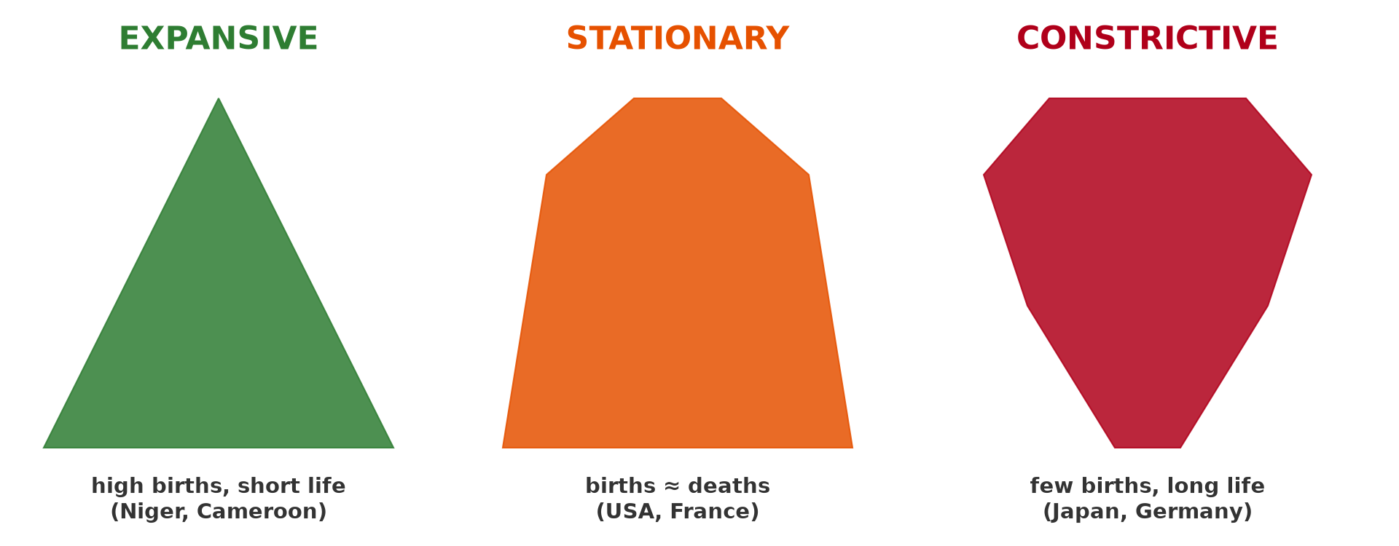
2. PROGRESSIVE PYRAMID
Activity 2
Types of pyramids.
Notes:
Activity 2. Look carefully at this diagram: types of pyramids. Observe every detail before I ask the question.

Slide 22
2. PROGRESSIVE PYRAMID
Activity 2: Question
Describe a progressive pyramid and give an example.
Notes:
Here is the question for Activity 2: Describe a progressive pyramid and give an example. Take one minute to think and write your answer in your rough notebook.

Slide 23
2. PROGRESSIVE PYRAMID
Activity 2: Answer
Wide base and narrow top (high birth and death rates), as in Cameroon or Niger.
Notes:
Let us check the answer together. Wide base and narrow top (high birth and death rates), as in Cameroon or Niger.

Slide 24
2. STATIONARY PYRAMID
Activity 3
Types of pyramids.
Notes:
Activity 3. Look carefully at this diagram: types of pyramids. Observe every detail before I ask the question.

Slide 25
2. STATIONARY PYRAMID
Activity 3: Question
Describe a stationary pyramid and give an example.
Notes:
Here is the question for Activity 3: Describe a stationary pyramid and give an example. Take one minute to think and write your answer in your rough notebook.

Slide 26
2. STATIONARY PYRAMID
Activity 3: Answer
Almost straight sides (low birth and death rates), as in the USA or France.
Notes:
Let us check the answer together. Almost straight sides (low birth and death rates), as in the USA or France.

Slide 27

2. REGRESSIVE PYRAMID
Activity 4
Pyramid of Japan.
Notes:
Activity 4. Look carefully at this diagram: pyramid of Japan. Observe every detail before I ask the question.

Slide 28
2. REGRESSIVE PYRAMID
Activity 4: Question
Describe a regressive pyramid and give an example.
Notes:
Here is the question for Activity 4: Describe a regressive pyramid and give an example. Take one minute to think and write your answer in your rough notebook.

Slide 29
2. REGRESSIVE PYRAMID
Activity 4: Answer
Narrow base and wider top (very low births, many old people), as in Japan or Germany.
Notes:
Let us check the answer together. Narrow base and wider top (very low births, many old people), as in Japan or Germany.

Slide 30
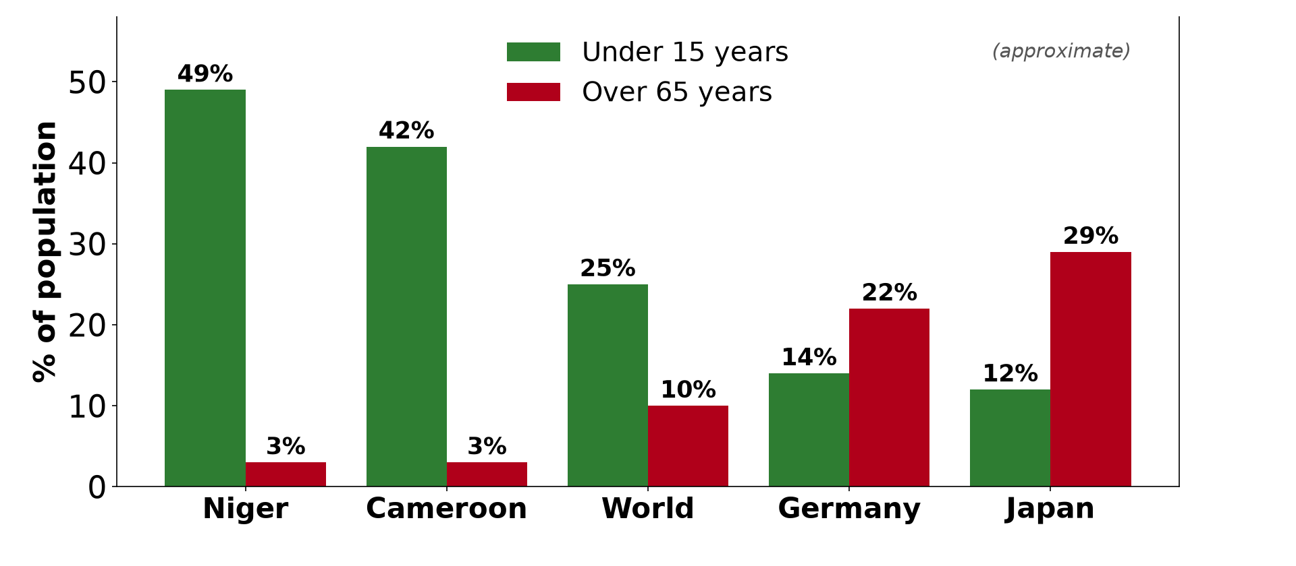
3. CHARACTERISTICS
Activity 5
Young and ageing populations.
Notes:
Activity 5. Look carefully at this diagram: young and ageing populations. Observe every detail before I ask the question.

Slide 31
3. CHARACTERISTICS
Activity 5: Question
Which type shows a growing population?
Notes:
Here is the question for Activity 5: Which type shows a growing population? Take one minute to think and write your answer in your rough notebook.

Slide 32
3. CHARACTERISTICS
Activity 5: Answer
The progressive pyramid.
Notes:
Let us check the answer together. The progressive pyramid.

Slide 33
BOARD SUMMARY
Board Summary
Topic: The Dynamics of Population and Implications
Sub-topic: Population Structure and Composition
Lesson 32: Basic Types of Age-Sex Pyramids
Notes:
Now we are going to copy the board summary. Write the title and the headings neatly in your notebooks. I will give you enough time for each slide, so do not rush.

Slide 34
BOARD SUMMARY
DEFINITIONS
The key terms of this lesson are defined as follows:
Age-sex pyramid: It is a graph showing the population by age groups and sex.
Notes:
Let us copy the definitions. The key terms of this lesson are defined as follows. On this slide we have Age-sex pyramid. Write each point on a new line, with the key term first, and explain it in your own words when we revise.

Slide 35
BOARD SUMMARY
1. Types of Pyramids
There are three basic types of pyramids:
Progressive pyramid: It has a wide base and a narrow top, as in Cameroon and Niger.
Stationary pyramid: It has almost straight sides, as in the USA and France.
Notes:
Let us copy Types of Pyramids. There are three basic types of pyramids. On this slide we have Progressive pyramid and Stationary pyramid. Write each point on a new line, with the key term first, and explain it in your own words when we revise. When you finish, we go to the next slide.

Slide 36
BOARD SUMMARY
1. Types of Pyramids (continued)
Regressive pyramid: It has a narrow base and a wider top, as in Japan and Germany.
Notes:
We continue with Types of Pyramids. On this slide we have Regressive pyramid. Write each point on a new line, with the key term first, and explain it in your own words when we revise.

Slide 37
BOARD SUMMARY
1. Types of Pyramids
Illustration: types of age-sex pyramids
Notes:
Now draw this illustration in your notebook: types of age-sex pyramids. Give it a title and label it clearly.

Slide 38
BOARD SUMMARY
2. Main Characteristics
Each type has the following characteristics:
Progressive: High birth rates, many young people and rapid growth.
Stationary: Low birth and death rates and slow growth.
Notes:
Let us copy Main Characteristics. Each type has the following characteristics. On this slide we have Progressive and Stationary. Write each point on a new line, with the key term first, and explain it in your own words when we revise. When you finish, we go to the next slide.

Slide 39
BOARD SUMMARY
2. Main Characteristics (continued)
Regressive: Very low birth rates, many old people and declining population.
Notes:
We continue with Main Characteristics. On this slide we have Regressive. Write each point on a new line, with the key term first, and explain it in your own words when we revise.

Slide 40
FORMATIVE EVALUATION
Evaluation 1
Name the three types of pyramids.
Notes:
Now let us check what you have understood. Question 1: Name the three types of pyramids. Answer in your exercise book.

Slide 41
FORMATIVE EVALUATION
Expected Answer
Progressive, stationary and regressive.
Notes:
The expected answer is: progressive, stationary and regressive. If you got it right, well done.

Slide 42
FORMATIVE EVALUATION
Evaluation 2
Give one characteristic and one example of a progressive pyramid.
Notes:
Now let us check what you have understood. Question 2: Give one characteristic and one example of a progressive pyramid. Answer in your exercise book.

Slide 43
FORMATIVE EVALUATION
Expected Answer
Wide base; Cameroon.
Notes:
The expected answer is: wide base; Cameroon. If you got it right, well done.

Slide 44
REMEDIATION
Remediation
Fill in the blanks:
A pyramid with a wide base is ______.
Japan has a ______ pyramid.
Males are shown on the ______ side.
Notes:
For those who need more practice, fill in the blanks in your exercise book. The answers are: number 1, progressive; number 2, regressive; number 3, left.

Slide 45
HOMEWORK
Homework
Draw the three types of age-sex pyramids and give one example of a country for each.
Notes:
For your homework: Draw the three types of age-sex pyramids and give one example of a country for each. We shall correct it at the beginning of our next lesson.

Slide 46
NEXT LESSON
Next Lesson
Our next lesson will be on:
Lesson 33: Population Growth
Notes:
Our next lesson will be on Lesson 33: Population Growth. Thank you for your attention, and see you next time.

Slide 47
BILINGUAL GAME
Bilingual Game (Jeu Bilingue)
English | Français
Pyramid | La pyramide
Progressive | Progressive
Regressive | Régressive
Stationary | Stationnaire
Male | Masculin
Female | Féminin
Notes:
Let us play the bilingual game. I say a word in English, and you give me the French word. Then we do the reverse.

Slide 48
LOGBOOK
Official Logbook (1/2)
Module / Topic | The Dynamics of Population and Implications
Lesson Title | Lesson 32: Basic Types of Age-Sex Pyramids
Expected Learning Outcomes | Define an age-sex pyramid. Draw the three types of pyramids. Give the characteristics and examples of each type.
Competence | Learners are able to draw and interpret the types of age-sex pyramids.
Notes:
I record this information in the official logbook of the class after the lesson.

Slide 49
LOGBOOK
Official Logbook (2/2)
Matter Taught | DEFINITIONS; Types of Pyramids; Main Characteristics.
Evaluation | Formative evaluation and remediation exercise.
Homework | Draw the three types of age-sex pyramids and give one example of a country for each.
Enrolment / Present / Absent | ____ / ____ / ____
Achievement | To be completed after the lesson.
Notes:
I complete the second page of the logbook: the matter taught, the evaluation, the homework and the attendance.

Slide 50
TEACHER'S NOTE
Teacher's Note
Timing: Homework correction, plan, objectives 8 min | Recall, situation, action 10 min | 5 activities 30 min | Board summary (copying) 30 min | Evaluation, remediation 10 min | Homework, next lesson 5 min | Logbook 7 min
Without the projector (Activity 1): describe.
Without the projector (Activity 2): draw.
Without the projector (Activity 3): draw.
Without the projector (Activity 4): draw.
Without the projector (Activity 5): discuss.
Notes:
This slide is for me, the teacher: it gives the timing of the lesson and what to do if the projector is not available.

Slide 51
REFERENCES
References
Geography Syllabus, Forms I–V, MINESEC (2023) — Form 5, Module III: Management of Population Growth and Space Colonisation.
Diagrams and animations: drawn for this lesson (Geography Department).
Notes:
These are the references and picture credits used to prepare this lesson.

