Slide 1
FORM 5
GEOGRAPHY
Lesson 34
The Demographic Transition Model (DTM)
Notes:
Good morning, class, and welcome to our geography lesson. I am your geography teacher, Mr Kamdem. Today we are starting Lesson 34: The Demographic Transition Model (DTM).

Slide 2
CLASS INFO
Class, Chapter and Duration
Class | Form 5
Chapter | Module III: Management of Population Growth and Space Colonisation
Duration | 2 periods (2 × 50 minutes)
Notes:
This lesson is for Form 5. It belongs to Module III: Management of Population Growth and Space Colonisation. We shall need 2 periods to cover it.

Slide 3
IDENTIFICATION
Lesson Identification
Topic | The Dynamics of Population and Implications
Sub-topic | Population Change in Time (Population Growth)
Lesson | Lesson 34: The Demographic Transition Model (DTM)
Notions / Concepts | Demographic transition, stages, birth rate, death rate.
Syllabus focus | Meaning; stages (diagram); main characteristics.
Competence | Learners are able to draw and explain the demographic transition model.
Notes:
Our topic is The Dynamics of Population and Implications, and the sub-topic is Population Change in Time (Population Growth). The key notions we shall use today are: demographic transition, stages, birth rate, death rate. At the end, you should be able to do this: learners are able to draw and explain the demographic transition model.

Slide 4

HOMEWORK CORRECTION
Correction of the Homework
Question (Lesson 33: Population Growth):
A town of 50,000 people has 1,900 births and 450 deaths in a year. Calculate the birth rate, death rate and natural increase rate.
Notes:
Before we start the new lesson, let us correct the homework I gave you at the end of Lesson 33: Population Growth. The question was: A town of 50,000 people has 1,900 births and 450 deaths in a year. Calculate the birth rate, death rate and natural increase rate. Take out your exercise books.

Slide 5
HOMEWORK CORRECTION
Correction: Possible Answer
BR = 1,900 ÷ 50,000 × 1,000 = 38‰; DR = 9‰; NIR = (38 − 9) ÷ 10 = 2.9 %.
Notes:
Here is a good answer. BR = 1,900 ÷ 50,000 × 1,000 = 38‰; DR = 9‰; NIR = (38 − 9) ÷ 10 = 2.9 %. Compare it with your own answer and correct your work in red.

Slide 6
LESSON PLAN
Lesson Plan
Correction of the homework
Objectives and recall
Real-life situation and action to take
Learning activities
Board summary
Evaluation, remediation and homework
Notes:
Here is the plan of our lesson today. First, we shall correct the homework. Then we shall look at the objectives and recall what you already know. After that, we shall study a situation from real life and the action to take, and do the learning activities. Finally, we shall copy the board summary, do the evaluation and the remediation, and I will give you the homework.

Slide 7
OBJECTIVES
Objectives
By the end of this lesson, you should be able to:
Define the demographic transition model.
Draw the DTM with its stages.
Give the characteristics of each stage.
Notes:
By the end of this lesson, you should be able to do three things. Number 1: define the demographic transition model. Number 2: draw the DTM with its stages. Number 3: give the characteristics of each stage.

Slide 8
PREVIOUS KNOWLEDGE
Previous Knowledge
Birth and death rates change over time.
Death rates fell with medicine.
Europe now has low birth rates.
Notes:
Let us first remember what you already know. Birth and death rates change over time. Death rates fell with medicine. Europe now has low birth rates. Keep this in mind, because we shall build on it today.

Slide 9
REAL-LIFE SITUATION
Situation in Real Life
In Britain, birth and death rates were high in 1700 and are low today. Cameroon is now between these two situations.
Notes:
Listen carefully to this situation from real life. In Britain, birth and death rates were high in 1700 and are low today. Cameroon is now between these two situations. Think about it, because I am going to ask you some questions.

Slide 10
REAL-LIFE SITUATION
Situation: Question 1
What is the problem in the situation?
Notes:
Question 1: What is the problem in the situation? Think for a moment, then raise your hand to answer.

Slide 11
REAL-LIFE SITUATION
Answer
We want to explain how birth and death rates change.
Notes:
Good. We want to explain how birth and death rates change.

Slide 12
REAL-LIFE SITUATION
Situation: Question 2
What were the rates in Britain in 1700?
Notes:
Question 2: What were the rates in Britain in 1700? Think for a moment, then raise your hand to answer.

Slide 13
REAL-LIFE SITUATION
Answer
High.
Notes:
Good. High.

Slide 14
REAL-LIFE SITUATION
Situation: Question 3
What are they today?
Notes:
Question 3: What are they today? Think for a moment, then raise your hand to answer.

Slide 15
REAL-LIFE SITUATION
Possible Answer
Low.
Notes:
Good. Low.

Slide 16
ACTION TO TAKE
Action to Take
Support education and health, which lower birth and death rates.
Notes:
From this situation, the action we are working towards in this lesson is the following: support education and health, which lower birth and death rates.

Slide 17
JUSTIFICATION
Justification of the Lesson
This lesson helps us to understand the stages of population change of countries.
Notes:
Why is this lesson important for you? This lesson helps us to understand the stages of population change of countries.

Slide 18
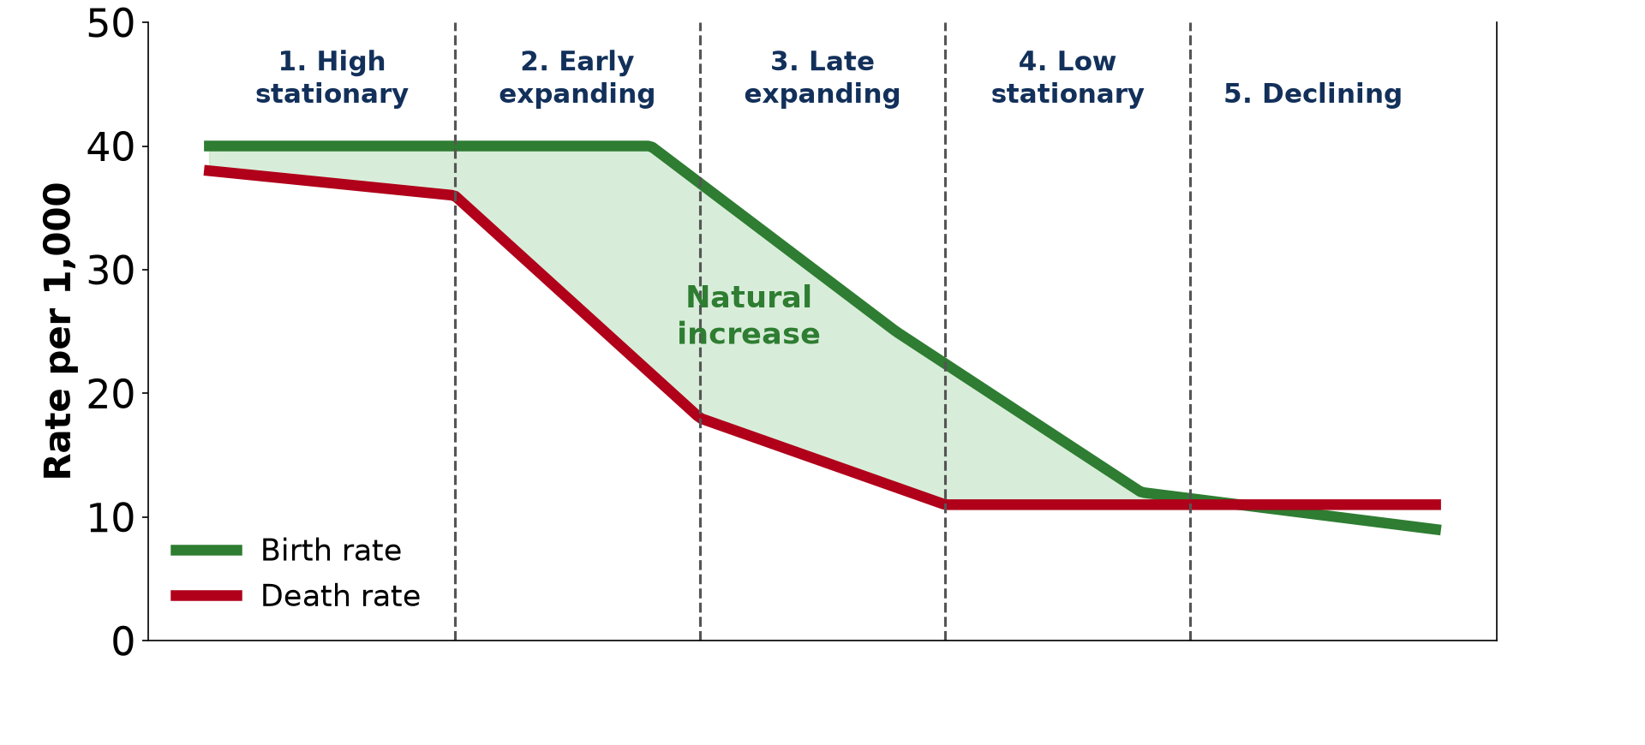
1. MEANING
Activity 1
The demographic transition model.
Notes:
Activity 1. Look carefully at this diagram: the demographic transition model. Observe every detail before I ask the question.

Slide 19
1. MEANING
Activity 1: Question
What is the DTM?
Notes:
Here is the question for Activity 1: What is the DTM? Take one minute to think and write your answer in your rough notebook.

Slide 20
1. MEANING
Activity 1: Answer
A model showing how birth and death rates change as a country develops.
Notes:
Let us check the answer together. A model showing how birth and death rates change as a country develops.

Slide 21
2. STAGES 1 AND 2
Activity 2
Stages 1 and 2.
Notes:
Activity 2. Look carefully at this diagram: stages 1 and 2. Observe every detail before I ask the question.

Slide 22
2. STAGES 1 AND 2
Activity 2: Question
Describe stages 1 and 2.
Notes:
Here is the question for Activity 2: Describe stages 1 and 2. Take one minute to think and write your answer in your rough notebook.

Slide 23
2. STAGES 1 AND 2
Activity 2: Answer
Stage 1: high birth and death rates; stage 2: death rate falls and population grows fast.
Notes:
Let us check the answer together. Stage 1: high birth and death rates; stage 2: death rate falls and population grows fast.

Slide 24
2. STAGES 3 AND 4
Activity 3
Stages 3 and 4.
Notes:
Activity 3. Look carefully at this diagram: stages 3 and 4. Observe every detail before I ask the question.

Slide 25
2. STAGES 3 AND 4
Activity 3: Question
Describe stages 3 and 4.
Notes:
Here is the question for Activity 3: Describe stages 3 and 4. Take one minute to think and write your answer in your rough notebook.

Slide 26
2. STAGES 3 AND 4
Activity 3: Answer
Stage 3: birth rate falls; stage 4: both rates are low and growth is slow.
Notes:
Let us check the answer together. Stage 3: birth rate falls; stage 4: both rates are low and growth is slow.

Slide 27

2. STAGE 5
Activity 4
An ageing country.
Notes:
Activity 4. Look carefully at this diagram: an ageing country. Observe every detail before I ask the question.

Slide 28
2. STAGE 5
Activity 4: Question
Describe stage 5.
Notes:
Here is the question for Activity 4: Describe stage 5. Take one minute to think and write your answer in your rough notebook.

Slide 29
2. STAGE 5
Activity 4: Answer
The birth rate falls below the death rate and the population declines.
Notes:
Let us check the answer together. The birth rate falls below the death rate and the population declines.

Slide 30
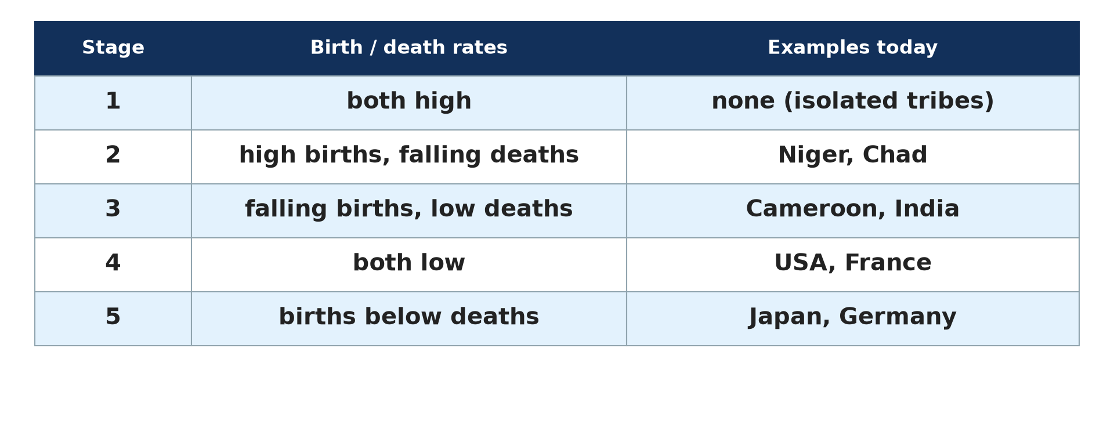
3. EXAMPLES
Activity 5
Countries in the DTM.
Notes:
Activity 5. Look carefully at this diagram: countries in the DTM. Observe every detail before I ask the question.

Slide 31
3. EXAMPLES
Activity 5: Question
Place Cameroon, Brazil and Japan in the DTM.
Notes:
Here is the question for Activity 5: Place Cameroon, Brazil and Japan in the DTM. Take one minute to think and write your answer in your rough notebook.

Slide 32
3. EXAMPLES
Activity 5: Answer
Cameroon: stage 2–3; Brazil: stage 3–4; Japan: stage 5.
Notes:
Let us check the answer together. Cameroon: stage 2–3; Brazil: stage 3–4; Japan: stage 5.

Slide 33
BOARD SUMMARY
Board Summary
Topic: The Dynamics of Population and Implications
Sub-topic: Population Change in Time (Population Growth)
Lesson 34: The Demographic Transition Model (DTM)
Notes:
Now we are going to copy the board summary. Write the title and the headings neatly in your notebooks. I will give you enough time for each slide, so do not rush.

Slide 34
BOARD SUMMARY
DEFINITIONS
The key terms of this lesson are defined as follows:
Demographic transition model: It is a model showing how birth and death rates change as a country develops.
Notes:
Let us copy the definitions. The key terms of this lesson are defined as follows. On this slide we have Demographic transition model. Write each point on a new line, with the key term first, and explain it in your own words when we revise.

Slide 35
BOARD SUMMARY
1. Stages of the DTM
The DTM has the following stages:
Stage 1 (high stationary): Birth and death rates are high and growth is slow.
Stage 2 (early expanding): The death rate falls fast and the population grows rapidly.
Notes:
Let us copy Stages of the DTM. The DTM has the following stages. On this slide we have Stage 1 (high stationary) and Stage 2 (early expanding). Write each point on a new line, with the key term first, and explain it in your own words when we revise. When you finish, we go to the next slide.

Slide 36
BOARD SUMMARY
1. Stages of the DTM (continued)
Stage 3 (late expanding): The birth rate falls and growth slows down.
Stage 4 (low stationary): Birth and death rates are low and growth is slow.
Stage 5 (declining): The birth rate falls below the death rate and the population declines.
Notes:
We continue with Stages of the DTM. On this slide we have Stage 3 (late expanding), Stage 4 (low stationary) and Stage 5 (declining). Write each point on a new line, with the key term first, and explain it in your own words when we revise.

Slide 37
BOARD SUMMARY
1. Stages of the DTM
Illustration: the demographic transition model
Notes:
Now draw this illustration in your notebook: the demographic transition model. Give it a title and label it clearly.

Slide 38
BOARD SUMMARY
2. Examples of Countries
Countries are at different stages:
Stages 2 and 3: Most LICs such as Cameroon and Niger are here.
Stage 4: The USA and France are here.
Stage 5: Japan and Germany are here.
Notes:
Let us copy Examples of Countries. Countries are at different stages. On this slide we have Stages 2 and 3, Stage 4 and Stage 5. Write each point on a new line, with the key term first, and explain it in your own words when we revise.

Slide 39
FORMATIVE EVALUATION
Evaluation 1
What is the DTM?
Notes:
Now let us check what you have understood. Question 1: What is the DTM? Answer in your exercise book.

Slide 40
FORMATIVE EVALUATION
Expected Answer
A model of changing birth and death rates with development.
Notes:
The expected answer is: a model of changing birth and death rates with development. If you got it right, well done.

Slide 41
FORMATIVE EVALUATION
Evaluation 2
Describe stage 2.
Notes:
Now let us check what you have understood. Question 2: Describe stage 2. Answer in your exercise book.

Slide 42
FORMATIVE EVALUATION
Expected Answer
The death rate falls and the population grows rapidly.
Notes:
The expected answer is: the death rate falls and the population grows rapidly. If you got it right, well done.

Slide 43
REMEDIATION
Remediation
Fill in the blanks:
In stage 1, birth and death rates are ______.
Rapid growth happens in stage ______.
Japan is in stage ______.
Notes:
For those who need more practice, fill in the blanks in your exercise book. The answers are: number 1, high; number 2, 2 (two); number 3, 5 (five).

Slide 44
HOMEWORK
Homework
Draw the DTM and place Cameroon on it.
Notes:
For your homework: Draw the DTM and place Cameroon on it. We shall correct it at the beginning of our next lesson.

Slide 45
NEXT LESSON
Next Lesson
Our next lesson will be on:
Lesson 35: Rapid Population Growth in Least Industrialised Countries
Notes:
Our next lesson will be on Lesson 35: Rapid Population Growth in Least Industrialised Countries. Thank you for your attention, and see you next time.

Slide 46
BILINGUAL GAME
Bilingual Game (Jeu Bilingue)
English | Français
Transition | La transition
Stage | Le stade
Model | Le modèle
Decline | Le déclin
Development | Le développement
Rate | Le taux
Notes:
Let us play the bilingual game. I say a word in English, and you give me the French word. Then we do the reverse.

Slide 47
LOGBOOK
Official Logbook (1/2)
Module / Topic | The Dynamics of Population and Implications
Lesson Title | Lesson 34: The Demographic Transition Model (DTM)
Expected Learning Outcomes | Define the demographic transition model. Draw the DTM with its stages. Give the characteristics of each stage.
Competence | Learners are able to draw and explain the demographic transition model.
Notes:
I record this information in the official logbook of the class after the lesson.

Slide 48
LOGBOOK
Official Logbook (2/2)
Matter Taught | DEFINITIONS; Stages of the DTM; Examples of Countries.
Evaluation | Formative evaluation and remediation exercise.
Homework | Draw the DTM and place Cameroon on it.
Enrolment / Present / Absent | ____ / ____ / ____
Achievement | To be completed after the lesson.
Notes:
I complete the second page of the logbook: the matter taught, the evaluation, the homework and the attendance.

Slide 49
TEACHER'S NOTE
Teacher's Note
Timing: Homework correction, plan, objectives 8 min | Recall, situation, action 10 min | 5 activities 30 min | Board summary (copying) 30 min | Evaluation, remediation 10 min | Homework, next lesson 5 min | Logbook 7 min
Without the projector (Activity 1): describe.
Without the projector (Activity 2): draw.
Without the projector (Activity 3): draw.
Without the projector (Activity 4): discuss.
Without the projector (Activity 5): discuss.
Notes:
This slide is for me, the teacher: it gives the timing of the lesson and what to do if the projector is not available.

Slide 50
REFERENCES
References
Geography Syllabus, Forms I–V, MINESEC (2023) — Form 5, Module III: Management of Population Growth and Space Colonisation.
Diagrams and animations: drawn for this lesson (Geography Department).
Notes:
These are the references and picture credits used to prepare this lesson.

