Slide 1
FORM 5
GEOGRAPHY
Lesson 35
Rapid Population Growth in Least Industrialised Countries
Notes:
Good morning, class, and welcome to our geography lesson. I am your geography teacher, Mr Kamdem. Today we are starting Lesson 35: Rapid Population Growth in Least Industrialised Countries.

Slide 2
CLASS INFO
Class, Chapter and Duration
Class | Form 5
Chapter | Module III: Management of Population Growth and Space Colonisation
Duration | 2 periods (2 × 50 minutes)
Notes:
This lesson is for Form 5. It belongs to Module III: Management of Population Growth and Space Colonisation. We shall need 2 periods to cover it.

Slide 3
IDENTIFICATION
Lesson Identification
Topic | The Dynamics of Population and Implications
Sub-topic | Population Change in Time (Population Growth)
Lesson | Lesson 35: Rapid Population Growth in Least Industrialised Countries
Notions / Concepts | Rapid population growth, high fertility, dependency.
Syllabus focus | Reasons; implications.
Competence | Learners are able to explain the causes and implications of rapid population growth in LICs.
Notes:
Our topic is The Dynamics of Population and Implications, and the sub-topic is Population Change in Time (Population Growth). The key notions we shall use today are: rapid population growth, high fertility, dependency. At the end, you should be able to do this: learners are able to explain the causes and implications of rapid population growth in LICs.

Slide 4

HOMEWORK CORRECTION
Correction of the Homework
Question (Lesson 34: The Demographic Transition Model (DTM)):
Draw the DTM and place Cameroon on it.
Notes:
Before we start the new lesson, let us correct the homework I gave you at the end of Lesson 34: The Demographic Transition Model (DTM). The question was: Draw the DTM and place Cameroon on it. Take out your exercise books.

Slide 5
HOMEWORK CORRECTION
Correction: Possible Answer
A graph with birth rate and death rate lines over five stages; Cameroon at the end of stage 2 or in stage 3 (falling death rate, slowly falling birth rate).
Notes:
Here is a good answer. A graph with birth rate and death rate lines over five stages; Cameroon at the end of stage 2 or in stage 3 (falling death rate, slowly falling birth rate). Compare it with your own answer and correct your work in red.

Slide 6
LESSON PLAN
Lesson Plan
Correction of the homework
Objectives and recall
Real-life situation and action to take
Learning activities
Board summary
Evaluation, remediation and homework
Notes:
Here is the plan of our lesson today. First, we shall correct the homework. Then we shall look at the objectives and recall what you already know. After that, we shall study a situation from real life and the action to take, and do the learning activities. Finally, we shall copy the board summary, do the evaluation and the remediation, and I will give you the homework.

Slide 7
OBJECTIVES
Objectives
By the end of this lesson, you should be able to:
Explain the reasons for rapid population growth in LICs.
Explain the implications.
Propose solutions.
Notes:
By the end of this lesson, you should be able to do three things. Number 1: explain the reasons for rapid population growth in LICs. Number 2: explain the implications. Number 3: propose solutions.

Slide 8
PREVIOUS KNOWLEDGE
Previous Knowledge
LICs have high birth rates.
Death rates have fallen.
Cameroon grows by about 2.6 percent per year.
Notes:
Let us first remember what you already know. LICs have high birth rates. Death rates have fallen. Cameroon grows by about 2.6 percent per year. Keep this in mind, because we shall build on it today.

Slide 9
REAL-LIFE SITUATION
Situation in Real Life
A family in a village has nine children. The school is overcrowded and there are not enough jobs for young people.
Notes:
Listen carefully to this situation from real life. A family in a village has nine children. The school is overcrowded and there are not enough jobs for young people. Think about it, because I am going to ask you some questions.

Slide 10
REAL-LIFE SITUATION
Situation: Question 1
What is the problem in the situation?
Notes:
Question 1: What is the problem in the situation? Think for a moment, then raise your hand to answer.

Slide 11
REAL-LIFE SITUATION
Answer
Rapid population growth.
Notes:
Good. Rapid population growth.

Slide 12
REAL-LIFE SITUATION
Situation: Question 2
How many children does the family have?
Notes:
Question 2: How many children does the family have? Think for a moment, then raise your hand to answer.

Slide 13
REAL-LIFE SITUATION
Answer
Nine.
Notes:
Good. Nine.

Slide 14
REAL-LIFE SITUATION
Situation: Question 3
Give two consequences.
Notes:
Question 3: Give two consequences. Think for a moment, then raise your hand to answer.

Slide 15
REAL-LIFE SITUATION
Possible Answer
Overcrowded schools and unemployment.
Notes:
Good. Overcrowded schools and unemployment.

Slide 16
ACTION TO TAKE
Action to Take
Refuse early marriages and send girls to school.
Notes:
From this situation, the action we are working towards in this lesson is the following: refuse early marriages and send girls to school.

Slide 17
JUSTIFICATION
Justification of the Lesson
This lesson helps us to understand a major challenge of developing countries.
Notes:
Why is this lesson important for you? This lesson helps us to understand a major challenge of developing countries.

Slide 18

1. REASONS: HIGH BIRTH RATES
Activity 1
Children.
Notes:
Activity 1. Look carefully at this picture: children. Observe every detail before I ask the question.

Slide 19
1. REASONS: HIGH BIRTH RATES
Activity 1: Question
Give three reasons for high birth rates in LICs.
Notes:
Here is the question for Activity 1: Give three reasons for high birth rates in LICs. Take one minute to think and write your answer in your rough notebook.

Slide 20
1. REASONS: HIGH BIRTH RATES
Activity 1: Answer
Early marriages, children as labour and security, and low use of contraception.
Notes:
Let us check the answer together. Early marriages, children as labour and security, and low use of contraception.

Slide 21
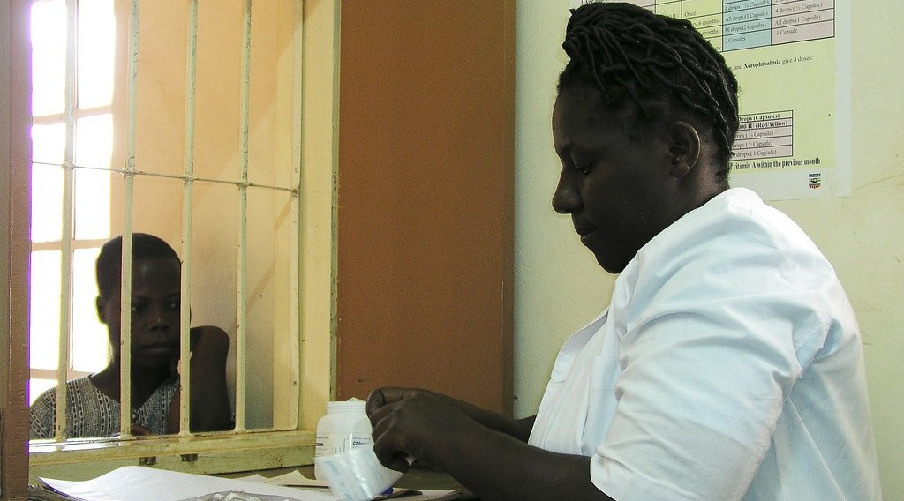
1. REASONS: FALLING DEATH RATES
Activity 2
A health centre.
Notes:
Activity 2. Look carefully at this picture: a health centre. Observe every detail before I ask the question.

Slide 22
1. REASONS: FALLING DEATH RATES
Activity 2: Question
Why have death rates fallen in LICs?
Notes:
Here is the question for Activity 2: Why have death rates fallen in LICs? Take one minute to think and write your answer in your rough notebook.

Slide 23
1. REASONS: FALLING DEATH RATES
Activity 2: Answer
Vaccines, better health care, clean water and more food.
Notes:
Let us check the answer together. Vaccines, better health care, clean water and more food.

Slide 24

2. IMPLICATIONS: SOCIAL
Activity 3
A crowded classroom.
Notes:
Activity 3. Look carefully at this picture: a crowded classroom. Observe every detail before I ask the question.

Slide 25
2. IMPLICATIONS: SOCIAL
Activity 3: Question
Give two social implications.
Notes:
Here is the question for Activity 3: Give two social implications. Take one minute to think and write your answer in your rough notebook.

Slide 26
2. IMPLICATIONS: SOCIAL
Activity 3: Answer
Overcrowded schools and hospitals and a shortage of housing.
Notes:
Let us check the answer together. Overcrowded schools and hospitals and a shortage of housing.

Slide 27

2. IMPLICATIONS: ECONOMIC
Activity 4
A slum.
Notes:
Activity 4. Look carefully at this picture: a slum. Observe every detail before I ask the question.

Slide 28
2. IMPLICATIONS: ECONOMIC
Activity 4: Question
Give two economic implications.
Notes:
Here is the question for Activity 4: Give two economic implications. Take one minute to think and write your answer in your rough notebook.

Slide 29
2. IMPLICATIONS: ECONOMIC
Activity 4: Answer
Unemployment and a high dependency burden (also food shortages).
Notes:
Let us check the answer together. Unemployment and a high dependency burden (also food shortages).

Slide 30

2. IMPLICATIONS: ENVIRONMENTAL
Activity 5
Deforestation.
Notes:
Activity 5. Look carefully at this picture: deforestation. Observe every detail before I ask the question.

Slide 31
2. IMPLICATIONS: ENVIRONMENTAL
Activity 5: Question
Give one environmental implication.
Notes:
Here is the question for Activity 5: Give one environmental implication. Take one minute to think and write your answer in your rough notebook.

Slide 32
2. IMPLICATIONS: ENVIRONMENTAL
Activity 5: Answer
Deforestation and soil exhaustion from pressure on land.
Notes:
Let us check the answer together. Deforestation and soil exhaustion from pressure on land.

Slide 33
BOARD SUMMARY
Board Summary
Topic: The Dynamics of Population and Implications
Sub-topic: Population Change in Time (Population Growth)
Lesson 35: Rapid Population Growth in Least Industrialised Countries
Notes:
Now we are going to copy the board summary. Write the title and the headings neatly in your notebooks. I will give you enough time for each slide, so do not rush.

Slide 34
BOARD SUMMARY
1. Reasons for Rapid Population Growth
The population of LICs grows fast for the following reasons:
High birth rates: Early marriages, polygamy and the value of children keep births high.
Low use of contraception: Religious beliefs, ignorance and cost limit family planning.
Notes:
Let us copy Reasons for Rapid Population Growth. The population of LICs grows fast for the following reasons. On this slide we have High birth rates and Low use of contraception. Write each point on a new line, with the key term first, and explain it in your own words when we revise. When you finish, we go to the next slide.

Slide 35
BOARD SUMMARY
1. Reasons for Rapid Population Growth (continued)
Falling death rates: Vaccines, medicine and clean water save many lives.
Notes:
We continue with Reasons for Rapid Population Growth. On this slide we have Falling death rates. Write each point on a new line, with the key term first, and explain it in your own words when we revise.

Slide 36
BOARD SUMMARY
2. Implications
Rapid population growth has the following implications:
Social: Schools, hospitals and housing become overcrowded.
Economic: Unemployment, food shortages and dependency increase.
Notes:
Let us copy Implications. Rapid population growth has the following implications. On this slide we have Social and Economic. Write each point on a new line, with the key term first, and explain it in your own words when we revise. When you finish, we go to the next slide.

Slide 37
BOARD SUMMARY
2. Implications (continued)
Environmental: Forests are cleared and soils are overused.
Positive: A large population can provide labour and a big market.
Notes:
We continue with Implications. On this slide we have Environmental and Positive. Write each point on a new line, with the key term first, and explain it in your own words when we revise.

Slide 38
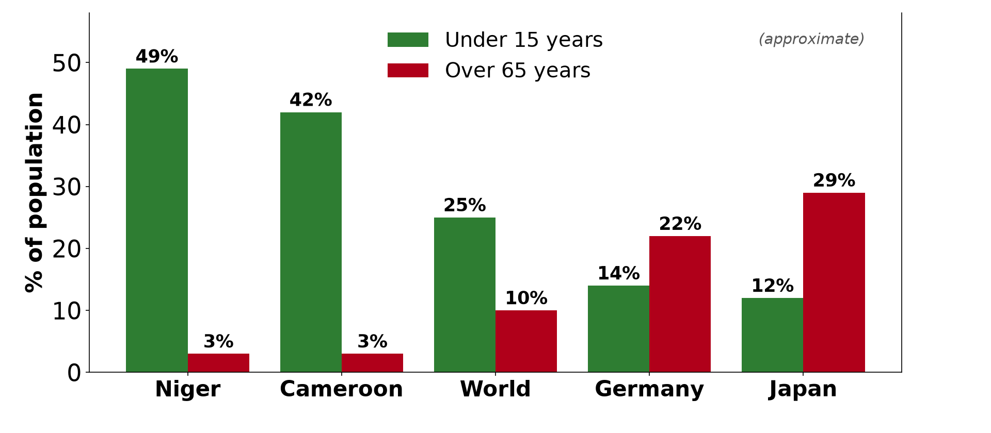
BOARD SUMMARY
2. Implications
Illustration: a youthful population
Notes:
Now draw this illustration in your notebook: a youthful population. Give it a title and label it clearly.

Slide 39
FORMATIVE EVALUATION
Evaluation 1
Give two reasons for rapid population growth in LICs.
Notes:
Now let us check what you have understood. Question 1: Give two reasons for rapid population growth in LICs. Answer in your exercise book.

Slide 40
FORMATIVE EVALUATION
Expected Answer
Early marriages and falling death rates.
Notes:
The expected answer is: early marriages and falling death rates. If you got it right, well done.

Slide 41
FORMATIVE EVALUATION
Evaluation 2
Give two implications.
Notes:
Now let us check what you have understood. Question 2: Give two implications. Answer in your exercise book.

Slide 42
FORMATIVE EVALUATION
Expected Answer
Unemployment and overcrowded schools.
Notes:
The expected answer is: unemployment and overcrowded schools. If you got it right, well done.

Slide 43
REMEDIATION
Remediation
Fill in the blanks:
Marriage of young girls is ______ marriage.
Family planning reduces the ______ rate.
Too many people for the jobs available causes ______.
Notes:
For those who need more practice, fill in the blanks in your exercise book. The answers are: number 1, early; number 2, birth; number 3, unemployment.

Slide 44
HOMEWORK
Homework
Explain three ways rapid population growth affects your town.
Notes:
For your homework: Explain three ways rapid population growth affects your town. We shall correct it at the beginning of our next lesson.

Slide 45
NEXT LESSON
Next Lesson
Our next lesson will be on:
Further Study 4: Control of Population Growth
Notes:
Our next lesson will be on Further Study 4: Control of Population Growth. Thank you for your attention, and see you next time.

Slide 46
BILINGUAL GAME
Bilingual Game (Jeu Bilingue)
English | Français
Rapid growth | La croissance rapide
Early marriage | Le mariage précoce
Contraception | La contraception
Family planning | La planification familiale
Unemployment | Le chômage
Overcrowding | Le surpeuplement
Notes:
Let us play the bilingual game. I say a word in English, and you give me the French word. Then we do the reverse.

Slide 47
LOGBOOK
Official Logbook (1/2)
Module / Topic | The Dynamics of Population and Implications
Lesson Title | Lesson 35: Rapid Population Growth in Least Industrialised Countries
Expected Learning Outcomes | Explain the reasons for rapid population growth in LICs. Explain the implications. Propose solutions.
Competence | Learners are able to explain the causes and implications of rapid population growth in LICs.
Notes:
I record this information in the official logbook of the class after the lesson.

Slide 48
LOGBOOK
Official Logbook (2/2)
Matter Taught | Reasons for Rapid Population Growth; Implications.
Evaluation | Formative evaluation and remediation exercise.
Homework | Explain three ways rapid population growth affects your town.
Enrolment / Present / Absent | ____ / ____ / ____
Achievement | To be completed after the lesson.
Notes:
I complete the second page of the logbook: the matter taught, the evaluation, the homework and the attendance.

Slide 49
TEACHER'S NOTE
Teacher's Note
Timing: Homework correction, plan, objectives 8 min | Recall, situation, action 10 min | 5 activities 30 min | Board summary (copying) 30 min | Evaluation, remediation 10 min | Homework, next lesson 5 min | Logbook 7 min
Without the projector (Activity 1): discuss.
Without the projector (Activity 2): discuss.
Without the projector (Activity 3): discuss.
Without the projector (Activity 4): discuss.
Without the projector (Activity 5): discuss.
Notes:
This slide is for me, the teacher: it gives the timing of the lesson and what to do if the projector is not available.

Slide 50
REFERENCES
References
Geography Syllabus, Forms I–V, MINESEC (2023) — Form 5, Module III: Management of Population Growth and Space Colonisation.
Photo, Activity 1: “African school children” by World Resources, CC BY-NC-SA 2.0, via Flickr (https://www.flickr.com/photos/26107309@N05/2658469563)
Photo, Activity 2: “Waiting at the dispensary” by World Bank Photo Collection, CC BY-NC-ND 2.0, via Flickr (https://www.flickr.com/photos/10816734@N03/7556643920)
Photo, Activity 3: “Students in Primary Seven at Zanaki Primary School” by World Bank Photo Collection, CC BY-NC-ND 2.0, via Flickr (https://www.flickr.com/photos/10816734@N03/33423887921)
Photo, Activity 4: “Mathare” by Book Aid International, CC BY-NC-ND 2.0, via Flickr (https://www.flickr.com/photos/45024905@N07/4135561707)
Photo, Activity 5: “Managed Destruction” by Harlz_, CC BY-NC 2.0, via Flickr (https://www.flickr.com/photos/35169553@N06/4295797661)
Diagrams and animations: drawn for this lesson (Geography Department).
Notes:
These are the references and picture credits used to prepare this lesson.

