Slide 1
FORM 5
GEOGRAPHY
Further Study 4
Control of Population Growth
Notes:
Good morning, class, and welcome to our geography lesson. I am your geography teacher, Mr Kamdem. Today we are starting Further Study 4: Control of Population Growth.

Slide 2
CLASS INFO
Class, Chapter and Duration
Class | Form 5
Chapter | Module III: Management of Population Growth and Space Colonisation
Duration | 2 periods (2 × 50 minutes)
Notes:
This lesson is for Form 5. It belongs to Module III: Management of Population Growth and Space Colonisation. We shall need 2 periods to cover it.

Slide 3
IDENTIFICATION
Lesson Identification
Topic | The Dynamics of Population and Implications
Sub-topic | Population Change in Time (Population Growth)
Lesson | Further Study 4: Control of Population Growth
Notions / Concepts | Birth control, family planning, one-child policy.
Syllabus focus | Measures of birth control; population control policies in modern China: a successful case of control of population growth in the NICs.
Competence | Learners are able to explain measures of birth control and assess China's population policy.
Notes:
Our topic is The Dynamics of Population and Implications, and the sub-topic is Population Change in Time (Population Growth). The key notions we shall use today are: birth control, family planning, one-child policy. At the end, you should be able to do this: learners are able to explain measures of birth control and assess China's population policy.

Slide 4

HOMEWORK CORRECTION
Correction of the Homework
Question (Lesson 35: Rapid Population Growth in Least Industrialised Countries):
Explain three ways rapid population growth affects your town.
Notes:
Before we start the new lesson, let us correct the homework I gave you at the end of Lesson 35: Rapid Population Growth in Least Industrialised Countries. The question was: Explain three ways rapid population growth affects your town. Take out your exercise books.

Slide 5
HOMEWORK CORRECTION
Correction: Possible Answer
Crowded schools and hospitals, unemployment of youths, and growth of unplanned quarters (also higher food prices).
Notes:
Here is a good answer. Crowded schools and hospitals, unemployment of youths, and growth of unplanned quarters (also higher food prices). Compare it with your own answer and correct your work in red.

Slide 6
LESSON PLAN
Lesson Plan
Correction of the homework
Objectives and recall
Real-life situation and action to take
Learning activities
Board summary
Evaluation, remediation and homework
Notes:
Here is the plan of our lesson today. First, we shall correct the homework. Then we shall look at the objectives and recall what you already know. After that, we shall study a situation from real life and the action to take, and do the learning activities. Finally, we shall copy the board summary, do the evaluation and the remediation, and I will give you the homework.

Slide 7
OBJECTIVES
Objectives
By the end of this lesson, you should be able to:
Explain the measures of birth control.
Describe the population policies of China.
Assess the results of the Chinese policy.
Notes:
By the end of this lesson, you should be able to do three things. Number 1: explain the measures of birth control. Number 2: describe the population policies of China. Number 3: assess the results of the Chinese policy.

Slide 8
PREVIOUS KNOWLEDGE
Previous Knowledge
Rapid growth causes problems.
China has a very large population.
Family planning reduces births.
Notes:
Let us first remember what you already know. Rapid growth causes problems. China has a very large population. Family planning reduces births. Keep this in mind, because we shall build on it today.

Slide 9
REAL-LIFE SITUATION
Situation in Real Life
In 1979, China introduced a policy allowing most families only one child. Later, it allowed two and then three children because the population was ageing.
Notes:
Listen carefully to this situation from real life. In 1979, China introduced a policy allowing most families only one child. Later, it allowed two and then three children because the population was ageing. Think about it, because I am going to ask you some questions.

Slide 10
REAL-LIFE SITUATION
Situation: Question 1
What is the problem in the situation?
Notes:
Question 1: What is the problem in the situation? Think for a moment, then raise your hand to answer.

Slide 11
REAL-LIFE SITUATION
Answer
We want to understand how China controlled its population.
Notes:
Good. We want to understand how China controlled its population.

Slide 12
REAL-LIFE SITUATION
Situation: Question 2
What policy began in 1979?
Notes:
Question 2: What policy began in 1979? Think for a moment, then raise your hand to answer.

Slide 13
REAL-LIFE SITUATION
Answer
The one-child policy.
Notes:
Good. The one-child policy.

Slide 14
REAL-LIFE SITUATION
Situation: Question 3
Why did China change it?
Notes:
Question 3: Why did China change it? Think for a moment, then raise your hand to answer.

Slide 15
REAL-LIFE SITUATION
Possible Answer
Because the population was ageing.
Notes:
Good. Because the population was ageing.

Slide 16
ACTION TO TAKE
Action to Take
Acquire sex education and support responsible parenthood.
Notes:
From this situation, the action we are working towards in this lesson is the following: acquire sex education and support responsible parenthood.

Slide 17
JUSTIFICATION
Justification of the Lesson
This further study helps us to understand how countries control population growth.
Notes:
Why is this lesson important for you? This further study helps us to understand how countries control population growth.

Slide 18
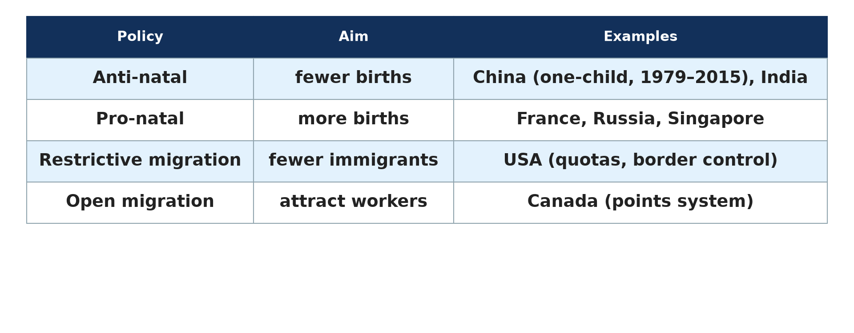
1. MEASURES OF BIRTH CONTROL
Activity 1
Population policies.
Notes:
Activity 1. Look carefully at this diagram: population policies. Observe every detail before I ask the question.

Slide 19
1. MEASURES OF BIRTH CONTROL
Activity 1: Question
Give three measures of birth control.
Notes:
Here is the question for Activity 1: Give three measures of birth control. Take one minute to think and write your answer in your rough notebook.

Slide 20
1. MEASURES OF BIRTH CONTROL
Activity 1: Answer
Contraception, education of girls and raising the marriage age.
Notes:
Let us check the answer together. Contraception, education of girls and raising the marriage age.

Slide 21
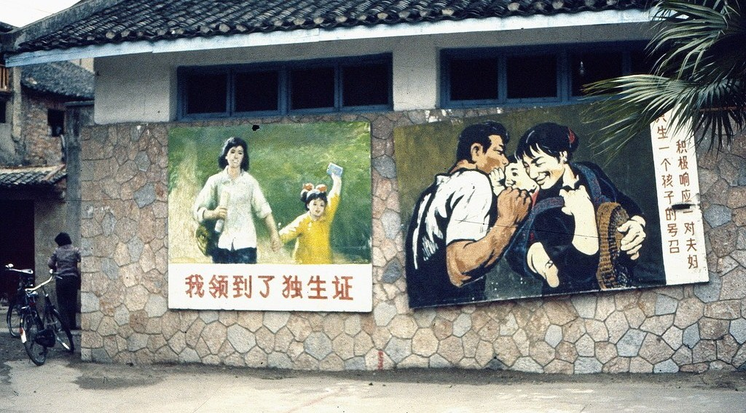
2. CHINA: THE ONE-CHILD POLICY
Activity 2
A one-child poster in China.
Notes:
Activity 2. Look carefully at this picture: a one-child poster in China. Observe every detail before I ask the question.

Slide 22
2. CHINA: THE ONE-CHILD POLICY
Activity 2: Question
What was the one-child policy?
Notes:
Here is the question for Activity 2: What was the one-child policy? Take one minute to think and write your answer in your rough notebook.

Slide 23
2. CHINA: THE ONE-CHILD POLICY
Activity 2: Answer
A 1979 law allowing most urban couples only one child.
Notes:
Let us check the answer together. A 1979 law allowing most urban couples only one child.

Slide 24
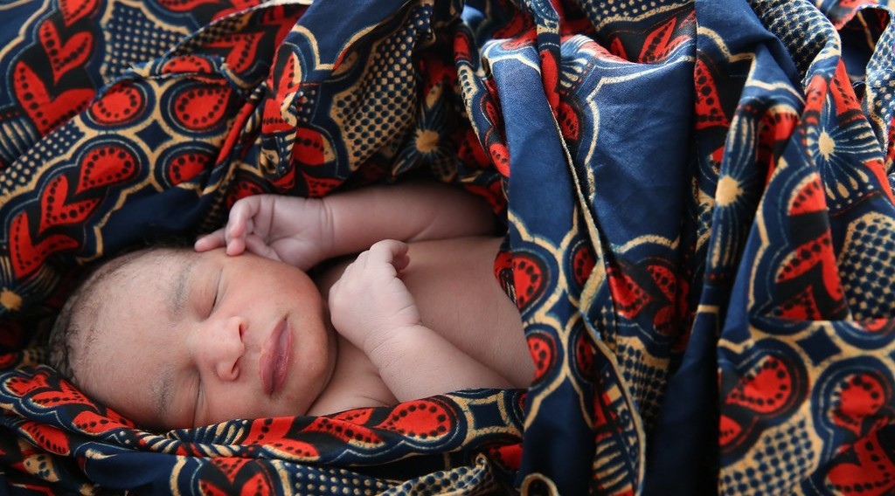
2. CHINA: METHODS
Activity 3
A newborn baby.
Notes:
Activity 3. Look carefully at this picture: a newborn baby. Observe every detail before I ask the question.

Slide 25
2. CHINA: METHODS
Activity 3: Question
How was the policy applied?
Notes:
Here is the question for Activity 3: How was the policy applied? Take one minute to think and write your answer in your rough notebook.

Slide 26
2. CHINA: METHODS
Activity 3: Answer
Rewards for one-child families, fines for extra births and free contraception.
Notes:
Let us check the answer together. Rewards for one-child families, fines for extra births and free contraception.

Slide 27
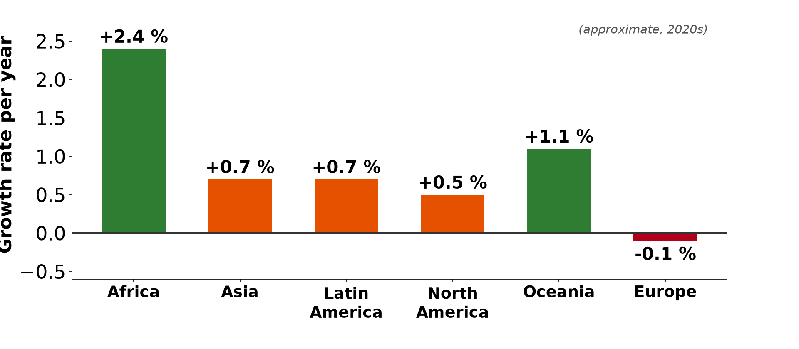
3. RESULTS
Activity 4
Growth rates.
Notes:
Activity 4. Look carefully at this diagram: growth rates. Observe every detail before I ask the question.

Slide 28
3. RESULTS
Activity 4: Question
Give two positive results.
Notes:
Here is the question for Activity 4: Give two positive results. Take one minute to think and write your answer in your rough notebook.

Slide 29
3. RESULTS
Activity 4: Answer
About 400 million fewer births and faster economic growth.
Notes:
Let us check the answer together. About 400 million fewer births and faster economic growth.

Slide 30

3. PROBLEMS
Activity 5
An ageing pyramid.
Notes:
Activity 5. Look carefully at this diagram: an ageing pyramid. Observe every detail before I ask the question.

Slide 31
3. PROBLEMS
Activity 5: Question
Give two problems of the policy.
Notes:
Here is the question for Activity 5: Give two problems of the policy. Take one minute to think and write your answer in your rough notebook.

Slide 32
3. PROBLEMS
Activity 5: Answer
An ageing population and more boys than girls.
Notes:
Let us check the answer together. An ageing population and more boys than girls.

Slide 33
BOARD SUMMARY
Board Summary
Topic: The Dynamics of Population and Implications
Sub-topic: Population Change in Time (Population Growth)
Further Study 4: Control of Population Growth
Notes:
Now we are going to copy the board summary. Write the title and the headings neatly in your notebooks. I will give you enough time for each slide, so do not rush.

Slide 34
BOARD SUMMARY
1. Measures of Birth Control
Birth rates are reduced by the following measures:
Family planning: Contraceptives are made available and affordable.
Education: Educated girls marry later and have fewer children.
Notes:
Let us copy Measures of Birth Control. Birth rates are reduced by the following measures. On this slide we have Family planning and Education. Write each point on a new line, with the key term first, and explain it in your own words when we revise. When you finish, we go to the next slide.

Slide 35
BOARD SUMMARY
1. Measures of Birth Control (continued)
Laws and incentives: Governments raise the marriage age and reward small families.
Notes:
We continue with Measures of Birth Control. On this slide we have Laws and incentives. Write each point on a new line, with the key term first, and explain it in your own words when we revise.

Slide 36
BOARD SUMMARY
1. Measures of Birth Control
Illustration: population policies
Notes:
Now draw this illustration in your notebook: population policies. Give it a title and label it clearly.

Slide 37
BOARD SUMMARY
2. Case Study: Population Policies in China
China controlled its population as follows:
One-child policy: From 1979, most couples were allowed only one child.
Methods: Rewards, fines and free contraception were used.
Notes:
Let us copy Case Study: Population Policies in China. China controlled its population as follows. On this slide we have One-child policy and Methods. Write each point on a new line, with the key term first, and explain it in your own words when we revise. When you finish, we go to the next slide.

Slide 38
BOARD SUMMARY
2. Case Study: Population Policies in China (continued)
Results: Growth fell sharply and about 400 million births were avoided.
Problems and changes: Ageing and a surplus of boys led China to allow two children in 2016 and three in 2021.
Notes:
We continue with Case Study: Population Policies in China. On this slide we have Results and Problems and changes. Write each point on a new line, with the key term first, and explain it in your own words when we revise.

Slide 39
FORMATIVE EVALUATION
Evaluation 1
Give two measures of birth control.
Notes:
Now let us check what you have understood. Question 1: Give two measures of birth control. Answer in your exercise book.

Slide 40
FORMATIVE EVALUATION
Expected Answer
Contraception and education of girls.
Notes:
The expected answer is: contraception and education of girls. If you got it right, well done.

Slide 41
FORMATIVE EVALUATION
Evaluation 2
Give one success and one problem of China's policy.
Notes:
Now let us check what you have understood. Question 2: Give one success and one problem of China's policy. Answer in your exercise book.

Slide 42
FORMATIVE EVALUATION
Expected Answer
Slower growth; an ageing population.
Notes:
The expected answer is: slower growth; an ageing population. If you got it right, well done.

Slide 43
REMEDIATION
Remediation
Fill in the blanks:
China introduced the one-child policy in ______.
Using pills and condoms is ______.
China now allows ______ children.
Notes:
For those who need more practice, fill in the blanks in your exercise book. The answers are: number 1, 1979; number 2, contraception; number 3, three.

Slide 44
HOMEWORK
Homework
Should Cameroon adopt a one-child policy? Give two arguments for and two against.
Notes:
For your homework: Should Cameroon adopt a one-child policy? Give two arguments for and two against. We shall correct it at the beginning of our next lesson.

Slide 45
NEXT LESSON
Next Lesson
Our next lesson will be on:
Lesson 36: Migration
Notes:
Our next lesson will be on Lesson 36: Migration. Thank you for your attention, and see you next time.

Slide 46
BILINGUAL GAME
Bilingual Game (Jeu Bilingue)
English | Français
Birth control | Le contrôle des naissances
One-child policy | La politique de l'enfant unique
Incentive | L'incitation
Fine | L'amende
Ageing | Le vieillissement
Policy | La politique
Notes:
Let us play the bilingual game. I say a word in English, and you give me the French word. Then we do the reverse.

Slide 47
LOGBOOK
Official Logbook (1/2)
Module / Topic | The Dynamics of Population and Implications
Lesson Title | Further Study 4: Control of Population Growth
Expected Learning Outcomes | Explain the measures of birth control. Describe the population policies of China. Assess the results of the Chinese policy.
Competence | Learners are able to explain measures of birth control and assess China's population policy.
Notes:
I record this information in the official logbook of the class after the lesson.

Slide 48
LOGBOOK
Official Logbook (2/2)
Matter Taught | Measures of Birth Control; Case Study: Population Policies in China.
Evaluation | Formative evaluation and remediation exercise.
Homework | Should Cameroon adopt a one-child policy? Give two arguments for and two against.
Enrolment / Present / Absent | ____ / ____ / ____
Achievement | To be completed after the lesson.
Notes:
I complete the second page of the logbook: the matter taught, the evaluation, the homework and the attendance.

Slide 49
TEACHER'S NOTE
Teacher's Note
Timing: Homework correction, plan, objectives 8 min | Recall, situation, action 10 min | 5 activities 30 min | Board summary (copying) 30 min | Evaluation, remediation 10 min | Homework, next lesson 5 min | Logbook 7 min
Without the projector (Activity 1): list.
Without the projector (Activity 2): discuss.
Without the projector (Activity 3): discuss.
Without the projector (Activity 4): discuss.
Without the projector (Activity 5): discuss.
Notes:
This slide is for me, the teacher: it gives the timing of the lesson and what to do if the projector is not available.

Slide 50
REFERENCES
References
Geography Syllabus, Forms I–V, MINESEC (2023) — Form 5, Module III: Management of Population Growth and Space Colonisation.
Photo, Activity 2: “propaganda posters, one child policy” by kattebelletje, CC BY-NC 2.0, via Flickr (https://www.flickr.com/photos/97249369@N00/3349125321)
Photo, Activity 3: “Newborn baby rests” by World Bank Photo Collection, CC BY-NC-ND 2.0, via Flickr (https://www.flickr.com/photos/10816734@N03/19845580540)
Diagrams and animations: drawn for this lesson (Geography Department).
Notes:
These are the references and picture credits used to prepare this lesson.

