Slide 1
FORM 5
GEOGRAPHY
Lesson 44
Rural Settlement Form
Notes:
Good morning, class, and welcome to our geography lesson. I am your geography teacher, Mr Kamdem. Today we are starting Lesson 44: Rural Settlement Form.

Slide 2
CLASS INFO
Class, Chapter and Duration
Class | Form 5
Chapter | Module III: Management of Population Growth and Space Colonisation
Duration | 2 periods (2 × 50 minutes)
Notes:
This lesson is for Form 5. It belongs to Module III: Management of Population Growth and Space Colonisation. We shall need 2 periods to cover it.

Slide 3
IDENTIFICATION
Lesson Identification
Topic | The Development of Settlements and their Implications
Sub-topic | Rural Settlements, their Morphology and Implications on the Environment
Lesson | Lesson 44: Rural Settlement Form
Notions / Concepts | Star form, linear form, rectangular form, cruciform.
Syllabus focus | Meaning; shapes.
Competence | Learners are able to identify and draw the forms of rural settlements.
Notes:
Our topic is The Development of Settlements and their Implications, and the sub-topic is Rural Settlements, their Morphology and Implications on the Environment. The key notions we shall use today are: star form, linear form, rectangular form, cruciform. At the end, you should be able to do this: learners are able to identify and draw the forms of rural settlements.

Slide 4

HOMEWORK CORRECTION
Correction of the Homework
Question (Lesson 43: Concept of Rural Settlement):
Describe a village you know and list its services.
Notes:
Before we start the new lesson, let us correct the homework I gave you at the end of Lesson 43: Concept of Rural Settlement. The question was: Describe a village you know and list its services. Take out your exercise books.

Slide 5
HOMEWORK CORRECTION
Correction: Possible Answer
Example: about 1,000 people, houses grouped near the road, with a primary school, a market, a mosque or church, a health centre and a chief's palace.
Notes:
Here is a good answer. Example: about 1,000 people, houses grouped near the road, with a primary school, a market, a mosque or church, a health centre and a chief's palace. Compare it with your own answer and correct your work in red.

Slide 6
LESSON PLAN
Lesson Plan
Correction of the homework
Objectives and recall
Real-life situation and action to take
Learning activities
Board summary
Evaluation, remediation and homework
Notes:
Here is the plan of our lesson today. First, we shall correct the homework. Then we shall look at the objectives and recall what you already know. After that, we shall study a situation from real life and the action to take, and do the learning activities. Finally, we shall copy the board summary, do the evaluation and the remediation, and I will give you the homework.

Slide 7
OBJECTIVES
Objectives
By the end of this lesson, you should be able to:
Define settlement form.
Identify the shapes of rural settlements.
Explain the reasons for each shape.
Notes:
By the end of this lesson, you should be able to do three things. Number 1: define settlement form. Number 2: identify the shapes of rural settlements. Number 3: explain the reasons for each shape.

Slide 8
PREVIOUS KNOWLEDGE
Previous Knowledge
Villages have houses and roads.
Many houses line the roads.
Some villages grow at crossroads.
Notes:
Let us first remember what you already know. Villages have houses and roads. Many houses line the roads. Some villages grow at crossroads. Keep this in mind, because we shall build on it today.

Slide 9
REAL-LIFE SITUATION
Situation in Real Life
Seen from a plane, one village looks like a line along a road, another like a cross at a crossroads and another like a star with many roads.
Notes:
Listen carefully to this situation from real life. Seen from a plane, one village looks like a line along a road, another like a cross at a crossroads and another like a star with many roads. Think about it, because I am going to ask you some questions.

Slide 10
REAL-LIFE SITUATION
Situation: Question 1
What is the problem in the situation?
Notes:
Question 1: What is the problem in the situation? Think for a moment, then raise your hand to answer.

Slide 11
REAL-LIFE SITUATION
Answer
Villages have different shapes.
Notes:
Good. Villages have different shapes.

Slide 12
REAL-LIFE SITUATION
Situation: Question 2
What shape follows a road?
Notes:
Question 2: What shape follows a road? Think for a moment, then raise your hand to answer.

Slide 13
REAL-LIFE SITUATION
Answer
Linear.
Notes:
Good. Linear.

Slide 14
REAL-LIFE SITUATION
Situation: Question 3
What shape grows at a crossroads?
Notes:
Question 3: What shape grows at a crossroads? Think for a moment, then raise your hand to answer.

Slide 15
REAL-LIFE SITUATION
Possible Answer
Cruciform.
Notes:
Good. Cruciform.

Slide 16
ACTION TO TAKE
Action to Take
Follow planning rules when building houses.
Notes:
From this situation, the action we are working towards in this lesson is the following: follow planning rules when building houses.

Slide 17
JUSTIFICATION
Justification of the Lesson
This lesson helps us to describe the shapes of settlements.
Notes:
Why is this lesson important for you? This lesson helps us to describe the shapes of settlements.

Slide 18
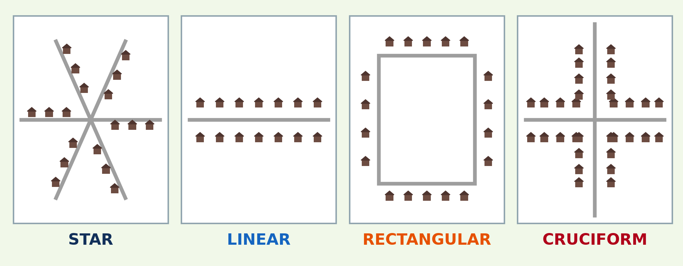
1. MEANING
Activity 1
Forms of rural settlements.
Notes:
Activity 1. Look carefully at this diagram: forms of rural settlements. Observe every detail before I ask the question.

Slide 19
1. MEANING
Activity 1: Question
What is settlement form?
Notes:
Here is the question for Activity 1: What is settlement form? Take one minute to think and write your answer in your rough notebook.

Slide 20
1. MEANING
Activity 1: Answer
The shape of a settlement as seen from above or on a map.
Notes:
Let us check the answer together. The shape of a settlement as seen from above or on a map.

Slide 21
2. STAR FORM
Activity 2
Star form.
Notes:
Activity 2. Look carefully at this diagram: star form. Observe every detail before I ask the question.

Slide 22
2. STAR FORM
Activity 2: Question
Describe a star-shaped settlement.
Notes:
Here is the question for Activity 2: Describe a star-shaped settlement. Take one minute to think and write your answer in your rough notebook.

Slide 23
2. STAR FORM
Activity 2: Answer
Houses spread along several roads that meet at a centre.
Notes:
Let us check the answer together. Houses spread along several roads that meet at a centre.

Slide 24
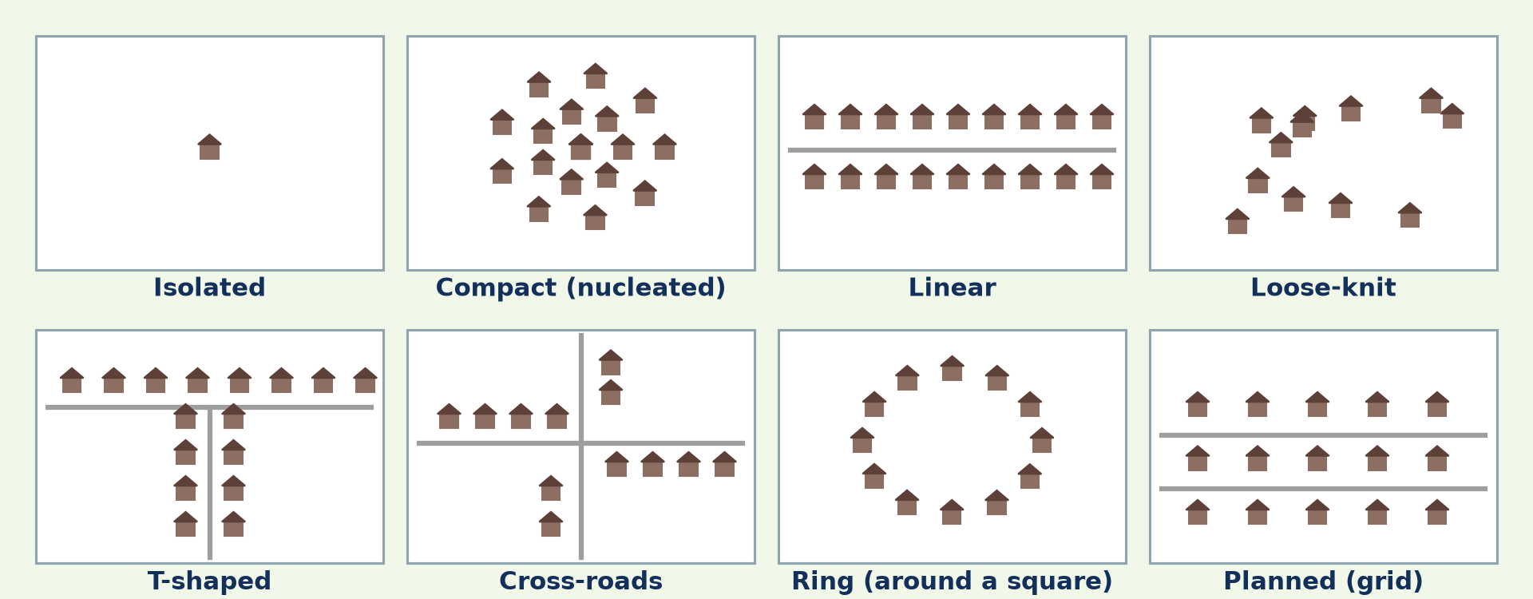
2. LINEAR FORM
Activity 3
Settlement shapes.
Notes:
Activity 3. Look carefully at this diagram: settlement shapes. Observe every detail before I ask the question.

Slide 25
2. LINEAR FORM
Activity 3: Question
Describe a linear settlement.
Notes:
Here is the question for Activity 3: Describe a linear settlement. Take one minute to think and write your answer in your rough notebook.

Slide 26
2. LINEAR FORM
Activity 3: Answer
Houses lined along a road, river or coast.
Notes:
Let us check the answer together. Houses lined along a road, river or coast.

Slide 27
2. RECTANGULAR FORM
Activity 4
Rectangular form.
Notes:
Activity 4. Look carefully at this diagram: rectangular form. Observe every detail before I ask the question.

Slide 28
2. RECTANGULAR FORM
Activity 4: Question
Describe a rectangular settlement.
Notes:
Here is the question for Activity 4: Describe a rectangular settlement. Take one minute to think and write your answer in your rough notebook.

Slide 29
2. RECTANGULAR FORM
Activity 4: Answer
Houses arranged around a rectangular square or block, often planned.
Notes:
Let us check the answer together. Houses arranged around a rectangular square or block, often planned.

Slide 30
2. CRUCIFORM
Activity 5
Cruciform.
Notes:
Activity 5. Look carefully at this diagram: cruciform. Observe every detail before I ask the question.

Slide 31
2. CRUCIFORM
Activity 5: Question
Describe a cruciform settlement.
Notes:
Here is the question for Activity 5: Describe a cruciform settlement. Take one minute to think and write your answer in your rough notebook.

Slide 32
2. CRUCIFORM
Activity 5: Answer
Houses along two roads that cross, forming a cross.
Notes:
Let us check the answer together. Houses along two roads that cross, forming a cross.

Slide 33
BOARD SUMMARY
Board Summary
Topic: The Development of Settlements and their Implications
Sub-topic: Rural Settlements, their Morphology and Implications on the Environment
Lesson 44: Rural Settlement Form
Notes:
Now we are going to copy the board summary. Write the title and the headings neatly in your notebooks. I will give you enough time for each slide, so do not rush.

Slide 34
BOARD SUMMARY
DEFINITIONS
The key terms of this lesson are defined as follows:
Settlement form: It is the shape of a settlement as seen from above or on a map.
Notes:
Let us copy the definitions. The key terms of this lesson are defined as follows. On this slide we have Settlement form. Write each point on a new line, with the key term first, and explain it in your own words when we revise.

Slide 35
BOARD SUMMARY
Shapes of Rural Settlements
Rural settlements have the following shapes:
Star form: Houses spread along several roads that meet at a centre.
Linear form: Houses are lined along a road, river, valley or coast.
Notes:
Let us copy Shapes of Rural Settlements. Rural settlements have the following shapes. On this slide we have Star form and Linear form. Write each point on a new line, with the key term first, and explain it in your own words when we revise. When you finish, we go to the next slide.

Slide 36
BOARD SUMMARY
Shapes of Rural Settlements (continued)
Rectangular form: Houses surround a rectangular square or block.
Cruciform: Houses are built along two crossing roads.
Notes:
We continue with Shapes of Rural Settlements. On this slide we have Rectangular form and Cruciform. Write each point on a new line, with the key term first, and explain it in your own words when we revise.

Slide 37
BOARD SUMMARY
Shapes of Rural Settlements
Illustration: forms of rural settlements
Notes:
Now draw this illustration in your notebook: forms of rural settlements. Give it a title and label it clearly.

Slide 38
FORMATIVE EVALUATION
Evaluation 1
Name four forms of rural settlements.
Notes:
Now let us check what you have understood. Question 1: Name four forms of rural settlements. Answer in your exercise book.

Slide 39
FORMATIVE EVALUATION
Expected Answer
Star, linear, rectangular and cruciform.
Notes:
The expected answer is: star, linear, rectangular and cruciform. If you got it right, well done.

Slide 40
FORMATIVE EVALUATION
Evaluation 2
Why do linear settlements develop?
Notes:
Now let us check what you have understood. Question 2: Why do linear settlements develop? Answer in your exercise book.

Slide 41
FORMATIVE EVALUATION
Expected Answer
Houses follow a road, river or coast.
Notes:
The expected answer is: houses follow a road, river or coast. If you got it right, well done.

Slide 42
REMEDIATION
Remediation
Fill in the blanks:
A settlement shaped like a cross is ______.
A settlement along a road is ______.
A settlement with many radiating roads is ______.
Notes:
For those who need more practice, fill in the blanks in your exercise book. The answers are: number 1, cruciform; number 2, linear; number 3, star-shaped.

Slide 43
HOMEWORK
Homework
Draw the forms of two settlements you know and name them.
Notes:
For your homework: Draw the forms of two settlements you know and name them. We shall correct it at the beginning of our next lesson.

Slide 44
NEXT LESSON
Next Lesson
Our next lesson will be on:
Lesson 45: Rural Settlement Patterns
Notes:
Our next lesson will be on Lesson 45: Rural Settlement Patterns. Thank you for your attention, and see you next time.

Slide 45
BILINGUAL GAME
Bilingual Game (Jeu Bilingue)
English | Français
Form | La forme
Linear | Linéaire
Star-shaped | En étoile
Cruciform | Cruciforme
Crossroads | Le carrefour
Square | La place
Notes:
Let us play the bilingual game. I say a word in English, and you give me the French word. Then we do the reverse.

Slide 46
LOGBOOK
Official Logbook (1/2)
Module / Topic | The Development of Settlements and their Implications
Lesson Title | Lesson 44: Rural Settlement Form
Expected Learning Outcomes | Define settlement form. Identify the shapes of rural settlements. Explain the reasons for each shape.
Competence | Learners are able to identify and draw the forms of rural settlements.
Notes:
I record this information in the official logbook of the class after the lesson.

Slide 47
LOGBOOK
Official Logbook (2/2)
Matter Taught | DEFINITIONS; Shapes of Rural Settlements.
Evaluation | Formative evaluation and remediation exercise.
Homework | Draw the forms of two settlements you know and name them.
Enrolment / Present / Absent | ____ / ____ / ____
Achievement | To be completed after the lesson.
Notes:
I complete the second page of the logbook: the matter taught, the evaluation, the homework and the attendance.

Slide 48
TEACHER'S NOTE
Teacher's Note
Timing: Homework correction, plan, objectives 8 min | Recall, situation, action 10 min | 5 activities 30 min | Board summary (copying) 30 min | Evaluation, remediation 10 min | Homework, next lesson 5 min | Logbook 7 min
Without the projector (Activity 1): describe.
Without the projector (Activity 2): draw.
Without the projector (Activity 3): draw.
Without the projector (Activity 4): draw.
Without the projector (Activity 5): draw.
Notes:
This slide is for me, the teacher: it gives the timing of the lesson and what to do if the projector is not available.

Slide 49
REFERENCES
References
Geography Syllabus, Forms I–V, MINESEC (2023) — Form 5, Module III: Management of Population Growth and Space Colonisation.
Diagrams and animations: drawn for this lesson (Geography Department).
Notes:
These are the references and picture credits used to prepare this lesson.

