Slide 1
FORM 5
GEOGRAPHY
Lesson 46
The Concept of Urban Settlement
Notes:
Good morning, class, and welcome to our geography lesson. I am your geography teacher, Mr Kamdem. Today we are starting Lesson 46: The Concept of Urban Settlement.

Slide 2
CLASS INFO
Class, Chapter and Duration
Class | Form 5
Chapter | Module III: Management of Population Growth and Space Colonisation
Duration | 2 periods (2 × 50 minutes)
Notes:
This lesson is for Form 5. It belongs to Module III: Management of Population Growth and Space Colonisation. We shall need 2 periods to cover it.

Slide 3
IDENTIFICATION
Lesson Identification
Topic | The Development of Settlements and their Implications
Sub-topic | Urban Settlements and their Spheres of Influence
Lesson | Lesson 46: The Concept of Urban Settlement
Notions / Concepts | Town, city, conurbation, megalopolis.
Syllabus focus | Meaning; classification into types.
Competence | Learners are able to define and classify urban settlements.
Notes:
Our topic is The Development of Settlements and their Implications, and the sub-topic is Urban Settlements and their Spheres of Influence. The key notions we shall use today are: town, city, conurbation, megalopolis. At the end, you should be able to do this: learners are able to define and classify urban settlements.

Slide 4

HOMEWORK CORRECTION
Correction of the Homework
Question (Lesson 45: Rural Settlement Patterns):
Identify the settlement pattern of your area and explain it.
Notes:
Before we start the new lesson, let us correct the homework I gave you at the end of Lesson 45: Rural Settlement Patterns. The question was: Identify the settlement pattern of your area and explain it. Take out your exercise books.

Slide 5
HOMEWORK CORRECTION
Correction: Possible Answer
Example: linear along the main road for transport and trade, or dispersed in the savanna because farms are large.
Notes:
Here is a good answer. Example: linear along the main road for transport and trade, or dispersed in the savanna because farms are large. Compare it with your own answer and correct your work in red.

Slide 6
LESSON PLAN
Lesson Plan
Correction of the homework
Objectives and recall
Real-life situation and action to take
Learning activities
Board summary
Evaluation, remediation and homework
Notes:
Here is the plan of our lesson today. First, we shall correct the homework. Then we shall look at the objectives and recall what you already know. After that, we shall study a situation from real life and the action to take, and do the learning activities. Finally, we shall copy the board summary, do the evaluation and the remediation, and I will give you the homework.

Slide 7
OBJECTIVES
Objectives
By the end of this lesson, you should be able to:
Define an urban settlement.
Classify urban settlements into types.
Give examples of each type.
Notes:
By the end of this lesson, you should be able to do three things. Number 1: define an urban settlement. Number 2: classify urban settlements into types. Number 3: give examples of each type.

Slide 8
PREVIOUS KNOWLEDGE
Previous Knowledge
Towns are larger than villages.
Douala is a big city.
Tokyo is one of the largest cities.
Notes:
Let us first remember what you already know. Towns are larger than villages. Douala is a big city. Tokyo is one of the largest cities. Keep this in mind, because we shall build on it today.

Slide 9
REAL-LIFE SITUATION
Situation in Real Life
Garoua is a town, Douala is a city with millions of people, and in Japan several cities have grown together into one huge urban area.
Notes:
Listen carefully to this situation from real life. Garoua is a town, Douala is a city with millions of people, and in Japan several cities have grown together into one huge urban area. Think about it, because I am going to ask you some questions.

Slide 10
REAL-LIFE SITUATION
Situation: Question 1
What is the problem in the situation?
Notes:
Question 1: What is the problem in the situation? Think for a moment, then raise your hand to answer.

Slide 11
REAL-LIFE SITUATION
Answer
We want to classify urban settlements.
Notes:
Good. We want to classify urban settlements.

Slide 12
REAL-LIFE SITUATION
Situation: Question 2
What is Douala?
Notes:
Question 2: What is Douala? Think for a moment, then raise your hand to answer.

Slide 13
REAL-LIFE SITUATION
Answer
A city.
Notes:
Good. A city.

Slide 14
REAL-LIFE SITUATION
Situation: Question 3
What do cities growing together form?
Notes:
Question 3: What do cities growing together form? Think for a moment, then raise your hand to answer.

Slide 15
REAL-LIFE SITUATION
Possible Answer
A conurbation.
Notes:
Good. A conurbation.

Slide 16
ACTION TO TAKE
Action to Take
Plan towns to control their growth.
Notes:
From this situation, the action we are working towards in this lesson is the following: plan towns to control their growth.

Slide 17
JUSTIFICATION
Justification of the Lesson
This lesson helps us to understand the different sizes of towns.
Notes:
Why is this lesson important for you? This lesson helps us to understand the different sizes of towns.

Slide 18
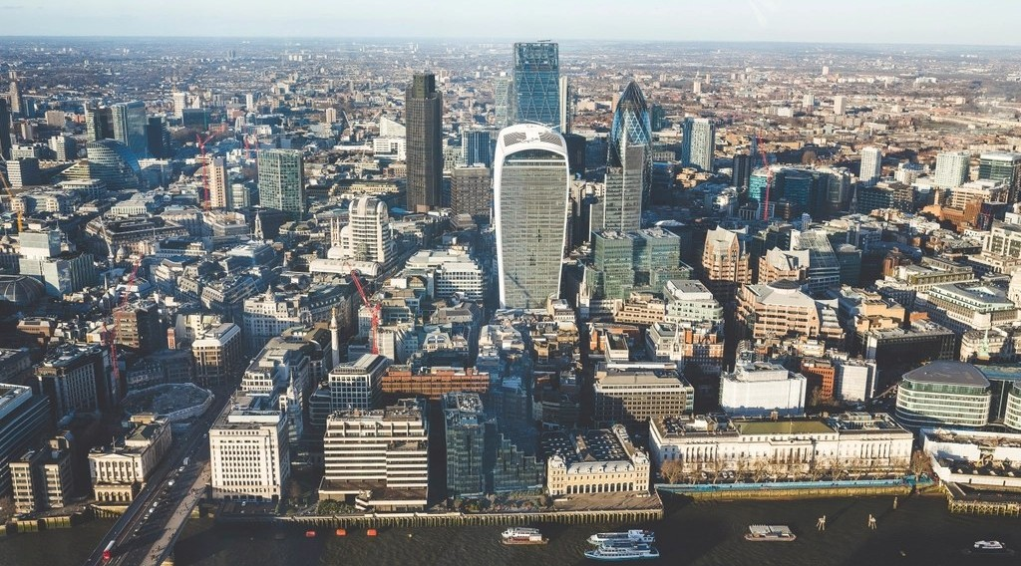
1. MEANING
Activity 1
A city.
Notes:
Activity 1. Look carefully at this picture: a city. Observe every detail before I ask the question.

Slide 19
1. MEANING
Activity 1: Question
What is an urban settlement?
Notes:
Here is the question for Activity 1: What is an urban settlement? Take one minute to think and write your answer in your rough notebook.

Slide 20
1. MEANING
Activity 1: Answer
A large and dense settlement where most people work in industry and services.
Notes:
Let us check the answer together. A large and dense settlement where most people work in industry and services.

Slide 21

2. TOWN AND CITY
Activity 2
Settlement hierarchy.
Notes:
Activity 2. Look carefully at this diagram: settlement hierarchy. Observe every detail before I ask the question.

Slide 22
2. TOWN AND CITY
Activity 2: Question
Distinguish a town and a city.
Notes:
Here is the question for Activity 2: Distinguish a town and a city. Take one minute to think and write your answer in your rough notebook.

Slide 23
2. TOWN AND CITY
Activity 2: Answer
A town is a medium urban settlement; a city is a large one with many functions.
Notes:
Let us check the answer together. A town is a medium urban settlement; a city is a large one with many functions.

Slide 24
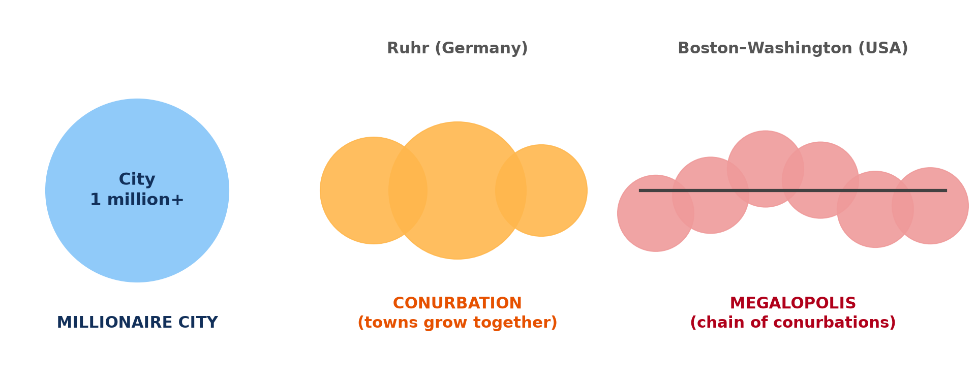
2. CONURBATION
Activity 3
Urban forms.
Notes:
Activity 3. Look carefully at this diagram: urban forms. Observe every detail before I ask the question.

Slide 25
2. CONURBATION
Activity 3: Question
What is a conurbation?
Notes:
Here is the question for Activity 3: What is a conurbation? Take one minute to think and write your answer in your rough notebook.

Slide 26
2. CONURBATION
Activity 3: Answer
Several towns that have grown together into one urban area.
Notes:
Let us check the answer together. Several towns that have grown together into one urban area.

Slide 27
2. MEGALOPOLIS
Activity 4
A megalopolis.
Notes:
Activity 4. Look carefully at this diagram: a megalopolis. Observe every detail before I ask the question.

Slide 28
2. MEGALOPOLIS
Activity 4: Question
What is a megalopolis?
Notes:
Here is the question for Activity 4: What is a megalopolis? Take one minute to think and write your answer in your rough notebook.

Slide 29
2. MEGALOPOLIS
Activity 4: Answer
A very large chain of conurbations, like Boston–Washington in the USA.
Notes:
Let us check the answer together. A very large chain of conurbations, like Boston–Washington in the USA.

Slide 30
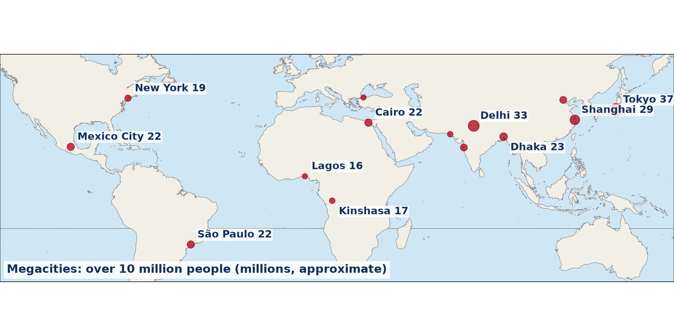
3. EXAMPLES
Activity 5
Megacities.
Notes:
Activity 5. Look carefully at this diagram: megacities. Observe every detail before I ask the question.

Slide 31
3. EXAMPLES
Activity 5: Question
Name two megacities of the world.
Notes:
Here is the question for Activity 5: Name two megacities of the world. Take one minute to think and write your answer in your rough notebook.

Slide 32
3. EXAMPLES
Activity 5: Answer
Tokyo and Lagos (also Delhi, Shanghai and Cairo).
Notes:
Let us check the answer together. Tokyo and Lagos (also Delhi, Shanghai and Cairo).

Slide 33
BOARD SUMMARY
Board Summary
Topic: The Development of Settlements and their Implications
Sub-topic: Urban Settlements and their Spheres of Influence
Lesson 46: The Concept of Urban Settlement
Notes:
Now we are going to copy the board summary. Write the title and the headings neatly in your notebooks. I will give you enough time for each slide, so do not rush.

Slide 34
BOARD SUMMARY
DEFINITIONS
The key terms of this lesson are defined as follows:
Urban settlement: It is a large and dense settlement where most people work in industry and services.
Notes:
Let us copy the definitions. The key terms of this lesson are defined as follows. On this slide we have Urban settlement. Write each point on a new line, with the key term first, and explain it in your own words when we revise.

Slide 35
BOARD SUMMARY
Classification of Urban Settlements
Urban settlements are classified as follows:
Town: It is a medium urban settlement, such as Garoua or Bertoua.
City: It is a large urban settlement with many functions, such as Douala or Yaoundé.
Notes:
Let us copy Classification of Urban Settlements. Urban settlements are classified as follows. On this slide we have Town and City. Write each point on a new line, with the key term first, and explain it in your own words when we revise. When you finish, we go to the next slide.

Slide 36
BOARD SUMMARY
Classification of Urban Settlements (continued)
Conurbation: It is formed when several towns grow together, as in the Ruhr.
Megalopolis: It is a chain of conurbations, such as Boston–Washington or Tokyo–Osaka.
Notes:
We continue with Classification of Urban Settlements. On this slide we have Conurbation and Megalopolis. Write each point on a new line, with the key term first, and explain it in your own words when we revise.

Slide 37
BOARD SUMMARY
Classification of Urban Settlements
Illustration: types of urban settlements
Notes:
Now draw this illustration in your notebook: types of urban settlements. Give it a title and label it clearly.

Slide 38
FORMATIVE EVALUATION
Evaluation 1
Define a conurbation.
Notes:
Now let us check what you have understood. Question 1: Define a conurbation. Answer in your exercise book.

Slide 39
FORMATIVE EVALUATION
Expected Answer
Several towns that have grown together.
Notes:
The expected answer is: several towns that have grown together. If you got it right, well done.

Slide 40
FORMATIVE EVALUATION
Evaluation 2
Give one example of a megalopolis.
Notes:
Now let us check what you have understood. Question 2: Give one example of a megalopolis. Answer in your exercise book.

Slide 41
FORMATIVE EVALUATION
Expected Answer
Boston–Washington (USA).
Notes:
The expected answer is: boston–Washington (USA). If you got it right, well done.

Slide 42
REMEDIATION
Remediation
Fill in the blanks:
Towns that grow together form a ______.
A chain of conurbations is a ______.
A city of over 10 million people is a ______.
Notes:
For those who need more practice, fill in the blanks in your exercise book. The answers are: number 1, conurbation; number 2, megalopolis; number 3, megacity.

Slide 43
HOMEWORK
Homework
Classify five settlements of Cameroon into village, town and city.
Notes:
For your homework: Classify five settlements of Cameroon into village, town and city. We shall correct it at the beginning of our next lesson.

Slide 44
NEXT LESSON
Next Lesson
Our next lesson will be on:
Lesson 47: Urbanisation
Notes:
Our next lesson will be on Lesson 47: Urbanisation. Thank you for your attention, and see you next time.

Slide 45
BILINGUAL GAME
Bilingual Game (Jeu Bilingue)
English | Français
Town | La ville
City | La grande ville / la cité
Conurbation | La conurbation
Megalopolis | La mégalopole
Megacity | La mégapole
Urban area | L'agglomération
Notes:
Let us play the bilingual game. I say a word in English, and you give me the French word. Then we do the reverse.

Slide 46
LOGBOOK
Official Logbook (1/2)
Module / Topic | The Development of Settlements and their Implications
Lesson Title | Lesson 46: The Concept of Urban Settlement
Expected Learning Outcomes | Define an urban settlement. Classify urban settlements into types. Give examples of each type.
Competence | Learners are able to define and classify urban settlements.
Notes:
I record this information in the official logbook of the class after the lesson.

Slide 47
LOGBOOK
Official Logbook (2/2)
Matter Taught | DEFINITIONS; Classification of Urban Settlements.
Evaluation | Formative evaluation and remediation exercise.
Homework | Classify five settlements of Cameroon into village, town and city.
Enrolment / Present / Absent | ____ / ____ / ____
Achievement | To be completed after the lesson.
Notes:
I complete the second page of the logbook: the matter taught, the evaluation, the homework and the attendance.

Slide 48
TEACHER'S NOTE
Teacher's Note
Timing: Homework correction, plan, objectives 8 min | Recall, situation, action 10 min | 5 activities 30 min | Board summary (copying) 30 min | Evaluation, remediation 10 min | Homework, next lesson 5 min | Logbook 7 min
Without the projector (Activity 1): discuss.
Without the projector (Activity 2): define.
Without the projector (Activity 3): give examples.
Without the projector (Activity 4): locate it.
Without the projector (Activity 5): use the atlas.
Notes:
This slide is for me, the teacher: it gives the timing of the lesson and what to do if the projector is not available.

Slide 49
REFERENCES
References
Geography Syllabus, Forms I–V, MINESEC (2023) — Form 5, Module III: Management of Population Growth and Space Colonisation.
Photo, Activity 1: “Aerial View City Skyline Skyscraper” by unknown, CC0 1.0, via rawpixel (https://www.rawpixel.com/image/5967710/aerial-view-city-skyline-skyscraper)
Diagrams and animations: drawn for this lesson (Geography Department).
Notes:
These are the references and picture credits used to prepare this lesson.

