Slide 1
FORM 5
GEOGRAPHY
Further Study 5
The Shanty Settlements (Ghettos/Slums) in the World
Notes:
Good morning, class, and welcome to our geography lesson. I am your geography teacher, Mr Kamdem. Today we are starting Further Study 5: The Shanty Settlements (Ghettos/Slums) in the World.

Slide 2
CLASS INFO
Class, Chapter and Duration
Class | Form 5
Chapter | Module III: Management of Population Growth and Space Colonisation
Duration | 2 periods (2 × 50 minutes)
Notes:
This lesson is for Form 5. It belongs to Module III: Management of Population Growth and Space Colonisation. We shall need 2 periods to cover it.

Slide 3
IDENTIFICATION
Lesson Identification
Topic | The Development of Settlements and their Implications
Sub-topic | Urban Settlements and their Spheres of Influence
Lesson | Further Study 5: The Shanty Settlements (Ghettos/Slums) in the World
Notions / Concepts | Shanty town, slum, ghetto, urban renewal.
Syllabus focus | Examples in Africa, their characteristics and attempted solutions; examples in NICs, their characteristics and attempted solutions; ghettos and slums in AICs, their characteristics and attempted solutions.
Competence | Learners are able to describe shanty settlements in the world and assess attempted solutions.
Notes:
Our topic is The Development of Settlements and their Implications, and the sub-topic is Urban Settlements and their Spheres of Influence. The key notions we shall use today are: shanty town, slum, ghetto, urban renewal. At the end, you should be able to do this: learners are able to describe shanty settlements in the world and assess attempted solutions.

Slide 4

HOMEWORK CORRECTION
Correction of the Homework
Question (Lesson 48: Consequences of the Urbanisation Process):
List three urban problems of your town and propose one solution for each.
Notes:
Before we start the new lesson, let us correct the homework I gave you at the end of Lesson 48: Consequences of the Urbanisation Process. The question was: List three urban problems of your town and propose one solution for each. Take out your exercise books.

Slide 5
HOMEWORK CORRECTION
Correction: Possible Answer
Waste (bins and collection), floods (clean drains), traffic jams (new roads and public transport).
Notes:
Here is a good answer. Waste (bins and collection), floods (clean drains), traffic jams (new roads and public transport). Compare it with your own answer and correct your work in red.

Slide 6
LESSON PLAN
Lesson Plan
Correction of the homework
Objectives and recall
Real-life situation and action to take
Learning activities
Board summary
Evaluation, remediation and homework
Notes:
Here is the plan of our lesson today. First, we shall correct the homework. Then we shall look at the objectives and recall what you already know. After that, we shall study a situation from real life and the action to take, and do the learning activities. Finally, we shall copy the board summary, do the evaluation and the remediation, and I will give you the homework.

Slide 7
OBJECTIVES
Objectives
By the end of this lesson, you should be able to:
Describe shanty settlements in Africa.
Describe shanty settlements in NICs and AICs.
Assess the attempted solutions.
Notes:
By the end of this lesson, you should be able to do three things. Number 1: describe shanty settlements in Africa. Number 2: describe shanty settlements in NICs and AICs. Number 3: assess the attempted solutions.

Slide 8
PREVIOUS KNOWLEDGE
Previous Knowledge
Urbanisation causes slums.
Poor migrants build cheap houses.
Slums lack services.
Notes:
Let us first remember what you already know. Urbanisation causes slums. Poor migrants build cheap houses. Slums lack services. Keep this in mind, because we shall build on it today.

Slide 9
REAL-LIFE SITUATION
Situation in Real Life
Kibera in Nairobi, the favelas of Rio de Janeiro and old ghettos in some American cities all have poor housing, but their causes and solutions differ.
Notes:
Listen carefully to this situation from real life. Kibera in Nairobi, the favelas of Rio de Janeiro and old ghettos in some American cities all have poor housing, but their causes and solutions differ. Think about it, because I am going to ask you some questions.

Slide 10
REAL-LIFE SITUATION
Situation: Question 1
What is the problem in the situation?
Notes:
Question 1: What is the problem in the situation? Think for a moment, then raise your hand to answer.

Slide 11
REAL-LIFE SITUATION
Answer
Shanty settlements exist in all parts of the world.
Notes:
Good. Shanty settlements exist in all parts of the world.

Slide 12
REAL-LIFE SITUATION
Situation: Question 2
Name one African example.
Notes:
Question 2: Name one African example. Think for a moment, then raise your hand to answer.

Slide 13
REAL-LIFE SITUATION
Answer
Kibera (Nairobi).
Notes:
Good. Kibera (Nairobi).

Slide 14
REAL-LIFE SITUATION
Situation: Question 3
Name one NIC example.
Notes:
Question 3: Name one NIC example. Think for a moment, then raise your hand to answer.

Slide 15
REAL-LIFE SITUATION
Possible Answer
The favelas of Rio de Janeiro.
Notes:
Good. The favelas of Rio de Janeiro.

Slide 16
ACTION TO TAKE
Action to Take
Support the renewal of old dilapidated sites.
Notes:
From this situation, the action we are working towards in this lesson is the following: support the renewal of old dilapidated sites.

Slide 17
JUSTIFICATION
Justification of the Lesson
This further study helps us to understand a major urban problem.
Notes:
Why is this lesson important for you? This further study helps us to understand a major urban problem.

Slide 18

1. AFRICA
Activity 1
A shanty town in Africa.
Notes:
Activity 1. Look carefully at this picture: a shanty town in Africa. Observe every detail before I ask the question.

Slide 19
1. AFRICA
Activity 1: Question
Give two characteristics of shanty towns in Africa.
Notes:
Here is the question for Activity 1: Give two characteristics of shanty towns in Africa. Take one minute to think and write your answer in your rough notebook.

Slide 20
1. AFRICA
Activity 1: Answer
Houses of mud, wood or metal sheets, and no water, drains or toilets.
Notes:
Let us check the answer together. Houses of mud, wood or metal sheets, and no water, drains or toilets.

Slide 21

1. AFRICA
Activity 2
Houses on stilts in a swamp.
Notes:
Activity 2. Look carefully at this picture: houses on stilts in a swamp. Observe every detail before I ask the question.

Slide 22
1. AFRICA
Activity 2: Question
Give an example and a solution in Africa.
Notes:
Here is the question for Activity 2: Give an example and a solution in Africa. Take one minute to think and write your answer in your rough notebook.

Slide 23
1. AFRICA
Activity 2: Answer
Kibera in Nairobi or Makoko in Lagos; slum upgrading with water and roads.
Notes:
Let us check the answer together. Kibera in Nairobi or Makoko in Lagos; slum upgrading with water and roads.

Slide 24
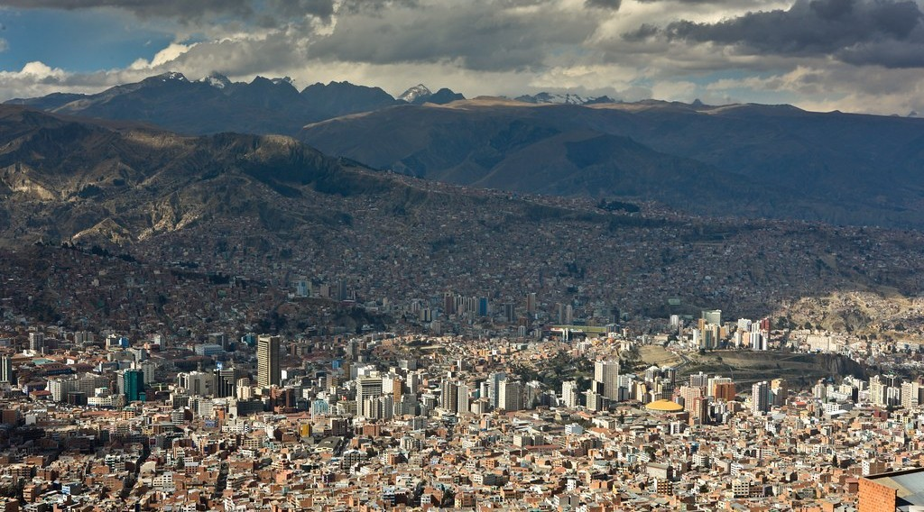
2. NICs
Activity 3
Hillside settlements.
Notes:
Activity 3. Look carefully at this picture: hillside settlements. Observe every detail before I ask the question.

Slide 25
2. NICs
Activity 3: Question
Give an example and a solution in NICs.
Notes:
Here is the question for Activity 3: Give an example and a solution in NICs. Take one minute to think and write your answer in your rough notebook.

Slide 26
2. NICs
Activity 3: Answer
The favelas of Rio; self-help housing and cable cars to link them.
Notes:
Let us check the answer together. The favelas of Rio; self-help housing and cable cars to link them.

Slide 27
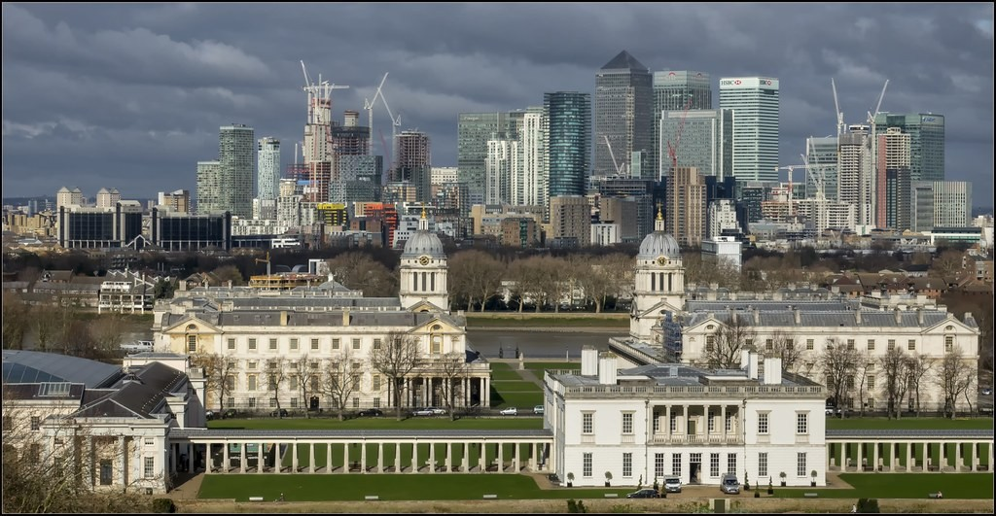
3. AICs
Activity 4
Renewed docklands.
Notes:
Activity 4. Look carefully at this picture: renewed docklands. Observe every detail before I ask the question.

Slide 28
3. AICs
Activity 4: Question
What are ghettos in AICs?
Notes:
Here is the question for Activity 4: What are ghettos in AICs? Take one minute to think and write your answer in your rough notebook.

Slide 29
3. AICs
Activity 4: Answer
Old poor inner-city areas, often of minorities, with bad housing and crime.
Notes:
Let us check the answer together. Old poor inner-city areas, often of minorities, with bad housing and crime.

Slide 30
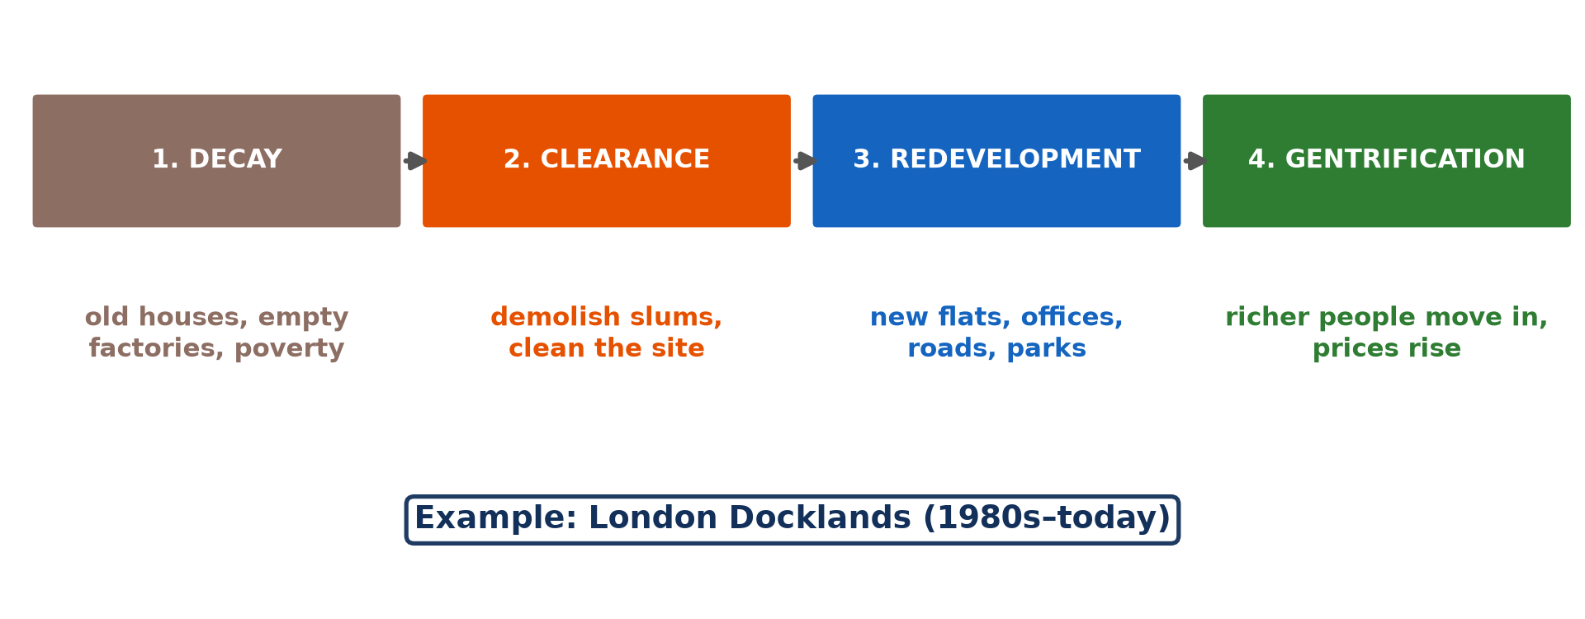
3. SOLUTIONS
Activity 5
Urban renewal.
Notes:
Activity 5. Look carefully at this diagram: urban renewal. Observe every detail before I ask the question.

Slide 31
3. SOLUTIONS
Activity 5: Question
Give two attempted solutions in AICs.
Notes:
Here is the question for Activity 5: Give two attempted solutions in AICs. Take one minute to think and write your answer in your rough notebook.

Slide 32
3. SOLUTIONS
Activity 5: Answer
Urban renewal and social housing.
Notes:
Let us check the answer together. Urban renewal and social housing.

Slide 33
BOARD SUMMARY
Board Summary
Topic: The Development of Settlements and their Implications
Sub-topic: Urban Settlements and their Spheres of Influence
Further Study 5: The Shanty Settlements (Ghettos/Slums) in the World
Notes:
Now we are going to copy the board summary. Write the title and the headings neatly in your notebooks. I will give you enough time for each slide, so do not rush.

Slide 34
BOARD SUMMARY
DEFINITIONS
The key terms of this lesson are defined as follows:
Shanty town: It is an unplanned settlement of poor, self-built houses without basic services.
Notes:
Let us copy the definitions. The key terms of this lesson are defined as follows. On this slide we have Shanty town. Write each point on a new line, with the key term first, and explain it in your own words when we revise.

Slide 35
BOARD SUMMARY
1. Shanty Settlements in Africa and in NICs
Shanty settlements in LICs and NICs are described as follows:
Africa: Kibera in Nairobi and Makoko in Lagos have huts of mud and metal sheets without water or toilets.
Notes:
Let us copy Shanty Settlements in Africa and in NICs. Shanty settlements in LICs and NICs are described as follows. On this slide we have Africa. Write each point on a new line, with the key term first, and explain it in your own words when we revise. When you finish, we go to the next slide.

Slide 36
BOARD SUMMARY
1. Shanty Settlements in Africa and in NICs (continued)
NICs: The favelas of Rio de Janeiro and the slums of Mumbai are crowded on hills and swamps.
Attempted solutions: Slum upgrading, site-and-service schemes and self-help housing are used.
Notes:
We continue with Shanty Settlements in Africa and in NICs. On this slide we have NICs and Attempted solutions. Write each point on a new line, with the key term first, and explain it in your own words when we revise.

Slide 37
BOARD SUMMARY
2. Ghettos and Slums in AICs
Ghettos in AICs are described as follows:
Characteristics: They are old inner-city areas with poor housing, unemployment and crime.
Attempted solutions: Urban renewal, social housing and job programmes are used.
Notes:
Let us copy Ghettos and Slums in AICs. Ghettos in AICs are described as follows. On this slide we have Characteristics and Attempted solutions. Write each point on a new line, with the key term first, and explain it in your own words when we revise.

Slide 38
BOARD SUMMARY
2. Ghettos and Slums in AICs
Illustration: urban renewal
Notes:
Now draw this illustration in your notebook: urban renewal. Give it a title and label it clearly.

Slide 39
FORMATIVE EVALUATION
Evaluation 1
Define a shanty town.
Notes:
Now let us check what you have understood. Question 1: Define a shanty town. Answer in your exercise book.

Slide 40
FORMATIVE EVALUATION
Expected Answer
An unplanned settlement of poor self-built houses without services.
Notes:
The expected answer is: an unplanned settlement of poor self-built houses without services. If you got it right, well done.

Slide 41
FORMATIVE EVALUATION
Evaluation 2
Give one example and one solution in an NIC.
Notes:
Now let us check what you have understood. Question 2: Give one example and one solution in an NIC. Answer in your exercise book.

Slide 42
FORMATIVE EVALUATION
Expected Answer
The favelas of Rio; self-help housing.
Notes:
The expected answer is: the favelas of Rio; self-help housing. If you got it right, well done.

Slide 43
REMEDIATION
Remediation
Fill in the blanks:
Shanty towns in Brazil are called ______.
A large slum in Nairobi is ______.
Rebuilding old city areas is urban ______.
Notes:
For those who need more practice, fill in the blanks in your exercise book. The answers are: number 1, favelas; number 2, Kibera; number 3, renewal.

Slide 44
HOMEWORK
Homework
Describe a poor quarter in a town of Cameroon and propose two solutions.
Notes:
For your homework: Describe a poor quarter in a town of Cameroon and propose two solutions. We shall correct it at the beginning of our next lesson.

Slide 45
NEXT LESSON
Next Lesson
Our next lesson will be on:
Lesson 49: Functions of Urban Settlements
Notes:
Our next lesson will be on Lesson 49: Functions of Urban Settlements. Thank you for your attention, and see you next time.

Slide 46
BILINGUAL GAME
Bilingual Game (Jeu Bilingue)
English | Français
Shanty town | Le bidonville
Slum | Le taudis
Ghetto | Le ghetto
Upgrading | L'amélioration / la réhabilitation
Social housing | Le logement social
Self-help | L'auto-construction
Notes:
Let us play the bilingual game. I say a word in English, and you give me the French word. Then we do the reverse.

Slide 47
LOGBOOK
Official Logbook (1/2)
Module / Topic | The Development of Settlements and their Implications
Lesson Title | Further Study 5: The Shanty Settlements (Ghettos/Slums) in the World
Expected Learning Outcomes | Describe shanty settlements in Africa. Describe shanty settlements in NICs and AICs. Assess the attempted solutions.
Competence | Learners are able to describe shanty settlements in the world and assess attempted solutions.
Notes:
I record this information in the official logbook of the class after the lesson.

Slide 48
LOGBOOK
Official Logbook (2/2)
Matter Taught | DEFINITIONS; Shanty Settlements in Africa and in NICs; Ghettos and Slums in AICs.
Evaluation | Formative evaluation and remediation exercise.
Homework | Describe a poor quarter in a town of Cameroon and propose two solutions.
Enrolment / Present / Absent | ____ / ____ / ____
Achievement | To be completed after the lesson.
Notes:
I complete the second page of the logbook: the matter taught, the evaluation, the homework and the attendance.

Slide 49
TEACHER'S NOTE
Teacher's Note
Timing: Homework correction, plan, objectives 8 min | Recall, situation, action 10 min | 5 activities 30 min | Board summary (copying) 30 min | Evaluation, remediation 10 min | Homework, next lesson 5 min | Logbook 7 min
Without the projector (Activity 1): describe.
Without the projector (Activity 2): discuss.
Without the projector (Activity 3): discuss.
Without the projector (Activity 4): discuss.
Without the projector (Activity 5): list.
Notes:
This slide is for me, the teacher: it gives the timing of the lesson and what to do if the projector is not available.

Slide 50
REFERENCES
References
Geography Syllabus, Forms I–V, MINESEC (2023) — Form 5, Module III: Management of Population Growth and Space Colonisation.
Photo, Activity 1: “Mathare” by Book Aid International, CC BY-NC-ND 2.0, via Flickr (https://www.flickr.com/photos/45024905@N07/4135561707)
Photo, Activity 2: “Village on the water Brunei.” by Bernard Spragg, CC0 1.0, via Flickr (https://www.flickr.com/photos/88123769@N02/15383937049)
Photo, Activity 3: “La Paz” by cliff.hellis, CC BY-NC-ND 2.0, via Flickr (https://www.flickr.com/photos/30099537@N02/6348597083)
Photo, Activity 4: “Old & new: University Greenwich, The Queen's House & London Docklands” by Bert Kaufmann, CC BY-NC 2.0, via Flickr (https://www.flickr.com/photos/22746515@N02/26742366958)
Diagrams and animations: drawn for this lesson (Geography Department).
Notes:
These are the references and picture credits used to prepare this lesson.

