Slide 1
LOWER SIXTH ARTS
GEOGRAPHY
Lesson 9
Major Pedogenic Regimes
Notes:
Good morning, class, and welcome to our geography lesson. I am your geography teacher, Mr Kamdem. Today we are starting Lesson 9: Major Pedogenic Regimes.

Slide 2
CLASS INFO
Class, Chapter and Duration
Class | Lower Sixth Arts
Chapter | Module 3: Understanding and managing biogeographic zones across the world in general and Cameroon in particular
Duration | 2 periods (2 × 50 minutes)
Notes:
This lesson is for Lower Sixth Arts. It belongs to Module 3: Understanding and managing biogeographic zones across the world in general and Cameroon in particular. We shall need 2 periods to cover it.

Slide 3
IDENTIFICATION
Lesson Identification
Topic | Soil Development
Sub-topic | Soil Profile Development and Forming Processes
Lesson | Lesson 9: Major Pedogenic Regimes
Notions / Concepts | Pedogenic regime, podsolisation, laterisation, calcification, salinisation, gleying.
Syllabus focus | Meaning and classification; podsolisation, laterisation, calcification, salinisation and gleying: location, movement of materials, processes.
Competence | Learners are able to explain the main soil-forming regimes and link them to climate zones.
Notes:
Our topic is Soil Development, and the sub-topic is Soil Profile Development and Forming Processes. The key notions we shall use today are: pedogenic regime, podsolisation, laterisation, calcification, salinisation, gleying. At the end, you should be able to do this: learners are able to explain the main soil-forming regimes and link them to climate zones.

Slide 4

HOMEWORK CORRECTION
Correction of the Homework
Question (Lesson 8: The Soil Profile):
Draw a soil profile seen in a road cutting near your home and label the horizons.
Notes:
Before we start the new lesson, let us correct the homework I gave you at the end of Lesson 8: The Soil Profile. The question was: Draw a soil profile seen in a road cutting near your home and label the horizons. Take out your exercise books.

Slide 5
HOMEWORK CORRECTION
Correction: Possible Answer
In a road cutting: a thin dark topsoil (A), a thick red or brown subsoil rich in clay (B), weathered rock with stones (C), and sometimes solid rock at the bottom (R).
Notes:
Here is a good answer. In a road cutting: a thin dark topsoil (A), a thick red or brown subsoil rich in clay (B), weathered rock with stones (C), and sometimes solid rock at the bottom (R). Compare it with your own answer and correct your work in red.

Slide 6
LESSON PLAN
Lesson Plan
Correction of the homework
Objectives and recall
Real-life situation and action to take
Learning activities
Board summary
Evaluation, remediation and homework
Notes:
Here is the plan of our lesson today. First, we shall correct the homework. Then we shall look at the objectives and recall what you already know. After that, we shall study a situation from real life and the action to take, and do the learning activities. Finally, we shall copy the board summary, do the evaluation and the remediation, and I will give you the homework.

Slide 7
OBJECTIVES
Objectives
By the end of this lesson, you should be able to:
Define a pedogenic regime.
Explain podsolisation and laterisation (downward movement).
Notes:
Take your time to copy this part; we will continue together.

Slide 8
OBJECTIVES
Objectives (continued)
Explain calcification, salinisation and gleying.
Notes:
By the end of this lesson, you should be able to do three things. Number 1: define a pedogenic regime. Number 2: explain podsolisation and laterisation (downward movement). Number 3: explain calcification, salinisation and gleying.

Slide 9
PREVIOUS KNOWLEDGE
Previous Knowledge
Water moves materials in the soil.
Climate is an active factor of soil formation.
Notes:
Let us first remember what you already know. Water moves materials in the soil. Climate is an active factor of soil formation. Keep this in mind, because we shall build on it today.

Slide 10
REAL-LIFE SITUATION
Situation in Real Life
A teacher shows photos of a red soil from Yaoundé, a grey soil from Canada and a salty white crust from an irrigated field in the Sahel. Learners ask why soils differ so much.
Notes:
Listen carefully to this situation from real life. A teacher shows photos of a red soil from Yaoundé, a grey soil from Canada and a salty white crust from an irrigated field in the Sahel. Learners ask why soils differ so much. Think about it, because I am going to ask you some questions.

Slide 11
REAL-LIFE SITUATION
Situation: Question 1
What is the problem in the situation?
Notes:
Question 1: What is the problem in the situation? Think for a moment, then raise your hand to answer.

Slide 12
REAL-LIFE SITUATION
Answer
Soils in different climates look very different.
Notes:
Good. Soils in different climates look very different.

Slide 13
REAL-LIFE SITUATION
Situation: Question 2
What controls these differences?
Notes:
Question 2: What controls these differences? Think for a moment, then raise your hand to answer.

Slide 14
REAL-LIFE SITUATION
Answer
The main soil-forming process (pedogenic regime), linked to climate.
Notes:
Good. The main soil-forming process (pedogenic regime), linked to climate.

Slide 15
REAL-LIFE SITUATION
Situation: Question 3
Name the regime of hot, wet tropics.
Notes:
Question 3: Name the regime of hot, wet tropics. Think for a moment, then raise your hand to answer.

Slide 16
REAL-LIFE SITUATION
Possible Answer
Laterisation.
Notes:
Good. Laterisation.

Slide 17
ACTION TO TAKE
Action to Take
Understand the main soil-forming regimes to manage soils in different climates.
Notes:
From this situation, the action we are working towards in this lesson is the following: understand the main soil-forming regimes to manage soils in different climates.

Slide 18
JUSTIFICATION
Justification of the Lesson
This lesson helps us to understand the great soil types of the world and their problems.
Notes:
Why is this lesson important for you? This lesson helps us to understand the great soil types of the world and their problems.

Slide 19
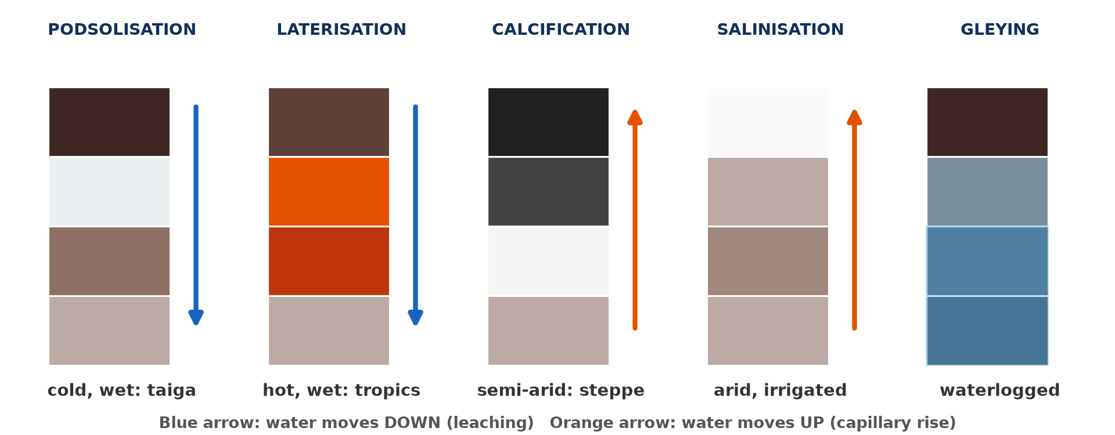
1. MEANING AND CLASSIFICATION
Activity 1
Five pedogenic regimes.
Notes:
Activity 1. Look carefully at this diagram: five pedogenic regimes. Observe every detail before I ask the question.

Slide 20
1. MEANING AND CLASSIFICATION
Activity 1: Question
In which regimes does water move mainly down? In which does it move up?
Notes:
Here is the question for Activity 1: In which regimes does water move mainly down? In which does it move up? Take one minute to think and write your answer in your rough notebook.

Slide 21
1. MEANING AND CLASSIFICATION
Activity 1: Answer
Down: podsolisation and laterisation. Up: calcification and salinisation.
Notes:
Let us check the answer together. Down: podsolisation and laterisation. Up: calcification and salinisation.

Slide 22

2. PODSOLISATION
Activity 2
A coniferous forest (taiga).
Notes:
Activity 2. Look carefully at this picture: a coniferous forest (taiga). Observe every detail before I ask the question.

Slide 23
2. PODSOLISATION
Activity 2: Question
Why are soils under coniferous forests acid and leached?
Notes:
Here is the question for Activity 2: Why are soils under coniferous forests acid and leached? Take one minute to think and write your answer in your rough notebook.

Slide 24
2. PODSOLISATION
Activity 2: Answer
Needles make acid humus, and rain washes iron and clay down.
Notes:
Let us check the answer together. Needles make acid humus, and rain washes iron and clay down.

Slide 25

3. LATERISATION
Activity 3
Laterite, a hard red layer.
Notes:
Activity 3. Look carefully at this picture: laterite, a hard red layer. Observe every detail before I ask the question.

Slide 26
3. LATERISATION
Activity 3: Question
Which elements stay in the soil during laterisation?
Notes:
Here is the question for Activity 3: Which elements stay in the soil during laterisation? Take one minute to think and write your answer in your rough notebook.

Slide 27
3. LATERISATION
Activity 3: Answer
Iron and aluminium oxides; silica and bases are washed out.
Notes:
Let us check the answer together. Iron and aluminium oxides; silica and bases are washed out.

Slide 28
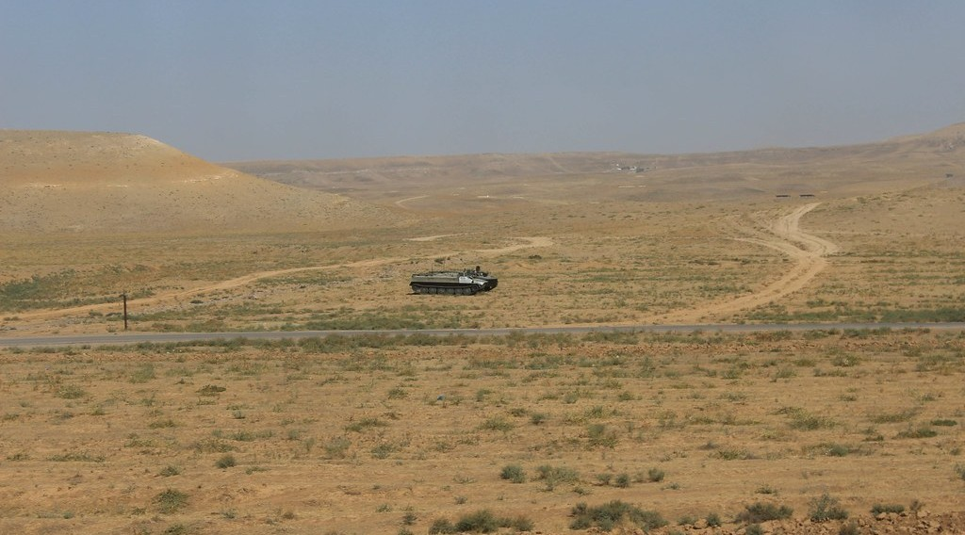
4. CALCIFICATION
Activity 4
The dry steppe of Kazakhstan.
Notes:
Activity 4. Look carefully at this picture: the dry steppe of Kazakhstan. Observe every detail before I ask the question.

Slide 29
4. CALCIFICATION
Activity 4: Question
Why does calcium collect near the surface in steppe soils?
Notes:
Here is the question for Activity 4: Why does calcium collect near the surface in steppe soils? Take one minute to think and write your answer in your rough notebook.

Slide 30
4. CALCIFICATION
Activity 4: Answer
Rain is low, so calcium is not washed away and evaporation brings it up.
Notes:
Let us check the answer together. Rain is low, so calcium is not washed away and evaporation brings it up.

Slide 31

5. SALINISATION
Activity 5
A salt crust on dry land.
Notes:
Activity 5. Look carefully at this picture: a salt crust on dry land. Observe every detail before I ask the question.

Slide 32
5. SALINISATION
Activity 5: Question
How can irrigation cause salinisation?
Notes:
Here is the question for Activity 5: How can irrigation cause salinisation? Take one minute to think and write your answer in your rough notebook.

Slide 33
5. SALINISATION
Activity 5: Answer
Water evaporates and leaves salts at the surface.
Notes:
Let us check the answer together. Water evaporates and leaves salts at the surface.

Slide 34
BOARD SUMMARY
Board Summary
Topic: Soil Development
Sub-topic: Soil Profile Development and Forming Processes
Lesson 9: Major Pedogenic Regimes
Notes:
Now we are going to copy the board summary. Write the title and the headings neatly in your notebooks. I will give you enough time for each slide, so do not rush.

Slide 35
BOARD SUMMARY
1. Meaning and Classification
Pedogenic regimes can be understood as follows:
Pedogenic regime: It is a major soil-forming process linked to a type of climate and vegetation.
Notes:
Let us copy Meaning and Classification. Pedogenic regimes can be understood as follows. On this slide we have Pedogenic regime. Write each point on a new line, with the key term first, and explain it in your own words when we revise. When you finish, we go to the next slide.

Slide 36
BOARD SUMMARY
1. Meaning and Classification (continued)
Classification: In wet climates, water moves down and leaches the soil (podsolisation, laterisation). In dry climates, water moves up and salts accumulate (calcification, salinisation); gleying occurs in waterlogged soils.
Notes:
We continue with Meaning and Classification. On this slide we have Classification. Write each point on a new line, with the key term first, and explain it in your own words when we revise.

Slide 37
BOARD SUMMARY
1. Meaning and Classification
Illustration: major pedogenic regimes
Notes:
Now draw this illustration in your notebook: major pedogenic regimes. Give it a title and label it clearly.

Slide 38
BOARD SUMMARY
2. Leaching Regimes
The main leaching regimes are:
Podsolisation: It occurs in cool, wet regions under coniferous forests (taiga). Acid water washes iron, aluminium and humus down, leaving a pale ash-grey E horizon and an iron pan below.
Notes:
Let us copy Leaching Regimes. The main leaching regimes are. On this slide we have Podsolisation. Write each point on a new line, with the key term first, and explain it in your own words when we revise. When you finish, we go to the next slide.

Slide 39
BOARD SUMMARY
2. Leaching Regimes (continued)
Laterisation: It occurs in hot, wet tropical regions such as southern Cameroon. Silica and bases are leached away, while iron and aluminium oxides remain, giving deep red soils and laterite crusts.
Notes:
We continue with Leaching Regimes. On this slide we have Laterisation. Write each point on a new line, with the key term first, and explain it in your own words when we revise.

Slide 40
BOARD SUMMARY
3. Accumulation Regimes
The main accumulation regimes are:
Calcification: It occurs in semi-arid grasslands such as the steppes and prairies. Evaporation draws calcium carbonate up, which collects near the surface and forms fertile chernozems.
Notes:
Let us copy Accumulation Regimes. The main accumulation regimes are. On this slide we have Calcification. Write each point on a new line, with the key term first, and explain it in your own words when we revise. When you finish, we go to the next slide.

Slide 41
BOARD SUMMARY
3. Accumulation Regimes (continued)
Salinisation: It occurs in hot, dry regions and in badly irrigated land. Capillary rise brings salts to the surface, forming a white crust that kills crops.
Notes:
We continue with Accumulation Regimes. On this slide we have Salinisation. Write each point on a new line, with the key term first, and explain it in your own words when we revise. When you finish, we go to the next slide.

Slide 42
BOARD SUMMARY
3. Accumulation Regimes (continued)
Gleying (gleization): It occurs in waterlogged soils without oxygen, such as swamps and floodplains. Iron is reduced, giving grey-blue colours with rusty mottles.
Notes:
We continue with Accumulation Regimes. On this slide we have Gleying (gleization). Write each point on a new line, with the key term first, and explain it in your own words when we revise.

Slide 43
FORMATIVE EVALUATION
Evaluation 1
Where does laterisation occur? Which elements stay?
Notes:
Now let us check what you have understood. Question 1: Where does laterisation occur? Which elements stay? Answer in your exercise book.

Slide 44
FORMATIVE EVALUATION
Expected Answer
In hot, wet tropics; iron and aluminium oxides stay.
Notes:
The expected answer is: in hot, wet tropics; iron and aluminium oxides stay. If you got it right, well done.

Slide 45
FORMATIVE EVALUATION
Evaluation 2
Explain salinisation.
Notes:
Now let us check what you have understood. Question 2: Explain salinisation. Answer in your exercise book.

Slide 46
FORMATIVE EVALUATION
Expected Answer
In dry areas, evaporation draws water up and leaves salts at the surface.
Notes:
The expected answer is: in dry areas, evaporation draws water up and leaves salts at the surface. If you got it right, well done.

Slide 47
REMEDIATION
Remediation
Fill in the blanks:
The regime of the taiga is ______.
The regime of the humid tropics is ______.
Grey waterlogged soils form by ______.
Notes:
For those who need more practice, fill in the blanks in your exercise book. The answers are: number 1, podsolisation; number 2, laterisation; number 3, gleying.

Slide 48
HOMEWORK
Homework
Copy the pedogenic diagram and give one climate for each regime.
Notes:
For your homework: Copy the pedogenic diagram and give one climate for each regime. We shall correct it at the beginning of our next lesson.

Slide 49
NEXT LESSON
Next Lesson
Our next lesson will be on:
Lesson 10: Minor Soil Forming Processes
Notes:
Our next lesson will be on Lesson 10: Minor Soil Forming Processes. Thank you for your attention, and see you next time.

Slide 50
BILINGUAL GAME
Bilingual Game (Jeu Bilingue)
English | Français
Podsolisation | La podzolisation
Laterisation | La latéritisation
Calcification | La calcification
Salinisation | La salinisation
Gleying | L'hydromorphie (gley)
Crust | La croûte
Notes:
Let us play the bilingual game. I say a word in English, and you give me the French word. Then we do the reverse.

Slide 51
LOGBOOK
Official Logbook (1/2)
Module / Topic | Soil Development
Lesson Title | Lesson 9: Major Pedogenic Regimes
Expected Learning Outcomes | Define a pedogenic regime. Explain podsolisation and laterisation (downward movement). Explain calcification, salinisation and gleying.
Competence | Learners are able to explain the main soil-forming regimes and link them to climate zones.
Notes:
I record this information in the official logbook of the class after the lesson.

Slide 52
LOGBOOK
Official Logbook (2/2)
Matter Taught | Meaning and Classification; Leaching Regimes; Accumulation Regimes.
Evaluation | Formative evaluation and remediation exercise.
Homework | Copy the pedogenic diagram and give one climate for each regime.
Enrolment / Present / Absent | ____ / ____ / ____
Achievement | To be completed after the lesson.
Notes:
I complete the second page of the logbook: the matter taught, the evaluation, the homework and the attendance.

Slide 53
TEACHER'S NOTE
Teacher's Note
Timing: Homework correction, plan, objectives 8 min | Recall, situation, action 10 min | 5 activities 30 min | Board summary (copying) 30 min | Evaluation, remediation 10 min | Homework, next lesson 5 min | Logbook 7 min
Without the projector (Activity 1): draw the five columns.
Without the projector (Activity 2): find the taiga on a map.
Without the projector (Activity 3): describe laterite roads.
Without the projector (Activity 4): find the steppes on a map.
Without the projector (Activity 5): describe salty wells in the north.
Notes:
This slide is for me, the teacher: it gives the timing of the lesson and what to do if the projector is not available.

Slide 54
REFERENCES
References
National Geography Syllabus, MINESEC/IGE/IP-SS, 2019 — Module 3 (Biogeography).
Photo, Activity 2: “Battleship Lake” by `James Wheeler, CC BY-NC-SA 2.0, via Flickr (https://www.flickr.com/photos/24128704@N08/16587218945)
Photo, Activity 3: “Laterite soil bricks in Richard Rebello's farm” by India Water Portal, CC BY-NC-SA 2.0, via Flickr (https://www.flickr.com/photos/21623815@N03/10720461943)
Photo, Activity 4: “Tank on the Kazakh steppe” by Timon91, CC BY-NC-SA 2.0, via Flickr (https://www.flickr.com/photos/52250985@N06/30964503402)
Photo, Activity 5: “Salt” by Phillie Casablanca, CC BY 2.0, via Flickr (https://www.flickr.com/photos/19451080@N00/2052715618)
Diagrams and animations: drawn for this lesson (Geography Department).
Notes:
These are the references and picture credits used to prepare this lesson.

