Slide 1
LOWER SIXTH ARTS
GEOGRAPHY
Lesson 13
Evolution of Vegetation over Time: Plant Succession
Notes:
Good morning, class, and welcome to our geography lesson. I am your geography teacher, Mr Kamdem. Today we are starting Lesson 13: Evolution of Vegetation over Time: Plant Succession.

Slide 2
CLASS INFO
Class, Chapter and Duration
Class | Lower Sixth Arts
Chapter | Module 3: Understanding and managing biogeographic zones across the world in general and Cameroon in particular
Duration | 2 periods (2 × 50 minutes)
Notes:
This lesson is for Lower Sixth Arts. It belongs to Module 3: Understanding and managing biogeographic zones across the world in general and Cameroon in particular. We shall need 2 periods to cover it.

Slide 3
IDENTIFICATION
Lesson Identification
Topic | Natural Vegetation
Sub-topic | Development of Vegetation
Lesson | Lesson 13: Evolution of Vegetation over Time: Plant Succession
Notions / Concepts | Plant succession, sere, prisere, pioneer, colonisation, climax, arresting factor.
Syllabus focus | Notion of succession; types; sites of priseres; process of colonisation; arresting factors.
Competence | Learners are able to explain how vegetation develops over time and what can stop it.
Notes:
Our topic is Natural Vegetation, and the sub-topic is Development of Vegetation. The key notions we shall use today are: plant succession, sere, prisere, pioneer, colonisation, climax, arresting factor. At the end, you should be able to do this: learners are able to explain how vegetation develops over time and what can stop it.

Slide 4

HOMEWORK CORRECTION
Correction of the Homework
Question (Lesson 12: Meaning of Natural Vegetation):
List five plants of your area and say whether each is natural or planted.
Notes:
Before we start the new lesson, let us correct the homework I gave you at the end of Lesson 12: Meaning of Natural Vegetation. The question was: List five plants of your area and say whether each is natural or planted. Take out your exercise books.

Slide 5
HOMEWORK CORRECTION
Correction: Possible Answer
Natural: elephant grass, shea tree, baobab, wild acacia. Planted: mango, maize, cotton, eucalyptus and neem around the house.
Notes:
Here is a good answer. Natural: elephant grass, shea tree, baobab, wild acacia. Planted: mango, maize, cotton, eucalyptus and neem around the house. Compare it with your own answer and correct your work in red.

Slide 6
LESSON PLAN
Lesson Plan
Correction of the homework
Objectives and recall
Real-life situation and action to take
Learning activities
Board summary
Evaluation, remediation and homework
Notes:
Here is the plan of our lesson today. First, we shall correct the homework. Then we shall look at the objectives and recall what you already know. After that, we shall study a situation from real life and the action to take, and do the learning activities. Finally, we shall copy the board summary, do the evaluation and the remediation, and I will give you the homework.

Slide 7
OBJECTIVES
Objectives
By the end of this lesson, you should be able to:
Define plant succession and its stages.
Name the types and sites of priseres.
Explain colonisation and arresting factors.
Notes:
By the end of this lesson, you should be able to do three things. Number 1: define plant succession and its stages. Number 2: name the types and sites of priseres. Number 3: explain colonisation and arresting factors.

Slide 8
PREVIOUS KNOWLEDGE
Previous Knowledge
Soil forms from bare rock over time.
Lichens and mosses grow on rocks.
Notes:
Let us first remember what you already know. Soil forms from bare rock over time. Lichens and mosses grow on rocks. Keep this in mind, because we shall build on it today.

Slide 9
REAL-LIFE SITUATION
Situation in Real Life
An old farm near Ebolowa was abandoned ten years ago. First grass covered it, then bushes, and now young trees are growing. Farmers say that "the forest is coming back".
Notes:
Listen carefully to this situation from real life. An old farm near Ebolowa was abandoned ten years ago. First grass covered it, then bushes, and now young trees are growing. Farmers say that "the forest is coming back". Think about it, because I am going to ask you some questions.

Slide 10
REAL-LIFE SITUATION
Situation: Question 1
What is the problem in the situation?
Notes:
Question 1: What is the problem in the situation? Think for a moment, then raise your hand to answer.

Slide 11
REAL-LIFE SITUATION
Answer
The vegetation changes over time on the same land.
Notes:
Good. The vegetation changes over time on the same land.

Slide 12
REAL-LIFE SITUATION
Situation: Question 2
What is this change called?
Notes:
Question 2: What is this change called? Think for a moment, then raise your hand to answer.

Slide 13
REAL-LIFE SITUATION
Answer
Plant succession.
Notes:
Good. Plant succession.

Slide 14
REAL-LIFE SITUATION
Situation: Question 3
What is the final stage?
Notes:
Question 3: What is the final stage? Think for a moment, then raise your hand to answer.

Slide 15
REAL-LIFE SITUATION
Possible Answer
The climax vegetation (here, forest).
Notes:
Good. The climax vegetation (here, forest).

Slide 16
ACTION TO TAKE
Action to Take
Allow vegetation to recover naturally and avoid factors that stop its growth.
Notes:
From this situation, the action we are working towards in this lesson is the following: allow vegetation to recover naturally and avoid factors that stop its growth.

Slide 17
JUSTIFICATION
Justification of the Lesson
This lesson helps us to understand how vegetation grows back and why it is sometimes stopped.
Notes:
Why is this lesson important for you? This lesson helps us to understand how vegetation grows back and why it is sometimes stopped.

Slide 18

1. NOTION OF PLANT SUCCESSION
Activity 1
Animation: from bare rock to forest.
Notes:
Activity 1. Look carefully at this animation: animation: from bare rock to forest. Watch the animation to the end; it will play again.

Slide 19
1. NOTION OF PLANT SUCCESSION
Activity 1: Question
Name the stages of a plant succession.
Notes:
Here is the question for Activity 1: Name the stages of a plant succession. Take one minute to think and write your answer in your rough notebook.

Slide 20
1. NOTION OF PLANT SUCCESSION
Activity 1: Answer
Bare ground, pioneers (lichens, mosses), grasses, shrubs, climax forest.
Notes:
Let us check the answer together. Bare ground, pioneers (lichens, mosses), grasses, shrubs, climax forest.

Slide 21
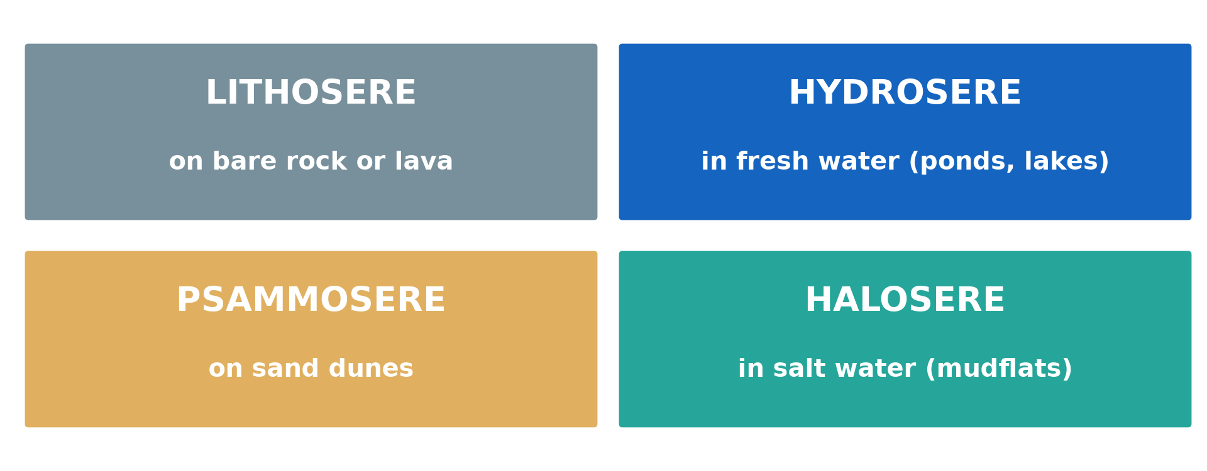
2. TYPES AND SITES OF PRISERES
Activity 2
The four priseres.
Notes:
Activity 2. Look carefully at this diagram: the four priseres. Observe every detail before I ask the question.

Slide 22
2. TYPES AND SITES OF PRISERES
Activity 2: Question
What is a hydrosere? Where does it begin?
Notes:
Here is the question for Activity 2: What is a hydrosere? Where does it begin? Take one minute to think and write your answer in your rough notebook.

Slide 23
2. TYPES AND SITES OF PRISERES
Activity 2: Answer
A succession that begins in fresh water (a pond or lake).
Notes:
Let us check the answer together. A succession that begins in fresh water (a pond or lake).

Slide 24
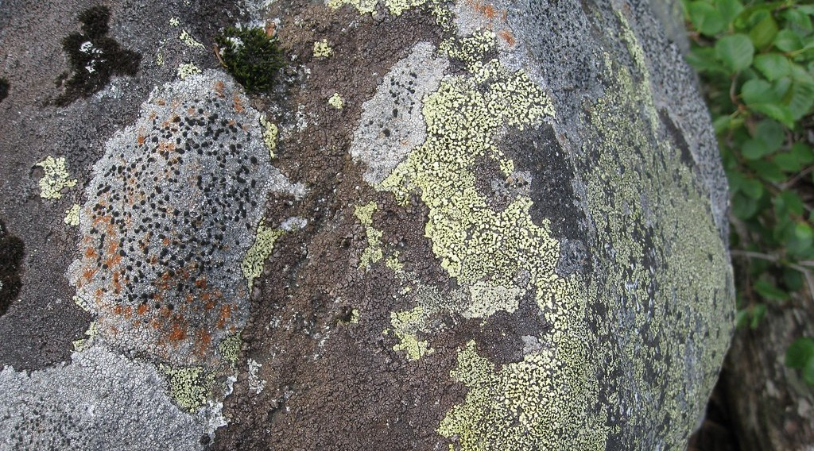
4. PROCESS OF COLONISATION
Activity 3
Lichens on bare rock.
Notes:
Activity 3. Look carefully at this picture: lichens on bare rock. Observe every detail before I ask the question.

Slide 25
4. PROCESS OF COLONISATION
Activity 3: Question
Why are lichens called pioneer plants?
Notes:
Here is the question for Activity 3: Why are lichens called pioneer plants? Take one minute to think and write your answer in your rough notebook.

Slide 26
4. PROCESS OF COLONISATION
Activity 3: Answer
They are the first to grow on bare rock and start soil formation.
Notes:
Let us check the answer together. They are the first to grow on bare rock and start soil formation.

Slide 27
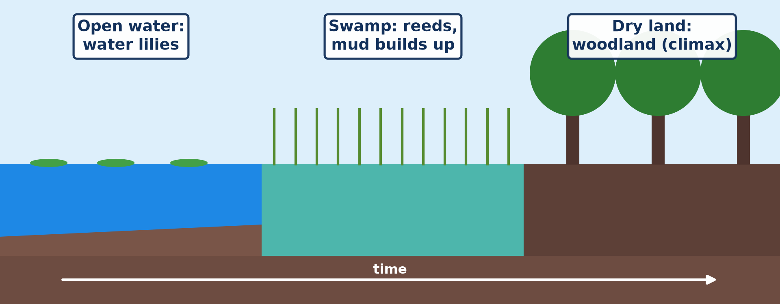
4. PROCESS OF COLONISATION
Activity 4
A hydrosere from open water to woodland.
Notes:
Activity 4. Look carefully at this diagram: a hydrosere from open water to woodland. Observe every detail before I ask the question.

Slide 28
4. PROCESS OF COLONISATION
Activity 4: Question
How does a pond slowly become dry land?
Notes:
Here is the question for Activity 4: How does a pond slowly become dry land? Take one minute to think and write your answer in your rough notebook.

Slide 29
4. PROCESS OF COLONISATION
Activity 4: Answer
Dead plants and mud fill it, and land plants replace water plants.
Notes:
Let us check the answer together. Dead plants and mud fill it, and land plants replace water plants.

Slide 30

5. ARRESTING FACTORS
Activity 5
Burnt land after a bush fire.
Notes:
Activity 5. Look carefully at this picture: burnt land after a bush fire. Observe every detail before I ask the question.

Slide 31
5. ARRESTING FACTORS
Activity 5: Question
Give two factors that can stop a succession.
Notes:
Here is the question for Activity 5: Give two factors that can stop a succession. Take one minute to think and write your answer in your rough notebook.

Slide 32
5. ARRESTING FACTORS
Activity 5: Answer
Fire and grazing (also farming, cutting).
Notes:
Let us check the answer together. Fire and grazing (also farming, cutting).

Slide 33
BOARD SUMMARY
Board Summary
Topic: Natural Vegetation
Sub-topic: Development of Vegetation
Lesson 13: Evolution of Vegetation over Time: Plant Succession
Notes:
Now we are going to copy the board summary. Write the title and the headings neatly in your notebooks. I will give you enough time for each slide, so do not rush.

Slide 34
BOARD SUMMARY
DEFINITIONS
The key terms of this lesson are defined as follows:
Plant succession: It is the gradual change of plant communities on a site over time until a stable climax is reached.
Sere: It is the whole series of plant communities in a succession.
Notes:
Let us copy the definitions. The key terms of this lesson are defined as follows. On this slide we have Plant succession and Sere. Write each point on a new line, with the key term first, and explain it in your own words when we revise. When you finish, we go to the next slide.

Slide 35
BOARD SUMMARY
DEFINITIONS (continued)
Prisere: It is a succession that begins on a bare surface that never had vegetation.
Notes:
We continue with the definitions. On this slide we have Prisere. Write each point on a new line, with the key term first, and explain it in your own words when we revise.

Slide 36
BOARD SUMMARY
1. Types and Sites of Priseres
Successions are of different types according to their site:
Primary and secondary succession: Primary succession starts on a new bare surface such as lava. Secondary succession starts where vegetation was removed, such as an abandoned farm.
Notes:
Let us copy Types and Sites of Priseres. Successions are of different types according to their site. On this slide we have Primary and secondary succession. Write each point on a new line, with the key term first, and explain it in your own words when we revise. When you finish, we go to the next slide.

Slide 37
BOARD SUMMARY
1. Types and Sites of Priseres (continued)
Sites of priseres: A lithosere begins on bare rock, a psammosere on sand dunes and a hydrosere in fresh water. A halosere begins in salt marshes.
Notes:
We continue with Types and Sites of Priseres. On this slide we have Sites of priseres. Write each point on a new line, with the key term first, and explain it in your own words when we revise.

Slide 38
BOARD SUMMARY
1. Types and Sites of Priseres
Illustration: types of priseres
Notes:
Now draw this illustration in your notebook: types of priseres. Give it a title and label it clearly.

Slide 39
BOARD SUMMARY
2. The Process of Plant Colonisation
Colonisation follows these stages:
Pioneer stage: Lichens and mosses colonise the bare surface and start weathering it. They add the first organic matter.
Notes:
Let us copy The Process of Plant Colonisation. Colonisation follows these stages. On this slide we have Pioneer stage. Write each point on a new line, with the key term first, and explain it in your own words when we revise. When you finish, we go to the next slide.

Slide 40
BOARD SUMMARY
2. The Process of Plant Colonisation (continued)
Intermediate stages: Grasses, herbs and shrubs follow as the soil deepens and improves. Each community changes the site and prepares it for the next.
Notes:
We continue with The Process of Plant Colonisation. On this slide we have Intermediate stages. Write each point on a new line, with the key term first, and explain it in your own words when we revise. When you finish, we go to the next slide.

Slide 41
BOARD SUMMARY
2. The Process of Plant Colonisation (continued)
Climax stage: Trees and a stable community are reached, in balance with the climate. The number of species and the biomass are highest.
Notes:
We continue with The Process of Plant Colonisation. On this slide we have Climax stage. Write each point on a new line, with the key term first, and explain it in your own words when we revise.

Slide 42
BOARD SUMMARY
2. The Process of Plant Colonisation
Illustration: stages of a plant succession
Notes:
Now draw this illustration in your notebook: stages of a plant succession. Give it a title and label it clearly.

Slide 43
BOARD SUMMARY
3. Arresting Factors
A succession can be stopped by:
Natural factors: Fire from lightning, floods, landslides and volcanic eruptions can stop or reverse a succession. Grazing by wild animals also keeps grasses.
Notes:
Let us copy Arresting Factors. A succession can be stopped by. On this slide we have Natural factors. Write each point on a new line, with the key term first, and explain it in your own words when we revise. When you finish, we go to the next slide.

Slide 44
BOARD SUMMARY
3. Arresting Factors (continued)
Human factors: Bush fires, farming, grazing, logging and building stop the succession. The vegetation that results is a plagioclimax.
Notes:
We continue with Arresting Factors. On this slide we have Human factors. Write each point on a new line, with the key term first, and explain it in your own words when we revise.

Slide 45
FORMATIVE EVALUATION
Evaluation 1
What is plant succession?
Notes:
Now let us check what you have understood. Question 1: What is plant succession? Answer in your exercise book.

Slide 46
FORMATIVE EVALUATION
Expected Answer
The gradual change of plant communities in an area over time.
Notes:
The expected answer is: the gradual change of plant communities in an area over time. If you got it right, well done.

Slide 47
FORMATIVE EVALUATION
Evaluation 2
Distinguish primary and secondary succession.
Notes:
Now let us check what you have understood. Question 2: Distinguish primary and secondary succession. Answer in your exercise book.

Slide 48
FORMATIVE EVALUATION
Expected Answer
Primary starts on bare ground without soil; secondary starts where soil remains.
Notes:
The expected answer is: primary starts on bare ground without soil; secondary starts where soil remains. If you got it right, well done.

Slide 49
REMEDIATION
Remediation
Fill in the blanks:
The first plants on bare rock are ______.
A succession in fresh water is a ______.
Fire and grazing are ______ factors.
Notes:
For those who need more practice, fill in the blanks in your exercise book. The answers are: number 1, pioneers; number 2, hydrosere; number 3, arresting.

Slide 50
HOMEWORK
Homework
Observe an abandoned field and describe the plants growing on it.
Notes:
For your homework: Observe an abandoned field and describe the plants growing on it. We shall correct it at the beginning of our next lesson.

Slide 51
NEXT LESSON
Next Lesson
Our next lesson will be on:
Lesson 14: The Concept of Climax Vegetation
Notes:
Our next lesson will be on Lesson 14: The Concept of Climax Vegetation. Thank you for your attention, and see you next time.

Slide 52
BILINGUAL GAME
Bilingual Game (Jeu Bilingue)
English | Français
Succession | La succession végétale
Pioneer | Pionnier
Climax | Le climax
Lichen | Le lichen
Colonisation | La colonisation
Pond | L'étang
Notes:
Let us play the bilingual game. I say a word in English, and you give me the French word. Then we do the reverse.

Slide 53
LOGBOOK
Official Logbook (1/2)
Module / Topic | Natural Vegetation
Lesson Title | Lesson 13: Evolution of Vegetation over Time: Plant Succession
Expected Learning Outcomes | Define plant succession and its stages. Name the types and sites of priseres. Explain colonisation and arresting factors.
Competence | Learners are able to explain how vegetation develops over time and what can stop it.
Notes:
I record this information in the official logbook of the class after the lesson.

Slide 54
LOGBOOK
Official Logbook (2/2)
Matter Taught | DEFINITIONS; Types and Sites of Priseres; The Process of Plant Colonisation; Arresting Factors.
Evaluation | Formative evaluation and remediation exercise.
Homework | Observe an abandoned field and describe the plants growing on it.
Enrolment / Present / Absent | ____ / ____ / ____
Achievement | To be completed after the lesson.
Notes:
I complete the second page of the logbook: the matter taught, the evaluation, the homework and the attendance.

Slide 55
TEACHER'S NOTE
Teacher's Note
Timing: Homework correction, plan, objectives 8 min | Recall, situation, action 10 min | 5 activities 30 min | Board summary (copying) 30 min | Evaluation, remediation 10 min | Homework, next lesson 5 min | Logbook 7 min
Activity 1 is an animation (GIF): it plays automatically in slide-show mode.
Without the projector (Activity 1): draw the stages on the board.
Without the projector (Activity 2): list the four priseres.
Without the projector (Activity 3): look for lichens on walls.
Without the projector (Activity 4): describe a swampy pond.
Without the projector (Activity 5): discuss yearly bush fires.
Notes:
This slide is for me, the teacher: it gives the timing of the lesson and what to do if the projector is not available.

Slide 56
REFERENCES
References
National Geography Syllabus, MINESEC/IGE/IP-SS, 2019 — Module 3 (Biogeography).
Photo, Activity 3: “Lichens on rock - Mason Lake” by brewbooks, CC BY-SA 2.0, via Flickr (https://www.flickr.com/photos/93452909@N00/2924427336)
Photo, Activity 5: “20111216-NRCS-LSC-0355” by USDAgov, CC BY 2.0, via Flickr (https://www.flickr.com/photos/41284017@N08/6551564351)
Diagrams and animations: drawn for this lesson (Geography Department).
Notes:
These are the references and picture credits used to prepare this lesson.

