Slide 1
LOWER SIXTH ARTS
GEOGRAPHY
Lesson 15
Examples of Plant Succession
Notes:
Good morning, class, and welcome to our geography lesson. I am your geography teacher, Mr Kamdem. Today we are starting Lesson 15: Examples of Plant Succession.

Slide 2
CLASS INFO
Class, Chapter and Duration
Class | Lower Sixth Arts
Chapter | Module 3: Understanding and managing biogeographic zones across the world in general and Cameroon in particular
Duration | 2 periods (2 × 50 minutes)
Notes:
This lesson is for Lower Sixth Arts. It belongs to Module 3: Understanding and managing biogeographic zones across the world in general and Cameroon in particular. We shall need 2 periods to cover it.

Slide 3
IDENTIFICATION
Lesson Identification
Topic | Natural Vegetation
Sub-topic | Development of Vegetation
Lesson | Lesson 15: Examples of Plant Succession
Notions / Concepts | Primary succession, lithosere, hydrosere, secondary succession, fallow, secondary forest.
Syllabus focus | Primary succession (lithosere, hydrosere) and secondary succession (fallow, cleared forest).
Competence | Learners are able to describe examples of primary and secondary succession.
Notes:
Our topic is Natural Vegetation, and the sub-topic is Development of Vegetation. The key notions we shall use today are: primary succession, lithosere, hydrosere, secondary succession, fallow, secondary forest. At the end, you should be able to do this: learners are able to describe examples of primary and secondary succession.

Slide 4

HOMEWORK CORRECTION
Correction of the Homework
Question (Lesson 14: The Concept of Climax Vegetation):
Write a short paragraph: "Is the savanna of Cameroon a climax?"
Notes:
Before we start the new lesson, let us correct the homework I gave you at the end of Lesson 14: The Concept of Climax Vegetation. The question was: Write a short paragraph: "Is the savanna of Cameroon a climax?". Take out your exercise books.

Slide 5
HOMEWORK CORRECTION
Correction: Possible Answer
The Guinea savanna of Cameroon is largely a plagioclimax maintained by bush fires and grazing; trees return where fire is controlled. The Sahel grassland is closer to a climatic climax because of low rainfall.
Notes:
Here is a good answer. The Guinea savanna of Cameroon is largely a plagioclimax maintained by bush fires and grazing; trees return where fire is controlled. The Sahel grassland is closer to a climatic climax because of low rainfall. Compare it with your own answer and correct your work in red.

Slide 6
LESSON PLAN
Lesson Plan
Correction of the homework
Objectives and recall
Real-life situation and action to take
Learning activities
Board summary
Evaluation, remediation and homework
Notes:
Here is the plan of our lesson today. First, we shall correct the homework. Then we shall look at the objectives and recall what you already know. After that, we shall study a situation from real life and the action to take, and do the learning activities. Finally, we shall copy the board summary, do the evaluation and the remediation, and I will give you the homework.

Slide 7
OBJECTIVES
Objectives
By the end of this lesson, you should be able to:
Describe a lithosere on lava.
Describe a hydrosere in a pond.
Describe secondary succession on abandoned farmland.
Notes:
By the end of this lesson, you should be able to do three things. Number 1: describe a lithosere on lava. Number 2: describe a hydrosere in a pond. Number 3: describe secondary succession on abandoned farmland.

Slide 8
PREVIOUS KNOWLEDGE
Previous Knowledge
Succession has stages from pioneers to climax.
Primary succession starts without soil.
Notes:
Let us first remember what you already know. Succession has stages from pioneers to climax. Primary succession starts without soil. Keep this in mind, because we shall build on it today.

Slide 9
REAL-LIFE SITUATION
Situation in Real Life
On Mount Cameroon, ferns now grow on lava from 1999, while an abandoned cassava farm nearby is already covered with bushes and young trees.
Notes:
Listen carefully to this situation from real life. On Mount Cameroon, ferns now grow on lava from 1999, while an abandoned cassava farm nearby is already covered with bushes and young trees. Think about it, because I am going to ask you some questions.

Slide 10
REAL-LIFE SITUATION
Situation: Question 1
What is the problem in the situation?
Notes:
Question 1: What is the problem in the situation? Think for a moment, then raise your hand to answer.

Slide 11
REAL-LIFE SITUATION
Answer
Plants return at different speeds.
Notes:
Good. Plants return at different speeds.

Slide 12
REAL-LIFE SITUATION
Situation: Question 2
Which is primary succession?
Notes:
Question 2: Which is primary succession? Think for a moment, then raise your hand to answer.

Slide 13
REAL-LIFE SITUATION
Answer
The lava flow, because it had no soil.
Notes:
Good. The lava flow, because it had no soil.

Slide 14
REAL-LIFE SITUATION
Situation: Question 3
Why is the farm faster?
Notes:
Question 3: Why is the farm faster? Think for a moment, then raise your hand to answer.

Slide 15
REAL-LIFE SITUATION
Possible Answer
Soil and seeds were still there: secondary succession.
Notes:
Good. Soil and seeds were still there: secondary succession.

Slide 16
ACTION TO TAKE
Action to Take
Help land recover naturally through fallowing and protection.
Notes:
From this situation, the action we are working towards in this lesson is the following: help land recover naturally through fallowing and protection.

Slide 17
JUSTIFICATION
Justification of the Lesson
This lesson helps us to recognise real successions around us and use them in farming and conservation.
Notes:
Why is this lesson important for you? This lesson helps us to recognise real successions around us and use them in farming and conservation.

Slide 18
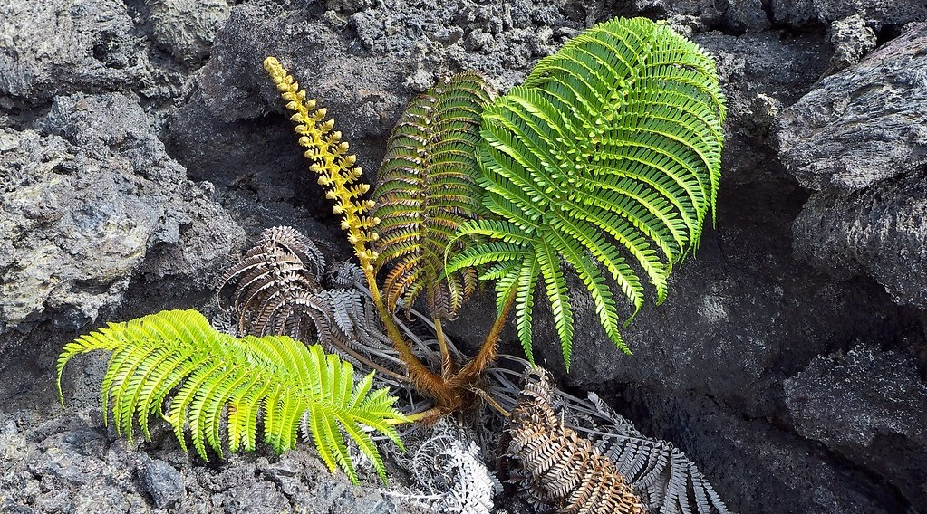
1. PRIMARY SUCCESSION: LITHOSERE
Activity 1
A fern growing on lava.
Notes:
Activity 1. Look carefully at this picture: a fern growing on lava. Observe every detail before I ask the question.

Slide 19
1. PRIMARY SUCCESSION: LITHOSERE
Activity 1: Question
Why can ferns grow here before trees?
Notes:
Here is the question for Activity 1: Why can ferns grow here before trees? Take one minute to think and write your answer in your rough notebook.

Slide 20
1. PRIMARY SUCCESSION: LITHOSERE
Activity 1: Answer
They need little soil and grow in cracks where water and dust collect.
Notes:
Let us check the answer together. They need little soil and grow in cracks where water and dust collect.

Slide 21
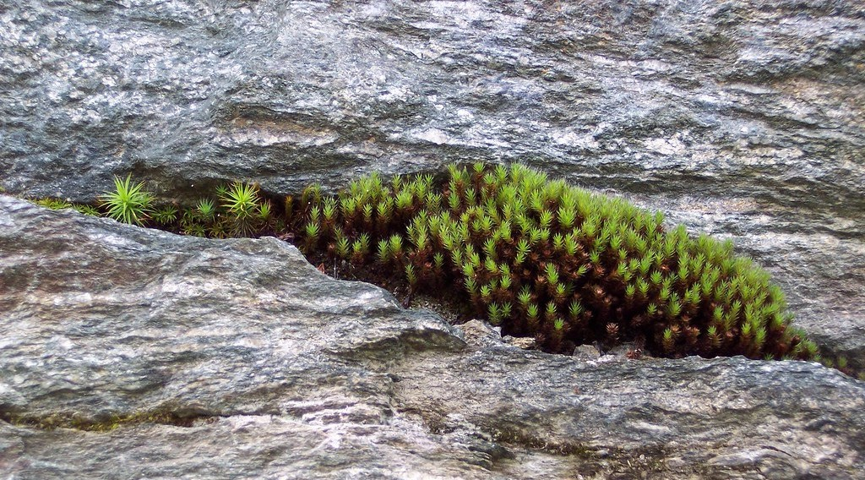
1. PRIMARY SUCCESSION: LITHOSERE
Activity 2
Moss growing in a rock crack.
Notes:
Activity 2. Look carefully at this picture: moss growing in a rock crack. Observe every detail before I ask the question.

Slide 22
1. PRIMARY SUCCESSION: LITHOSERE
Activity 2: Question
What do mosses do for later plants?
Notes:
Here is the question for Activity 2: What do mosses do for later plants? Take one minute to think and write your answer in your rough notebook.

Slide 23
1. PRIMARY SUCCESSION: LITHOSERE
Activity 2: Answer
They trap dust and water and add humus: they start the soil.
Notes:
Let us check the answer together. They trap dust and water and add humus: they start the soil.

Slide 24

1. PRIMARY SUCCESSION: HYDROSERE
Activity 3
A pond with water lilies.
Notes:
Activity 3. Look carefully at this picture: a pond with water lilies. Observe every detail before I ask the question.

Slide 25
1. PRIMARY SUCCESSION: HYDROSERE
Activity 3: Question
What will this pond become after a long time?
Notes:
Here is the question for Activity 3: What will this pond become after a long time? Take one minute to think and write your answer in your rough notebook.

Slide 26
1. PRIMARY SUCCESSION: HYDROSERE
Activity 3: Answer
A swamp, then dry land with woodland.
Notes:
Let us check the answer together. A swamp, then dry land with woodland.

Slide 27
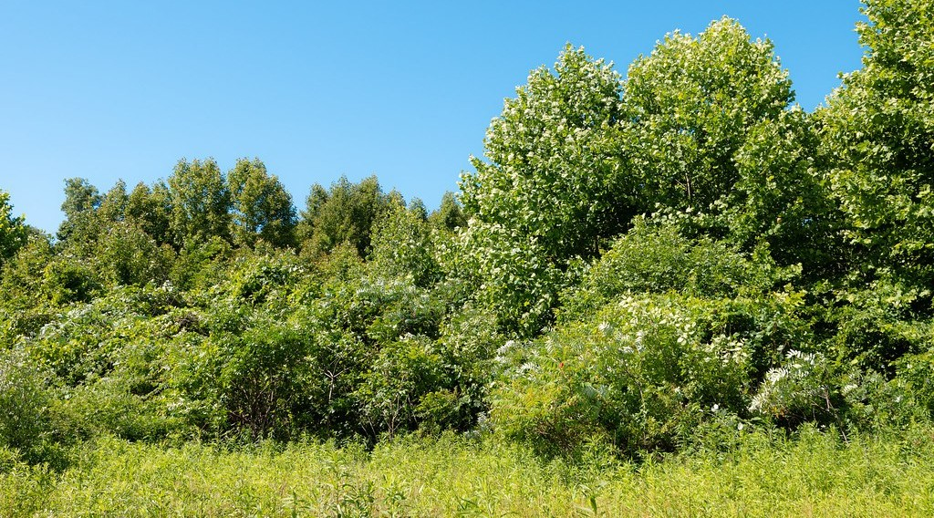
2. SECONDARY SUCCESSION
Activity 4
Young shrubs and trees growing back on cleared land.
Notes:
Activity 4. Look carefully at this picture: young shrubs and trees growing back on cleared land. Observe every detail before I ask the question.

Slide 28
2. SECONDARY SUCCESSION
Activity 4: Question
Why is secondary succession faster than primary?
Notes:
Here is the question for Activity 4: Why is secondary succession faster than primary? Take one minute to think and write your answer in your rough notebook.

Slide 29
2. SECONDARY SUCCESSION
Activity 4: Answer
Soil, roots and seeds are already there.
Notes:
Let us check the answer together. Soil, roots and seeds are already there.

Slide 30

2. SECONDARY SUCCESSION
Activity 5
Logs from a cleared forest.
Notes:
Activity 5. Look carefully at this picture: logs from a cleared forest. Observe every detail before I ask the question.

Slide 31
2. SECONDARY SUCCESSION
Activity 5: Question
Is the forest that grows back the same as the original?
Notes:
Here is the question for Activity 5: Is the forest that grows back the same as the original? Take one minute to think and write your answer in your rough notebook.

Slide 32
2. SECONDARY SUCCESSION
Activity 5: Answer
No. It is a secondary forest with different, faster-growing species.
Notes:
Let us check the answer together. No. It is a secondary forest with different, faster-growing species.

Slide 33
BOARD SUMMARY
Board Summary
Topic: Natural Vegetation
Sub-topic: Development of Vegetation
Lesson 15: Examples of Plant Succession
Notes:
Now we are going to copy the board summary. Write the title and the headings neatly in your notebooks. I will give you enough time for each slide, so do not rush.

Slide 34
BOARD SUMMARY
1. Primary Succession
Examples of primary succession are:
Lithosere: On new lava, lichens and mosses colonise first and form the first soil. Ferns, grasses, shrubs and finally forest follow, as on Mount Cameroon lava flows.
Notes:
Let us copy Primary Succession. Examples of primary succession are. On this slide we have Lithosere. Write each point on a new line, with the key term first, and explain it in your own words when we revise. When you finish, we go to the next slide.

Slide 35
BOARD SUMMARY
1. Primary Succession (continued)
Hydrosere: In a pond, submerged plants, then floating plants and reeds colonise. Silt and dead plants fill the pond until it becomes a marsh, then dry land with trees.
Notes:
We continue with Primary Succession. On this slide we have Hydrosere. Write each point on a new line, with the key term first, and explain it in your own words when we revise.

Slide 36
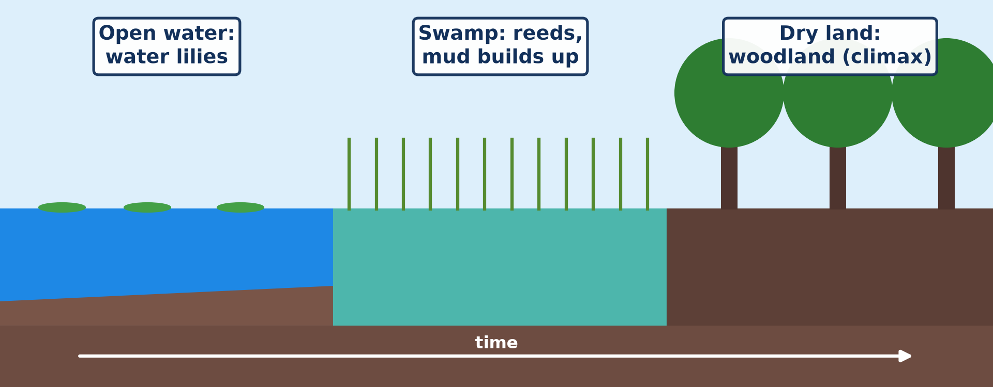
BOARD SUMMARY
1. Primary Succession
Illustration: a hydrosere
Notes:
Now draw this illustration in your notebook: a hydrosere. Give it a title and label it clearly.

Slide 37
BOARD SUMMARY
2. Secondary Succession
Secondary succession can be illustrated as follows:
Process: On an abandoned farm or after logging, grasses and weeds grow first, then shrubs and fast-growing trees. It is faster than primary succession because the soil and seeds are already there.
Notes:
Let us copy Secondary Succession. Secondary succession can be illustrated as follows. On this slide we have Process. Write each point on a new line, with the key term first, and explain it in your own words when we revise. When you finish, we go to the next slide.

Slide 38
BOARD SUMMARY
2. Secondary Succession (continued)
Result: After many years a secondary forest develops, but it is poorer in species than the original forest. Continuous cutting keeps it at a lower stage.
Notes:
We continue with Secondary Succession. On this slide we have Result. Write each point on a new line, with the key term first, and explain it in your own words when we revise.

Slide 39
FORMATIVE EVALUATION
Evaluation 1
Describe the stages of a lithosere.
Notes:
Now let us check what you have understood. Question 1: Describe the stages of a lithosere. Answer in your exercise book.

Slide 40
FORMATIVE EVALUATION
Expected Answer
Lichens and mosses, then ferns and grasses, then shrubs, then trees (climax).
Notes:
The expected answer is: lichens and mosses, then ferns and grasses, then shrubs, then trees (climax). If you got it right, well done.

Slide 41
FORMATIVE EVALUATION
Evaluation 2
Why is secondary succession faster?
Notes:
Now let us check what you have understood. Question 2: Why is secondary succession faster? Answer in your exercise book.

Slide 42
FORMATIVE EVALUATION
Expected Answer
Soil, roots and seeds are already present.
Notes:
The expected answer is: soil, roots and seeds are already present. If you got it right, well done.

Slide 43
REMEDIATION
Remediation
Fill in the blanks:
A succession on lava is a ______.
A succession in a pond is a ______.
Forest that grows back after clearing is ______ forest.
Notes:
For those who need more practice, fill in the blanks in your exercise book. The answers are: number 1, lithosere; number 2, hydrosere; number 3, secondary.

Slide 44
HOMEWORK
Homework
Describe the plants on a fallow field near you and say which stage it has reached.
Notes:
For your homework: Describe the plants on a fallow field near you and say which stage it has reached. We shall correct it at the beginning of our next lesson.

Slide 45
NEXT LESSON
Next Lesson
Our next lesson will be on:
Lesson 16: Spatial Distribution of Vegetation
Notes:
Our next lesson will be on Lesson 16: Spatial Distribution of Vegetation. Thank you for your attention, and see you next time.

Slide 46
BILINGUAL GAME
Bilingual Game (Jeu Bilingue)
English | Français
Lava | La lave
Moss | La mousse
Fern | La fougère
Swamp | Le marécage
Fallow | La jachère
Regrowth | La repousse
Notes:
Let us play the bilingual game. I say a word in English, and you give me the French word. Then we do the reverse.

Slide 47
LOGBOOK
Official Logbook (1/2)
Module / Topic | Natural Vegetation
Lesson Title | Lesson 15: Examples of Plant Succession
Expected Learning Outcomes | Describe a lithosere on lava. Describe a hydrosere in a pond. Describe secondary succession on abandoned farmland.
Competence | Learners are able to describe examples of primary and secondary succession.
Notes:
I record this information in the official logbook of the class after the lesson.

Slide 48
LOGBOOK
Official Logbook (2/2)
Matter Taught | Primary Succession; Secondary Succession.
Evaluation | Formative evaluation and remediation exercise.
Homework | Describe the plants on a fallow field near you and say which stage it has reached.
Enrolment / Present / Absent | ____ / ____ / ____
Achievement | To be completed after the lesson.
Notes:
I complete the second page of the logbook: the matter taught, the evaluation, the homework and the attendance.

Slide 49
TEACHER'S NOTE
Teacher's Note
Timing: Homework correction, plan, objectives 8 min | Recall, situation, action 10 min | 5 activities 30 min | Board summary (copying) 30 min | Evaluation, remediation 10 min | Homework, next lesson 5 min | Logbook 7 min
Without the projector (Activity 1): describe the 1999 and 2000 lava flows.
Without the projector (Activity 2): look for moss on old walls.
Without the projector (Activity 3): describe ponds that dried up.
Without the projector (Activity 4): describe a fallow farm.
Without the projector (Activity 5): discuss logging in the East.
Notes:
This slide is for me, the teacher: it gives the timing of the lesson and what to do if the projector is not available.

Slide 50
REFERENCES
References
National Geography Syllabus, MINESEC/IGE/IP-SS, 2019 — Module 3 (Biogeography).
Photo, Activity 1: “Fern Growing in Lava” by Ed Suominen, CC BY-NC 2.0, via Flickr (https://www.flickr.com/photos/37960170@N07/9688955410)
Photo, Activity 2: “Moss growing in rock crevace” by binarydreams, CC BY-NC 2.0, via Flickr (https://www.flickr.com/photos/30479406@N00/1399948300)
Photo, Activity 3: “Gooderstone Water Gardens - pond - water lilies” by ell brown, CC BY 2.0, via Flickr (https://www.flickr.com/photos/39415781@N06/5993988041)
Photo, Activity 4: “Young, Shrubby Forest” by Wayne National Forest, Public domain 1.0, via Flickr (https://www.flickr.com/photos/39244790@N04/53956302430)
Photo, Activity 5: “Logging truck, Cameroon” by World Resources, CC BY-NC-SA 2.0, via Flickr (https://www.flickr.com/photos/26107309@N05/4764354366)
Diagrams and animations: drawn for this lesson (Geography Department).
Notes:
These are the references and picture credits used to prepare this lesson.

