Slide 1
LOWER SIXTH ARTS
GEOGRAPHY
Lesson 19
Examples of Ecosystems: The Pond
Notes:
Good morning, class, and welcome to our geography lesson. I am your geography teacher, Mr Kamdem. Today we are starting Lesson 19: Examples of Ecosystems: The Pond.

Slide 2
CLASS INFO
Class, Chapter and Duration
Class | Lower Sixth Arts
Chapter | Module 3: Understanding and managing biogeographic zones across the world in general and Cameroon in particular
Duration | 2 periods (2 × 50 minutes)
Notes:
This lesson is for Lower Sixth Arts. It belongs to Module 3: Understanding and managing biogeographic zones across the world in general and Cameroon in particular. We shall need 2 periods to cover it.

Slide 3
IDENTIFICATION
Lesson Identification
Topic | Ecological Systems (Ecosystems)
Sub-topic | The Structure of an Ecosystem
Lesson | Lesson 19: Examples of Ecosystems: The Pond
Notions / Concepts | Aquatic ecosystem, pond, algae, plankton, producer, consumer, decomposer, food chain.
Syllabus focus | Example of an aquatic ecosystem (pond): components, characteristics and functioning as a system.
Competence | Learners are able to describe a pond as an ecosystem with its components and processes.
Notes:
Our topic is Ecological Systems (Ecosystems), and the sub-topic is The Structure of an Ecosystem. The key notions we shall use today are: aquatic ecosystem, pond, algae, plankton, producer, consumer, decomposer, food chain. At the end, you should be able to do this: learners are able to describe a pond as an ecosystem with its components and processes.

Slide 4

HOMEWORK CORRECTION
Correction of the Homework
Question (Lesson 18: The Ecosystem as a System):
Draw the ecosystem of a farm as a system with inputs, stores and outputs.
Notes:
Before we start the new lesson, let us correct the homework I gave you at the end of Lesson 18: The Ecosystem as a System. The question was: Draw the ecosystem of a farm as a system with inputs, stores and outputs. Take out your exercise books.

Slide 5
HOMEWORK CORRECTION
Correction: Possible Answer
Farm system: inputs – sun, rain, seeds, manure and labour; stores – crops, soil and livestock; outputs – harvest, milk, eroded soil and water lost by evaporation.
Notes:
Here is a good answer. Farm system: inputs – sun, rain, seeds, manure and labour; stores – crops, soil and livestock; outputs – harvest, milk, eroded soil and water lost by evaporation. Compare it with your own answer and correct your work in red.

Slide 6
LESSON PLAN
Lesson Plan
Correction of the homework
Objectives and recall
Real-life situation and action to take
Learning activities
Board summary
Evaluation, remediation and homework
Notes:
Here is the plan of our lesson today. First, we shall correct the homework. Then we shall look at the objectives and recall what you already know. After that, we shall study a situation from real life and the action to take, and do the learning activities. Finally, we shall copy the board summary, do the evaluation and the remediation, and I will give you the homework.

Slide 7
OBJECTIVES
Objectives
By the end of this lesson, you should be able to:
Identify the abiotic and biotic components of a pond.
Describe a pond food chain.
Show the pond as a system.
Notes:
By the end of this lesson, you should be able to do three things. Number 1: identify the abiotic and biotic components of a pond. Number 2: describe a pond food chain. Number 3: show the pond as a system.

Slide 8
PREVIOUS KNOWLEDGE
Previous Knowledge
An ecosystem has producers, consumers and decomposers.
Ecosystems are open systems.
Notes:
Let us first remember what you already know. An ecosystem has producers, consumers and decomposers. Ecosystems are open systems. Keep this in mind, because we shall build on it today.

Slide 9
REAL-LIFE SITUATION
Situation in Real Life
A fish farmer near Foumban notices that when he adds too much animal waste to his pond, the water turns green and the fish die.
Notes:
Listen carefully to this situation from real life. A fish farmer near Foumban notices that when he adds too much animal waste to his pond, the water turns green and the fish die. Think about it, because I am going to ask you some questions.

Slide 10
REAL-LIFE SITUATION
Situation: Question 1
What is the problem in the situation?
Notes:
Question 1: What is the problem in the situation? Think for a moment, then raise your hand to answer.

Slide 11
REAL-LIFE SITUATION
Answer
The pond ecosystem was upset and fish died.
Notes:
Good. The pond ecosystem was upset and fish died.

Slide 12
REAL-LIFE SITUATION
Situation: Question 2
What made the water green?
Notes:
Question 2: What made the water green? Think for a moment, then raise your hand to answer.

Slide 13
REAL-LIFE SITUATION
Answer
Too many nutrients made algae grow fast.
Notes:
Good. Too many nutrients made algae grow fast.

Slide 14
REAL-LIFE SITUATION
Situation: Question 3
Why did the fish die?
Notes:
Question 3: Why did the fish die? Think for a moment, then raise your hand to answer.

Slide 15
REAL-LIFE SITUATION
Possible Answer
Rotting algae used up the oxygen.
Notes:
Good. Rotting algae used up the oxygen.

Slide 16
ACTION TO TAKE
Action to Take
Protect ponds and wetlands from pollution and drying.
Notes:
From this situation, the action we are working towards in this lesson is the following: protect ponds and wetlands from pollution and drying.

Slide 17
JUSTIFICATION
Justification of the Lesson
This lesson helps us to study a small ecosystem that we can observe near us.
Notes:
Why is this lesson important for you? This lesson helps us to study a small ecosystem that we can observe near us.

Slide 18
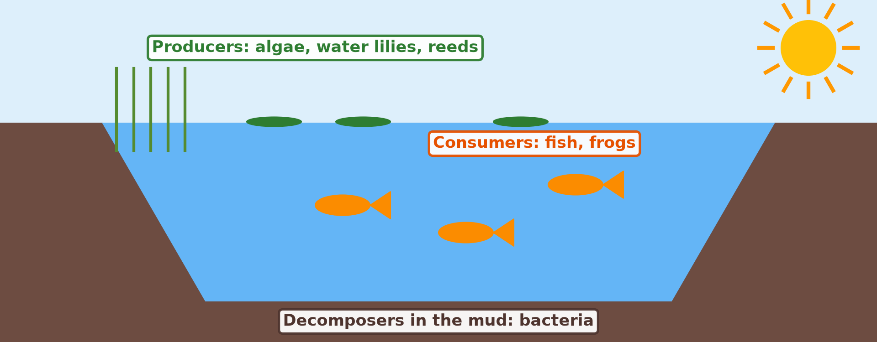
1. COMPONENTS OF THE POND
Activity 1
The pond ecosystem.
Notes:
Activity 1. Look carefully at this diagram: the pond ecosystem. Observe every detail before I ask the question.

Slide 19
1. COMPONENTS OF THE POND
Activity 1: Question
Name the producers, consumers and decomposers of the pond.
Notes:
Here is the question for Activity 1: Name the producers, consumers and decomposers of the pond. Take one minute to think and write your answer in your rough notebook.

Slide 20
1. COMPONENTS OF THE POND
Activity 1: Answer
Producers: algae, water lilies. Consumers: fish, frogs. Decomposers: bacteria.
Notes:
Let us check the answer together. Producers: algae, water lilies. Consumers: fish, frogs. Decomposers: bacteria.

Slide 21
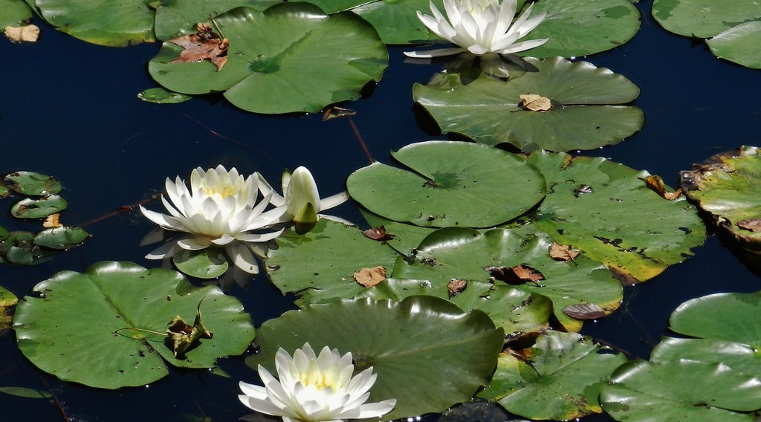
1. COMPONENTS: PRODUCERS
Activity 2
Water lilies on a pond.
Notes:
Activity 2. Look carefully at this picture: water lilies on a pond. Observe every detail before I ask the question.

Slide 22
1. COMPONENTS: PRODUCERS
Activity 2: Question
Why are water lilies producers?
Notes:
Here is the question for Activity 2: Why are water lilies producers? Take one minute to think and write your answer in your rough notebook.

Slide 23
1. COMPONENTS: PRODUCERS
Activity 2: Answer
They make food by photosynthesis.
Notes:
Let us check the answer together. They make food by photosynthesis.

Slide 24

2. FOOD CHAIN
Activity 3
Fishermen on the water.
Notes:
Activity 3. Look carefully at this picture: fishermen on the water. Observe every detail before I ask the question.

Slide 25
2. FOOD CHAIN
Activity 3: Question
Give a pond food chain ending with man.
Notes:
Here is the question for Activity 3: Give a pond food chain ending with man. Take one minute to think and write your answer in your rough notebook.

Slide 26
2. FOOD CHAIN
Activity 3: Answer
Algae → small animals (zooplankton) → fish → man.
Notes:
Let us check the answer together. Algae → small animals (zooplankton) → fish → man.

Slide 27

3. THE POND AS A SYSTEM
Activity 4
A garden pond.
Notes:
Activity 4. Look carefully at this picture: a garden pond. Observe every detail before I ask the question.

Slide 28
3. THE POND AS A SYSTEM
Activity 4: Question
Name two inputs of the pond system.
Notes:
Here is the question for Activity 4: Name two inputs of the pond system. Take one minute to think and write your answer in your rough notebook.

Slide 29
3. THE POND AS A SYSTEM
Activity 4: Answer
Sunlight and nutrients (also rain water, leaves).
Notes:
Let us check the answer together. Sunlight and nutrients (also rain water, leaves).

Slide 30

3. COMPARISON
Activity 5
The savanna, a land ecosystem.
Notes:
Activity 5. Look carefully at this picture: the savanna, a land ecosystem. Observe every detail before I ask the question.

Slide 31
3. COMPARISON
Activity 5: Question
Give one difference between a pond and a savanna ecosystem.
Notes:
Here is the question for Activity 5: Give one difference between a pond and a savanna ecosystem. Take one minute to think and write your answer in your rough notebook.

Slide 32
3. COMPARISON
Activity 5: Answer
The pond is in water; its producers are mainly algae, not grass.
Notes:
Let us check the answer together. The pond is in water; its producers are mainly algae, not grass.

Slide 33
BOARD SUMMARY
Board Summary
Topic: Ecological Systems (Ecosystems)
Sub-topic: The Structure of an Ecosystem
Lesson 19: Examples of Ecosystems: The Pond
Notes:
Now we are going to copy the board summary. Write the title and the headings neatly in your notebooks. I will give you enough time for each slide, so do not rush.

Slide 34
BOARD SUMMARY
1. Components and Characteristics of a Pond
A pond ecosystem has the following components:
Abiotic components: Water, sunlight, dissolved oxygen, nutrients and bottom mud. Temperature and light change with depth.
Notes:
Let us copy Components and Characteristics of a Pond. A pond ecosystem has the following components. On this slide we have Abiotic components. Write each point on a new line, with the key term first, and explain it in your own words when we revise. When you finish, we go to the next slide.

Slide 35
BOARD SUMMARY
1. Components and Characteristics of a Pond (continued)
Producers: Algae, water lilies and reeds make food by photosynthesis. Phytoplankton are tiny floating producers.
Notes:
We continue with Components and Characteristics of a Pond. On this slide we have Producers. Write each point on a new line, with the key term first, and explain it in your own words when we revise. When you finish, we go to the next slide.

Slide 36
BOARD SUMMARY
1. Components and Characteristics of a Pond (continued)
Consumers and decomposers: Zooplankton, insects, tadpoles and small fish are consumers, and large fish, birds and man are top consumers. Bacteria in the mud decompose dead matter.
Notes:
We continue with Components and Characteristics of a Pond. On this slide we have Consumers and decomposers. Write each point on a new line, with the key term first, and explain it in your own words when we revise.

Slide 37
BOARD SUMMARY
1. Components and Characteristics of a Pond
Illustration: a pond ecosystem
Notes:
Now draw this illustration in your notebook: a pond ecosystem. Give it a title and label it clearly.

Slide 38
BOARD SUMMARY
2. The Pond as a System
The pond works as a system:
Inputs and outputs: Inputs are sunlight, rain, runoff with nutrients and leaves. Outputs are evaporation, outflow, fish caught and heat.
Notes:
Let us copy The Pond as a System. The pond works as a system. On this slide we have Inputs and outputs. Write each point on a new line, with the key term first, and explain it in your own words when we revise. When you finish, we go to the next slide.

Slide 39
BOARD SUMMARY
2. The Pond as a System (continued)
Food chain and characteristics: A typical chain is algae → zooplankton → small fish → large fish → man. The pond is small, clearly limited and sensitive to pollution.
Notes:
We continue with The Pond as a System. On this slide we have Food chain and characteristics. Write each point on a new line, with the key term first, and explain it in your own words when we revise.

Slide 40
FORMATIVE EVALUATION
Evaluation 1
Name one producer, one consumer and one decomposer of a pond.
Notes:
Now let us check what you have understood. Question 1: Name one producer, one consumer and one decomposer of a pond. Answer in your exercise book.

Slide 41
FORMATIVE EVALUATION
Expected Answer
Algae; fish; bacteria.
Notes:
The expected answer is: algae; fish; bacteria. If you got it right, well done.

Slide 42
FORMATIVE EVALUATION
Evaluation 2
What is eutrophication?
Notes:
Now let us check what you have understood. Question 2: What is eutrophication? Answer in your exercise book.

Slide 43
FORMATIVE EVALUATION
Expected Answer
Rapid algae growth from excess nutrients, which reduces oxygen.
Notes:
The expected answer is: rapid algae growth from excess nutrients, which reduces oxygen. If you got it right, well done.

Slide 44
REMEDIATION
Remediation
Fill in the blanks:
Simple water plants are ______.
Bacteria in the mud are ______.
Excess nutrients cause ______.
Notes:
For those who need more practice, fill in the blanks in your exercise book. The answers are: number 1, algae; number 2, decomposers; number 3, eutrophication.

Slide 45
HOMEWORK
Homework
Observe a pond or stream and list what lives in it.
Notes:
For your homework: Observe a pond or stream and list what lives in it. We shall correct it at the beginning of our next lesson.

Slide 46
NEXT LESSON
Next Lesson
Our next lesson will be on:
Lesson 20: Interactions within Ecosystems
Notes:
Our next lesson will be on Lesson 20: Interactions within Ecosystems. Thank you for your attention, and see you next time.

Slide 47
BILINGUAL GAME
Bilingual Game (Jeu Bilingue)
English | Français
Pond | L'étang
Algae | Les algues
Fish | Le poisson
Food chain | La chaîne alimentaire
Oxygen | L'oxygène
Mud | La vase
Notes:
Let us play the bilingual game. I say a word in English, and you give me the French word. Then we do the reverse.

Slide 48
LOGBOOK
Official Logbook (1/2)
Module / Topic | Ecological Systems (Ecosystems)
Lesson Title | Lesson 19: Examples of Ecosystems: The Pond
Expected Learning Outcomes | Identify the abiotic and biotic components of a pond. Describe a pond food chain. Show the pond as a system.
Competence | Learners are able to describe a pond as an ecosystem with its components and processes.
Notes:
I record this information in the official logbook of the class after the lesson.

Slide 49
LOGBOOK
Official Logbook (2/2)
Matter Taught | Components and Characteristics of a Pond; The Pond as a System.
Evaluation | Formative evaluation and remediation exercise.
Homework | Observe a pond or stream and list what lives in it.
Enrolment / Present / Absent | ____ / ____ / ____
Achievement | To be completed after the lesson.
Notes:
I complete the second page of the logbook: the matter taught, the evaluation, the homework and the attendance.

Slide 50
TEACHER'S NOTE
Teacher's Note
Timing: Homework correction, plan, objectives 8 min | Recall, situation, action 10 min | 5 activities 30 min | Board summary (copying) 30 min | Evaluation, remediation 10 min | Homework, next lesson 5 min | Logbook 7 min
Without the projector (Activity 1): draw the pond.
Without the projector (Activity 2): look at water plants.
Without the projector (Activity 3): write the chain on the board.
Without the projector (Activity 4): list inputs and outputs.
Without the projector (Activity 5): compare the two.
Notes:
This slide is for me, the teacher: it gives the timing of the lesson and what to do if the projector is not available.

Slide 51
REFERENCES
References
National Geography Syllabus, MINESEC/IGE/IP-SS, 2019 — Module 3 (Biogeography).
Photo, Activity 2: “Rieve's Pond Water Lilies 2015” by matthewbeziat, CC BY-NC 2.0, via Flickr (https://www.flickr.com/photos/109690096@N08/20146588069)
Photo, Activity 3: “Fishermen, Lake Tana” by A.Davey, CC BY 2.0, via Flickr (https://www.flickr.com/photos/40595948@N00/2260748777)
Photo, Activity 4: “Gooderstone Water Gardens - pond - water lilies” by ell brown, CC BY 2.0, via Flickr (https://www.flickr.com/photos/39415781@N06/5993988041)
Photo, Activity 5: “Blue Wildebeest in the Lowveld” by Martin_Heigan, CC BY-NC-ND 2.0, via Flickr (https://www.flickr.com/photos/97303475@N00/2089079933)
Diagrams and animations: drawn for this lesson (Geography Department).
Notes:
These are the references and picture credits used to prepare this lesson.

