Slide 1
LOWER SIXTH ARTS
GEOGRAPHY
Further Study 2
Theory of Sea-Floor Spreading
Notes:
Good morning, class, and welcome to our geography lesson. I am your geography teacher, Mr Kamdem. Today we are starting Further Study 2: Theory of Sea-Floor Spreading.

Slide 2
CLASS INFO
Class, Chapter and Duration
Class | Lower Sixth Arts
Chapter | Module 2: Understanding and managing physical landscapes, geomorphological processes and hazards across the world in general and Cameroon in particular
Duration | 2 periods (2 × 50 minutes)
Notes:
This lesson is for Lower Sixth Arts. It belongs to Module 2: Understanding and managing physical landscapes, geomorphological processes and hazards across the world in general and Cameroon in particular. We shall need 2 periods to cover it.

Slide 3
IDENTIFICATION
Lesson Identification
Topic | The Development of the Earth's Structure
Sub-topic | Theories of Earth Structure and Resultant Landforms
Lesson | Further Study 2: Theory of Sea-Floor Spreading
Notions / Concepts | Sea-floor spreading, mid-ocean ridge, convection current, palaeomagnetism, magnetic stripes, rift valley.
Syllabus focus | The theory of sea-floor spreading (Hess, 1960s) and its cause; evidence (age of oceanic rocks, palaeomagnetism); effects on ocean relief.
Competence | Learners are able to explain sea-floor spreading and use its evidence to show how continents are pushed apart.
Notes:
Our topic is The Development of the Earth's Structure, and the sub-topic is Theories of Earth Structure and Resultant Landforms. The key notions we shall use today are: sea-floor spreading, mid-ocean ridge, convection current, palaeomagnetism, magnetic stripes, rift valley. At the end, you should be able to do this: learners are able to explain sea-floor spreading and use its evidence to show how continents are pushed apart.

Slide 4

HOMEWORK CORRECTION
Correction of the Homework
Question (Further Study 1: Early Theories of Crustal Movements):
Define a mid-ocean ridge.
Notes:
Before we start the new lesson, let us correct the homework I gave you at the end of Further Study 1: Early Theories of Crustal Movements. The question was: Define a mid-ocean ridge. Take out your exercise books.

Slide 5
HOMEWORK CORRECTION
Correction: Possible Answer
A mid-ocean ridge is a long underwater mountain chain where new oceanic crust is formed, such as the Mid-Atlantic Ridge.
Notes:
Here is a good answer. A mid-ocean ridge is a long underwater mountain chain where new oceanic crust is formed, such as the Mid-Atlantic Ridge. Compare it with your own answer and correct your work in red.

Slide 6
LESSON PLAN
Lesson Plan
Correction of the homework
Objectives and recall
Real-life situation and action to take
Learning activities
Board summary
Evaluation, remediation and homework
Notes:
Here is the plan of our lesson today. First, we shall correct the homework. Then we shall look at the objectives and recall what you already know. After that, we shall study a situation from real life and the action to take, and do the learning activities. Finally, we shall copy the board summary, do the evaluation and the remediation, and I will give you the homework.

Slide 7
OBJECTIVES
Objectives
By the end of this lesson, you should be able to:
State the theory of sea-floor spreading.
Explain its cause (mantle convection and eruptions at ridges).
Notes:
Take your time to copy this part; we will continue together.

Slide 8
OBJECTIVES
Objectives (continued)
Explain the evidence of the age of rocks and palaeomagnetism.
Describe the landforms it creates on the ocean floor.
Notes:
By the end of this lesson, you should be able to do four things. Number 1: state the theory of sea-floor spreading. Number 2: explain its cause (mantle convection and eruptions at ridges). Number 3: explain the evidence of the age of rocks and palaeomagnetism. Number 4: describe the landforms it creates on the ocean floor.

Slide 9
PREVIOUS KNOWLEDGE
Previous Knowledge
Wegener could not explain what moved the continents.
The mantle flows very slowly.
Basalt forms when lava cools.
Notes:
Let us first remember what you already know. Wegener could not explain what moved the continents. The mantle flows very slowly. Basalt forms when lava cools. Keep this in mind, because we shall build on it today.

Slide 10
REAL-LIFE SITUATION
Situation in Real Life
You help your mother prepare a big pot of bouillie.
As it gets very hot, you notice that the thick porridge in the middle rises to the surface, moves to the sides and sinks back along the edges.
Notes:
Take your time to copy this part; we will continue together.

Slide 11
REAL-LIFE SITUATION
Situation in Real Life (continued)
This reminds you of the last geography lesson: we knew that the continents move, but not why.
You ask: "Could the answer be similar to what happens in this pot?"
Notes:
Listen carefully to this situation from real life. You help your mother prepare a big pot of bouillie. As it gets very hot, you notice that the thick porridge in the middle rises to the surface, moves to the sides and sinks back along the edges. This reminds you of the last geography lesson: we knew that the continents move, but not why. You ask: "Could the answer be similar to what happens in this pot?" Think about it, because I am going to ask you some questions.

Slide 12
REAL-LIFE SITUATION
Situation: Question 1
What is the problem in the situation?
Notes:
Question 1: What is the problem in the situation? Think for a moment, then raise your hand to answer.

Slide 13
REAL-LIFE SITUATION
Answer
The learner does not know what force moves the continents.
Notes:
Good. The learner does not know what force moves the continents.

Slide 14
REAL-LIFE SITUATION
Situation: Question 2
What makes the porridge move in circles?
Notes:
Question 2: What makes the porridge move in circles? Think for a moment, then raise your hand to answer.

Slide 15
REAL-LIFE SITUATION
Answer
Heat from below: hot porridge rises, cools and sinks (convection).
Notes:
Good. Heat from below: hot porridge rises, cools and sinks (convection).

Slide 16
REAL-LIFE SITUATION
Situation: Question 3
Where did scientists find the "engine" of drift?
Notes:
Question 3: Where did scientists find the "engine" of drift? Think for a moment, then raise your hand to answer.

Slide 17
REAL-LIFE SITUATION
Possible Answer
Along the mid-ocean ridges, where new sea floor is formed.
Notes:
Good. Along the mid-ocean ridges, where new sea floor is formed.

Slide 18
ACTION TO TAKE
Action to Take
Use simple models, like the pot of porridge, to explain natural processes.
Notes:
From this situation, the action we are working towards in this lesson is the following: use simple models, like the pot of porridge, to explain natural processes.

Slide 19
JUSTIFICATION
Justification of the Lesson
This lesson gives the missing explanation of continental drift and prepares the theory of plate tectonics.
Notes:
Why is this lesson important for you? This lesson gives the missing explanation of continental drift and prepares the theory of plate tectonics.

Slide 20
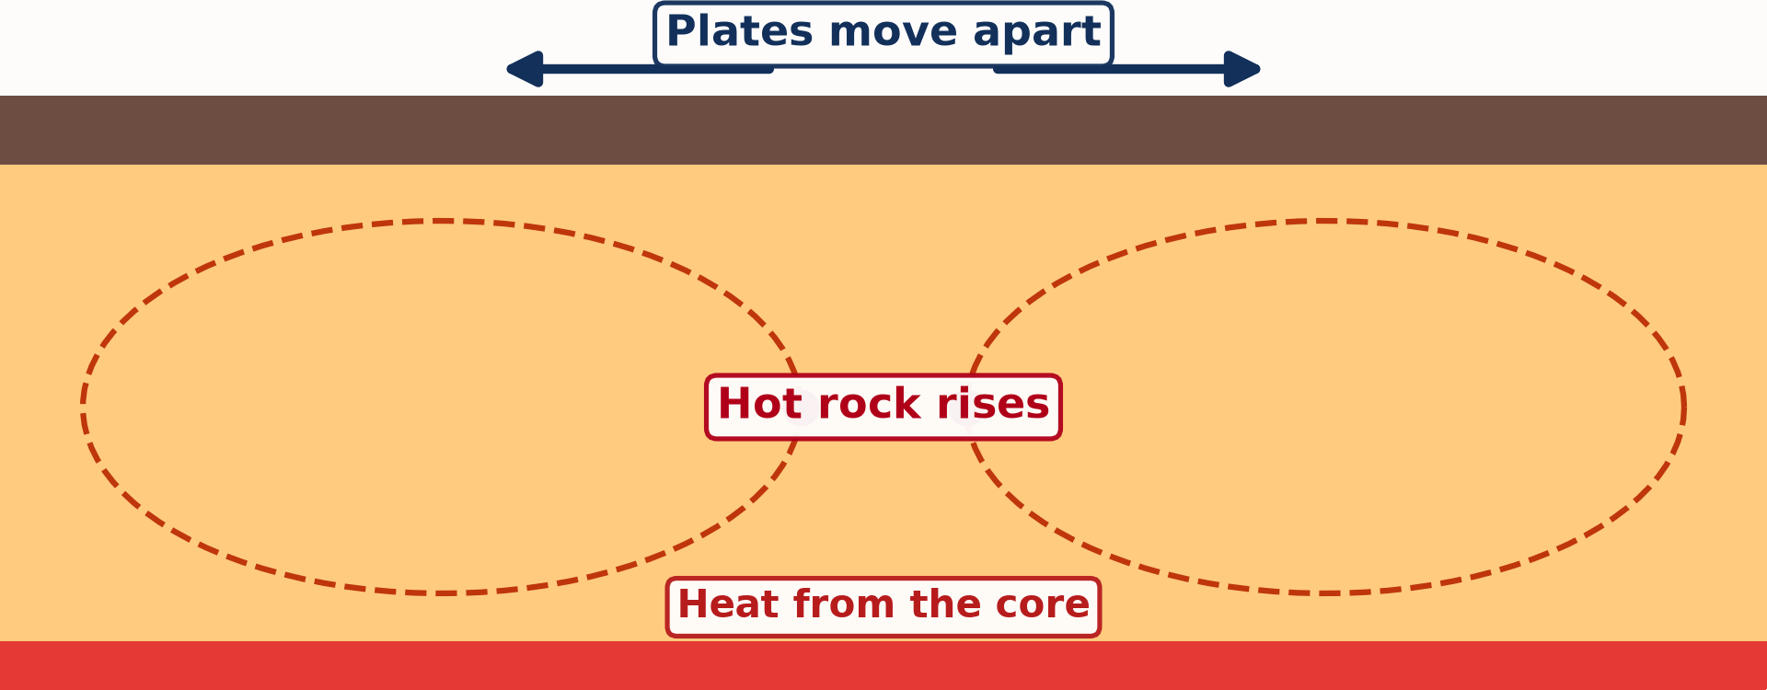
1. THE THEORY
Activity 1
Animation: convection currents in the mantle.
Notes:
Activity 1. Look carefully at this animation: animation: convection currents in the mantle. Watch the animation to the end; it will play again.

Slide 21
1. THE THEORY
Activity 1: Question
What drives sea-floor spreading?
Notes:
Here is the question for Activity 1: What drives sea-floor spreading? Take one minute to think and write your answer in your rough notebook.

Slide 22
1. THE THEORY
Activity 1: Answer
Convection currents in the mantle.
Notes:
Let us check the answer together. Convection currents in the mantle.

Slide 23
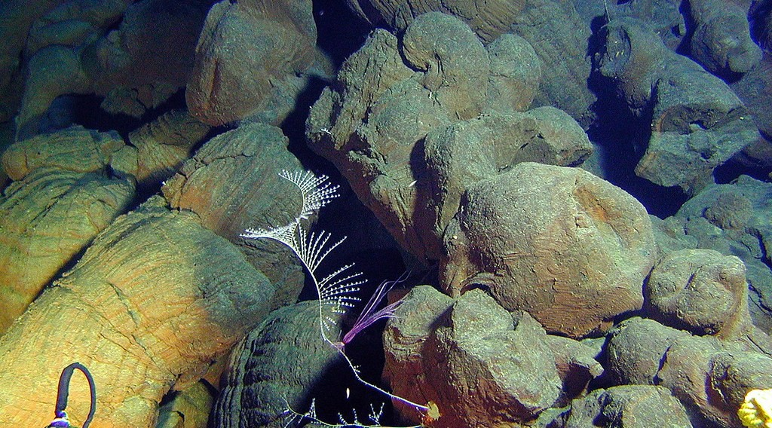
1. THE THEORY
Activity 2
Pillow lava cooled under the sea.
Notes:
Activity 2. Look carefully at this picture: pillow lava cooled under the sea. Observe every detail before I ask the question.

Slide 24
1. THE THEORY
Activity 2: Question
What rock forms when lava cools at a mid-ocean ridge?
Notes:
Here is the question for Activity 2: What rock forms when lava cools at a mid-ocean ridge? Take one minute to think and write your answer in your rough notebook.

Slide 25
1. THE THEORY
Activity 2: Answer
Basalt.
Notes:
Let us check the answer together. Basalt.

Slide 26
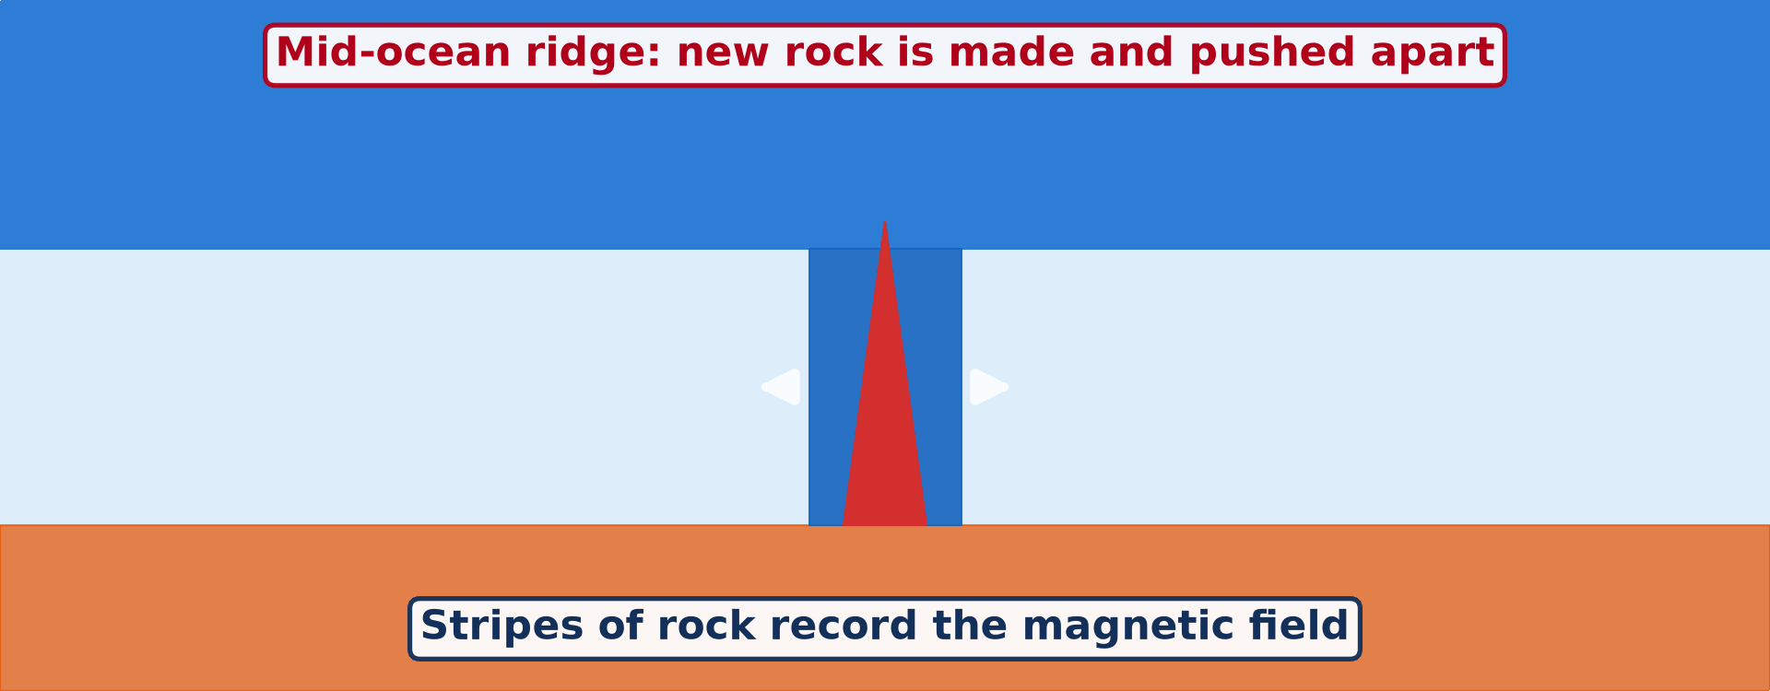
2. EVIDENCE
Activity 3
Animation: new sea floor and magnetic stripes.
Notes:
Activity 3. Look carefully at this animation: animation: new sea floor and magnetic stripes. Watch the animation to the end; it will play again.

Slide 27
2. EVIDENCE
Activity 3: Question
Where are the youngest rocks of the ocean floor?
Notes:
Here is the question for Activity 3: Where are the youngest rocks of the ocean floor? Take one minute to think and write your answer in your rough notebook.

Slide 28
2. EVIDENCE
Activity 3: Answer
At the centre of the mid-ocean ridges.
Notes:
Let us check the answer together. At the centre of the mid-ocean ridges.

Slide 29
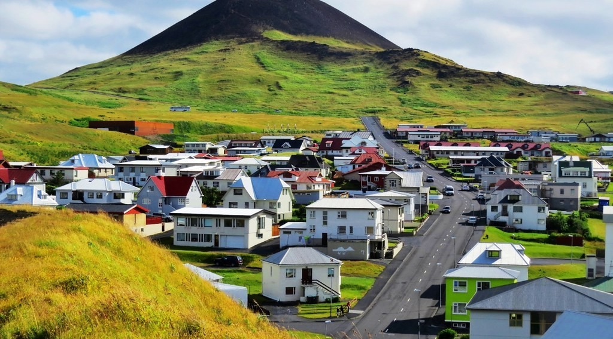
2. EVIDENCE
Activity 4
A new volcanic island.
Notes:
Activity 4. Look carefully at this picture: a new volcanic island. Observe every detail before I ask the question.

Slide 30
2. EVIDENCE
Activity 4: Question
Why do the magnetic stripes form a mirror image on each side of the ridge?
Notes:
Here is the question for Activity 4: Why do the magnetic stripes form a mirror image on each side of the ridge? Take one minute to think and write your answer in your rough notebook.

Slide 31
2. EVIDENCE
Activity 4: Answer
New rock records the magnetic field and is pushed equally to both sides.
Notes:
Let us check the answer together. New rock records the magnetic field and is pushed equally to both sides.

Slide 32

3. OCEAN RELIEF
Activity 5
A rift in Iceland.
Notes:
Activity 5. Look carefully at this picture: a rift in Iceland. Observe every detail before I ask the question.

Slide 33
3. OCEAN RELIEF
Activity 5: Question
Which ridge crosses Iceland?
Notes:
Here is the question for Activity 5: Which ridge crosses Iceland? Take one minute to think and write your answer in your rough notebook.

Slide 34
3. OCEAN RELIEF
Activity 5: Answer
The Mid-Atlantic Ridge.
Notes:
Let us check the answer together. The Mid-Atlantic Ridge.

Slide 35
BOARD SUMMARY
Board Summary
Topic: The Development of the Earth's Structure
Sub-topic: Theories of Earth Structure and Resultant Landforms
Further Study 2: Theory of Sea-Floor Spreading
Notes:
Now we are going to copy the board summary. Write the title and the headings neatly in your notebooks. I will give you enough time for each slide, so do not rush.

Slide 36
BOARD SUMMARY
DEFINITIONS
The key terms of this lesson are defined as follows:
Sea-floor spreading: It is the process by which new oceanic crust forms at mid-ocean ridges and moves away from them.
Notes:
Let us copy the definitions. The key terms of this lesson are defined as follows. On this slide we have Sea-floor spreading. Write each point on a new line, with the key term first, and explain it in your own words when we revise. When you finish, we go to the next slide.

Slide 37
BOARD SUMMARY
DEFINITIONS (continued)
Mid-ocean ridge: It is a long underwater mountain chain where new oceanic crust is formed.
Convection current: It is the circular movement of hot material that rises, cools and sinks.
Notes:
We continue with the definitions. On this slide we have Mid-ocean ridge and Convection current. Write each point on a new line, with the key term first, and explain it in your own words when we revise. When you finish, we go to the next slide.

Slide 38
BOARD SUMMARY
DEFINITIONS (continued)
Palaeomagnetism: It is the record of the past magnetic field of the Earth kept in rocks.
Notes:
We continue with the definitions. On this slide we have Palaeomagnetism. Write each point on a new line, with the key term first, and explain it in your own words when we revise.

Slide 39
BOARD SUMMARY
1. The Theory of Sea-Floor Spreading
The theory of sea-floor spreading is presented as follows:
Author: Harry Hess proposed it in the early 1960s, giving the mechanism that Wegener lacked.
Notes:
Let us copy The Theory of Sea-Floor Spreading. The theory of sea-floor spreading is presented as follows. On this slide we have Author. Write each point on a new line, with the key term first, and explain it in your own words when we revise.

Slide 40
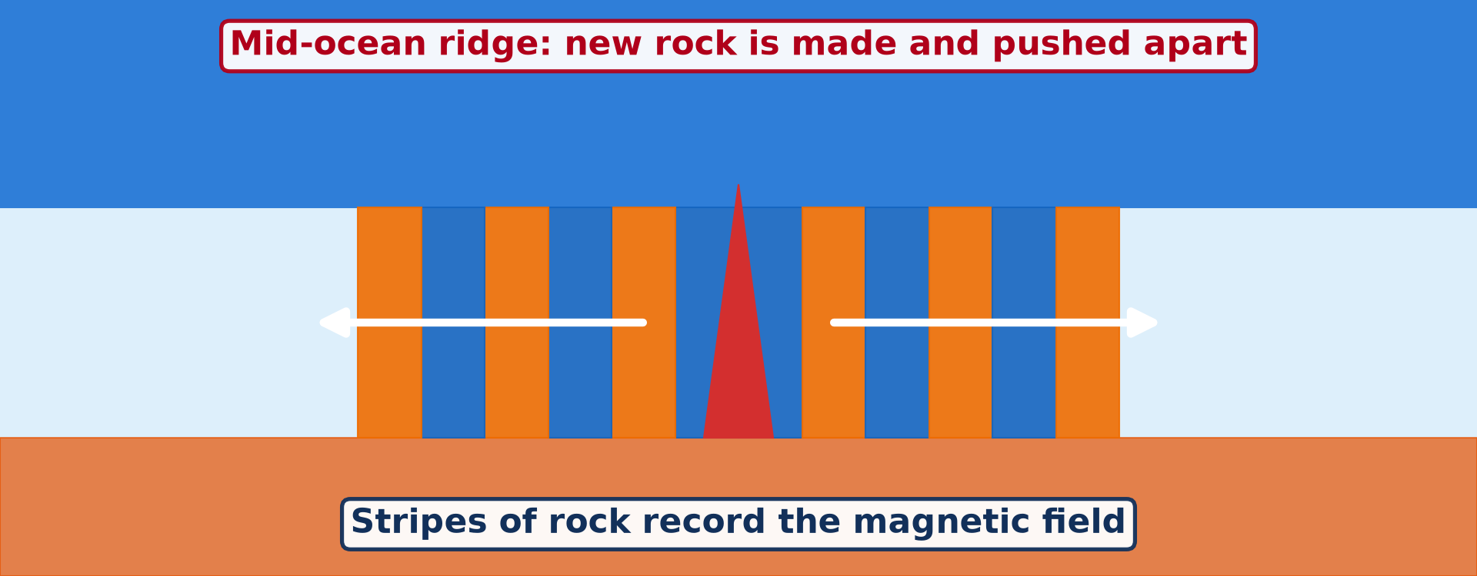
BOARD SUMMARY
1. The Theory of Sea-Floor Spreading
Principle: The sea floor spreads apart along the crests of mid-ocean ridges.
Illustration: new sea floor
Notes:
Copy the point on Principle on the left, then draw the diagram on the right: new sea floor. Give it a title and label it clearly.

Slide 41
BOARD SUMMARY
1. The Theory of Sea-Floor Spreading
Conveyor belt: New crust pushes older crust away from the ridge and carries the continents with it.
Notes:
We continue with The Theory of Sea-Floor Spreading. On this slide we have Conveyor belt. Write each point on a new line, with the key term first, and explain it in your own words when we revise.

Slide 42
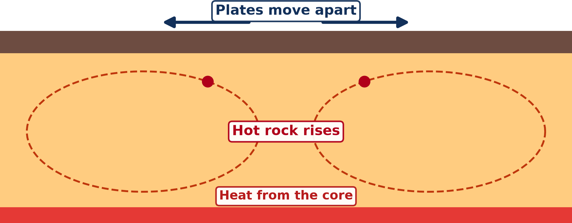
BOARD SUMMARY
1. The Theory of Sea-Floor Spreading
Cause: Heat in the mantle creates convection currents; hot magma rises at the ridges and erupts as lava, which cools into new basalt.
Illustration: mantle convection
Notes:
Copy the point on Cause on the left, then draw the diagram on the right: mantle convection. Give it a title and label it clearly.

Slide 43
BOARD SUMMARY
2. Evidence of Sea-Floor Spreading
The evidence of sea-floor spreading is the following:
Age of oceanic rocks: Drilling shows that the youngest rocks are at the ridges and that rocks become older towards the continents.
Notes:
Let us copy Evidence of Sea-Floor Spreading. The evidence of sea-floor spreading is the following. On this slide we have Age of oceanic rocks. Write each point on a new line, with the key term first, and explain it in your own words when we revise. When you finish, we go to the next slide.

Slide 44
BOARD SUMMARY
2. Evidence of Sea-Floor Spreading (continued)
Thin sediments at the ridges: Sediments are thin near the ridges and thicker further away, because the sea floor there is older.
Notes:
We continue with Evidence of Sea-Floor Spreading. On this slide we have Thin sediments at the ridges. Write each point on a new line, with the key term first, and explain it in your own words when we revise.

Slide 45
BOARD SUMMARY
2. Evidence of Sea-Floor Spreading
Palaeomagnetism: Iron minerals in cooling lava align with the magnetic field of the Earth, which has reversed many times.
Illustration: pillow lava
Notes:
Copy the point on Palaeomagnetism on the left, then draw the diagram on the right: pillow lava. Give it a title and label it clearly.

Slide 46
BOARD SUMMARY
2. Evidence of Sea-Floor Spreading
Magnetic stripes: Stripes of normal and reversed polarity form a perfect mirror image on both sides of the ridge, proving spreading from the centre.
Notes:
We continue with Evidence of Sea-Floor Spreading. On this slide we have Magnetic stripes. Write each point on a new line, with the key term first, and explain it in your own words when we revise.

Slide 47
BOARD SUMMARY
3. Effects on Ocean Relief
Sea-floor spreading creates the following landforms:
Mid-ocean ridges: They are the longest mountain chains on Earth, like the Mid-Atlantic Ridge.
Illustration: the Mid-Atlantic rift in Iceland
Notes:
Let us copy Effects on Ocean Relief. Sea-floor spreading creates the following landforms. Copy the point on Mid-ocean ridges on the left, then draw the diagram on the right: the Mid-Atlantic rift in Iceland. Give it a title and label it clearly.

Slide 48
BOARD SUMMARY
3. Effects on Ocean Relief
Rift valleys: A deep, steep-sided valley runs along the centre of the ridge where the crust is pulled apart.
Notes:
We continue with Effects on Ocean Relief. On this slide we have Rift valleys. Write each point on a new line, with the key term first, and explain it in your own words when we revise.

Slide 49
BOARD SUMMARY
3. Effects on Ocean Relief
Volcanic islands: Eruptions build islands on the ridge, like Iceland and Surtsey.
Illustration: a new volcanic island
Notes:
Copy the point on Volcanic islands on the left, then draw the diagram on the right: a new volcanic island. Give it a title and label it clearly.

Slide 50
FORMATIVE EVALUATION
Evaluation 1
How does the age of oceanic rocks prove sea-floor spreading?
Notes:
Now let us check what you have understood. Question 1: How does the age of oceanic rocks prove sea-floor spreading? Answer in your exercise book.

Slide 51
FORMATIVE EVALUATION
Expected Answer
Rocks are youngest at the ridge and older away from it, showing that new crust forms at the ridge and moves outwards.
Notes:
The expected answer is: rocks are youngest at the ridge and older away from it, showing that new crust forms at the ridge and moves outwards. If you got it right, well done.

Slide 52
FORMATIVE EVALUATION
Evaluation 2
What is the cause of sea-floor spreading?
Notes:
Now let us check what you have understood. Question 2: What is the cause of sea-floor spreading? Answer in your exercise book.

Slide 53
FORMATIVE EVALUATION
Expected Answer
Convection currents in the mantle bring magma up at the mid-ocean ridges.
Notes:
The expected answer is: convection currents in the mantle bring magma up at the mid-ocean ridges. If you got it right, well done.

Slide 54
REMEDIATION
Remediation
Fill in the blanks:
Sea-floor spreading was proposed by ______.
The youngest oceanic rocks are at the ______.
Magnetic stripes are evidence from ______.
Notes:
For those who need more practice, fill in the blanks in your exercise book. The answers are: number 1, Harry Hess; number 2, mid-ocean ridges; number 3, palaeomagnetism.

Slide 55
HOMEWORK
Homework
Name the three types of plate margins.
Notes:
For your homework: Name the three types of plate margins. We shall correct it at the beginning of our next lesson.

Slide 56
NEXT LESSON
Next Lesson
Our next lesson will be on:
Lesson 3: Theory of Plate Tectonics
Notes:
Our next lesson will be on Lesson 3: Theory of Plate Tectonics. Thank you for your attention, and see you next time.

Slide 57
BILINGUAL GAME
Bilingual Game (Jeu Bilingue)
English | Français
Sea-floor spreading | L'expansion des fonds océaniques
Mid-ocean ridge | La dorsale médio-océanique
Magma | Le magma
Rift valley | Le rift
Palaeomagnetism | Le paléomagnétisme
Convection current | Le courant de convection
Notes:
Let us play the bilingual game. I say a word in English, and you give me the French word. Then we do the reverse.

Slide 58
LOGBOOK
Official Logbook (1/2)
Module / Topic | The Development of the Earth's Structure
Lesson Title | Further Study 2: Theory of Sea-Floor Spreading
Expected Learning Outcomes | State the theory of sea-floor spreading. Explain its cause (mantle convection and eruptions at ridges). Explain the evidence of the age of rocks and palaeomagnetism. Describe the landforms it creates on the ocean floor.
Competence | Learners are able to explain sea-floor spreading and use its evidence to show how continents are pushed apart.
Notes:
I record this information in the official logbook of the class after the lesson.

Slide 59
LOGBOOK
Official Logbook (2/2)
Matter Taught | DEFINITIONS; The Theory of Sea-Floor Spreading; Evidence of Sea-Floor Spreading; Effects on Ocean Relief.
Evaluation | Formative evaluation and remediation exercise.
Homework | Name the three types of plate margins.
Enrolment / Present / Absent | ____ / ____ / ____
Achievement | To be completed after the lesson.
Notes:
I complete the second page of the logbook: the matter taught, the evaluation, the homework and the attendance.

Slide 60
TEACHER'S NOTE
Teacher's Note
Timing: Homework correction, plan, objectives 8 min | Recall, situation, action 10 min | 5 activities 30 min | Board summary (copying) 30 min | Evaluation, remediation 10 min | Homework, next lesson 5 min | Logbook 7 min
Activities 1 and 3 are animations (GIF): it plays automatically in slide-show mode.
Without the projector (Activity 1): describe the pot of porridge.
Without the projector (Activity 2): show a piece of dark rock.
Without the projector (Activity 3): draw the ridge and the stripes.
Without the projector (Activity 4): fold a paper with stripes.
Without the projector (Activity 5): locate Iceland on a map.
Notes:
This slide is for me, the teacher: it gives the timing of the lesson and what to do if the projector is not available.

Slide 61
REFERENCES
References
Geography Syllabus for Sixth Forms (Lower and Upper Sixth), MINESEC, 2019 — Module 2 (Geomorphology).
Teacher's course notes: Mr KAMDEM E., Geomorphology (LSA), GBHS Garoua, 2026.
Photo, Activity 2: “expl1536” by NOAA Photo Library, CC BY 2.0, via Flickr (https://www.flickr.com/photos/51647007@N08/9664185645)
Photo, Activity 4: “Iceland's Vestmannaeyjar the town that held back an erupting lava flow” by moonjazz, CC BY-SA 2.0, via Flickr (https://www.flickr.com/photos/8398907@N02/21228033348)
Photo, Activity 5: “Silfra Fissure” by Daveography.ca, CC BY-NC-SA 2.0, via Flickr (https://www.flickr.com/photos/71482738@N00/32857247053)
Diagrams and animations: drawn for this lesson (Geography Department).
Notes:
These are the references and picture credits used to prepare this lesson.

