Slide 1
LOWER SIXTH ARTS
GEOGRAPHY
Lesson 3
Theory of Plate Tectonics
Notes:
Good morning, class, and welcome to our geography lesson. I am your geography teacher, Mr Kamdem. Today we are starting Lesson 3: Theory of Plate Tectonics.

Slide 2
CLASS INFO
Class, Chapter and Duration
Class | Lower Sixth Arts
Chapter | Module 2: Understanding and managing physical landscapes, geomorphological processes and hazards across the world in general and Cameroon in particular
Duration | 2 periods (2 × 50 minutes)
Notes:
This lesson is for Lower Sixth Arts. It belongs to Module 2: Understanding and managing physical landscapes, geomorphological processes and hazards across the world in general and Cameroon in particular. We shall need 2 periods to cover it.

Slide 3
IDENTIFICATION
Lesson Identification
Topic | The Development of the Earth's Structure
Sub-topic | Theories of Earth Structure and Resultant Landforms
Lesson | Lesson 3: Theory of Plate Tectonics
Notions / Concepts | Plate tectonics, lithosphere, asthenosphere, tectonic plate, plate margin, divergent, convergent, conservative, subduction, convection current.
Syllabus focus | Genesis and principles of plate tectonics; the three types of plate margins with their processes and landforms; causes of plate motion; the Cameroon Volcanic Line.
Competence | Learners are able to explain plate tectonics and use it to explain the distribution of volcanoes and earthquakes, including in Cameroon.
Notes:
Our topic is The Development of the Earth's Structure, and the sub-topic is Theories of Earth Structure and Resultant Landforms. The key notions we shall use today are: plate tectonics, lithosphere, asthenosphere, tectonic plate, plate margin, divergent, convergent, conservative, subduction, convection current. At the end, you should be able to do this: learners are able to explain plate tectonics and use it to explain the distribution of volcanoes and earthquakes, including in Cameroon.

Slide 4

HOMEWORK CORRECTION
Correction of the Homework
Question (Further Study 2: Theory of Sea-Floor Spreading):
Name the three types of plate margins.
Notes:
Before we start the new lesson, let us correct the homework I gave you at the end of Further Study 2: Theory of Sea-Floor Spreading. The question was: Name the three types of plate margins. Take out your exercise books.

Slide 5
HOMEWORK CORRECTION
Correction: Possible Answer
Constructive (divergent), destructive (convergent) and conservative (transform) margins.
Notes:
Here is a good answer. Constructive (divergent), destructive (convergent) and conservative (transform) margins. Compare it with your own answer and correct your work in red.

Slide 6
LESSON PLAN
Lesson Plan
Correction of the homework
Objectives and recall
Real-life situation and action to take
Learning activities
Board summary
Evaluation, remediation and homework
Notes:
Here is the plan of our lesson today. First, we shall correct the homework. Then we shall look at the objectives and recall what you already know. After that, we shall study a situation from real life and the action to take, and do the learning activities. Finally, we shall copy the board summary, do the evaluation and the remediation, and I will give you the homework.

Slide 7
OBJECTIVES
Objectives
By the end of this lesson, you should be able to:
State the principles of plate tectonics.
Describe constructive, destructive and conservative margins.
Notes:
Take your time to copy this part; we will continue together.

Slide 8
OBJECTIVES
Objectives (continued)
Explain the landforms and activities of each margin.
Explain the cause of plate movement.
Explain the Cameroon Volcanic Line.
Notes:
By the end of this lesson, you should be able to do five things. Number 1: state the principles of plate tectonics. Number 2: describe constructive, destructive and conservative margins. Number 3: explain the landforms and activities of each margin. Number 4: explain the cause of plate movement. Number 5: explain the Cameroon Volcanic Line.

Slide 9
PREVIOUS KNOWLEDGE
Previous Knowledge
New sea floor forms at mid-ocean ridges.
Convection currents move in the mantle.
Mount Cameroon is an active volcano.
Notes:
Let us first remember what you already know. New sea floor forms at mid-ocean ridges. Convection currents move in the mantle. Mount Cameroon is an active volcano. Keep this in mind, because we shall build on it today.

Slide 10
REAL-LIFE SITUATION
Situation in Real Life
On the radio in Garoua, a reporter announces a small earth tremor near Mount Cameroon and says that the mountain is an active volcano.
You think of the old volcanic peaks of Rhumsiki in the Mandara Mountains.
Notes:
Take your time to copy this part; we will continue together.

Slide 11
REAL-LIFE SITUATION
Situation in Real Life (continued)
You ask your elder brother: "Why does Cameroon have volcanoes and tremors while Chad and the Central African Republic rarely do?
What is happening deep under the ground?"
Notes:
Listen carefully to this situation from real life. On the radio in Garoua, a reporter announces a small earth tremor near Mount Cameroon and says that the mountain is an active volcano. You think of the old volcanic peaks of Rhumsiki in the Mandara Mountains. You ask your elder brother: "Why does Cameroon have volcanoes and tremors while Chad and the Central African Republic rarely do? What is happening deep under the ground?" Think about it, because I am going to ask you some questions.

Slide 12
REAL-LIFE SITUATION
Situation: Question 1
What is the problem in the situation?
Notes:
Question 1: What is the problem in the situation? Think for a moment, then raise your hand to answer.

Slide 13
REAL-LIFE SITUATION
Answer
The learner does not know the theory that explains volcanoes and earthquakes.
Notes:
Good. The learner does not know the theory that explains volcanoes and earthquakes.

Slide 14
REAL-LIFE SITUATION
Situation: Question 2
Which theory explains them?
Notes:
Question 2: Which theory explains them? Think for a moment, then raise your hand to answer.

Slide 15
REAL-LIFE SITUATION
Answer
The theory of plate tectonics.
Notes:
Good. The theory of plate tectonics.

Slide 16
REAL-LIFE SITUATION
Situation: Question 3
Where are most volcanoes and earthquakes found?
Notes:
Question 3: Where are most volcanoes and earthquakes found? Think for a moment, then raise your hand to answer.

Slide 17
REAL-LIFE SITUATION
Possible Answer
At plate margins, where plates meet.
Notes:
Good. At plate margins, where plates meet.

Slide 18
ACTION TO TAKE
Action to Take
Use maps of plates to identify areas at risk of earthquakes and eruptions.
Notes:
From this situation, the action we are working towards in this lesson is the following: use maps of plates to identify areas at risk of earthquakes and eruptions.

Slide 19
JUSTIFICATION
Justification of the Lesson
This lesson gives the modern explanation of the major landforms and hazards of the Earth, including those of Cameroon.
Notes:
Why is this lesson important for you? This lesson gives the modern explanation of the major landforms and hazards of the Earth, including those of Cameroon.

Slide 20

1. PRINCIPLES
Activity 1
The main tectonic plates.
Notes:
Activity 1. Look carefully at this diagram: the main tectonic plates. Observe every detail before I ask the question.

Slide 21
1. PRINCIPLES
Activity 1: Question
On which plate is Cameroon?
Notes:
Here is the question for Activity 1: On which plate is Cameroon? Take one minute to think and write your answer in your rough notebook.

Slide 22
1. PRINCIPLES
Activity 1: Answer
The African plate.
Notes:
Let us check the answer together. The African plate.

Slide 23

2. PLATE MARGINS
Activity 2
Animation: plates move apart and together.
Notes:
Activity 2. Look carefully at this animation: animation: plates move apart and together. Watch the animation to the end; it will play again.

Slide 24
2. PLATE MARGINS
Activity 2: Question
What happens at a divergent margin?
Notes:
Here is the question for Activity 2: What happens at a divergent margin? Take one minute to think and write your answer in your rough notebook.

Slide 25
2. PLATE MARGINS
Activity 2: Answer
Plates move apart and magma rises to form new crust.
Notes:
Let us check the answer together. Plates move apart and magma rises to form new crust.

Slide 26
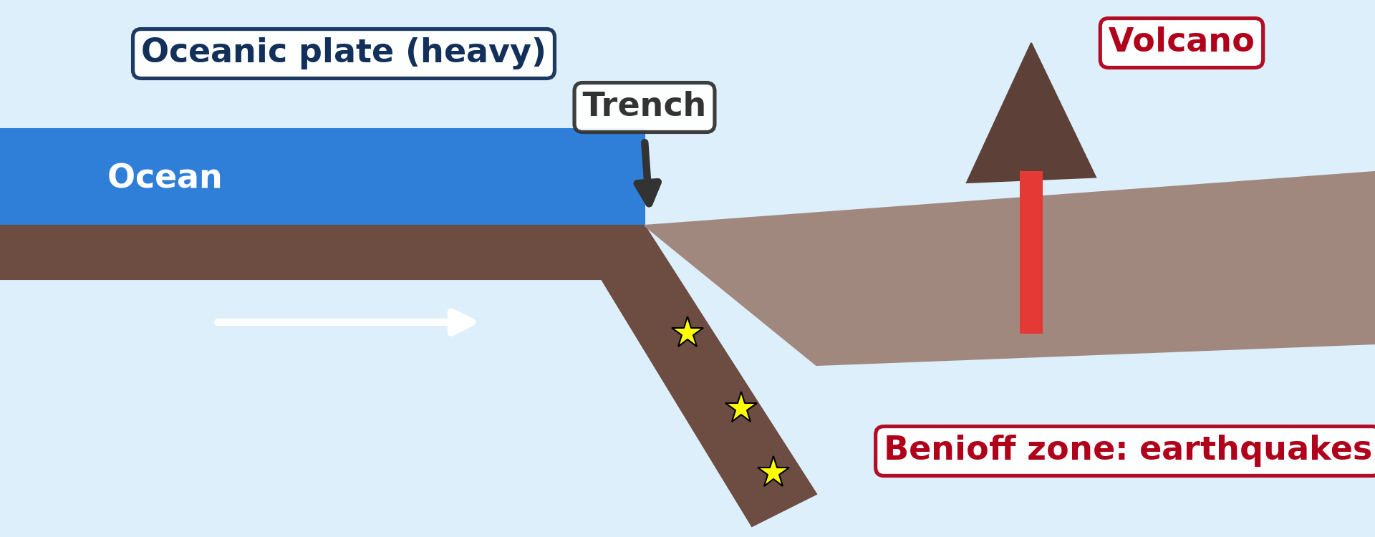
2. PLATE MARGINS
Activity 3
Subduction.
Notes:
Activity 3. Look carefully at this diagram: subduction. Observe every detail before I ask the question.

Slide 27
2. PLATE MARGINS
Activity 3: Question
Why does the oceanic plate sink under the continental plate?
Notes:
Here is the question for Activity 3: Why does the oceanic plate sink under the continental plate? Take one minute to think and write your answer in your rough notebook.

Slide 28
2. PLATE MARGINS
Activity 3: Answer
It is denser (heavier).
Notes:
Let us check the answer together. It is denser (heavier).

Slide 29

2. PLATE MARGINS
Activity 4
The San Andreas Fault.
Notes:
Activity 4. Look carefully at this picture: the San Andreas Fault. Observe every detail before I ask the question.

Slide 30
2. PLATE MARGINS
Activity 4: Question
Why are there no volcanoes at a conservative margin?
Notes:
Here is the question for Activity 4: Why are there no volcanoes at a conservative margin? Take one minute to think and write your answer in your rough notebook.

Slide 31
2. PLATE MARGINS
Activity 4: Answer
No crust is destroyed, so no magma is formed.
Notes:
Let us check the answer together. No crust is destroyed, so no magma is formed.

Slide 32
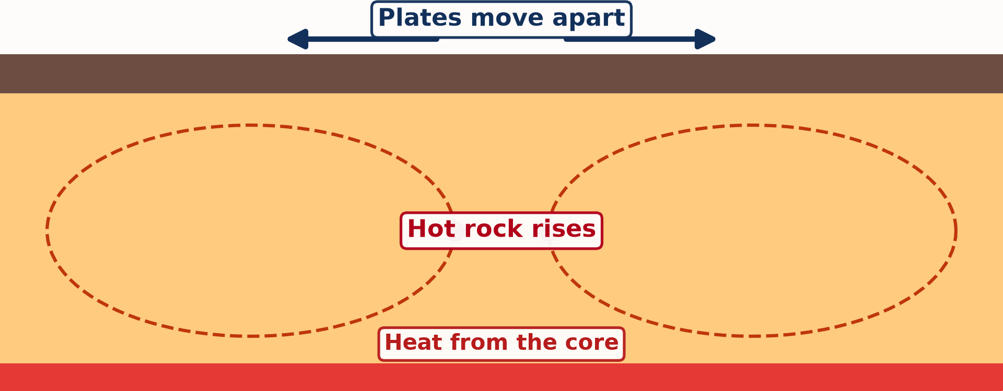
3. CAUSES
Activity 5
Animation: mantle convection.
Notes:
Activity 5. Look carefully at this animation: animation: mantle convection. Watch the animation to the end; it will play again.

Slide 33
3. CAUSES
Activity 5: Question
What drags the plates along?
Notes:
Here is the question for Activity 5: What drags the plates along? Take one minute to think and write your answer in your rough notebook.

Slide 34
3. CAUSES
Activity 5: Answer
Convection currents in the mantle.
Notes:
Let us check the answer together. Convection currents in the mantle.

Slide 35
BOARD SUMMARY
Board Summary
Topic: The Development of the Earth's Structure
Sub-topic: Theories of Earth Structure and Resultant Landforms
Lesson 3: Theory of Plate Tectonics
Notes:
Now we are going to copy the board summary. Write the title and the headings neatly in your notebooks. I will give you enough time for each slide, so do not rush.

Slide 36
BOARD SUMMARY
DEFINITIONS
The key terms of this lesson are defined as follows:
Plate tectonics: It is the theory that the lithosphere is broken into plates that move over the asthenosphere.
Tectonic plate: It is a large rigid piece of the lithosphere.
Notes:
Let us copy the definitions. The key terms of this lesson are defined as follows. On this slide we have Plate tectonics and Tectonic plate. Write each point on a new line, with the key term first, and explain it in your own words when we revise. When you finish, we go to the next slide.

Slide 37
BOARD SUMMARY
DEFINITIONS (continued)
Plate margin: It is the boundary where two plates meet.
Subduction: It is the sinking of a denser plate beneath another plate into the mantle.
Notes:
We continue with the definitions. On this slide we have Plate margin and Subduction. Write each point on a new line, with the key term first, and explain it in your own words when we revise.

Slide 38
BOARD SUMMARY
1. Genesis and Principles
The genesis and principles of plate tectonics are the following:
Genesis: The theory appeared in the 1960s, combining continental drift and sea-floor spreading.
Notes:
Let us copy Genesis and Principles. The genesis and principles of plate tectonics are the following. On this slide we have Genesis. Write each point on a new line, with the key term first, and explain it in your own words when we revise.

Slide 39
BOARD SUMMARY
1. Genesis and Principles
Plates: The lithosphere is broken into about seven large and many small plates, such as the African, Eurasian and Pacific plates.
Illustration: the main plates
Notes:
Copy the point on Plates on the left, then draw the diagram on the right: the main plates. Give it a title and label it clearly.

Slide 40
BOARD SUMMARY
1. Genesis and Principles
Movement: Plates move a few centimetres a year over the soft asthenosphere.
Notes:
We continue with Genesis and Principles. On this slide we have Movement. Write each point on a new line, with the key term first, and explain it in your own words when we revise.

Slide 41
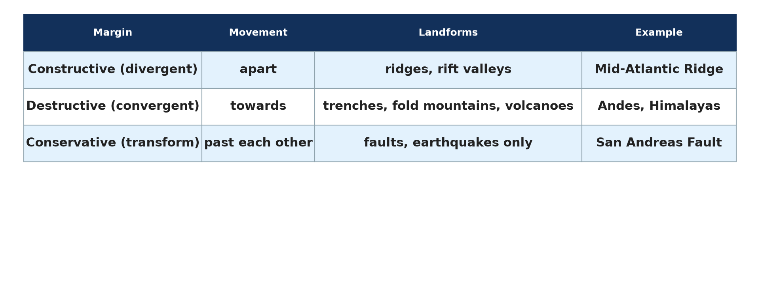
BOARD SUMMARY
1. Genesis and Principles
Activity at margins: Most earthquakes, volcanoes and mountain building happen at plate margins.
Illustration: three types of margins
Notes:
Copy the point on Activity at margins on the left, then draw the diagram on the right: three types of margins. Give it a title and label it clearly.

Slide 42
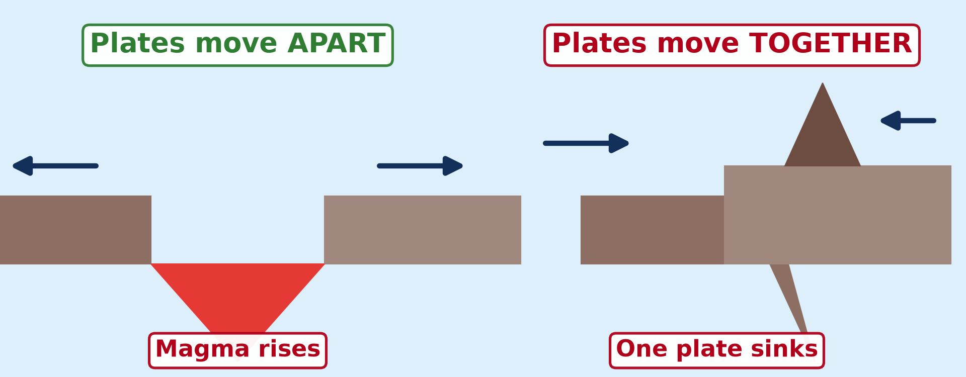
BOARD SUMMARY
2. Plate Margins and Activities
The three types of plate margins are the following:
Constructive (divergent) margin: Plates move apart and rising magma forms new crust, creating mid-ocean ridges and rift valleys.
Illustration: plates moving apart and together
Notes:
Let us copy Plate Margins and Activities. The three types of plate margins are the following. Copy the point on Constructive (divergent) margin on the left, then draw the diagram on the right: plates moving apart and together. Give it a title and label it clearly.

Slide 43
BOARD SUMMARY
2. Plate Margins and Activities
Activity of constructive margins: Gentle volcanoes and small, shallow earthquakes occur, as along the Mid-Atlantic Ridge and the East African Rift.
Notes:
We continue with Plate Margins and Activities. On this slide we have Activity of constructive margins. Write each point on a new line, with the key term first, and explain it in your own words when we revise.

Slide 44
BOARD SUMMARY
2. Plate Margins and Activities
Destructive (convergent) margin: Plates move towards each other and the denser plate sinks (subduction), creating trenches, explosive volcanoes and fold mountains.
Illustration: subduction
Notes:
Copy the point on Destructive (convergent) margin on the left, then draw the diagram on the right: subduction. Give it a title and label it clearly.

Slide 45
BOARD SUMMARY
2. Plate Margins and Activities
Conservative (transform) margin: Plates slide past each other; no crust is made or destroyed, so there are strong earthquakes but no volcanoes, as on the San Andreas Fault.
Illustration: the San Andreas Fault
Notes:
Copy the point on Conservative (transform) margin on the left, then draw the diagram on the right: the San Andreas Fault. Give it a title and label it clearly.

Slide 46
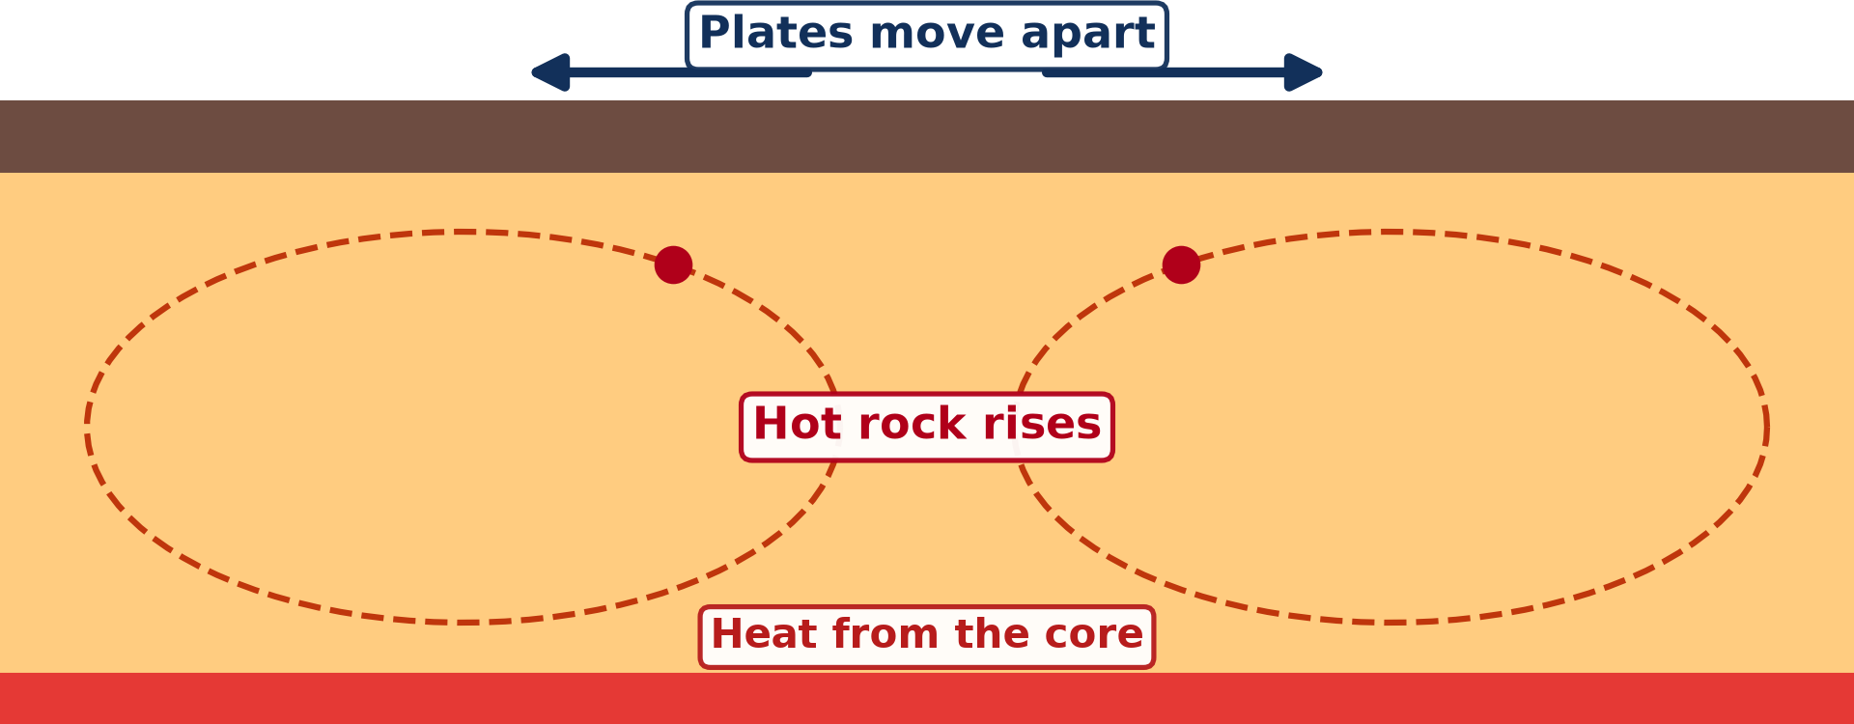
BOARD SUMMARY
3. Causes of Plate Motion
The causes of plate motion are the following:
Convection currents: Heat from the core warms the mantle; hot rock rises, cools and sinks in slow circular currents.
Illustration: mantle convection
Notes:
Let us copy Causes of Plate Motion. The causes of plate motion are the following. Copy the point on Convection currents on the left, then draw the diagram on the right: mantle convection. Give it a title and label it clearly.

Slide 47
BOARD SUMMARY
3. Causes of Plate Motion
Conveyor belt: These currents drag the plates along, like luggage on a conveyor belt at an airport.
Ridge push and slab pull: New crust pushes plates away from the ridges, and sinking plates pull the rest behind them.
Notes:
We continue with Causes of Plate Motion. On this slide we have Conveyor belt and Ridge push and slab pull. Write each point on a new line, with the key term first, and explain it in your own words when we revise.

Slide 48
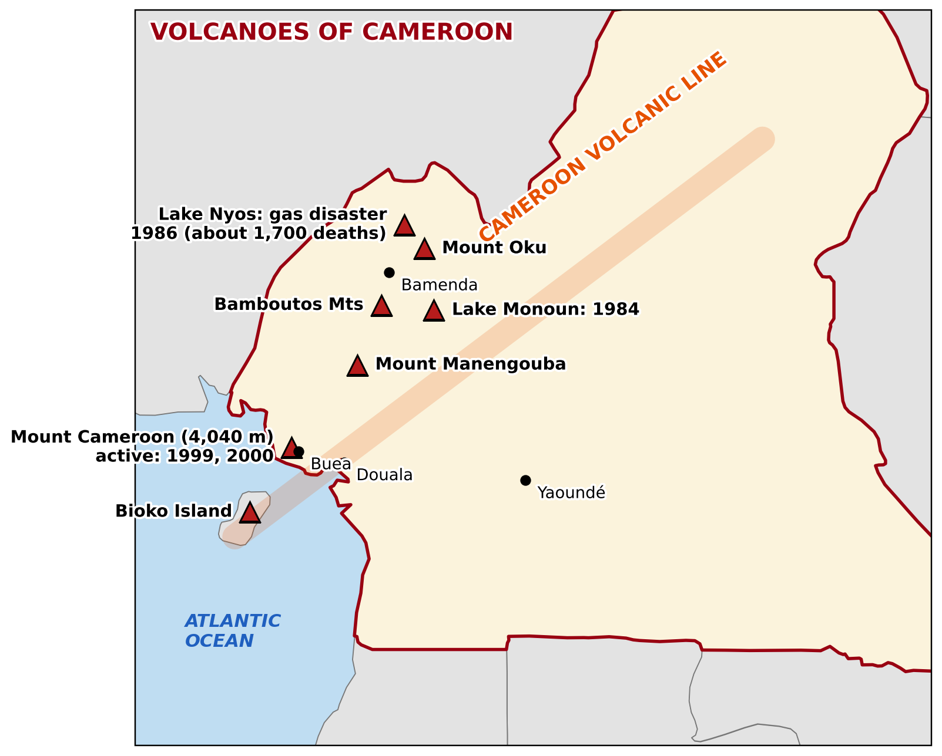
BOARD SUMMARY
4. Application to Cameroon
Plate tectonics explains the relief of Cameroon as follows:
The Cameroon Volcanic Line: It runs from the islands of the Gulf of Guinea through Mount Cameroon, the Western Highlands and the Adamawa.
Illustration: the Cameroon Volcanic Line
Notes:
Let us copy Application to Cameroon. Plate tectonics explains the relief of Cameroon as follows. Copy the point on The Cameroon Volcanic Line on the left, then draw the diagram on the right: the Cameroon Volcanic Line. Give it a title and label it clearly.

Slide 49
BOARD SUMMARY
4. Application to Cameroon
Not a plate margin: It lies inside the African plate, along an old zone of weakness where magma can rise.
Notes:
We continue with Application to Cameroon. On this slide we have Not a plate margin. Write each point on a new line, with the key term first, and explain it in your own words when we revise.

Slide 50

BOARD SUMMARY
4. Application to Cameroon
Consequences: It explains Mount Cameroon (active), the crater lakes such as Nyos, and the tremors of the South-West.
Illustration: Mount Cameroon
Notes:
Copy the point on Consequences on the left, then draw the diagram on the right: mount Cameroon. Give it a title and label it clearly.

Slide 51
FORMATIVE EVALUATION
Evaluation 1
Describe what happens at a destructive margin.
Notes:
Now let us check what you have understood. Question 1: Describe what happens at a destructive margin. Answer in your exercise book.

Slide 52
FORMATIVE EVALUATION
Expected Answer
Two plates move towards each other; the denser plate sinks (subduction), forming trenches, explosive volcanoes, earthquakes and fold mountains.
Notes:
The expected answer is: two plates move towards each other; the denser plate sinks (subduction), forming trenches, explosive volcanoes, earthquakes and fold mountains. If you got it right, well done.

Slide 53
FORMATIVE EVALUATION
Evaluation 2
Why is the Cameroon Volcanic Line volcanic although it is not on a plate margin?
Notes:
Now let us check what you have understood. Question 2: Why is the Cameroon Volcanic Line volcanic although it is not on a plate margin? Answer in your exercise book.

Slide 54
FORMATIVE EVALUATION
Expected Answer
It is a zone of weakness in the African plate where magma rises to the surface.
Notes:
The expected answer is: it is a zone of weakness in the African plate where magma rises to the surface. If you got it right, well done.

Slide 55
REMEDIATION
Remediation
Fill in the blanks:
Plates move over the ______.
At a ______ margin, plates slide past each other.
The sinking of a plate is called ______.
Notes:
For those who need more practice, fill in the blanks in your exercise book. The answers are: number 1, asthenosphere; number 2, conservative; number 3, subduction.

Slide 56
HOMEWORK
Homework
Define a fault.
Notes:
For your homework: Define a fault. We shall correct it at the beginning of our next lesson.

Slide 57
NEXT LESSON
Next Lesson
Our next lesson will be on:
Lesson 4: Landforms at Constructive or Divergent Margins
Notes:
Our next lesson will be on Lesson 4: Landforms at Constructive or Divergent Margins. Thank you for your attention, and see you next time.

Slide 58
BILINGUAL GAME
Bilingual Game (Jeu Bilingue)
English | Français
Plate tectonics | La tectonique des plaques
Plate margin | La limite de plaque
Volcano | Le volcan
Earthquake | Le séisme
Convection current | Le courant de convection
Subduction | La subduction
Notes:
Let us play the bilingual game. I say a word in English, and you give me the French word. Then we do the reverse.

Slide 59
LOGBOOK
Official Logbook (1/2)
Module / Topic | The Development of the Earth's Structure
Lesson Title | Lesson 3: Theory of Plate Tectonics
Expected Learning Outcomes | State the principles of plate tectonics. Describe constructive, destructive and conservative margins. Explain the landforms and activities of each margin. Explain the cause of plate movement. Explain the Cameroon Volcanic Line.
Competence | Learners are able to explain plate tectonics and use it to explain the distribution of volcanoes and earthquakes, including in Cameroon.
Notes:
I record this information in the official logbook of the class after the lesson.

Slide 60
LOGBOOK
Official Logbook (2/2)
Matter Taught | DEFINITIONS; Genesis and Principles; Plate Margins and Activities; Causes of Plate Motion; Application to Cameroon.
Evaluation | Formative evaluation and remediation exercise.
Homework | Define a fault.
Enrolment / Present / Absent | ____ / ____ / ____
Achievement | To be completed after the lesson.
Notes:
I complete the second page of the logbook: the matter taught, the evaluation, the homework and the attendance.

Slide 61
TEACHER'S NOTE
Teacher's Note
Timing: Homework correction, plan, objectives 8 min | Recall, situation, action 10 min | 5 activities 30 min | Board summary (copying) 30 min | Evaluation, remediation 10 min | Homework, next lesson 5 min | Logbook 7 min
Activities 2 and 5 are animations (GIF): it plays automatically in slide-show mode.
Without the projector (Activity 1): draw the main plates on a world sketch.
Without the projector (Activity 2): use two books to show the movements.
Without the projector (Activity 3): draw the subduction zone.
Without the projector (Activity 4): slide two hands past each other.
Without the projector (Activity 5): describe the pot of porridge.
Notes:
This slide is for me, the teacher: it gives the timing of the lesson and what to do if the projector is not available.

Slide 62
REFERENCES
References
Geography Syllabus for Sixth Forms (Lower and Upper Sixth), MINESEC, 2019 — Module 2 (Geomorphology).
Teacher's course notes: Mr KAMDEM E., Geomorphology (LSA), GBHS Garoua, 2026.
Photo, Activity 4: “faultfind_48” by dsearls, CC BY-SA 2.0, via Flickr (https://www.flickr.com/photos/52614599@N00/15392616)
Photo, board summary (Consequences): “Mount Cameroon” by John & Mel Kots, CC BY-NC-ND 2.0, via Flickr (https://www.flickr.com/photos/26745817@N00/2347261849)
Diagrams and animations: drawn for this lesson (Geography Department).
Notes:
These are the references and picture credits used to prepare this lesson.

