Slide 1
LOWER SIXTH ARTS
GEOGRAPHY
Lesson 8
Earthquakes and Man
Notes:
Good morning, class, and welcome to our geography lesson. I am your geography teacher, Mr Kamdem. Today we are starting Lesson 8: Earthquakes and Man.

Slide 2
CLASS INFO
Class, Chapter and Duration
Class | Lower Sixth Arts
Chapter | Module 2: Understanding and managing physical landscapes, geomorphological processes and hazards across the world in general and Cameroon in particular
Duration | 2 periods (2 × 50 minutes)
Notes:
This lesson is for Lower Sixth Arts. It belongs to Module 2: Understanding and managing physical landscapes, geomorphological processes and hazards across the world in general and Cameroon in particular. We shall need 2 periods to cover it.

Slide 3
IDENTIFICATION
Lesson Identification
Topic | Crustal Processes and their Effect on the Land Surface and Man
Sub-topic | Seismic Activity (Earthquakes)
Lesson | Lesson 8: Earthquakes and Man
Notions / Concepts | Earthquake, focus (hypocentre), epicentre, seismic waves, seismograph, Ring of Fire, liquefaction, tsunami, mitigation.
Syllabus focus | Meaning and nature of earthquakes; causes and distribution (world and Cameroon); earthquakes as hazards; mitigation measures.
Competence | Learners are able to explain the causes, distribution and effects of earthquakes and propose ways of reducing their damage.
Notes:
Our topic is Crustal Processes and their Effect on the Land Surface and Man, and the sub-topic is Seismic Activity (Earthquakes). The key notions we shall use today are: earthquake, focus (hypocentre), epicentre, seismic waves, seismograph, Ring of Fire, liquefaction, tsunami, mitigation. At the end, you should be able to do this: learners are able to explain the causes, distribution and effects of earthquakes and propose ways of reducing their damage.

Slide 4

HOMEWORK CORRECTION
Correction of the Homework
Question (Lesson 7: Volcanoes and Man):
Define the epicentre of an earthquake.
Notes:
Before we start the new lesson, let us correct the homework I gave you at the end of Lesson 7: Volcanoes and Man. The question was: Define the epicentre of an earthquake. Take out your exercise books.

Slide 5
HOMEWORK CORRECTION
Correction: Possible Answer
The epicentre is the point on the surface of the Earth directly above the focus of an earthquake.
Notes:
Here is a good answer. The epicentre is the point on the surface of the Earth directly above the focus of an earthquake. Compare it with your own answer and correct your work in red.

Slide 6
LESSON PLAN
Lesson Plan
Correction of the homework
Objectives and recall
Real-life situation and action to take
Learning activities
Board summary
Evaluation, remediation and homework
Notes:
Here is the plan of our lesson today. First, we shall correct the homework. Then we shall look at the objectives and recall what you already know. After that, we shall study a situation from real life and the action to take, and do the learning activities. Finally, we shall copy the board summary, do the evaluation and the remediation, and I will give you the homework.

Slide 7
OBJECTIVES
Objectives
By the end of this lesson, you should be able to:
Define an earthquake, the focus and the epicentre.
Explain the causes of earthquakes.
Notes:
Take your time to copy this part; we will continue together.

Slide 8
OBJECTIVES
Objectives (continued)
Describe their distribution in the world and in Cameroon.
Explain their effects.
Describe mitigation measures.
Notes:
By the end of this lesson, you should be able to do five things. Number 1: define an earthquake, the focus and the epicentre. Number 2: explain the causes of earthquakes. Number 3: describe their distribution in the world and in Cameroon. Number 4: explain their effects. Number 5: describe mitigation measures.

Slide 9
PREVIOUS KNOWLEDGE
Previous Knowledge
Plates slide, collide or move apart at margins.
The Cameroon Volcanic Line is a zone of weakness.
Mount Cameroon is monitored.
Notes:
Let us first remember what you already know. Plates slide, collide or move apart at margins. The Cameroon Volcanic Line is a zone of weakness. Mount Cameroon is monitored. Keep this in mind, because we shall build on it today.

Slide 10
REAL-LIFE SITUATION
Situation in Real Life
One evening in Garoua, the CRTV news reports a small earth tremor felt in Bamenda.
There was no major damage, but people were frightened by the sudden shaking.
You have never felt such a thing in Garoua.
Notes:
Take your time to copy this part; we will continue together.

Slide 11
REAL-LIFE SITUATION
Situation in Real Life (continued)
You ask your father: "Why does the ground shake in some parts of our country but not here?
What causes it, and is it dangerous?"
Notes:
Listen carefully to this situation from real life. One evening in Garoua, the CRTV news reports a small earth tremor felt in Bamenda. There was no major damage, but people were frightened by the sudden shaking. You have never felt such a thing in Garoua. You ask your father: "Why does the ground shake in some parts of our country but not here? What causes it, and is it dangerous?" Think about it, because I am going to ask you some questions.

Slide 12
REAL-LIFE SITUATION
Situation: Question 1
What is the problem in the situation?
Notes:
Question 1: What is the problem in the situation? Think for a moment, then raise your hand to answer.

Slide 13
REAL-LIFE SITUATION
Answer
The learner does not know the causes, distribution and dangers of earthquakes.
Notes:
Good. The learner does not know the causes, distribution and dangers of earthquakes.

Slide 14
REAL-LIFE SITUATION
Situation: Question 2
What is the sudden shaking of the ground called?
Notes:
Question 2: What is the sudden shaking of the ground called? Think for a moment, then raise your hand to answer.

Slide 15
REAL-LIFE SITUATION
Answer
An earthquake.
Notes:
Good. An earthquake.

Slide 16
REAL-LIFE SITUATION
Situation: Question 3
Why is Bamenda more exposed than Garoua?
Notes:
Question 3: Why is Bamenda more exposed than Garoua? Think for a moment, then raise your hand to answer.

Slide 17
REAL-LIFE SITUATION
Possible Answer
It lies on the Cameroon Volcanic Line, a weak and active zone.
Notes:
Good. It lies on the Cameroon Volcanic Line, a weak and active zone.

Slide 18
ACTION TO TAKE
Action to Take
Learn and practise "Drop, Cover and Hold On" and build with reinforced materials in exposed areas.
Notes:
From this situation, the action we are working towards in this lesson is the following: learn and practise "Drop, Cover and Hold On" and build with reinforced materials in exposed areas.

Slide 19
JUSTIFICATION
Justification of the Lesson
This lesson helps us to understand earthquakes and to reduce their effects through good building and preparedness.
Notes:
Why is this lesson important for you? This lesson helps us to understand earthquakes and to reduce their effects through good building and preparedness.

Slide 20
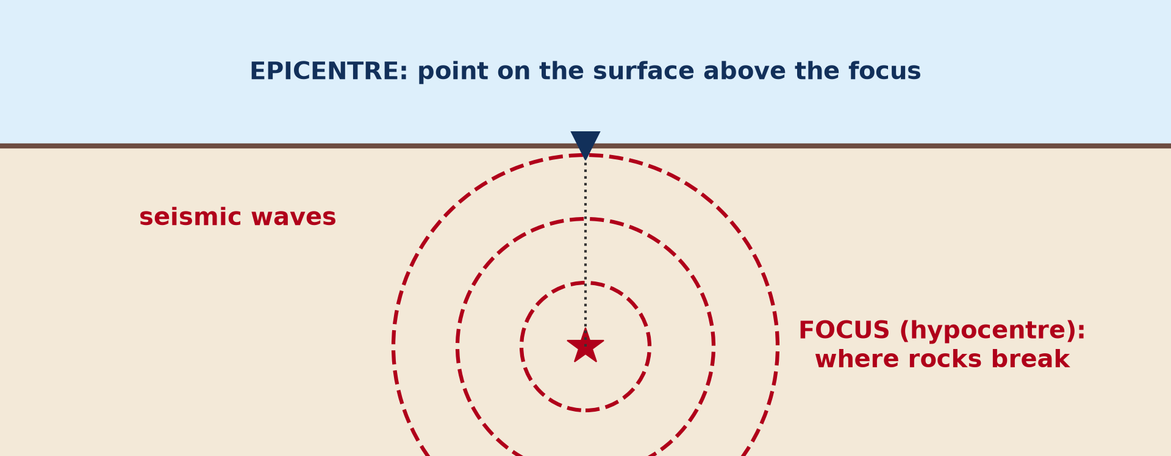
1. MEANING
Activity 1
Focus and epicentre.
Notes:
Activity 1. Look carefully at this picture: focus and epicentre. Observe every detail before I ask the question.

Slide 21
1. MEANING
Activity 1: Question
Where is the shaking usually strongest?
Notes:
Here is the question for Activity 1: Where is the shaking usually strongest? Take one minute to think and write your answer in your rough notebook.

Slide 22
1. MEANING
Activity 1: Answer
At the epicentre, directly above the focus.
Notes:
Let us check the answer together. At the epicentre, directly above the focus.

Slide 23
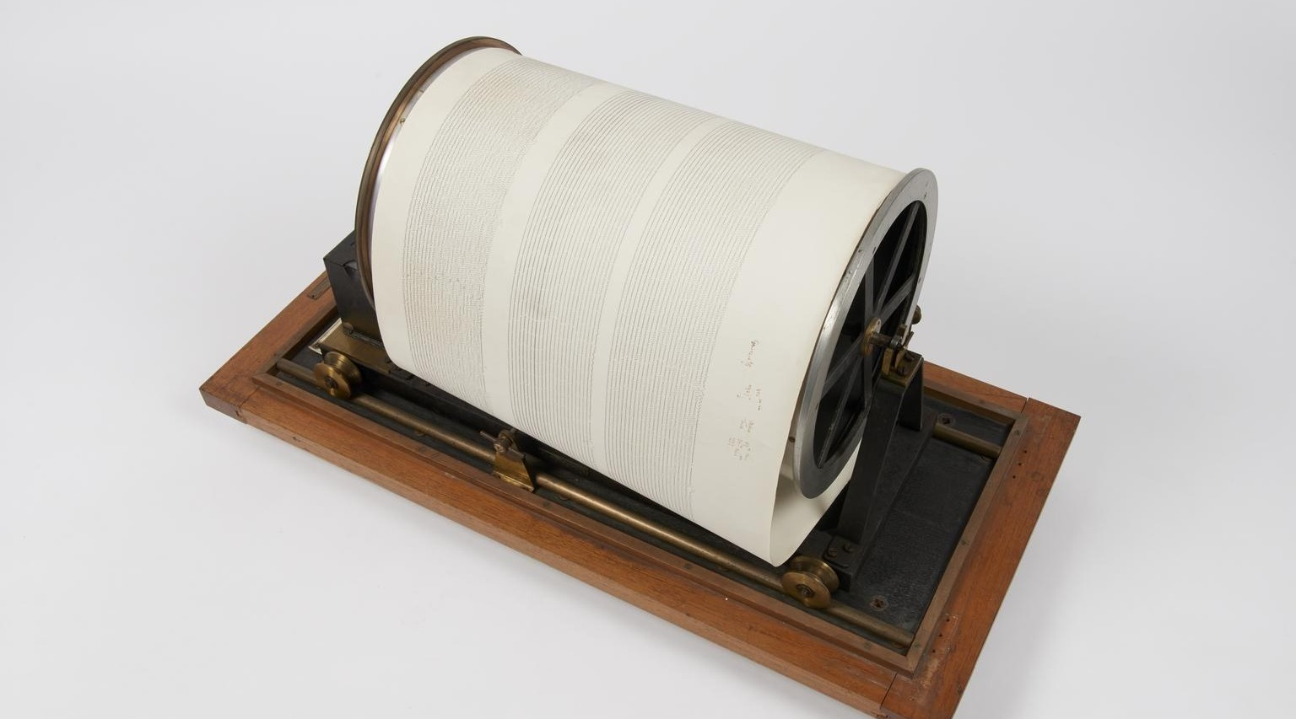
1. MEANING
Activity 2
A seismograph.
Notes:
Activity 2. Look carefully at this picture: a seismograph. Observe every detail before I ask the question.

Slide 24
1. MEANING
Activity 2: Question
What does a seismograph record?
Notes:
Here is the question for Activity 2: What does a seismograph record? Take one minute to think and write your answer in your rough notebook.

Slide 25
1. MEANING
Activity 2: Answer
Seismic waves (ground vibrations).
Notes:
Let us check the answer together. Seismic waves (ground vibrations).

Slide 26

2. DISTRIBUTION
Activity 3
Plates and their margins.
Notes:
Activity 3. Look carefully at this diagram: plates and their margins. Observe every detail before I ask the question.

Slide 27
2. DISTRIBUTION
Activity 3: Question
Where is the most active earthquake zone?
Notes:
Here is the question for Activity 3: Where is the most active earthquake zone? Take one minute to think and write your answer in your rough notebook.

Slide 28
2. DISTRIBUTION
Activity 3: Answer
The Pacific Ring of Fire.
Notes:
Let us check the answer together. The Pacific Ring of Fire.

Slide 29

3. HAZARDS
Activity 4
Buildings destroyed by an earthquake.
Notes:
Activity 4. Look carefully at this picture: buildings destroyed by an earthquake. Observe every detail before I ask the question.

Slide 30
3. HAZARDS
Activity 4: Question
Give two effects of an earthquake on people.
Notes:
Here is the question for Activity 4: Give two effects of an earthquake on people. Take one minute to think and write your answer in your rough notebook.

Slide 31
3. HAZARDS
Activity 4: Answer
Collapse of buildings, fires, injuries, deaths, homelessness (any two).
Notes:
Let us check the answer together. Collapse of buildings, fires, injuries, deaths, homelessness (any two).

Slide 32
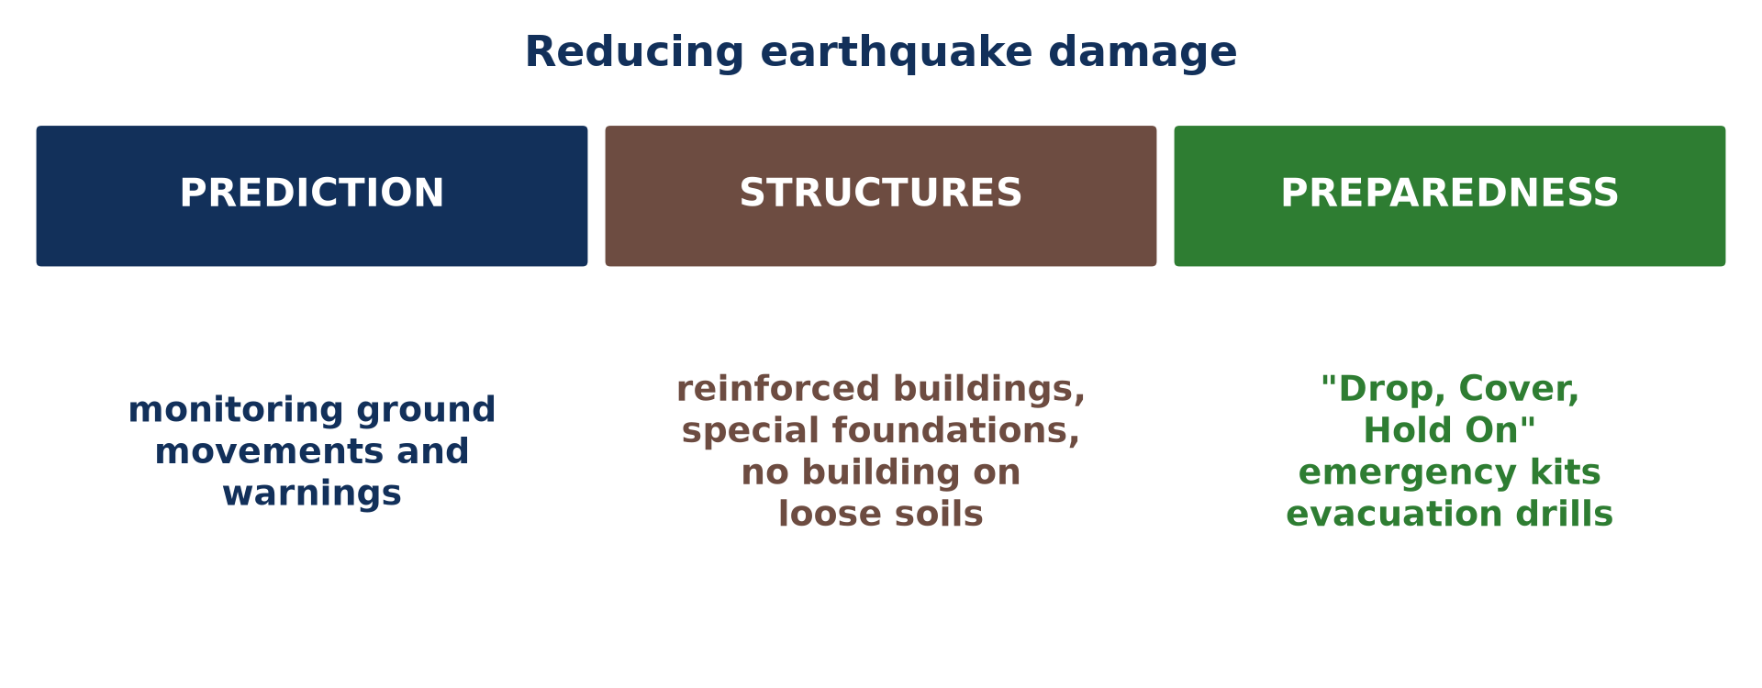
4. MITIGATION
Activity 5
Reducing earthquake damage.
Notes:
Activity 5. Look carefully at this picture: reducing earthquake damage. Observe every detail before I ask the question.

Slide 33
4. MITIGATION
Activity 5: Question
What should you do during an earthquake?
Notes:
Here is the question for Activity 5: What should you do during an earthquake? Take one minute to think and write your answer in your rough notebook.

Slide 34
4. MITIGATION
Activity 5: Answer
Drop, cover (under a table) and hold on.
Notes:
Let us check the answer together. Drop, cover (under a table) and hold on.

Slide 35
BOARD SUMMARY
Board Summary
Topic: Crustal Processes and their Effect on the Land Surface and Man
Sub-topic: Seismic Activity (Earthquakes)
Lesson 8: Earthquakes and Man
Notes:
Now we are going to copy the board summary. Write the title and the headings neatly in your notebooks. I will give you enough time for each slide, so do not rush.

Slide 36
BOARD SUMMARY
DEFINITIONS
The key terms of this lesson are defined as follows:
Earthquake: It is a sudden, violent shaking of the ground caused by the release of energy stored in the crust.
Notes:
Let us copy the definitions. The key terms of this lesson are defined as follows. On this slide we have Earthquake. Write each point on a new line, with the key term first, and explain it in your own words when we revise. When you finish, we go to the next slide.

Slide 37
BOARD SUMMARY
DEFINITIONS (continued)
Focus (hypocentre): It is the point inside the Earth where the rocks break and the earthquake starts.
Epicentre: It is the point on the surface directly above the focus.
Seismic waves: They are waves of energy that travel from the focus and shake the ground.
Notes:
We continue with the definitions. On this slide we have Focus (hypocentre), Epicentre and Seismic waves. Write each point on a new line, with the key term first, and explain it in your own words when we revise.

Slide 38
BOARD SUMMARY
1. Meaning and Nature of an Earthquake
An earthquake is presented as follows:
Release of energy: Stress builds up in the rocks until they break suddenly, releasing energy.
Illustration: focus and epicentre
Notes:
Let us copy Meaning and Nature of an Earthquake. An earthquake is presented as follows. Copy the point on Release of energy on the left, then draw the diagram on the right: focus and epicentre. Give it a title and label it clearly.

Slide 39
BOARD SUMMARY
1. Meaning and Nature of an Earthquake
Focus and epicentre: The earthquake starts at the focus, and shaking is usually strongest at the epicentre.
Notes:
We continue with Meaning and Nature of an Earthquake. On this slide we have Focus and epicentre. Write each point on a new line, with the key term first, and explain it in your own words when we revise.

Slide 40
BOARD SUMMARY
1. Meaning and Nature of an Earthquake
Measurement: Seismographs record the waves, and the magnitude is measured on the Richter or moment magnitude scale.
Illustration: a seismograph
Notes:
Copy the point on Measurement on the left, then draw the diagram on the right: a seismograph. Give it a title and label it clearly.

Slide 41
BOARD SUMMARY
2. Causes and Distribution
The causes and distribution of earthquakes are the following:
Plate margins: Most earthquakes happen when plates collide, slide past or move apart.
Illustration: plates and margins
Notes:
Let us copy Causes and Distribution. The causes and distribution of earthquakes are the following. Copy the point on Plate margins on the left, then draw the diagram on the right: plates and margins. Give it a title and label it clearly.

Slide 42
BOARD SUMMARY
2. Causes and Distribution
Volcanism: Moving magma under volcanoes causes small to moderate earthquakes, as around Mount Cameroon.
Isostatic adjustment: The rising or sinking of the crust causes minor tremors.
Notes:
We continue with Causes and Distribution. On this slide we have Volcanism and Isostatic adjustment. Write each point on a new line, with the key term first, and explain it in your own words when we revise. When you finish, we go to the next slide.

Slide 43
BOARD SUMMARY
2. Causes and Distribution (continued)
World distribution: The Pacific Ring of Fire is the most active zone, followed by the Alps–Himalaya belt.
Notes:
We continue with Causes and Distribution. On this slide we have World distribution. Write each point on a new line, with the key term first, and explain it in your own words when we revise.

Slide 44
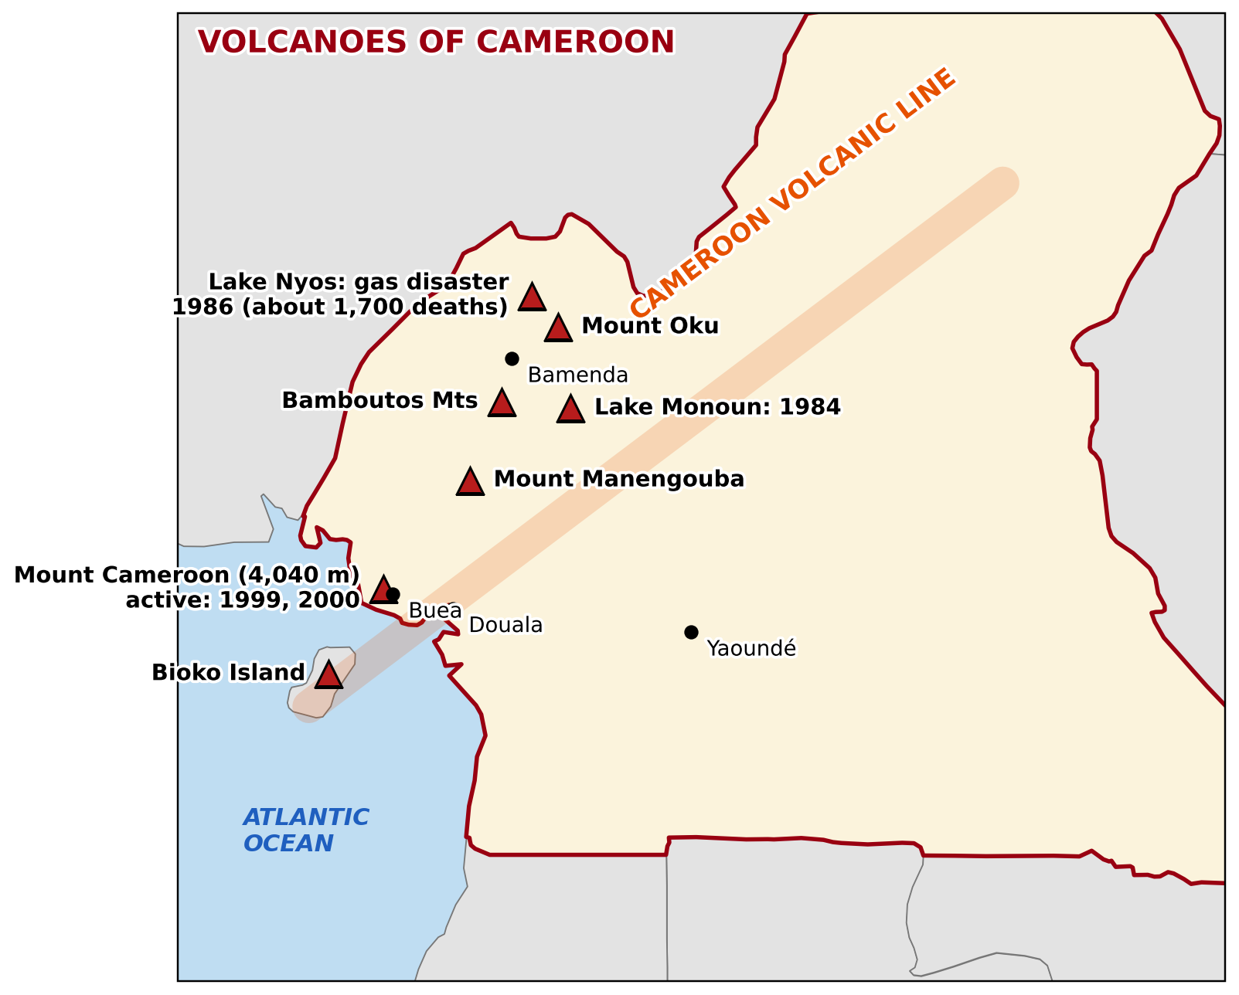
BOARD SUMMARY
2. Causes and Distribution
Cameroon: Tremors are linked to the Cameroon Volcanic Line, around Mount Cameroon, Bamenda and Foumban, while Garoua is stable.
Illustration: the Cameroon Volcanic Line
Notes:
Copy the point on Cameroon on the left, then draw the diagram on the right: the Cameroon Volcanic Line. Give it a title and label it clearly.

Slide 45
BOARD SUMMARY
3. Earthquakes as a Hazard
Earthquakes cause the following effects:
Primary effects:
Ground shaking, the main cause of damage.
Landslides and rockfalls in hilly areas.
Liquefaction: wet soil behaves like a liquid and buildings sink.
Notes:
Let us copy Earthquakes as a Hazard. Earthquakes cause the following effects. On this slide we have Primary effects. Write each point on a new line, with the key term first, and explain it in your own words when we revise. When you finish, we go to the next slide.

Slide 46
BOARD SUMMARY
3. Earthquakes as a Hazard (continued)
Secondary effects:
Collapse of buildings, bridges and roads.
Fires from broken gas and electric lines.
Tsunamis after undersea earthquakes.
Deaths, injuries and homelessness.
Notes:
We continue with Earthquakes as a Hazard. On this slide we have Secondary effects. Write each point on a new line, with the key term first, and explain it in your own words when we revise.

Slide 47
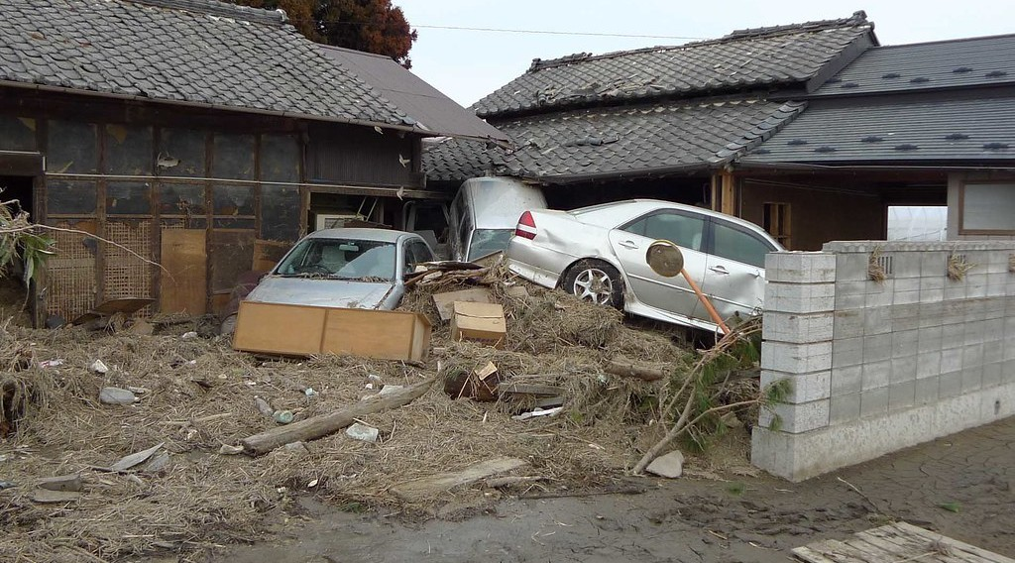
BOARD SUMMARY
3. Earthquakes as a Hazard
Example: The 2004 Indian Ocean earthquake and tsunami killed about 230,000 people.
Illustration: a tsunami
Notes:
Copy the point on Example on the left, then draw the diagram on the right: a tsunami. Give it a title and label it clearly.

Slide 48
BOARD SUMMARY
4. Measures to Mitigate Earthquake Effects
The effects of earthquakes are reduced by the following measures:
Prediction and warning: Ground movements are monitored, but exact prediction is still impossible.
Notes:
Let us copy Measures to Mitigate Earthquake Effects. The effects of earthquakes are reduced by the following measures. On this slide we have Prediction and warning. Write each point on a new line, with the key term first, and explain it in your own words when we revise.

Slide 49
BOARD SUMMARY
4. Measures to Mitigate Earthquake Effects
Building protection: Reinforced buildings and special foundations resist shaking.
Illustration: damage to buildings
Notes:
Copy the point on Building protection on the left, then draw the diagram on the right: damage to buildings. Give it a title and label it clearly.

Slide 50
BOARD SUMMARY
4. Measures to Mitigate Earthquake Effects
Education and preparedness: People learn "Drop, Cover and Hold On", prepare emergency kits and practise evacuation.
Illustration: reducing earthquake damage
Notes:
Copy the point on Education and preparedness on the left, then draw the diagram on the right: reducing earthquake damage. Give it a title and label it clearly.

Slide 51
BOARD SUMMARY
4. Measures to Mitigate Earthquake Effects
Land-use planning: Building on loose soils and steep slopes is avoided in exposed zones.
Notes:
We continue with Measures to Mitigate Earthquake Effects. On this slide we have Land-use planning. Write each point on a new line, with the key term first, and explain it in your own words when we revise.

Slide 52
FORMATIVE EVALUATION
Evaluation 1
Distinguish the focus from the epicentre.
Notes:
Now let us check what you have understood. Question 1: Distinguish the focus from the epicentre. Answer in your exercise book.

Slide 53
FORMATIVE EVALUATION
Expected Answer
The focus is where the earthquake starts inside the Earth; the epicentre is the point on the surface above it.
Notes:
The expected answer is: the focus is where the earthquake starts inside the Earth; the epicentre is the point on the surface above it. If you got it right, well done.

Slide 54
FORMATIVE EVALUATION
Evaluation 2
Why is Garoua rarely affected by earthquakes?
Notes:
Now let us check what you have understood. Question 2: Why is Garoua rarely affected by earthquakes? Answer in your exercise book.

Slide 55
FORMATIVE EVALUATION
Expected Answer
It is far from plate margins and from the Cameroon Volcanic Line.
Notes:
The expected answer is: it is far from plate margins and from the Cameroon Volcanic Line. If you got it right, well done.

Slide 56
REMEDIATION
Remediation
Fill in the blanks:
The point where an earthquake starts is the ______.
The most active earthquake zone is the Pacific ______ of Fire.
Undersea earthquakes can cause ______.
Notes:
For those who need more practice, fill in the blanks in your exercise book. The answers are: number 1, focus (hypocentre); number 2, Ring; number 3, tsunamis.

Slide 57
HOMEWORK
Homework
Define weathering.
Notes:
For your homework: Define weathering. We shall correct it at the beginning of our next lesson.

Slide 58
NEXT LESSON
Next Lesson
Our next lesson will be on:
Lesson 9: Denudation and Weathering
Notes:
Our next lesson will be on Lesson 9: Denudation and Weathering. Thank you for your attention, and see you next time.

Slide 59
BILINGUAL GAME
Bilingual Game (Jeu Bilingue)
English | Français
Earthquake | Le séisme
Epicentre | L'épicentre
Focus | Le foyer (l'hypocentre)
Seismic waves | Les ondes sismiques
Hazard | Le risque
Tsunami | Le tsunami
Notes:
Let us play the bilingual game. I say a word in English, and you give me the French word. Then we do the reverse.

Slide 60
LOGBOOK
Official Logbook (1/2)
Module / Topic | Crustal Processes and their Effect on the Land Surface and Man
Lesson Title | Lesson 8: Earthquakes and Man
Expected Learning Outcomes | Define an earthquake, the focus and the epicentre. Explain the causes of earthquakes. Describe their distribution in the world and in Cameroon. Explain their effects. Describe mitigation measures.
Competence | Learners are able to explain the causes, distribution and effects of earthquakes and propose ways of reducing their damage.
Notes:
I record this information in the official logbook of the class after the lesson.

Slide 61
LOGBOOK
Official Logbook (2/2)
Matter Taught | DEFINITIONS; Meaning and Nature of an Earthquake; Causes and Distribution; Earthquakes as a Hazard; Measures to Mitigate Earthquake Effects.
Evaluation | Formative evaluation and remediation exercise.
Homework | Define weathering.
Enrolment / Present / Absent | ____ / ____ / ____
Achievement | To be completed after the lesson.
Notes:
I complete the second page of the logbook: the matter taught, the evaluation, the homework and the attendance.

Slide 62
TEACHER'S NOTE
Teacher's Note
Timing: Homework correction, plan, objectives 8 min | Recall, situation, action 10 min | 5 activities 30 min | Board summary (copying) 30 min | Evaluation, remediation 10 min | Homework, next lesson 5 min | Logbook 7 min
Without the projector (Activity 1): drop a stone in water to show waves.
Without the projector (Activity 2): describe a seismograph.
Without the projector (Activity 3): trace the Ring of Fire on a map.
Without the projector (Activity 4): list effects on the board.
Without the projector (Activity 5): practise the drill.
Notes:
This slide is for me, the teacher: it gives the timing of the lesson and what to do if the projector is not available.

Slide 63
REFERENCES
References
Geography Syllabus for Sixth Forms (Lower and Upper Sixth), MINESEC, 2019 — Module 2 (Geomorphology).
Teacher's course notes: Mr KAMDEM E., Geomorphology (LSA), GBHS Garoua, 2026.
Photo, Activity 2: “Recording drum from Golitsyn seismograph” by Galitzin, Boris; Masing, Hugo, CC BY-NC-SA 4.0, via sciencemuseum (https://collection.sciencemuseumgroup.org.uk/objects/co8647018/recording-drum-from-golitsyn-seismograph)
Photo, Activity 4: “Collapsed buildings in earthquake-hit Chautara, Nepal” by DFID - UK Department for International Development, CC BY 2.0, via Flickr (https://www.flickr.com/photos/14214150@N02/16693413433)
Photo, board summary (Example): “Tsunami damage” by robertodevido, CC BY-NC-ND 2.0, via Flickr (https://www.flickr.com/photos/63082042@N00/5531541425)
Diagrams and animations: drawn for this lesson (Geography Department).
Notes:
These are the references and picture credits used to prepare this lesson.

