Slide 1
LOWER SIXTH ARTS
GEOGRAPHY
Lesson 12
Mass Wasting (Movement)
Notes:
Good morning, class, and welcome to our geography lesson. I am your geography teacher, Mr Kamdem. Today we are starting Lesson 12: Mass Wasting (Movement).

Slide 2
CLASS INFO
Class, Chapter and Duration
Class | Lower Sixth Arts
Chapter | Module 2: Understanding and managing physical landscapes, geomorphological processes and hazards across the world in general and Cameroon in particular
Duration | 2 periods (2 × 50 minutes)
Notes:
This lesson is for Lower Sixth Arts. It belongs to Module 2: Understanding and managing physical landscapes, geomorphological processes and hazards across the world in general and Cameroon in particular. We shall need 2 periods to cover it.

Slide 3
IDENTIFICATION
Lesson Identification
Topic | Denudational Processes on Slopes
Sub-topic | Mass Movements
Lesson | Lesson 12: Mass Wasting (Movement)
Notions / Concepts | Mass wasting, gravity, angle of repose, soil creep, terracettes, tension cracks, fall, slide, flow, Carson and Kirkby.
Syllabus focus | Meaning and evidence of mass wasting; factors influencing it; classification by speed and water content (Carson and Kirkby).
Competence | Learners are able to recognise signs of mass wasting, explain its factors and classify its types.
Notes:
Our topic is Denudational Processes on Slopes, and the sub-topic is Mass Movements. The key notions we shall use today are: mass wasting, gravity, angle of repose, soil creep, terracettes, tension cracks, fall, slide, flow, Carson and Kirkby. At the end, you should be able to do this: learners are able to recognise signs of mass wasting, explain its factors and classify its types.

Slide 4

HOMEWORK CORRECTION
Correction of the Homework
Question (Lesson 11: The Impact of Weathering):
Define mass wasting.
Notes:
Before we start the new lesson, let us correct the homework I gave you at the end of Lesson 11: The Impact of Weathering. The question was: Define mass wasting. Take out your exercise books.

Slide 5
HOMEWORK CORRECTION
Correction: Possible Answer
Mass wasting is the movement of rock, soil and debris down a slope under the influence of gravity.
Notes:
Here is a good answer. Mass wasting is the movement of rock, soil and debris down a slope under the influence of gravity. Compare it with your own answer and correct your work in red.

Slide 6
LESSON PLAN
Lesson Plan
Correction of the homework
Objectives and recall
Real-life situation and action to take
Learning activities
Board summary
Evaluation, remediation and homework
Notes:
Here is the plan of our lesson today. First, we shall correct the homework. Then we shall look at the objectives and recall what you already know. After that, we shall study a situation from real life and the action to take, and do the learning activities. Finally, we shall copy the board summary, do the evaluation and the remediation, and I will give you the homework.

Slide 7
OBJECTIVES
Objectives
By the end of this lesson, you should be able to:
Define mass wasting.
Identify the evidence of mass wasting.
Explain its factors.
Notes:
Take your time to copy this part; we will continue together.

Slide 8
OBJECTIVES
Objectives (continued)
Classify mass movements by speed and water content.
Notes:
By the end of this lesson, you should be able to do four things. Number 1: define mass wasting. Number 2: identify the evidence of mass wasting. Number 3: explain its factors. Number 4: classify mass movements by speed and water content.

Slide 9
PREVIOUS KNOWLEDGE
Previous Knowledge
Weathered material moves down slopes.
Water adds weight to soil.
Roots bind the soil.
Notes:
Let us first remember what you already know. Weathered material moves down slopes. Water adds weight to soil. Roots bind the soil. Keep this in mind, because we shall build on it today.

Slide 10
REAL-LIFE SITUATION
Situation in Real Life
In the rainy season, you travel on the road from Garoua towards Maroua through hilly areas.
A telephone pole on a hillside, straight last year, now leans downhill.
Further on, part of a muddy slope has slid onto the road and workers are clearing it.
Notes:
Take your time to copy this part; we will continue together.

Slide 11
REAL-LIFE SITUATION
Situation in Real Life (continued)
You ask: "Why is the ground moving, and why does a whole part of a hill suddenly give way, especially when it rains a lot?"
Notes:
Listen carefully to this situation from real life. In the rainy season, you travel on the road from Garoua towards Maroua through hilly areas. A telephone pole on a hillside, straight last year, now leans downhill. Further on, part of a muddy slope has slid onto the road and workers are clearing it. You ask: "Why is the ground moving, and why does a whole part of a hill suddenly give way, especially when it rains a lot?" Think about it, because I am going to ask you some questions.

Slide 12
REAL-LIFE SITUATION
Situation: Question 1
What is the problem in the situation?
Notes:
Question 1: What is the problem in the situation? Think for a moment, then raise your hand to answer.

Slide 13
REAL-LIFE SITUATION
Answer
The learner does not know the causes and types of mass wasting.
Notes:
Good. The learner does not know the causes and types of mass wasting.

Slide 14
REAL-LIFE SITUATION
Situation: Question 2
What is the movement of soil and rock down a slope called?
Notes:
Question 2: What is the movement of soil and rock down a slope called? Think for a moment, then raise your hand to answer.

Slide 15
REAL-LIFE SITUATION
Answer
Mass wasting (mass movement).
Notes:
Good. Mass wasting (mass movement).

Slide 16
REAL-LIFE SITUATION
Situation: Question 3
Is the leaning pole the same as the slide onto the road?
Notes:
Question 3: Is the leaning pole the same as the slide onto the road? Think for a moment, then raise your hand to answer.

Slide 17
REAL-LIFE SITUATION
Possible Answer
No: the pole shows slow creep, the road shows a fast slide or flow.
Notes:
Good. No: the pole shows slow creep, the road shows a fast slide or flow.

Slide 18
ACTION TO TAKE
Action to Take
Report signs of moving slopes (cracks, leaning poles) to the authorities.
Notes:
From this situation, the action we are working towards in this lesson is the following: report signs of moving slopes (cracks, leaning poles) to the authorities.

Slide 19
JUSTIFICATION
Justification of the Lesson
This lesson helps us to recognise dangerous slopes and to avoid building or travelling where the ground may move.
Notes:
Why is this lesson important for you? This lesson helps us to recognise dangerous slopes and to avoid building or travelling where the ground may move.

Slide 20
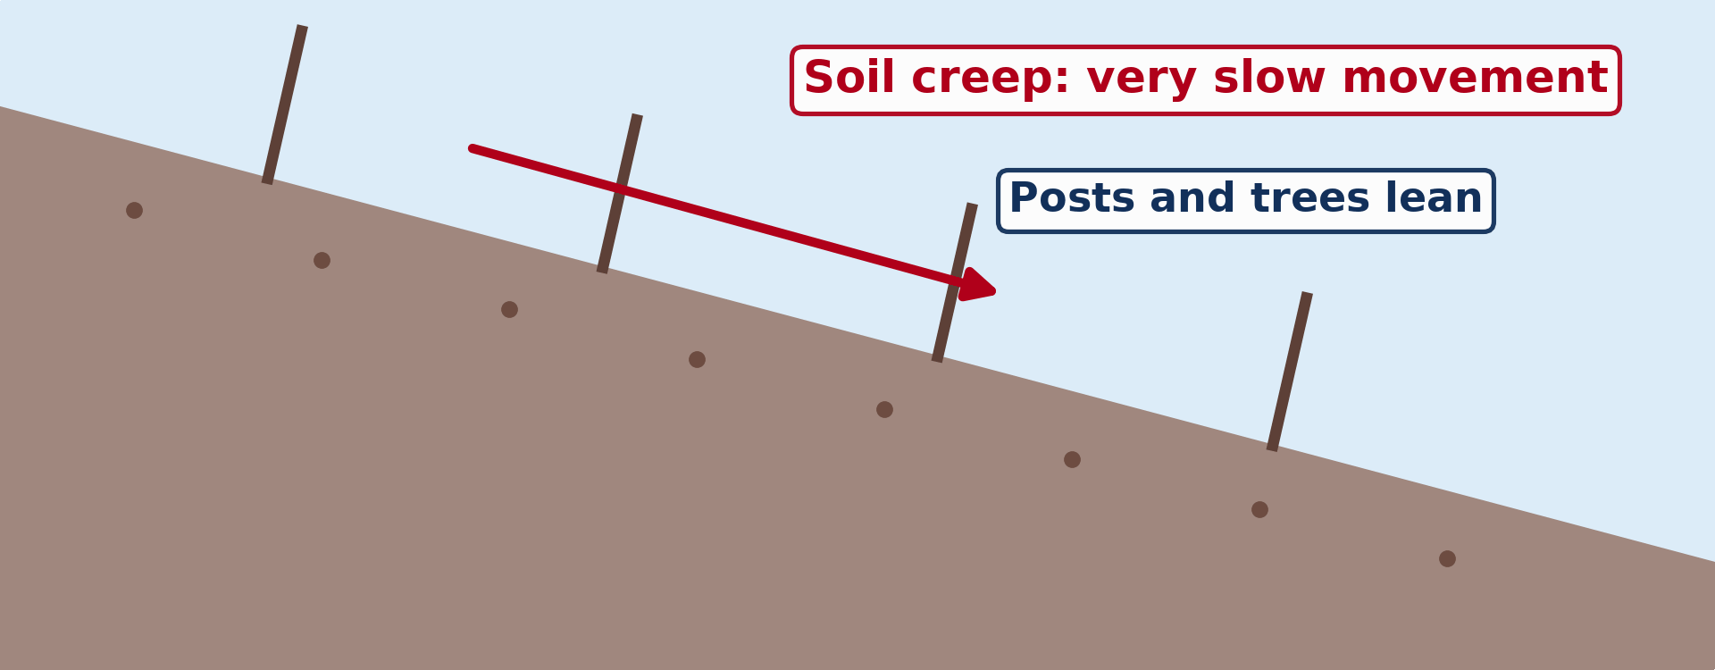
1. EVIDENCE
Activity 1
Animation: soil creep.
Notes:
Activity 1. Look carefully at this animation: animation: soil creep. Watch the animation to the end; it will play again.

Slide 21
1. EVIDENCE
Activity 1: Question
Give one sign of soil creep.
Notes:
Here is the question for Activity 1: Give one sign of soil creep. Take one minute to think and write your answer in your rough notebook.

Slide 22
1. EVIDENCE
Activity 1: Answer
Leaning poles or fences, curved tree trunks, terracettes.
Notes:
Let us check the answer together. Leaning poles or fences, curved tree trunks, terracettes.

Slide 23
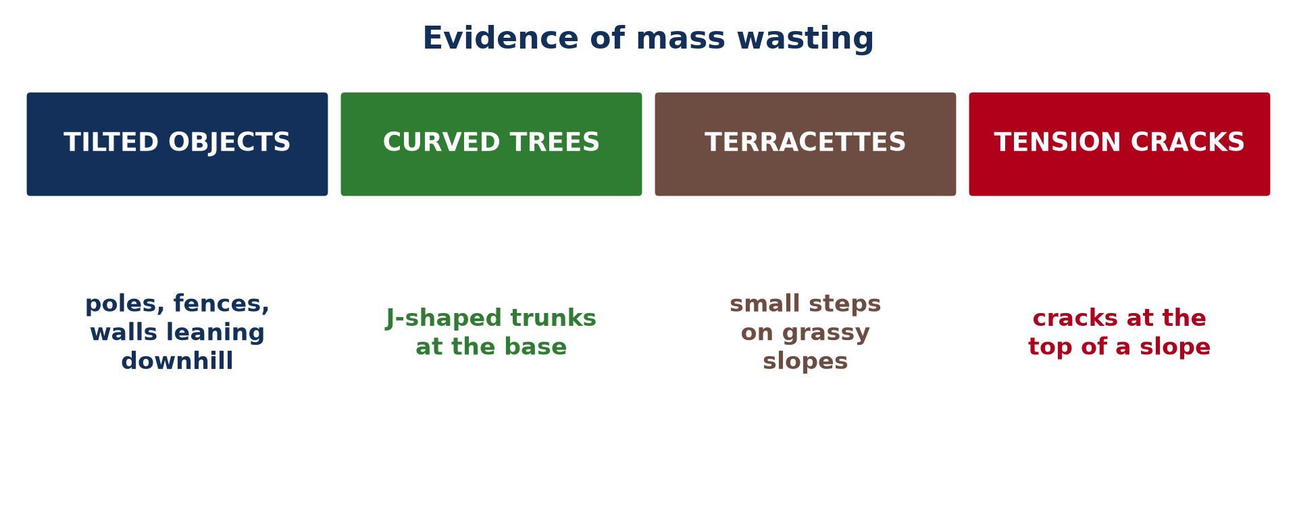
1. EVIDENCE
Activity 2
Evidence of mass wasting.
Notes:
Activity 2. Look carefully at this picture: evidence of mass wasting. Observe every detail before I ask the question.

Slide 24
1. EVIDENCE
Activity 2: Question
What do tension cracks at the top of a slope show?
Notes:
Here is the question for Activity 2: What do tension cracks at the top of a slope show? Take one minute to think and write your answer in your rough notebook.

Slide 25
1. EVIDENCE
Activity 2: Answer
That part of the slope is starting to pull away.
Notes:
Let us check the answer together. That part of the slope is starting to pull away.

Slide 26
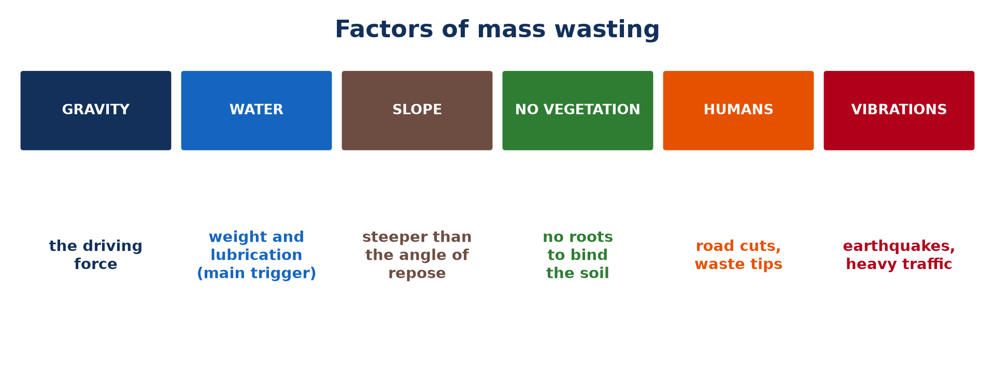
2. FACTORS
Activity 3
Factors of mass wasting.
Notes:
Activity 3. Look carefully at this picture: factors of mass wasting. Observe every detail before I ask the question.

Slide 27
2. FACTORS
Activity 3: Question
What is the most common trigger of mass wasting?
Notes:
Here is the question for Activity 3: What is the most common trigger of mass wasting? Take one minute to think and write your answer in your rough notebook.

Slide 28
2. FACTORS
Activity 3: Answer
Heavy rainfall (water).
Notes:
Let us check the answer together. Heavy rainfall (water).

Slide 29
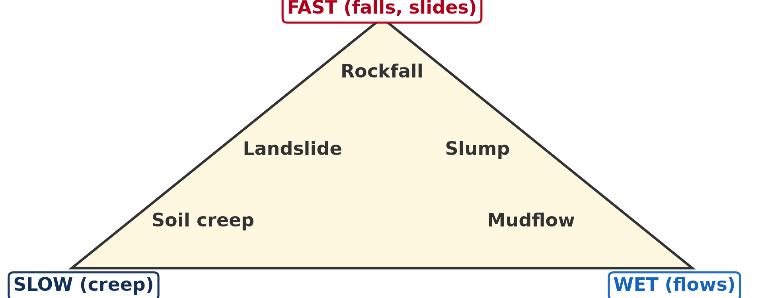
3. CLASSIFICATION
Activity 4
Classification of mass movements.
Notes:
Activity 4. Look carefully at this diagram: classification of mass movements. Observe every detail before I ask the question.

Slide 30
3. CLASSIFICATION
Activity 4: Question
Which movement is fast and dry?
Notes:
Here is the question for Activity 4: Which movement is fast and dry? Take one minute to think and write your answer in your rough notebook.

Slide 31
3. CLASSIFICATION
Activity 4: Answer
A rockfall.
Notes:
Let us check the answer together. A rockfall.

Slide 32

3. CLASSIFICATION
Activity 5
A landslide.
Notes:
Activity 5. Look carefully at this picture: a landslide. Observe every detail before I ask the question.

Slide 33
3. CLASSIFICATION
Activity 5: Question
Is a landslide slow or fast?
Notes:
Here is the question for Activity 5: Is a landslide slow or fast? Take one minute to think and write your answer in your rough notebook.

Slide 34
3. CLASSIFICATION
Activity 5: Answer
Fast.
Notes:
Let us check the answer together. Fast.

Slide 35
BOARD SUMMARY
Board Summary
Topic: Denudational Processes on Slopes
Sub-topic: Mass Movements
Lesson 12: Mass Wasting (Movement)
Notes:
Now we are going to copy the board summary. Write the title and the headings neatly in your notebooks. I will give you enough time for each slide, so do not rush.

Slide 36
BOARD SUMMARY
DEFINITIONS
The key terms of this lesson are defined as follows:
Mass wasting (mass movement): It is the large-scale movement of rock, soil and debris down slopes under the direct influence of gravity.
Notes:
Let us copy the definitions. The key terms of this lesson are defined as follows. On this slide we have Mass wasting (mass movement). Write each point on a new line, with the key term first, and explain it in your own words when we revise. When you finish, we go to the next slide.

Slide 37
BOARD SUMMARY
DEFINITIONS (continued)
Angle of repose: It is the steepest angle at which loose material remains stable.
Soil creep: It is the very slow downhill movement of soil.
Notes:
We continue with the definitions. On this slide we have Angle of repose and Soil creep. Write each point on a new line, with the key term first, and explain it in your own words when we revise.

Slide 38
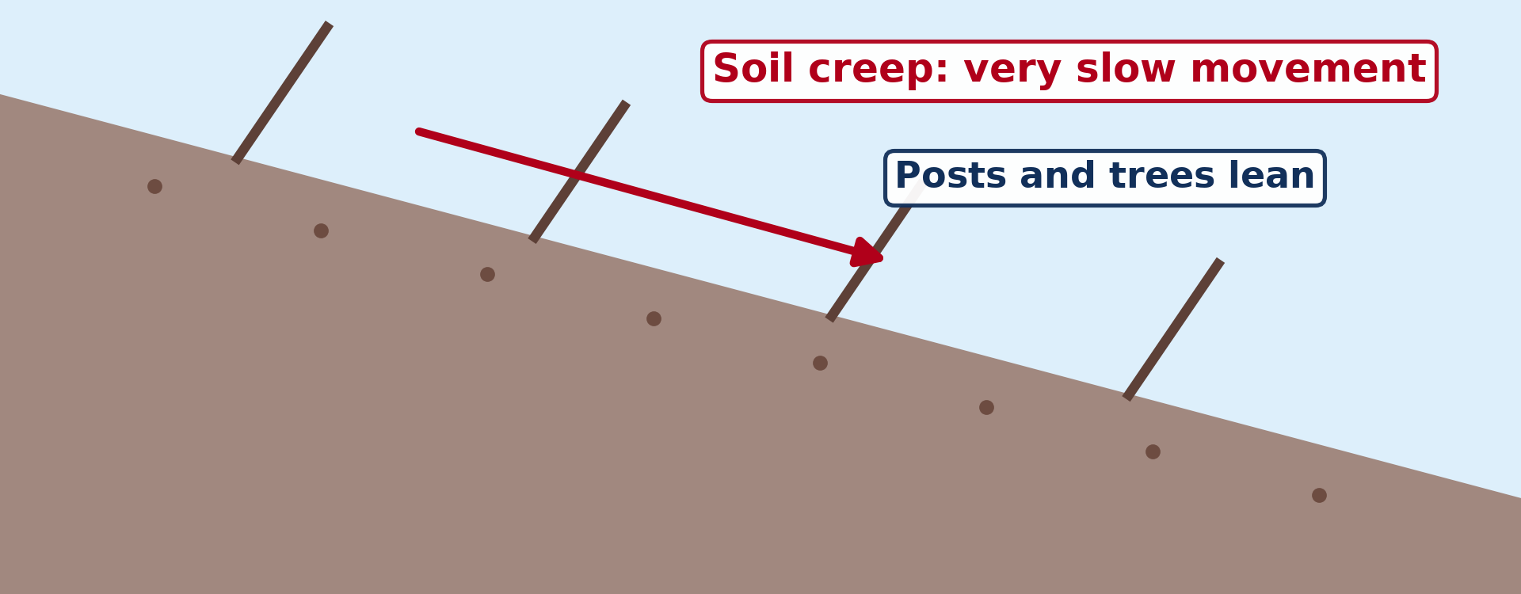
BOARD SUMMARY
1. Meaning and Evidence of Mass Wasting
Mass wasting and its evidence are presented as follows:
Meaning: Unlike erosion, mass wasting needs no transporting agent: gravity is the main force.
Illustration: soil creep
Notes:
Let us copy Meaning and Evidence of Mass Wasting. Mass wasting and its evidence are presented as follows. Copy the point on Meaning on the left, then draw the diagram on the right: soil creep. Give it a title and label it clearly.

Slide 39
BOARD SUMMARY
1. Meaning and Evidence of Mass Wasting
Tilted objects: Fences, poles and walls lean downhill.
Curved tree trunks: Trees keep growing upwards while the soil moves, so their base curves.
Notes:
We continue with Meaning and Evidence of Mass Wasting. On this slide we have Tilted objects and Curved tree trunks. Write each point on a new line, with the key term first, and explain it in your own words when we revise.

Slide 40
BOARD SUMMARY
1. Meaning and Evidence of Mass Wasting
Terracettes: Small step-like ridges form on grassy slopes.
Illustration: evidence of mass wasting
Notes:
Copy the point on Terracettes on the left, then draw the diagram on the right: evidence of mass wasting. Give it a title and label it clearly.

Slide 41
BOARD SUMMARY
1. Meaning and Evidence of Mass Wasting
Tension cracks: Cracks at the top of a slope show that a block is pulling away.
Notes:
We continue with Meaning and Evidence of Mass Wasting. On this slide we have Tension cracks. Write each point on a new line, with the key term first, and explain it in your own words when we revise.

Slide 42
BOARD SUMMARY
2. Factors of Mass Wasting
The factors of mass wasting are the following:
Gravity: It is the driving force pulling material downslope.
Illustration: factors of mass wasting
Notes:
Let us copy Factors of Mass Wasting. The factors of mass wasting are the following. Copy the point on Gravity on the left, then draw the diagram on the right: factors of mass wasting. Give it a title and label it clearly.

Slide 43
BOARD SUMMARY
2. Factors of Mass Wasting
Water: Heavy rain adds weight and lubricates particles; it is the most common trigger.
Slope angle: Slopes steeper than the angle of repose become unstable.
Lack of vegetation: Deforestation, bush fires and overgrazing remove the roots that bind the soil.
Notes:
We continue with Factors of Mass Wasting. On this slide we have Water, Slope angle and Lack of vegetation. Write each point on a new line, with the key term first, and explain it in your own words when we revise. When you finish, we go to the next slide.

Slide 44
BOARD SUMMARY
2. Factors of Mass Wasting (continued)
Human activities and vibrations: Road cuts, waste tips, earthquakes and heavy traffic destabilise slopes.
Notes:
We continue with Factors of Mass Wasting. On this slide we have Human activities and vibrations. Write each point on a new line, with the key term first, and explain it in your own words when we revise.

Slide 45
BOARD SUMMARY
3. Classification of Mass Wasting
Mass movements are classified by speed and water content as follows:
Carson and Kirkby: Their triangle classifies movements from slow to fast and from dry to wet.
Illustration: classification of mass movements
Notes:
Let us copy Classification of Mass Wasting. Mass movements are classified by speed and water content as follows. Copy the point on Carson and Kirkby on the left, then draw the diagram on the right: classification of mass movements. Give it a title and label it clearly.

Slide 46
BOARD SUMMARY
3. Classification of Mass Wasting
Creep: It is the slowest and most common movement.
Falls: They are fast and dry: rocks fall freely from steep cliffs.
Notes:
We continue with Classification of Mass Wasting. On this slide we have Creep and Falls. Write each point on a new line, with the key term first, and explain it in your own words when we revise.

Slide 47
BOARD SUMMARY
3. Classification of Mass Wasting
Slides: A block moves quickly over a distinct surface, as in a landslide.
Illustration: a landslide
Notes:
Copy the point on Slides on the left, then draw the diagram on the right: a landslide. Give it a title and label it clearly.

Slide 48
BOARD SUMMARY
3. Classification of Mass Wasting
Flows: They are fast and wet: material moves like a thick liquid, as in mudflows after sudden storms.
Notes:
We continue with Classification of Mass Wasting. On this slide we have Flows. Write each point on a new line, with the key term first, and explain it in your own words when we revise.

Slide 49
FORMATIVE EVALUATION
Evaluation 1
How does removing trees from a steep slope increase the risk of mass wasting?
Notes:
Now let us check what you have understood. Question 1: How does removing trees from a steep slope increase the risk of mass wasting? Answer in your exercise book.

Slide 50
FORMATIVE EVALUATION
Expected Answer
Without roots, the soil is no longer bound and absorbs more water, so it slides more easily.
Notes:
The expected answer is: without roots, the soil is no longer bound and absorbs more water, so it slides more easily. If you got it right, well done.

Slide 51
FORMATIVE EVALUATION
Evaluation 2
Give two pieces of evidence of soil creep.
Notes:
Now let us check what you have understood. Question 2: Give two pieces of evidence of soil creep. Answer in your exercise book.

Slide 52
FORMATIVE EVALUATION
Expected Answer
Leaning poles or fences, curved tree trunks, terracettes (any two).
Notes:
The expected answer is: leaning poles or fences, curved tree trunks, terracettes (any two). If you got it right, well done.

Slide 53
REMEDIATION
Remediation
Fill in the blanks:
The main force of mass wasting is ______.
The slowest mass movement is soil ______.
A fast, wet movement is a ______.
Notes:
For those who need more practice, fill in the blanks in your exercise book. The answers are: number 1, gravity; number 2, creep; number 3, flow (mudflow).

Slide 54
HOMEWORK
Homework
Name one slow mass movement.
Notes:
For your homework: Name one slow mass movement. We shall correct it at the beginning of our next lesson.

Slide 55
NEXT LESSON
Next Lesson
Our next lesson will be on:
Lesson 13: Processes and Features of Mass Wasting
Notes:
Our next lesson will be on Lesson 13: Processes and Features of Mass Wasting. Thank you for your attention, and see you next time.

Slide 56
BILINGUAL GAME
Bilingual Game (Jeu Bilingue)
English | Français
Mass wasting | Le mouvement de masse
Gravity | La gravité
Slope | La pente
Landslide | Le glissement de terrain
Soil creep | La reptation du sol
Rockfall | L'éboulement
Notes:
Let us play the bilingual game. I say a word in English, and you give me the French word. Then we do the reverse.

Slide 57
LOGBOOK
Official Logbook (1/2)
Module / Topic | Denudational Processes on Slopes
Lesson Title | Lesson 12: Mass Wasting (Movement)
Expected Learning Outcomes | Define mass wasting. Identify the evidence of mass wasting. Explain its factors. Classify mass movements by speed and water content.
Competence | Learners are able to recognise signs of mass wasting, explain its factors and classify its types.
Notes:
I record this information in the official logbook of the class after the lesson.

Slide 58
LOGBOOK
Official Logbook (2/2)
Matter Taught | DEFINITIONS; Meaning and Evidence of Mass Wasting; Factors of Mass Wasting; Classification of Mass Wasting.
Evaluation | Formative evaluation and remediation exercise.
Homework | Name one slow mass movement.
Enrolment / Present / Absent | ____ / ____ / ____
Achievement | To be completed after the lesson.
Notes:
I complete the second page of the logbook: the matter taught, the evaluation, the homework and the attendance.

Slide 59
TEACHER'S NOTE
Teacher's Note
Timing: Homework correction, plan, objectives 8 min | Recall, situation, action 10 min | 5 activities 30 min | Board summary (copying) 30 min | Evaluation, remediation 10 min | Homework, next lesson 5 min | Logbook 7 min
Activity 1 is an animation (GIF): it plays automatically in slide-show mode.
Without the projector (Activity 1): list signs on the board.
Without the projector (Activity 2): draw a slope with cracks.
Without the projector (Activity 3): tilt a book with an eraser on it.
Without the projector (Activity 4): draw the triangle.
Without the projector (Activity 5): describe a landslide on a road.
Notes:
This slide is for me, the teacher: it gives the timing of the lesson and what to do if the projector is not available.

Slide 60
REFERENCES
References
Geography Syllabus for Sixth Forms (Lower and Upper Sixth), MINESEC, 2019 — Module 2 (Geomorphology).
Teacher's course notes: Mr KAMDEM E., Geomorphology (LSA), GBHS Garoua, 2026.
Photo, Activity 5: “Siuslaw National Forest, landslide, road failure.jpg” by Forest Service Pacific Northwest Region, Public domain 1.0, via Flickr (https://www.flickr.com/photos/135886671@N08/36218241110)
Diagrams and animations: drawn for this lesson (Geography Department).
Notes:
These are the references and picture credits used to prepare this lesson.

