Slide 1
LOWER SIXTH ARTS
GEOGRAPHY
Lesson 13
Processes and Features of Mass Wasting
Notes:
Good morning, class, and welcome to our geography lesson. I am your geography teacher, Mr Kamdem. Today we are starting Lesson 13: Processes and Features of Mass Wasting.

Slide 2
CLASS INFO
Class, Chapter and Duration
Class | Lower Sixth Arts
Chapter | Module 2: Understanding and managing physical landscapes, geomorphological processes and hazards across the world in general and Cameroon in particular
Duration | 2 periods (2 × 50 minutes)
Notes:
This lesson is for Lower Sixth Arts. It belongs to Module 2: Understanding and managing physical landscapes, geomorphological processes and hazards across the world in general and Cameroon in particular. We shall need 2 periods to cover it.

Slide 3
IDENTIFICATION
Lesson Identification
Topic | Denudational Processes on Slopes
Sub-topic | Mass Movements
Lesson | Lesson 13: Processes and Features of Mass Wasting
Notions / Concepts | Soil creep, solifluction, landslide, slump, mudflow, debris flow, rockfall, scree (talus), afforestation, retaining wall, terracing, zoning.
Syllabus focus | Slow mass movements (creep, solifluction); fast mass movements (landslides, slumps, mudflows, rockfalls); impacts on man and the environment; control measures.
Competence | Learners are able to describe the types of mass movements, explain their impacts and propose measures to control them.
Notes:
Our topic is Denudational Processes on Slopes, and the sub-topic is Mass Movements. The key notions we shall use today are: soil creep, solifluction, landslide, slump, mudflow, debris flow, rockfall, scree (talus), afforestation, retaining wall, terracing, zoning. At the end, you should be able to do this: learners are able to describe the types of mass movements, explain their impacts and propose measures to control them.

Slide 4

HOMEWORK CORRECTION
Correction of the Homework
Question (Lesson 12: Mass Wasting (Movement)):
Name one slow mass movement.
Notes:
Before we start the new lesson, let us correct the homework I gave you at the end of Lesson 12: Mass Wasting (Movement). The question was: Name one slow mass movement. Take out your exercise books.

Slide 5
HOMEWORK CORRECTION
Correction: Possible Answer
Soil creep or solifluction.
Notes:
Here is a good answer. Soil creep or solifluction. Compare it with your own answer and correct your work in red.

Slide 6
LESSON PLAN
Lesson Plan
Correction of the homework
Objectives and recall
Real-life situation and action to take
Learning activities
Board summary
Evaluation, remediation and homework
Notes:
Here is the plan of our lesson today. First, we shall correct the homework. Then we shall look at the objectives and recall what you already know. After that, we shall study a situation from real life and the action to take, and do the learning activities. Finally, we shall copy the board summary, do the evaluation and the remediation, and I will give you the homework.

Slide 7
OBJECTIVES
Objectives
By the end of this lesson, you should be able to:
Describe slow mass movements.
Describe fast mass movements and their features.
Explain the impacts of mass wasting.
Notes:
Take your time to copy this part; we will continue together.

Slide 8
OBJECTIVES
Objectives (continued)
Propose solutions to control mass wasting.
Notes:
By the end of this lesson, you should be able to do four things. Number 1: describe slow mass movements. Number 2: describe fast mass movements and their features. Number 3: explain the impacts of mass wasting. Number 4: propose solutions to control mass wasting.

Slide 9
PREVIOUS KNOWLEDGE
Previous Knowledge
Water is the main trigger of mass wasting.
Creep is slow and falls are fast.
The angle of repose limits stable slopes.
Notes:
Let us first remember what you already know. Water is the main trigger of mass wasting. Creep is slow and falls are fast. The angle of repose limits stable slopes. Keep this in mind, because we shall build on it today.

Slide 10
REAL-LIFE SITUATION
Situation in Real Life
At the peak of the rainy season, you pass a steep road cutting near the high banks of the Benue.
A large section of soil and rock that was stable in the dry season has collapsed, leaving a fresh scar on the slope.
Notes:
Take your time to copy this part; we will continue together.

Slide 11
REAL-LIFE SITUATION
Situation in Real Life (continued)
A small tree at the edge now leans at a strange angle.
You ask: "What force made this part of the slope fall suddenly, can it also happen slowly, and how can we prevent it?"
Notes:
Listen carefully to this situation from real life. At the peak of the rainy season, you pass a steep road cutting near the high banks of the Benue. A large section of soil and rock that was stable in the dry season has collapsed, leaving a fresh scar on the slope. A small tree at the edge now leans at a strange angle. You ask: "What force made this part of the slope fall suddenly, can it also happen slowly, and how can we prevent it?" Think about it, because I am going to ask you some questions.

Slide 12
REAL-LIFE SITUATION
Situation: Question 1
What is the problem in the situation?
Notes:
Question 1: What is the problem in the situation? Think for a moment, then raise your hand to answer.

Slide 13
REAL-LIFE SITUATION
Answer
The learner does not know the types of mass movements and how to control them.
Notes:
Good. The learner does not know the types of mass movements and how to control them.

Slide 14
REAL-LIFE SITUATION
Situation: Question 2
What is a very slow movement that tilts trees over years?
Notes:
Question 2: What is a very slow movement that tilts trees over years? Think for a moment, then raise your hand to answer.

Slide 15
REAL-LIFE SITUATION
Answer
Soil creep.
Notes:
Good. Soil creep.

Slide 16
REAL-LIFE SITUATION
Situation: Question 3
What is a sudden collapse after heavy rain?
Notes:
Question 3: What is a sudden collapse after heavy rain? Think for a moment, then raise your hand to answer.

Slide 17
REAL-LIFE SITUATION
Possible Answer
A fast mass movement such as a landslide or a slump.
Notes:
Good. A fast mass movement such as a landslide or a slump.

Slide 18
ACTION TO TAKE
Action to Take
Plant trees and keep drains clear on slopes near your home.
Notes:
From this situation, the action we are working towards in this lesson is the following: plant trees and keep drains clear on slopes near your home.

Slide 19
JUSTIFICATION
Justification of the Lesson
This lesson helps us to protect lives, houses and roads from landslides and bank collapses.
Notes:
Why is this lesson important for you? This lesson helps us to protect lives, houses and roads from landslides and bank collapses.

Slide 20
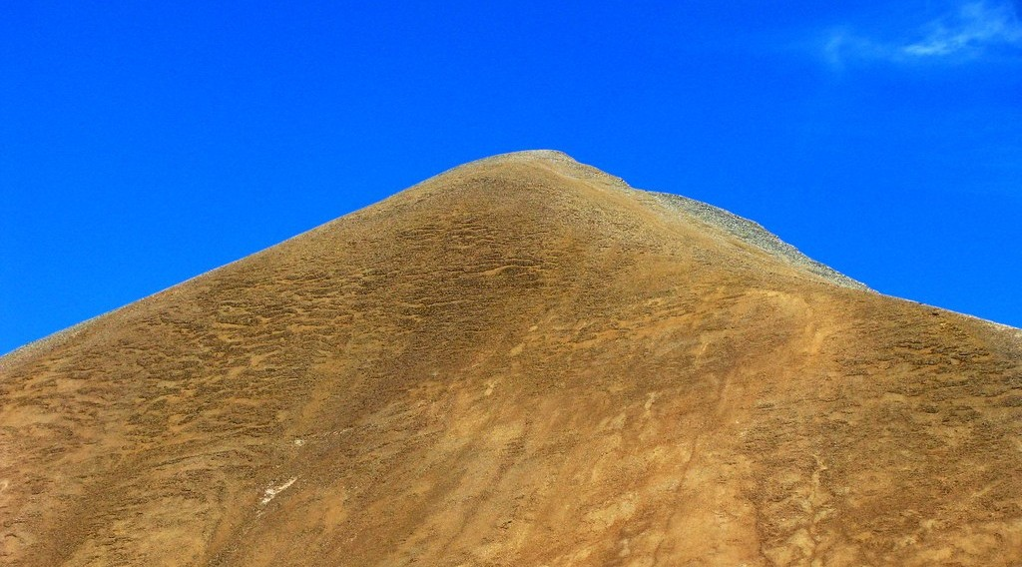
1. SLOW MOVEMENTS
Activity 1
Solifluction lobes.
Notes:
Activity 1. Look carefully at this picture: solifluction lobes. Observe every detail before I ask the question.

Slide 21
1. SLOW MOVEMENTS
Activity 1: Question
What is solifluction?
Notes:
Here is the question for Activity 1: What is solifluction? Take one minute to think and write your answer in your rough notebook.

Slide 22
1. SLOW MOVEMENTS
Activity 1: Answer
The slow flow of waterlogged soil over impermeable ground.
Notes:
Let us check the answer together. The slow flow of waterlogged soil over impermeable ground.

Slide 23
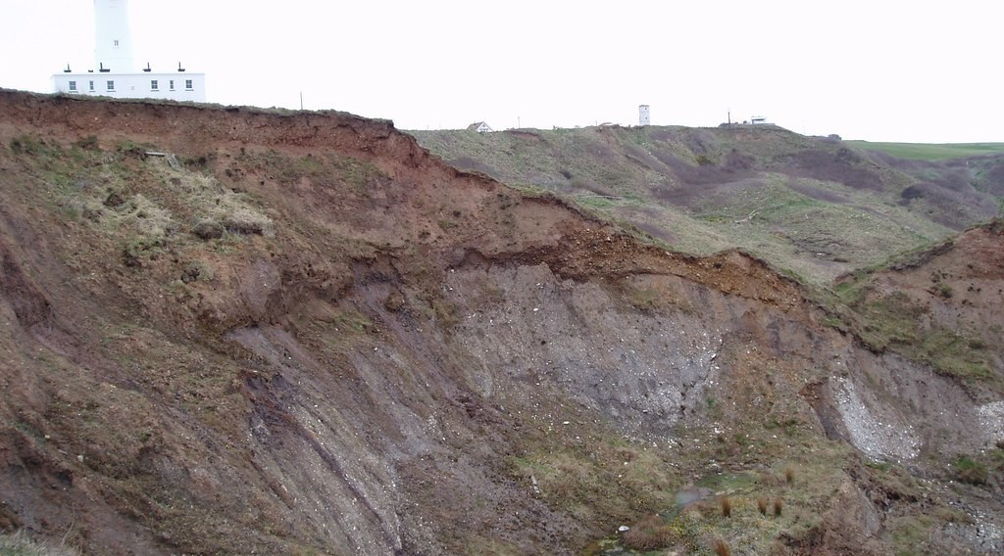
2. FAST MOVEMENTS
Activity 2
A slump.
Notes:
Activity 2. Look carefully at this picture: a slump. Observe every detail before I ask the question.

Slide 24
2. FAST MOVEMENTS
Activity 2: Question
How does a slump move?
Notes:
Here is the question for Activity 2: How does a slump move? Take one minute to think and write your answer in your rough notebook.

Slide 25
2. FAST MOVEMENTS
Activity 2: Answer
Along a curved surface, with the block rotating backwards.
Notes:
Let us check the answer together. Along a curved surface, with the block rotating backwards.

Slide 26

2. FAST MOVEMENTS
Activity 3
Scree at the foot of a cliff.
Notes:
Activity 3. Look carefully at this picture: scree at the foot of a cliff. Observe every detail before I ask the question.

Slide 27
2. FAST MOVEMENTS
Activity 3: Question
What is the pile of rocks at the foot of a cliff called?
Notes:
Here is the question for Activity 3: What is the pile of rocks at the foot of a cliff called? Take one minute to think and write your answer in your rough notebook.

Slide 28
2. FAST MOVEMENTS
Activity 3: Answer
Scree (talus).
Notes:
Let us check the answer together. Scree (talus).

Slide 29
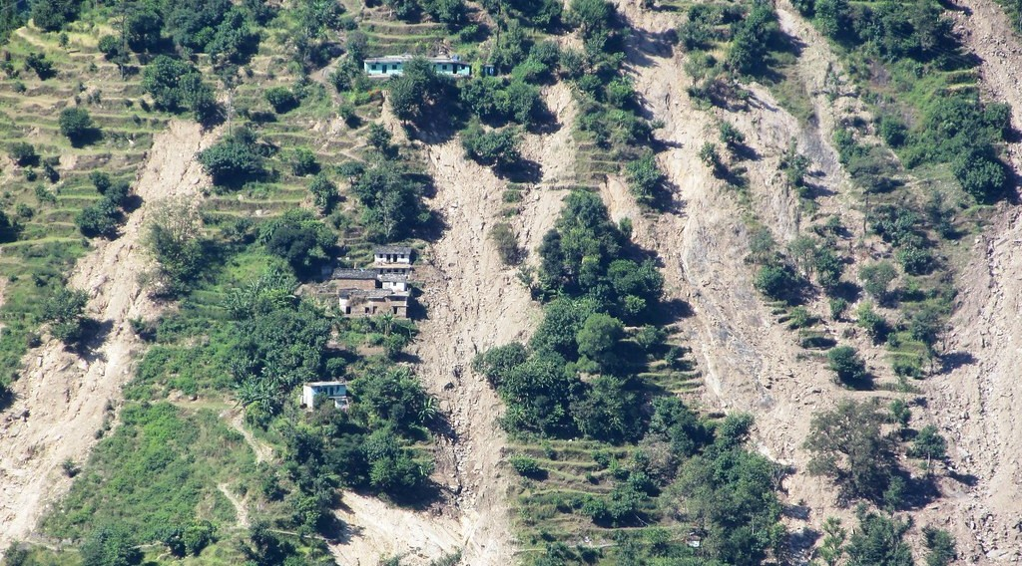
3. IMPACTS
Activity 4
A landslide scar.
Notes:
Activity 4. Look carefully at this picture: a landslide scar. Observe every detail before I ask the question.

Slide 30
3. IMPACTS
Activity 4: Question
Give one impact of mass wasting on man.
Notes:
Here is the question for Activity 4: Give one impact of mass wasting on man. Take one minute to think and write your answer in your rough notebook.

Slide 31
3. IMPACTS
Activity 4: Answer
Deaths, destroyed houses and farms, blocked roads.
Notes:
Let us check the answer together. Deaths, destroyed houses and farms, blocked roads.

Slide 32

4. SOLUTIONS
Activity 5
Terraced slopes.
Notes:
Activity 5. Look carefully at this picture: terraced slopes. Observe every detail before I ask the question.

Slide 33
4. SOLUTIONS
Activity 5: Question
How do terraces reduce mass wasting?
Notes:
Here is the question for Activity 5: How do terraces reduce mass wasting? Take one minute to think and write your answer in your rough notebook.

Slide 34
4. SOLUTIONS
Activity 5: Answer
They reduce the slope angle and slow down runoff.
Notes:
Let us check the answer together. They reduce the slope angle and slow down runoff.

Slide 35
BOARD SUMMARY
Board Summary
Topic: Denudational Processes on Slopes
Sub-topic: Mass Movements
Lesson 13: Processes and Features of Mass Wasting
Notes:
Now we are going to copy the board summary. Write the title and the headings neatly in your notebooks. I will give you enough time for each slide, so do not rush.

Slide 36
BOARD SUMMARY
DEFINITIONS
The key terms of this lesson are defined as follows:
Solifluction: It is the slow flow of waterlogged soil over impermeable ground.
Landslide: It is the rapid movement of a mass of rock or soil down a slope.
Notes:
Let us copy the definitions. The key terms of this lesson are defined as follows. On this slide we have Solifluction and Landslide. Write each point on a new line, with the key term first, and explain it in your own words when we revise. When you finish, we go to the next slide.

Slide 37
BOARD SUMMARY
DEFINITIONS (continued)
Slump: It is a slide along a curved surface.
Scree (talus): It is the pile of rock fragments at the foot of a cliff.
Notes:
We continue with the definitions. On this slide we have Slump and Scree (talus). Write each point on a new line, with the key term first, and explain it in your own words when we revise.

Slide 38
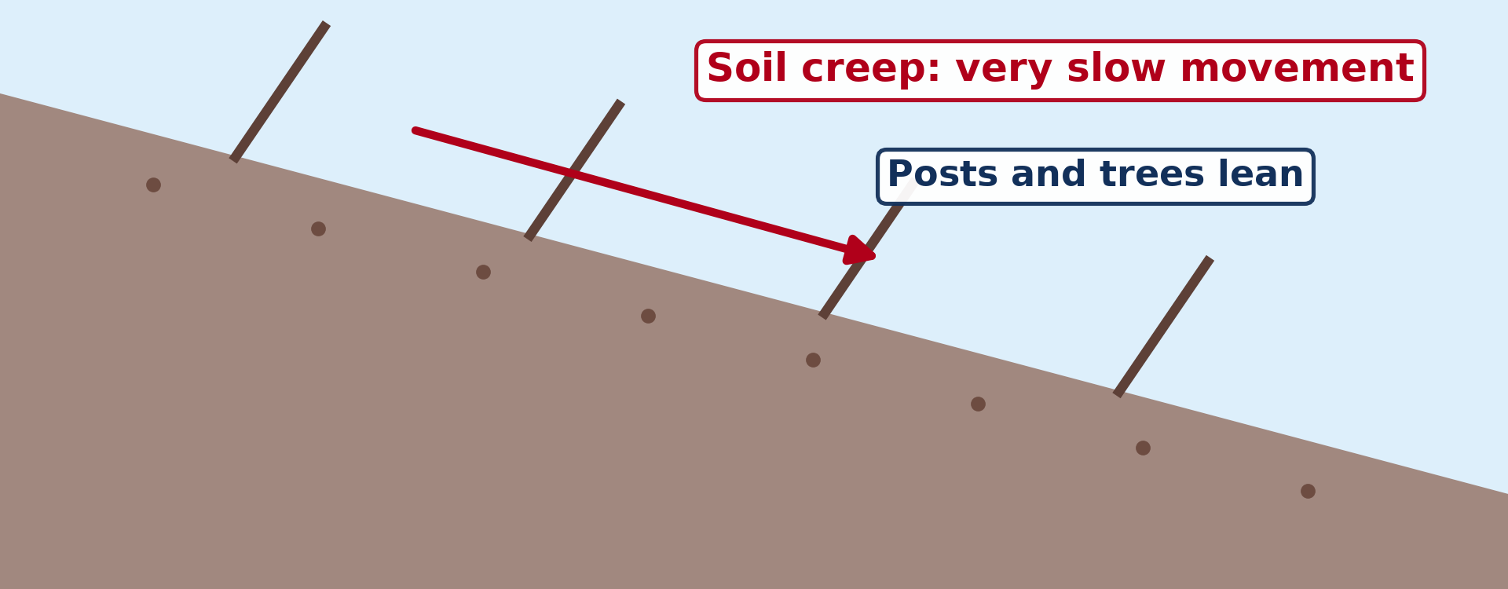
BOARD SUMMARY
1. Slow Mass Movements
The slow mass movements are the following:
Soil creep: The slow downhill movement of soil, a few centimetres a year, shown by tilted poles and cracked roads.
Illustration: soil creep
Notes:
Let us copy Slow Mass Movements. The slow mass movements are the following. Copy the point on Soil creep on the left, then draw the diagram on the right: soil creep. Give it a title and label it clearly.

Slide 39
BOARD SUMMARY
1. Slow Mass Movements
Solifluction: Waterlogged soil flows slowly over frozen ground or impermeable clay.
Illustration: solifluction lobes
Notes:
Copy the point on Solifluction on the left, then draw the diagram on the right: solifluction lobes. Give it a title and label it clearly.

Slide 40

BOARD SUMMARY
2. Fast Mass Movements
The fast mass movements are the following:
Landslides: A large block of rock or soil moves rapidly down a slope.
Illustration: a landslide
Notes:
Let us copy Fast Mass Movements. The fast mass movements are the following. Copy the point on Landslides on the left, then draw the diagram on the right: a landslide. Give it a title and label it clearly.

Slide 41
BOARD SUMMARY
2. Fast Mass Movements
Slumps: Material slides along a curved surface and rotates, as on the banks of the Benue after heavy rain.
Illustration: a slump
Notes:
Copy the point on Slumps on the left, then draw the diagram on the right: a slump. Give it a title and label it clearly.

Slide 42
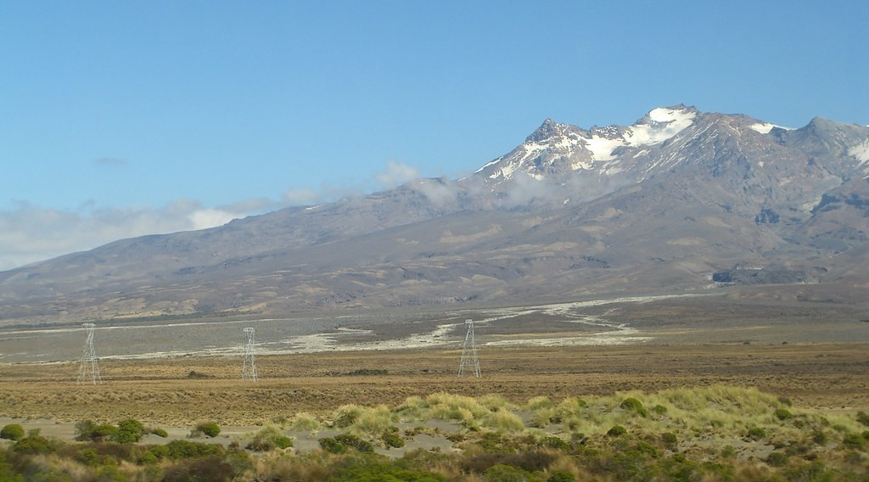
BOARD SUMMARY
2. Fast Mass Movements
Mudflows and debris flows: Water, soil and rock move like wet concrete in hilly areas after heavy rain.
Illustration: a mudflow
Notes:
Copy the point on Mudflows and debris flows on the left, then draw the diagram on the right: a mudflow. Give it a title and label it clearly.

Slide 43
BOARD SUMMARY
2. Fast Mass Movements
Rockfalls: Rocks fall freely from a steep cliff and pile up as scree at its foot.
Illustration: scree
Notes:
Copy the point on Rockfalls on the left, then draw the diagram on the right: scree. Give it a title and label it clearly.

Slide 44
BOARD SUMMARY
3. Impacts of Mass Wasting
Mass wasting has the following impacts:
On man:
Loss of life and injuries.
Destruction of houses and farms.
Damage to roads, railways and bridges.
High costs of repair and cleaning.
Notes:
Let us copy Impacts of Mass Wasting. Mass wasting has the following impacts. On this slide we have On man. Write each point on a new line, with the key term first, and explain it in your own words when we revise. When you finish, we go to the next slide.

Slide 45
BOARD SUMMARY
3. Impacts of Mass Wasting (continued)
On the environment:
Bare scars on slopes.
Rivers dammed by debris, causing floods upstream.
Destruction of habitats.
Notes:
We continue with Impacts of Mass Wasting. On this slide we have On the environment. Write each point on a new line, with the key term first, and explain it in your own words when we revise.

Slide 46
BOARD SUMMARY
3. Impacts of Mass Wasting
Example: The landslide at Gouache (Bafoussam) in 2019 killed more than 40 people.
Illustration: a landslide scar
Notes:
Copy the point on Example on the left, then draw the diagram on the right: a landslide scar. Give it a title and label it clearly.

Slide 47
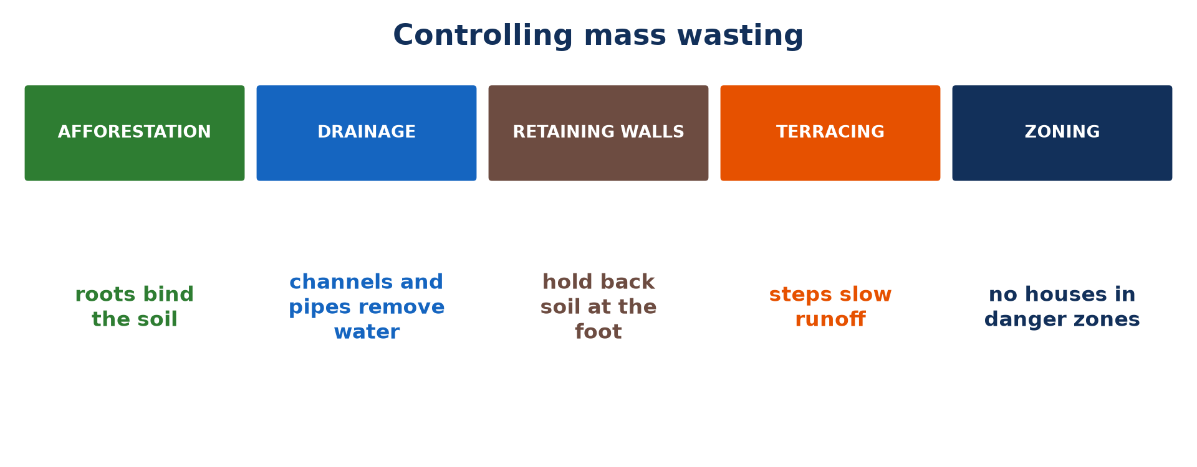
BOARD SUMMARY
4. Solutions to Control Mass Wasting
Mass wasting is controlled by the following measures:
Afforestation: Trees and grass bind the soil with their roots.
Illustration: controlling mass wasting
Notes:
Let us copy Solutions to Control Mass Wasting. Mass wasting is controlled by the following measures. Copy the point on Afforestation on the left, then draw the diagram on the right: controlling mass wasting. Give it a title and label it clearly.

Slide 48
BOARD SUMMARY
4. Solutions to Control Mass Wasting
Drainage: Channels and pipes remove excess water from slopes.
Retaining walls: Strong walls at the foot of slopes hold back soil and rock.
Notes:
We continue with Solutions to Control Mass Wasting. On this slide we have Drainage and Retaining walls. Write each point on a new line, with the key term first, and explain it in your own words when we revise.

Slide 49
BOARD SUMMARY
4. Solutions to Control Mass Wasting
Terracing: Steps cut into slopes reduce the angle and slow runoff, as in the Mandara Mountains.
Illustration: terraced slopes
Notes:
Copy the point on Terracing on the left, then draw the diagram on the right: terraced slopes. Give it a title and label it clearly.

Slide 50
BOARD SUMMARY
4. Solutions to Control Mass Wasting
Land-use zoning: Laws forbid building in high-risk zones.
Notes:
We continue with Solutions to Control Mass Wasting. On this slide we have Land-use zoning. Write each point on a new line, with the key term first, and explain it in your own words when we revise.

Slide 51
FORMATIVE EVALUATION
Evaluation 1
Distinguish soil creep from a landslide.
Notes:
Now let us check what you have understood. Question 1: Distinguish soil creep from a landslide. Answer in your exercise book.

Slide 52
FORMATIVE EVALUATION
Expected Answer
Soil creep is a very slow, continuous movement of soil; a landslide is a sudden, rapid movement of a large mass.
Notes:
The expected answer is: soil creep is a very slow, continuous movement of soil; a landslide is a sudden, rapid movement of a large mass. If you got it right, well done.

Slide 53
FORMATIVE EVALUATION
Evaluation 2
Give two measures to control mass wasting.
Notes:
Now let us check what you have understood. Question 2: Give two measures to control mass wasting. Answer in your exercise book.

Slide 54
FORMATIVE EVALUATION
Expected Answer
Afforestation, drainage, retaining walls, terracing, zoning (any two).
Notes:
The expected answer is: afforestation, drainage, retaining walls, terracing, zoning (any two). If you got it right, well done.

Slide 55
REMEDIATION
Remediation
Fill in the blanks:
A slide along a curved surface is a ______.
Rock fragments at the foot of a cliff form ______.
Planting trees on slopes is ______.
Notes:
For those who need more practice, fill in the blanks in your exercise book. The answers are: number 1, slump; number 2, scree (talus); number 3, afforestation.

Slide 56
HOMEWORK
Homework
Name the three types of work of a river.
Notes:
For your homework: Name the three types of work of a river. We shall correct it at the beginning of our next lesson.

Slide 57
NEXT LESSON
Next Lesson
Our next lesson will be on:
Lesson 14: Erosional Processes and the Fluvial System
Notes:
Our next lesson will be on Lesson 14: Erosional Processes and the Fluvial System. Thank you for your attention, and see you next time.

Slide 58
BILINGUAL GAME
Bilingual Game (Jeu Bilingue)
English | Français
Mass wasting | Le mouvement de masse
Landslide | Le glissement de terrain
Soil creep | La reptation du sol
Mudflow | La coulée de boue
Retaining wall | Le mur de soutènement
Terracing | Les cultures en terrasses
Notes:
Let us play the bilingual game. I say a word in English, and you give me the French word. Then we do the reverse.

Slide 59
LOGBOOK
Official Logbook (1/2)
Module / Topic | Denudational Processes on Slopes
Lesson Title | Lesson 13: Processes and Features of Mass Wasting
Expected Learning Outcomes | Describe slow mass movements. Describe fast mass movements and their features. Explain the impacts of mass wasting. Propose solutions to control mass wasting.
Competence | Learners are able to describe the types of mass movements, explain their impacts and propose measures to control them.
Notes:
I record this information in the official logbook of the class after the lesson.

Slide 60
LOGBOOK
Official Logbook (2/2)
Matter Taught | DEFINITIONS; Slow Mass Movements; Fast Mass Movements; Impacts of Mass Wasting; Solutions to Control Mass Wasting.
Evaluation | Formative evaluation and remediation exercise.
Homework | Name the three types of work of a river.
Enrolment / Present / Absent | ____ / ____ / ____
Achievement | To be completed after the lesson.
Notes:
I complete the second page of the logbook: the matter taught, the evaluation, the homework and the attendance.

Slide 61
TEACHER'S NOTE
Teacher's Note
Timing: Homework correction, plan, objectives 8 min | Recall, situation, action 10 min | 5 activities 30 min | Board summary (copying) 30 min | Evaluation, remediation 10 min | Homework, next lesson 5 min | Logbook 7 min
Without the projector (Activity 1): describe waterlogged soil.
Without the projector (Activity 2): draw a curved slip surface.
Without the projector (Activity 3): pour gravel into a pile.
Without the projector (Activity 4): list impacts on the board.
Without the projector (Activity 5): describe terraces in the Mandara Mountains.
Notes:
This slide is for me, the teacher: it gives the timing of the lesson and what to do if the projector is not available.

Slide 62
REFERENCES
References
Geography Syllabus for Sixth Forms (Lower and Upper Sixth), MINESEC, 2019 — Module 2 (Geomorphology).
Teacher's course notes: Mr KAMDEM E., Geomorphology (LSA), GBHS Garoua, 2026.
Photo, Activity 1: “Opal Hills” by Dru!, CC BY-NC 2.0, via Flickr (https://www.flickr.com/photos/36543076@N00/17159561341)
Photo, Activity 2: “Holderness landslides 026” by Madingley, CC BY-NC 2.0, via Flickr (https://www.flickr.com/photos/26004680@N00/256596582)
Photo, Activity 3: “Full Screen Plate Tectonics” by subarcticmike, CC BY 2.0, via Flickr (https://www.flickr.com/photos/31856336@N03/3109980958)
Photo, Activity 4: “Hillsides scarred by landslides caused by cloudbursts, Rudraprayag, Ut” by ICIMOD.Gallery, CC BY-NC 2.0, via Flickr (https://www.flickr.com/photos/127267759@N06/16051008426)
Photo, Activity 5: “Terraced Hillside” by AdamCohn, CC BY-NC-ND 2.0, via Flickr (https://www.flickr.com/photos/96142515@N00/6311042523)
Notes:
Take your time to copy this part; we will continue together.

Slide 63
REFERENCES
References (continued)
Photo, board summary (Landslides): “Siuslaw National Forest, landslide, road failure.jpg” by Forest Service Pacific Northwest Region, Public domain 1.0, via Flickr (https://www.flickr.com/photos/135886671@N08/36218241110)
Photo, board summary (Mudflows and debris flows): “Lahar (mudflow) remnants from Mount Ruapehu” by Wade Tregaskis, CC BY-NC 2.0, via Flickr (https://www.flickr.com/photos/7725552@N06/502073245)
Diagrams and animations: drawn for this lesson (Geography Department).
Notes:
These are the references and picture credits used to prepare this lesson.

