Slide 1
LOWER SIXTH ARTS
GEOGRAPHY
Lesson 23
The Hydrological Cycle
Notes:
Good morning, class, and welcome to our geography lesson. I am your geography teacher, Mr Kamdem. Today we are starting Lesson 23: The Hydrological Cycle.

Slide 2
CLASS INFO
Class, Chapter and Duration
Class | Lower Sixth Arts
Chapter | Module 1: Understanding and managing atmospheric and hydrological phenomena and hazards across the world in general and Cameroon in particular
Duration | 2 periods (2 × 50 minutes)
Notes:
This lesson is for Lower Sixth Arts. It belongs to Module 1: Understanding and managing atmospheric and hydrological phenomena and hazards across the world in general and Cameroon in particular. We shall need 2 periods to cover it.

Slide 3
IDENTIFICATION
Lesson Identification
Topic | Global Water in Storage and Circulation
Sub-topic | The Hydrological Cycle
Lesson | Lesson 23: The Hydrological Cycle
Notions / Concepts | Hydrological cycle, system, store, flow, closed system, residence time.
Syllabus focus | Meaning; systems approach; the global hydrological cycle as a closed system with its stores, flows and quantities.
Competence | Learners are able to describe the global water cycle as a closed system with stores and flows.
Notes:
Our topic is Global Water in Storage and Circulation, and the sub-topic is The Hydrological Cycle. The key notions we shall use today are: hydrological cycle, system, store, flow, closed system, residence time. At the end, you should be able to do this: learners are able to describe the global water cycle as a closed system with stores and flows.

Slide 4

HOMEWORK CORRECTION
Correction of the Homework
Question (Lesson 22: Introduction to Hydrology):
List the sources of water in your area and say which ones dry up in the dry season.
Notes:
Before we start the new lesson, let us correct the homework I gave you at the end of Lesson 22: Introduction to Hydrology. The question was: List the sources of water in your area and say which ones dry up in the dry season. Take out your exercise books.

Slide 5
HOMEWORK CORRECTION
Correction: Possible Answer
Sources in Garoua: the Benue river, wells, boreholes, streams (mayos) and rain water. Wells and mayos often dry up in the dry season, while boreholes and the Benue remain.
Notes:
Here is a good answer. Sources in Garoua: the Benue river, wells, boreholes, streams (mayos) and rain water. Wells and mayos often dry up in the dry season, while boreholes and the Benue remain. Compare it with your own answer and correct your work in red.

Slide 6
LESSON PLAN
Lesson Plan
Correction of the homework
Objectives and recall
Real-life situation and action to take
Learning activities
Board summary
Evaluation, remediation and homework
Notes:
Here is the plan of our lesson today. First, we shall correct the homework. Then we shall look at the objectives and recall what you already know. After that, we shall study a situation from real life and the action to take, and do the learning activities. Finally, we shall copy the board summary, do the evaluation and the remediation, and I will give you the homework.

Slide 7
OBJECTIVES
Objectives
By the end of this lesson, you should be able to:
Define the hydrological cycle.
Explain the systems approach (stores and flows).
Notes:
Take your time to copy this part; we will continue together.

Slide 8
OBJECTIVES
Objectives (continued)
Describe the global cycle as a closed system with quantities.
Notes:
By the end of this lesson, you should be able to do three things. Number 1: define the hydrological cycle. Number 2: explain the systems approach (stores and flows). Number 3: describe the global cycle as a closed system with quantities.

Slide 9
PREVIOUS KNOWLEDGE
Previous Knowledge
Water evaporates, condenses and falls as rain.
Most water is in the oceans.
Notes:
Let us first remember what you already know. Water evaporates, condenses and falls as rain. Most water is in the oceans. Keep this in mind, because we shall build on it today.

Slide 10
REAL-LIFE SITUATION
Situation in Real Life
A teacher says that the water we drink today may once have been drunk by a dinosaur. Learners laugh, but the teacher insists that water is never lost; it only moves.
Notes:
Listen carefully to this situation from real life. A teacher says that the water we drink today may once have been drunk by a dinosaur. Learners laugh, but the teacher insists that water is never lost; it only moves. Think about it, because I am going to ask you some questions.

Slide 11
REAL-LIFE SITUATION
Situation: Question 1
What is the problem in the situation?
Notes:
Question 1: What is the problem in the situation? Think for a moment, then raise your hand to answer.

Slide 12
REAL-LIFE SITUATION
Answer
Learners do not see how water moves and is reused.
Notes:
Good. Learners do not see how water moves and is reused.

Slide 13
REAL-LIFE SITUATION
Situation: Question 2
Is water lost from the Earth?
Notes:
Question 2: Is water lost from the Earth? Think for a moment, then raise your hand to answer.

Slide 14
REAL-LIFE SITUATION
Answer
No. The total amount stays the same.
Notes:
Good. No. The total amount stays the same.

Slide 15
REAL-LIFE SITUATION
Situation: Question 3
What is this movement called?
Notes:
Question 3: What is this movement called? Think for a moment, then raise your hand to answer.

Slide 16
REAL-LIFE SITUATION
Possible Answer
The hydrological (water) cycle.
Notes:
Good. The hydrological (water) cycle.

Slide 17
ACTION TO TAKE
Action to Take
Understand the circulation of water on Earth to manage it sustainably.
Notes:
From this situation, the action we are working towards in this lesson is the following: understand the circulation of water on Earth to manage it sustainably.

Slide 18
JUSTIFICATION
Justification of the Lesson
This lesson helps us to understand how water moves between the sea, the air and the land.
Notes:
Why is this lesson important for you? This lesson helps us to understand how water moves between the sea, the air and the land.

Slide 19

1. MEANING
Activity 1
Animation: the water cycle.
Notes:
Activity 1. Look carefully at this animation: animation: the water cycle. Watch the animation to the end; it will play again.

Slide 20
1. MEANING
Activity 1: Question
Name the main processes of the water cycle.
Notes:
Here is the question for Activity 1: Name the main processes of the water cycle. Take one minute to think and write your answer in your rough notebook.

Slide 21
1. MEANING
Activity 1: Answer
Evaporation, condensation, precipitation and runoff.
Notes:
Let us check the answer together. Evaporation, condensation, precipitation and runoff.

Slide 22

2. THE SYSTEMS APPROACH: A CLOSED SYSTEM
Activity 2
The Earth: its water never leaves the planet.
Notes:
Activity 2. Look carefully at this picture: the Earth: its water never leaves the planet. Observe every detail before I ask the question.

Slide 23
2. THE SYSTEMS APPROACH: A CLOSED SYSTEM
Activity 2: Question
Why is the global water cycle called a closed system?
Notes:
Here is the question for Activity 2: Why is the global water cycle called a closed system? Take one minute to think and write your answer in your rough notebook.

Slide 24
2. THE SYSTEMS APPROACH: A CLOSED SYSTEM
Activity 2: Answer
No water enters or leaves the Earth; it only moves between stores.
Notes:
Let us check the answer together. No water enters or leaves the Earth; it only moves between stores.

Slide 25
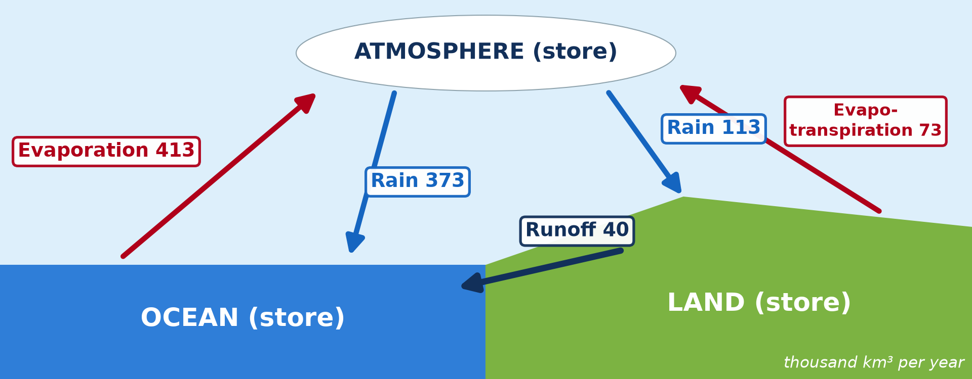
3. FLOWS AND QUANTITIES
Activity 3
Flows between the stores.
Notes:
Activity 3. Look carefully at this diagram: flows between the stores. Observe every detail before I ask the question.

Slide 26
3. FLOWS AND QUANTITIES
Activity 3: Question
Evaporation from the ocean is 413 and rain on the ocean is 373. Where do the other 40 go?
Notes:
Here is the question for Activity 3: Evaporation from the ocean is 413 and rain on the ocean is 373. Where do the other 40 go? Take one minute to think and write your answer in your rough notebook.

Slide 27
3. FLOWS AND QUANTITIES
Activity 3: Answer
They fall on land and return to the sea as runoff (40).
Notes:
Let us check the answer together. They fall on land and return to the sea as runoff (40).

Slide 28

3. STORES: ATMOSPHERE
Activity 4
Clouds: water stored in the atmosphere.
Notes:
Activity 4. Look carefully at this picture: clouds: water stored in the atmosphere. Observe every detail before I ask the question.

Slide 29
3. STORES: ATMOSPHERE
Activity 4: Question
Is the atmosphere a big or a small store? Why is it important?
Notes:
Here is the question for Activity 4: Is the atmosphere a big or a small store? Why is it important? Take one minute to think and write your answer in your rough notebook.

Slide 30
3. STORES: ATMOSPHERE
Activity 4: Answer
A small store, but water passes through it quickly and gives all the rain.
Notes:
Let us check the answer together. A small store, but water passes through it quickly and gives all the rain.

Slide 31
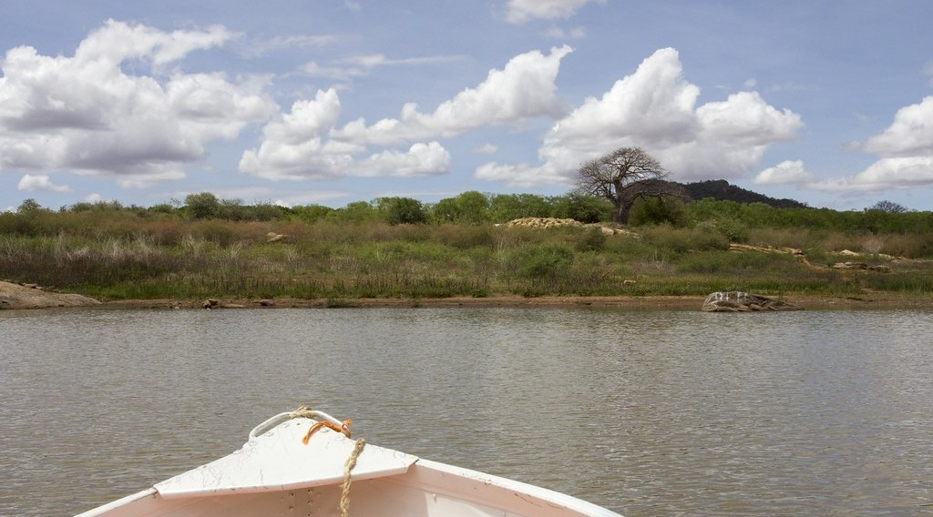
3. STORES ON LAND
Activity 5
A lake: a surface store of water.
Notes:
Activity 5. Look carefully at this picture: a lake: a surface store of water. Observe every detail before I ask the question.

Slide 32
3. STORES ON LAND
Activity 5: Question
Name three stores of water on land.
Notes:
Here is the question for Activity 5: Name three stores of water on land. Take one minute to think and write your answer in your rough notebook.

Slide 33
3. STORES ON LAND
Activity 5: Answer
Lakes and rivers, soil water, ground water (also ice and plants).
Notes:
Let us check the answer together. Lakes and rivers, soil water, ground water (also ice and plants).

Slide 34
BOARD SUMMARY
Board Summary
Topic: Global Water in Storage and Circulation
Sub-topic: The Hydrological Cycle
Lesson 23: The Hydrological Cycle
Notes:
Now we are going to copy the board summary. Write the title and the headings neatly in your notebooks. I will give you enough time for each slide, so do not rush.

Slide 35
BOARD SUMMARY
1. Meaning of the Hydrological Cycle
The hydrological cycle can be understood as follows:
Hydrological (water) cycle: It is the continuous movement of water between the oceans, the atmosphere and the land. It is powered by solar energy and gravity.
Notes:
Let us copy Meaning of the Hydrological Cycle. The hydrological cycle can be understood as follows. On this slide we have Hydrological (water) cycle. Write each point on a new line, with the key term first, and explain it in your own words when we revise.

Slide 36
BOARD SUMMARY
1. Meaning of the Hydrological Cycle
Illustration: the water cycle
Notes:
Now draw this illustration in your notebook: the water cycle. Give it a title and label it clearly.

Slide 37
BOARD SUMMARY
2. The Systems Approach
The hydrological cycle can be studied as a system:
System: A system is a set of stores linked by flows or transfers of matter and energy. It has inputs, stores, flows and outputs.
Notes:
Let us copy The Systems Approach. The hydrological cycle can be studied as a system. On this slide we have System. Write each point on a new line, with the key term first, and explain it in your own words when we revise. When you finish, we go to the next slide.

Slide 38
BOARD SUMMARY
2. The Systems Approach (continued)
Closed system: At the global scale, the water cycle is a closed system, because no water enters or leaves the Earth. Only energy (sunlight) enters and leaves.
Notes:
We continue with The Systems Approach. On this slide we have Closed system. Write each point on a new line, with the key term first, and explain it in your own words when we revise.

Slide 39
BOARD SUMMARY
3. Components of the Global Cycle
A) Stores (Storages)
The main stores of the global cycle are:
Oceans: They are by far the largest store, with about 1,338 million km³ of water. Water may stay there for thousands of years.
Notes:
Let us copy Stores (Storages). The main stores of the global cycle are. On this slide we have Oceans. Write each point on a new line, with the key term first, and explain it in your own words when we revise. When you finish, we go to the next slide.

Slide 40
BOARD SUMMARY
3. Components of the Global Cycle
A) Stores (Storages) (continued)
Ice, groundwater, lakes and rivers: Ice caps and groundwater are large stores on land. Lakes, rivers and soil moisture are small but important for people.
Notes:
We continue with Stores (Storages). On this slide we have Ice, groundwater, lakes and rivers. Write each point on a new line, with the key term first, and explain it in your own words when we revise. When you finish, we go to the next slide.

Slide 41
BOARD SUMMARY
3. Components of the Global Cycle
A) Stores (Storages) (continued)
Atmosphere: It is a very small store (about 13,000 km³). But water passes through it quickly, in about 9 days, so it feeds all rainfall.
Notes:
We continue with Stores (Storages). On this slide we have Atmosphere. Write each point on a new line, with the key term first, and explain it in your own words when we revise.

Slide 42
BOARD SUMMARY
3. Components of the Global Cycle
B) Flows (Linkages) and Quantities
Water moves between the stores through the following flows:
Evaporation and transpiration: About 413,000 km³ evaporate from the oceans and 73,000 km³ from the land each year. They move water up into the atmosphere.
Notes:
Let us copy Flows (Linkages) and Quantities. Water moves between the stores through the following flows. On this slide we have Evaporation and transpiration. Write each point on a new line, with the key term first, and explain it in your own words when we revise. When you finish, we go to the next slide.

Slide 43
BOARD SUMMARY
3. Components of the Global Cycle
B) Flows (Linkages) and Quantities (continued)
Precipitation: About 373,000 km³ fall on the oceans and 113,000 km³ on the land. More falls on land than evaporates from it.
Notes:
We continue with Flows (Linkages) and Quantities. On this slide we have Precipitation. Write each point on a new line, with the key term first, and explain it in your own words when we revise. When you finish, we go to the next slide.

Slide 44
BOARD SUMMARY
3. Components of the Global Cycle
B) Flows (Linkages) and Quantities (continued)
Runoff: The extra 40,000 km³ that falls on land returns to the sea by rivers and groundwater flow. This keeps the cycle balanced.
Notes:
We continue with Flows (Linkages) and Quantities. On this slide we have Runoff. Write each point on a new line, with the key term first, and explain it in your own words when we revise.

Slide 45
BOARD SUMMARY
3. Components of the Global Cycle
Illustration: the global water cycle (thousand km³ per year)
Notes:
Now draw this illustration in your notebook: the global water cycle (thousand km³ per year). Give it a title and label it clearly.

Slide 46
FORMATIVE EVALUATION
Evaluation 1
Why is the global hydrological cycle a closed system?
Notes:
Now let us check what you have understood. Question 1: Why is the global hydrological cycle a closed system? Answer in your exercise book.

Slide 47
FORMATIVE EVALUATION
Expected Answer
Water does not enter or leave the Earth; it only moves between stores.
Notes:
The expected answer is: water does not enter or leave the Earth; it only moves between stores. If you got it right, well done.

Slide 48
FORMATIVE EVALUATION
Evaluation 2
Name four flows of the water cycle.
Notes:
Now let us check what you have understood. Question 2: Name four flows of the water cycle. Answer in your exercise book.

Slide 49
FORMATIVE EVALUATION
Expected Answer
Evaporation, condensation, precipitation, runoff (also infiltration).
Notes:
The expected answer is: evaporation, condensation, precipitation, runoff (also infiltration). If you got it right, well done.

Slide 50
REMEDIATION
Remediation
Fill in the blanks:
The largest store of water is the ______.
Water returns from land to sea as ______.
The energy of the water cycle comes from the ______.
Notes:
For those who need more practice, fill in the blanks in your exercise book. The answers are: number 1, ocean; number 2, runoff; number 3, Sun.

Slide 51
HOMEWORK
Homework
Draw the global water cycle and write the quantities on the arrows.
Notes:
For your homework: Draw the global water cycle and write the quantities on the arrows. We shall correct it at the beginning of our next lesson.

Slide 52
NEXT LESSON
Next Lesson
Our next lesson will be on:
Lesson 24: The Drainage Basin as an Open System
Notes:
Our next lesson will be on Lesson 24: The Drainage Basin as an Open System. Thank you for your attention, and see you next time.

Slide 53
BILINGUAL GAME
Bilingual Game (Jeu Bilingue)
English | Français
Water cycle | Le cycle de l'eau
Store | Le stock
Flow | Le flux
Closed system | Le système fermé
Runoff | L'écoulement
Evaporation | L'évaporation
Notes:
Let us play the bilingual game. I say a word in English, and you give me the French word. Then we do the reverse.

Slide 54
LOGBOOK
Official Logbook (1/2)
Module / Topic | Global Water in Storage and Circulation
Lesson Title | Lesson 23: The Hydrological Cycle
Expected Learning Outcomes | Define the hydrological cycle. Explain the systems approach (stores and flows). Describe the global cycle as a closed system with quantities.
Competence | Learners are able to describe the global water cycle as a closed system with stores and flows.
Notes:
I record this information in the official logbook of the class after the lesson.

Slide 55
LOGBOOK
Official Logbook (2/2)
Matter Taught | Meaning of the Hydrological Cycle; The Systems Approach; Stores (Storages); Flows (Linkages) and Quantities.
Evaluation | Formative evaluation and remediation exercise.
Homework | Draw the global water cycle and write the quantities on the arrows.
Enrolment / Present / Absent | ____ / ____ / ____
Achievement | To be completed after the lesson.
Notes:
I complete the second page of the logbook: the matter taught, the evaluation, the homework and the attendance.

Slide 56
TEACHER'S NOTE
Teacher's Note
Timing: Homework correction, plan, objectives 8 min | Recall, situation, action 10 min | 5 activities 30 min | Board summary (copying) 30 min | Evaluation, remediation 10 min | Homework, next lesson 5 min | Logbook 7 min
Activity 1 is an animation (GIF): it plays automatically in slide-show mode.
Without the projector (Activity 1): draw the cycle on the board.
Without the projector (Activity 2): compare with water boiling in a closed pot.
Without the projector (Activity 3): do the calculation on the board.
Without the projector (Activity 4): explain residence time with a bus stop.
Without the projector (Activity 5): list stores on the board.
Notes:
This slide is for me, the teacher: it gives the timing of the lesson and what to do if the projector is not available.

Slide 57
REFERENCES
References
National Geography Syllabus, MINESEC/IGE/IP-SS, 2019 — Module 1 (Meteorology, Climatology & Hydrology).
Photo, Activity 2: “Blue Marble, Eastern Hemisphere March 2014” by NASA Goddard Photo and Video, CC BY 2.0, via nasa (https://www.flickr.com/photos/24662369@N07/14990033062)
Photo, Activity 4: “06172012 Sunday evening pulse storms/cumulonimbi” by StormRider93 | Into the Storm, CC BY-NC-ND 2.0, via Flickr (https://www.flickr.com/photos/65232104@N04/7395715628)
Photo, Activity 5: “Lake Kamburu” by World Bank Photo Collection, CC BY-NC-ND 2.0, via Flickr (https://www.flickr.com/photos/10816734@N03/25644146245)
Diagrams and animations: drawn for this lesson (Geography Department).
Notes:
These are the references and picture credits used to prepare this lesson.

