Slide 1
LOWER SIXTH ARTS
GEOGRAPHY
Lesson 28
Interception as a Store
Notes:
Good morning, class, and welcome to our geography lesson. I am your geography teacher, Mr Kamdem. Today we are starting Lesson 28: Interception as a Store.

Slide 2
CLASS INFO
Class, Chapter and Duration
Class | Lower Sixth Arts
Chapter | Module 1: Understanding and managing atmospheric and hydrological phenomena and hazards across the world in general and Cameroon in particular
Duration | 2 periods (2 × 50 minutes)
Notes:
This lesson is for Lower Sixth Arts. It belongs to Module 1: Understanding and managing atmospheric and hydrological phenomena and hazards across the world in general and Cameroon in particular. We shall need 2 periods to cover it.

Slide 3
IDENTIFICATION
Lesson Identification
Topic | The Drainage Basin Hydrological Cycle
Sub-topic | Components of the Drainage Basin Hydrological Cycle
Lesson | Lesson 28: Interception as a Store
Notions / Concepts | Interception, throughfall, stemflow, interception loss, canopy.
Syllabus focus | Meaning, types, process, measurement, variations, factors and significance of interception.
Competence | Learners are able to explain how vegetation intercepts rain and why this reduces floods.
Notes:
Our topic is The Drainage Basin Hydrological Cycle, and the sub-topic is Components of the Drainage Basin Hydrological Cycle. The key notions we shall use today are: interception, throughfall, stemflow, interception loss, canopy. At the end, you should be able to do this: learners are able to explain how vegetation intercepts rain and why this reduces floods.

Slide 4

HOMEWORK CORRECTION
Correction of the Homework
Question (Lesson 27: Precipitation as the Input of the Drainage Basin):
Make a rain gauge with a bottle and record rainfall for one week.
Notes:
Before we start the new lesson, let us correct the homework I gave you at the end of Lesson 27: Precipitation as the Input of the Drainage Basin. The question was: Make a rain gauge with a bottle and record rainfall for one week. Take out your exercise books.

Slide 5
HOMEWORK CORRECTION
Correction: Possible Answer
A bottle rain gauge with a funnel is placed in an open space; each morning the water depth is measured in mm and recorded. The week total is the sum of the daily values.
Notes:
Here is a good answer. A bottle rain gauge with a funnel is placed in an open space; each morning the water depth is measured in mm and recorded. The week total is the sum of the daily values. Compare it with your own answer and correct your work in red.

Slide 6
LESSON PLAN
Lesson Plan
Correction of the homework
Objectives and recall
Real-life situation and action to take
Learning activities
Board summary
Evaluation, remediation and homework
Notes:
Here is the plan of our lesson today. First, we shall correct the homework. Then we shall look at the objectives and recall what you already know. After that, we shall study a situation from real life and the action to take, and do the learning activities. Finally, we shall copy the board summary, do the evaluation and the remediation, and I will give you the homework.

Slide 7
OBJECTIVES
Objectives
By the end of this lesson, you should be able to:
Define interception and its components.
Explain the factors of interception.
Explain the significance of interception in the basin.
Notes:
By the end of this lesson, you should be able to do three things. Number 1: define interception and its components. Number 2: explain the factors of interception. Number 3: explain the significance of interception in the basin.

Slide 8
PREVIOUS KNOWLEDGE
Previous Knowledge
Precipitation is the input of the drainage basin.
Deforestation increases runoff.
Notes:
Let us first remember what you already know. Precipitation is the input of the drainage basin. Deforestation increases runoff. Keep this in mind, because we shall build on it today.

Slide 9
REAL-LIFE SITUATION
Situation in Real Life
During a sudden shower, people in a village run to stand under a big mango tree. After a few minutes, drops start falling from the leaves and water runs down the trunk.
Notes:
Listen carefully to this situation from real life. During a sudden shower, people in a village run to stand under a big mango tree. After a few minutes, drops start falling from the leaves and water runs down the trunk. Think about it, because I am going to ask you some questions.

Slide 10
REAL-LIFE SITUATION
Situation: Question 1
What is the problem in the situation?
Notes:
Question 1: What is the problem in the situation? Think for a moment, then raise your hand to answer.

Slide 11
REAL-LIFE SITUATION
Answer
People wonder how the tree holds and then releases rain.
Notes:
Good. People wonder how the tree holds and then releases rain.

Slide 12
REAL-LIFE SITUATION
Situation: Question 2
What is the rain caught by leaves called?
Notes:
Question 2: What is the rain caught by leaves called? Think for a moment, then raise your hand to answer.

Slide 13
REAL-LIFE SITUATION
Answer
Interception.
Notes:
Good. Interception.

Slide 14
REAL-LIFE SITUATION
Situation: Question 3
How does the water reach the ground later?
Notes:
Question 3: How does the water reach the ground later? Think for a moment, then raise your hand to answer.

Slide 15
REAL-LIFE SITUATION
Possible Answer
By dripping (throughfall) and running down the trunk (stemflow).
Notes:
Good. By dripping (throughfall) and running down the trunk (stemflow).

Slide 16
ACTION TO TAKE
Action to Take
Protect vegetation cover to reduce floods and soil erosion.
Notes:
From this situation, the action we are working towards in this lesson is the following: protect vegetation cover to reduce floods and soil erosion.

Slide 17
JUSTIFICATION
Justification of the Lesson
This lesson helps us to understand why forests protect soils and reduce floods.
Notes:
Why is this lesson important for you? This lesson helps us to understand why forests protect soils and reduce floods.

Slide 18
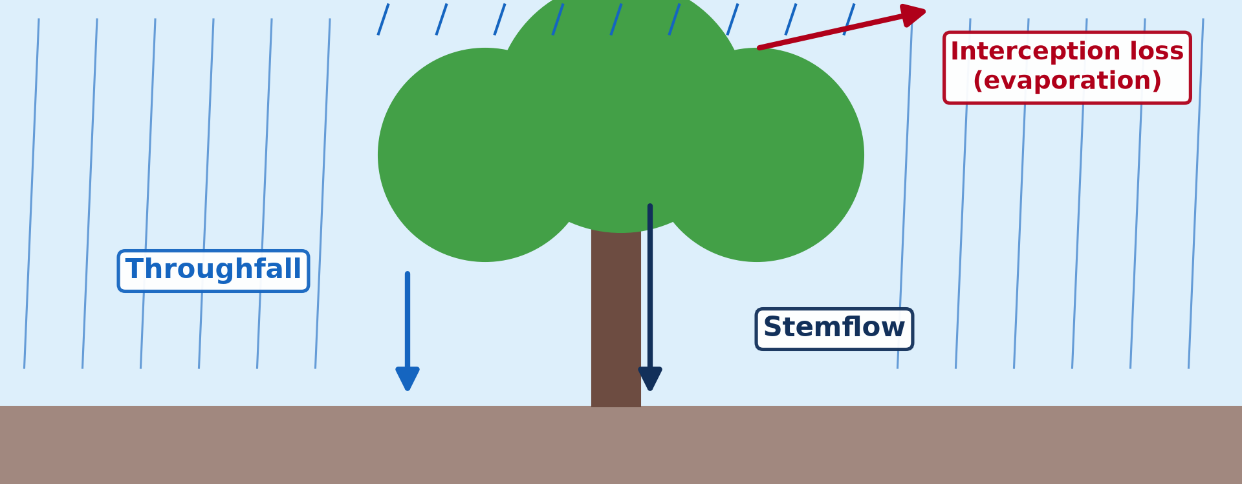
1. MEANING AND PROCESS
Activity 1
Throughfall, stemflow and interception loss.
Notes:
Activity 1. Look carefully at this diagram: throughfall, stemflow and interception loss. Observe every detail before I ask the question.

Slide 19
1. MEANING AND PROCESS
Activity 1: Question
Name the three things that can happen to rain caught by a tree.
Notes:
Here is the question for Activity 1: Name the three things that can happen to rain caught by a tree. Take one minute to think and write your answer in your rough notebook.

Slide 20
1. MEANING AND PROCESS
Activity 1: Answer
It drips (throughfall), runs down the trunk (stemflow) or evaporates (interception loss).
Notes:
Let us check the answer together. It drips (throughfall), runs down the trunk (stemflow) or evaporates (interception loss).

Slide 21
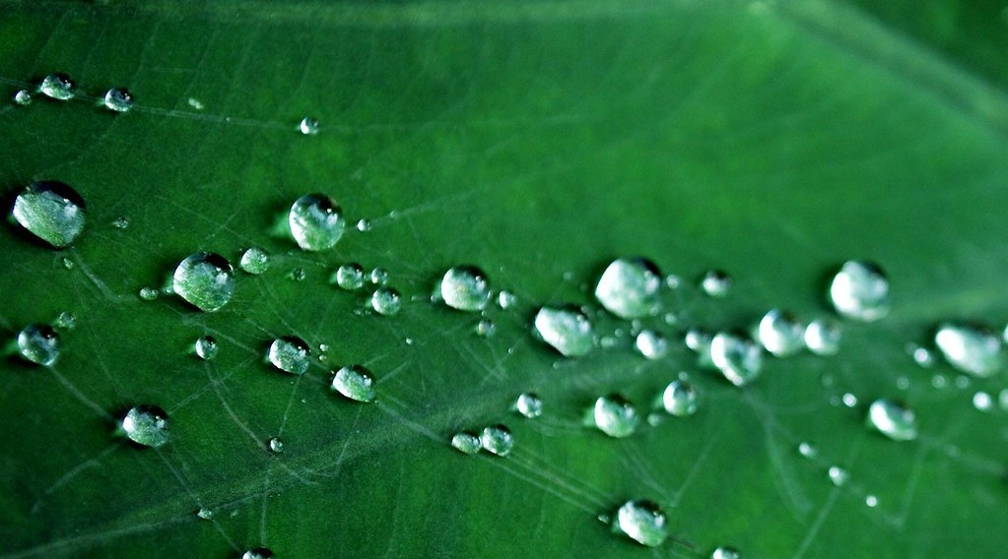
1. MEANING AND PROCESS
Activity 2
Rain drops held on a leaf.
Notes:
Activity 2. Look carefully at this picture: rain drops held on a leaf. Observe every detail before I ask the question.

Slide 22
1. MEANING AND PROCESS
Activity 2: Question
Why is the water on leaves called a store?
Notes:
Here is the question for Activity 2: Why is the water on leaves called a store? Take one minute to think and write your answer in your rough notebook.

Slide 23
1. MEANING AND PROCESS
Activity 2: Answer
It is held for a short time before it drips or evaporates.
Notes:
Let us check the answer together. It is held for a short time before it drips or evaporates.

Slide 24

5. FACTORS: VEGETATION
Activity 3
A dense forest canopy.
Notes:
Activity 3. Look carefully at this picture: a dense forest canopy. Observe every detail before I ask the question.

Slide 25
5. FACTORS: VEGETATION
Activity 3: Question
Why does a dense forest intercept much rain?
Notes:
Here is the question for Activity 3: Why does a dense forest intercept much rain? Take one minute to think and write your answer in your rough notebook.

Slide 26
5. FACTORS: VEGETATION
Activity 3: Answer
It has many layers of leaves that catch and hold water.
Notes:
Let us check the answer together. It has many layers of leaves that catch and hold water.

Slide 27

5. FACTORS: LAND USE
Activity 4
A cotton field.
Notes:
Activity 4. Look carefully at this picture: a cotton field. Observe every detail before I ask the question.

Slide 28
5. FACTORS: LAND USE
Activity 4: Question
Why does a crop field intercept less rain than a forest?
Notes:
Here is the question for Activity 4: Why does a crop field intercept less rain than a forest? Take one minute to think and write your answer in your rough notebook.

Slide 29
5. FACTORS: LAND USE
Activity 4: Answer
It has fewer leaves and more bare soil.
Notes:
Let us check the answer together. It has fewer leaves and more bare soil.

Slide 30

6. SIGNIFICANCE
Activity 5
A gully cut by runoff on bare land.
Notes:
Activity 5. Look carefully at this picture: a gully cut by runoff on bare land. Observe every detail before I ask the question.

Slide 31
6. SIGNIFICANCE
Activity 5: Question
What happens when trees are cut and interception stops?
Notes:
Here is the question for Activity 5: What happens when trees are cut and interception stops? Take one minute to think and write your answer in your rough notebook.

Slide 32
6. SIGNIFICANCE
Activity 5: Answer
Rain hits the soil directly, runoff and erosion increase.
Notes:
Let us check the answer together. Rain hits the soil directly, runoff and erosion increase.

Slide 33
BOARD SUMMARY
Board Summary
Topic: The Drainage Basin Hydrological Cycle
Sub-topic: Components of the Drainage Basin Hydrological Cycle
Lesson 28: Interception as a Store
Notes:
Now we are going to copy the board summary. Write the title and the headings neatly in your notebooks. I will give you enough time for each slide, so do not rush.

Slide 34
BOARD SUMMARY
1. Meaning, Types and Process
Interception can be understood as follows:
Interception: It is the catching and temporary storage of rain by vegetation and other surfaces before it reaches the ground.
Notes:
Let us copy Meaning, Types and Process. Interception can be understood as follows. On this slide we have Interception. Write each point on a new line, with the key term first, and explain it in your own words when we revise. When you finish, we go to the next slide.

Slide 35
BOARD SUMMARY
1. Meaning, Types and Process (continued)
Types and process: Rain held on leaves may evaporate (interception loss), drip to the ground (throughfall) or run down the trunk (stemflow). Buildings and litter can also intercept water.
Notes:
We continue with Meaning, Types and Process. On this slide we have Types and process. Write each point on a new line, with the key term first, and explain it in your own words when we revise.

Slide 36
BOARD SUMMARY
1. Meaning, Types and Process
Illustration: interception, throughfall and stemflow
Notes:
Now draw this illustration in your notebook: interception, throughfall and stemflow. Give it a title and label it clearly.

Slide 37
BOARD SUMMARY
2. Measurement and Variations
Interception is measured and varies as follows:
Measurement: Rain gauges are placed under and outside the tree canopy, and collars on trunks collect stemflow. Interception = rainfall − (throughfall + stemflow).
Notes:
Let us copy Measurement and Variations. Interception is measured and varies as follows. On this slide we have Measurement. Write each point on a new line, with the key term first, and explain it in your own words when we revise. When you finish, we go to the next slide.

Slide 38
BOARD SUMMARY
2. Measurement and Variations (continued)
Space-time variations: Dense forests may intercept 20–30 % of rain, grasslands much less. Interception is higher at the start of a storm and in light rain.
Notes:
We continue with Measurement and Variations. On this slide we have Space-time variations. Write each point on a new line, with the key term first, and explain it in your own words when we revise.

Slide 39
BOARD SUMMARY
3. Factors and Significance
The factors and significance of interception are:
Factors: Vegetation type, density, leaf shape and season control interception. Rainfall intensity, duration and wind also matter.
Notes:
Let us copy Factors and Significance. The factors and significance of interception are. On this slide we have Factors. Write each point on a new line, with the key term first, and explain it in your own words when we revise. When you finish, we go to the next slide.

Slide 40
BOARD SUMMARY
3. Factors and Significance (continued)
Significance: Interception slows water reaching the ground and increases infiltration. It reduces runoff, floods and soil erosion; when forests are cut, gullies appear.
Notes:
We continue with Factors and Significance. On this slide we have Significance. Write each point on a new line, with the key term first, and explain it in your own words when we revise.

Slide 41
FORMATIVE EVALUATION
Evaluation 1
Define throughfall and stemflow.
Notes:
Now let us check what you have understood. Question 1: Define throughfall and stemflow. Answer in your exercise book.

Slide 42
FORMATIVE EVALUATION
Expected Answer
Throughfall drips from leaves; stemflow runs down branches and trunks.
Notes:
The expected answer is: throughfall drips from leaves; stemflow runs down branches and trunks. If you got it right, well done.

Slide 43
FORMATIVE EVALUATION
Evaluation 2
Why does deforestation increase floods?
Notes:
Now let us check what you have understood. Question 2: Why does deforestation increase floods? Answer in your exercise book.

Slide 44
FORMATIVE EVALUATION
Expected Answer
Interception stops, so rain reaches the ground quickly and runs off.
Notes:
The expected answer is: interception stops, so rain reaches the ground quickly and runs off. If you got it right, well done.

Slide 45
REMEDIATION
Remediation
Fill in the blanks:
Rain caught by leaves is ______.
Water running down a trunk is ______.
Dense forests intercept ______ rain than grass.
Notes:
For those who need more practice, fill in the blanks in your exercise book. The answers are: number 1, interception; number 2, stemflow; number 3, more.

Slide 46
HOMEWORK
Homework
Put one cup under a tree and one in the open during rain. Compare the water collected.
Notes:
For your homework: Put one cup under a tree and one in the open during rain. Compare the water collected. We shall correct it at the beginning of our next lesson.

Slide 47
NEXT LESSON
Next Lesson
Our next lesson will be on:
Lesson 29: Infiltration and Overland Flow
Notes:
Our next lesson will be on Lesson 29: Infiltration and Overland Flow. Thank you for your attention, and see you next time.

Slide 48
BILINGUAL GAME
Bilingual Game (Jeu Bilingue)
English | Français
Interception | L'interception
Canopy | La canopée
Trunk | Le tronc
Throughfall | Égouttement
Stemflow | L'écoulement le long des troncs
Erosion | L'érosion
Notes:
Let us play the bilingual game. I say a word in English, and you give me the French word. Then we do the reverse.

Slide 49
LOGBOOK
Official Logbook (1/2)
Module / Topic | The Drainage Basin Hydrological Cycle
Lesson Title | Lesson 28: Interception as a Store
Expected Learning Outcomes | Define interception and its components. Explain the factors of interception. Explain the significance of interception in the basin.
Competence | Learners are able to explain how vegetation intercepts rain and why this reduces floods.
Notes:
I record this information in the official logbook of the class after the lesson.

Slide 50
LOGBOOK
Official Logbook (2/2)
Matter Taught | Meaning, Types and Process; Measurement and Variations; Factors and Significance.
Evaluation | Formative evaluation and remediation exercise.
Homework | Put one cup under a tree and one in the open during rain. Compare the water collected.
Enrolment / Present / Absent | ____ / ____ / ____
Achievement | To be completed after the lesson.
Notes:
I complete the second page of the logbook: the matter taught, the evaluation, the homework and the attendance.

Slide 51
TEACHER'S NOTE
Teacher's Note
Timing: Homework correction, plan, objectives 8 min | Recall, situation, action 10 min | 5 activities 30 min | Board summary (copying) 30 min | Evaluation, remediation 10 min | Homework, next lesson 5 min | Logbook 7 min
Without the projector (Activity 1): draw a tree in the rain.
Without the projector (Activity 2): sprinkle water on a leaf.
Without the projector (Activity 3): compare a forest and a grass field.
Without the projector (Activity 4): describe a field just after planting.
Without the projector (Activity 5): describe erosion after clearing.
Notes:
This slide is for me, the teacher: it gives the timing of the lesson and what to do if the projector is not available.

Slide 52
REFERENCES
References
National Geography Syllabus, MINESEC/IGE/IP-SS, 2019 — Module 1 (Meteorology, Climatology & Hydrology).
Photo, Activity 2: “Water drops” by Photoctor, CC BY-SA 2.0, via Flickr (https://www.flickr.com/photos/57227563@N00/2963134371)
Photo, Activity 3: “Amazon 11” by CIAT International Center for Tropical Agriculture, CC BY-SA 2.0, via Flickr (https://www.flickr.com/photos/38476503@N08/5641587148)
Photo, Activity 4: “Cotton Fields, U.S. 65, Tensas Parish, Louisiana (4)” by Ken Lund, CC BY-SA 2.0, via Flickr (https://www.flickr.com/photos/75683070@N00/3934873451)
Photo, Activity 5: “Soil erosion in the central Mexican Highlands” by CIMMYT, CC BY-NC-SA 2.0, via Flickr (https://www.flickr.com/photos/44760652@N05/6244930288)
Diagrams and animations: drawn for this lesson (Geography Department).
Notes:
These are the references and picture credits used to prepare this lesson.

