Slide 1
LOWER SIXTH ARTS
GEOGRAPHY
Lesson 13
Pressure Systems
Notes:
Good morning, class, and welcome to our geography lesson. I am your geography teacher, Mr Kamdem. Today we are starting Lesson 13: Pressure Systems.

Slide 2
CLASS INFO
Class, Chapter and Duration
Class | Lower Sixth Arts
Chapter | Module 1: Understanding and managing atmospheric and hydrological phenomena and hazards across the world in general and Cameroon in particular
Duration | 2 periods (2 × 50 minutes)
Notes:
This lesson is for Lower Sixth Arts. It belongs to Module 1: Understanding and managing atmospheric and hydrological phenomena and hazards across the world in general and Cameroon in particular. We shall need 2 periods to cover it.

Slide 3
IDENTIFICATION
Lesson Identification
Topic | Global and Local Atmospheric Circulation
Sub-topic | Pressure Belts
Lesson | Lesson 13: Pressure Systems
Notions / Concepts | Atmospheric pressure, barometer, hectopascal, anticyclone, cyclone (depression), pressure belts, ITCZ, tricellular model, Hadley, Ferrel and polar cells, Coriolis effect.
Syllabus focus | Meaning of pressure systems (anticyclones and cyclones); global distribution of pressure belts; the tricellular model with emphasis on the Hadley cell.
Competence | Learners are able to explain the pressure belts and the tricellular circulation and relate them to the seasons of Garoua.
Notes:
Our topic is Global and Local Atmospheric Circulation, and the sub-topic is Pressure Belts. The key notions we shall use today are: atmospheric pressure, barometer, hectopascal, anticyclone, cyclone (depression), pressure belts, ITCZ, tricellular model, Hadley, Ferrel and polar cells, Coriolis effect. At the end, you should be able to do this: learners are able to explain the pressure belts and the tricellular circulation and relate them to the seasons of Garoua.

Slide 4

HOMEWORK CORRECTION
Correction of the Homework
Question (Lesson 12: Global Distribution of Precipitation):
Define atmospheric pressure.
Notes:
Before we start the new lesson, let us correct the homework I gave you at the end of Lesson 12: Global Distribution of Precipitation. The question was: Define atmospheric pressure. Take out your exercise books.

Slide 5
HOMEWORK CORRECTION
Correction: Possible Answer
Atmospheric pressure is the weight of the air pressing on a unit area of the surface of the Earth.
Notes:
Here is a good answer. Atmospheric pressure is the weight of the air pressing on a unit area of the surface of the Earth. Compare it with your own answer and correct your work in red.

Slide 6
LESSON PLAN
Lesson Plan
Correction of the homework
Objectives and recall
Real-life situation and action to take
Learning activities
Board summary
Evaluation, remediation and homework
Notes:
Here is the plan of our lesson today. First, we shall correct the homework. Then we shall look at the objectives and recall what you already know. After that, we shall study a situation from real life and the action to take, and do the learning activities. Finally, we shall copy the board summary, do the evaluation and the remediation, and I will give you the homework.

Slide 7
OBJECTIVES
Objectives
By the end of this lesson, you should be able to:
Define atmospheric pressure and pressure systems.
Distinguish anticyclones and cyclones and their weather.
Notes:
Take your time to copy this part; we will continue together.

Slide 8
OBJECTIVES
Objectives (continued)
Describe the global pressure belts.
Explain the tricellular model and the Hadley cell.
Notes:
By the end of this lesson, you should be able to do four things. Number 1: define atmospheric pressure and pressure systems. Number 2: distinguish anticyclones and cyclones and their weather. Number 3: describe the global pressure belts. Number 4: explain the tricellular model and the Hadley cell.

Slide 9
PREVIOUS KNOWLEDGE
Previous Knowledge
Warm air rises and cool air sinks.
Rising air cools and forms clouds.
The Sahara lies near 20–30° N.
Notes:
Let us first remember what you already know. Warm air rises and cool air sinks. Rising air cools and forms clouds. The Sahara lies near 20–30° N. Keep this in mind, because we shall build on it today.

Slide 10
REAL-LIFE SITUATION
Situation in Real Life
Watching the weather news, you see heavy thunderstorms over the Congo Basin near the Equator while the Sahara, near 25° N, has clear skies and dry heat.
The presenter speaks of "low pressure" over one region and "high pressure" over the other.
Notes:
Take your time to copy this part; we will continue together.

Slide 11
REAL-LIFE SITUATION
Situation in Real Life (continued)
In Garoua, the dry north-east wind blows for months, then the moist south-west wind comes.
You ask: "What are these pressure systems, and how do they organise the winds and weather of the world?"
Notes:
Listen carefully to this situation from real life. Watching the weather news, you see heavy thunderstorms over the Congo Basin near the Equator while the Sahara, near 25° N, has clear skies and dry heat. The presenter speaks of "low pressure" over one region and "high pressure" over the other. In Garoua, the dry north-east wind blows for months, then the moist south-west wind comes. You ask: "What are these pressure systems, and how do they organise the winds and weather of the world?" Think about it, because I am going to ask you some questions.

Slide 12
REAL-LIFE SITUATION
Situation: Question 1
What is the problem in the situation?
Notes:
Question 1: What is the problem in the situation? Think for a moment, then raise your hand to answer.

Slide 13
REAL-LIFE SITUATION
Answer
The learner does not know the pressure systems and the global circulation of the atmosphere.
Notes:
Good. The learner does not know the pressure systems and the global circulation of the atmosphere.

Slide 14
REAL-LIFE SITUATION
Situation: Question 2
Why is there heavy rain near the Equator?
Notes:
Question 2: Why is there heavy rain near the Equator? Think for a moment, then raise your hand to answer.

Slide 15
REAL-LIFE SITUATION
Answer
Air rises in a low-pressure zone (the ITCZ), cools and forms rain clouds.
Notes:
Good. Air rises in a low-pressure zone (the ITCZ), cools and forms rain clouds.

Slide 16
REAL-LIFE SITUATION
Situation: Question 3
Why is the Sahara dry?
Notes:
Question 3: Why is the Sahara dry? Think for a moment, then raise your hand to answer.

Slide 17
REAL-LIFE SITUATION
Possible Answer
Air sinks in the subtropical high-pressure belt, so clouds do not form.
Notes:
Good. Air sinks in the subtropical high-pressure belt, so clouds do not form.

Slide 18
ACTION TO TAKE
Action to Take
Read pressure on weather maps to understand the coming weather.
Notes:
From this situation, the action we are working towards in this lesson is the following: read pressure on weather maps to understand the coming weather.

Slide 19
JUSTIFICATION
Justification of the Lesson
This lesson explains the great belts of pressure and winds that control the climates of the world and of Cameroon.
Notes:
Why is this lesson important for you? This lesson explains the great belts of pressure and winds that control the climates of the world and of Cameroon.

Slide 20

1. PRESSURE SYSTEMS
Activity 1
A barometer.
Notes:
Activity 1. Look carefully at this picture: a barometer. Observe every detail before I ask the question.

Slide 21
1. PRESSURE SYSTEMS
Activity 1: Question
Which instrument measures atmospheric pressure?
Notes:
Here is the question for Activity 1: Which instrument measures atmospheric pressure? Take one minute to think and write your answer in your rough notebook.

Slide 22
1. PRESSURE SYSTEMS
Activity 1: Answer
The barometer.
Notes:
Let us check the answer together. The barometer.

Slide 23
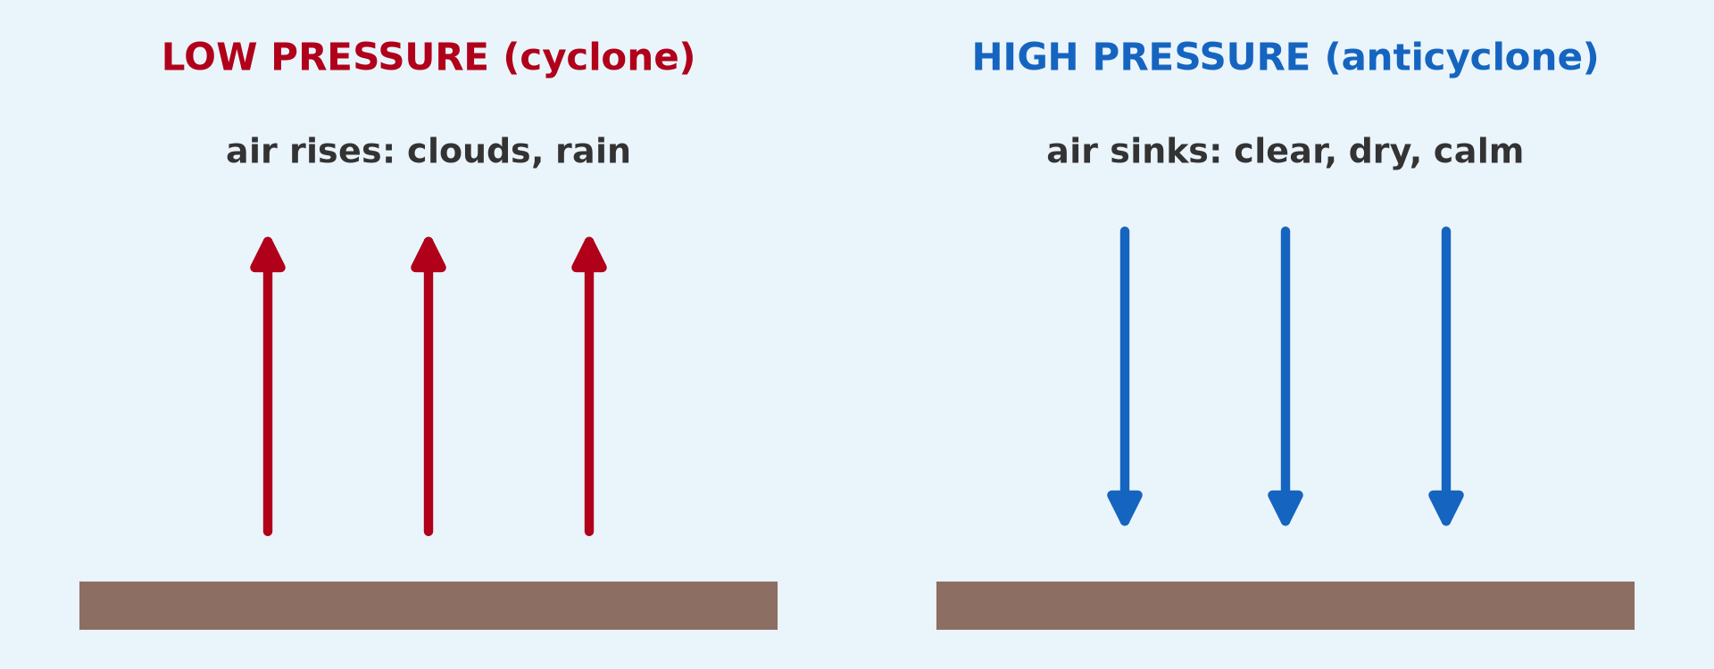
1. PRESSURE SYSTEMS
Activity 2
Low and high pressure.
Notes:
Activity 2. Look carefully at this picture: low and high pressure. Observe every detail before I ask the question.

Slide 24
1. PRESSURE SYSTEMS
Activity 2: Question
What weather is associated with an anticyclone?
Notes:
Here is the question for Activity 2: What weather is associated with an anticyclone? Take one minute to think and write your answer in your rough notebook.

Slide 25
1. PRESSURE SYSTEMS
Activity 2: Answer
Clear skies, dry and calm weather.
Notes:
Let us check the answer together. Clear skies, dry and calm weather.

Slide 26

2. PRESSURE BELTS
Activity 3
The pressure belts of the world.
Notes:
Activity 3. Look carefully at this diagram: the pressure belts of the world. Observe every detail before I ask the question.

Slide 27
2. PRESSURE BELTS
Activity 3: Question
Which pressure belt lies around 30° N and S?
Notes:
Here is the question for Activity 3: Which pressure belt lies around 30° N and S? Take one minute to think and write your answer in your rough notebook.

Slide 28
2. PRESSURE BELTS
Activity 3: Answer
The subtropical high-pressure belt.
Notes:
Let us check the answer together. The subtropical high-pressure belt.

Slide 29
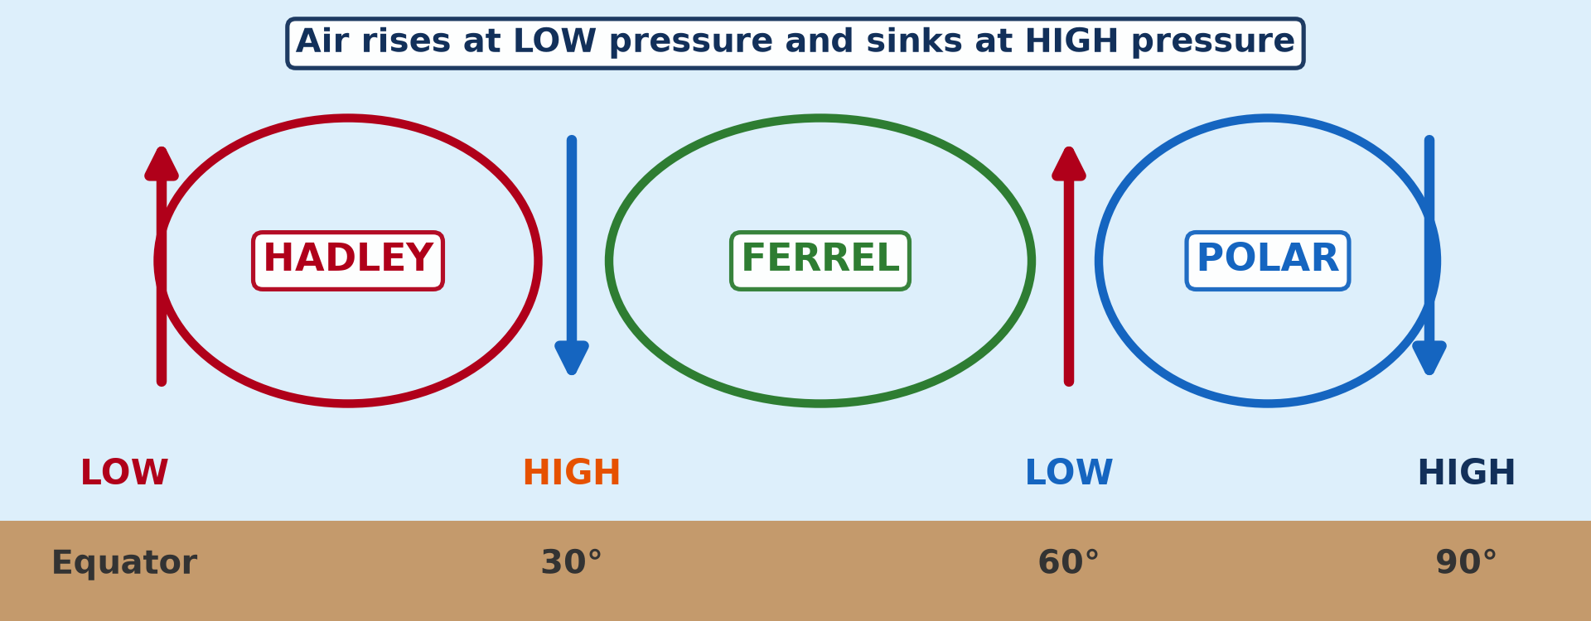
3. TRICELLULAR MODEL
Activity 4
The three cells.
Notes:
Activity 4. Look carefully at this diagram: the three cells. Observe every detail before I ask the question.

Slide 30
3. TRICELLULAR MODEL
Activity 4: Question
Name the three cells of each hemisphere.
Notes:
Here is the question for Activity 4: Name the three cells of each hemisphere. Take one minute to think and write your answer in your rough notebook.

Slide 31
3. TRICELLULAR MODEL
Activity 4: Answer
The Hadley, Ferrel and polar cells.
Notes:
Let us check the answer together. The Hadley, Ferrel and polar cells.

Slide 32
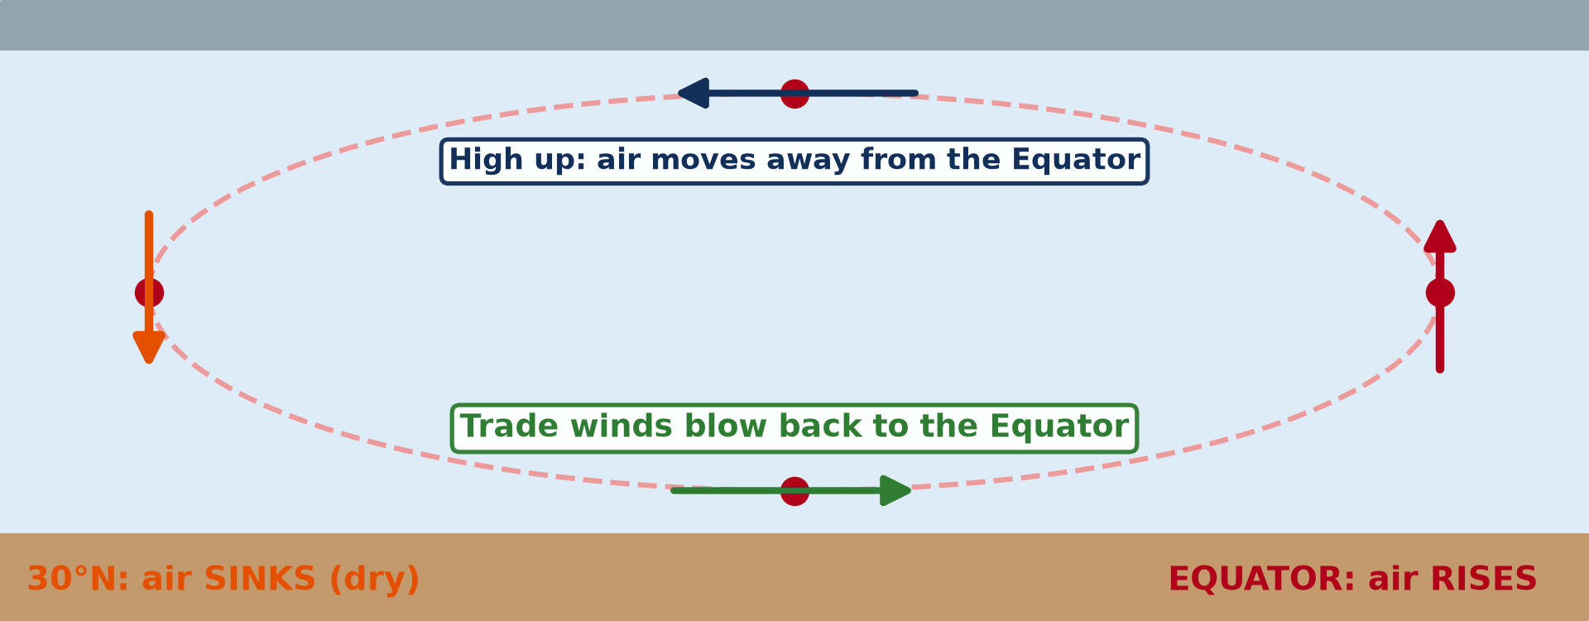
3. HADLEY CELL
Activity 5
Animation: the Hadley cell.
Notes:
Activity 5. Look carefully at this animation: animation: the Hadley cell. Watch the animation to the end; it will play again.

Slide 33
3. HADLEY CELL
Activity 5: Question
Which surface winds complete the Hadley cell in the northern hemisphere?
Notes:
Here is the question for Activity 5: Which surface winds complete the Hadley cell in the northern hemisphere? Take one minute to think and write your answer in your rough notebook.

Slide 34
3. HADLEY CELL
Activity 5: Answer
The north-east trade winds (the Harmattan over West Africa).
Notes:
Let us check the answer together. The north-east trade winds (the Harmattan over West Africa).

Slide 35
BOARD SUMMARY
Board Summary
Topic: Global and Local Atmospheric Circulation
Sub-topic: Pressure Belts
Lesson 13: Pressure Systems
Notes:
Now we are going to copy the board summary. Write the title and the headings neatly in your notebooks. I will give you enough time for each slide, so do not rush.

Slide 36
BOARD SUMMARY
DEFINITIONS
The key terms of this lesson are defined as follows:
Atmospheric pressure: It is the force exerted by the weight of the air on a unit area of the surface, measured in hectopascals (hPa).
Notes:
Let us copy the definitions. The key terms of this lesson are defined as follows. On this slide we have Atmospheric pressure. Write each point on a new line, with the key term first, and explain it in your own words when we revise. When you finish, we go to the next slide.

Slide 37
BOARD SUMMARY
DEFINITIONS (continued)
Anticyclone: It is a high-pressure system of sinking air that brings clear, dry weather.
Cyclone (depression): It is a low-pressure system of rising air that brings clouds and rain.
Notes:
We continue with the definitions. On this slide we have Anticyclone and Cyclone (depression). Write each point on a new line, with the key term first, and explain it in your own words when we revise. When you finish, we go to the next slide.

Slide 38
BOARD SUMMARY
DEFINITIONS (continued)
Tricellular model: It is a model of three circulation cells in each hemisphere that carry heat from the Equator to the poles.
Notes:
We continue with the definitions. On this slide we have Tricellular model. Write each point on a new line, with the key term first, and explain it in your own words when we revise.

Slide 39
BOARD SUMMARY
1. Meaning of Pressure Systems
Pressure systems are presented as follows:
Atmospheric pressure: The average pressure at sea level is about 1,013 hPa; it falls with altitude.
Illustration: a barometer
Notes:
Let us copy Meaning of Pressure Systems. Pressure systems are presented as follows. Copy the point on Atmospheric pressure on the left, then draw the diagram on the right: a barometer. Give it a title and label it clearly.

Slide 40
BOARD SUMMARY
1. Meaning of Pressure Systems
High pressure (anticyclone): Air sinks and spreads out at the surface, giving clear, dry and calm weather.
Illustration: low and high pressure
Notes:
Copy the point on High pressure (anticyclone) on the left, then draw the diagram on the right: low and high pressure. Give it a title and label it clearly.

Slide 41
BOARD SUMMARY
1. Meaning of Pressure Systems
Low pressure (cyclone, depression): Air converges and rises, giving clouds, rain and often storms.
Wind: Air moves from high pressure towards low pressure.
Notes:
We continue with Meaning of Pressure Systems. On this slide we have Low pressure (cyclone, depression) and Wind. Write each point on a new line, with the key term first, and explain it in your own words when we revise.

Slide 42
BOARD SUMMARY
2. Global Distribution of Pressure Belts
The pressure belts of the world are the following:
Equatorial low (ITCZ): Strong heating makes air rise near the Equator, giving heavy rain and rainforests, as in southern Cameroon.
Illustration: the pressure belts
Notes:
Let us copy Global Distribution of Pressure Belts. The pressure belts of the world are the following. Copy the point on Equatorial low (ITCZ) on the left, then draw the diagram on the right: the pressure belts. Give it a title and label it clearly.

Slide 43
BOARD SUMMARY
2. Global Distribution of Pressure Belts
Subtropical highs (about 30° N and S): Air sinks and gives arid conditions and deserts like the Sahara.
Subpolar lows (about 60° N and S): Cold polar air meets warmer air, which rises and forms depressions.
Notes:
We continue with Global Distribution of Pressure Belts. On this slide we have Subtropical highs (about 30° N and S) and Subpolar lows (about 60° N and S). Write each point on a new line, with the key term first, and explain it in your own words when we revise. When you finish, we go to the next slide.

Slide 44
BOARD SUMMARY
2. Global Distribution of Pressure Belts (continued)
Polar highs: Very cold, dense air sinks over the poles.
Seasonal shift: The belts move north and south with the overhead sun, which explains the seasons of Garoua.
Notes:
We continue with Global Distribution of Pressure Belts. On this slide we have Polar highs and Seasonal shift. Write each point on a new line, with the key term first, and explain it in your own words when we revise.

Slide 45
BOARD SUMMARY
3. The Tricellular Model
The tricellular model is presented as follows:
Three cells:
Hadley cell: from the Equator to about 30°.
Ferrel cell: from about 30° to 60°.
Notes:
Let us copy The Tricellular Model. The tricellular model is presented as follows. On this slide we have Three cells. Write each point on a new line, with the key term first, and explain it in your own words when we revise. When you finish, we go to the next slide.

Slide 46
BOARD SUMMARY
3. The Tricellular Model (continued)
Polar cell: from about 60° to the poles.
Notes:
We continue with The Tricellular Model. Copy this carefully.

Slide 47
BOARD SUMMARY
3. The Tricellular Model
Illustration: The cells carry heat from the zone of surplus to the zones of deficit.
Illustration: the three cells
Notes:
Copy the point on Illustration on the left, then draw the diagram on the right: the three cells. Give it a title and label it clearly.

Slide 48
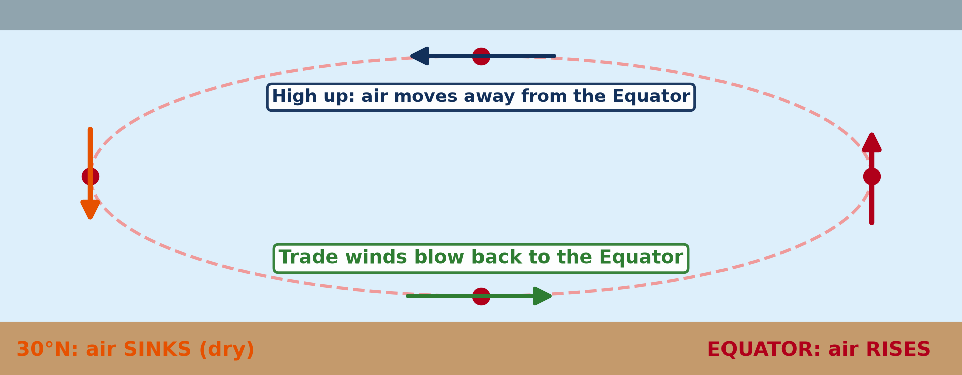
BOARD SUMMARY
3. The Tricellular Model
Hadley cell, step 1: Air heated at the Equator rises and forms the ITCZ, with heavy rain.
Illustration: the Hadley cell
Notes:
Copy the point on Hadley cell, step 1 on the left, then draw the diagram on the right: the Hadley cell. Give it a title and label it clearly.

Slide 49
BOARD SUMMARY
3. The Tricellular Model
Steps 2 and 3: At high altitude the air moves poleward, cools and sinks near 30°, forming the subtropical high and deserts.
Step 4: Surface air returns to the Equator; deflected by the Coriolis effect, it becomes the north-east trade winds, the Harmattan of Garoua.
Notes:
We continue with The Tricellular Model. On this slide we have Steps 2 and 3 and Step 4. Write each point on a new line, with the key term first, and explain it in your own words when we revise.

Slide 50
FORMATIVE EVALUATION
Evaluation 1
Distinguish an anticyclone from a depression.
Notes:
Now let us check what you have understood. Question 1: Distinguish an anticyclone from a depression. Answer in your exercise book.

Slide 51
FORMATIVE EVALUATION
Expected Answer
An anticyclone is high pressure with sinking air and clear weather; a depression is low pressure with rising air, clouds and rain.
Notes:
The expected answer is: an anticyclone is high pressure with sinking air and clear weather; a depression is low pressure with rising air, clouds and rain. If you got it right, well done.

Slide 52
FORMATIVE EVALUATION
Evaluation 2
Explain how the Hadley cell creates the Sahara Desert.
Notes:
Now let us check what you have understood. Question 2: Explain how the Hadley cell creates the Sahara Desert. Answer in your exercise book.

Slide 53
FORMATIVE EVALUATION
Expected Answer
Air rising at the Equator moves poleward, cools and sinks near 30° N, forming high pressure where clouds cannot form.
Notes:
The expected answer is: air rising at the Equator moves poleward, cools and sinks near 30° N, forming high pressure where clouds cannot form. If you got it right, well done.

Slide 54
REMEDIATION
Remediation
Fill in the blanks:
Pressure is measured with a ______.
Sinking air forms ______ pressure.
The cell between the Equator and 30° is the ______ cell.
Notes:
For those who need more practice, fill in the blanks in your exercise book. The answers are: number 1, barometer; number 2, high; number 3, Hadley.

Slide 55
HOMEWORK
Homework
State why warm air rises.
Notes:
For your homework: State why warm air rises. We shall correct it at the beginning of our next lesson.

Slide 56
NEXT LESSON
Next Lesson
Our next lesson will be on:
Lesson 14: Vertical Motions: Stability and Instability
Notes:
Our next lesson will be on Lesson 14: Vertical Motions: Stability and Instability. Thank you for your attention, and see you next time.

Slide 57
BILINGUAL GAME
Bilingual Game (Jeu Bilingue)
English | Français
Air pressure | La pression atmosphérique
Wind | Le vent
Circulation | La circulation
Hadley cell | La cellule de Hadley
Anticyclone | L'anticyclone
Depression | La dépression
Notes:
Let us play the bilingual game. I say a word in English, and you give me the French word. Then we do the reverse.

Slide 58
LOGBOOK
Official Logbook (1/2)
Module / Topic | Global and Local Atmospheric Circulation
Lesson Title | Lesson 13: Pressure Systems
Expected Learning Outcomes | Define atmospheric pressure and pressure systems. Distinguish anticyclones and cyclones and their weather. Describe the global pressure belts. Explain the tricellular model and the Hadley cell.
Competence | Learners are able to explain the pressure belts and the tricellular circulation and relate them to the seasons of Garoua.
Notes:
I record this information in the official logbook of the class after the lesson.

Slide 59
LOGBOOK
Official Logbook (2/2)
Matter Taught | DEFINITIONS; Meaning of Pressure Systems; Global Distribution of Pressure Belts; The Tricellular Model.
Evaluation | Formative evaluation and remediation exercise.
Homework | State why warm air rises.
Enrolment / Present / Absent | ____ / ____ / ____
Achievement | To be completed after the lesson.
Notes:
I complete the second page of the logbook: the matter taught, the evaluation, the homework and the attendance.

Slide 60
TEACHER'S NOTE
Teacher's Note
Timing: Homework correction, plan, objectives 8 min | Recall, situation, action 10 min | 5 activities 30 min | Board summary (copying) 30 min | Evaluation, remediation 10 min | Homework, next lesson 5 min | Logbook 7 min
Activity 5 is an animation (GIF): it plays automatically in slide-show mode.
Without the projector (Activity 1): press on a table to show weight.
Without the projector (Activity 2): draw rising and sinking air.
Without the projector (Activity 3): draw the belts on a globe sketch.
Without the projector (Activity 4): draw the three cells.
Without the projector (Activity 5): draw the four steps of the cell.
Notes:
This slide is for me, the teacher: it gives the timing of the lesson and what to do if the projector is not available.

Slide 61
REFERENCES
References
Geography Syllabus for Sixth Forms (Lower and Upper Sixth), MINESEC, 2019 — Module 1 (Meteorology, Climatology & Hydrology).
Teacher's course notes: Mr KAMDEM E., Meteorology (LSA), GBHS Garoua, 2026.
Photo, Activity 1: “Aneroid Barometer, with dial designed by Sir Napier Shaw, 1914” by Negretti & Zambra; Shaw, Sir Napier, CC BY-NC-SA 4.0, via sciencemuseum (https://collection.sciencemuseumgroup.org.uk/objects/co54459/aneroid-barometer-with-dial-designed-by-sir-napier-shaw-1914)
Diagrams and animations: drawn for this lesson (Geography Department).
Notes:
These are the references and picture credits used to prepare this lesson.

