Slide 1

DIVINE GRACE COLLEGE OF ARTS, SCIENCE AND TECHNOLOGY
(DGCAST) — GAROUA | GEOGRAPHY DEPARTMENT
LOWER SIXTH ARTS — BIOGEOGRAPHY — LESSON 3
Soil Structure
Mr KAMDEM EMMANUEL
Geography Teacher — PLEG
Academic Year 2026 / 2027
Notes:
Good morning, class. Today we study Lesson 3: Soil Structure.

Slide 2
GEOGRAPHY — LOWER SIXTH ARTS
CLASS INFO
Class, Chapter & Duration
Class | Lower Sixth Arts
Chapter | Module 3: Understanding and managing biogeographic zones across the world in general and Cameroon in particular
Duration | 2 periods (2 × 50 minutes)
2026 / 2027
DGCAST GAROUA — GEOGRAPHY DEPARTMENT
Mr KAMDEM E. | 2

Slide 3
GEOGRAPHY — LOWER SIXTH ARTS
IDENTIFICATION
Lesson Identification
Topic | Soil and its Properties
Sub-topic | Soil Properties and their Significance
Lesson | Lesson 3: Soil Structure
Notions / Concepts | Soil structure, ped, crumb, blocky, platy, prismatic, compaction.
Syllabus focus | Meaning and types of soil structure; factors; significance.
Competence | Learners are able to identify soil structures and explain how to keep a good structure.
2026 / 2027
DGCAST GAROUA — GEOGRAPHY DEPARTMENT
Mr KAMDEM E. | 3

Slide 4
GEOGRAPHY — LOWER SIXTH ARTS
OBJECTIVES
Learning Objectives
By the end of the lesson, the learner should be able to:
Define soil structure.
Describe the main types of structure.
Explain the factors and significance of structure.
2026 / 2027
DGCAST GAROUA — GEOGRAPHY DEPARTMENT
Mr KAMDEM E. | 4

Slide 5
GEOGRAPHY — LOWER SIXTH ARTS
RECALL
Recall
Texture is the proportion of sand, silt and clay.
Earthworms mix the soil.
2026 / 2027
DGCAST GAROUA — GEOGRAPHY DEPARTMENT
Mr KAMDEM E. | 5

Slide 6
GEOGRAPHY — LOWER SIXTH ARTS
REAL-LIFE SITUATION
Real-Life Situation
On a school farm, the soil where tractors pass is hard and water lies on it after rain. Under the bushes, the soil is loose and crumbly and water soaks in quickly.
2026 / 2027
DGCAST GAROUA — GEOGRAPHY DEPARTMENT
Mr KAMDEM E. | 6
Notes:
Read the situation slowly, twice.

Slide 7
GEOGRAPHY — LOWER SIXTH ARTS
REAL-LIFE SITUATION
Situation — Question 1
What is the problem in the situation?
2026 / 2027
DGCAST GAROUA — GEOGRAPHY DEPARTMENT
Mr KAMDEM E. | 7

Slide 8
GEOGRAPHY — LOWER SIXTH ARTS
REAL-LIFE SITUATION
Answer
Some soils are hard and do not let water in.
2026 / 2027
DGCAST GAROUA — GEOGRAPHY DEPARTMENT
Mr KAMDEM E. | 8

Slide 9
GEOGRAPHY — LOWER SIXTH ARTS
REAL-LIFE SITUATION
Situation — Question 2
What property is different?
2026 / 2027
DGCAST GAROUA — GEOGRAPHY DEPARTMENT
Mr KAMDEM E. | 9

Slide 10
GEOGRAPHY — LOWER SIXTH ARTS
REAL-LIFE SITUATION
Answer
Soil structure.
2026 / 2027
DGCAST GAROUA — GEOGRAPHY DEPARTMENT
Mr KAMDEM E. | 10

Slide 11
GEOGRAPHY — LOWER SIXTH ARTS
REAL-LIFE SITUATION
Situation — Question 3
What damaged the structure?
2026 / 2027
DGCAST GAROUA — GEOGRAPHY DEPARTMENT
Mr KAMDEM E. | 11

Slide 12
GEOGRAPHY — LOWER SIXTH ARTS
REAL-LIFE SITUATION
Possible Answer
Compaction by heavy machines.
2026 / 2027
DGCAST GAROUA — GEOGRAPHY DEPARTMENT
Mr KAMDEM E. | 12

Slide 13
GEOGRAPHY — LOWER SIXTH ARTS
JUSTIFICATION
Justification of the Lesson
This lesson helps us to understand how soil particles are arranged, which controls water, air and roots.
2026 / 2027
DGCAST GAROUA — GEOGRAPHY DEPARTMENT
Mr KAMDEM E. | 13

Slide 14
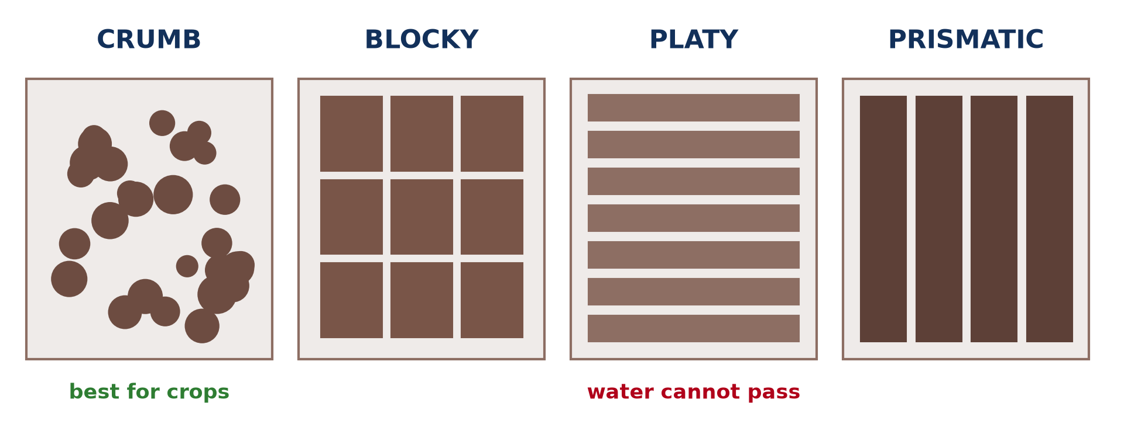
GEOGRAPHY — LOWER SIXTH ARTS
I. TYPES
Activity 1
The main types of soil structure.
2026 / 2027
DGCAST GAROUA — GEOGRAPHY DEPARTMENT
Mr KAMDEM E. | 14
Notes:
Without the projector: break a lump of soil in the hand.

Slide 15
GEOGRAPHY — LOWER SIXTH ARTS
I. TYPES
Activity 1: Question
Which structure is best for crops? Why?
2026 / 2027
DGCAST GAROUA — GEOGRAPHY DEPARTMENT
Mr KAMDEM E. | 15

Slide 16
GEOGRAPHY — LOWER SIXTH ARTS
I. TYPES
Answer
Crumb: it lets water, air and roots pass easily.
2026 / 2027
DGCAST GAROUA — GEOGRAPHY DEPARTMENT
Mr KAMDEM E. | 16

Slide 17
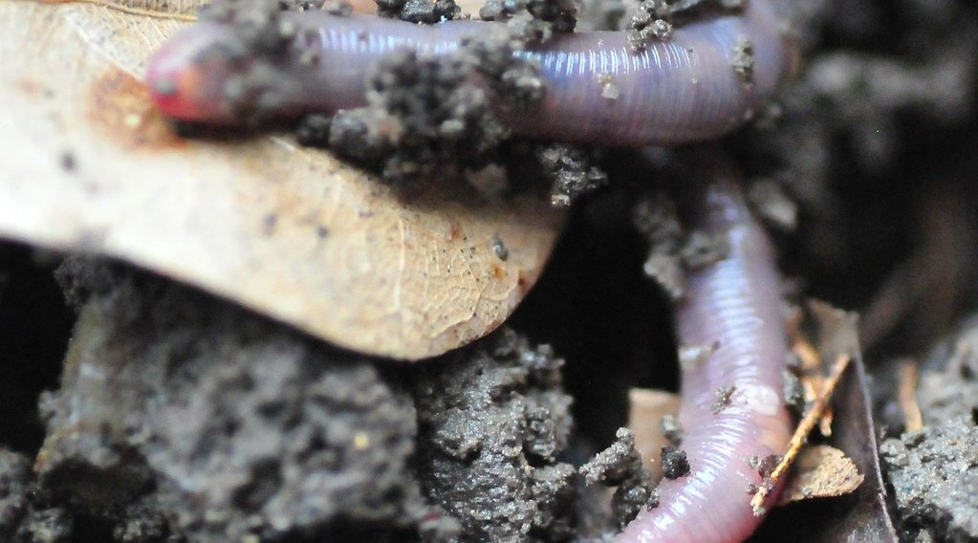
GEOGRAPHY — LOWER SIXTH ARTS
II. FACTORS
Activity 2
An earthworm in the soil.
2026 / 2027
DGCAST GAROUA — GEOGRAPHY DEPARTMENT
Mr KAMDEM E. | 17
Notes:
Without the projector: look for worm casts.

Slide 18
GEOGRAPHY — LOWER SIXTH ARTS
II. FACTORS
Activity 2: Question
How do earthworms improve soil structure?
2026 / 2027
DGCAST GAROUA — GEOGRAPHY DEPARTMENT
Mr KAMDEM E. | 18

Slide 19
GEOGRAPHY — LOWER SIXTH ARTS
II. FACTORS
Answer
They mix the soil and glue particles into crumbs.
2026 / 2027
DGCAST GAROUA — GEOGRAPHY DEPARTMENT
Mr KAMDEM E. | 19

Slide 20

GEOGRAPHY — LOWER SIXTH ARTS
II. FACTORS
Activity 3
Cracked clay soil in the dry season.
2026 / 2027
DGCAST GAROUA — GEOGRAPHY DEPARTMENT
Mr KAMDEM E. | 20
Notes:
Without the projector: describe dry clay in the north.

Slide 21
GEOGRAPHY — LOWER SIXTH ARTS
II. FACTORS
Activity 3: Question
What happens to clay soils when they dry?
2026 / 2027
DGCAST GAROUA — GEOGRAPHY DEPARTMENT
Mr KAMDEM E. | 21

Slide 22
GEOGRAPHY — LOWER SIXTH ARTS
II. FACTORS
Answer
They shrink and crack into large blocks or columns.
2026 / 2027
DGCAST GAROUA — GEOGRAPHY DEPARTMENT
Mr KAMDEM E. | 22

Slide 23

GEOGRAPHY — LOWER SIXTH ARTS
II. FACTORS
Activity 4
A heavy farm machine.
2026 / 2027
DGCAST GAROUA — GEOGRAPHY DEPARTMENT
Mr KAMDEM E. | 23
Notes:
Without the projector: compare a path and a field.

Slide 24
GEOGRAPHY — LOWER SIXTH ARTS
II. FACTORS
Activity 4: Question
How can heavy machines damage soil structure?
2026 / 2027
DGCAST GAROUA — GEOGRAPHY DEPARTMENT
Mr KAMDEM E. | 24

Slide 25
GEOGRAPHY — LOWER SIXTH ARTS
II. FACTORS
Answer
They press the soil and make it compact, so water cannot enter.
2026 / 2027
DGCAST GAROUA — GEOGRAPHY DEPARTMENT
Mr KAMDEM E. | 25

Slide 26

GEOGRAPHY — LOWER SIXTH ARTS
III. SIGNIFICANCE
Activity 5
Roots growing through soil and rock.
2026 / 2027
DGCAST GAROUA — GEOGRAPHY DEPARTMENT
Mr KAMDEM E. | 26
Notes:
Without the projector: pull a plant from loose and hard soil.

Slide 27
GEOGRAPHY — LOWER SIXTH ARTS
III. SIGNIFICANCE
Activity 5: Question
Why do roots grow better in soils with a good structure?
2026 / 2027
DGCAST GAROUA — GEOGRAPHY DEPARTMENT
Mr KAMDEM E. | 27

Slide 28
GEOGRAPHY — LOWER SIXTH ARTS
III. SIGNIFICANCE
Answer
There are many pores for roots, air and water.
2026 / 2027
DGCAST GAROUA — GEOGRAPHY DEPARTMENT
Mr KAMDEM E. | 28

Slide 29
GEOGRAPHY — LOWER SIXTH ARTS
BOARD SUMMARY
Soil Structure
Topic: Soil and its Properties
Sub-topic: Soil Properties and their Significance
Lesson 3: Soil Structure
2026 / 2027
DGCAST GAROUA — GEOGRAPHY DEPARTMENT
Mr KAMDEM E. | 29
Notes:
Learners copy the board summary now. Give them enough time for each slide.

Slide 30
GEOGRAPHY — LOWER SIXTH ARTS
BOARD SUMMARY
I. Definitions
Soil structure: It is the way soil particles are grouped together.
Ped: It is a single lump or aggregate of soil particles.
Compaction: It is the pressing of soil so that its pores become small.
2026 / 2027
DGCAST GAROUA — GEOGRAPHY DEPARTMENT
Mr KAMDEM E. | 30

Slide 31
GEOGRAPHY — LOWER SIXTH ARTS
BOARD SUMMARY
II. Types of Structure (1/2)
A. Crumb and granular: They are small, round, porous peds. They are found in topsoils rich in humus.
B. Blocky: It has angular block-shaped peds. It is common in subsoils.
2026 / 2027
DGCAST GAROUA — GEOGRAPHY DEPARTMENT
Mr KAMDEM E. | 31

Slide 32
GEOGRAPHY — LOWER SIXTH ARTS
BOARD SUMMARY
II. Types of Structure (2/2)
C. Platy and prismatic: Platy peds are flat layers that stop water. Prismatic peds are tall columns found in dry clay soils.
2026 / 2027
DGCAST GAROUA — GEOGRAPHY DEPARTMENT
Mr KAMDEM E. | 32

Slide 33
GEOGRAPHY — LOWER SIXTH ARTS
BOARD SUMMARY
III. Factors and Significance (1/3)
A. Factors: Humus, clay, roots and soil animals help particles to stick together. Wetting and drying, frost and machines also change structure.
B. Significance: A good structure lets water, air and roots move easily. It reduces runoff and erosion.
2026 / 2027
DGCAST GAROUA — GEOGRAPHY DEPARTMENT
Mr KAMDEM E. | 33

Slide 34
GEOGRAPHY — LOWER SIXTH ARTS
BOARD SUMMARY
III. Factors and Significance (2/3)
C. Management: Adding manure and avoiding heavy machines on wet soil keep a good structure. Mulching protects the surface.
2026 / 2027
DGCAST GAROUA — GEOGRAPHY DEPARTMENT
Mr KAMDEM E. | 34

Slide 35
GEOGRAPHY — LOWER SIXTH ARTS
BOARD SUMMARY
III. Factors and Significance (3/3)
Copy the four structures.
2026 / 2027
DGCAST GAROUA — GEOGRAPHY DEPARTMENT
Mr KAMDEM E. | 35

Slide 36
GEOGRAPHY — LOWER SIXTH ARTS
FORMATIVE EVALUATION
Formative Evaluation 1
Distinguish soil texture and soil structure.
2026 / 2027
DGCAST GAROUA — GEOGRAPHY DEPARTMENT
Mr KAMDEM E. | 36

Slide 37
GEOGRAPHY — LOWER SIXTH ARTS
FORMATIVE EVALUATION
Expected Answer
Texture is the proportion of particles; structure is how particles are grouped.
2026 / 2027
DGCAST GAROUA — GEOGRAPHY DEPARTMENT
Mr KAMDEM E. | 37

Slide 38
GEOGRAPHY — LOWER SIXTH ARTS
FORMATIVE EVALUATION
Formative Evaluation 2
Give two ways to improve soil structure.
2026 / 2027
DGCAST GAROUA — GEOGRAPHY DEPARTMENT
Mr KAMDEM E. | 38

Slide 39
GEOGRAPHY — LOWER SIXTH ARTS
FORMATIVE EVALUATION
Expected Answer
Add manure (humus) and avoid compaction (also mulching).
2026 / 2027
DGCAST GAROUA — GEOGRAPHY DEPARTMENT
Mr KAMDEM E. | 39

Slide 40
GEOGRAPHY — LOWER SIXTH ARTS
REMEDIATION
Remediation
Fill in the blanks:
A lump of soil particles is a ______.
The best structure for crops is ______.
Heavy machines cause ______.
2026 / 2027
DGCAST GAROUA — GEOGRAPHY DEPARTMENT
Mr KAMDEM E. | 40
Notes:
Answers: 1. ped 2. crumb 3. compaction

Slide 41
GEOGRAPHY — LOWER SIXTH ARTS
HOMEWORK
Homework
Break soil from a path and from a garden. Describe the structure of each.
This prepares Lesson 4: Soil Depth and Organic Matter.
2026 / 2027
DGCAST GAROUA — GEOGRAPHY DEPARTMENT
Mr KAMDEM E. | 41
Notes:
This homework prepares the next lesson.

Slide 42
GEOGRAPHY — LOWER SIXTH ARTS
BILINGUAL GAME
Bilingual Game (Jeu Bilingue)
English | Français
Structure | La structure
Crumb | Grumeleuse
Compaction | Le tassement
Root | La racine
Manure | Le fumier
Mulch | Le paillis
2026 / 2027
DGCAST GAROUA — GEOGRAPHY DEPARTMENT
Mr KAMDEM E. | 42
Notes:
Say the English word; learners give the French word, then the reverse.

Slide 43
GEOGRAPHY — LOWER SIXTH ARTS
LOGBOOK
Official Logbook (1/2)
Module / Topic | Soil and its Properties
Lesson Title | Lesson 3: Soil Structure
Expected Learning Outcomes | Define soil structure. Describe the main types of structure. Explain the factors and significance of structure.
Competence | Learners are able to identify soil structures and explain how to keep a good structure.
2026 / 2027
DGCAST GAROUA — GEOGRAPHY DEPARTMENT
Mr KAMDEM E. | 43

Slide 44
GEOGRAPHY — LOWER SIXTH ARTS
LOGBOOK
Official Logbook (2/2)
Matter Taught | I. Definitions: Soil structure, Ped, Compaction; II. Types of Structure: Crumb and granular, Blocky, Platy and prismatic; III. Factors and Significance: Factors, Significance, Management.
Evaluation | Formative evaluation (3 questions) and remediation exercise.
Homework | Break soil from a path and from a garden. Describe the structure of each.
Enrolment / Present / Absent | ____ / ____ / ____
Achievement | To be completed by the teacher after the lesson.
2026 / 2027
DGCAST GAROUA — GEOGRAPHY DEPARTMENT
Mr KAMDEM E. | 44

Slide 45
GEOGRAPHY — LOWER SIXTH ARTS
TEACHER'S NOTE
Teacher's Note
Timing: Set-up, recall 8 min | Situation 8 min | 5 activities 30 min | Board summary (copying) 30 min | Evaluation, remediation 10 min | Homework, logbook 9 min | Spare 5 min
2026 / 2027
DGCAST GAROUA — GEOGRAPHY DEPARTMENT
Mr KAMDEM E. | 45

Slide 46
GEOGRAPHY — LOWER SIXTH ARTS
REFERENCES
References
National Geography Syllabus, Sixth Forms (Lower & Upper Sixth), MINESEC/IGE/IP-SS, August 2019 — Module 3 (Biogeography).
Photo, Activity 2: “Earthworm In Soil” by jwinfred, CC BY-NC-ND 2.0, via Flickr (https://www.flickr.com/photos/98937825@N00/3532746937)
Photo, Activity 3: “Cracked Earth” by Aleatoric Consonance, CC BY 2.0, via Flickr (https://www.flickr.com/photos/93921318@N00/3772011444)
Photo, Activity 4: “John Deere Combine” by SnoShuu, CC BY-NC-ND 2.0, via Flickr (https://www.flickr.com/photos/85888233@N00/2776467094)
Photo, Activity 5: “Stones 'n' Roots” by erix!, CC BY 2.0, via Flickr (https://www.flickr.com/photos/68387408@N00/55692423)
Diagrams and animations: drawn for this lesson (DGCAST Geography Department).
2026 / 2027
DGCAST GAROUA — GEOGRAPHY DEPARTMENT
Mr KAMDEM E. | 46

