Slide 1

DIVINE GRACE COLLEGE OF ARTS, SCIENCE AND TECHNOLOGY
(DGCAST) — GAROUA | GEOGRAPHY DEPARTMENT
LOWER SIXTH ARTS — BIOGEOGRAPHY — LESSON 9
Major Pedogenic Regimes
Mr KAMDEM EMMANUEL
Geography Teacher — PLEG
Academic Year 2026 / 2027
Notes:
Good morning, class. Today we study Lesson 9: Major Pedogenic Regimes.

Slide 2
GEOGRAPHY — LOWER SIXTH ARTS
CLASS INFO
Class, Chapter & Duration
Class | Lower Sixth Arts
Chapter | Module 3: Understanding and managing biogeographic zones across the world in general and Cameroon in particular
Duration | 2 periods (2 × 50 minutes)
2026 / 2027
DGCAST GAROUA — GEOGRAPHY DEPARTMENT
Mr KAMDEM E. | 2

Slide 3
GEOGRAPHY — LOWER SIXTH ARTS
IDENTIFICATION
Lesson Identification
Topic | Soil Development
Sub-topic | Soil Profile Development and Forming Processes
Lesson | Lesson 9: Major Pedogenic Regimes
Notions / Concepts | Pedogenic regime, podsolisation, laterisation, calcification, salinisation, gleying.
Syllabus focus | Meaning and classification; podsolisation, laterisation, calcification, salinisation and gleying: location, movement of materials, processes.
Competence | Learners are able to explain the main soil-forming regimes and link them to climate zones.
2026 / 2027
DGCAST GAROUA — GEOGRAPHY DEPARTMENT
Mr KAMDEM E. | 3

Slide 4
GEOGRAPHY — LOWER SIXTH ARTS
OBJECTIVES
Learning Objectives
By the end of the lesson, the learner should be able to:
Define a pedogenic regime.
Explain podsolisation and laterisation (downward movement).
Explain calcification, salinisation and gleying.
2026 / 2027
DGCAST GAROUA — GEOGRAPHY DEPARTMENT
Mr KAMDEM E. | 4

Slide 5
GEOGRAPHY — LOWER SIXTH ARTS
RECALL
Recall
Water moves materials in the soil.
Climate is an active factor of soil formation.
2026 / 2027
DGCAST GAROUA — GEOGRAPHY DEPARTMENT
Mr KAMDEM E. | 5

Slide 6
GEOGRAPHY — LOWER SIXTH ARTS
REAL-LIFE SITUATION
Real-Life Situation
A teacher shows photos of a red soil from Yaoundé, a grey soil from Canada and a salty white crust from an irrigated field in the Sahel. Learners ask why soils differ so much.
2026 / 2027
DGCAST GAROUA — GEOGRAPHY DEPARTMENT
Mr KAMDEM E. | 6
Notes:
Read the situation slowly, twice.

Slide 7
GEOGRAPHY — LOWER SIXTH ARTS
REAL-LIFE SITUATION
Situation — Question 1
What is the problem in the situation?
2026 / 2027
DGCAST GAROUA — GEOGRAPHY DEPARTMENT
Mr KAMDEM E. | 7

Slide 8
GEOGRAPHY — LOWER SIXTH ARTS
REAL-LIFE SITUATION
Answer
Soils in different climates look very different.
2026 / 2027
DGCAST GAROUA — GEOGRAPHY DEPARTMENT
Mr KAMDEM E. | 8

Slide 9
GEOGRAPHY — LOWER SIXTH ARTS
REAL-LIFE SITUATION
Situation — Question 2
What controls these differences?
2026 / 2027
DGCAST GAROUA — GEOGRAPHY DEPARTMENT
Mr KAMDEM E. | 9

Slide 10
GEOGRAPHY — LOWER SIXTH ARTS
REAL-LIFE SITUATION
Answer
The main soil-forming process (pedogenic regime), linked to climate.
2026 / 2027
DGCAST GAROUA — GEOGRAPHY DEPARTMENT
Mr KAMDEM E. | 10

Slide 11
GEOGRAPHY — LOWER SIXTH ARTS
REAL-LIFE SITUATION
Situation — Question 3
Name the regime of hot, wet tropics.
2026 / 2027
DGCAST GAROUA — GEOGRAPHY DEPARTMENT
Mr KAMDEM E. | 11

Slide 12
GEOGRAPHY — LOWER SIXTH ARTS
REAL-LIFE SITUATION
Possible Answer
Laterisation.
2026 / 2027
DGCAST GAROUA — GEOGRAPHY DEPARTMENT
Mr KAMDEM E. | 12

Slide 13
GEOGRAPHY — LOWER SIXTH ARTS
JUSTIFICATION
Justification of the Lesson
This lesson helps us to understand the great soil types of the world and their problems.
2026 / 2027
DGCAST GAROUA — GEOGRAPHY DEPARTMENT
Mr KAMDEM E. | 13

Slide 14
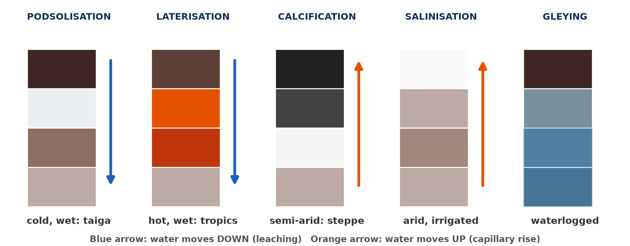
GEOGRAPHY — LOWER SIXTH ARTS
I. CLASSIFICATION
Activity 1
Five pedogenic regimes.
2026 / 2027
DGCAST GAROUA — GEOGRAPHY DEPARTMENT
Mr KAMDEM E. | 14
Notes:
Without the projector: draw the five columns.

Slide 15
GEOGRAPHY — LOWER SIXTH ARTS
I. CLASSIFICATION
Activity 1: Question
In which regimes does water move mainly down? In which does it move up?
2026 / 2027
DGCAST GAROUA — GEOGRAPHY DEPARTMENT
Mr KAMDEM E. | 15

Slide 16
GEOGRAPHY — LOWER SIXTH ARTS
I. CLASSIFICATION
Answer
Down: podsolisation and laterisation. Up: calcification and salinisation.
2026 / 2027
DGCAST GAROUA — GEOGRAPHY DEPARTMENT
Mr KAMDEM E. | 16

Slide 17

GEOGRAPHY — LOWER SIXTH ARTS
II. PODSOLISATION
Activity 2
A coniferous forest (taiga).
2026 / 2027
DGCAST GAROUA — GEOGRAPHY DEPARTMENT
Mr KAMDEM E. | 17
Notes:
Without the projector: find the taiga on a map.

Slide 18
GEOGRAPHY — LOWER SIXTH ARTS
II. PODSOLISATION
Activity 2: Question
Why are soils under coniferous forests acid and leached?
2026 / 2027
DGCAST GAROUA — GEOGRAPHY DEPARTMENT
Mr KAMDEM E. | 18

Slide 19
GEOGRAPHY — LOWER SIXTH ARTS
II. PODSOLISATION
Answer
Needles make acid humus, and rain washes iron and clay down.
2026 / 2027
DGCAST GAROUA — GEOGRAPHY DEPARTMENT
Mr KAMDEM E. | 19

Slide 20

GEOGRAPHY — LOWER SIXTH ARTS
III. LATERISATION
Activity 3
Laterite, a hard red layer.
2026 / 2027
DGCAST GAROUA — GEOGRAPHY DEPARTMENT
Mr KAMDEM E. | 20
Notes:
Without the projector: describe laterite roads.

Slide 21
GEOGRAPHY — LOWER SIXTH ARTS
III. LATERISATION
Activity 3: Question
Which elements stay in the soil during laterisation?
2026 / 2027
DGCAST GAROUA — GEOGRAPHY DEPARTMENT
Mr KAMDEM E. | 21

Slide 22
GEOGRAPHY — LOWER SIXTH ARTS
III. LATERISATION
Answer
Iron and aluminium oxides; silica and bases are washed out.
2026 / 2027
DGCAST GAROUA — GEOGRAPHY DEPARTMENT
Mr KAMDEM E. | 22

Slide 23
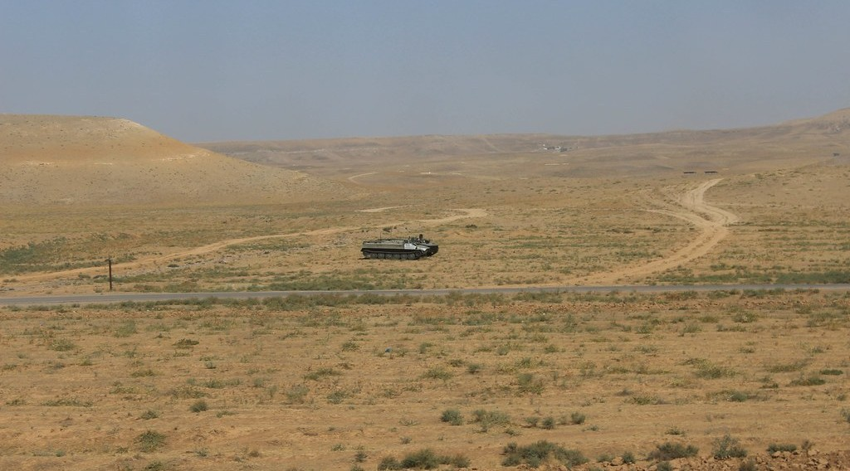
GEOGRAPHY — LOWER SIXTH ARTS
IV. CALCIFICATION
Activity 4
The dry steppe of Kazakhstan.
2026 / 2027
DGCAST GAROUA — GEOGRAPHY DEPARTMENT
Mr KAMDEM E. | 23
Notes:
Without the projector: find the steppes on a map.

Slide 24
GEOGRAPHY — LOWER SIXTH ARTS
IV. CALCIFICATION
Activity 4: Question
Why does calcium collect near the surface in steppe soils?
2026 / 2027
DGCAST GAROUA — GEOGRAPHY DEPARTMENT
Mr KAMDEM E. | 24

Slide 25
GEOGRAPHY — LOWER SIXTH ARTS
IV. CALCIFICATION
Answer
Rain is low, so calcium is not washed away and evaporation brings it up.
2026 / 2027
DGCAST GAROUA — GEOGRAPHY DEPARTMENT
Mr KAMDEM E. | 25

Slide 26

GEOGRAPHY — LOWER SIXTH ARTS
V. SALINISATION
Activity 5
A salt crust on dry land.
2026 / 2027
DGCAST GAROUA — GEOGRAPHY DEPARTMENT
Mr KAMDEM E. | 26
Notes:
Without the projector: describe salty wells in the north.

Slide 27
GEOGRAPHY — LOWER SIXTH ARTS
V. SALINISATION
Activity 5: Question
How can irrigation cause salinisation?
2026 / 2027
DGCAST GAROUA — GEOGRAPHY DEPARTMENT
Mr KAMDEM E. | 27

Slide 28
GEOGRAPHY — LOWER SIXTH ARTS
V. SALINISATION
Answer
Water evaporates and leaves salts at the surface.
2026 / 2027
DGCAST GAROUA — GEOGRAPHY DEPARTMENT
Mr KAMDEM E. | 28

Slide 29
GEOGRAPHY — LOWER SIXTH ARTS
BOARD SUMMARY
Major Pedogenic Regimes
Topic: Soil Development
Sub-topic: Soil Profile Development and Forming Processes
Lesson 9: Major Pedogenic Regimes
2026 / 2027
DGCAST GAROUA — GEOGRAPHY DEPARTMENT
Mr KAMDEM E. | 29
Notes:
Learners copy the board summary now. Give them enough time for each slide.

Slide 30
GEOGRAPHY — LOWER SIXTH ARTS
BOARD SUMMARY
I. Definitions
Pedogenic regime: It is the main process that gives a soil its character.
Leaching: It is the washing down of dissolved minerals by water.
Capillary rise: It is the upward movement of water in small pores.
2026 / 2027
DGCAST GAROUA — GEOGRAPHY DEPARTMENT
Mr KAMDEM E. | 30

Slide 31
GEOGRAPHY — LOWER SIXTH ARTS
BOARD SUMMARY
II. Downward Movement
A. Podsolisation: It happens in cold, wet climates under coniferous forests. Acid water leaches iron and humus from the E horizon into B.
B. Laterisation: It happens in hot, wet tropics. Silica and bases are leached, and iron and aluminium oxides stay and form red soils or laterite.
2026 / 2027
DGCAST GAROUA — GEOGRAPHY DEPARTMENT
Mr KAMDEM E. | 31

Slide 32
GEOGRAPHY — LOWER SIXTH ARTS
BOARD SUMMARY
III. Upward Movement and Waterlogging (1/3)
A. Calcification: It happens in semi-arid grasslands like the steppe. Calcium collects in the upper soil and gives fertile black soils.
B. Salinisation: It happens in hot, dry areas and irrigated land. Evaporation draws water up and leaves salts at the surface.
2026 / 2027
DGCAST GAROUA — GEOGRAPHY DEPARTMENT
Mr KAMDEM E. | 32

Slide 33
GEOGRAPHY — LOWER SIXTH ARTS
BOARD SUMMARY
III. Upward Movement and Waterlogging (2/3)
C. Gleying: It happens where soils are waterlogged. Lack of air turns iron grey-blue.
2026 / 2027
DGCAST GAROUA — GEOGRAPHY DEPARTMENT
Mr KAMDEM E. | 33

Slide 34
GEOGRAPHY — LOWER SIXTH ARTS
BOARD SUMMARY
III. Upward Movement and Waterlogging (3/3)
Copy the diagram.
2026 / 2027
DGCAST GAROUA — GEOGRAPHY DEPARTMENT
Mr KAMDEM E. | 34

Slide 35
GEOGRAPHY — LOWER SIXTH ARTS
FORMATIVE EVALUATION
Formative Evaluation 1
Where does laterisation occur? Which elements stay?
2026 / 2027
DGCAST GAROUA — GEOGRAPHY DEPARTMENT
Mr KAMDEM E. | 35

Slide 36
GEOGRAPHY — LOWER SIXTH ARTS
FORMATIVE EVALUATION
Expected Answer
In hot, wet tropics; iron and aluminium oxides stay.
2026 / 2027
DGCAST GAROUA — GEOGRAPHY DEPARTMENT
Mr KAMDEM E. | 36

Slide 37
GEOGRAPHY — LOWER SIXTH ARTS
FORMATIVE EVALUATION
Formative Evaluation 2
Explain salinisation.
2026 / 2027
DGCAST GAROUA — GEOGRAPHY DEPARTMENT
Mr KAMDEM E. | 37

Slide 38
GEOGRAPHY — LOWER SIXTH ARTS
FORMATIVE EVALUATION
Expected Answer
In dry areas, evaporation draws water up and leaves salts at the surface.
2026 / 2027
DGCAST GAROUA — GEOGRAPHY DEPARTMENT
Mr KAMDEM E. | 38

Slide 39
GEOGRAPHY — LOWER SIXTH ARTS
REMEDIATION
Remediation
Fill in the blanks:
The regime of the taiga is ______.
The regime of the humid tropics is ______.
Grey waterlogged soils form by ______.
2026 / 2027
DGCAST GAROUA — GEOGRAPHY DEPARTMENT
Mr KAMDEM E. | 39
Notes:
Answers: 1. podsolisation 2. laterisation 3. gleying

Slide 40
GEOGRAPHY — LOWER SIXTH ARTS
HOMEWORK
Homework
Copy the pedogenic diagram and give one climate for each regime.
This prepares Lesson 10: Minor Soil Forming Processes.
2026 / 2027
DGCAST GAROUA — GEOGRAPHY DEPARTMENT
Mr KAMDEM E. | 40
Notes:
This homework prepares the next lesson.

Slide 41
GEOGRAPHY — LOWER SIXTH ARTS
BILINGUAL GAME
Bilingual Game (Jeu Bilingue)
English | Français
Podsolisation | La podzolisation
Laterisation | La latéritisation
Calcification | La calcification
Salinisation | La salinisation
Gleying | L'hydromorphie (gley)
Crust | La croûte
2026 / 2027
DGCAST GAROUA — GEOGRAPHY DEPARTMENT
Mr KAMDEM E. | 41
Notes:
Say the English word; learners give the French word, then the reverse.

Slide 42
GEOGRAPHY — LOWER SIXTH ARTS
LOGBOOK
Official Logbook (1/2)
Module / Topic | Soil Development
Lesson Title | Lesson 9: Major Pedogenic Regimes
Expected Learning Outcomes | Define a pedogenic regime. Explain podsolisation and laterisation (downward movement). Explain calcification, salinisation and gleying.
Competence | Learners are able to explain the main soil-forming regimes and link them to climate zones.
2026 / 2027
DGCAST GAROUA — GEOGRAPHY DEPARTMENT
Mr KAMDEM E. | 42

Slide 43
GEOGRAPHY — LOWER SIXTH ARTS
LOGBOOK
Official Logbook (2/2)
Matter Taught | I. Definitions: Pedogenic regime, Leaching, Capillary rise; II. Downward Movement: Podsolisation, Laterisation; III. Upward Movement and Waterlogging: Calcification, Salinisation, Gleying.
Evaluation | Formative evaluation (3 questions) and remediation exercise.
Homework | Copy the pedogenic diagram and give one climate for each regime.
Enrolment / Present / Absent | ____ / ____ / ____
Achievement | To be completed by the teacher after the lesson.
2026 / 2027
DGCAST GAROUA — GEOGRAPHY DEPARTMENT
Mr KAMDEM E. | 43

Slide 44
GEOGRAPHY — LOWER SIXTH ARTS
TEACHER'S NOTE
Teacher's Note
Timing: Set-up, recall 8 min | Situation 8 min | 5 activities 30 min | Board summary (copying) 30 min | Evaluation, remediation 10 min | Homework, logbook 9 min | Spare 5 min
2026 / 2027
DGCAST GAROUA — GEOGRAPHY DEPARTMENT
Mr KAMDEM E. | 44

Slide 45
GEOGRAPHY — LOWER SIXTH ARTS
REFERENCES
References
National Geography Syllabus, Sixth Forms (Lower & Upper Sixth), MINESEC/IGE/IP-SS, August 2019 — Module 3 (Biogeography).
Photo, Activity 2: “Battleship Lake” by `James Wheeler, CC BY-NC-SA 2.0, via Flickr (https://www.flickr.com/photos/24128704@N08/16587218945)
Photo, Activity 3: “Laterite soil bricks in Richard Rebello's farm” by India Water Portal, CC BY-NC-SA 2.0, via Flickr (https://www.flickr.com/photos/21623815@N03/10720461943)
Photo, Activity 4: “Tank on the Kazakh steppe” by Timon91, CC BY-NC-SA 2.0, via Flickr (https://www.flickr.com/photos/52250985@N06/30964503402)
Photo, Activity 5: “Salt” by Phillie Casablanca, CC BY 2.0, via Flickr (https://www.flickr.com/photos/19451080@N00/2052715618)
Diagrams and animations: drawn for this lesson (DGCAST Geography Department).
2026 / 2027
DGCAST GAROUA — GEOGRAPHY DEPARTMENT
Mr KAMDEM E. | 45

