Slide 1

DIVINE GRACE COLLEGE OF ARTS, SCIENCE AND TECHNOLOGY
(DGCAST) — GAROUA | GEOGRAPHY DEPARTMENT
LOWER SIXTH ARTS — BIOGEOGRAPHY — LESSON 11
Classes of Soil
Mr KAMDEM EMMANUEL
Geography Teacher — PLEG
Academic Year 2026 / 2027
Notes:
Good morning, class. Today we study Lesson 11: Classes of Soil.

Slide 2
GEOGRAPHY — LOWER SIXTH ARTS
CLASS INFO
Class, Chapter & Duration
Class | Lower Sixth Arts
Chapter | Module 3: Understanding and managing biogeographic zones across the world in general and Cameroon in particular
Duration | 2 periods (2 × 50 minutes)
2026 / 2027
DGCAST GAROUA — GEOGRAPHY DEPARTMENT
Mr KAMDEM E. | 2

Slide 3
GEOGRAPHY — LOWER SIXTH ARTS
IDENTIFICATION
Lesson Identification
Topic | Soil Development
Sub-topic | Classification of Soils
Lesson | Lesson 11: Classes of Soil
Notions / Concepts | Soil classification, zonal, intrazonal, azonal soils.
Syllabus focus | Basis of classification; zonal, intrazonal and azonal soils: meaning and characteristics.
Competence | Learners are able to classify soils into zonal, intrazonal and azonal groups with examples.
2026 / 2027
DGCAST GAROUA — GEOGRAPHY DEPARTMENT
Mr KAMDEM E. | 3

Slide 4
GEOGRAPHY — LOWER SIXTH ARTS
OBJECTIVES
Learning Objectives
By the end of the lesson, the learner should be able to:
Explain the basis of soil classification.
Describe zonal soils.
Describe intrazonal and azonal soils.
2026 / 2027
DGCAST GAROUA — GEOGRAPHY DEPARTMENT
Mr KAMDEM E. | 4

Slide 5
GEOGRAPHY — LOWER SIXTH ARTS
RECALL
Recall
Climate controls the main pedogenic regimes.
Young soils have few horizons.
2026 / 2027
DGCAST GAROUA — GEOGRAPHY DEPARTMENT
Mr KAMDEM E. | 5

Slide 6
GEOGRAPHY — LOWER SIXTH ARTS
REAL-LIFE SITUATION
Real-Life Situation
Along the Logone, farmers grow rice on grey, wet soils, while a few kilometres away the soils are dry and sandy. On the slopes of Mount Cameroon, young ash soils have no clear layers.
2026 / 2027
DGCAST GAROUA — GEOGRAPHY DEPARTMENT
Mr KAMDEM E. | 6
Notes:
Read the situation slowly, twice.

Slide 7
GEOGRAPHY — LOWER SIXTH ARTS
REAL-LIFE SITUATION
Situation — Question 1
What is the problem in the situation?
2026 / 2027
DGCAST GAROUA — GEOGRAPHY DEPARTMENT
Mr KAMDEM E. | 7

Slide 8
GEOGRAPHY — LOWER SIXTH ARTS
REAL-LIFE SITUATION
Answer
Soils in the same region are very different.
2026 / 2027
DGCAST GAROUA — GEOGRAPHY DEPARTMENT
Mr KAMDEM E. | 8

Slide 9
GEOGRAPHY — LOWER SIXTH ARTS
REAL-LIFE SITUATION
Situation — Question 2
Why are the Logone soils grey and wet?
2026 / 2027
DGCAST GAROUA — GEOGRAPHY DEPARTMENT
Mr KAMDEM E. | 9

Slide 10
GEOGRAPHY — LOWER SIXTH ARTS
REAL-LIFE SITUATION
Answer
They are waterlogged (a local factor).
2026 / 2027
DGCAST GAROUA — GEOGRAPHY DEPARTMENT
Mr KAMDEM E. | 10

Slide 11
GEOGRAPHY — LOWER SIXTH ARTS
REAL-LIFE SITUATION
Situation — Question 3
How are soils grouped?
2026 / 2027
DGCAST GAROUA — GEOGRAPHY DEPARTMENT
Mr KAMDEM E. | 11

Slide 12
GEOGRAPHY — LOWER SIXTH ARTS
REAL-LIFE SITUATION
Possible Answer
Into zonal, intrazonal and azonal soils.
2026 / 2027
DGCAST GAROUA — GEOGRAPHY DEPARTMENT
Mr KAMDEM E. | 12

Slide 13
GEOGRAPHY — LOWER SIXTH ARTS
JUSTIFICATION
Justification of the Lesson
This lesson helps us to classify soils and understand why they differ even in the same climate.
2026 / 2027
DGCAST GAROUA — GEOGRAPHY DEPARTMENT
Mr KAMDEM E. | 13

Slide 14
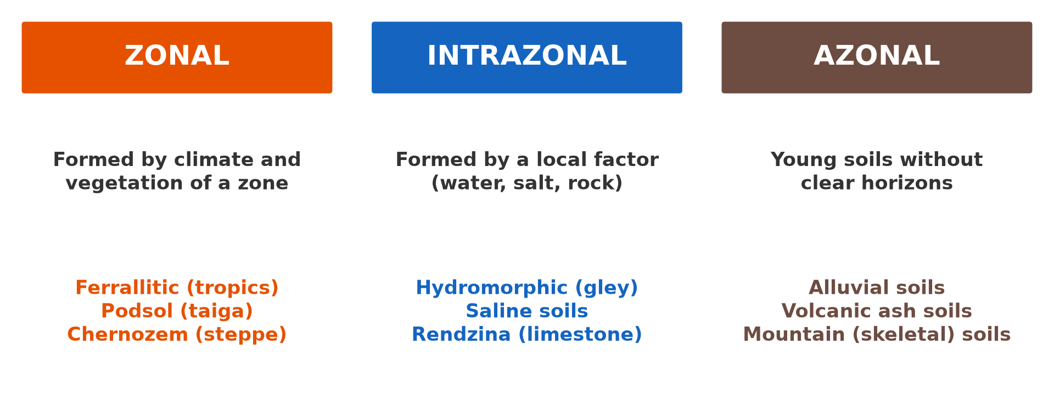
GEOGRAPHY — LOWER SIXTH ARTS
I. BASIS
Activity 1
The three classes of soil.
2026 / 2027
DGCAST GAROUA — GEOGRAPHY DEPARTMENT
Mr KAMDEM E. | 14
Notes:
Without the projector: draw the three boxes.

Slide 15
GEOGRAPHY — LOWER SIXTH ARTS
I. BASIS
Activity 1: Question
On what basis are soils divided into zonal, intrazonal and azonal?
2026 / 2027
DGCAST GAROUA — GEOGRAPHY DEPARTMENT
Mr KAMDEM E. | 15

Slide 16
GEOGRAPHY — LOWER SIXTH ARTS
I. BASIS
Answer
On the main factor that formed them and on their maturity.
2026 / 2027
DGCAST GAROUA — GEOGRAPHY DEPARTMENT
Mr KAMDEM E. | 16

Slide 17

GEOGRAPHY — LOWER SIXTH ARTS
II. ZONAL SOILS
Activity 2
A ferrallitic soil of the humid tropics.
2026 / 2027
DGCAST GAROUA — GEOGRAPHY DEPARTMENT
Mr KAMDEM E. | 17
Notes:
Without the projector: match soils to climate zones.

Slide 18
GEOGRAPHY — LOWER SIXTH ARTS
II. ZONAL SOILS
Activity 2: Question
Why is this a zonal soil?
2026 / 2027
DGCAST GAROUA — GEOGRAPHY DEPARTMENT
Mr KAMDEM E. | 18

Slide 19
GEOGRAPHY — LOWER SIXTH ARTS
II. ZONAL SOILS
Answer
It was formed mainly by the climate and vegetation of its zone.
2026 / 2027
DGCAST GAROUA — GEOGRAPHY DEPARTMENT
Mr KAMDEM E. | 19

Slide 20

GEOGRAPHY — LOWER SIXTH ARTS
III. INTRAZONAL SOILS
Activity 3
Rice on a waterlogged soil.
2026 / 2027
DGCAST GAROUA — GEOGRAPHY DEPARTMENT
Mr KAMDEM E. | 20
Notes:
Without the projector: describe swampy valleys.

Slide 21
GEOGRAPHY — LOWER SIXTH ARTS
III. INTRAZONAL SOILS
Activity 3: Question
Why are waterlogged soils called intrazonal?
2026 / 2027
DGCAST GAROUA — GEOGRAPHY DEPARTMENT
Mr KAMDEM E. | 21

Slide 22
GEOGRAPHY — LOWER SIXTH ARTS
III. INTRAZONAL SOILS
Answer
A local factor (water) is stronger than the climate.
2026 / 2027
DGCAST GAROUA — GEOGRAPHY DEPARTMENT
Mr KAMDEM E. | 22

Slide 23
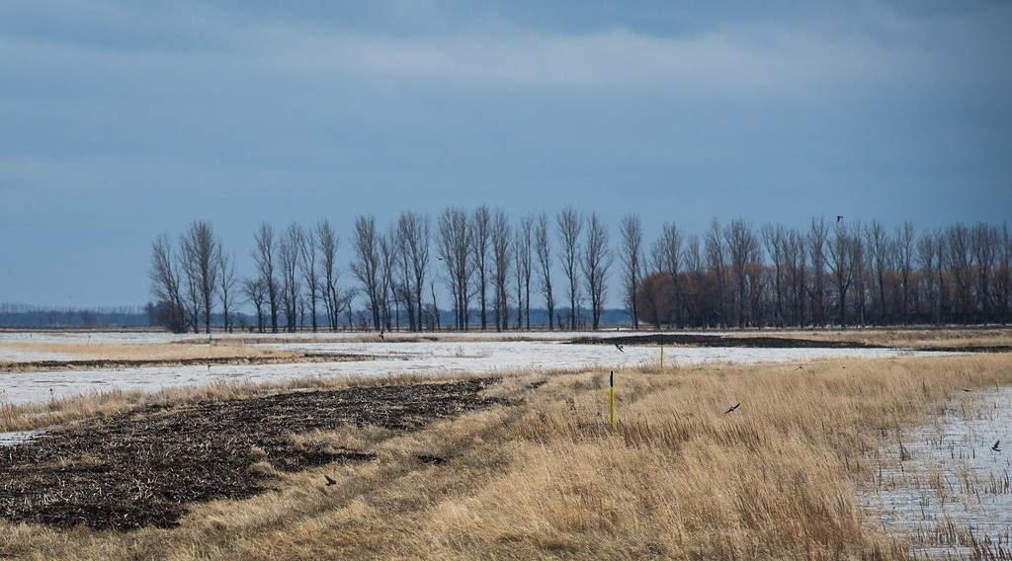
GEOGRAPHY — LOWER SIXTH ARTS
IV. AZONAL SOILS
Activity 4
A river floodplain.
2026 / 2027
DGCAST GAROUA — GEOGRAPHY DEPARTMENT
Mr KAMDEM E. | 23
Notes:
Without the projector: describe fields beside a river.

Slide 24
GEOGRAPHY — LOWER SIXTH ARTS
IV. AZONAL SOILS
Activity 4: Question
Why are alluvial soils azonal?
2026 / 2027
DGCAST GAROUA — GEOGRAPHY DEPARTMENT
Mr KAMDEM E. | 24

Slide 25
GEOGRAPHY — LOWER SIXTH ARTS
IV. AZONAL SOILS
Answer
They are young, new layers of mud with no clear horizons.
2026 / 2027
DGCAST GAROUA — GEOGRAPHY DEPARTMENT
Mr KAMDEM E. | 25

Slide 26
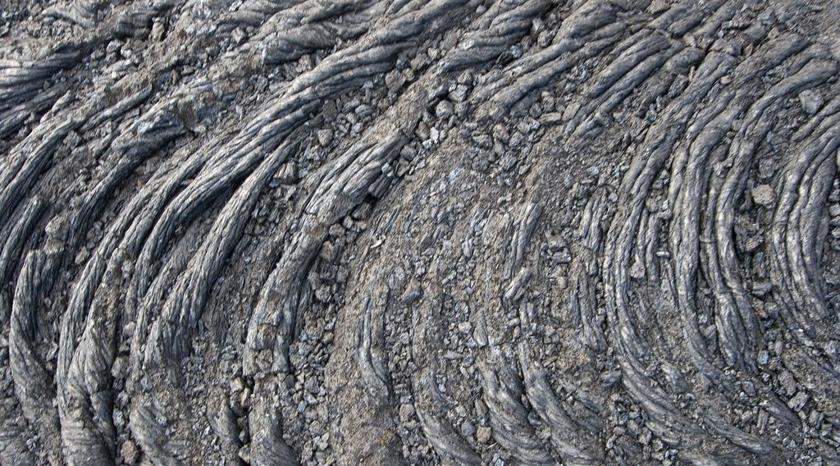
GEOGRAPHY — LOWER SIXTH ARTS
IV. AZONAL SOILS
Activity 5
Young lava.
2026 / 2027
DGCAST GAROUA — GEOGRAPHY DEPARTMENT
Mr KAMDEM E. | 26
Notes:
Without the projector: mention Mount Cameroon lava flows.

Slide 27
GEOGRAPHY — LOWER SIXTH ARTS
IV. AZONAL SOILS
Activity 5: Question
Why are soils on young lava or ash azonal?
2026 / 2027
DGCAST GAROUA — GEOGRAPHY DEPARTMENT
Mr KAMDEM E. | 27

Slide 28
GEOGRAPHY — LOWER SIXTH ARTS
IV. AZONAL SOILS
Answer
There has not been enough time for horizons to form.
2026 / 2027
DGCAST GAROUA — GEOGRAPHY DEPARTMENT
Mr KAMDEM E. | 28

Slide 29
GEOGRAPHY — LOWER SIXTH ARTS
BOARD SUMMARY
Classes of Soil
Topic: Soil Development
Sub-topic: Classification of Soils
Lesson 11: Classes of Soil
2026 / 2027
DGCAST GAROUA — GEOGRAPHY DEPARTMENT
Mr KAMDEM E. | 29
Notes:
Learners copy the board summary now. Give them enough time for each slide.

Slide 30
GEOGRAPHY — LOWER SIXTH ARTS
BOARD SUMMARY
I. Definitions
Zonal soils: They are mature soils formed mainly by the climate and vegetation of a zone.
Intrazonal soils: They are soils formed mainly by a local factor such as water, salt or rock.
Azonal soils: They are young soils without clear horizons.
2026 / 2027
DGCAST GAROUA — GEOGRAPHY DEPARTMENT
Mr KAMDEM E. | 30

Slide 31
GEOGRAPHY — LOWER SIXTH ARTS
BOARD SUMMARY
II. Basis of Classification
A. Genetic basis: Soils are grouped by the factor and process that formed them. The profile and maturity are also used.
B. Other bases: Soils can also be grouped by texture, colour or use. International systems like the FAO use detailed classes.
2026 / 2027
DGCAST GAROUA — GEOGRAPHY DEPARTMENT
Mr KAMDEM E. | 31

Slide 32
GEOGRAPHY — LOWER SIXTH ARTS
BOARD SUMMARY
III. Characteristics (1/3)
A. Zonal: They have well-developed horizons and follow climate zones. Examples are ferrallitic soils, podsols and chernozems.
B. Intrazonal: A local factor is stronger than the climate. Examples are hydromorphic, saline and limestone soils.
2026 / 2027
DGCAST GAROUA — GEOGRAPHY DEPARTMENT
Mr KAMDEM E. | 32

Slide 33
GEOGRAPHY — LOWER SIXTH ARTS
BOARD SUMMARY
III. Characteristics (2/3)
C. Azonal: They are young and have little profile development. Examples are alluvial, volcanic ash and mountain soils.
2026 / 2027
DGCAST GAROUA — GEOGRAPHY DEPARTMENT
Mr KAMDEM E. | 33

Slide 34
GEOGRAPHY — LOWER SIXTH ARTS
BOARD SUMMARY
III. Characteristics (3/3)
Copy the three classes.
2026 / 2027
DGCAST GAROUA — GEOGRAPHY DEPARTMENT
Mr KAMDEM E. | 34

Slide 35
GEOGRAPHY — LOWER SIXTH ARTS
FORMATIVE EVALUATION
Formative Evaluation 1
Distinguish zonal and azonal soils.
2026 / 2027
DGCAST GAROUA — GEOGRAPHY DEPARTMENT
Mr KAMDEM E. | 35

Slide 36
GEOGRAPHY — LOWER SIXTH ARTS
FORMATIVE EVALUATION
Expected Answer
Zonal soils are mature and follow climate; azonal soils are young without clear horizons.
2026 / 2027
DGCAST GAROUA — GEOGRAPHY DEPARTMENT
Mr KAMDEM E. | 36

Slide 37
GEOGRAPHY — LOWER SIXTH ARTS
FORMATIVE EVALUATION
Formative Evaluation 2
Give one example of each class.
2026 / 2027
DGCAST GAROUA — GEOGRAPHY DEPARTMENT
Mr KAMDEM E. | 37

Slide 38
GEOGRAPHY — LOWER SIXTH ARTS
FORMATIVE EVALUATION
Expected Answer
Zonal: ferrallitic; intrazonal: hydromorphic; azonal: alluvial.
2026 / 2027
DGCAST GAROUA — GEOGRAPHY DEPARTMENT
Mr KAMDEM E. | 38

Slide 39
GEOGRAPHY — LOWER SIXTH ARTS
REMEDIATION
Remediation
Fill in the blanks:
Soils formed by climate are ______.
Waterlogged soils are ______.
Alluvial soils are ______.
2026 / 2027
DGCAST GAROUA — GEOGRAPHY DEPARTMENT
Mr KAMDEM E. | 39
Notes:
Answers: 1. zonal 2. intrazonal 3. azonal

Slide 40
GEOGRAPHY — LOWER SIXTH ARTS
HOMEWORK
Homework
Give one zonal, one intrazonal and one azonal soil found in Cameroon.
This prepares Further Study 1: Soils of Cameroon.
2026 / 2027
DGCAST GAROUA — GEOGRAPHY DEPARTMENT
Mr KAMDEM E. | 40
Notes:
This homework prepares the next lesson.

Slide 41
GEOGRAPHY — LOWER SIXTH ARTS
BILINGUAL GAME
Bilingual Game (Jeu Bilingue)
English | Français
Classification | La classification
Zonal | Zonal
Alluvial | Alluvial
Waterlogged | Engorgé d'eau
Mature | Évolué
Young | Jeune
2026 / 2027
DGCAST GAROUA — GEOGRAPHY DEPARTMENT
Mr KAMDEM E. | 41
Notes:
Say the English word; learners give the French word, then the reverse.

Slide 42
GEOGRAPHY — LOWER SIXTH ARTS
LOGBOOK
Official Logbook (1/2)
Module / Topic | Soil Development
Lesson Title | Lesson 11: Classes of Soil
Expected Learning Outcomes | Explain the basis of soil classification. Describe zonal soils. Describe intrazonal and azonal soils.
Competence | Learners are able to classify soils into zonal, intrazonal and azonal groups with examples.
2026 / 2027
DGCAST GAROUA — GEOGRAPHY DEPARTMENT
Mr KAMDEM E. | 42

Slide 43
GEOGRAPHY — LOWER SIXTH ARTS
LOGBOOK
Official Logbook (2/2)
Matter Taught | I. Definitions: Zonal soils, Intrazonal soils, Azonal soils; II. Basis of Classification: Genetic basis, Other bases; III. Characteristics: Zonal, Intrazonal, Azonal.
Evaluation | Formative evaluation (3 questions) and remediation exercise.
Homework | Give one zonal, one intrazonal and one azonal soil found in Cameroon.
Enrolment / Present / Absent | ____ / ____ / ____
Achievement | To be completed by the teacher after the lesson.
2026 / 2027
DGCAST GAROUA — GEOGRAPHY DEPARTMENT
Mr KAMDEM E. | 43

Slide 44
GEOGRAPHY — LOWER SIXTH ARTS
TEACHER'S NOTE
Teacher's Note
Timing: Set-up, recall 8 min | Situation 8 min | 5 activities 30 min | Board summary (copying) 30 min | Evaluation, remediation 10 min | Homework, logbook 9 min | Spare 5 min
2026 / 2027
DGCAST GAROUA — GEOGRAPHY DEPARTMENT
Mr KAMDEM E. | 44

Slide 45
GEOGRAPHY — LOWER SIXTH ARTS
REFERENCES
References
National Geography Syllabus, Sixth Forms (Lower & Upper Sixth), MINESEC/IGE/IP-SS, August 2019 — Module 3 (Biogeography).
Photo, Activity 2: “in the middle of nowhere, morocco” by mariusz kluzniak, CC BY-NC-ND 2.0, via Flickr (https://www.flickr.com/photos/39997856@N03/8398997251)
Photo, Activity 3: “Irrigated rice fields in Sefula, Zambia. Photo by Kate Longley, 2013.” by WorldFish, CC BY-NC-ND 2.0, via Flickr (https://www.flickr.com/photos/61545321@N06/8608804590)
Photo, Activity 4: “20130501-NRCS-LSC-0605” by USDAgov, Public domain 1.0, via Flickr (https://www.flickr.com/photos/41284017@N08/8725089904)
Photo, Activity 5: “Pahoehoe Lava Flow” by graysky., CC BY-NC-SA 2.0, via Flickr (https://www.flickr.com/photos/20021588@N00/540223861)
Diagrams and animations: drawn for this lesson (DGCAST Geography Department).
2026 / 2027
DGCAST GAROUA — GEOGRAPHY DEPARTMENT
Mr KAMDEM E. | 45

