Slide 1

DIVINE GRACE COLLEGE OF ARTS, SCIENCE AND TECHNOLOGY
(DGCAST) — GAROUA | GEOGRAPHY DEPARTMENT
LOWER SIXTH ARTS — BIOGEOGRAPHY — LESSON 13
Evolution of Vegetation over Time: Plant Succession
Mr KAMDEM EMMANUEL
Geography Teacher — PLEG
Academic Year 2026 / 2027
Notes:
Good morning, class. Today we study Lesson 13: Evolution of Vegetation over Time: Plant Succession.

Slide 2
GEOGRAPHY — LOWER SIXTH ARTS
CLASS INFO
Class, Chapter & Duration
Class | Lower Sixth Arts
Chapter | Module 3: Understanding and managing biogeographic zones across the world in general and Cameroon in particular
Duration | 2 periods (2 × 50 minutes)
2026 / 2027
DGCAST GAROUA — GEOGRAPHY DEPARTMENT
Mr KAMDEM E. | 2

Slide 3
GEOGRAPHY — LOWER SIXTH ARTS
IDENTIFICATION
Lesson Identification
Topic | Natural Vegetation
Sub-topic | Development of Vegetation
Lesson | Lesson 13: Evolution of Vegetation over Time: Plant Succession
Notions / Concepts | Plant succession, sere, prisere, pioneer, colonisation, climax, arresting factor.
Syllabus focus | Notion of succession; types; sites of priseres; process of colonisation; arresting factors.
Competence | Learners are able to explain how vegetation develops over time and what can stop it.
2026 / 2027
DGCAST GAROUA — GEOGRAPHY DEPARTMENT
Mr KAMDEM E. | 3

Slide 4
GEOGRAPHY — LOWER SIXTH ARTS
OBJECTIVES
Learning Objectives
By the end of the lesson, the learner should be able to:
Define plant succession and its stages.
Name the types and sites of priseres.
Explain colonisation and arresting factors.
2026 / 2027
DGCAST GAROUA — GEOGRAPHY DEPARTMENT
Mr KAMDEM E. | 4

Slide 5
GEOGRAPHY — LOWER SIXTH ARTS
RECALL
Recall
Soil forms from bare rock over time.
Lichens and mosses grow on rocks.
2026 / 2027
DGCAST GAROUA — GEOGRAPHY DEPARTMENT
Mr KAMDEM E. | 5

Slide 6
GEOGRAPHY — LOWER SIXTH ARTS
REAL-LIFE SITUATION
Real-Life Situation
An old farm near Ebolowa was abandoned ten years ago. First grass covered it, then bushes, and now young trees are growing. Farmers say that "the forest is coming back".
2026 / 2027
DGCAST GAROUA — GEOGRAPHY DEPARTMENT
Mr KAMDEM E. | 6
Notes:
Read the situation slowly, twice.

Slide 7
GEOGRAPHY — LOWER SIXTH ARTS
REAL-LIFE SITUATION
Situation — Question 1
What is the problem in the situation?
2026 / 2027
DGCAST GAROUA — GEOGRAPHY DEPARTMENT
Mr KAMDEM E. | 7

Slide 8
GEOGRAPHY — LOWER SIXTH ARTS
REAL-LIFE SITUATION
Answer
The vegetation changes over time on the same land.
2026 / 2027
DGCAST GAROUA — GEOGRAPHY DEPARTMENT
Mr KAMDEM E. | 8

Slide 9
GEOGRAPHY — LOWER SIXTH ARTS
REAL-LIFE SITUATION
Situation — Question 2
What is this change called?
2026 / 2027
DGCAST GAROUA — GEOGRAPHY DEPARTMENT
Mr KAMDEM E. | 9

Slide 10
GEOGRAPHY — LOWER SIXTH ARTS
REAL-LIFE SITUATION
Answer
Plant succession.
2026 / 2027
DGCAST GAROUA — GEOGRAPHY DEPARTMENT
Mr KAMDEM E. | 10

Slide 11
GEOGRAPHY — LOWER SIXTH ARTS
REAL-LIFE SITUATION
Situation — Question 3
What is the final stage?
2026 / 2027
DGCAST GAROUA — GEOGRAPHY DEPARTMENT
Mr KAMDEM E. | 11

Slide 12
GEOGRAPHY — LOWER SIXTH ARTS
REAL-LIFE SITUATION
Possible Answer
The climax vegetation (here, forest).
2026 / 2027
DGCAST GAROUA — GEOGRAPHY DEPARTMENT
Mr KAMDEM E. | 12

Slide 13
GEOGRAPHY — LOWER SIXTH ARTS
JUSTIFICATION
Justification of the Lesson
This lesson helps us to understand how vegetation grows back and why it is sometimes stopped.
2026 / 2027
DGCAST GAROUA — GEOGRAPHY DEPARTMENT
Mr KAMDEM E. | 13

Slide 14

GEOGRAPHY — LOWER SIXTH ARTS
I. SUCCESSION
Activity 1
Animation: from bare rock to forest.
2026 / 2027
DGCAST GAROUA — GEOGRAPHY DEPARTMENT
Mr KAMDEM E. | 14
Notes:
Without the projector: draw the stages on the board.

Slide 15
GEOGRAPHY — LOWER SIXTH ARTS
I. SUCCESSION
Activity 1: Question
Name the stages of a plant succession.
2026 / 2027
DGCAST GAROUA — GEOGRAPHY DEPARTMENT
Mr KAMDEM E. | 15

Slide 16
GEOGRAPHY — LOWER SIXTH ARTS
I. SUCCESSION
Answer
Bare ground, pioneers (lichens, mosses), grasses, shrubs, climax forest.
2026 / 2027
DGCAST GAROUA — GEOGRAPHY DEPARTMENT
Mr KAMDEM E. | 16

Slide 17
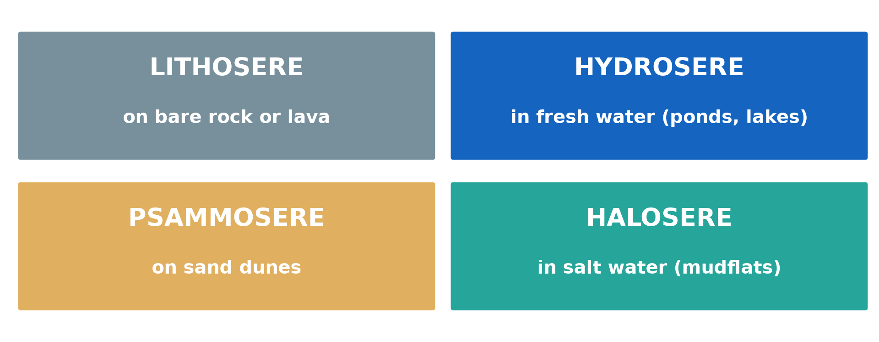
GEOGRAPHY — LOWER SIXTH ARTS
II. TYPES AND SITES
Activity 2
The four priseres.
2026 / 2027
DGCAST GAROUA — GEOGRAPHY DEPARTMENT
Mr KAMDEM E. | 17
Notes:
Without the projector: list the four priseres.

Slide 18
GEOGRAPHY — LOWER SIXTH ARTS
II. TYPES AND SITES
Activity 2: Question
What is a hydrosere? Where does it begin?
2026 / 2027
DGCAST GAROUA — GEOGRAPHY DEPARTMENT
Mr KAMDEM E. | 18

Slide 19
GEOGRAPHY — LOWER SIXTH ARTS
II. TYPES AND SITES
Answer
A succession that begins in fresh water (a pond or lake).
2026 / 2027
DGCAST GAROUA — GEOGRAPHY DEPARTMENT
Mr KAMDEM E. | 19

Slide 20
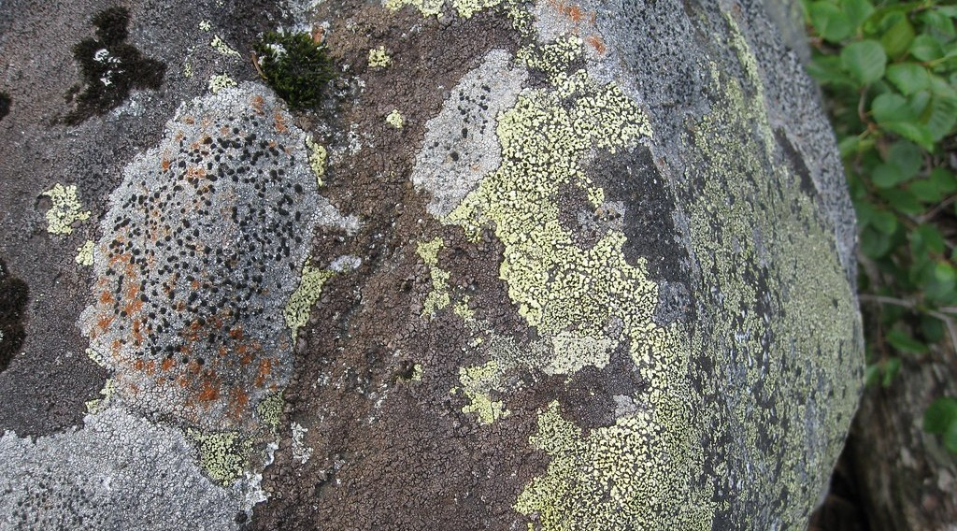
GEOGRAPHY — LOWER SIXTH ARTS
III. COLONISATION
Activity 3
Lichens on bare rock.
2026 / 2027
DGCAST GAROUA — GEOGRAPHY DEPARTMENT
Mr KAMDEM E. | 20
Notes:
Without the projector: look for lichens on walls.

Slide 21
GEOGRAPHY — LOWER SIXTH ARTS
III. COLONISATION
Activity 3: Question
Why are lichens called pioneer plants?
2026 / 2027
DGCAST GAROUA — GEOGRAPHY DEPARTMENT
Mr KAMDEM E. | 21

Slide 22
GEOGRAPHY — LOWER SIXTH ARTS
III. COLONISATION
Answer
They are the first to grow on bare rock and start soil formation.
2026 / 2027
DGCAST GAROUA — GEOGRAPHY DEPARTMENT
Mr KAMDEM E. | 22

Slide 23
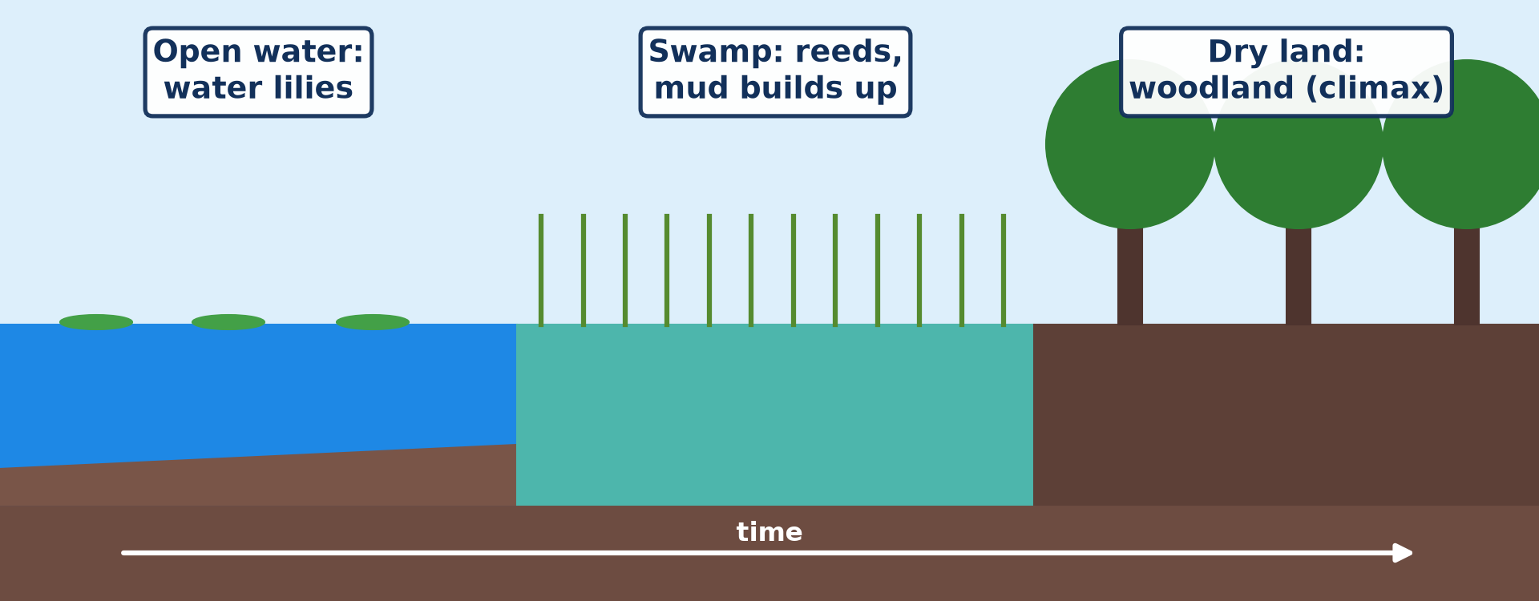
GEOGRAPHY — LOWER SIXTH ARTS
III. COLONISATION
Activity 4
A hydrosere from open water to woodland.
2026 / 2027
DGCAST GAROUA — GEOGRAPHY DEPARTMENT
Mr KAMDEM E. | 23
Notes:
Without the projector: describe a swampy pond.

Slide 24
GEOGRAPHY — LOWER SIXTH ARTS
III. COLONISATION
Activity 4: Question
How does a pond slowly become dry land?
2026 / 2027
DGCAST GAROUA — GEOGRAPHY DEPARTMENT
Mr KAMDEM E. | 24

Slide 25
GEOGRAPHY — LOWER SIXTH ARTS
III. COLONISATION
Answer
Dead plants and mud fill it, and land plants replace water plants.
2026 / 2027
DGCAST GAROUA — GEOGRAPHY DEPARTMENT
Mr KAMDEM E. | 25

Slide 26

GEOGRAPHY — LOWER SIXTH ARTS
IV. ARRESTING FACTORS
Activity 5
Burnt land after a bush fire.
2026 / 2027
DGCAST GAROUA — GEOGRAPHY DEPARTMENT
Mr KAMDEM E. | 26
Notes:
Without the projector: discuss yearly bush fires.

Slide 27
GEOGRAPHY — LOWER SIXTH ARTS
IV. ARRESTING FACTORS
Activity 5: Question
Give two factors that can stop a succession.
2026 / 2027
DGCAST GAROUA — GEOGRAPHY DEPARTMENT
Mr KAMDEM E. | 27

Slide 28
GEOGRAPHY — LOWER SIXTH ARTS
IV. ARRESTING FACTORS
Answer
Fire and grazing (also farming, cutting).
2026 / 2027
DGCAST GAROUA — GEOGRAPHY DEPARTMENT
Mr KAMDEM E. | 28

Slide 29
GEOGRAPHY — LOWER SIXTH ARTS
BOARD SUMMARY
Evolution of Vegetation over Time: Plant Succession
Topic: Natural Vegetation
Sub-topic: Development of Vegetation
Lesson 13: Evolution of Vegetation over Time: Plant Succession
2026 / 2027
DGCAST GAROUA — GEOGRAPHY DEPARTMENT
Mr KAMDEM E. | 29
Notes:
Learners copy the board summary now. Give them enough time for each slide.

Slide 30
GEOGRAPHY — LOWER SIXTH ARTS
BOARD SUMMARY
I. Definitions (1/2)
Plant succession: It is the gradual change of plant communities in an area over time.
Sere: It is the whole series of stages in a succession.
Pioneer species: They are the first plants to grow on bare ground.
2026 / 2027
DGCAST GAROUA — GEOGRAPHY DEPARTMENT
Mr KAMDEM E. | 30

Slide 31
GEOGRAPHY — LOWER SIXTH ARTS
BOARD SUMMARY
I. Definitions (2/2)
Climax: It is the final, stable stage of a succession.
2026 / 2027
DGCAST GAROUA — GEOGRAPHY DEPARTMENT
Mr KAMDEM E. | 31

Slide 32
GEOGRAPHY — LOWER SIXTH ARTS
BOARD SUMMARY
II. Types and Sites (1/2)
A. Primary succession: It starts on new bare surfaces with no soil, like lava or sand. It is called a prisere.
B. Secondary succession: It starts where vegetation was removed but soil remains. It is faster than primary succession.
2026 / 2027
DGCAST GAROUA — GEOGRAPHY DEPARTMENT
Mr KAMDEM E. | 32

Slide 33
GEOGRAPHY — LOWER SIXTH ARTS
BOARD SUMMARY
II. Types and Sites (2/2)
C. Sites of priseres: A lithosere starts on rock and a hydrosere in fresh water. A psammosere starts on sand and a halosere in salt water.
2026 / 2027
DGCAST GAROUA — GEOGRAPHY DEPARTMENT
Mr KAMDEM E. | 33

Slide 34
GEOGRAPHY — LOWER SIXTH ARTS
BOARD SUMMARY
III. Process and Arresting Factors (1/2)
A. Colonisation: Pioneers arrive, grow and change the site by adding humus. New plants then replace them.
B. Competition: Taller plants shade smaller ones. The community becomes richer until the climax.
2026 / 2027
DGCAST GAROUA — GEOGRAPHY DEPARTMENT
Mr KAMDEM E. | 34

Slide 35
GEOGRAPHY — LOWER SIXTH ARTS
BOARD SUMMARY
III. Process and Arresting Factors (2/2)
C. Arresting factors: Fire, grazing, cutting and farming stop succession. The result is a plagioclimax, like many savannas.
2026 / 2027
DGCAST GAROUA — GEOGRAPHY DEPARTMENT
Mr KAMDEM E. | 35

Slide 36
GEOGRAPHY — LOWER SIXTH ARTS
FORMATIVE EVALUATION
Formative Evaluation 1
What is plant succession?
2026 / 2027
DGCAST GAROUA — GEOGRAPHY DEPARTMENT
Mr KAMDEM E. | 36

Slide 37
GEOGRAPHY — LOWER SIXTH ARTS
FORMATIVE EVALUATION
Expected Answer
The gradual change of plant communities in an area over time.
2026 / 2027
DGCAST GAROUA — GEOGRAPHY DEPARTMENT
Mr KAMDEM E. | 37

Slide 38
GEOGRAPHY — LOWER SIXTH ARTS
FORMATIVE EVALUATION
Formative Evaluation 2
Distinguish primary and secondary succession.
2026 / 2027
DGCAST GAROUA — GEOGRAPHY DEPARTMENT
Mr KAMDEM E. | 38

Slide 39
GEOGRAPHY — LOWER SIXTH ARTS
FORMATIVE EVALUATION
Expected Answer
Primary starts on bare ground without soil; secondary starts where soil remains.
2026 / 2027
DGCAST GAROUA — GEOGRAPHY DEPARTMENT
Mr KAMDEM E. | 39

Slide 40
GEOGRAPHY — LOWER SIXTH ARTS
REMEDIATION
Remediation
Fill in the blanks:
The first plants on bare rock are ______.
A succession in fresh water is a ______.
Fire and grazing are ______ factors.
2026 / 2027
DGCAST GAROUA — GEOGRAPHY DEPARTMENT
Mr KAMDEM E. | 40
Notes:
Answers: 1. pioneers 2. hydrosere 3. arresting

Slide 41
GEOGRAPHY — LOWER SIXTH ARTS
HOMEWORK
Homework
Observe an abandoned field and describe the plants growing on it.
This prepares Lesson 14: The Concept of Climax Vegetation.
2026 / 2027
DGCAST GAROUA — GEOGRAPHY DEPARTMENT
Mr KAMDEM E. | 41
Notes:
This homework prepares the next lesson.

Slide 42
GEOGRAPHY — LOWER SIXTH ARTS
BILINGUAL GAME
Bilingual Game (Jeu Bilingue)
English | Français
Succession | La succession végétale
Pioneer | Pionnier
Climax | Le climax
Lichen | Le lichen
Colonisation | La colonisation
Pond | L'étang
2026 / 2027
DGCAST GAROUA — GEOGRAPHY DEPARTMENT
Mr KAMDEM E. | 42
Notes:
Say the English word; learners give the French word, then the reverse.

Slide 43
GEOGRAPHY — LOWER SIXTH ARTS
LOGBOOK
Official Logbook (1/2)
Module / Topic | Natural Vegetation
Lesson Title | Lesson 13: Evolution of Vegetation over Time: Plant Succession
Expected Learning Outcomes | Define plant succession and its stages. Name the types and sites of priseres. Explain colonisation and arresting factors.
Competence | Learners are able to explain how vegetation develops over time and what can stop it.
2026 / 2027
DGCAST GAROUA — GEOGRAPHY DEPARTMENT
Mr KAMDEM E. | 43

Slide 44
GEOGRAPHY — LOWER SIXTH ARTS
LOGBOOK
Official Logbook (2/2)
Matter Taught | I. Definitions: Plant succession, Sere, Pioneer species, Climax; II. Types and Sites: Primary succession, Secondary succession, Sites of priseres; III. Process and Arresting Factors: Colonisation, Competition, Arresting factors.
Evaluation | Formative evaluation (3 questions) and remediation exercise.
Homework | Observe an abandoned field and describe the plants growing on it.
Enrolment / Present / Absent | ____ / ____ / ____
Achievement | To be completed by the teacher after the lesson.
2026 / 2027
DGCAST GAROUA — GEOGRAPHY DEPARTMENT
Mr KAMDEM E. | 44

Slide 45
GEOGRAPHY — LOWER SIXTH ARTS
TEACHER'S NOTE
Teacher's Note
Timing: Set-up, recall 8 min | Situation 8 min | 5 activities 30 min | Board summary (copying) 30 min | Evaluation, remediation 10 min | Homework, logbook 9 min | Spare 5 min
Activity 1 is an animation (GIF): it plays automatically in slide-show mode.
2026 / 2027
DGCAST GAROUA — GEOGRAPHY DEPARTMENT
Mr KAMDEM E. | 45

Slide 46
GEOGRAPHY — LOWER SIXTH ARTS
REFERENCES
References
National Geography Syllabus, Sixth Forms (Lower & Upper Sixth), MINESEC/IGE/IP-SS, August 2019 — Module 3 (Biogeography).
Photo, Activity 3: “Lichens on rock - Mason Lake” by brewbooks, CC BY-SA 2.0, via Flickr (https://www.flickr.com/photos/93452909@N00/2924427336)
Photo, Activity 5: “20111216-NRCS-LSC-0355” by USDAgov, CC BY 2.0, via Flickr (https://www.flickr.com/photos/41284017@N08/6551564351)
Diagrams and animations: drawn for this lesson (DGCAST Geography Department).
2026 / 2027
DGCAST GAROUA — GEOGRAPHY DEPARTMENT
Mr KAMDEM E. | 46

