Slide 1

DIVINE GRACE COLLEGE OF ARTS, SCIENCE AND TECHNOLOGY
(DGCAST) — GAROUA | GEOGRAPHY DEPARTMENT
LOWER SIXTH ARTS — BIOGEOGRAPHY — LESSON 15
Examples of Plant Succession
Mr KAMDEM EMMANUEL
Geography Teacher — PLEG
Academic Year 2026 / 2027
Notes:
Good morning, class. Today we study Lesson 15: Examples of Plant Succession.

Slide 2
GEOGRAPHY — LOWER SIXTH ARTS
CLASS INFO
Class, Chapter & Duration
Class | Lower Sixth Arts
Chapter | Module 3: Understanding and managing biogeographic zones across the world in general and Cameroon in particular
Duration | 2 periods (2 × 50 minutes)
2026 / 2027
DGCAST GAROUA — GEOGRAPHY DEPARTMENT
Mr KAMDEM E. | 2

Slide 3
GEOGRAPHY — LOWER SIXTH ARTS
IDENTIFICATION
Lesson Identification
Topic | Natural Vegetation
Sub-topic | Development of Vegetation
Lesson | Lesson 15: Examples of Plant Succession
Notions / Concepts | Primary succession, lithosere, hydrosere, secondary succession, fallow, secondary forest.
Syllabus focus | Primary succession (lithosere, hydrosere) and secondary succession (fallow, cleared forest).
Competence | Learners are able to describe examples of primary and secondary succession.
2026 / 2027
DGCAST GAROUA — GEOGRAPHY DEPARTMENT
Mr KAMDEM E. | 3

Slide 4
GEOGRAPHY — LOWER SIXTH ARTS
OBJECTIVES
Learning Objectives
By the end of the lesson, the learner should be able to:
Describe a lithosere on lava.
Describe a hydrosere in a pond.
Describe secondary succession on abandoned farmland.
2026 / 2027
DGCAST GAROUA — GEOGRAPHY DEPARTMENT
Mr KAMDEM E. | 4

Slide 5
GEOGRAPHY — LOWER SIXTH ARTS
RECALL
Recall
Succession has stages from pioneers to climax.
Primary succession starts without soil.
2026 / 2027
DGCAST GAROUA — GEOGRAPHY DEPARTMENT
Mr KAMDEM E. | 5

Slide 6
GEOGRAPHY — LOWER SIXTH ARTS
REAL-LIFE SITUATION
Real-Life Situation
On Mount Cameroon, ferns now grow on lava from 1999, while an abandoned cassava farm nearby is already covered with bushes and young trees.
2026 / 2027
DGCAST GAROUA — GEOGRAPHY DEPARTMENT
Mr KAMDEM E. | 6
Notes:
Read the situation slowly, twice.

Slide 7
GEOGRAPHY — LOWER SIXTH ARTS
REAL-LIFE SITUATION
Situation — Question 1
What is the problem in the situation?
2026 / 2027
DGCAST GAROUA — GEOGRAPHY DEPARTMENT
Mr KAMDEM E. | 7

Slide 8
GEOGRAPHY — LOWER SIXTH ARTS
REAL-LIFE SITUATION
Answer
Plants return at different speeds.
2026 / 2027
DGCAST GAROUA — GEOGRAPHY DEPARTMENT
Mr KAMDEM E. | 8

Slide 9
GEOGRAPHY — LOWER SIXTH ARTS
REAL-LIFE SITUATION
Situation — Question 2
Which is primary succession?
2026 / 2027
DGCAST GAROUA — GEOGRAPHY DEPARTMENT
Mr KAMDEM E. | 9

Slide 10
GEOGRAPHY — LOWER SIXTH ARTS
REAL-LIFE SITUATION
Answer
The lava flow, because it had no soil.
2026 / 2027
DGCAST GAROUA — GEOGRAPHY DEPARTMENT
Mr KAMDEM E. | 10

Slide 11
GEOGRAPHY — LOWER SIXTH ARTS
REAL-LIFE SITUATION
Situation — Question 3
Why is the farm faster?
2026 / 2027
DGCAST GAROUA — GEOGRAPHY DEPARTMENT
Mr KAMDEM E. | 11

Slide 12
GEOGRAPHY — LOWER SIXTH ARTS
REAL-LIFE SITUATION
Possible Answer
Soil and seeds were still there: secondary succession.
2026 / 2027
DGCAST GAROUA — GEOGRAPHY DEPARTMENT
Mr KAMDEM E. | 12

Slide 13
GEOGRAPHY — LOWER SIXTH ARTS
JUSTIFICATION
Justification of the Lesson
This lesson helps us to recognise real successions around us and use them in farming and conservation.
2026 / 2027
DGCAST GAROUA — GEOGRAPHY DEPARTMENT
Mr KAMDEM E. | 13

Slide 14
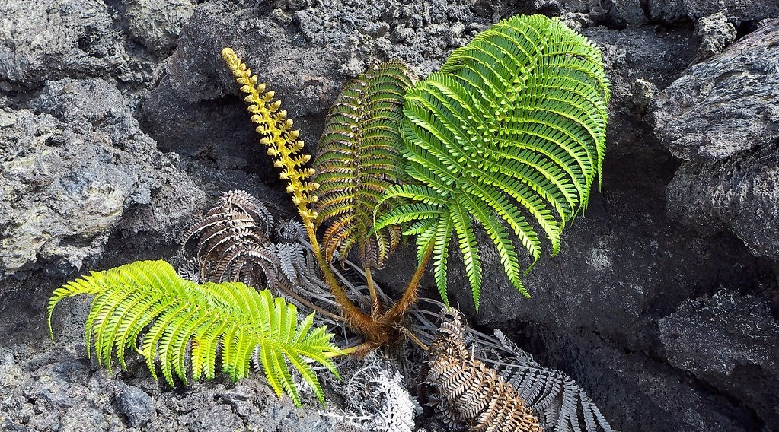
GEOGRAPHY — LOWER SIXTH ARTS
I. LITHOSERE
Activity 1
A fern growing on lava.
2026 / 2027
DGCAST GAROUA — GEOGRAPHY DEPARTMENT
Mr KAMDEM E. | 14
Notes:
Without the projector: describe the 1999 and 2000 lava flows.

Slide 15
GEOGRAPHY — LOWER SIXTH ARTS
I. LITHOSERE
Activity 1: Question
Why can ferns grow here before trees?
2026 / 2027
DGCAST GAROUA — GEOGRAPHY DEPARTMENT
Mr KAMDEM E. | 15

Slide 16
GEOGRAPHY — LOWER SIXTH ARTS
I. LITHOSERE
Answer
They need little soil and grow in cracks where water and dust collect.
2026 / 2027
DGCAST GAROUA — GEOGRAPHY DEPARTMENT
Mr KAMDEM E. | 16

Slide 17
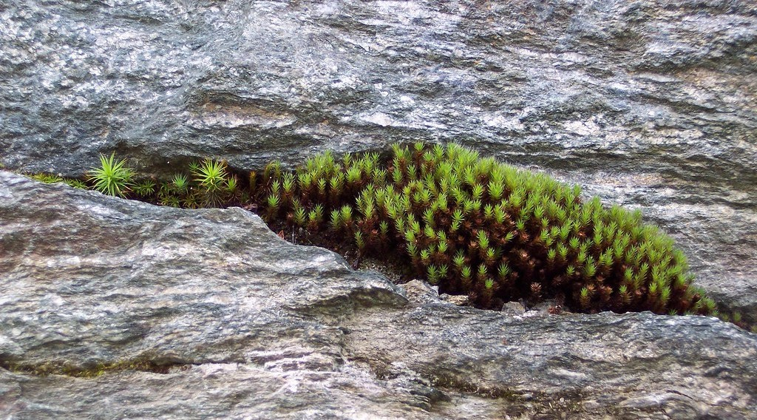
GEOGRAPHY — LOWER SIXTH ARTS
I. LITHOSERE
Activity 2
Moss growing in a rock crack.
2026 / 2027
DGCAST GAROUA — GEOGRAPHY DEPARTMENT
Mr KAMDEM E. | 17
Notes:
Without the projector: look for moss on old walls.

Slide 18
GEOGRAPHY — LOWER SIXTH ARTS
I. LITHOSERE
Activity 2: Question
What do mosses do for later plants?
2026 / 2027
DGCAST GAROUA — GEOGRAPHY DEPARTMENT
Mr KAMDEM E. | 18

Slide 19
GEOGRAPHY — LOWER SIXTH ARTS
I. LITHOSERE
Answer
They trap dust and water and add humus: they start the soil.
2026 / 2027
DGCAST GAROUA — GEOGRAPHY DEPARTMENT
Mr KAMDEM E. | 19

Slide 20

GEOGRAPHY — LOWER SIXTH ARTS
II. HYDROSERE
Activity 3
A pond with water lilies.
2026 / 2027
DGCAST GAROUA — GEOGRAPHY DEPARTMENT
Mr KAMDEM E. | 20
Notes:
Without the projector: describe ponds that dried up.

Slide 21
GEOGRAPHY — LOWER SIXTH ARTS
II. HYDROSERE
Activity 3: Question
What will this pond become after a long time?
2026 / 2027
DGCAST GAROUA — GEOGRAPHY DEPARTMENT
Mr KAMDEM E. | 21

Slide 22
GEOGRAPHY — LOWER SIXTH ARTS
II. HYDROSERE
Answer
A swamp, then dry land with woodland.
2026 / 2027
DGCAST GAROUA — GEOGRAPHY DEPARTMENT
Mr KAMDEM E. | 22

Slide 23
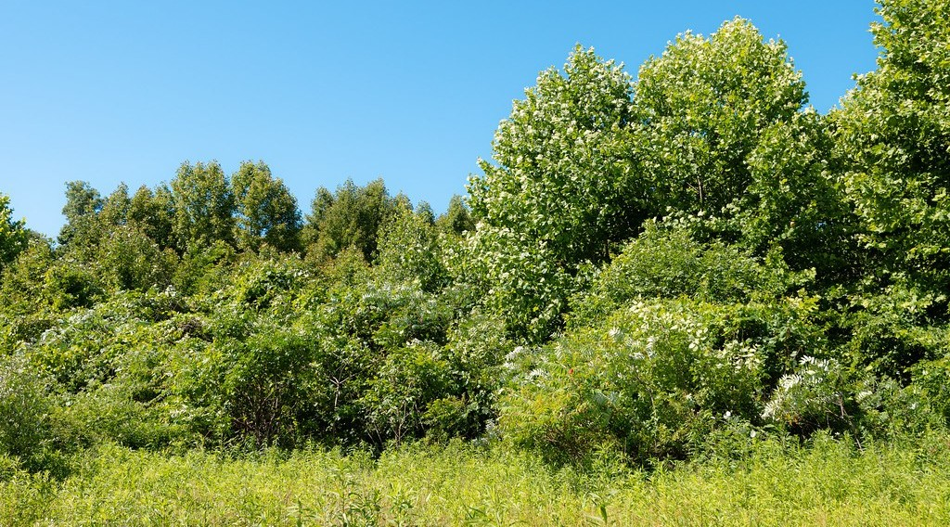
GEOGRAPHY — LOWER SIXTH ARTS
III. SECONDARY SUCCESSION
Activity 4
Young shrubs and trees growing back on cleared land.
2026 / 2027
DGCAST GAROUA — GEOGRAPHY DEPARTMENT
Mr KAMDEM E. | 23
Notes:
Without the projector: describe a fallow farm.

Slide 24
GEOGRAPHY — LOWER SIXTH ARTS
III. SECONDARY SUCCESSION
Activity 4: Question
Why is secondary succession faster than primary?
2026 / 2027
DGCAST GAROUA — GEOGRAPHY DEPARTMENT
Mr KAMDEM E. | 24

Slide 25
GEOGRAPHY — LOWER SIXTH ARTS
III. SECONDARY SUCCESSION
Answer
Soil, roots and seeds are already there.
2026 / 2027
DGCAST GAROUA — GEOGRAPHY DEPARTMENT
Mr KAMDEM E. | 25

Slide 26

GEOGRAPHY — LOWER SIXTH ARTS
III. SECONDARY SUCCESSION
Activity 5
Logs from a cleared forest.
2026 / 2027
DGCAST GAROUA — GEOGRAPHY DEPARTMENT
Mr KAMDEM E. | 26
Notes:
Without the projector: discuss logging in the East.

Slide 27
GEOGRAPHY — LOWER SIXTH ARTS
III. SECONDARY SUCCESSION
Activity 5: Question
Is the forest that grows back the same as the original?
2026 / 2027
DGCAST GAROUA — GEOGRAPHY DEPARTMENT
Mr KAMDEM E. | 27

Slide 28
GEOGRAPHY — LOWER SIXTH ARTS
III. SECONDARY SUCCESSION
Answer
No. It is a secondary forest with different, faster-growing species.
2026 / 2027
DGCAST GAROUA — GEOGRAPHY DEPARTMENT
Mr KAMDEM E. | 28

Slide 29
GEOGRAPHY — LOWER SIXTH ARTS
BOARD SUMMARY
Examples of Plant Succession
Topic: Natural Vegetation
Sub-topic: Development of Vegetation
Lesson 15: Examples of Plant Succession
2026 / 2027
DGCAST GAROUA — GEOGRAPHY DEPARTMENT
Mr KAMDEM E. | 29
Notes:
Learners copy the board summary now. Give them enough time for each slide.

Slide 30
GEOGRAPHY — LOWER SIXTH ARTS
BOARD SUMMARY
I. Definitions
Lithosere: It is a primary succession that starts on bare rock or lava.
Hydrosere: It is a succession that starts in fresh water.
Secondary forest: It is forest that grows back after the first forest was cleared.
2026 / 2027
DGCAST GAROUA — GEOGRAPHY DEPARTMENT
Mr KAMDEM E. | 30

Slide 31
GEOGRAPHY — LOWER SIXTH ARTS
BOARD SUMMARY
II. Primary Succession (1/2)
A. Lithosere: Lichens and mosses colonise bare rock and make thin soil. Ferns and grasses, then shrubs and trees follow.
B. Example: On Mount Cameroon lava flows, ferns and mosses appear first. Forest takes hundreds of years to return.
2026 / 2027
DGCAST GAROUA — GEOGRAPHY DEPARTMENT
Mr KAMDEM E. | 31

Slide 32
GEOGRAPHY — LOWER SIXTH ARTS
BOARD SUMMARY
II. Primary Succession (2/2)
C. Hydrosere: Water plants grow and mud collects in a pond. Reeds, then swamp trees and dry woodland replace them.
2026 / 2027
DGCAST GAROUA — GEOGRAPHY DEPARTMENT
Mr KAMDEM E. | 32

Slide 33
GEOGRAPHY — LOWER SIXTH ARTS
BOARD SUMMARY
III. Secondary Succession (1/2)
A. On fallow land: Grasses and weeds come first, then bushes and fast-growing trees. After many years, forest may return.
B. After logging: Light-loving trees like umbrella trees grow first. The secondary forest is poorer than the original.
2026 / 2027
DGCAST GAROUA — GEOGRAPHY DEPARTMENT
Mr KAMDEM E. | 33

Slide 34
GEOGRAPHY — LOWER SIXTH ARTS
BOARD SUMMARY
III. Secondary Succession (2/2)
C. Use in farming: Bush fallow uses secondary succession to restore soil fertility. Short fallows do not give enough time.
2026 / 2027
DGCAST GAROUA — GEOGRAPHY DEPARTMENT
Mr KAMDEM E. | 34

Slide 35
GEOGRAPHY — LOWER SIXTH ARTS
FORMATIVE EVALUATION
Formative Evaluation 1
Describe the stages of a lithosere.
2026 / 2027
DGCAST GAROUA — GEOGRAPHY DEPARTMENT
Mr KAMDEM E. | 35

Slide 36
GEOGRAPHY — LOWER SIXTH ARTS
FORMATIVE EVALUATION
Expected Answer
Lichens and mosses, then ferns and grasses, then shrubs, then trees (climax).
2026 / 2027
DGCAST GAROUA — GEOGRAPHY DEPARTMENT
Mr KAMDEM E. | 36

Slide 37
GEOGRAPHY — LOWER SIXTH ARTS
FORMATIVE EVALUATION
Formative Evaluation 2
Why is secondary succession faster?
2026 / 2027
DGCAST GAROUA — GEOGRAPHY DEPARTMENT
Mr KAMDEM E. | 37

Slide 38
GEOGRAPHY — LOWER SIXTH ARTS
FORMATIVE EVALUATION
Expected Answer
Soil, roots and seeds are already present.
2026 / 2027
DGCAST GAROUA — GEOGRAPHY DEPARTMENT
Mr KAMDEM E. | 38

Slide 39
GEOGRAPHY — LOWER SIXTH ARTS
REMEDIATION
Remediation
Fill in the blanks:
A succession on lava is a ______.
A succession in a pond is a ______.
Forest that grows back after clearing is ______ forest.
2026 / 2027
DGCAST GAROUA — GEOGRAPHY DEPARTMENT
Mr KAMDEM E. | 39
Notes:
Answers: 1. lithosere 2. hydrosere 3. secondary

Slide 40
GEOGRAPHY — LOWER SIXTH ARTS
HOMEWORK
Homework
Describe the plants on a fallow field near you and say which stage it has reached.
This prepares Lesson 16: Spatial Distribution of Vegetation.
2026 / 2027
DGCAST GAROUA — GEOGRAPHY DEPARTMENT
Mr KAMDEM E. | 40
Notes:
This homework prepares the next lesson.

Slide 41
GEOGRAPHY — LOWER SIXTH ARTS
BILINGUAL GAME
Bilingual Game (Jeu Bilingue)
English | Français
Lava | La lave
Moss | La mousse
Fern | La fougère
Swamp | Le marécage
Fallow | La jachère
Regrowth | La repousse
2026 / 2027
DGCAST GAROUA — GEOGRAPHY DEPARTMENT
Mr KAMDEM E. | 41
Notes:
Say the English word; learners give the French word, then the reverse.

Slide 42
GEOGRAPHY — LOWER SIXTH ARTS
LOGBOOK
Official Logbook (1/2)
Module / Topic | Natural Vegetation
Lesson Title | Lesson 15: Examples of Plant Succession
Expected Learning Outcomes | Describe a lithosere on lava. Describe a hydrosere in a pond. Describe secondary succession on abandoned farmland.
Competence | Learners are able to describe examples of primary and secondary succession.
2026 / 2027
DGCAST GAROUA — GEOGRAPHY DEPARTMENT
Mr KAMDEM E. | 42

Slide 43
GEOGRAPHY — LOWER SIXTH ARTS
LOGBOOK
Official Logbook (2/2)
Matter Taught | I. Definitions: Lithosere, Hydrosere, Secondary forest; II. Primary Succession: Lithosere, Example, Hydrosere; III. Secondary Succession: On fallow land, After logging, Use in farming.
Evaluation | Formative evaluation (3 questions) and remediation exercise.
Homework | Describe the plants on a fallow field near you and say which stage it has reached.
Enrolment / Present / Absent | ____ / ____ / ____
Achievement | To be completed by the teacher after the lesson.
2026 / 2027
DGCAST GAROUA — GEOGRAPHY DEPARTMENT
Mr KAMDEM E. | 43

Slide 44
GEOGRAPHY — LOWER SIXTH ARTS
TEACHER'S NOTE
Teacher's Note
Timing: Set-up, recall 8 min | Situation 8 min | 5 activities 30 min | Board summary (copying) 30 min | Evaluation, remediation 10 min | Homework, logbook 9 min | Spare 5 min
2026 / 2027
DGCAST GAROUA — GEOGRAPHY DEPARTMENT
Mr KAMDEM E. | 44

Slide 45
GEOGRAPHY — LOWER SIXTH ARTS
REFERENCES
References
National Geography Syllabus, Sixth Forms (Lower & Upper Sixth), MINESEC/IGE/IP-SS, August 2019 — Module 3 (Biogeography).
Photo, Activity 1: “Fern Growing in Lava” by Ed Suominen, CC BY-NC 2.0, via Flickr (https://www.flickr.com/photos/37960170@N07/9688955410)
Photo, Activity 2: “Moss growing in rock crevace” by binarydreams, CC BY-NC 2.0, via Flickr (https://www.flickr.com/photos/30479406@N00/1399948300)
Photo, Activity 3: “Gooderstone Water Gardens - pond - water lilies” by ell brown, CC BY 2.0, via Flickr (https://www.flickr.com/photos/39415781@N06/5993988041)
Photo, Activity 4: “Young, Shrubby Forest” by Wayne National Forest, Public domain 1.0, via Flickr (https://www.flickr.com/photos/39244790@N04/53956302430)
Photo, Activity 5: “Logging truck, Cameroon” by World Resources, CC BY-NC-SA 2.0, via Flickr (https://www.flickr.com/photos/26107309@N05/4764354366)
Diagrams and animations: drawn for this lesson (DGCAST Geography Department).
2026 / 2027
DGCAST GAROUA — GEOGRAPHY DEPARTMENT
Mr KAMDEM E. | 45

