Slide 1

DIVINE GRACE COLLEGE OF ARTS, SCIENCE AND TECHNOLOGY
(DGCAST) — GAROUA | GEOGRAPHY DEPARTMENT
LOWER SIXTH ARTS — BIOGEOGRAPHY — LESSON 20
Interactions within Ecosystems
Mr KAMDEM EMMANUEL
Geography Teacher — PLEG
Academic Year 2026 / 2027
Notes:
Good morning, class. Today we study Lesson 20: Interactions within Ecosystems.

Slide 2
GEOGRAPHY — LOWER SIXTH ARTS
CLASS INFO
Class, Chapter & Duration
Class | Lower Sixth Arts
Chapter | Module 3: Understanding and managing biogeographic zones across the world in general and Cameroon in particular
Duration | 2 periods (2 × 50 minutes)
2026 / 2027
DGCAST GAROUA — GEOGRAPHY DEPARTMENT
Mr KAMDEM E. | 2

Slide 3
GEOGRAPHY — LOWER SIXTH ARTS
IDENTIFICATION
Lesson Identification
Topic | Ecological Systems (Ecosystems)
Sub-topic | The Structure of an Ecosystem
Lesson | Lesson 20: Interactions within Ecosystems
Notions / Concepts | Compartment, four-compartment model, equilibrium, dynamic equilibrium, disequilibrium, feedback.
Syllabus focus | Structure with four compartments; interrelations; equilibrium and its nature; factors of disequilibrium, notably man.
Competence | Learners are able to explain the equilibrium of ecosystems and how man can upset it.
2026 / 2027
DGCAST GAROUA — GEOGRAPHY DEPARTMENT
Mr KAMDEM E. | 3

Slide 4
GEOGRAPHY — LOWER SIXTH ARTS
OBJECTIVES
Learning Objectives
By the end of the lesson, the learner should be able to:
Describe the four compartments of an ecosystem.
Explain the interrelations and the equilibrium between them.
Explain the factors of disequilibrium, especially man.
2026 / 2027
DGCAST GAROUA — GEOGRAPHY DEPARTMENT
Mr KAMDEM E. | 4

Slide 5
GEOGRAPHY — LOWER SIXTH ARTS
RECALL
Recall
An ecosystem is an open system.
Nutrients move between biomass, litter and soil.
2026 / 2027
DGCAST GAROUA — GEOGRAPHY DEPARTMENT
Mr KAMDEM E. | 5

Slide 6
GEOGRAPHY — LOWER SIXTH ARTS
REAL-LIFE SITUATION
Real-Life Situation
For many years, farmers around Garoua cleared land, burned bush and kept large herds. Now the soils are poor, the grass is thin and the rains wash the soil away.
2026 / 2027
DGCAST GAROUA — GEOGRAPHY DEPARTMENT
Mr KAMDEM E. | 6
Notes:
Read the situation slowly, twice.

Slide 7
GEOGRAPHY — LOWER SIXTH ARTS
REAL-LIFE SITUATION
Situation — Question 1
What is the problem in the situation?
2026 / 2027
DGCAST GAROUA — GEOGRAPHY DEPARTMENT
Mr KAMDEM E. | 7

Slide 8
GEOGRAPHY — LOWER SIXTH ARTS
REAL-LIFE SITUATION
Answer
The ecosystem has lost its balance.
2026 / 2027
DGCAST GAROUA — GEOGRAPHY DEPARTMENT
Mr KAMDEM E. | 8

Slide 9
GEOGRAPHY — LOWER SIXTH ARTS
REAL-LIFE SITUATION
Situation — Question 2
What caused this?
2026 / 2027
DGCAST GAROUA — GEOGRAPHY DEPARTMENT
Mr KAMDEM E. | 9

Slide 10
GEOGRAPHY — LOWER SIXTH ARTS
REAL-LIFE SITUATION
Answer
Human activities: clearing, burning and overgrazing.
2026 / 2027
DGCAST GAROUA — GEOGRAPHY DEPARTMENT
Mr KAMDEM E. | 10

Slide 11
GEOGRAPHY — LOWER SIXTH ARTS
REAL-LIFE SITUATION
Situation — Question 3
What do we call the balance of an ecosystem?
2026 / 2027
DGCAST GAROUA — GEOGRAPHY DEPARTMENT
Mr KAMDEM E. | 11

Slide 12
GEOGRAPHY — LOWER SIXTH ARTS
REAL-LIFE SITUATION
Possible Answer
Equilibrium.
2026 / 2027
DGCAST GAROUA — GEOGRAPHY DEPARTMENT
Mr KAMDEM E. | 12

Slide 13
GEOGRAPHY — LOWER SIXTH ARTS
JUSTIFICATION
Justification of the Lesson
This lesson helps us to understand the balance of nature and our role in keeping it.
2026 / 2027
DGCAST GAROUA — GEOGRAPHY DEPARTMENT
Mr KAMDEM E. | 13

Slide 14
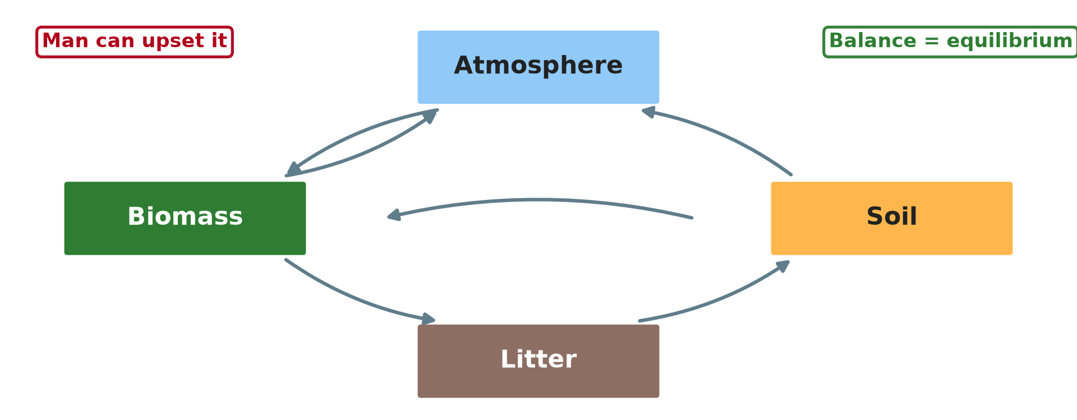
GEOGRAPHY — LOWER SIXTH ARTS
I. COMPARTMENTS
Activity 1
The four compartments of an ecosystem.
2026 / 2027
DGCAST GAROUA — GEOGRAPHY DEPARTMENT
Mr KAMDEM E. | 14
Notes:
Without the projector: draw four boxes with arrows.

Slide 15
GEOGRAPHY — LOWER SIXTH ARTS
I. COMPARTMENTS
Activity 1: Question
Name the four compartments.
2026 / 2027
DGCAST GAROUA — GEOGRAPHY DEPARTMENT
Mr KAMDEM E. | 15

Slide 16
GEOGRAPHY — LOWER SIXTH ARTS
I. COMPARTMENTS
Answer
Atmosphere, biomass, litter and soil.
2026 / 2027
DGCAST GAROUA — GEOGRAPHY DEPARTMENT
Mr KAMDEM E. | 16

Slide 17

GEOGRAPHY — LOWER SIXTH ARTS
II. INTERRELATIONS
Activity 2
Nutrients moving between biomass, litter and soil.
2026 / 2027
DGCAST GAROUA — GEOGRAPHY DEPARTMENT
Mr KAMDEM E. | 17
Notes:
Without the projector: describe the cycle.

Slide 18
GEOGRAPHY — LOWER SIXTH ARTS
II. INTERRELATIONS
Activity 2: Question
How do nutrients move from biomass to litter to soil?
2026 / 2027
DGCAST GAROUA — GEOGRAPHY DEPARTMENT
Mr KAMDEM E. | 18

Slide 19
GEOGRAPHY — LOWER SIXTH ARTS
II. INTERRELATIONS
Answer
Leaves fall (fallout), then decompose into the soil.
2026 / 2027
DGCAST GAROUA — GEOGRAPHY DEPARTMENT
Mr KAMDEM E. | 19

Slide 20

GEOGRAPHY — LOWER SIXTH ARTS
III. EQUILIBRIUM
Activity 3
Litter on the forest floor.
2026 / 2027
DGCAST GAROUA — GEOGRAPHY DEPARTMENT
Mr KAMDEM E. | 20
Notes:
Without the projector: compare with a full bucket with a tap and a hole.

Slide 21
GEOGRAPHY — LOWER SIXTH ARTS
III. EQUILIBRIUM
Activity 3: Question
Why is the equilibrium called dynamic?
2026 / 2027
DGCAST GAROUA — GEOGRAPHY DEPARTMENT
Mr KAMDEM E. | 21

Slide 22
GEOGRAPHY — LOWER SIXTH ARTS
III. EQUILIBRIUM
Answer
Matter keeps moving, but inputs and outputs stay balanced.
2026 / 2027
DGCAST GAROUA — GEOGRAPHY DEPARTMENT
Mr KAMDEM E. | 22

Slide 23

GEOGRAPHY — LOWER SIXTH ARTS
IV. DISEQUILIBRIUM
Activity 4
Logs from a cleared forest.
2026 / 2027
DGCAST GAROUA — GEOGRAPHY DEPARTMENT
Mr KAMDEM E. | 23
Notes:
Without the projector: discuss logging.

Slide 24
GEOGRAPHY — LOWER SIXTH ARTS
IV. DISEQUILIBRIUM
Activity 4: Question
How does logging upset the equilibrium?
2026 / 2027
DGCAST GAROUA — GEOGRAPHY DEPARTMENT
Mr KAMDEM E. | 24

Slide 25
GEOGRAPHY — LOWER SIXTH ARTS
IV. DISEQUILIBRIUM
Answer
It removes biomass and nutrients and exposes the soil to erosion.
2026 / 2027
DGCAST GAROUA — GEOGRAPHY DEPARTMENT
Mr KAMDEM E. | 25

Slide 26
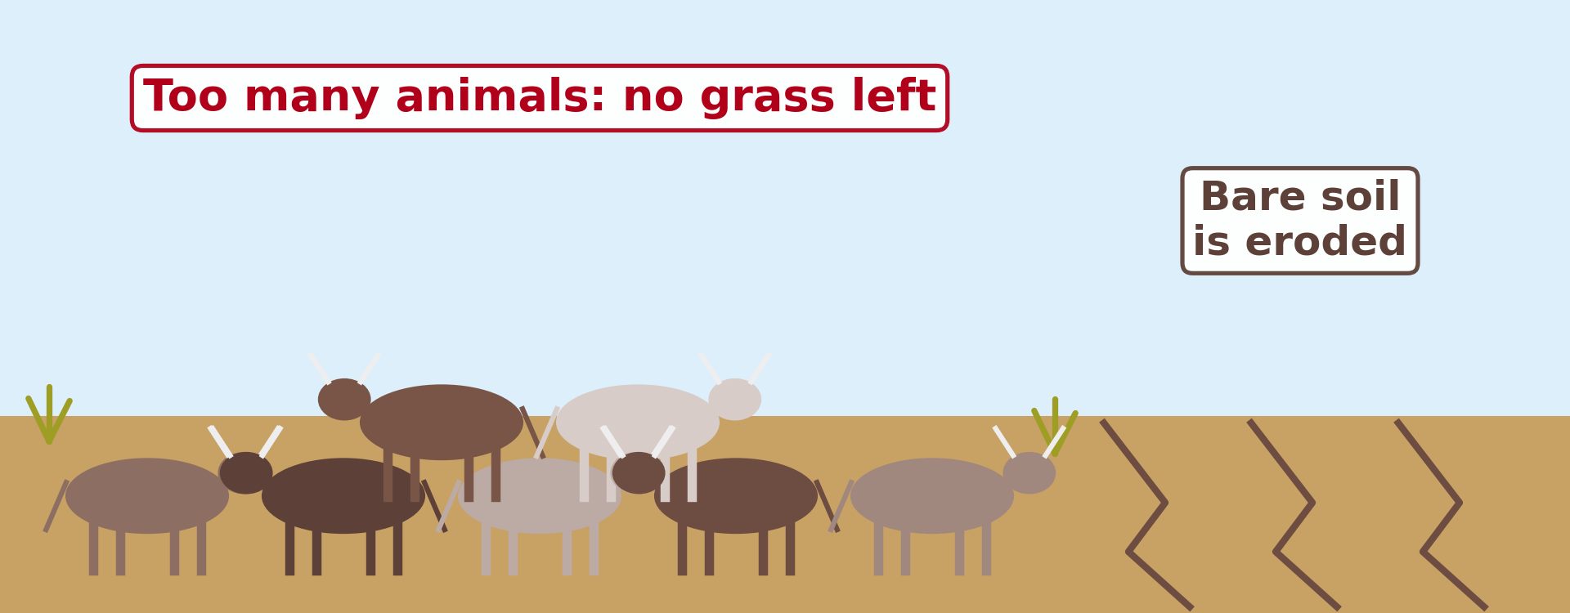
GEOGRAPHY — LOWER SIXTH ARTS
IV. DISEQUILIBRIUM
Activity 5
Overgrazing leaves bare soil.
2026 / 2027
DGCAST GAROUA — GEOGRAPHY DEPARTMENT
Mr KAMDEM E. | 26
Notes:
Without the projector: describe bare grazing land.

Slide 27
GEOGRAPHY — LOWER SIXTH ARTS
IV. DISEQUILIBRIUM
Activity 5: Question
Give two human factors of disequilibrium.
2026 / 2027
DGCAST GAROUA — GEOGRAPHY DEPARTMENT
Mr KAMDEM E. | 27

Slide 28
GEOGRAPHY — LOWER SIXTH ARTS
IV. DISEQUILIBRIUM
Answer
Overgrazing and bush fires (also logging, pollution).
2026 / 2027
DGCAST GAROUA — GEOGRAPHY DEPARTMENT
Mr KAMDEM E. | 28

Slide 29
GEOGRAPHY — LOWER SIXTH ARTS
BOARD SUMMARY
Interactions within Ecosystems
Topic: Ecological Systems (Ecosystems)
Sub-topic: The Structure of an Ecosystem
Lesson 20: Interactions within Ecosystems
2026 / 2027
DGCAST GAROUA — GEOGRAPHY DEPARTMENT
Mr KAMDEM E. | 29
Notes:
Learners copy the board summary now. Give them enough time for each slide.

Slide 30
GEOGRAPHY — LOWER SIXTH ARTS
BOARD SUMMARY
I. Definitions
Compartment: It is a store in an ecosystem, such as biomass or soil.
Equilibrium: It is the balance between the parts of an ecosystem.
Disequilibrium: It is the loss of balance in an ecosystem.
2026 / 2027
DGCAST GAROUA — GEOGRAPHY DEPARTMENT
Mr KAMDEM E. | 30

Slide 31
GEOGRAPHY — LOWER SIXTH ARTS
BOARD SUMMARY
II. Structure and Interrelations (1/2)
A. Four compartments: The atmosphere, biomass, litter and soil store energy and matter. They are linked by flows.
B. Flows: Plants take carbon dioxide from the air and nutrients from the soil. Litter falls, decomposes and returns nutrients.
2026 / 2027
DGCAST GAROUA — GEOGRAPHY DEPARTMENT
Mr KAMDEM E. | 31

Slide 32
GEOGRAPHY — LOWER SIXTH ARTS
BOARD SUMMARY
II. Structure and Interrelations (2/2)
C. Feedback: A change in one compartment affects the others. Negative feedback helps to restore balance.
2026 / 2027
DGCAST GAROUA — GEOGRAPHY DEPARTMENT
Mr KAMDEM E. | 32

Slide 33
GEOGRAPHY — LOWER SIXTH ARTS
BOARD SUMMARY
III. Equilibrium and Disequilibrium (1/3)
A. Dynamic equilibrium: Matter and energy keep moving, but the stores stay about the same. The ecosystem can recover from small changes.
B. Natural factors: Droughts, floods and volcanic eruptions can upset the balance. Most ecosystems recover with time.
2026 / 2027
DGCAST GAROUA — GEOGRAPHY DEPARTMENT
Mr KAMDEM E. | 33

Slide 34
GEOGRAPHY — LOWER SIXTH ARTS
BOARD SUMMARY
III. Equilibrium and Disequilibrium (2/3)
C. Man: Logging, fire, overgrazing and pollution cause serious disequilibrium. Soils lose fertility, and species disappear.
2026 / 2027
DGCAST GAROUA — GEOGRAPHY DEPARTMENT
Mr KAMDEM E. | 34

Slide 35
GEOGRAPHY — LOWER SIXTH ARTS
BOARD SUMMARY
III. Equilibrium and Disequilibrium (3/3)
Copy the four compartments.
2026 / 2027
DGCAST GAROUA — GEOGRAPHY DEPARTMENT
Mr KAMDEM E. | 35

Slide 36
GEOGRAPHY — LOWER SIXTH ARTS
FORMATIVE EVALUATION
Formative Evaluation 1
Name the four compartments of an ecosystem.
2026 / 2027
DGCAST GAROUA — GEOGRAPHY DEPARTMENT
Mr KAMDEM E. | 36

Slide 37
GEOGRAPHY — LOWER SIXTH ARTS
FORMATIVE EVALUATION
Expected Answer
Atmosphere, biomass, litter and soil.
2026 / 2027
DGCAST GAROUA — GEOGRAPHY DEPARTMENT
Mr KAMDEM E. | 37

Slide 38
GEOGRAPHY — LOWER SIXTH ARTS
FORMATIVE EVALUATION
Formative Evaluation 2
Explain how man causes disequilibrium.
2026 / 2027
DGCAST GAROUA — GEOGRAPHY DEPARTMENT
Mr KAMDEM E. | 38

Slide 39
GEOGRAPHY — LOWER SIXTH ARTS
FORMATIVE EVALUATION
Expected Answer
Logging, fire, overgrazing and pollution remove stores and increase losses.
2026 / 2027
DGCAST GAROUA — GEOGRAPHY DEPARTMENT
Mr KAMDEM E. | 39

Slide 40
GEOGRAPHY — LOWER SIXTH ARTS
REMEDIATION
Remediation
Fill in the blanks:
Balance in an ecosystem is ______.
A store in an ecosystem is a ______.
Overgrazing causes ______.
2026 / 2027
DGCAST GAROUA — GEOGRAPHY DEPARTMENT
Mr KAMDEM E. | 40
Notes:
Answers: 1. equilibrium 2. compartment 3. disequilibrium

Slide 41
GEOGRAPHY — LOWER SIXTH ARTS
HOMEWORK
Homework
Give an example of an ecosystem in your area that has lost its balance and explain why.
This prepares Lesson 21: Energy Flows.
2026 / 2027
DGCAST GAROUA — GEOGRAPHY DEPARTMENT
Mr KAMDEM E. | 41
Notes:
This homework prepares the next lesson.

Slide 42
GEOGRAPHY — LOWER SIXTH ARTS
BILINGUAL GAME
Bilingual Game (Jeu Bilingue)
English | Français
Compartment | Le compartiment
Equilibrium | L'équilibre
Feedback | La rétroaction
Overgrazing | Le surpâturage
Pollution | La pollution
Recovery | Le rétablissement
2026 / 2027
DGCAST GAROUA — GEOGRAPHY DEPARTMENT
Mr KAMDEM E. | 42
Notes:
Say the English word; learners give the French word, then the reverse.

Slide 43
GEOGRAPHY — LOWER SIXTH ARTS
LOGBOOK
Official Logbook (1/2)
Module / Topic | Ecological Systems (Ecosystems)
Lesson Title | Lesson 20: Interactions within Ecosystems
Expected Learning Outcomes | Describe the four compartments of an ecosystem. Explain the interrelations and the equilibrium between them. Explain the factors of disequilibrium, especially man.
Competence | Learners are able to explain the equilibrium of ecosystems and how man can upset it.
2026 / 2027
DGCAST GAROUA — GEOGRAPHY DEPARTMENT
Mr KAMDEM E. | 43

Slide 44
GEOGRAPHY — LOWER SIXTH ARTS
LOGBOOK
Official Logbook (2/2)
Matter Taught | I. Definitions: Compartment, Equilibrium, Disequilibrium; II. Structure and Interrelations: Four compartments, Flows, Feedback; III. Equilibrium and Disequilibrium: Dynamic equilibrium, Natural factors, Man.
Evaluation | Formative evaluation (3 questions) and remediation exercise.
Homework | Give an example of an ecosystem in your area that has lost its balance and explain why.
Enrolment / Present / Absent | ____ / ____ / ____
Achievement | To be completed by the teacher after the lesson.
2026 / 2027
DGCAST GAROUA — GEOGRAPHY DEPARTMENT
Mr KAMDEM E. | 44

Slide 45
GEOGRAPHY — LOWER SIXTH ARTS
TEACHER'S NOTE
Teacher's Note
Timing: Set-up, recall 8 min | Situation 8 min | 5 activities 30 min | Board summary (copying) 30 min | Evaluation, remediation 10 min | Homework, logbook 9 min | Spare 5 min
2026 / 2027
DGCAST GAROUA — GEOGRAPHY DEPARTMENT
Mr KAMDEM E. | 45

Slide 46
GEOGRAPHY — LOWER SIXTH ARTS
REFERENCES
References
National Geography Syllabus, Sixth Forms (Lower & Upper Sixth), MINESEC/IGE/IP-SS, August 2019 — Module 3 (Biogeography).
Photo, Activity 3: “Heavily earthworm-infested soil” by esagor, CC BY-NC 2.0, via Flickr (https://www.flickr.com/photos/7357861@N03/1993224477)
Photo, Activity 4: “Logging truck, Cameroon” by World Resources, CC BY-NC-SA 2.0, via Flickr (https://www.flickr.com/photos/26107309@N05/4764354366)
Diagrams and animations: drawn for this lesson (DGCAST Geography Department).
2026 / 2027
DGCAST GAROUA — GEOGRAPHY DEPARTMENT
Mr KAMDEM E. | 46

