Slide 1
FORM 1
GEOGRAPHY
Practical Work 2
Locate a Place on a Map
Notes:
Good morning, class, and welcome to our geography lesson. I am your geography teacher, Mr Kamdem. Today we are starting Practical Work 2: Locate a Place on a Map.

Slide 2
CLASS INFO
Class, Chapter and Duration
Class | Form 1
Chapter | Module 1: The Earth in the Universe
Duration | 2 periods (2 × 50 minutes)
Notes:
This lesson is for Form 1. It belongs to Module 1: The Earth in the Universe. We shall need 2 periods to cover it.

Slide 3
IDENTIFICATION
Lesson Identification
Topic | The Earth in the Universe
Sub-topic | The Earth: A Planet of the Solar System
Lesson | Practical Work 2: Locate a Place on a Map
Notions / Concepts | Latitude, longitude, geographical coordinates, Equator, Greenwich Meridian.
Syllabus focus | Theoretical basis: the Earth in the solar system. Practical exercise: read the coordinates of a place on a map; locate Cameroon on the map of Africa using geographical coordinates. Contextualisation: situate a town in Cameroon using geographical coordinates.
Competence | Learners are able to read and write the geographical coordinates of a place.
Notes:
Our topic is The Earth in the Universe, and the sub-topic is The Earth: A Planet of the Solar System. The key notions we shall use today are: latitude, longitude, geographical coordinates, Equator, Greenwich Meridian. At the end, you should be able to do this: learners are able to read and write the geographical coordinates of a place.

Slide 4

HOMEWORK CORRECTION
Correction of the Homework
Question (Practical Work 1: Representation of the Earth's Shape and Size):
Give the latitude of the Equator.
Notes:
Before we start the new lesson, let us correct the homework I gave you at the end of Practical Work 1: Representation of the Earth's Shape and Size. The question was: Give the latitude of the Equator. Take out your exercise books.

Slide 5
HOMEWORK CORRECTION
Correction: Possible Answer
0°.
Notes:
Here is a good answer. 0°. Compare it with your own answer and correct your work in red.

Slide 6
LESSON PLAN
Lesson Plan
Correction of the homework
Objectives and recall
Real-life situation and action to take
Learning activities
Board summary
Evaluation, remediation and homework
Notes:
Here is the plan of our lesson today. First, we shall correct the homework. Then we shall look at the objectives and recall what you already know. After that, we shall study a situation from real life and the action to take, and do the learning activities. Finally, we shall copy the board summary, do the evaluation and the remediation, and I will give you the homework.

Slide 7
OBJECTIVES
Objectives
By the end of this lesson, you should be able to:
Read the coordinates of a place on a map.
Locate Cameroon on the map of Africa with coordinates.
Notes:
Take your time to copy this part; we will continue together.

Slide 8
OBJECTIVES
Objectives (continued)
Situate towns of Cameroon with coordinates.
Notes:
By the end of this lesson, you should be able to do three things. Number 1: read the coordinates of a place on a map. Number 2: locate Cameroon on the map of Africa with coordinates. Number 3: situate towns of Cameroon with coordinates.

Slide 9
PREVIOUS KNOWLEDGE
Previous Knowledge
The Equator is the line of latitude 0°.
The Greenwich Meridian is the line of longitude 0°.
Maps have grid lines.
Notes:
Let us first remember what you already know. The Equator is the line of latitude 0°. The Greenwich Meridian is the line of longitude 0°. Maps have grid lines. Keep this in mind, because we shall build on it today.

Slide 10
REAL-LIFE SITUATION
Situation in Real Life
A pilot must fly from Douala to Garoua. On the radio, Hassan hears the control tower give the position of Garoua as "9° N, 13° E". He asks his teacher: "What do these numbers mean, and how can I find a town with them?"
Notes:
Listen carefully to this situation from real life. A pilot must fly from Douala to Garoua. On the radio, Hassan hears the control tower give the position of Garoua as "9° N, 13° E". He asks his teacher: "What do these numbers mean, and how can I find a town with them?" Think about it, because I am going to ask you some questions.

Slide 11
REAL-LIFE SITUATION
Situation: Question 1
What is the problem in the situation?
Notes:
Question 1: What is the problem in the situation? Think for a moment, then raise your hand to answer.

Slide 12
REAL-LIFE SITUATION
Answer
Hassan does not understand the position of Garoua given to the pilot.
Notes:
Good. Hassan does not understand the position of Garoua given to the pilot.

Slide 13
REAL-LIFE SITUATION
Situation: Question 2
What do "9° N" and "13° E" represent?
Notes:
Question 2: What do "9° N" and "13° E" represent? Think for a moment, then raise your hand to answer.

Slide 14
REAL-LIFE SITUATION
Answer
The latitude and the longitude of Garoua.
Notes:
Good. The latitude and the longitude of Garoua.

Slide 15
REAL-LIFE SITUATION
Situation: Question 3
Why does the pilot need them?
Notes:
Question 3: Why does the pilot need them? Think for a moment, then raise your hand to answer.

Slide 16
REAL-LIFE SITUATION
Possible Answer
To find the exact position of Garoua.
Notes:
Good. To find the exact position of Garoua.

Slide 17
ACTION TO TAKE
Action to Take
Always write the latitude first and the longitude second.
Notes:
From this situation, the action we are working towards in this lesson is the following: always write the latitude first and the longitude second.

Slide 18
JUSTIFICATION
Justification of the Lesson
This practical work helps us to find the exact position of any place on a map.
Notes:
Why is this lesson important for you? This practical work helps us to find the exact position of any place on a map.

Slide 19

1. REVISION
Activity 1
Lines of latitude.
Notes:
Activity 1. Look carefully at this diagram: lines of latitude. Observe every detail before I ask the question.

Slide 20
1. REVISION
Activity 1: Question
What does the latitude of a place tell us?
Notes:
Here is the question for Activity 1: What does the latitude of a place tell us? Take one minute to think and write your answer in your rough notebook.

Slide 21
1. REVISION
Activity 1: Answer
How far north or south of the Equator the place is.
Notes:
Let us check the answer together. How far north or south of the Equator the place is.

Slide 22
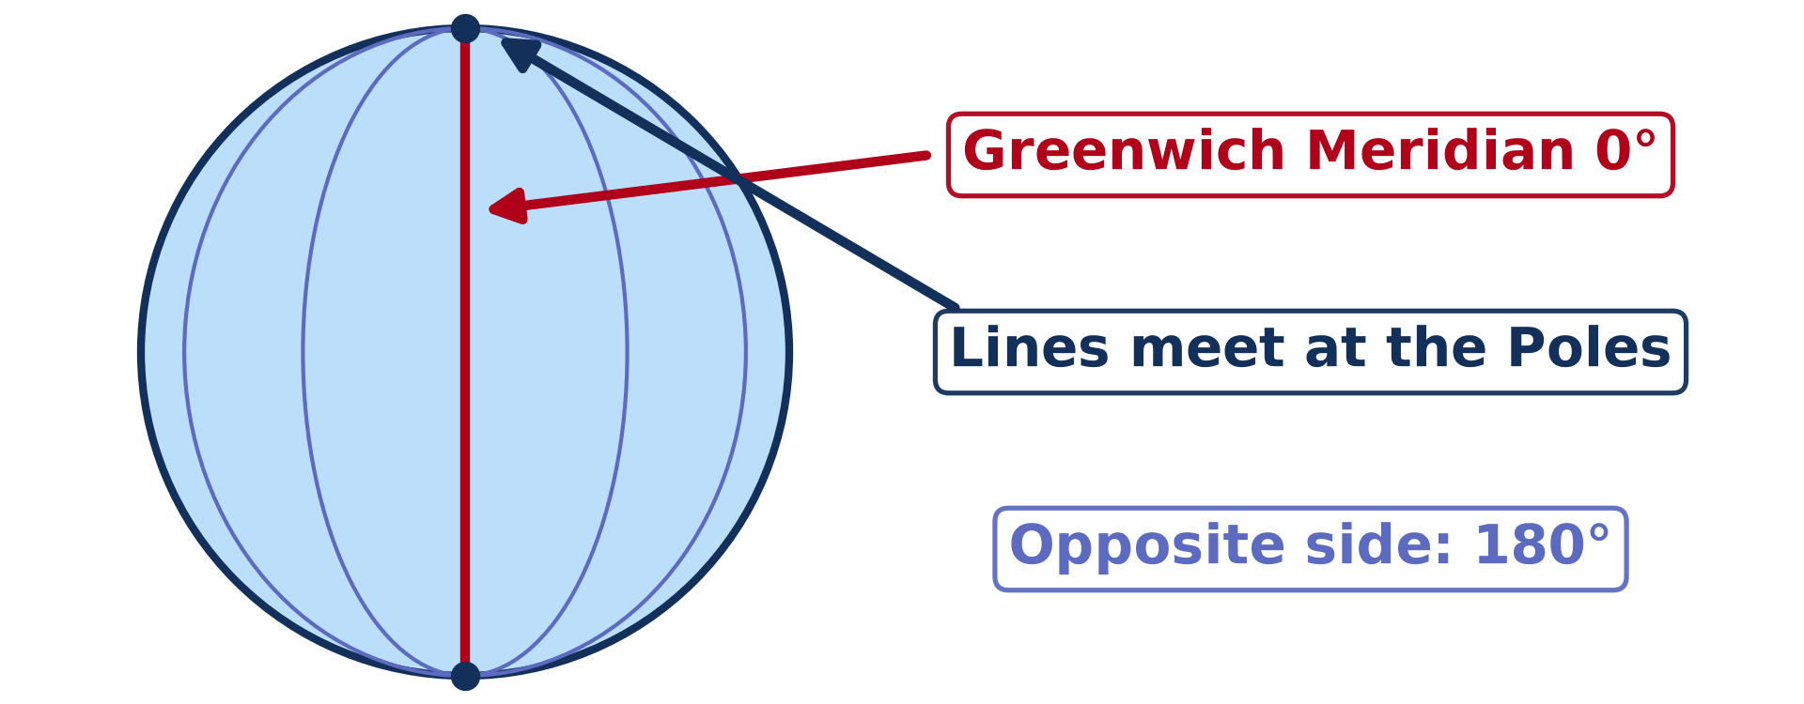
1. REVISION
Activity 2
Lines of longitude.
Notes:
Activity 2. Look carefully at this diagram: lines of longitude. Observe every detail before I ask the question.

Slide 23
1. REVISION
Activity 2: Question
What does the longitude of a place tell us?
Notes:
Here is the question for Activity 2: What does the longitude of a place tell us? Take one minute to think and write your answer in your rough notebook.

Slide 24
1. REVISION
Activity 2: Answer
How far east or west of the Greenwich Meridian the place is.
Notes:
Let us check the answer together. How far east or west of the Greenwich Meridian the place is.

Slide 25
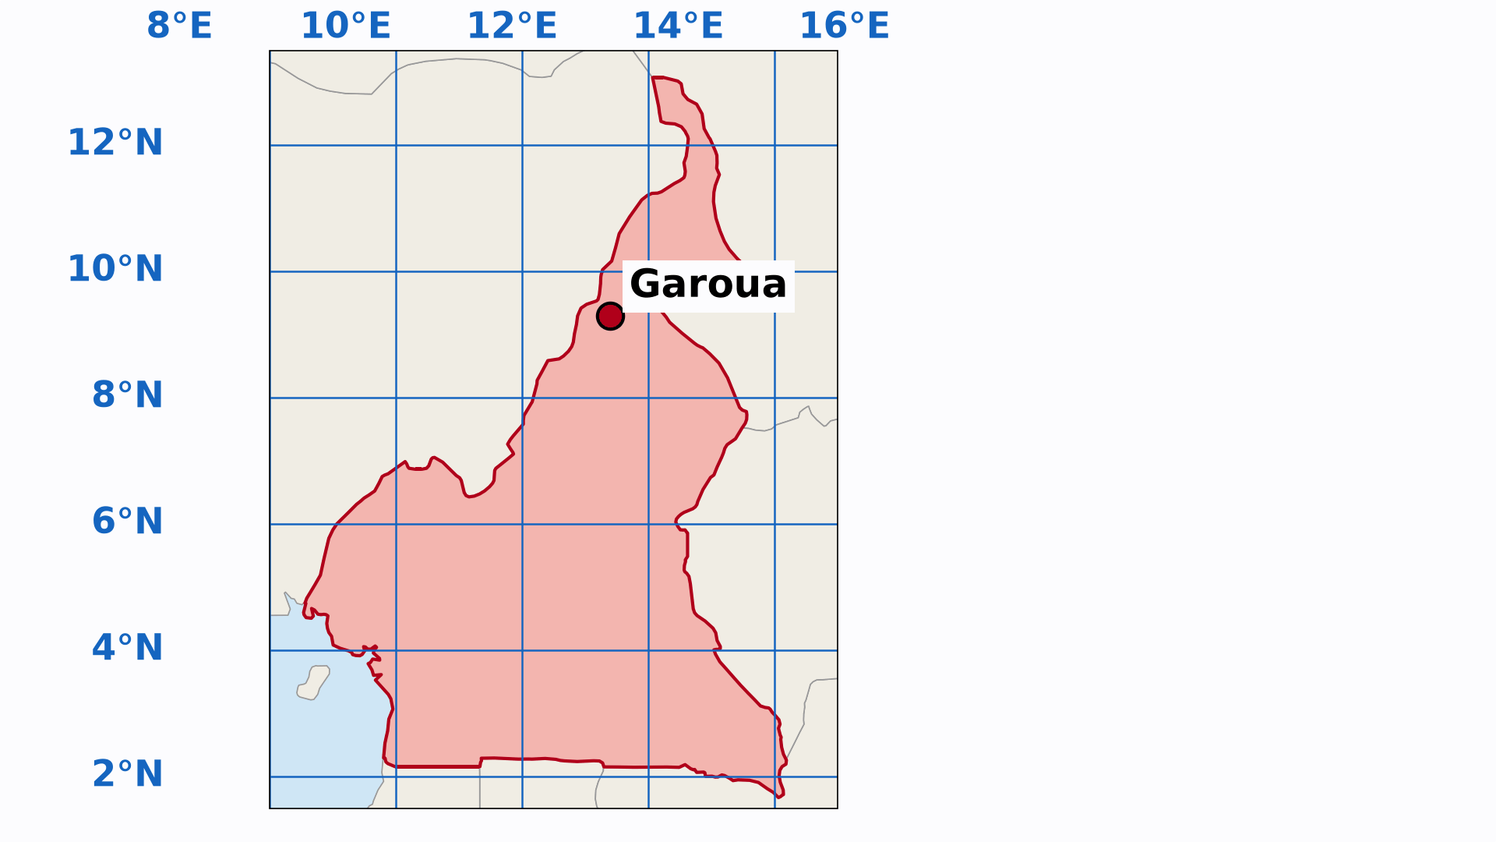
1. READING COORDINATES
Activity 3
Animation: finding a place on a grid.
Notes:
Activity 3. Look carefully at this animation: animation: finding a place on a grid. Watch the animation to the end; it will play again.

Slide 26
1. READING COORDINATES
Activity 3: Question
Which do we write first: the latitude or the longitude?
Notes:
Here is the question for Activity 3: Which do we write first: the latitude or the longitude? Take one minute to think and write your answer in your rough notebook.

Slide 27
1. READING COORDINATES
Activity 3: Answer
The latitude first, then the longitude, for example 9° N, 13° E.
Notes:
Let us check the answer together. The latitude first, then the longitude, for example 9° N, 13° E.

Slide 28
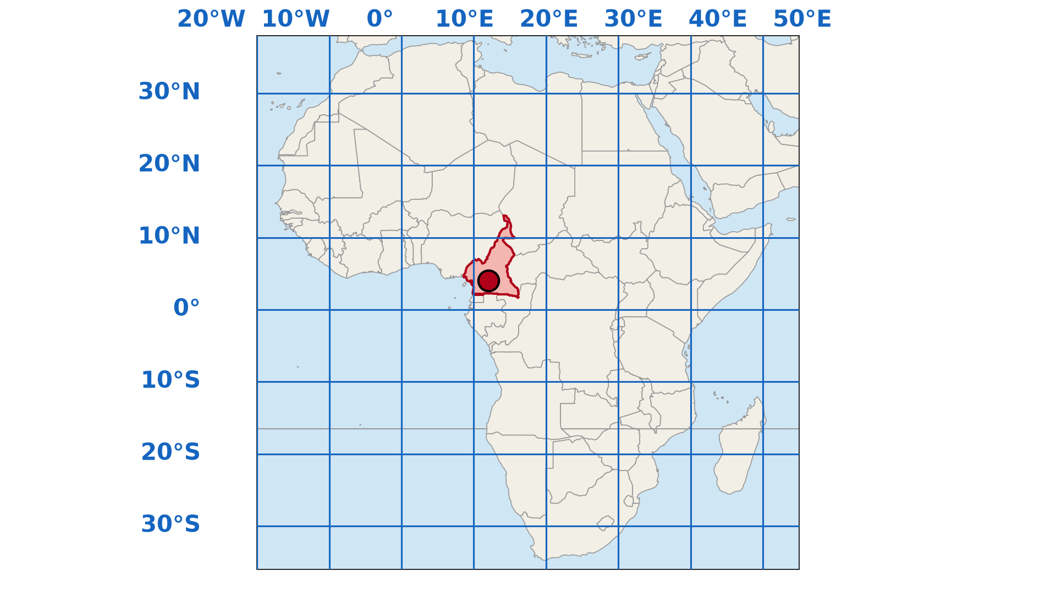
2. LOCATING CAMEROON
Activity 4
Africa with lines of latitude and longitude.
Notes:
Activity 4. Look carefully at this diagram: africa with lines of latitude and longitude. Observe every detail before I ask the question.

Slide 29
2. LOCATING CAMEROON
Activity 4: Question
Between which lines of latitude is Cameroon found?
Notes:
Here is the question for Activity 4: Between which lines of latitude is Cameroon found? Take one minute to think and write your answer in your rough notebook.

Slide 30
2. LOCATING CAMEROON
Activity 4: Answer
Between about 2° N and 13° N.
Notes:
Let us check the answer together. Between about 2° N and 13° N.

Slide 31

3. SITUATING TOWNS
Activity 5
Towns of Cameroon on a grid.
Notes:
Activity 5. Look carefully at this diagram: towns of Cameroon on a grid. Observe every detail before I ask the question.

Slide 32
3. SITUATING TOWNS
Activity 5: Question
What are the coordinates of Garoua?
Notes:
Here is the question for Activity 5: What are the coordinates of Garoua? Take one minute to think and write your answer in your rough notebook.

Slide 33
3. SITUATING TOWNS
Activity 5: Answer
About 9° N, 13° E.
Notes:
Let us check the answer together. About 9° N, 13° E.

Slide 34
BOARD SUMMARY
Board Summary
Topic: The Earth in the Universe
Sub-topic: The Earth: A Planet of the Solar System
Practical Work 2: Locate a Place on a Map
Notes:
Now we are going to copy the board summary. Write the title and the headings neatly in your notebooks. I will give you enough time for each slide, so do not rush.

Slide 35
BOARD SUMMARY
DEFINITIONS
The key terms of this lesson are defined as follows:
Latitude: It is the distance of a place north or south of the Equator, measured in degrees.
Notes:
Let us copy the definitions. The key terms of this lesson are defined as follows. On this slide we have Latitude. Write each point on a new line, with the key term first, and explain it in your own words when we revise. When you finish, we go to the next slide.

Slide 36
BOARD SUMMARY
DEFINITIONS (continued)
Longitude: It is the distance of a place east or west of the Greenwich Meridian, measured in degrees.
Geographical coordinates: They are the latitude and the longitude of a place.
Notes:
We continue with the definitions. On this slide we have Longitude and Geographical coordinates. Write each point on a new line, with the key term first, and explain it in your own words when we revise.

Slide 37
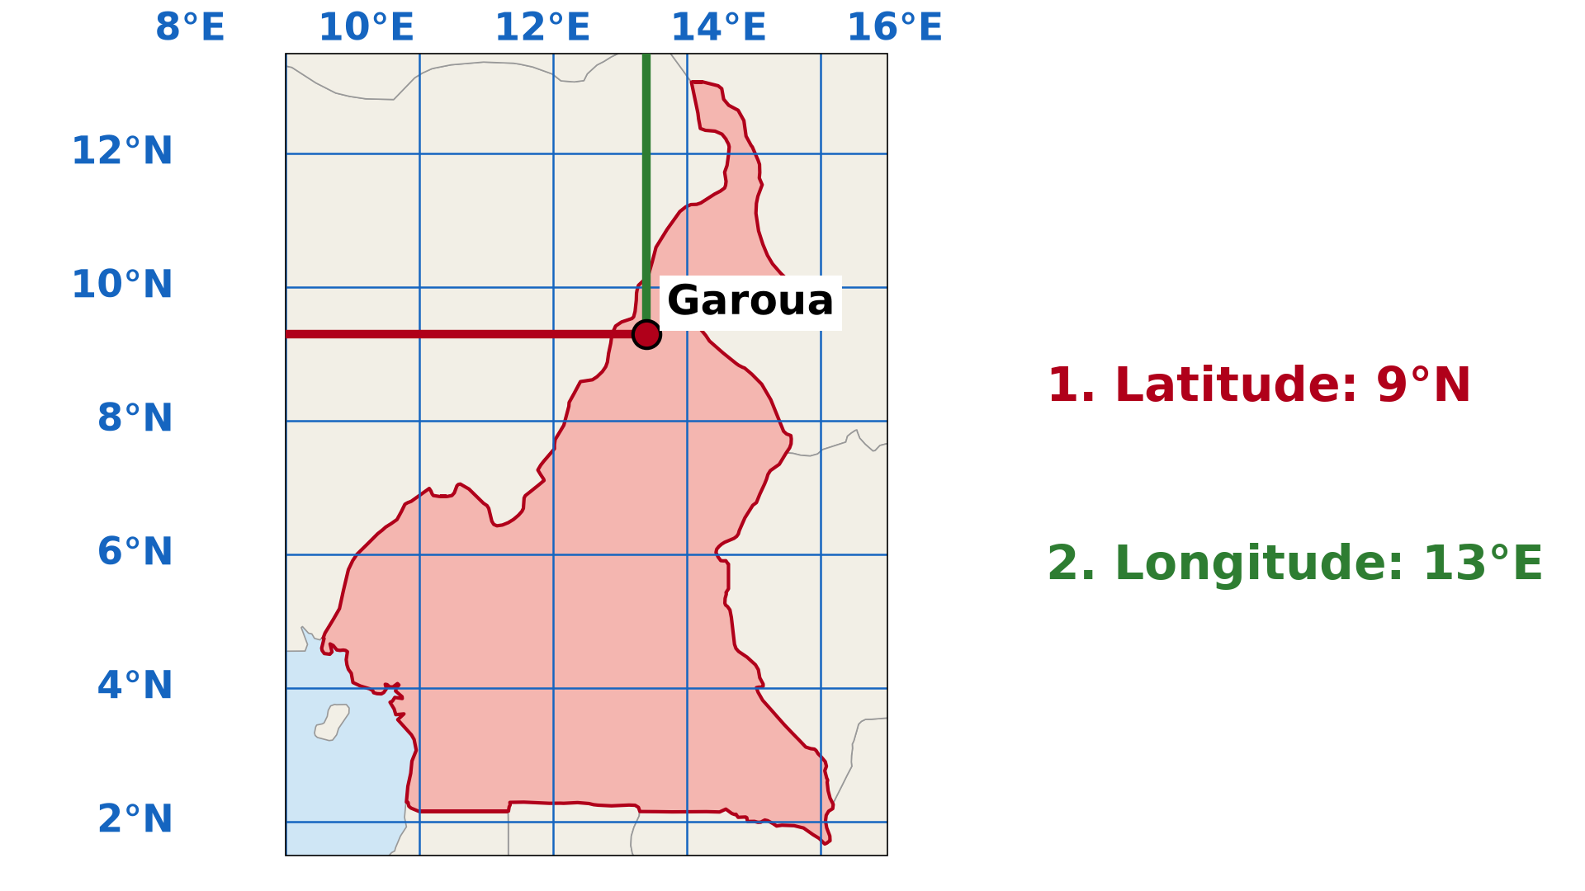
BOARD SUMMARY
1. Reading the Coordinates of a Place
We read the coordinates of a place in the following steps:
Step 1: We find the place on the map.
Illustration: reading coordinates on a grid
Notes:
Let us copy Reading the Coordinates of a Place. We read the coordinates of a place in the following steps. Copy the point on Step 1 on the left, then draw the diagram on the right: reading coordinates on a grid. Give it a title and label it clearly.

Slide 38
BOARD SUMMARY
1. Reading the Coordinates of a Place
Step 2: We follow the line of latitude to the side of the map and read its value with N or S.
Step 3: We follow the line of longitude to the top or bottom of the map and read its value with E or W.
Notes:
We continue with Reading the Coordinates of a Place. On this slide we have Step 2 and Step 3. Write each point on a new line, with the key term first, and explain it in your own words when we revise. When you finish, we go to the next slide.

Slide 39
BOARD SUMMARY
1. Reading the Coordinates of a Place (continued)
Step 4: We write the latitude first and the longitude second, for example 9° N, 13° E.
Notes:
We continue with Reading the Coordinates of a Place. On this slide we have Step 4. Write each point on a new line, with the key term first, and explain it in your own words when we revise.

Slide 40
BOARD SUMMARY
2. Locating Cameroon on the Map of Africa
Cameroon is located as follows:
Latitudes: Cameroon lies between about 2° N and 13° N, just north of the Equator.
Illustration: Cameroon on the map of Africa
Notes:
Let us copy Locating Cameroon on the Map of Africa. Cameroon is located as follows. Copy the point on Latitudes on the left, then draw the diagram on the right: cameroon on the map of Africa. Give it a title and label it clearly.

Slide 41
BOARD SUMMARY
2. Locating Cameroon on the Map of Africa
Longitudes: Cameroon lies between about 8° E and 16° E, east of the Greenwich Meridian.
Notes:
We continue with Locating Cameroon on the Map of Africa. On this slide we have Longitudes. Write each point on a new line, with the key term first, and explain it in your own words when we revise.

Slide 42
BOARD SUMMARY
3. Situating Towns of Cameroon
Some towns of Cameroon have the following coordinates:
Garoua: It is at about 9° N, 13° E.
Illustration: towns of Cameroon on a grid
Notes:
Let us copy Situating Towns of Cameroon. Some towns of Cameroon have the following coordinates. Copy the point on Garoua on the left, then draw the diagram on the right: towns of Cameroon on a grid. Give it a title and label it clearly.

Slide 43
BOARD SUMMARY
3. Situating Towns of Cameroon
Maroua: It is at about 11° N, 14° E.
Yaoundé: It is at about 4° N, 12° E.
Douala: It is at about 4° N, 10° E.
Notes:
We continue with Situating Towns of Cameroon. On this slide we have Maroua, Yaoundé and Douala. Write each point on a new line, with the key term first, and explain it in your own words when we revise.

Slide 44
FORMATIVE EVALUATION
Evaluation 1
Write the coordinates of Maroua (about 11° N, 14° E) and explain them.
Notes:
Now let us check what you have understood. Question 1: Write the coordinates of Maroua (about 11° N, 14° E) and explain them. Answer in your exercise book.

Slide 45
FORMATIVE EVALUATION
Expected Answer
11° north of the Equator and 14° east of the Greenwich Meridian.
Notes:
The expected answer is: 11° north of the Equator and 14° east of the Greenwich Meridian. If you got it right, well done.

Slide 46
FORMATIVE EVALUATION
Evaluation 2
Which comes first in coordinates?
Notes:
Now let us check what you have understood. Question 2: Which comes first in coordinates? Answer in your exercise book.

Slide 47
FORMATIVE EVALUATION
Expected Answer
The latitude.
Notes:
The expected answer is: the latitude. If you got it right, well done.

Slide 48
REMEDIATION
Remediation
Fill in the blanks:
The line of latitude 0° is the ______.
The line of longitude 0° is the ______ Meridian.
In coordinates, we write the ______ first.
Notes:
For those who need more practice, fill in the blanks in your exercise book. The answers are: number 1, Equator; number 2, Greenwich; number 3, latitude.

Slide 49
HOMEWORK
Homework
Name the two movements of the Earth.
Notes:
For your homework: Name the two movements of the Earth. We shall correct it at the beginning of our next lesson.

Slide 50
NEXT LESSON
Next Lesson
Our next lesson will be on:
Lesson 3: The Earth: A Planet Moving in Space
Notes:
Our next lesson will be on Lesson 3: The Earth: A Planet Moving in Space. Thank you for your attention, and see you next time.

Slide 51
BILINGUAL GAME
Bilingual Game (Jeu Bilingue)
English | Français
Latitude | La latitude
Longitude | La longitude
Coordinates | Les coordonnées
Degree | Le degré
North | Le nord
East | L'est
Notes:
Let us play the bilingual game. I say a word in English, and you give me the French word. Then we do the reverse.

Slide 52
LOGBOOK
Official Logbook (1/2)
Module / Topic | The Earth in the Universe
Lesson Title | Practical Work 2: Locate a Place on a Map
Expected Learning Outcomes | Read the coordinates of a place on a map. Locate Cameroon on the map of Africa with coordinates. Situate towns of Cameroon with coordinates.
Competence | Learners are able to read and write the geographical coordinates of a place.
Notes:
I record this information in the official logbook of the class after the lesson.

Slide 53
LOGBOOK
Official Logbook (2/2)
Matter Taught | DEFINITIONS; Reading the Coordinates of a Place; Locating Cameroon on the Map of Africa; Situating Towns of Cameroon.
Evaluation | Formative evaluation and remediation exercise.
Homework | Name the two movements of the Earth.
Enrolment / Present / Absent | ____ / ____ / ____
Achievement | To be completed after the lesson.
Notes:
I complete the second page of the logbook: the matter taught, the evaluation, the homework and the attendance.

Slide 54
TEACHER'S NOTE
Teacher's Note
Timing: Homework correction, plan, objectives 8 min | Recall, situation, action 10 min | 5 activities 30 min | Board summary (copying) 30 min | Evaluation, remediation 10 min | Homework, next lesson 5 min | Logbook 7 min
Activity 3 is an animation (GIF): it plays automatically in slide-show mode.
Without the projector (Activity 1): draw the Equator and the tropics.
Without the projector (Activity 2): draw meridians from pole to pole.
Without the projector (Activity 3): show the steps on a grid on the board.
Without the projector (Activity 4): use the atlas.
Without the projector (Activity 5): use the atlas.
Notes:
This slide is for me, the teacher: it gives the timing of the lesson and what to do if the projector is not available.

Slide 55
REFERENCES
References
Geography Syllabus, Forms I–V, MINESEC (2023) — Form 1, Module 1: The Earth in the Universe.
Diagrams and animations: drawn for this lesson (Geography Department).
Notes:
These are the references and picture credits used to prepare this lesson.

