Slide 1
FORM 2
GEOGRAPHY
Lesson 4
Man in the Tropical Zone
Notes:
Good morning, class, and welcome to our geography lesson. I am your geography teacher, Mr Kamdem. Today we are starting Lesson 4: Man in the Tropical Zone.

Slide 2
CLASS INFO
Class, Chapter and Duration
Class | Form 2
Chapter | Module 1: Man in his Environment
Duration | 2 periods (2 × 50 minutes)
Notes:
This lesson is for Form 2. It belongs to Module 1: Man in his Environment. We shall need 2 periods to cover it.

Slide 3
IDENTIFICATION
Lesson Identification
Topic | Man in his Environment
Sub-topic | Exploitation of Resources in the Natural Environment
Lesson | Lesson 4: Man in the Tropical Zone
Notions / Concepts | Tropical grassland, pastoral nomadism, wildlife, crop rotation, bush fallowing, cereals.
Syllabus focus | Location; brief presentation of the climatic characteristics and resources; methods of exploitation of the resources; problems faced; proposed solutions.
Competence | Learners are able to describe how people use the resources of the tropical zone and solve its problems.
Notes:
Our topic is Man in his Environment, and the sub-topic is Exploitation of Resources in the Natural Environment. The key notions we shall use today are: tropical grassland, pastoral nomadism, wildlife, crop rotation, bush fallowing, cereals. At the end, you should be able to do this: learners are able to describe how people use the resources of the tropical zone and solve its problems.

Slide 4

HOMEWORK CORRECTION
Correction of the Homework
Question (Further Study 1: Deforestation in Cameroon):
Name two resources of the tropical zone of Cameroon.
Notes:
Before we start the new lesson, let us correct the homework I gave you at the end of Further Study 1: Deforestation in Cameroon. The question was: Name two resources of the tropical zone of Cameroon. Take out your exercise books.

Slide 5
HOMEWORK CORRECTION
Correction: Possible Answer
Pasture for cattle and farmland for cotton (also wildlife and the Lagdo lake).
Notes:
Here is a good answer. Pasture for cattle and farmland for cotton (also wildlife and the Lagdo lake). Compare it with your own answer and correct your work in red.

Slide 6
LESSON PLAN
Lesson Plan
Correction of the homework
Objectives and recall
Real-life situation and action to take
Learning activities
Board summary
Evaluation, remediation and homework
Notes:
Here is the plan of our lesson today. First, we shall correct the homework. Then we shall look at the objectives and recall what you already know. After that, we shall study a situation from real life and the action to take, and do the learning activities. Finally, we shall copy the board summary, do the evaluation and the remediation, and I will give you the homework.

Slide 7
OBJECTIVES
Objectives
By the end of this lesson, you should be able to:
Locate the tropical zone and describe its climate and resources.
Describe the methods of exploitation of its resources.
Notes:
Take your time to copy this part; we will continue together.

Slide 8
OBJECTIVES
Objectives (continued)
Explain the problems faced and propose solutions.
Notes:
By the end of this lesson, you should be able to do three things. Number 1: locate the tropical zone and describe its climate and resources. Number 2: describe the methods of exploitation of its resources. Number 3: explain the problems faced and propose solutions.

Slide 9
PREVIOUS KNOWLEDGE
Previous Knowledge
Garoua has a rainy season and a dry season.
The savanna has grass and scattered trees.
Many cattle are reared in the north.
Notes:
Let us first remember what you already know. Garoua has a rainy season and a dry season. The savanna has grass and scattered trees. Many cattle are reared in the north. Keep this in mind, because we shall build on it today.

Slide 10
REAL-LIFE SITUATION
Situation in Real Life
Near Garoua, farmers grow cotton, maize and sorghum in the rainy season. In the dry season, herders move their cattle to find grass and water, and sometimes the cattle enter the farms. A farmer asks the chief: "How can farmers and herders share the land without fighting?"
Notes:
Listen carefully to this situation from real life. Near Garoua, farmers grow cotton, maize and sorghum in the rainy season. In the dry season, herders move their cattle to find grass and water, and sometimes the cattle enter the farms. A farmer asks the chief: "How can farmers and herders share the land without fighting?" Think about it, because I am going to ask you some questions.

Slide 11
REAL-LIFE SITUATION
Situation: Question 1
What is the problem in the situation?
Notes:
Question 1: What is the problem in the situation? Think for a moment, then raise your hand to answer.

Slide 12
REAL-LIFE SITUATION
Answer
Farmers and herders compete for land and water.
Notes:
Good. Farmers and herders compete for land and water.

Slide 13
REAL-LIFE SITUATION
Situation: Question 2
Name two crops of the area.
Notes:
Question 2: Name two crops of the area. Think for a moment, then raise your hand to answer.

Slide 14
REAL-LIFE SITUATION
Answer
Cotton and sorghum (also maize).
Notes:
Good. Cotton and sorghum (also maize).

Slide 15
REAL-LIFE SITUATION
Situation: Question 3
Why do herders move in the dry season?
Notes:
Question 3: Why do herders move in the dry season? Think for a moment, then raise your hand to answer.

Slide 16
REAL-LIFE SITUATION
Possible Answer
To find grass and water.
Notes:
Good. To find grass and water.

Slide 17
ACTION TO TAKE
Action to Take
Respect grazing zones and protect wildlife.
Notes:
From this situation, the action we are working towards in this lesson is the following: respect grazing zones and protect wildlife.

Slide 18
JUSTIFICATION
Justification of the Lesson
This lesson helps us to understand life and activities in our own tropical zone.
Notes:
Why is this lesson important for you? This lesson helps us to understand life and activities in our own tropical zone.

Slide 19
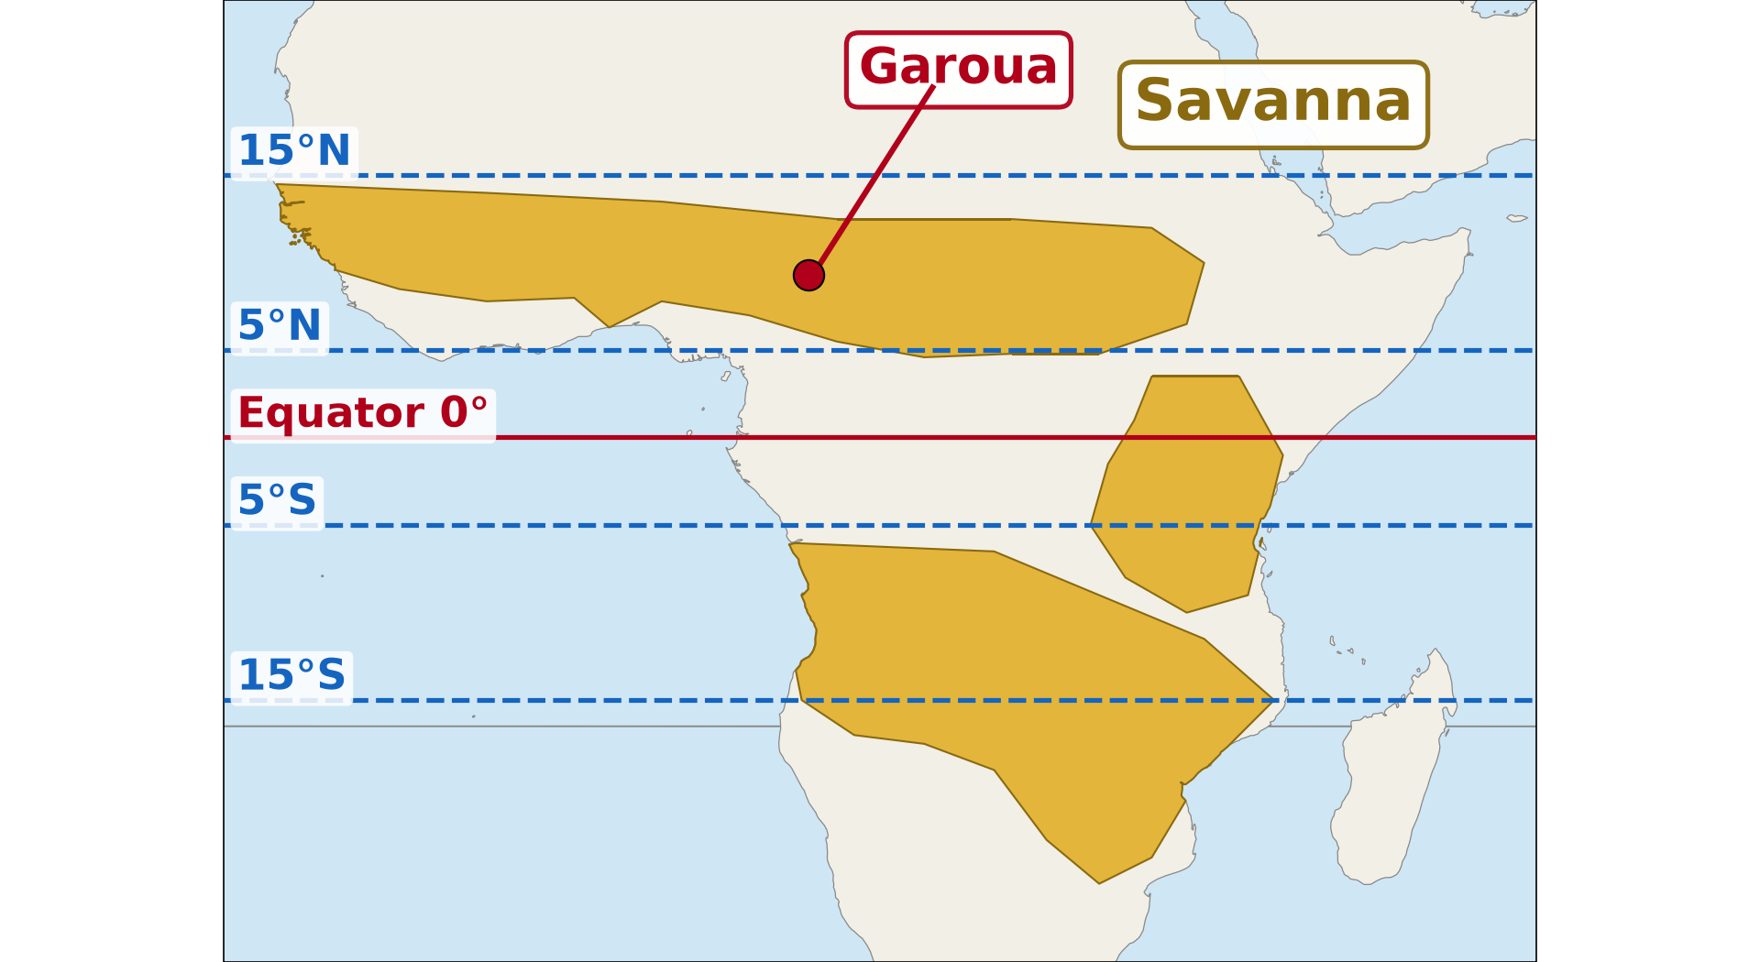
1. LOCATION
Activity 1
Savanna regions of Africa.
Notes:
Activity 1. Look carefully at this diagram: savanna regions of Africa. Observe every detail before I ask the question.

Slide 20
1. LOCATION
Activity 1: Question
Is northern Cameroon in the tropical zone?
Notes:
Here is the question for Activity 1: Is northern Cameroon in the tropical zone? Take one minute to think and write your answer in your rough notebook.

Slide 21
1. LOCATION
Activity 1: Answer
Yes, the tropical zone lies between about 5° and 15° north and south of the Equator.
Notes:
Let us check the answer together. Yes, the tropical zone lies between about 5° and 15° north and south of the Equator.

Slide 22

1. CLIMATE
Activity 2
The climate of Garoua.
Notes:
Activity 2. Look carefully at this diagram: the climate of Garoua. Observe every detail before I ask the question.

Slide 23
1. CLIMATE
Activity 2: Question
How many seasons does Garoua have?
Notes:
Here is the question for Activity 2: How many seasons does Garoua have? Take one minute to think and write your answer in your rough notebook.

Slide 24
1. CLIMATE
Activity 2: Answer
Two: a rainy season and a long dry season.
Notes:
Let us check the answer together. Two: a rainy season and a long dry season.

Slide 25

1. RESOURCES
Activity 3
Wildlife in the savanna.
Notes:
Activity 3. Look carefully at this picture: wildlife in the savanna. Observe every detail before I ask the question.

Slide 26
1. RESOURCES
Activity 3: Question
Which resource of the savanna do these animals represent?
Notes:
Here is the question for Activity 3: Which resource of the savanna do these animals represent? Take one minute to think and write your answer in your rough notebook.

Slide 27
1. RESOURCES
Activity 3: Answer
Wildlife, which attracts tourists to parks such as Waza and Bénoué.
Notes:
Let us check the answer together. Wildlife, which attracts tourists to parks such as Waza and Bénoué.

Slide 28
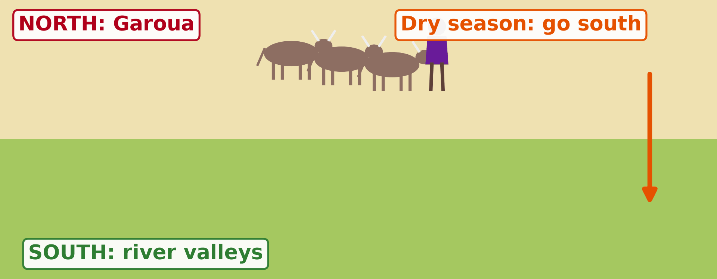
2. METHODS OF EXPLOITATION
Activity 4
Animation: herders move with their cattle.
Notes:
Activity 4. Look carefully at this animation: animation: herders move with their cattle. Watch the animation to the end; it will play again.

Slide 29
2. METHODS OF EXPLOITATION
Activity 4: Question
Why do these herders move with their cattle?
Notes:
Here is the question for Activity 4: Why do these herders move with their cattle? Take one minute to think and write your answer in your rough notebook.

Slide 30
2. METHODS OF EXPLOITATION
Activity 4: Answer
To find grass and water in the dry season: this is pastoral nomadism or transhumance.
Notes:
Let us check the answer together. To find grass and water in the dry season: this is pastoral nomadism or transhumance.

Slide 31

3. PROBLEMS
Activity 5
A bush fire.
Notes:
Activity 5. Look carefully at this picture: a bush fire. Observe every detail before I ask the question.

Slide 32
3. PROBLEMS
Activity 5: Question
What damage do bush fires cause in the savanna?
Notes:
Here is the question for Activity 5: What damage do bush fires cause in the savanna? Take one minute to think and write your answer in your rough notebook.

Slide 33
3. PROBLEMS
Activity 5: Answer
They burn the grass and trees and leave the soil bare.
Notes:
Let us check the answer together. They burn the grass and trees and leave the soil bare.

Slide 34
BOARD SUMMARY
Board Summary
Topic: Man in his Environment
Sub-topic: Exploitation of Resources in the Natural Environment
Lesson 4: Man in the Tropical Zone
Notes:
Now we are going to copy the board summary. Write the title and the headings neatly in your notebooks. I will give you enough time for each slide, so do not rush.

Slide 35
BOARD SUMMARY
DEFINITIONS
The key terms of this lesson are defined as follows:
Tropical zone: It is the hot zone with a rainy season and a dry season, covered by savanna.
Pastoral nomadism: It is moving with animals from place to place to find grass and water.
Notes:
Let us copy the definitions. The key terms of this lesson are defined as follows. On this slide we have Tropical zone and Pastoral nomadism. Write each point on a new line, with the key term first, and explain it in your own words when we revise. When you finish, we go to the next slide.

Slide 36
BOARD SUMMARY
DEFINITIONS (continued)
Crop rotation: It is growing different crops on the same land from year to year.
Notes:
We continue with the definitions. On this slide we have Crop rotation. Write each point on a new line, with the key term first, and explain it in your own words when we revise.

Slide 37
BOARD SUMMARY
1. Brief Presentation of the Tropical Zone
The tropical zone is presented as follows:
Location: It lies between about 5° and 15° north and south of the Equator, including northern Cameroon.
Illustration: the savanna regions of Africa
Notes:
Let us copy Brief Presentation of the Tropical Zone. The tropical zone is presented as follows. Copy the point on Location on the left, then draw the diagram on the right: the savanna regions of Africa. Give it a title and label it clearly.

Slide 38
BOARD SUMMARY
1. Brief Presentation of the Tropical Zone
Climate: It is hot all year, with a rainy season and a long dry season.
Illustration: the climate of Garoua
Notes:
Copy the point on Climate on the left, then draw the diagram on the right: the climate of Garoua. Give it a title and label it clearly.

Slide 39

BOARD SUMMARY
1. Brief Presentation of the Tropical Zone
Resources: It has grassland for animals, land for cereals and cotton, wildlife and rivers.
Illustration: the savanna
Notes:
Copy the point on Resources on the left, then draw the diagram on the right: the savanna. Give it a title and label it clearly.

Slide 40

BOARD SUMMARY
2. Methods of Exploitation of the Resources
The resources are exploited in the following ways:
Crop farming: Farmers grow cereals (sorghum, millet, maize) and cotton using bush fallowing and crop rotation.
Illustration: a cotton farm
Notes:
Let us copy Methods of Exploitation of the Resources. The resources are exploited in the following ways. Copy the point on Crop farming on the left, then draw the diagram on the right: a cotton farm. Give it a title and label it clearly.

Slide 41
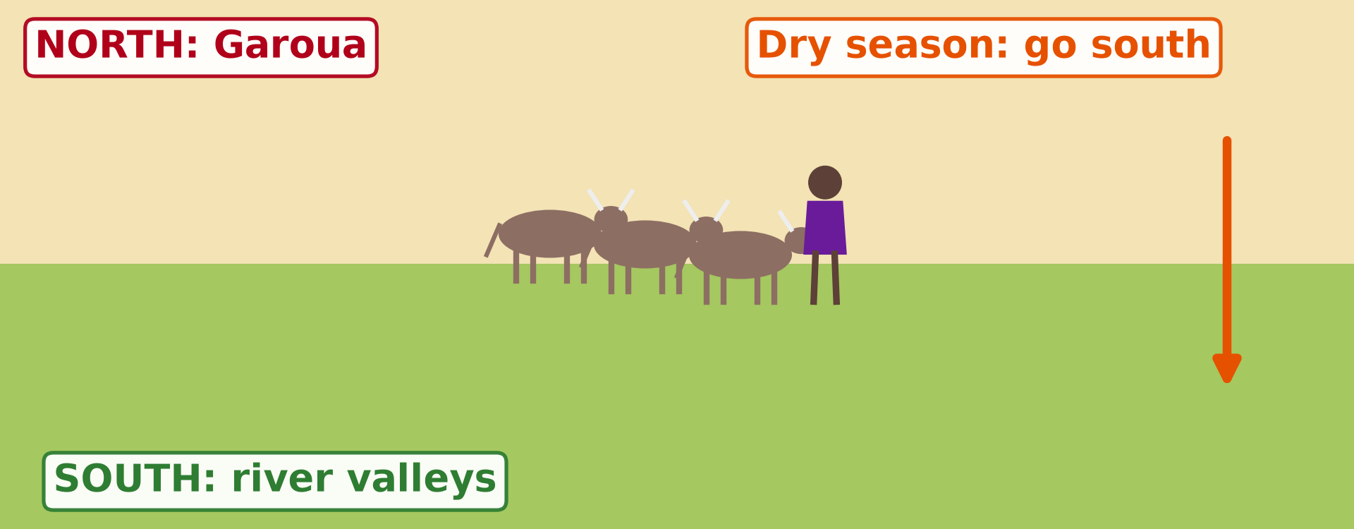
BOARD SUMMARY
2. Methods of Exploitation of the Resources
Pastoral nomadism and transhumance: Herders move with cattle, sheep and goats to find grass and water.
Illustration: transhumance
Notes:
Copy the point on Pastoral nomadism and transhumance on the left, then draw the diagram on the right: transhumance. Give it a title and label it clearly.

Slide 42

BOARD SUMMARY
2. Methods of Exploitation of the Resources
Tourism: National parks such as Waza and Bénoué attract tourists.
Illustration: a national park
Notes:
Copy the point on Tourism on the left, then draw the diagram on the right: a national park. Give it a title and label it clearly.

Slide 43
BOARD SUMMARY
2. Methods of Exploitation of the Resources
Fishing and irrigation: People fish and grow onions and rice near rivers and lakes.
Notes:
We continue with Methods of Exploitation of the Resources. On this slide we have Fishing and irrigation. Write each point on a new line, with the key term first, and explain it in your own words when we revise.

Slide 44

BOARD SUMMARY
3. Problems Faced
People face the following problems:
Drought: The rains are short and irregular.
Illustration: drought
Notes:
Let us copy Problems Faced. People face the following problems. Copy the point on Drought on the left, then draw the diagram on the right: drought. Give it a title and label it clearly.

Slide 45
BOARD SUMMARY
3. Problems Faced
Bush fires: Fires burn the grass and trees.
Soil erosion and overgrazing: Too many animals and bare soils damage the land.
Farmer–herder conflicts: Cattle enter the farms and destroy crops.
Notes:
We continue with Problems Faced. On this slide we have Bush fires, Soil erosion and overgrazing and Farmer–herder conflicts. Write each point on a new line, with the key term first, and explain it in your own words when we revise.

Slide 46

BOARD SUMMARY
4. Proposed Solutions
The following solutions are proposed:
Irrigation: Water from rivers and wells is used for farming.
Illustration: irrigated rice
Notes:
Let us copy Proposed Solutions. The following solutions are proposed. Copy the point on Irrigation on the left, then draw the diagram on the right: irrigated rice. Give it a title and label it clearly.

Slide 47
BOARD SUMMARY
4. Proposed Solutions
Firebreaks: Bare strips stop bush fires.
Grazing zones: Separate zones for animals reduce conflicts.
Tree planting: Trees protect the soil and give shade.
Notes:
We continue with Proposed Solutions. On this slide we have Firebreaks, Grazing zones and Tree planting. Write each point on a new line, with the key term first, and explain it in your own words when we revise.

Slide 48
FORMATIVE EVALUATION
Evaluation 1
Give two cereals of the tropical zone.
Notes:
Now let us check what you have understood. Question 1: Give two cereals of the tropical zone. Answer in your exercise book.

Slide 49
FORMATIVE EVALUATION
Expected Answer
Sorghum and millet (also maize).
Notes:
The expected answer is: sorghum and millet (also maize). If you got it right, well done.

Slide 50
FORMATIVE EVALUATION
Evaluation 2
Give two problems of the tropical zone.
Notes:
Now let us check what you have understood. Question 2: Give two problems of the tropical zone. Answer in your exercise book.

Slide 51
FORMATIVE EVALUATION
Expected Answer
Drought and bush fires.
Notes:
The expected answer is: drought and bush fires. If you got it right, well done.

Slide 52
REMEDIATION
Remediation
Fill in the blanks:
Moving with animals to find grass is pastoral ______.
Changing crops on the same land each year is crop ______.
A national park in the North is ______.
Notes:
For those who need more practice, fill in the blanks in your exercise book. The answers are: number 1, nomadism; number 2, rotation; number 3, Bénoué (or Waza).

Slide 53
HOMEWORK
Homework
Give two causes of the firewood crisis.
Notes:
For your homework: Give two causes of the firewood crisis. We shall correct it at the beginning of our next lesson.

Slide 54
NEXT LESSON
Next Lesson
Our next lesson will be on:
Further Study 2: The Firewood Crisis
Notes:
Our next lesson will be on Further Study 2: The Firewood Crisis. Thank you for your attention, and see you next time.

Slide 55
BILINGUAL GAME
Bilingual Game (Jeu Bilingue)
English | Français
Savanna | La savane
Cattle | Le bétail
Herder | L'éleveur
Cereal | La céréale
Cotton | Le coton
Drought | La sécheresse
Notes:
Let us play the bilingual game. I say a word in English, and you give me the French word. Then we do the reverse.

Slide 56
LOGBOOK
Official Logbook (1/2)
Module / Topic | Man in his Environment
Lesson Title | Lesson 4: Man in the Tropical Zone
Expected Learning Outcomes | Locate the tropical zone and describe its climate and resources. Describe the methods of exploitation of its resources. Explain the problems faced and propose solutions.
Competence | Learners are able to describe how people use the resources of the tropical zone and solve its problems.
Notes:
I record this information in the official logbook of the class after the lesson.

Slide 57
LOGBOOK
Official Logbook (2/2)
Matter Taught | DEFINITIONS; Brief Presentation of the Tropical Zone; Methods of Exploitation of the Resources; Problems Faced; Proposed Solutions.
Evaluation | Formative evaluation and remediation exercise.
Homework | Give two causes of the firewood crisis.
Enrolment / Present / Absent | ____ / ____ / ____
Achievement | To be completed after the lesson.
Notes:
I complete the second page of the logbook: the matter taught, the evaluation, the homework and the attendance.

Slide 58
TEACHER'S NOTE
Teacher's Note
Timing: Homework correction, plan, objectives 8 min | Recall, situation, action 10 min | 5 activities 30 min | Board summary (copying) 30 min | Evaluation, remediation 10 min | Homework, next lesson 5 min | Logbook 7 min
Activity 4 is an animation (GIF): it plays automatically in slide-show mode.
Without the projector (Activity 1): use the atlas.
Without the projector (Activity 2): describe the seasons of Garoua.
Without the projector (Activity 3): list resources of the North.
Without the projector (Activity 4): describe herders of the North.
Without the projector (Activity 5): discuss problems of the North.
Notes:
This slide is for me, the teacher: it gives the timing of the lesson and what to do if the projector is not available.

Slide 59
REFERENCES
References
Geography Syllabus, Forms I–V, MINESEC (2023) — Form 2, Module 1: Man in his Environment.
Photo, Activity 3: “African Bush Elephants, Maasai Mara” by Ray in Manila, CC BY 2.0, via Flickr (https://www.flickr.com/photos/21186555@N07/50627864261)
Photo, Activity 5: “20111216-NRCS-LSC-0355” by USDAgov, CC BY 2.0, via Flickr (https://www.flickr.com/photos/41284017@N08/6551564351)
Photo, board summary (Resources): “Blue Wildebeest in the Lowveld” by Martin_Heigan, CC BY-NC-ND 2.0, via Flickr (https://www.flickr.com/photos/97303475@N00/2089079933)
Photo, board summary (Crop farming): “Cotton Fields, U.S. 65, Tensas Parish, Louisiana (4)” by Ken Lund, CC BY-SA 2.0, via Flickr (https://www.flickr.com/photos/75683070@N00/3934873451)
Photo, board summary (Tourism): “Sri Lankan Leopard” by Shanaka Kalubowila, CC BY-NC-ND 2.0, via Flickr (https://www.flickr.com/photos/50057113@N06/43689916724)
Photo, board summary (Drought): “Imagine a world without trees” by aloshbennett, CC BY 2.0, via Flickr (https://www.flickr.com/photos/13203757@N00/3480223314)
Notes:
Take your time to copy this part; we will continue together.

Slide 60
REFERENCES
References (continued)
Photo, board summary (Irrigation): “Irrigated rice fields in Sefula, Zambia. Photo by Kate Longley, 2013.” by WorldFish, CC BY-NC-ND 2.0, via Flickr (https://www.flickr.com/photos/61545321@N06/8608804590)
Diagrams and animations: drawn for this lesson (Geography Department).
Notes:
These are the references and picture credits used to prepare this lesson.

