Slide 1
FORM 4
GEOGRAPHY
Lesson 5
The Rotation of the Earth
Notes:
Good morning, class, and welcome to our geography lesson. I am your geography teacher, Mr Kamdem. Today we are starting Lesson 5: The Rotation of the Earth.

Slide 2
CLASS INFO
Class, Chapter and Duration
Class | Form 4
Chapter | The Earth as a Planet in the Solar System — Location and Time
Duration | 50 minutes
Notes:
This lesson is for Form 4. It belongs to The Earth as a Planet in the Solar System — Location and Time. We shall need 50 minutes to cover it.

Slide 3
IDENTIFICATION
Lesson Identification
Topic | The Earth as a Planet in the Solar System
Sub-topic | Location and Time
Lesson | Lesson 5: The Rotation of the Earth
Notions / Concepts | Axis, rotation, tides, deflection of winds and ocean currents.
Syllabus focus | Rotation: meaning, illustration and effects.
Competence | Learners are able to explain day and night, the rising of the Sun in the east, and the difference in time between places.
Notes:
Our topic is The Earth as a Planet in the Solar System, and the sub-topic is Location and Time. The key notions we shall use today are: axis, rotation, tides, deflection of winds and ocean currents. At the end, you should be able to do this: learners are able to explain day and night, the rising of the Sun in the east, and the difference in time between places.

Slide 4

HOMEWORK CORRECTION
Correction of the Homework
Question (Practical Work 2: Calculation of Time and Date):
Define the rotation of the Earth.
Notes:
Before we start the new lesson, let us correct the homework I gave you at the end of Practical Work 2: Calculation of Time and Date. The question was: Define the rotation of the Earth. Take out your exercise books.

Slide 5
HOMEWORK CORRECTION
Correction: Possible Answer
It is the turning of the Earth on its axis from west to east.
Notes:
Here is a good answer. It is the turning of the Earth on its axis from west to east. Compare it with your own answer and correct your work in red.

Slide 6
LESSON PLAN
Lesson Plan
Correction of the homework
Objectives and recall
Real-life situation and action to take
Learning activities
Board summary
Evaluation, remediation and homework
Notes:
Here is the plan of our lesson today. First, we shall correct the homework. Then we shall look at the objectives and recall what you already know. After that, we shall study a situation from real life and the action to take, and do the learning activities. Finally, we shall copy the board summary, do the evaluation and the remediation, and I will give you the homework.

Slide 7
OBJECTIVES
Objectives
By the end of this lesson, you should be able to:
Define rotation and the axis of the Earth.
Illustrate the rotation of the Earth.
Explain the effects of rotation.
Notes:
By the end of this lesson, you should be able to do three things. Number 1: define rotation and the axis of the Earth. Number 2: illustrate the rotation of the Earth. Number 3: explain the effects of rotation.

Slide 8
PREVIOUS KNOWLEDGE
Previous Knowledge
15° of longitude = 1 hour.
Places to the east are ahead in time.
Cameroon uses GMT + 1.
Notes:
Let us first remember what you already know. 15° of longitude = 1 hour. Places to the east are ahead in time. Cameroon uses GMT + 1. Keep this in mind, because we shall build on it today.

Slide 9
REAL-LIFE SITUATION
Situation in Real Life
Every morning in Garoua, the first light appears in the east, and in the evening the Sun disappears in the west. Oumarou's little sister thinks that the Sun walks around the Earth every day. She asks: "What really moves, and why do we have day and night?"
Notes:
Listen carefully to this situation from real life. Every morning in Garoua, the first light appears in the east, and in the evening the Sun disappears in the west. Oumarou's little sister thinks that the Sun walks around the Earth every day. She asks: "What really moves, and why do we have day and night?" Think about it, because I am going to ask you some questions.

Slide 10
REAL-LIFE SITUATION
Situation: Question 1
What is the problem in the situation?
Notes:
Question 1: What is the problem in the situation? Think for a moment, then raise your hand to answer.

Slide 11
REAL-LIFE SITUATION
Answer
The sister does not know what really causes day and night.
Notes:
Good. The sister does not know what really causes day and night.

Slide 12
REAL-LIFE SITUATION
Situation: Question 2
Where does the Sun rise and set?
Notes:
Question 2: Where does the Sun rise and set? Think for a moment, then raise your hand to answer.

Slide 13
REAL-LIFE SITUATION
Answer
It rises in the east and sets in the west.
Notes:
Good. It rises in the east and sets in the west.

Slide 14
REAL-LIFE SITUATION
Situation: Question 3
What really moves?
Notes:
Question 3: What really moves? Think for a moment, then raise your hand to answer.

Slide 15
REAL-LIFE SITUATION
Possible Answer
The Earth turns on itself.
Notes:
Good. The Earth turns on itself.

Slide 16
ACTION TO TAKE
Action to Take
Use the rotation of the Earth to explain day, night and time differences.
Notes:
From this situation, the action we are working towards in this lesson is the following: use the rotation of the Earth to explain day, night and time differences.

Slide 17
JUSTIFICATION
Justification of the Lesson
This lesson helps us to understand day and night.
Notes:
Why is this lesson important for you? This lesson helps us to understand day and night.

Slide 18
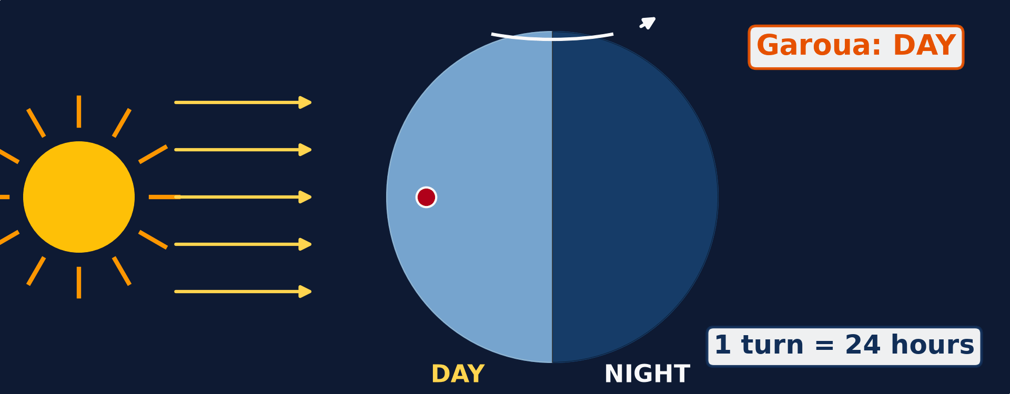
1. MEANING OF ROTATION
Activity 1
Animation: the Earth turns on itself.
Notes:
Activity 1. Look carefully at this animation: animation: the Earth turns on itself. Watch the animation to the end; it will play again.

Slide 19
1. MEANING OF ROTATION
Activity 1: Question
Watch Garoua (red dot). Why does it have day and then night?
Notes:
Here is the question for Activity 1: Watch Garoua (red dot). Why does it have day and then night? Take one minute to think and write your answer in your rough notebook.

Slide 20
1. MEANING OF ROTATION
Activity 1: Answer
The Earth turns: Garoua faces the Sun (day), then turns away from it (night).
Notes:
Let us check the answer together. The Earth turns: Garoua faces the Sun (day), then turns away from it (night).

Slide 21

2. EFFECTS OF ROTATION
Activity 2
The Sun low over the savanna.
Notes:
Activity 2. Look carefully at this picture: the Sun low over the savanna. Observe every detail before I ask the question.

Slide 22
2. EFFECTS OF ROTATION
Activity 2: Question
Why does the Sun seem to rise in the east?
Notes:
Here is the question for Activity 2: Why does the Sun seem to rise in the east? Take one minute to think and write your answer in your rough notebook.

Slide 23
2. EFFECTS OF ROTATION
Activity 2: Answer
The Earth turns from west to east.
Notes:
Let us check the answer together. The Earth turns from west to east.

Slide 24
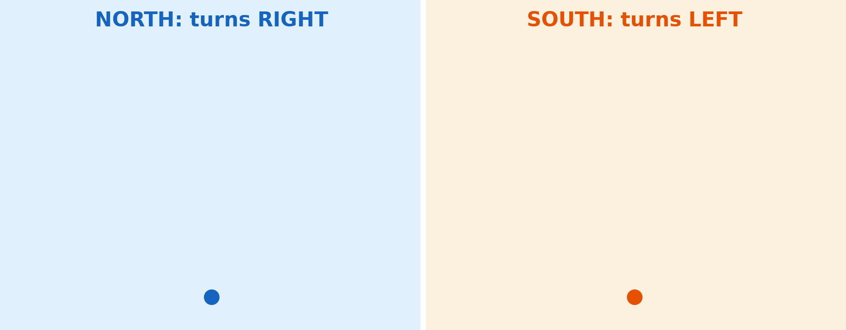
2. EFFECTS OF ROTATION
Activity 3
Animation: winds are bent by the rotation of the Earth.
Notes:
Activity 3. Look carefully at this animation: animation: winds are bent by the rotation of the Earth. Watch the animation to the end; it will play again.

Slide 25
2. EFFECTS OF ROTATION
Activity 3: Question
In which direction are winds bent in the Northern Hemisphere?
Notes:
Here is the question for Activity 3: In which direction are winds bent in the Northern Hemisphere? Take one minute to think and write your answer in your rough notebook.

Slide 26
2. EFFECTS OF ROTATION
Activity 3: Answer
To the right.
Notes:
Let us check the answer together. To the right.

Slide 27
BOARD SUMMARY
Board Summary
Topic: The Earth as a Planet in the Solar System
Sub-topic: Location and Time
Lesson 5: The Rotation of the Earth
Notes:
Now we are going to copy the board summary. Write the title and the headings neatly in your notebooks. I will give you enough time for each slide, so do not rush.

Slide 28
BOARD SUMMARY
DEFINITIONS
The key terms of this lesson are defined as follows:
Rotation: It is the turning of the Earth on its axis from west to east.
Axis: It is the imaginary line through the centre of the Earth from the North Pole to the South Pole.
Notes:
Let us copy the definitions. The key terms of this lesson are defined as follows. On this slide we have Rotation and Axis. Write each point on a new line, with the key term first, and explain it in your own words when we revise.

Slide 29
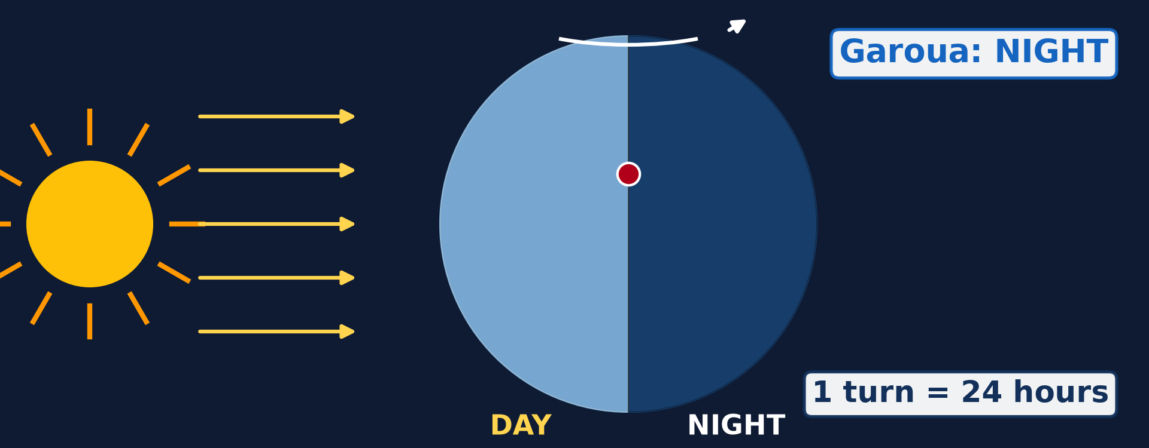
BOARD SUMMARY
1. Meaning and Illustration of Rotation
The rotation of the Earth is described as follows:
Direction: The Earth turns from west to east.
Illustration: the rotation of the Earth
Notes:
Let us copy Meaning and Illustration of Rotation. The rotation of the Earth is described as follows. Copy the point on Direction on the left, then draw the diagram on the right: the rotation of the Earth. Give it a title and label it clearly.

Slide 30
BOARD SUMMARY
1. Meaning and Illustration of Rotation
Duration: One complete turn takes 24 hours, which is one day.
Tilt of the axis: The axis is tilted at 23½° from the vertical.
Speed: A place on the Equator moves at about 1,670 km per hour.
Notes:
We continue with Meaning and Illustration of Rotation. On this slide we have Duration, Tilt of the axis and Speed. Write each point on a new line, with the key term first, and explain it in your own words when we revise.

Slide 31
BOARD SUMMARY
2. Effects of Rotation
The rotation of the Earth has the following effects:
Day and night: The side facing the Sun has day, while the other side has night.
Illustration: day and night
Notes:
Let us copy Effects of Rotation. The rotation of the Earth has the following effects. Copy the point on Day and night on the left, then draw the diagram on the right: day and night. Give it a title and label it clearly.

Slide 32
BOARD SUMMARY
2. Effects of Rotation
Sunrise in the east: The Sun seems to rise in the east and set in the west because the Earth turns eastwards.
Illustration: the Sun low over the savanna
Notes:
Copy the point on Sunrise in the east on the left, then draw the diagram on the right: the Sun low over the savanna. Give it a title and label it clearly.

Slide 33
BOARD SUMMARY
2. Effects of Rotation
Difference in time: Places to the east see the Sun first, so they are ahead in time.
Notes:
We continue with Effects of Rotation. On this slide we have Difference in time. Write each point on a new line, with the key term first, and explain it in your own words when we revise.

Slide 34
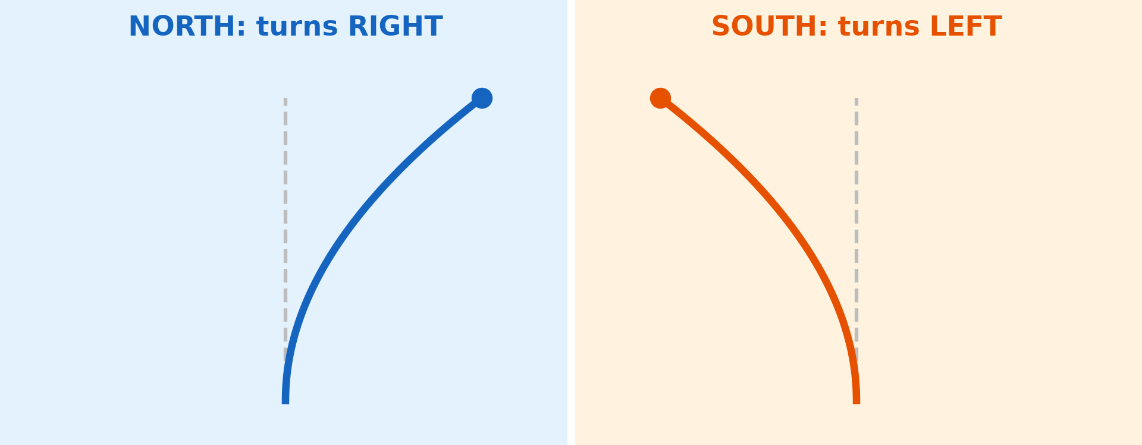
BOARD SUMMARY
2. Effects of Rotation
Deflection of winds and currents: Winds and ocean currents are bent to the right in the Northern Hemisphere and to the left in the Southern Hemisphere.
Illustration: deflection of winds
Notes:
Copy the point on Deflection of winds and currents on the left, then draw the diagram on the right: deflection of winds. Give it a title and label it clearly.

Slide 35
BOARD SUMMARY
2. Effects of Rotation
Tides: Rotation, with the pull of the Moon, gives two high tides and two low tides a day.
Notes:
We continue with Effects of Rotation. On this slide we have Tides. Write each point on a new line, with the key term first, and explain it in your own words when we revise.

Slide 36
FORMATIVE EVALUATION
Evaluation 1
What is rotation?
Notes:
Now let us check what you have understood. Question 1: What is rotation? Answer in your exercise book.

Slide 37
FORMATIVE EVALUATION
Expected Answer
The turning of the Earth on its axis.
Notes:
The expected answer is: the turning of the Earth on its axis. If you got it right, well done.

Slide 38
FORMATIVE EVALUATION
Evaluation 2
Give two effects of rotation.
Notes:
Now let us check what you have understood. Question 2: Give two effects of rotation. Answer in your exercise book.

Slide 39
FORMATIVE EVALUATION
Expected Answer
Day and night; the Sun seems to rise in the east.
Notes:
The expected answer is: day and night; the Sun seems to rise in the east. If you got it right, well done.

Slide 40
REMEDIATION
Remediation
Fill in the blanks:
The Earth turns on its ______.
One rotation takes ______ hours.
The Earth turns from west to ______.
Notes:
For those who need more practice, fill in the blanks in your exercise book. The answers are: number 1, axis; number 2, 24; number 3, east.

Slide 41
HOMEWORK
Homework
State how long the Earth takes to go around the Sun.
Notes:
For your homework: State how long the Earth takes to go around the Sun. We shall correct it at the beginning of our next lesson.

Slide 42
NEXT LESSON
Next Lesson
Our next lesson will be on:
Lesson 6: The Revolution of the Earth
Notes:
Our next lesson will be on Lesson 6: The Revolution of the Earth. Thank you for your attention, and see you next time.

Slide 43
BILINGUAL GAME
Bilingual Game (Jeu Bilingue)
English | Français
Rotation | La rotation
Axis | L'axe
Day | Le jour
Night | La nuit
Sunrise | Le lever du soleil
Sunset | Le coucher du soleil
Deflection | La déviation
Ocean current | Le courant marin
Notes:
Let us play the bilingual game. I say a word in English, and you give me the French word. Then we do the reverse.

Slide 44
LOGBOOK
Official Logbook (1/2)
Module / Topic | The Earth as a Planet in the Solar System
Lesson Title | Lesson 5: The Rotation of the Earth
Expected Learning Outcomes | Define rotation and the axis of the Earth. Illustrate the rotation of the Earth. Explain the effects of rotation.
Competence | Learners are able to explain day and night, the rising of the Sun in the east, and the difference in time between places.
Notes:
I record this information in the official logbook of the class after the lesson.

Slide 45
LOGBOOK
Official Logbook (2/2)
Matter Taught | DEFINITIONS; Meaning and Illustration of Rotation; Effects of Rotation.
Evaluation | Formative evaluation and remediation exercise.
Homework | State how long the Earth takes to go around the Sun.
Enrolment / Present / Absent | ____ / ____ / ____
Achievement | To be completed after the lesson.
Notes:
I complete the second page of the logbook: the matter taught, the evaluation, the homework and the attendance.

Slide 46
TEACHER'S NOTE
Teacher's Note
Timing: Homework correction, plan, objectives 4 min | Recall, situation, action 6 min | 3 activities 12 min | Board summary (copying) 15 min | Evaluation, remediation 5 min | Homework, next lesson 3 min | Logbook 5 min
Activities 1 and 3 are animations (GIF): it plays automatically in slide-show mode.
Without the projector (Activity 1): turn a ball with a mark on it in front of a torch.
Without the projector (Activity 2): ask learners where the Sun rises in Garoua.
Without the projector (Activity 3): draw a curved arrow on a circle.
Notes:
This slide is for me, the teacher: it gives the timing of the lesson and what to do if the projector is not available.

Slide 47
REFERENCES
References
National Geography Syllabus (MINESEC), Form 4 — The Earth as a Planet in the Solar System.
Teacher's lesson notes (Form 4), checked and corrected where necessary.
Photo, Activity 2: “African Sunrise, Amboseli National Park” by Ray in Manila, CC BY 2.0, via Flickr (https://www.flickr.com/photos/21186555@N07/30385097358)
Diagrams and animations: drawn for this lesson (Geography Department).
Notes:
These are the references and picture credits used to prepare this lesson.

