Slide 1
FORM 4
GEOGRAPHY
Lesson 24
Main Erosional Processes and Features of Wave Action
Notes:
Good morning, class, and welcome to our geography lesson. I am your geography teacher, Mr Kamdem. Today we are starting Lesson 24: Main Erosional Processes and Features of Wave Action.

Slide 2
CLASS INFO
Class, Chapter and Duration
Class | Form 4
Chapter | Denudation Processes, Landforms and Impacts on Man — Wave Action along the Coast and Impacts on Man
Duration | 50 minutes
Notes:
This lesson is for Form 4. It belongs to Denudation Processes, Landforms and Impacts on Man — Wave Action along the Coast and Impacts on Man. We shall need 50 minutes to cover it.

Slide 3
IDENTIFICATION
Lesson Identification
Topic | Denudation Processes, Landforms and Impacts on Man
Sub-topic | Wave Action along the Coast and Impacts on Man
Lesson | Lesson 24: Main Erosional Processes and Features of Wave Action
Notions / Concepts | Capes and bays, cliffs, wave-cut platforms, caves, arches, stacks and stumps.
Syllabus focus | Erosional processes of waves; erosional features (use local examples).
Competence | Learners are able to recognise and explain the landforms of a rocky coast, and to respect the dangers of cliffs and caves.
Notes:
Our topic is Denudation Processes, Landforms and Impacts on Man, and the sub-topic is Wave Action along the Coast and Impacts on Man. The key notions we shall use today are: capes and bays, cliffs, wave-cut platforms, caves, arches, stacks and stumps. At the end, you should be able to do this: learners are able to recognise and explain the landforms of a rocky coast, and to respect the dangers of cliffs and caves.

Slide 4

HOMEWORK CORRECTION
Correction of the Homework
Question (Lesson 23: Wave Action in Coastal Areas):
Name three erosional features of waves.
Notes:
Before we start the new lesson, let us correct the homework I gave you at the end of Lesson 23: Wave Action in Coastal Areas. The question was: Name three erosional features of waves. Take out your exercise books.

Slide 5
HOMEWORK CORRECTION
Correction: Possible Answer
The cliff, the cave and the arch (also the stack and the stump).
Notes:
Here is a good answer. The cliff, the cave and the arch (also the stack and the stump). Compare it with your own answer and correct your work in red.

Slide 6
LESSON PLAN
Lesson Plan
Correction of the homework
Objectives and recall
Real-life situation and action to take
Learning activities
Board summary
Evaluation, remediation and homework
Notes:
Here is the plan of our lesson today. First, we shall correct the homework. Then we shall look at the objectives and recall what you already know. After that, we shall study a situation from real life and the action to take, and do the learning activities. Finally, we shall copy the board summary, do the evaluation and the remediation, and I will give you the homework.

Slide 7
OBJECTIVES
Objectives
By the end of this lesson, you should be able to:
Explain the four erosional processes of waves.
Explain the formation of capes and bays, cliffs and wave-cut platforms.
Notes:
Take your time to copy this part; we will continue together.

Slide 8
OBJECTIVES
Objectives (continued)
Explain the formation of caves, arches, stacks and stumps.
Notes:
By the end of this lesson, you should be able to do three things. Number 1: explain the four erosional processes of waves. Number 2: explain the formation of capes and bays, cliffs and wave-cut platforms. Number 3: explain the formation of caves, arches, stacks and stumps.

Slide 9
PREVIOUS KNOWLEDGE
Previous Knowledge
Destructive waves erode the coast.
The backwash of destructive waves is stronger than the swash.
Rivers erode by hydraulic action, abrasion, attrition and solution.
Notes:
Let us first remember what you already know. Destructive waves erode the coast. The backwash of destructive waves is stronger than the swash. Rivers erode by hydraulic action, abrasion, attrition and solution. Keep this in mind, because we shall build on it today.

Slide 10
REAL-LIFE SITUATION
Situation in Real Life
On holiday in Limbe, Rahila sees big waves crash against the rocky coast. At the bottom of a rock face, the waves have cut a hollow and small caves, and a rock stands alone in the sea. She asks: "How can water cut such hard rock, and what shapes does it make?"
Notes:
Listen carefully to this situation from real life. On holiday in Limbe, Rahila sees big waves crash against the rocky coast. At the bottom of a rock face, the waves have cut a hollow and small caves, and a rock stands alone in the sea. She asks: "How can water cut such hard rock, and what shapes does it make?" Think about it, because I am going to ask you some questions.

Slide 11
REAL-LIFE SITUATION
Situation: Question 1
What is the problem in the situation?
Notes:
Question 1: What is the problem in the situation? Think for a moment, then raise your hand to answer.

Slide 12
REAL-LIFE SITUATION
Answer
Rahila does not understand how waves cut rock and what features they form.
Notes:
Good. Rahila does not understand how waves cut rock and what features they form.

Slide 13
REAL-LIFE SITUATION
Situation: Question 2
What did the waves cut at the bottom of the rock face?
Notes:
Question 2: What did the waves cut at the bottom of the rock face? Think for a moment, then raise your hand to answer.

Slide 14
REAL-LIFE SITUATION
Answer
A hollow and small caves.
Notes:
Good. A hollow and small caves.

Slide 15
REAL-LIFE SITUATION
Situation: Question 3
What stands alone in the sea?
Notes:
Question 3: What stands alone in the sea? Think for a moment, then raise your hand to answer.

Slide 16
REAL-LIFE SITUATION
Possible Answer
A rock: a stack.
Notes:
Good. A rock: a stack.

Slide 17
ACTION TO TAKE
Action to Take
Stay away from the edges of cliffs, which can collapse.
Notes:
From this situation, the action we are working towards in this lesson is the following: stay away from the edges of cliffs, which can collapse.

Slide 18
JUSTIFICATION
Justification of the Lesson
This lesson helps us to know the landforms made by wave erosion.
Notes:
Why is this lesson important for you? This lesson helps us to know the landforms made by wave erosion.

Slide 19
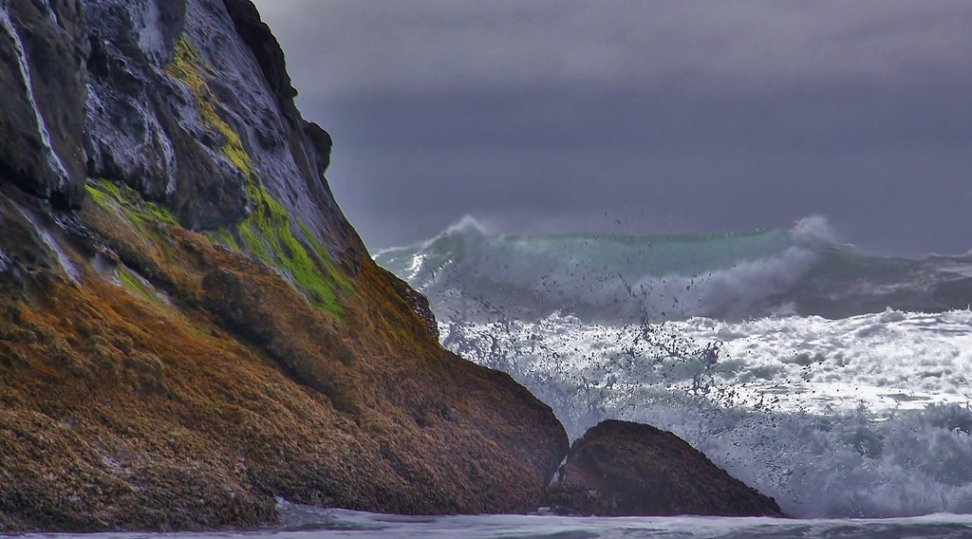
2. EROSIONAL FEATURES
Activity 1
A steep rock face on the coast.
Notes:
Activity 1. Look carefully at this picture: a steep rock face on the coast. Observe every detail before I ask the question.

Slide 20
2. EROSIONAL FEATURES
Activity 1: Question
How do waves make a cliff?
Notes:
Here is the question for Activity 1: How do waves make a cliff? Take one minute to think and write your answer in your rough notebook.

Slide 21
2. EROSIONAL FEATURES
Activity 1: Answer
They cut the bottom of the rock, the top falls, and a steep cliff is left.
Notes:
Let us check the answer together. They cut the bottom of the rock, the top falls, and a steep cliff is left.

Slide 22
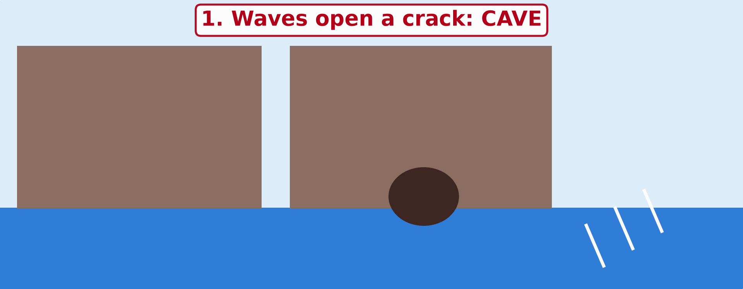
2. EROSIONAL FEATURES
Activity 2
Animation: erosion of a headland.
Notes:
Activity 2. Look carefully at this animation: animation: erosion of a headland. Watch the animation to the end; it will play again.

Slide 23
2. EROSIONAL FEATURES
Activity 2: Question
Put these features in order: stack, cave, stump, arch.
Notes:
Here is the question for Activity 2: Put these features in order: stack, cave, stump, arch. Take one minute to think and write your answer in your rough notebook.

Slide 24
2. EROSIONAL FEATURES
Activity 2: Answer
Cave, arch, stack, stump.
Notes:
Let us check the answer together. Cave, arch, stack, stump.

Slide 25
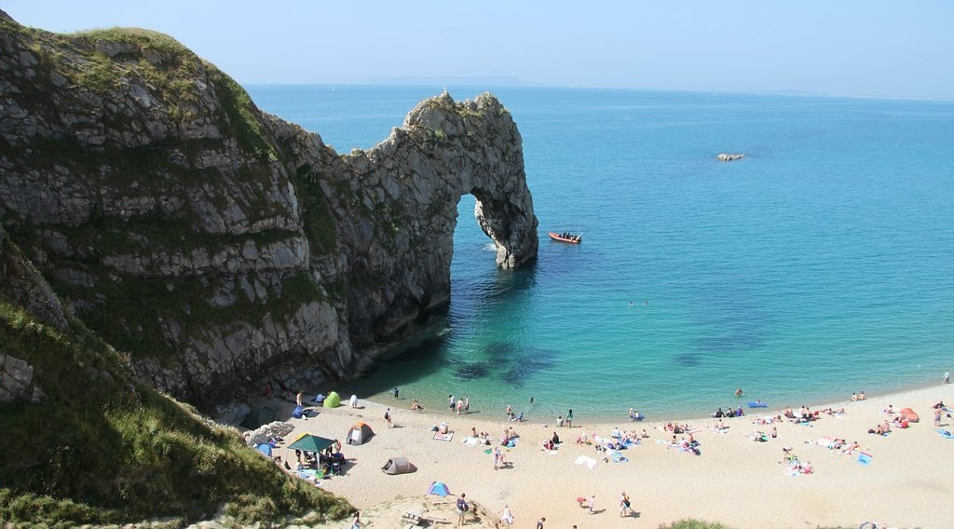
2. EROSIONAL FEATURES
Activity 3
A hole through a rock on the coast.
Notes:
Activity 3. Look carefully at this picture: a hole through a rock on the coast. Observe every detail before I ask the question.

Slide 26
2. EROSIONAL FEATURES
Activity 3: Question
The waves have cut a hole right through the rock. What is it called?
Notes:
Here is the question for Activity 3: The waves have cut a hole right through the rock. What is it called? Take one minute to think and write your answer in your rough notebook.

Slide 27
2. EROSIONAL FEATURES
Activity 3: Answer
An arch.
Notes:
Let us check the answer together. An arch.

Slide 28
BOARD SUMMARY
Board Summary
Topic: Denudation Processes, Landforms and Impacts on Man
Sub-topic: Wave Action along the Coast and Impacts on Man
Lesson 24: Main Erosional Processes and Features of Wave Action
Notes:
Now we are going to copy the board summary. Write the title and the headings neatly in your notebooks. I will give you enough time for each slide, so do not rush.

Slide 29
BOARD SUMMARY
DEFINITIONS
The key terms of this lesson are defined as follows:
Wave erosion: It is the wearing away of the coast by the action of waves.
Headland (cape): It is a part of the land that sticks out into the sea.
Notes:
Let us copy the definitions. The key terms of this lesson are defined as follows. On this slide we have Wave erosion and Headland (cape). Write each point on a new line, with the key term first, and explain it in your own words when we revise. When you finish, we go to the next slide.

Slide 30
BOARD SUMMARY
DEFINITIONS (continued)
Bay: It is a part of the sea that curves into the land between two headlands.
Notes:
We continue with the definitions. On this slide we have Bay. Write each point on a new line, with the key term first, and explain it in your own words when we revise.

Slide 31
BOARD SUMMARY
1. Erosional Processes of Waves
Waves erode the coast through the following processes:
Hydraulic action: The force of the waves compresses air in cracks, and the pressure breaks the rock.
Abrasion (corrasion): Stones and sand thrown by the waves wear away the cliff.
Notes:
Let us copy Erosional Processes of Waves. Waves erode the coast through the following processes. On this slide we have Hydraulic action and Abrasion (corrasion). Write each point on a new line, with the key term first, and explain it in your own words when we revise. When you finish, we go to the next slide.

Slide 32
BOARD SUMMARY
1. Erosional Processes of Waves (continued)
Attrition: Stones carried by the waves hit one another and become small and round.
Solution (corrosion): Sea water dissolves some rocks, such as limestone.
Notes:
We continue with Erosional Processes of Waves. On this slide we have Attrition and Solution (corrosion). Write each point on a new line, with the key term first, and explain it in your own words when we revise.

Slide 33
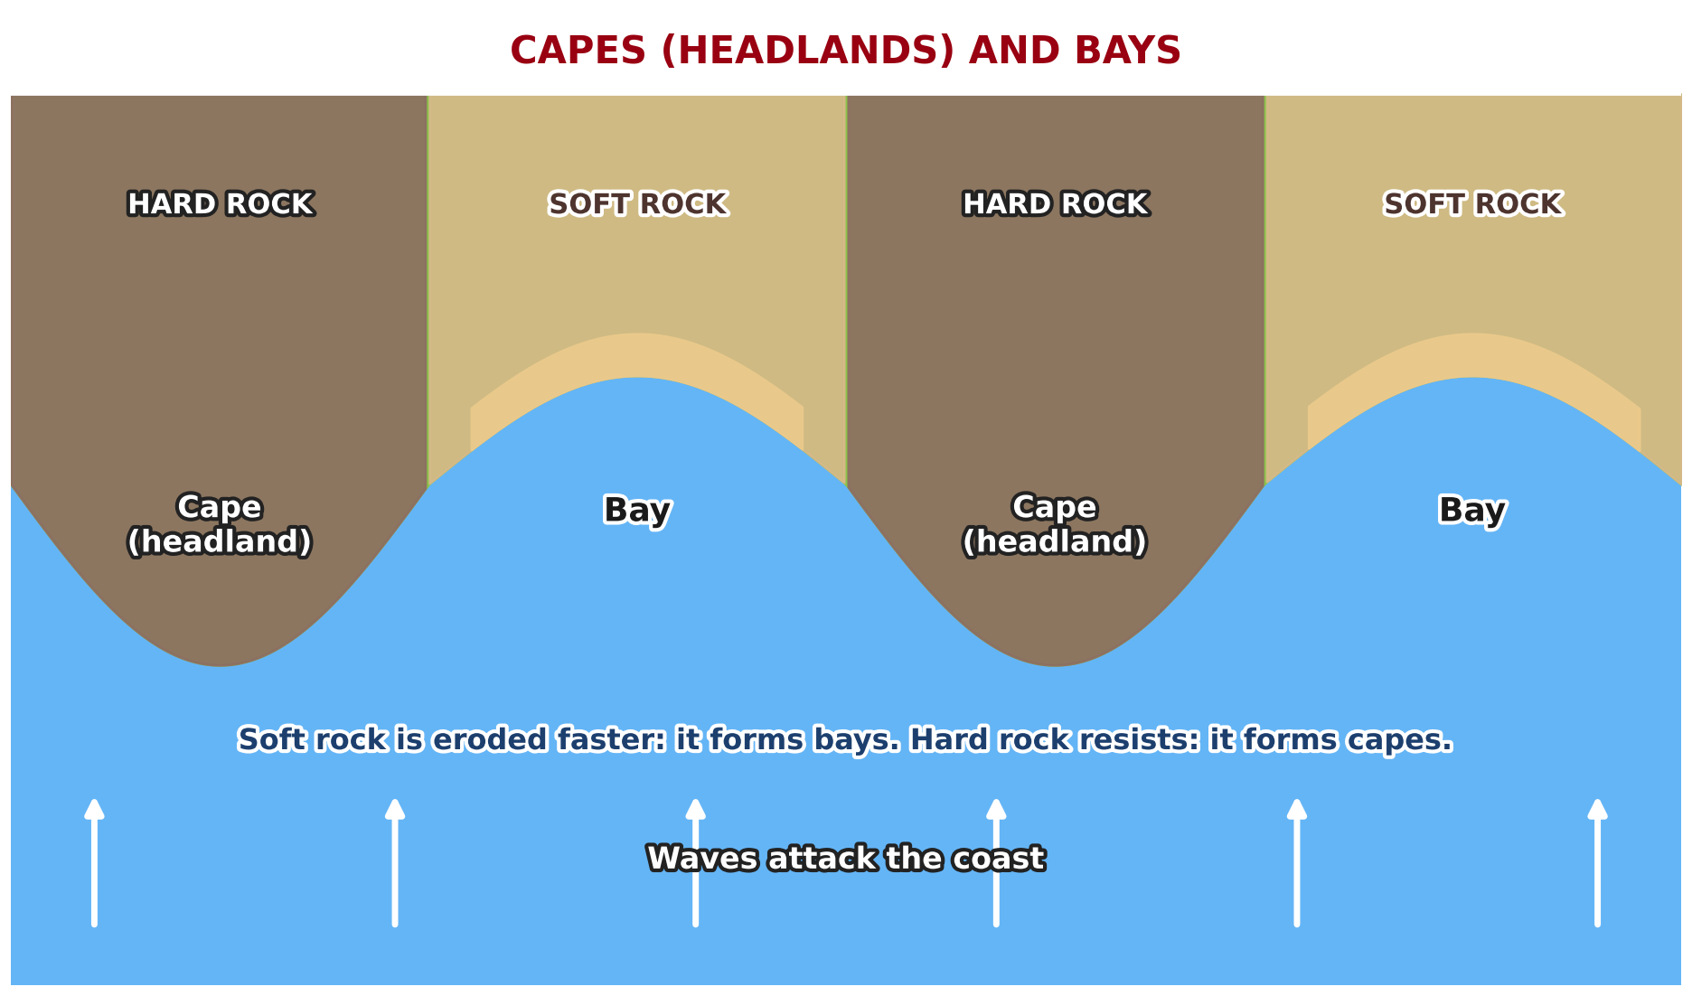
BOARD SUMMARY
2. Erosional Features
The erosional features of waves and local examples are the following:
Capes and bays: Where hard and soft rocks alternate, hard rock remains as capes and soft rock is worn back into bays.
Illustration: capes and bays
Notes:
Let us copy Erosional Features. The erosional features of waves and local examples are the following. Copy the point on Capes and bays on the left, then draw the diagram on the right: capes and bays. Give it a title and label it clearly.

Slide 34
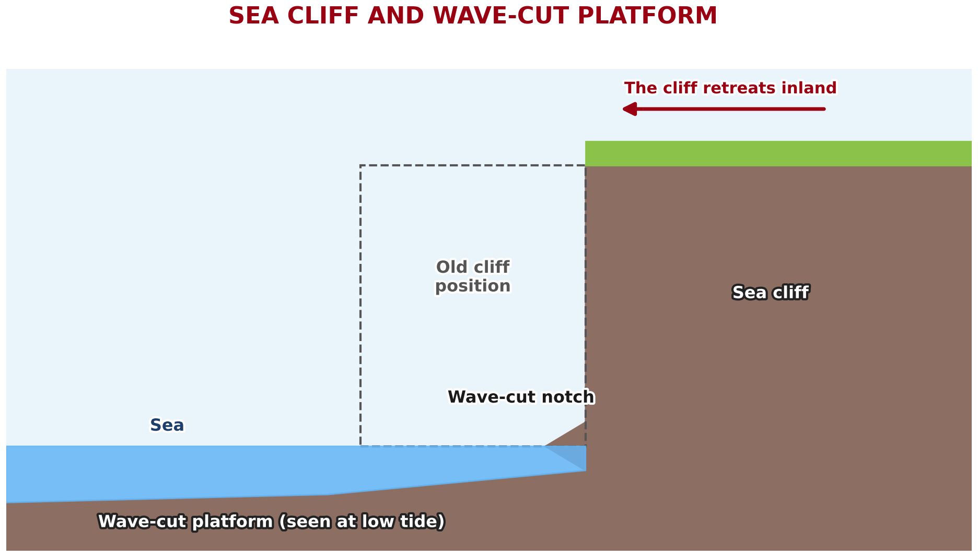
BOARD SUMMARY
2. Erosional Features
Cliff and wave-cut platform: Waves cut a notch at the foot of the rock, the top collapses, and the cliff retreats, leaving a flat rock platform.
Illustration: cliff and wave-cut platform
Notes:
Copy the point on Cliff and wave-cut platform on the left, then draw the diagram on the right: cliff and wave-cut platform. Give it a title and label it clearly.

Slide 35
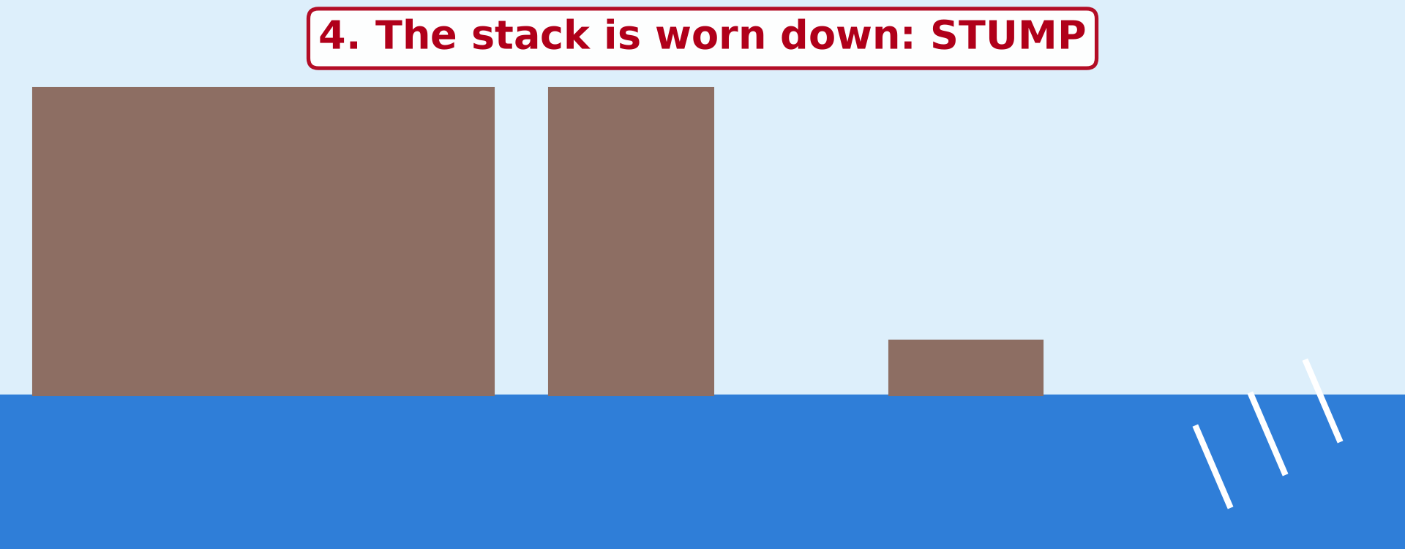
BOARD SUMMARY
2. Erosional Features
Cave: Waves enlarge a crack at the foot of a headland into a hollow.
Illustration: cave, arch, stack and stump
Notes:
Copy the point on Cave on the left, then draw the diagram on the right: cave, arch, stack and stump. Give it a title and label it clearly.

Slide 36
BOARD SUMMARY
2. Erosional Features
Arch: Two caves on each side of a headland meet and form a hole through it.
Illustration: an arch
Notes:
Copy the point on Arch on the left, then draw the diagram on the right: an arch. Give it a title and label it clearly.

Slide 37
BOARD SUMMARY
2. Erosional Features
Stack: The roof of the arch collapses and leaves a pillar of rock standing in the sea.
Stump: The stack is worn down into a low rock covered at high tide.
Local examples: Rocky cliffs, caves and small bays are found along the volcanic coast of Limbe and around Kribi.
Notes:
We continue with Erosional Features. On this slide we have Stack, Stump and Local examples. Write each point on a new line, with the key term first, and explain it in your own words when we revise.

Slide 38
FORMATIVE EVALUATION
Evaluation 1
Put in order: arch, stump, cave, stack.
Notes:
Now let us check what you have understood. Question 1: Put in order: arch, stump, cave, stack. Answer in your exercise book.

Slide 39
FORMATIVE EVALUATION
Expected Answer
Cave, arch, stack, stump.
Notes:
The expected answer is: cave, arch, stack, stump. If you got it right, well done.

Slide 40
FORMATIVE EVALUATION
Evaluation 2
What is hydraulic action?
Notes:
Now let us check what you have understood. Question 2: What is hydraulic action? Answer in your exercise book.

Slide 41
FORMATIVE EVALUATION
Expected Answer
The force of the waves breaking the rock.
Notes:
The expected answer is: the force of the waves breaking the rock. If you got it right, well done.

Slide 42
REMEDIATION
Remediation
Fill in the blanks:
A steep rock face on the coast is a ______.
A cave that goes through a headland becomes an ______.
A pillar of rock in the sea is a ______.
Notes:
For those who need more practice, fill in the blanks in your exercise book. The answers are: number 1, cliff; number 2, arch; number 3, stack.

Slide 43
HOMEWORK
Homework
Name two depositional features of waves.
Notes:
For your homework: Name two depositional features of waves. We shall correct it at the beginning of our next lesson.

Slide 44
NEXT LESSON
Next Lesson
Our next lesson will be on:
Lesson 25: Main Depositional Features of Wave Action
Notes:
Our next lesson will be on Lesson 25: Main Depositional Features of Wave Action. Thank you for your attention, and see you next time.

Slide 45
BILINGUAL GAME
Bilingual Game (Jeu Bilingue)
English | Français
Cliff | La falaise
Cape / headland | Le cap
Bay | La baie
Cave | La grotte
Arch | L'arche
Stack | L'aiguille / le stack
Wave-cut platform | La plate-forme d'abrasion
Notch | L'encoche
Notes:
Let us play the bilingual game. I say a word in English, and you give me the French word. Then we do the reverse.

Slide 46
LOGBOOK
Official Logbook (1/2)
Module / Topic | Denudation Processes, Landforms and Impacts on Man
Lesson Title | Lesson 24: Main Erosional Processes and Features of Wave Action
Expected Learning Outcomes | Explain the four erosional processes of waves. Explain the formation of capes and bays, cliffs and wave-cut platforms. Explain the formation of caves, arches, stacks and stumps.
Competence | Learners are able to recognise and explain the landforms of a rocky coast, and to respect the dangers of cliffs and caves.
Notes:
I record this information in the official logbook of the class after the lesson.

Slide 47
LOGBOOK
Official Logbook (2/2)
Matter Taught | DEFINITIONS; Erosional Processes of Waves; Erosional Features.
Evaluation | Formative evaluation and remediation exercise.
Homework | Name two depositional features of waves.
Enrolment / Present / Absent | ____ / ____ / ____
Achievement | To be completed after the lesson.
Notes:
I complete the second page of the logbook: the matter taught, the evaluation, the homework and the attendance.

Slide 48
TEACHER'S NOTE
Teacher's Note
Timing: Homework correction, plan, objectives 4 min | Recall, situation, action 6 min | 3 activities 12 min | Board summary (copying) 15 min | Evaluation, remediation 5 min | Homework, next lesson 3 min | Logbook 5 min
Activity 2 is an animation (GIF): it plays automatically in slide-show mode.
Without the projector (Activity 1): draw a notch at the foot of a cliff.
Without the projector (Activity 2): draw the four stages on the board.
Without the projector (Activity 3): describe the rocks near Limbe.
Notes:
This slide is for me, the teacher: it gives the timing of the lesson and what to do if the projector is not available.

Slide 49
REFERENCES
References
National Geography Syllabus (MINESEC), Form 4 — Denudation Processes, Landforms and Impacts on Man.
Teacher's lesson notes (Form 4), checked and corrected where necessary.
Photo, Activity 1: “Forces of Nature” by liquidcrash, CC BY-SA 2.0, via Flickr (https://www.flickr.com/photos/124320023@N06/13938903780)
Photo, Activity 3: “Jurassic Coast Coastal Landform - Sea Arch - Durdle Door” by Richard Allaway, CC BY 2.0, via Flickr (https://www.flickr.com/photos/16287002@N00/9503598134)
Diagrams and animations: drawn for this lesson (Geography Department).
Notes:
These are the references and picture credits used to prepare this lesson.

