Slide 1
FORM 4
GEOGRAPHY
Lesson 29
Man in the Hot Desert Environments
Notes:
Good morning, class, and welcome to our geography lesson. I am your geography teacher, Mr Kamdem. Today we are starting Lesson 29: Man in the Hot Desert Environments.

Slide 2
CLASS INFO
Class, Chapter and Duration
Class | Form 4
Chapter | Denudation Processes, Landforms and Impacts on Man — Hot Desert Landscapes: Wind Action and Human Adaptation
Duration | 50 minutes
Notes:
This lesson is for Form 4. It belongs to Denudation Processes, Landforms and Impacts on Man — Hot Desert Landscapes: Wind Action and Human Adaptation. We shall need 50 minutes to cover it.

Slide 3
IDENTIFICATION
Lesson Identification
Topic | Denudation Processes, Landforms and Impacts on Man
Sub-topic | Hot Desert Landscapes: Wind Action and Human Adaptation
Lesson | Lesson 29: Man in the Hot Desert Environments
Notions / Concepts | Resource, hazard.
Syllabus focus | Resources of hot deserts; challenges (hazards) of hot deserts; human adaptations.
Competence | Learners are able to use water carefully and protect themselves from heat and dust during the dry season, as desert people do.
Notes:
Our topic is Denudation Processes, Landforms and Impacts on Man, and the sub-topic is Hot Desert Landscapes: Wind Action and Human Adaptation. The key notions we shall use today are: resource, hazard. At the end, you should be able to do this: learners are able to use water carefully and protect themselves from heat and dust during the dry season, as desert people do.

Slide 4

HOMEWORK CORRECTION
Correction of the Homework
Question (Lesson 28: Depositional Features of Wind Action):
Give two resources of hot deserts.
Notes:
Before we start the new lesson, let us correct the homework I gave you at the end of Lesson 28: Depositional Features of Wind Action. The question was: Give two resources of hot deserts. Take out your exercise books.

Slide 5
HOMEWORK CORRECTION
Correction: Possible Answer
Oil and solar energy (also oases and minerals).
Notes:
Here is a good answer. Oil and solar energy (also oases and minerals). Compare it with your own answer and correct your work in red.

Slide 6
LESSON PLAN
Lesson Plan
Correction of the homework
Objectives and recall
Real-life situation and action to take
Learning activities
Board summary
Evaluation, remediation and homework
Notes:
Here is the plan of our lesson today. First, we shall correct the homework. Then we shall look at the objectives and recall what you already know. After that, we shall study a situation from real life and the action to take, and do the learning activities. Finally, we shall copy the board summary, do the evaluation and the remediation, and I will give you the homework.

Slide 7
OBJECTIVES
Objectives
By the end of this lesson, you should be able to:
Define a resource and a hazard.
Identify the main resources of hot deserts.
Notes:
Take your time to copy this part; we will continue together.

Slide 8
OBJECTIVES
Objectives (continued)
Describe the main challenges of living in hot deserts.
Explain how people adapt to life in hot deserts.
Notes:
By the end of this lesson, you should be able to do four things. Number 1: define a resource and a hazard. Number 2: identify the main resources of hot deserts. Number 3: describe the main challenges of living in hot deserts. Number 4: explain how people adapt to life in hot deserts.

Slide 9
PREVIOUS KNOWLEDGE
Previous Knowledge
The wind deposits sand when it slows down or meets an obstacle.
Sand dunes (barchans and seifs) move in the direction of the wind.
Moving dunes and dust can cause problems for people who live near deserts.
Notes:
Let us first remember what you already know. The wind deposits sand when it slows down or meets an obstacle. Sand dunes (barchans and seifs) move in the direction of the wind. Moving dunes and dust can cause problems for people who live near deserts. Keep this in mind, because we shall build on it today.

Slide 10
REAL-LIFE SITUATION
Situation in Real Life
In March, the well of the Bouba family dries up.
Mrs Bouba walks for more than an hour every morning to get water, and the goats are thin.
Yet in the Sahara, people live in oases and even produce oil and solar electricity.
Notes:
Take your time to copy this part; we will continue together.

Slide 11
REAL-LIFE SITUATION
Situation in Real Life (continued)
Her son asks: "How can people live, and even become rich, in such dry places?"
Notes:
Listen carefully to this situation from real life. In March, the well of the Bouba family dries up. Mrs Bouba walks for more than an hour every morning to get water, and the goats are thin. Yet in the Sahara, people live in oases and even produce oil and solar electricity. Her son asks: "How can people live, and even become rich, in such dry places?" Think about it, because I am going to ask you some questions.

Slide 12
REAL-LIFE SITUATION
Situation: Question 1
What is the problem in the situation?
Notes:
Question 1: What is the problem in the situation? Think for a moment, then raise your hand to answer.

Slide 13
REAL-LIFE SITUATION
Answer
The son does not understand how people can live and find resources in hot deserts.
Notes:
Good. The son does not understand how people can live and find resources in hot deserts.

Slide 14
REAL-LIFE SITUATION
Situation: Question 2
What is the main difficulty of the Bouba family?
Notes:
Question 2: What is the main difficulty of the Bouba family? Think for a moment, then raise your hand to answer.

Slide 15
REAL-LIFE SITUATION
Answer
The lack of water.
Notes:
Good. The lack of water.

Slide 16
REAL-LIFE SITUATION
Situation: Question 3
Name one resource of the Sahara.
Notes:
Question 3: Name one resource of the Sahara. Think for a moment, then raise your hand to answer.

Slide 17
REAL-LIFE SITUATION
Possible Answer
Oil (or sunshine for solar electricity).
Notes:
Good. Oil (or sunshine for solar electricity).

Slide 18
ACTION TO TAKE
Action to Take
Save water and plant trees to fight desertification.
Notes:
From this situation, the action we are working towards in this lesson is the following: save water and plant trees to fight desertification.

Slide 19
JUSTIFICATION
Justification of the Lesson
This lesson helps us to know how people live in hot deserts.
Notes:
Why is this lesson important for you? This lesson helps us to know how people live in hot deserts.

Slide 20

1. RESOURCES
Activity 1
Solar panels in a sunny area.
Notes:
Activity 1. Look carefully at this picture: solar panels in a sunny area. Observe every detail before I ask the question.

Slide 21
1. RESOURCES
Activity 1: Question
Why is the desert a good place for solar power?
Notes:
Here is the question for Activity 1: Why is the desert a good place for solar power? Take one minute to think and write your answer in your rough notebook.

Slide 22
1. RESOURCES
Activity 1: Answer
The Sun shines strongly almost every day.
Notes:
Let us check the answer together. The Sun shines strongly almost every day.

Slide 23

2. CHALLENGES
Activity 2
Women fetch water.
Notes:
Activity 2. Look carefully at this picture: women fetch water. Observe every detail before I ask the question.

Slide 24
2. CHALLENGES
Activity 2: Question
What is the biggest problem of people in dry areas?
Notes:
Here is the question for Activity 2: What is the biggest problem of people in dry areas? Take one minute to think and write your answer in your rough notebook.

Slide 25
2. CHALLENGES
Activity 2: Answer
The lack of water.
Notes:
Let us check the answer together. The lack of water.

Slide 26
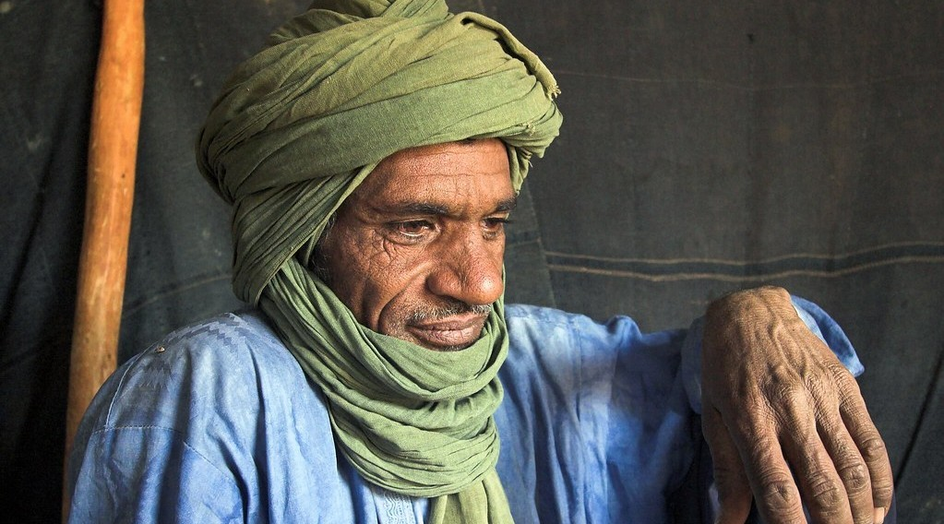
3. ADAPTATIONS
Activity 3
Tuareg people in the Sahara.
Notes:
Activity 3. Look carefully at this picture: tuareg people in the Sahara. Observe every detail before I ask the question.

Slide 27
3. ADAPTATIONS
Activity 3: Question
Why do these people wear long, loose clothes and cover their heads?
Notes:
Here is the question for Activity 3: Why do these people wear long, loose clothes and cover their heads? Take one minute to think and write your answer in your rough notebook.

Slide 28
3. ADAPTATIONS
Activity 3: Answer
To protect themselves from the Sun, the heat and the sand.
Notes:
Let us check the answer together. To protect themselves from the Sun, the heat and the sand.

Slide 29
BOARD SUMMARY
Board Summary
Topic: Denudation Processes, Landforms and Impacts on Man
Sub-topic: Hot Desert Landscapes: Wind Action and Human Adaptation
Lesson 29: Man in the Hot Desert Environments
Notes:
Now we are going to copy the board summary. Write the title and the headings neatly in your notebooks. I will give you enough time for each slide, so do not rush.

Slide 30
BOARD SUMMARY
DEFINITIONS
The key terms of this lesson are defined as follows:
Resource: It is anything in nature that people can use.
Hazard: It is an event or condition that can harm people and property.
Notes:
Let us copy the definitions. The key terms of this lesson are defined as follows. On this slide we have Resource and Hazard. Write each point on a new line, with the key term first, and explain it in your own words when we revise. When you finish, we go to the next slide.

Slide 31
BOARD SUMMARY
DEFINITIONS (continued)
Adaptation: It is the way people change their way of life to live in an environment.
Notes:
We continue with the definitions. On this slide we have Adaptation. Write each point on a new line, with the key term first, and explain it in your own words when we revise.

Slide 32
BOARD SUMMARY
1. Resources of Hot Deserts
Hot deserts have the following resources:
Minerals: Deserts contain oil and gas in Algeria and Libya, uranium in Niger and phosphates in Morocco.
Notes:
Let us copy Resources of Hot Deserts. Hot deserts have the following resources. On this slide we have Minerals. Write each point on a new line, with the key term first, and explain it in your own words when we revise.

Slide 33
BOARD SUMMARY
1. Resources of Hot Deserts
Solar energy: Strong sunshine is used for solar power, as at Ouarzazate in Morocco.
Illustration: solar panels
Notes:
Copy the point on Solar energy on the left, then draw the diagram on the right: solar panels. Give it a title and label it clearly.

Slide 34
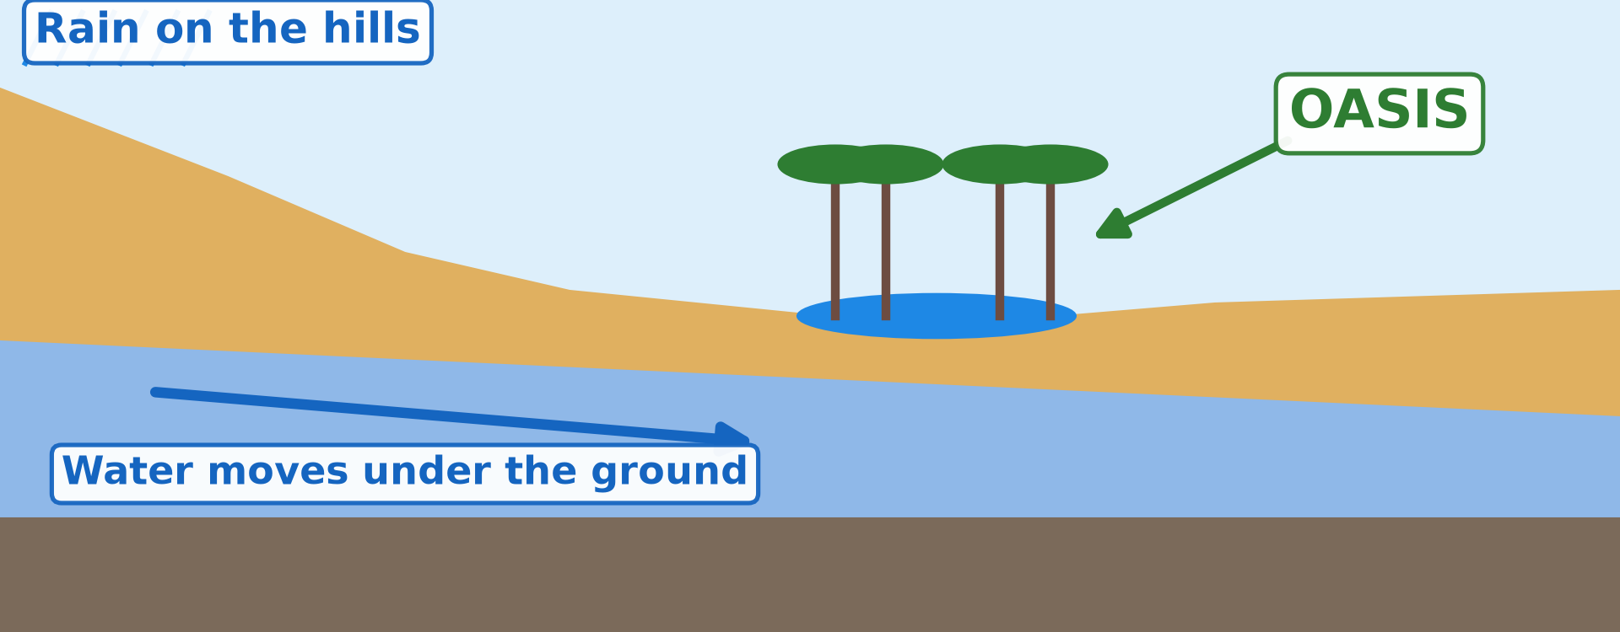
BOARD SUMMARY
1. Resources of Hot Deserts
Water: Oases, wells and rivers such as the Nile provide water for people and crops.
Illustration: an oasis
Notes:
Copy the point on Water on the left, then draw the diagram on the right: an oasis. Give it a title and label it clearly.

Slide 35
BOARD SUMMARY
1. Resources of Hot Deserts
Pasture: After rain, grass and shrubs feed camels, goats and sheep.
Tourism: Dunes, oases and ancient monuments such as the pyramids attract tourists.
Notes:
We continue with Resources of Hot Deserts. On this slide we have Pasture and Tourism. Write each point on a new line, with the key term first, and explain it in your own words when we revise.

Slide 36
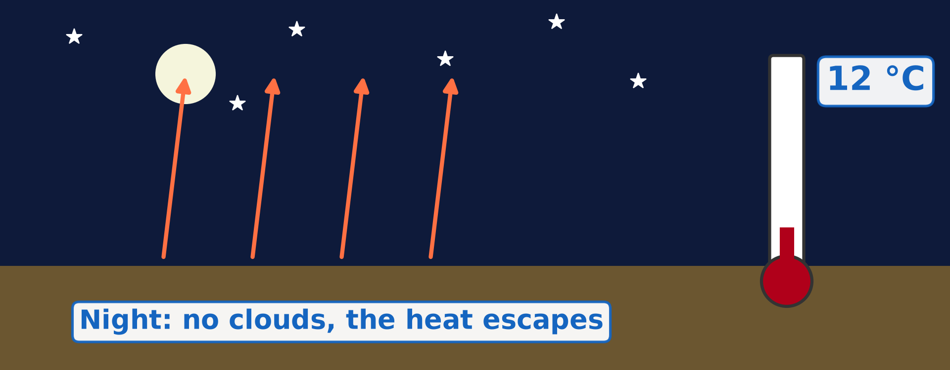
BOARD SUMMARY
2. Challenges of Hot Deserts
People in hot deserts face the following challenges:
Extreme temperatures: Days are very hot, and nights can be cold.
Illustration: cold desert nights
Notes:
Let us copy Challenges of Hot Deserts. People in hot deserts face the following challenges. Copy the point on Extreme temperatures on the left, then draw the diagram on the right: cold desert nights. Give it a title and label it clearly.

Slide 37
BOARD SUMMARY
2. Challenges of Hot Deserts
Lack of water: Deserts receive less than 250 mm of rain per year, and wells dry up.
Illustration: fetching water
Notes:
Copy the point on Lack of water on the left, then draw the diagram on the right: fetching water. Give it a title and label it clearly.

Slide 38

BOARD SUMMARY
2. Challenges of Hot Deserts
Sandstorms: Sandstorms hurt the eyes and lungs and bury roads and fields.
Illustration: a sandstorm
Notes:
Copy the point on Sandstorms on the left, then draw the diagram on the right: a sandstorm. Give it a title and label it clearly.

Slide 39
BOARD SUMMARY
2. Challenges of Hot Deserts
Flash floods: Rare but heavy storms cause sudden floods in dry valleys (wadis).
Desertification: The desert spreads into neighbouring lands because of drought, overgrazing and tree cutting.
Notes:
We continue with Challenges of Hot Deserts. On this slide we have Flash floods and Desertification. Write each point on a new line, with the key term first, and explain it in your own words when we revise.

Slide 40
BOARD SUMMARY
3. Human Adaptations
People adapt to hot deserts in the following ways:
Nomadism: Nomads such as the Tuareg move with their animals in search of water and pasture.
Illustration: Tuareg people
Notes:
Let us copy Human Adaptations. People adapt to hot deserts in the following ways. Copy the point on Nomadism on the left, then draw the diagram on the right: tuareg people. Give it a title and label it clearly.

Slide 41
BOARD SUMMARY
3. Human Adaptations
Clothes: People wear long, loose clothes and cover their heads against the Sun and the sand.
Houses: Houses have thick mud walls, small windows and flat roofs to keep cool.
Notes:
We continue with Human Adaptations. On this slide we have Clothes and Houses. Write each point on a new line, with the key term first, and explain it in your own words when we revise. When you finish, we go to the next slide.

Slide 42
BOARD SUMMARY
3. Human Adaptations (continued)
Water management: People dig wells, store water and irrigate crops with water from rivers, such as the Nile.
Tree planting: Projects such as the Great Green Wall plant trees to stop the desert.
Notes:
We continue with Human Adaptations. On this slide we have Water management and Tree planting. Write each point on a new line, with the key term first, and explain it in your own words when we revise.

Slide 43
FORMATIVE EVALUATION
Evaluation 1
Give two resources of hot deserts.
Notes:
Now let us check what you have understood. Question 1: Give two resources of hot deserts. Answer in your exercise book.

Slide 44
FORMATIVE EVALUATION
Expected Answer
Oil and solar energy.
Notes:
The expected answer is: oil and solar energy. If you got it right, well done.

Slide 45
FORMATIVE EVALUATION
Evaluation 2
How can we fight desertification?
Notes:
Now let us check what you have understood. Question 2: How can we fight desertification? Answer in your exercise book.

Slide 46
FORMATIVE EVALUATION
Expected Answer
Plant trees (Great Green Wall).
Notes:
The expected answer is: plant trees (Great Green Wall). If you got it right, well done.

Slide 47
REMEDIATION
Remediation
Fill in the blanks:
The spread of the desert is ______.
Morocco makes electricity from the ______.
The Tuareg are ______ who move with their animals.
Notes:
For those who need more practice, fill in the blanks in your exercise book. The answers are: number 1, desertification; number 2, sun; number 3, nomads.

Slide 48
HOMEWORK
Homework
Name the four main layers of the atmosphere.
Notes:
For your homework: Name the four main layers of the atmosphere. We shall correct it at the beginning of our next lesson.

Slide 49
NEXT LESSON
Next Lesson
Our next lesson will be on:
Lesson 30: The Atmosphere
Notes:
Our next lesson will be on Lesson 30: The Atmosphere. Thank you for your attention, and see you next time.

Slide 50
BILINGUAL GAME
Bilingual Game (Jeu Bilingue)
English | Français
Resource | La ressource
Hazard | Le risque / l'aléa
Oasis | L'oasis
Nomadism | Le nomadisme
Irrigation | L'irrigation
Sandstorm | La tempête de sable
Desertification | La désertification
Adaptation | L'adaptation
Notes:
Let us play the bilingual game. I say a word in English, and you give me the French word. Then we do the reverse.

Slide 51
LOGBOOK
Official Logbook (1/2)
Module / Topic | Denudation Processes, Landforms and Impacts on Man
Lesson Title | Lesson 29: Man in the Hot Desert Environments
Expected Learning Outcomes | Define a resource and a hazard. Identify the main resources of hot deserts. Describe the main challenges of living in hot deserts. Explain how people adapt to life in hot deserts.
Competence | Learners are able to use water carefully and protect themselves from heat and dust during the dry season, as desert people do.
Notes:
I record this information in the official logbook of the class after the lesson.

Slide 52
LOGBOOK
Official Logbook (2/2)
Matter Taught | DEFINITIONS; Resources of Hot Deserts; Challenges of Hot Deserts; Human Adaptations.
Evaluation | Formative evaluation and remediation exercise.
Homework | Name the four main layers of the atmosphere.
Enrolment / Present / Absent | ____ / ____ / ____
Achievement | To be completed after the lesson.
Notes:
I complete the second page of the logbook: the matter taught, the evaluation, the homework and the attendance.

Slide 53
TEACHER'S NOTE
Teacher's Note
Timing: Homework correction, plan, objectives 4 min | Recall, situation, action 6 min | 3 activities 12 min | Board summary (copying) 15 min | Evaluation, remediation 5 min | Homework, next lesson 3 min | Logbook 5 min
Without the projector (Activity 1): ask about solar panels in Garoua.
Without the projector (Activity 2): ask learners how far they walk for water in the dry season.
Without the projector (Activity 3): describe the clothes of herders in the North.
Notes:
This slide is for me, the teacher: it gives the timing of the lesson and what to do if the projector is not available.

Slide 54
REFERENCES
References
National Geography Syllabus (MINESEC), Form 4 — Denudation processes, landforms and impacts on man — Lesson 29.
Teacher's lesson notes, Lesson 29 (f4.docx).
MINEPDED: Opération Sahel Vert (minepded.gov.cm).
Resource map and oasis diagram drawn for this lesson from Natural Earth data.
Photo, Activity 1: “Noor Ouarzazate III Solar Plant” by Richard Allaway, CC BY 2.0, via Flickr (https://www.flickr.com/photos/16287002@N00/52769922684)
Photo, Activity 2: “Women fetch water in Kilte-Awlaelo woreda, Tigray” by UNICEF Ethiopia, CC BY-NC-ND 2.0, via Flickr (https://www.flickr.com/photos/86783452@N02/14056445728)
Photo, Activity 3: “my neighbor” by Emilia Tjernström [Arriving at the horizon], CC BY-NC-SA 2.0, via Flickr (https://www.flickr.com/photos/60614633@N00/502315074)
Photo, board summary (Sandstorms): “Sandstorm at Camp Bastion, Afghanistan” by Defence Images, CC BY-NC 2.0, via Flickr (https://www.flickr.com/photos/48399297@N04/10343833885)
Notes:
Take your time to copy this part; we will continue together.

Slide 55
REFERENCES
References (continued)
Diagrams and animations: drawn for this lesson (Geography Department).
Notes:
These are the references and picture credits used to prepare this lesson.

