Slide 1
FORM 4
GEOGRAPHY
Lesson 5
The Ecosystem
Notes:
Good morning, class, and welcome to our geography lesson. I am your geography teacher, Mr Kamdem. Today we are starting Lesson 5: The Ecosystem.

Slide 2
CLASS INFO
Class, Chapter and Duration
Class | Form 4
Chapter | Module I: Ecological Systems and their Resources
Duration | 2 periods (2 × 50 minutes)
Notes:
This lesson is for Form 4. It belongs to Module I: Ecological Systems and their Resources. We shall need 2 periods to cover it.

Slide 3
IDENTIFICATION
Lesson Identification
Topic | Conservation of World's Biomes and Resources
Sub-topic | The Ecosystem
Lesson | Lesson 5: The Ecosystem
Notions / Concepts | Ecosystem, biotic components, abiotic components, equilibrium.
Syllabus focus | Definition; components of ecosystems; characteristics with notion of equilibrium.
Competence | Learners are able to identify the components of an ecosystem and explain its balance.
Notes:
Our topic is Conservation of World's Biomes and Resources, and the sub-topic is The Ecosystem. The key notions we shall use today are: ecosystem, biotic components, abiotic components, equilibrium. At the end, you should be able to do this: learners are able to identify the components of an ecosystem and explain its balance.

Slide 4

HOMEWORK CORRECTION
Correction of the Homework
Question (Lesson 4: Soil Conservation):
Propose three ways to protect the soil of your school compound.
Notes:
Before we start the new lesson, let us correct the homework I gave you at the end of Lesson 4: Soil Conservation. The question was: Propose three ways to protect the soil of your school compound. Take out your exercise books.

Slide 5
HOMEWORK CORRECTION
Correction: Possible Answer
Plant grass and trees on bare areas, build stone lines on slopes, and make paths so that people do not trample the soil everywhere.
Notes:
Here is a good answer. Plant grass and trees on bare areas, build stone lines on slopes, and make paths so that people do not trample the soil everywhere. Compare it with your own answer and correct your work in red.

Slide 6
LESSON PLAN
Lesson Plan
Correction of the homework
Objectives and recall
Real-life situation and action to take
Learning activities
Board summary
Evaluation, remediation and homework
Notes:
Here is the plan of our lesson today. First, we shall correct the homework. Then we shall look at the objectives and recall what you already know. After that, we shall study a situation from real life and the action to take, and do the learning activities. Finally, we shall copy the board summary, do the evaluation and the remediation, and I will give you the homework.

Slide 7
OBJECTIVES
Objectives
By the end of this lesson, you should be able to:
Define an ecosystem.
Identify its biotic and abiotic components.
Explain the notion of equilibrium.
Notes:
By the end of this lesson, you should be able to do three things. Number 1: define an ecosystem. Number 2: identify its biotic and abiotic components. Number 3: explain the notion of equilibrium.

Slide 8
PREVIOUS KNOWLEDGE
Previous Knowledge
Plants and animals depend on each other.
Plants need sunlight, water and soil.
Animals eat plants or other animals.
Notes:
Let us first remember what you already know. Plants and animals depend on each other. Plants need sunlight, water and soil. Animals eat plants or other animals. Keep this in mind, because we shall build on it today.

Slide 9
REAL-LIFE SITUATION
Situation in Real Life
In a pond near Garoua, there are water lilies, fish, frogs, insects, mud and water. When people used chemicals on the farms nearby, many fish died and the frogs disappeared.
Notes:
Listen carefully to this situation from real life. In a pond near Garoua, there are water lilies, fish, frogs, insects, mud and water. When people used chemicals on the farms nearby, many fish died and the frogs disappeared. Think about it, because I am going to ask you some questions.

Slide 10
REAL-LIFE SITUATION
Situation: Question 1
What is the problem in the situation?
Notes:
Question 1: What is the problem in the situation? Think for a moment, then raise your hand to answer.

Slide 11
REAL-LIFE SITUATION
Answer
Chemicals upset the balance of the pond.
Notes:
Good. Chemicals upset the balance of the pond.

Slide 12
REAL-LIFE SITUATION
Situation: Question 2
Name two living things in the pond.
Notes:
Question 2: Name two living things in the pond. Think for a moment, then raise your hand to answer.

Slide 13
REAL-LIFE SITUATION
Answer
Fish and frogs (also lilies, insects).
Notes:
Good. Fish and frogs (also lilies, insects).

Slide 14
REAL-LIFE SITUATION
Situation: Question 3
Name two non-living things.
Notes:
Question 3: Name two non-living things. Think for a moment, then raise your hand to answer.

Slide 15
REAL-LIFE SITUATION
Possible Answer
Water and mud.
Notes:
Good. Water and mud.

Slide 16
ACTION TO TAKE
Action to Take
Avoid actions that upset the balance of nature, such as pollution and over-hunting.
Notes:
From this situation, the action we are working towards in this lesson is the following: avoid actions that upset the balance of nature, such as pollution and over-hunting.

Slide 17
JUSTIFICATION
Justification of the Lesson
This lesson helps us to understand how living things and their surroundings depend on each other.
Notes:
Why is this lesson important for you? This lesson helps us to understand how living things and their surroundings depend on each other.

Slide 18

1. MEANING
Activity 1
A pond ecosystem.
Notes:
Activity 1. Look carefully at this picture: a pond ecosystem. Observe every detail before I ask the question.

Slide 19
1. MEANING
Activity 1: Question
What is an ecosystem?
Notes:
Here is the question for Activity 1: What is an ecosystem? Take one minute to think and write your answer in your rough notebook.

Slide 20
1. MEANING
Activity 1: Answer
A community of living things interacting with their non-living environment.
Notes:
Let us check the answer together. A community of living things interacting with their non-living environment.

Slide 21
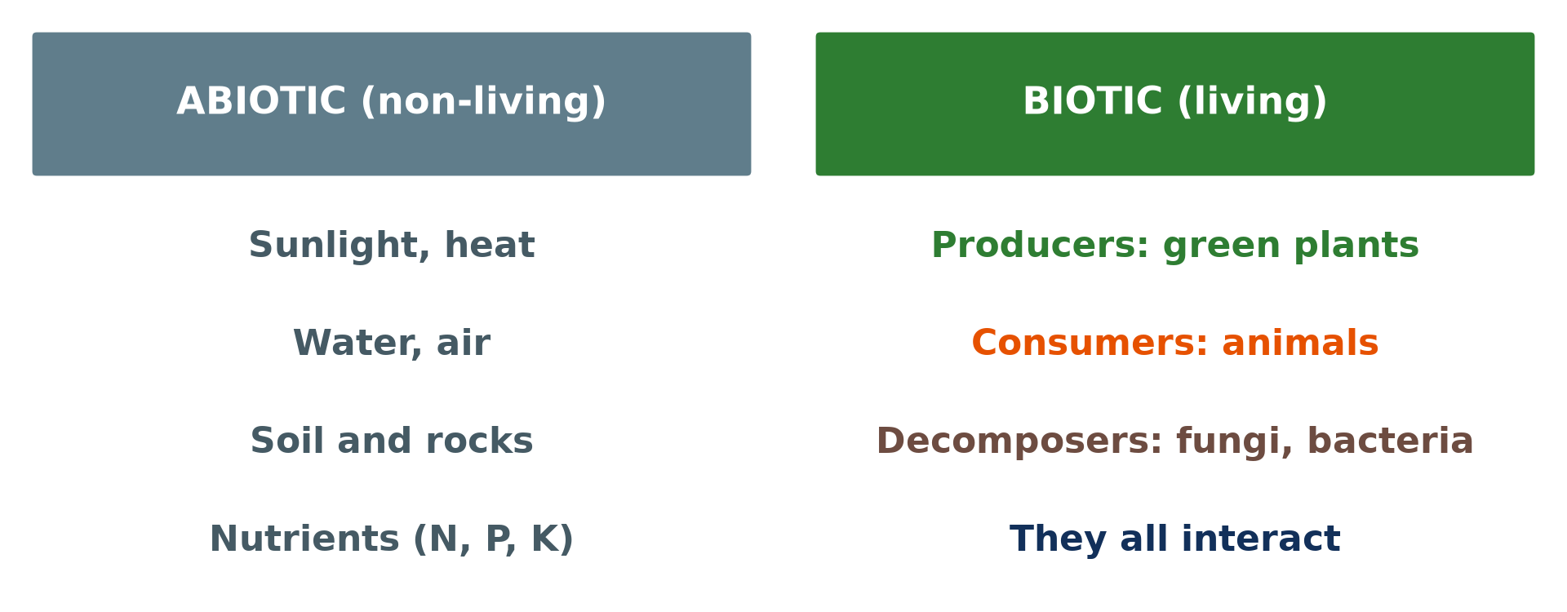
2. COMPONENTS
Activity 2
Biotic and abiotic components.
Notes:
Activity 2. Look carefully at this diagram: biotic and abiotic components. Observe every detail before I ask the question.

Slide 22
2. COMPONENTS
Activity 2: Question
Distinguish biotic and abiotic components.
Notes:
Here is the question for Activity 2: Distinguish biotic and abiotic components. Take one minute to think and write your answer in your rough notebook.

Slide 23
2. COMPONENTS
Activity 2: Answer
Biotic: living things (plants, animals). Abiotic: non-living things (sun, water, soil, air).
Notes:
Let us check the answer together. Biotic: living things (plants, animals). Abiotic: non-living things (sun, water, soil, air).

Slide 24

2. COMPONENTS
Activity 3
A mushroom (fungus).
Notes:
Activity 3. Look carefully at this picture: a mushroom (fungus). Observe every detail before I ask the question.

Slide 25
2. COMPONENTS
Activity 3: Question
What is the role of decomposers such as fungi?
Notes:
Here is the question for Activity 3: What is the role of decomposers such as fungi? Take one minute to think and write your answer in your rough notebook.

Slide 26
2. COMPONENTS
Activity 3: Answer
They break down dead matter and return nutrients to the soil.
Notes:
Let us check the answer together. They break down dead matter and return nutrients to the soil.

Slide 27

3. CHARACTERISTICS
Activity 4
A savanna ecosystem.
Notes:
Activity 4. Look carefully at this picture: a savanna ecosystem. Observe every detail before I ask the question.

Slide 28
3. CHARACTERISTICS
Activity 4: Question
Give two examples of ecosystems of different sizes.
Notes:
Here is the question for Activity 4: Give two examples of ecosystems of different sizes. Take one minute to think and write your answer in your rough notebook.

Slide 29
3. CHARACTERISTICS
Activity 4: Answer
A pond (small) and the savanna or the forest (large).
Notes:
Let us check the answer together. A pond (small) and the savanna or the forest (large).

Slide 30
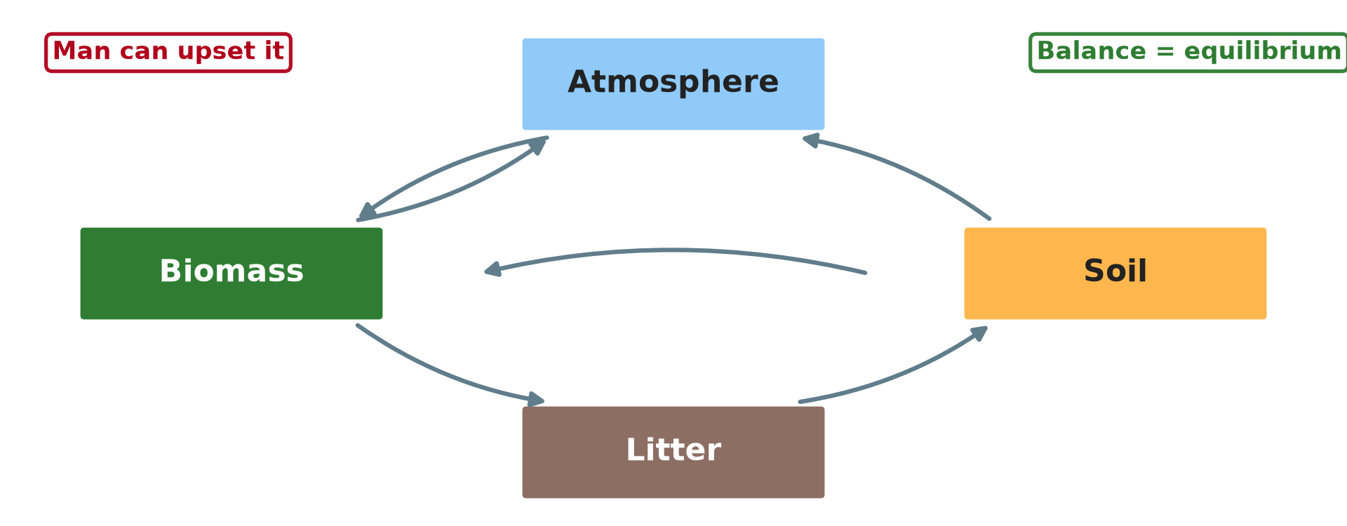
3. EQUILIBRIUM
Activity 5
The balance of an ecosystem.
Notes:
Activity 5. Look carefully at this diagram: the balance of an ecosystem. Observe every detail before I ask the question.

Slide 31
3. EQUILIBRIUM
Activity 5: Question
What happens when one part of an ecosystem is destroyed?
Notes:
Here is the question for Activity 5: What happens when one part of an ecosystem is destroyed? Take one minute to think and write your answer in your rough notebook.

Slide 32
3. EQUILIBRIUM
Activity 5: Answer
The balance (equilibrium) is broken and other parts suffer.
Notes:
Let us check the answer together. The balance (equilibrium) is broken and other parts suffer.

Slide 33
BOARD SUMMARY
Board Summary
Topic: Conservation of World's Biomes and Resources
Sub-topic: The Ecosystem
Lesson 5: The Ecosystem
Notes:
Now we are going to copy the board summary. Write the title and the headings neatly in your notebooks. I will give you enough time for each slide, so do not rush.

Slide 34
BOARD SUMMARY
DEFINITIONS
The key terms of this lesson are defined as follows:
Ecosystem: It is a community of living things interacting with their non-living environment.
Notes:
Let us copy the definitions. The key terms of this lesson are defined as follows. On this slide we have Ecosystem. Write each point on a new line, with the key term first, and explain it in your own words when we revise.

Slide 35
BOARD SUMMARY
1. Components of Ecosystems
An ecosystem has the following components:
Abiotic components: They are non-living things such as sunlight, water, air, soil and temperature.
Producers: They are green plants that make food from sunlight.
Notes:
Let us copy Components of Ecosystems. An ecosystem has the following components. On this slide we have Abiotic components and Producers. Write each point on a new line, with the key term first, and explain it in your own words when we revise. When you finish, we go to the next slide.

Slide 36
BOARD SUMMARY
1. Components of Ecosystems (continued)
Consumers: They are animals that eat plants or other animals.
Decomposers: They are fungi and bacteria that break down dead matter.
Notes:
We continue with Components of Ecosystems. On this slide we have Consumers and Decomposers. Write each point on a new line, with the key term first, and explain it in your own words when we revise.

Slide 37
BOARD SUMMARY
1. Components of Ecosystems
Illustration: components of an ecosystem
Notes:
Now draw this illustration in your notebook: components of an ecosystem. Give it a title and label it clearly.

Slide 38
BOARD SUMMARY
2. Characteristics and Equilibrium
Ecosystems have the following characteristics:
Size: Ecosystems can be small, like a pond, or large, like a forest.
Interdependence: All components depend on one another.
Notes:
Let us copy Characteristics and Equilibrium. Ecosystems have the following characteristics. On this slide we have Size and Interdependence. Write each point on a new line, with the key term first, and explain it in your own words when we revise. When you finish, we go to the next slide.

Slide 39
BOARD SUMMARY
2. Characteristics and Equilibrium (continued)
Equilibrium: A healthy ecosystem is in balance, but pollution or over-hunting can break it.
Notes:
We continue with Characteristics and Equilibrium. On this slide we have Equilibrium. Write each point on a new line, with the key term first, and explain it in your own words when we revise.

Slide 40
FORMATIVE EVALUATION
Evaluation 1
What is an ecosystem?
Notes:
Now let us check what you have understood. Question 1: What is an ecosystem? Answer in your exercise book.

Slide 41
FORMATIVE EVALUATION
Expected Answer
A community of living things interacting with their environment.
Notes:
The expected answer is: a community of living things interacting with their environment. If you got it right, well done.

Slide 42
FORMATIVE EVALUATION
Evaluation 2
Give two abiotic components.
Notes:
Now let us check what you have understood. Question 2: Give two abiotic components. Answer in your exercise book.

Slide 43
FORMATIVE EVALUATION
Expected Answer
Water and sunlight.
Notes:
The expected answer is: water and sunlight. If you got it right, well done.

Slide 44
REMEDIATION
Remediation
Fill in the blanks:
Living components are ______ components.
Green plants are ______.
Fungi and bacteria are ______.
Notes:
For those who need more practice, fill in the blanks in your exercise book. The answers are: number 1, biotic; number 2, producers; number 3, decomposers.

Slide 45
HOMEWORK
Homework
Choose an ecosystem near your home and list three biotic and three abiotic components.
Notes:
For your homework: Choose an ecosystem near your home and list three biotic and three abiotic components. We shall correct it at the beginning of our next lesson.

Slide 46
NEXT LESSON
Next Lesson
Our next lesson will be on:
Lesson 6: The Functioning of Ecosystems
Notes:
Our next lesson will be on Lesson 6: The Functioning of Ecosystems. Thank you for your attention, and see you next time.

Slide 47
BILINGUAL GAME
Bilingual Game (Jeu Bilingue)
English | Français
Ecosystem | L'écosystème
Living | Vivant
Balance | L'équilibre
Producer | Le producteur
Consumer | Le consommateur
Decomposer | Le décomposeur
Notes:
Let us play the bilingual game. I say a word in English, and you give me the French word. Then we do the reverse.

Slide 48
LOGBOOK
Official Logbook (1/2)
Module / Topic | Conservation of World's Biomes and Resources
Lesson Title | Lesson 5: The Ecosystem
Expected Learning Outcomes | Define an ecosystem. Identify its biotic and abiotic components. Explain the notion of equilibrium.
Competence | Learners are able to identify the components of an ecosystem and explain its balance.
Notes:
I record this information in the official logbook of the class after the lesson.

Slide 49
LOGBOOK
Official Logbook (2/2)
Matter Taught | DEFINITIONS; Components of Ecosystems; Characteristics and Equilibrium.
Evaluation | Formative evaluation and remediation exercise.
Homework | Choose an ecosystem near your home and list three biotic and three abiotic components.
Enrolment / Present / Absent | ____ / ____ / ____
Achievement | To be completed after the lesson.
Notes:
I complete the second page of the logbook: the matter taught, the evaluation, the homework and the attendance.

Slide 50
TEACHER'S NOTE
Teacher's Note
Timing: Homework correction, plan, objectives 8 min | Recall, situation, action 10 min | 5 activities 30 min | Board summary (copying) 30 min | Evaluation, remediation 10 min | Homework, next lesson 5 min | Logbook 7 min
Without the projector (Activity 1): describe a pond.
Without the projector (Activity 2): make two lists.
Without the projector (Activity 3): show rotting leaves.
Without the projector (Activity 4): name ecosystems of Cameroon.
Without the projector (Activity 5): discuss the pond in the situation.
Notes:
This slide is for me, the teacher: it gives the timing of the lesson and what to do if the projector is not available.

Slide 51
REFERENCES
References
Geography Syllabus, Forms I–V, MINESEC (2023) — Form 4, Module I: Ecological Systems and their Resources.
Photo, Activity 1: “Gooderstone Water Gardens - pond - water lilies” by ell brown, CC BY 2.0, via Flickr (https://www.flickr.com/photos/39415781@N06/5993988041)
Photo, Activity 3: “Mushroom, underneath_2012-09-21-14.51.00 ZS PMax” by Sam Droege, Public domain 1.0, via Flickr (https://www.flickr.com/photos/54563451@N08/8016189217)
Photo, Activity 4: “Blue Wildebeest in the Lowveld” by Martin_Heigan, CC BY-NC-ND 2.0, via Flickr (https://www.flickr.com/photos/97303475@N00/2089079933)
Diagrams and animations: drawn for this lesson (Geography Department).
Notes:
These are the references and picture credits used to prepare this lesson.

