Slide 1
FORM 4
GEOGRAPHY
Practical Work 2
Conventional Signs and Symbols on Ordnance Survey Maps
Notes:
Good morning, class, and welcome to our geography lesson. I am your geography teacher, Mr Kamdem. Today we are starting Practical Work 2: Conventional Signs and Symbols on Ordnance Survey Maps.

Slide 2
CLASS INFO
Class, Chapter and Duration
Class | Form 4
Chapter | Module I: Ecological Systems and their Resources
Duration | 2 periods (2 × 50 minutes)
Notes:
This lesson is for Form 4. It belongs to Module I: Ecological Systems and their Resources. We shall need 2 periods to cover it.

Slide 3
IDENTIFICATION
Lesson Identification
Topic | Initiation to Map Analysis
Sub-topic | Map Reading
Lesson | Practical Work 2: Conventional Signs and Symbols on Ordnance Survey Maps
Notions / Concepts | Conventional sign, symbol, colour.
Syllabus focus | Meaning; what they represent; significance of colours.
Competence | Learners are able to recognise conventional signs and colours on topographic maps.
Notes:
Our topic is Initiation to Map Analysis, and the sub-topic is Map Reading. The key notions we shall use today are: conventional sign, symbol, colour. At the end, you should be able to do this: learners are able to recognise conventional signs and colours on topographic maps.

Slide 4

HOMEWORK CORRECTION
Correction of the Homework
Question (Practical Work 1: Basic Principles of Map Analysis):
List the marginal information found on a map in your atlas.
Notes:
Before we start the new lesson, let us correct the homework I gave you at the end of Practical Work 1: Basic Principles of Map Analysis. The question was: List the marginal information found on a map in your atlas. Take out your exercise books.

Slide 5
HOMEWORK CORRECTION
Correction: Possible Answer
Title, key (legend), scale (linear and ratio), north arrow, lines of latitude and longitude, and the source or date.
Notes:
Here is a good answer. Title, key (legend), scale (linear and ratio), north arrow, lines of latitude and longitude, and the source or date. Compare it with your own answer and correct your work in red.

Slide 6
LESSON PLAN
Lesson Plan
Correction of the homework
Objectives and recall
Real-life situation and action to take
Learning activities
Board summary
Evaluation, remediation and homework
Notes:
Here is the plan of our lesson today. First, we shall correct the homework. Then we shall look at the objectives and recall what you already know. After that, we shall study a situation from real life and the action to take, and do the learning activities. Finally, we shall copy the board summary, do the evaluation and the remediation, and I will give you the homework.

Slide 7
OBJECTIVES
Objectives
By the end of this lesson, you should be able to:
Define conventional signs and symbols.
Identify what they represent.
Explain the significance of colours.
Notes:
By the end of this lesson, you should be able to do three things. Number 1: define conventional signs and symbols. Number 2: identify what they represent. Number 3: explain the significance of colours.

Slide 8
PREVIOUS KNOWLEDGE
Previous Knowledge
The key explains the signs of a map.
Maps show roads, rivers and settlements.
Colours make maps easier to read.
Notes:
Let us first remember what you already know. The key explains the signs of a map. Maps show roads, rivers and settlements. Colours make maps easier to read. Keep this in mind, because we shall build on it today.

Slide 9
REAL-LIFE SITUATION
Situation in Real Life
On a topographic map, Djibril sees blue lines, black squares, green areas and brown curved lines. He wonders what they all mean.
Notes:
Listen carefully to this situation from real life. On a topographic map, Djibril sees blue lines, black squares, green areas and brown curved lines. He wonders what they all mean. Think about it, because I am going to ask you some questions.

Slide 10
REAL-LIFE SITUATION
Situation: Question 1
What is the problem in the situation?
Notes:
Question 1: What is the problem in the situation? Think for a moment, then raise your hand to answer.

Slide 11
REAL-LIFE SITUATION
Answer
Djibril does not know the meaning of the signs and colours.
Notes:
Good. Djibril does not know the meaning of the signs and colours.

Slide 12
REAL-LIFE SITUATION
Situation: Question 2
What do blue lines usually show?
Notes:
Question 2: What do blue lines usually show? Think for a moment, then raise your hand to answer.

Slide 13
REAL-LIFE SITUATION
Answer
Rivers and water.
Notes:
Good. Rivers and water.

Slide 14
REAL-LIFE SITUATION
Situation: Question 3
Where can he find their meanings?
Notes:
Question 3: Where can he find their meanings? Think for a moment, then raise your hand to answer.

Slide 15
REAL-LIFE SITUATION
Possible Answer
In the key.
Notes:
Good. In the key.

Slide 16
ACTION TO TAKE
Action to Take
Learn the common signs and colours of maps.
Notes:
From this situation, the action we are working towards in this lesson is the following: learn the common signs and colours of maps.

Slide 17
JUSTIFICATION
Justification of the Lesson
This practical work helps us to understand the language of maps.
Notes:
Why is this lesson important for you? This practical work helps us to understand the language of maps.

Slide 18

1. MEANING
Activity 1
Conventional signs.
Notes:
Activity 1. Look carefully at this diagram: conventional signs. Observe every detail before I ask the question.

Slide 19
1. MEANING
Activity 1: Question
What are conventional signs?
Notes:
Here is the question for Activity 1: What are conventional signs? Take one minute to think and write your answer in your rough notebook.

Slide 20
1. MEANING
Activity 1: Answer
Standard symbols used on maps to represent features.
Notes:
Let us check the answer together. Standard symbols used on maps to represent features.

Slide 21
2. LINE SIGNS
Activity 2
Line signs.
Notes:
Activity 2. Look carefully at this diagram: line signs. Observe every detail before I ask the question.

Slide 22
2. LINE SIGNS
Activity 2: Question
How are roads, railways and rivers shown?
Notes:
Here is the question for Activity 2: How are roads, railways and rivers shown? Take one minute to think and write your answer in your rough notebook.

Slide 23
2. LINE SIGNS
Activity 2: Answer
Roads by red or black lines, railways by black lines with bars, rivers by blue lines.
Notes:
Let us check the answer together. Roads by red or black lines, railways by black lines with bars, rivers by blue lines.

Slide 24
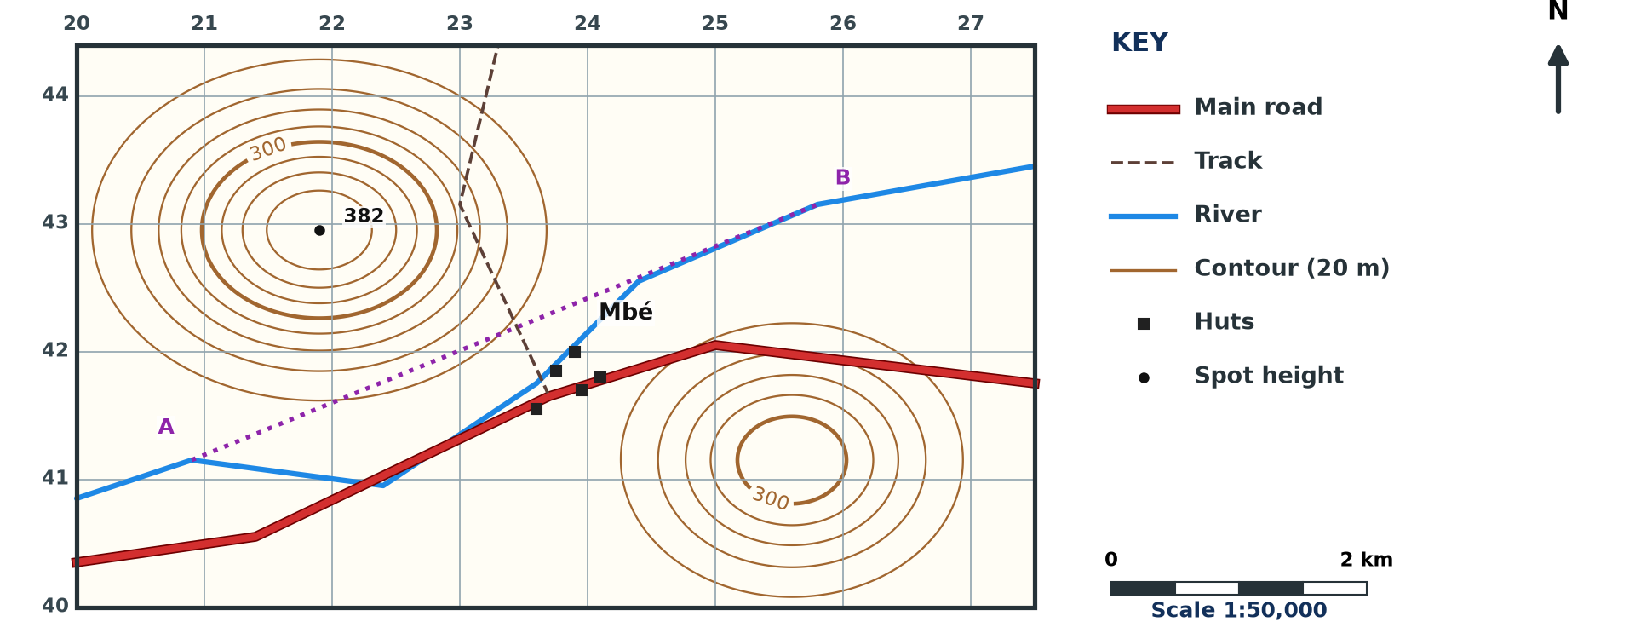
2. POINT AND AREA SIGNS
Activity 3
A map extract.
Notes:
Activity 3. Look carefully at this diagram: a map extract. Observe every detail before I ask the question.

Slide 25
2. POINT AND AREA SIGNS
Activity 3: Question
How are huts, forests and swamps shown?
Notes:
Here is the question for Activity 3: How are huts, forests and swamps shown? Take one minute to think and write your answer in your rough notebook.

Slide 26
2. POINT AND AREA SIGNS
Activity 3: Answer
Huts by small black squares, forests by green areas with tree symbols, swamps by blue tufts.
Notes:
Let us check the answer together. Huts by small black squares, forests by green areas with tree symbols, swamps by blue tufts.

Slide 27
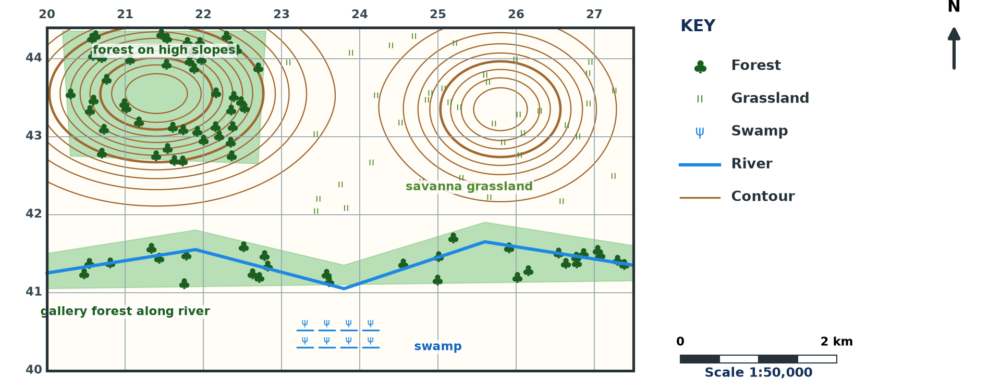
3. COLOURS
Activity 4
Colours on a map.
Notes:
Activity 4. Look carefully at this diagram: colours on a map. Observe every detail before I ask the question.

Slide 28
3. COLOURS
Activity 4: Question
What do blue, green and brown usually represent?
Notes:
Here is the question for Activity 4: What do blue, green and brown usually represent? Take one minute to think and write your answer in your rough notebook.

Slide 29
3. COLOURS
Activity 4: Answer
Blue: water; green: vegetation; brown: relief (contours).
Notes:
Let us check the answer together. Blue: water; green: vegetation; brown: relief (contours).

Slide 30
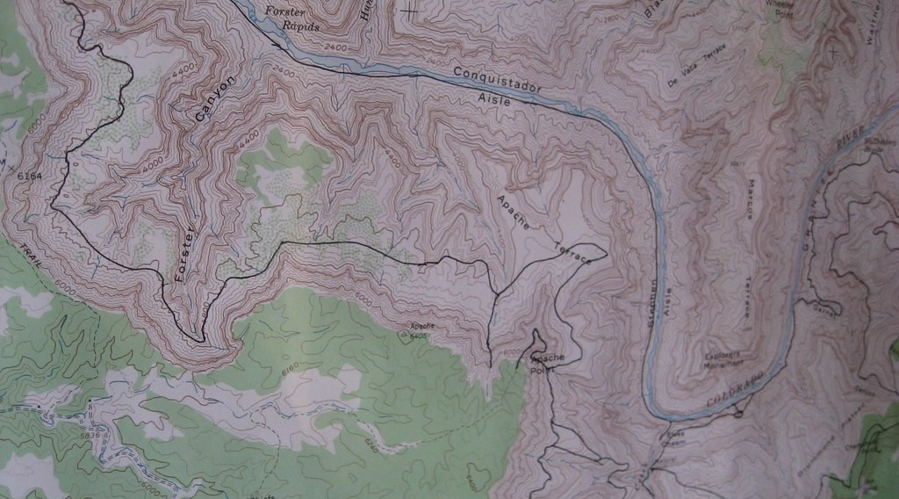
3. SIGNIFICANCE
Activity 5
A topographic map.
Notes:
Activity 5. Look carefully at this picture: a topographic map. Observe every detail before I ask the question.

Slide 31
3. SIGNIFICANCE
Activity 5: Question
Why are conventional signs used?
Notes:
Here is the question for Activity 5: Why are conventional signs used? Take one minute to think and write your answer in your rough notebook.

Slide 32
3. SIGNIFICANCE
Activity 5: Answer
They show many features in a small space in a standard way that everyone understands.
Notes:
Let us check the answer together. They show many features in a small space in a standard way that everyone understands.

Slide 33
BOARD SUMMARY
Board Summary
Topic: Initiation to Map Analysis
Sub-topic: Map Reading
Practical Work 2: Conventional Signs and Symbols on Ordnance Survey Maps
Notes:
Now we are going to copy the board summary. Write the title and the headings neatly in your notebooks. I will give you enough time for each slide, so do not rush.

Slide 34
BOARD SUMMARY
DEFINITIONS
The key terms of this lesson are defined as follows:
Conventional signs: They are standard symbols used on maps to represent real features.
Notes:
Let us copy the definitions. The key terms of this lesson are defined as follows. On this slide we have Conventional signs. Write each point on a new line, with the key term first, and explain it in your own words when we revise.

Slide 35
BOARD SUMMARY
1. What they Represent
Conventional signs represent the following features:
Line features: Roads, railways, rivers, boundaries and contours are shown by lines.
Point features: Huts, churches, schools and spot heights are shown by small symbols.
Notes:
Let us copy What they Represent. Conventional signs represent the following features. On this slide we have Line features and Point features. Write each point on a new line, with the key term first, and explain it in your own words when we revise. When you finish, we go to the next slide.

Slide 36
BOARD SUMMARY
1. What they Represent (continued)
Area features: Forests, swamps and settlements are shown by shaded areas.
Notes:
We continue with What they Represent. On this slide we have Area features. Write each point on a new line, with the key term first, and explain it in your own words when we revise.

Slide 37
BOARD SUMMARY
1. What they Represent
Illustration: conventional signs
Notes:
Now draw this illustration in your notebook: conventional signs. Give it a title and label it clearly.

Slide 38
BOARD SUMMARY
2. Significance of Colours
Colours on maps have the following meanings:
Blue: It shows water: rivers, lakes, swamps and the sea.
Green: It shows vegetation: forests and grassland.
Notes:
Let us copy Significance of Colours. Colours on maps have the following meanings. On this slide we have Blue and Green. Write each point on a new line, with the key term first, and explain it in your own words when we revise. When you finish, we go to the next slide.

Slide 39
BOARD SUMMARY
2. Significance of Colours (continued)
Brown: It shows relief: contours and spot heights.
Red and black: They show human features: roads, railways and buildings.
Notes:
We continue with Significance of Colours. On this slide we have Brown and Red and black. Write each point on a new line, with the key term first, and explain it in your own words when we revise.

Slide 40
FORMATIVE EVALUATION
Evaluation 1
What does blue show on a map?
Notes:
Now let us check what you have understood. Question 1: What does blue show on a map? Answer in your exercise book.

Slide 41
FORMATIVE EVALUATION
Expected Answer
Water features.
Notes:
The expected answer is: water features. If you got it right, well done.

Slide 42
FORMATIVE EVALUATION
Evaluation 2
Give one line, one point and one area feature.
Notes:
Now let us check what you have understood. Question 2: Give one line, one point and one area feature. Answer in your exercise book.

Slide 43
FORMATIVE EVALUATION
Expected Answer
Road, hut and forest.
Notes:
The expected answer is: road, hut and forest. If you got it right, well done.

Slide 44
REMEDIATION
Remediation
Fill in the blanks:
Contours are drawn in ______.
Forests are shown in ______.
Signs used on all maps are ______ signs.
Notes:
For those who need more practice, fill in the blanks in your exercise book. The answers are: number 1, brown; number 2, green; number 3, conventional.

Slide 45
HOMEWORK
Homework
Draw ten conventional signs and write what each represents.
Notes:
For your homework: Draw ten conventional signs and write what each represents. We shall correct it at the beginning of our next lesson.

Slide 46
NEXT LESSON
Next Lesson
Our next lesson will be on:
Practical Work 3: Gridlines and Locational References on Maps
Notes:
Our next lesson will be on Practical Work 3: Gridlines and Locational References on Maps. Thank you for your attention, and see you next time.

Slide 47
BILINGUAL GAME
Bilingual Game (Jeu Bilingue)
English | Français
Sign | Le signe
Symbol | Le symbole
Colour | La couleur
Railway | Le chemin de fer
Swamp | Le marécage
Bridge | Le pont
Notes:
Let us play the bilingual game. I say a word in English, and you give me the French word. Then we do the reverse.

Slide 48
LOGBOOK
Official Logbook (1/2)
Module / Topic | Initiation to Map Analysis
Lesson Title | Practical Work 2: Conventional Signs and Symbols on Ordnance Survey Maps
Expected Learning Outcomes | Define conventional signs and symbols. Identify what they represent. Explain the significance of colours.
Competence | Learners are able to recognise conventional signs and colours on topographic maps.
Notes:
I record this information in the official logbook of the class after the lesson.

Slide 49
LOGBOOK
Official Logbook (2/2)
Matter Taught | DEFINITIONS; What they Represent; Significance of Colours.
Evaluation | Formative evaluation and remediation exercise.
Homework | Draw ten conventional signs and write what each represents.
Enrolment / Present / Absent | ____ / ____ / ____
Achievement | To be completed after the lesson.
Notes:
I complete the second page of the logbook: the matter taught, the evaluation, the homework and the attendance.

Slide 50
TEACHER'S NOTE
Teacher's Note
Timing: Homework correction, plan, objectives 8 min | Recall, situation, action 10 min | 5 activities 30 min | Board summary (copying) 30 min | Evaluation, remediation 10 min | Homework, next lesson 5 min | Logbook 7 min
Without the projector (Activity 1): draw five signs.
Without the projector (Activity 2): draw each line.
Without the projector (Activity 3): find them on a map.
Without the projector (Activity 4): match colours with features.
Without the projector (Activity 5): discuss.
Notes:
This slide is for me, the teacher: it gives the timing of the lesson and what to do if the projector is not available.

Slide 51
REFERENCES
References
Geography Syllabus, Forms I–V, MINESEC (2023) — Form 4, Module I: Ecological Systems and their Resources.
Photo, Activity 5: “Harvey Butchart's hiking map” by brewbooks, CC BY-SA 2.0, via Flickr (https://www.flickr.com/photos/93452909@N00/5289678354)
Diagrams and animations: drawn for this lesson (Geography Department).
Notes:
These are the references and picture credits used to prepare this lesson.

