Slide 1
FORM 4
GEOGRAPHY
Lesson 34
Arable Agriculture in Cameroon
Notes:
Good morning, class, and welcome to our geography lesson. I am your geography teacher, Mr Kamdem. Today we are starting Lesson 34: Arable Agriculture in Cameroon.

Slide 2
CLASS INFO
Class, Chapter and Duration
Class | Form 4
Chapter | Module II: Development and the Management of Primary Resources
Duration | 2 periods (2 × 50 minutes)
Notes:
This lesson is for Form 4. It belongs to Module II: Development and the Management of Primary Resources. We shall need 2 periods to cover it.

Slide 3
IDENTIFICATION
Lesson Identification
Topic | Managing Resources for Development through Economic Activities
Sub-topic | The Economic Development Potentials of Cameroon in the Primary Sector: Agriculture
Lesson | Lesson 34: Arable Agriculture in Cameroon
Notions / Concepts | Food crops, cash crops, subsistence farming, commercial farming.
Syllabus focus | Subsistence and commercial farming.
Competence | Learners are able to describe arable farming in Cameroon and locate its main crops.
Notes:
Our topic is Managing Resources for Development through Economic Activities, and the sub-topic is The Economic Development Potentials of Cameroon in the Primary Sector: Agriculture. The key notions we shall use today are: food crops, cash crops, subsistence farming, commercial farming. At the end, you should be able to do this: learners are able to describe arable farming in Cameroon and locate its main crops.

Slide 4

HOMEWORK CORRECTION
Correction of the Homework
Question (Lesson 33: Spatial Patterns of Agriculture: Von Thünen's Model of Agricultural Land Use):
Draw the land use around your town or village and compare it with Von Thünen's rings.
Notes:
Before we start the new lesson, let us correct the homework I gave you at the end of Lesson 33: Spatial Patterns of Agriculture: Von Thünen's Model of Agricultural Land Use. The question was: Draw the land use around your town or village and compare it with Von Thünen's rings. Take out your exercise books.

Slide 5
HOMEWORK CORRECTION
Correction: Possible Answer
Around Garoua: vegetable gardens and dairy near town, then maize and cotton fields, then bush pasture for cattle — similar to Von Thünen, though rivers and roads distort the rings.
Notes:
Here is a good answer. Around Garoua: vegetable gardens and dairy near town, then maize and cotton fields, then bush pasture for cattle — similar to Von Thünen, though rivers and roads distort the rings. Compare it with your own answer and correct your work in red.

Slide 6
LESSON PLAN
Lesson Plan
Correction of the homework
Objectives and recall
Real-life situation and action to take
Learning activities
Board summary
Evaluation, remediation and homework
Notes:
Here is the plan of our lesson today. First, we shall correct the homework. Then we shall look at the objectives and recall what you already know. After that, we shall study a situation from real life and the action to take, and do the learning activities. Finally, we shall copy the board summary, do the evaluation and the remediation, and I will give you the homework.

Slide 7
OBJECTIVES
Objectives
By the end of this lesson, you should be able to:
Describe subsistence farming in Cameroon.
Describe commercial farming in Cameroon.
Locate the main crops.
Notes:
By the end of this lesson, you should be able to do three things. Number 1: describe subsistence farming in Cameroon. Number 2: describe commercial farming in Cameroon. Number 3: locate the main crops.

Slide 8
PREVIOUS KNOWLEDGE
Previous Knowledge
Cameroon has forest and savanna regions.
Farmers grow food crops and cash crops.
Cocoa grows in the south and cotton in the north.
Notes:
Let us first remember what you already know. Cameroon has forest and savanna regions. Farmers grow food crops and cash crops. Cocoa grows in the south and cotton in the north. Keep this in mind, because we shall build on it today.

Slide 9
REAL-LIFE SITUATION
Situation in Real Life
In the South, farmers grow cassava and plantains for the family and cocoa for sale. In the North, farmers grow sorghum and maize to eat and cotton to sell to SODECOTON.
Notes:
Listen carefully to this situation from real life. In the South, farmers grow cassava and plantains for the family and cocoa for sale. In the North, farmers grow sorghum and maize to eat and cotton to sell to SODECOTON. Think about it, because I am going to ask you some questions.

Slide 10
REAL-LIFE SITUATION
Situation: Question 1
What is the problem in the situation?
Notes:
Question 1: What is the problem in the situation? Think for a moment, then raise your hand to answer.

Slide 11
REAL-LIFE SITUATION
Answer
We want to describe arable farming in Cameroon.
Notes:
Good. We want to describe arable farming in Cameroon.

Slide 12
REAL-LIFE SITUATION
Situation: Question 2
Name two food crops.
Notes:
Question 2: Name two food crops. Think for a moment, then raise your hand to answer.

Slide 13
REAL-LIFE SITUATION
Answer
Cassava and sorghum (also plantains, maize).
Notes:
Good. Cassava and sorghum (also plantains, maize).

Slide 14
REAL-LIFE SITUATION
Situation: Question 3
Name two cash crops.
Notes:
Question 3: Name two cash crops. Think for a moment, then raise your hand to answer.

Slide 15
REAL-LIFE SITUATION
Possible Answer
Cocoa and cotton.
Notes:
Good. Cocoa and cotton.

Slide 16
ACTION TO TAKE
Action to Take
Support local farmers by buying local food.
Notes:
From this situation, the action we are working towards in this lesson is the following: support local farmers by buying local food.

Slide 17
JUSTIFICATION
Justification of the Lesson
This lesson helps us to know the farming that feeds Cameroon.
Notes:
Why is this lesson important for you? This lesson helps us to know the farming that feeds Cameroon.

Slide 18
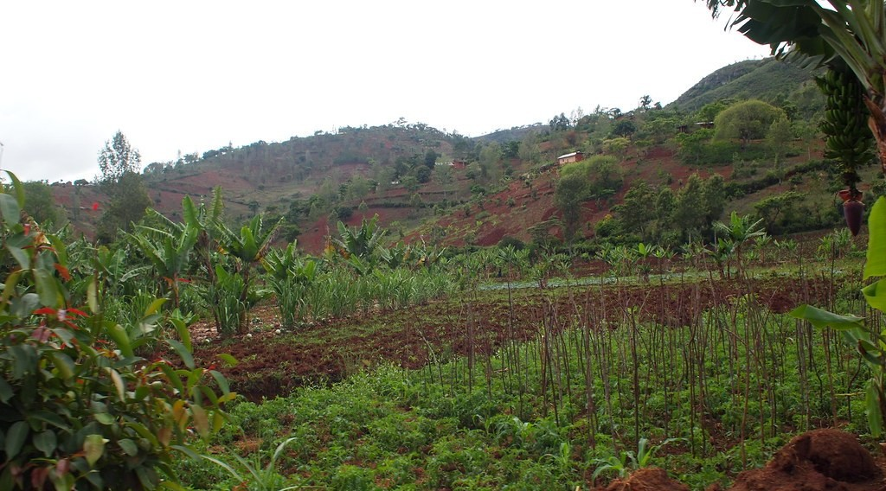
1. SUBSISTENCE FARMING
Activity 1
A food crop farm.
Notes:
Activity 1. Look carefully at this picture: a food crop farm. Observe every detail before I ask the question.

Slide 19
1. SUBSISTENCE FARMING
Activity 1: Question
What is subsistence farming? Name three food crops of Cameroon.
Notes:
Here is the question for Activity 1: What is subsistence farming? Name three food crops of Cameroon. Take one minute to think and write your answer in your rough notebook.

Slide 20
1. SUBSISTENCE FARMING
Activity 1: Answer
Farming to feed the family; cassava, maize and sorghum (also plantains, yams).
Notes:
Let us check the answer together. Farming to feed the family; cassava, maize and sorghum (also plantains, yams).

Slide 21
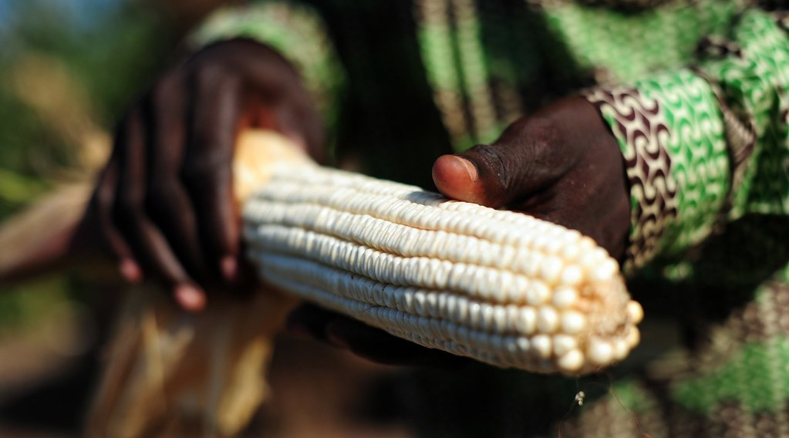
1. SUBSISTENCE FARMING
Activity 2
Maize.
Notes:
Activity 2. Look carefully at this picture: maize. Observe every detail before I ask the question.

Slide 22
1. SUBSISTENCE FARMING
Activity 2: Question
Give two characteristics of subsistence farming.
Notes:
Here is the question for Activity 2: Give two characteristics of subsistence farming. Take one minute to think and write your answer in your rough notebook.

Slide 23
1. SUBSISTENCE FARMING
Activity 2: Answer
Small farms and simple tools with family labour.
Notes:
Let us check the answer together. Small farms and simple tools with family labour.

Slide 24

2. COMMERCIAL FARMING
Activity 3
Drying cocoa.
Notes:
Activity 3. Look carefully at this picture: drying cocoa. Observe every detail before I ask the question.

Slide 25
2. COMMERCIAL FARMING
Activity 3: Question
What is commercial farming? Name three cash crops.
Notes:
Here is the question for Activity 3: What is commercial farming? Name three cash crops. Take one minute to think and write your answer in your rough notebook.

Slide 26
2. COMMERCIAL FARMING
Activity 3: Answer
Farming for sale; cocoa, coffee and cotton (also bananas, oil palm, rubber).
Notes:
Let us check the answer together. Farming for sale; cocoa, coffee and cotton (also bananas, oil palm, rubber).

Slide 27
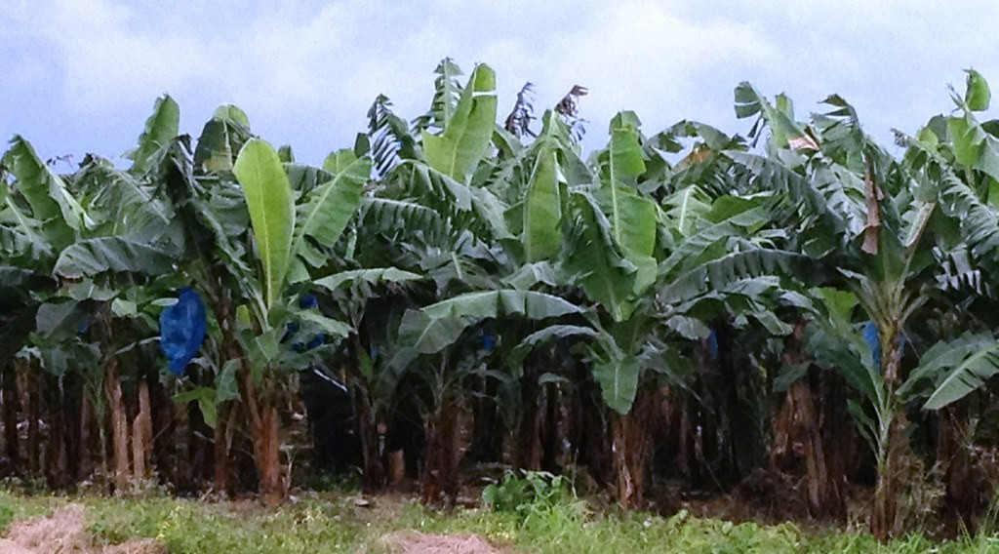
2. PLANTATIONS
Activity 4
A banana plantation.
Notes:
Activity 4. Look carefully at this picture: a banana plantation. Observe every detail before I ask the question.

Slide 28
2. PLANTATIONS
Activity 4: Question
Name two agro-industrial companies of Cameroon.
Notes:
Here is the question for Activity 4: Name two agro-industrial companies of Cameroon. Take one minute to think and write your answer in your rough notebook.

Slide 29
2. PLANTATIONS
Activity 4: Answer
The CDC and SODECOTON (also SOCAPALM, SOSUCAM).
Notes:
Let us check the answer together. The CDC and SODECOTON (also SOCAPALM, SOSUCAM).

Slide 30
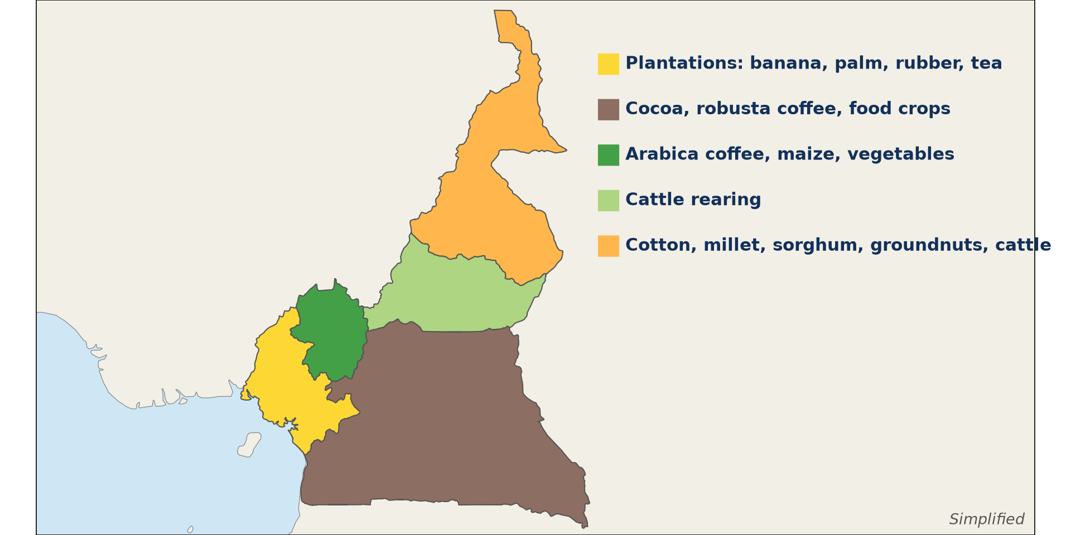
3. DISTRIBUTION
Activity 5
Farming regions of Cameroon.
Notes:
Activity 5. Look carefully at this diagram: farming regions of Cameroon. Observe every detail before I ask the question.

Slide 31
3. DISTRIBUTION
Activity 5: Question
Where are cocoa, coffee and cotton grown?
Notes:
Here is the question for Activity 5: Where are cocoa, coffee and cotton grown? Take one minute to think and write your answer in your rough notebook.

Slide 32
3. DISTRIBUTION
Activity 5: Answer
Cocoa in the Centre and South; arabica coffee in the West; cotton in the North and Far North.
Notes:
Let us check the answer together. Cocoa in the Centre and South; arabica coffee in the West; cotton in the North and Far North.

Slide 33
BOARD SUMMARY
Board Summary
Topic: Managing Resources for Development through Economic Activities
Sub-topic: The Economic Development Potentials of Cameroon in the Primary Sector: Agriculture
Lesson 34: Arable Agriculture in Cameroon
Notes:
Now we are going to copy the board summary. Write the title and the headings neatly in your notebooks. I will give you enough time for each slide, so do not rush.

Slide 34
BOARD SUMMARY
1. Subsistence Farming
Subsistence farming in Cameroon has the following characteristics:
Purpose: Farmers grow food mainly to feed their families.
Crops: They grow cassava, plantains and cocoyams in the south and sorghum, millet and maize in the north.
Notes:
Let us copy Subsistence Farming. Subsistence farming in Cameroon has the following characteristics. On this slide we have Purpose and Crops. Write each point on a new line, with the key term first, and explain it in your own words when we revise. When you finish, we go to the next slide.

Slide 35
BOARD SUMMARY
1. Subsistence Farming (continued)
Methods: Farms are small, with hoes, family labour and bush fallowing.
Notes:
We continue with Subsistence Farming. On this slide we have Methods. Write each point on a new line, with the key term first, and explain it in your own words when we revise.

Slide 36
BOARD SUMMARY
2. Commercial Farming
The characteristics and distribution of commercial farming in Cameroon are the following:
Small-holder cash crops: Farmers grow cocoa, coffee and cotton for sale.
Notes:
Let us copy Commercial Farming. The characteristics and distribution of commercial farming in Cameroon are the following. On this slide we have Small-holder cash crops. Write each point on a new line, with the key term first, and explain it in your own words when we revise. When you finish, we go to the next slide.

Slide 37
BOARD SUMMARY
2. Commercial Farming (continued)
Plantations: Agro-industries such as the CDC, SOCAPALM and SOSUCAM grow bananas, oil palm, rubber and sugar cane.
Distribution: Cocoa grows in the Centre and South, coffee in the West and cotton in the North.
Notes:
We continue with Commercial Farming. On this slide we have Plantations and Distribution. Write each point on a new line, with the key term first, and explain it in your own words when we revise.

Slide 38
BOARD SUMMARY
2. Commercial Farming
Illustration: farming regions of Cameroon
Notes:
Now draw this illustration in your notebook: farming regions of Cameroon. Give it a title and label it clearly.

Slide 39
FORMATIVE EVALUATION
Evaluation 1
Distinguish subsistence and commercial farming.
Notes:
Now let us check what you have understood. Question 1: Distinguish subsistence and commercial farming. Answer in your exercise book.

Slide 40
FORMATIVE EVALUATION
Expected Answer
Subsistence feeds the family; commercial farming sells the produce.
Notes:
The expected answer is: subsistence feeds the family; commercial farming sells the produce. If you got it right, well done.

Slide 41
FORMATIVE EVALUATION
Evaluation 2
Where is cotton grown?
Notes:
Now let us check what you have understood. Question 2: Where is cotton grown? Answer in your exercise book.

Slide 42
FORMATIVE EVALUATION
Expected Answer
In the North and Far North.
Notes:
The expected answer is: in the North and Far North. If you got it right, well done.

Slide 43
REMEDIATION
Remediation
Fill in the blanks:
Farming to feed the family is ______ farming.
Cotton is bought by ______.
Arabica coffee is grown in the ______ Region.
Notes:
For those who need more practice, fill in the blanks in your exercise book. The answers are: number 1, subsistence; number 2, SODECOTON; number 3, West.

Slide 44
HOMEWORK
Homework
List the food crops and cash crops grown in your region.
Notes:
For your homework: List the food crops and cash crops grown in your region. We shall correct it at the beginning of our next lesson.

Slide 45
NEXT LESSON
Next Lesson
Our next lesson will be on:
Lesson 35: Pastoral Agriculture in Cameroon
Notes:
Our next lesson will be on Lesson 35: Pastoral Agriculture in Cameroon. Thank you for your attention, and see you next time.

Slide 46
BILINGUAL GAME
Bilingual Game (Jeu Bilingue)
English | Français
Food crop | La culture vivrière
Cash crop | La culture de rente
Cassava | Le manioc
Cocoa | Le cacao
Coffee | Le café
Cotton | Le coton
Notes:
Let us play the bilingual game. I say a word in English, and you give me the French word. Then we do the reverse.

Slide 47
LOGBOOK
Official Logbook (1/2)
Module / Topic | Managing Resources for Development through Economic Activities
Lesson Title | Lesson 34: Arable Agriculture in Cameroon
Expected Learning Outcomes | Describe subsistence farming in Cameroon. Describe commercial farming in Cameroon. Locate the main crops.
Competence | Learners are able to describe arable farming in Cameroon and locate its main crops.
Notes:
I record this information in the official logbook of the class after the lesson.

Slide 48
LOGBOOK
Official Logbook (2/2)
Matter Taught | Subsistence Farming; Commercial Farming.
Evaluation | Formative evaluation and remediation exercise.
Homework | List the food crops and cash crops grown in your region.
Enrolment / Present / Absent | ____ / ____ / ____
Achievement | To be completed after the lesson.
Notes:
I complete the second page of the logbook: the matter taught, the evaluation, the homework and the attendance.

Slide 49
TEACHER'S NOTE
Teacher's Note
Timing: Homework correction, plan, objectives 8 min | Recall, situation, action 10 min | 5 activities 30 min | Board summary (copying) 30 min | Evaluation, remediation 10 min | Homework, next lesson 5 min | Logbook 7 min
Without the projector (Activity 1): list foods.
Without the projector (Activity 2): describe family farms.
Without the projector (Activity 3): list exports.
Without the projector (Activity 4): name companies.
Without the projector (Activity 5): use the map.
Notes:
This slide is for me, the teacher: it gives the timing of the lesson and what to do if the projector is not available.

Slide 50
REFERENCES
References
Geography Syllabus, Forms I–V, MINESEC (2023) — Form 4, Module II: Development and the Management of Primary Resources.
Photo, Activity 1: “Workshop in Lushoto, Tanzania” by CGIAR Climate, CC BY-NC-SA 2.0, via Flickr (https://www.flickr.com/photos/55227776@N04/8551480688)
Photo, Activity 2: “Ghana 15” by CIAT International Center for Tropical Agriculture, CC BY-NC-SA 2.0, via Flickr (https://www.flickr.com/photos/38476503@N08/5207540264)
Photo, Activity 3: “Farmer sun drying cocoa beans” by IITA Image Library, CC BY-NC 2.0, via Flickr (https://www.flickr.com/photos/45796762@N03/4598613756)
Photo, Activity 4: “Banana Plantation” by AfricaTravelAssociation, CC BY 2.0, via Flickr (https://www.flickr.com/photos/65134942@N06/8164706151)
Diagrams and animations: drawn for this lesson (Geography Department).
Notes:
These are the references and picture credits used to prepare this lesson.

