Slide 1
FORM 4
GEOGRAPHY
Lesson 37
Food Loss and Food Waste
Notes:
Good morning, class, and welcome to our geography lesson. I am your geography teacher, Mr Kamdem. Today we are starting Lesson 37: Food Loss and Food Waste.

Slide 2
CLASS INFO
Class, Chapter and Duration
Class | Form 4
Chapter | Module II: Development and the Management of Primary Resources
Duration | 2 periods (2 × 50 minutes)
Notes:
This lesson is for Form 4. It belongs to Module II: Development and the Management of Primary Resources. We shall need 2 periods to cover it.

Slide 3
IDENTIFICATION
Lesson Identification
Topic | Managing Resources for Development through Economic Activities
Sub-topic | The Economic Development Potentials of Cameroon in the Primary Sector: Agriculture
Lesson | Lesson 37: Food Loss and Food Waste
Notions / Concepts | Food loss, food waste, production waste, retail waste.
Syllabus focus | Definitions; causes; consequences; solutions.
Competence | Learners are able to explain food loss and waste and act to reduce them.
Notes:
Our topic is Managing Resources for Development through Economic Activities, and the sub-topic is The Economic Development Potentials of Cameroon in the Primary Sector: Agriculture. The key notions we shall use today are: food loss, food waste, production waste, retail waste. At the end, you should be able to do this: learners are able to explain food loss and waste and act to reduce them.

Slide 4

HOMEWORK CORRECTION
Correction of the Homework
Question (Lesson 36: The Impact of Agriculture on the Economy of Cameroon):
Name three factories in Cameroon that use farm products and their raw materials.
Notes:
Before we start the new lesson, let us correct the homework I gave you at the end of Lesson 36: The Impact of Agriculture on the Economy of Cameroon. The question was: Name three factories in Cameroon that use farm products and their raw materials. Take out your exercise books.

Slide 5
HOMEWORK CORRECTION
Correction: Possible Answer
CICAM (cotton → cloth), SABC (maize and sorghum → drinks), SOSUCAM (sugar cane → sugar) (also SOCAPALM: palm oil).
Notes:
Here is a good answer. CICAM (cotton → cloth), SABC (maize and sorghum → drinks), SOSUCAM (sugar cane → sugar) (also SOCAPALM: palm oil). Compare it with your own answer and correct your work in red.

Slide 6
LESSON PLAN
Lesson Plan
Correction of the homework
Objectives and recall
Real-life situation and action to take
Learning activities
Board summary
Evaluation, remediation and homework
Notes:
Here is the plan of our lesson today. First, we shall correct the homework. Then we shall look at the objectives and recall what you already know. After that, we shall study a situation from real life and the action to take, and do the learning activities. Finally, we shall copy the board summary, do the evaluation and the remediation, and I will give you the homework.

Slide 7
OBJECTIVES
Objectives
By the end of this lesson, you should be able to:
Define food loss and food waste.
Explain their causes and consequences.
Propose solutions.
Notes:
By the end of this lesson, you should be able to do three things. Number 1: define food loss and food waste. Number 2: explain their causes and consequences. Number 3: propose solutions.

Slide 8
PREVIOUS KNOWLEDGE
Previous Knowledge
Farmers harvest crops.
Food is sold in markets.
Some food rots before it is eaten.
Notes:
Let us first remember what you already know. Farmers harvest crops. Food is sold in markets. Some food rots before it is eaten. Keep this in mind, because we shall build on it today.

Slide 9
REAL-LIFE SITUATION
Situation in Real Life
After the harvest, tomatoes rot in a village near Garoua because the road is bad and there is no storage. In town, families throw away leftover food.
Notes:
Listen carefully to this situation from real life. After the harvest, tomatoes rot in a village near Garoua because the road is bad and there is no storage. In town, families throw away leftover food. Think about it, because I am going to ask you some questions.

Slide 10
REAL-LIFE SITUATION
Situation: Question 1
What is the problem in the situation?
Notes:
Question 1: What is the problem in the situation? Think for a moment, then raise your hand to answer.

Slide 11
REAL-LIFE SITUATION
Answer
Food is lost and wasted.
Notes:
Good. Food is lost and wasted.

Slide 12
REAL-LIFE SITUATION
Situation: Question 2
Why do tomatoes rot in the village?
Notes:
Question 2: Why do tomatoes rot in the village? Think for a moment, then raise your hand to answer.

Slide 13
REAL-LIFE SITUATION
Answer
Bad roads and no storage.
Notes:
Good. Bad roads and no storage.

Slide 14
REAL-LIFE SITUATION
Situation: Question 3
What do families in town throw away?
Notes:
Question 3: What do families in town throw away? Think for a moment, then raise your hand to answer.

Slide 15
REAL-LIFE SITUATION
Possible Answer
Leftover food.
Notes:
Good. Leftover food.

Slide 16
ACTION TO TAKE
Action to Take
Buy only what you need and store food well.
Notes:
From this situation, the action we are working towards in this lesson is the following: buy only what you need and store food well.

Slide 17
JUSTIFICATION
Justification of the Lesson
This lesson helps us to save food and money.
Notes:
Why is this lesson important for you? This lesson helps us to save food and money.

Slide 18
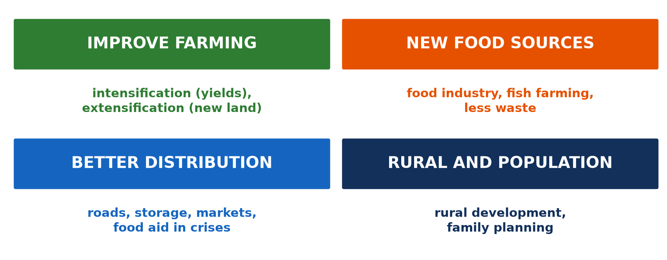
1. DEFINITIONS
Activity 1
Solutions to food problems.
Notes:
Activity 1. Look carefully at this diagram: solutions to food problems. Observe every detail before I ask the question.

Slide 19
1. DEFINITIONS
Activity 1: Question
Distinguish food loss and food waste.
Notes:
Here is the question for Activity 1: Distinguish food loss and food waste. Take one minute to think and write your answer in your rough notebook.

Slide 20
1. DEFINITIONS
Activity 1: Answer
Food loss happens during harvest, storage and transport; food waste happens in shops and homes.
Notes:
Let us check the answer together. Food loss happens during harvest, storage and transport; food waste happens in shops and homes.

Slide 21

2. CAUSES OF LOSS
Activity 2
A bad road.
Notes:
Activity 2. Look carefully at this picture: a bad road. Observe every detail before I ask the question.

Slide 22
2. CAUSES OF LOSS
Activity 2: Question
Give two causes of food loss.
Notes:
Here is the question for Activity 2: Give two causes of food loss. Take one minute to think and write your answer in your rough notebook.

Slide 23
2. CAUSES OF LOSS
Activity 2: Answer
Poor storage and bad roads (also pests, lack of processing).
Notes:
Let us check the answer together. Poor storage and bad roads (also pests, lack of processing).

Slide 24

2. CAUSES OF WASTE
Activity 3
A market.
Notes:
Activity 3. Look carefully at this picture: a market. Observe every detail before I ask the question.

Slide 25
2. CAUSES OF WASTE
Activity 3: Question
Give two causes of food waste.
Notes:
Here is the question for Activity 3: Give two causes of food waste. Take one minute to think and write your answer in your rough notebook.

Slide 26
2. CAUSES OF WASTE
Activity 3: Answer
Buying too much and throwing away leftovers (also food spoiling in shops).
Notes:
Let us check the answer together. Buying too much and throwing away leftovers (also food spoiling in shops).

Slide 27

3. CONSEQUENCES
Activity 4
Food aid.
Notes:
Activity 4. Look carefully at this picture: food aid. Observe every detail before I ask the question.

Slide 28
3. CONSEQUENCES
Activity 4: Question
Give two consequences.
Notes:
Here is the question for Activity 4: Give two consequences. Take one minute to think and write your answer in your rough notebook.

Slide 29
3. CONSEQUENCES
Activity 4: Answer
Hunger and loss of money (also wasted water and land, pollution).
Notes:
Let us check the answer together. Hunger and loss of money (also wasted water and land, pollution).

Slide 30
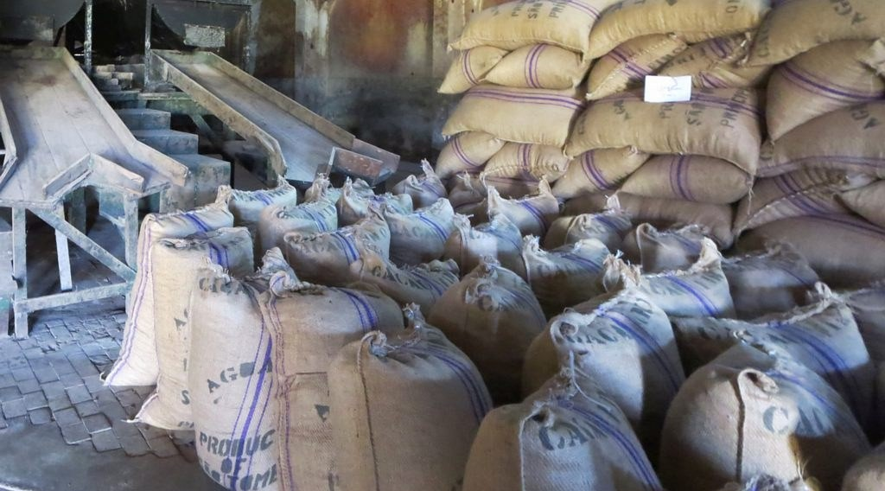
4. SOLUTIONS
Activity 5
Stored sacks.
Notes:
Activity 5. Look carefully at this picture: stored sacks. Observe every detail before I ask the question.

Slide 31
4. SOLUTIONS
Activity 5: Question
Give three solutions.
Notes:
Here is the question for Activity 5: Give three solutions. Take one minute to think and write your answer in your rough notebook.

Slide 32
4. SOLUTIONS
Activity 5: Answer
Better storage and processing, good roads, and buying only what we need.
Notes:
Let us check the answer together. Better storage and processing, good roads, and buying only what we need.

Slide 33
BOARD SUMMARY
Board Summary
Topic: Managing Resources for Development through Economic Activities
Sub-topic: The Economic Development Potentials of Cameroon in the Primary Sector: Agriculture
Lesson 37: Food Loss and Food Waste
Notes:
Now we are going to copy the board summary. Write the title and the headings neatly in your notebooks. I will give you enough time for each slide, so do not rush.

Slide 34
BOARD SUMMARY
DEFINITIONS
The key terms of this lesson are defined as follows:
Food loss: It is food lost during harvest, storage, processing and transport.
Food waste: It is good food thrown away by shops, restaurants and households.
Notes:
Let us copy the definitions. The key terms of this lesson are defined as follows. On this slide we have Food loss and Food waste. Write each point on a new line, with the key term first, and explain it in your own words when we revise.

Slide 35
BOARD SUMMARY
1. Causes
A) Causes of Food Loss
Food is lost for the following reasons:
Poor storage: Grain rots or is eaten by insects in bad stores.
Pests: Rats and insects destroy food.
Bad roads: Food spoils before reaching the market.
Notes:
Let us copy Causes of Food Loss. Food is lost for the following reasons. On this slide we have Poor storage, Pests and Bad roads. Write each point on a new line, with the key term first, and explain it in your own words when we revise. When you finish, we go to the next slide.

Slide 36
BOARD SUMMARY
1. Causes
A) Causes of Food Loss (continued)
Lack of processing: Fresh food cannot be kept for long.
Notes:
We continue with Causes of Food Loss. On this slide we have Lack of processing. Write each point on a new line, with the key term first, and explain it in your own words when we revise.

Slide 37
BOARD SUMMARY
1. Causes
B) Causes of Food Waste
Food is wasted for the following reasons:
Buying too much: People buy more than they need.
Poor planning: Meals are not planned, so food spoils.
Notes:
Let us copy Causes of Food Waste. Food is wasted for the following reasons. On this slide we have Buying too much and Poor planning. Write each point on a new line, with the key term first, and explain it in your own words when we revise. When you finish, we go to the next slide.

Slide 38
BOARD SUMMARY
1. Causes
B) Causes of Food Waste (continued)
Throwing away leftovers: Good food is thrown in the bin.
Notes:
We continue with Causes of Food Waste. On this slide we have Throwing away leftovers. Write each point on a new line, with the key term first, and explain it in your own words when we revise.

Slide 39
BOARD SUMMARY
2. Consequences
Food loss and waste have the following consequences:
Social consequences: Hunger remains while food is thrown away.
Economic and environmental consequences: Money, water, land and energy are wasted and rotting food pollutes.
Notes:
Let us copy Consequences. Food loss and waste have the following consequences. On this slide we have Social consequences and Economic and environmental consequences. Write each point on a new line, with the key term first, and explain it in your own words when we revise.

Slide 40
BOARD SUMMARY
3. Solutions
Food loss and waste can be reduced as follows:
Better storage and processing: Granaries, drying and processing keep food longer.
Good roads and markets: They bring food quickly to consumers.
Notes:
Let us copy Solutions. Food loss and waste can be reduced as follows. On this slide we have Better storage and processing and Good roads and markets. Write each point on a new line, with the key term first, and explain it in your own words when we revise. When you finish, we go to the next slide.

Slide 41
BOARD SUMMARY
3. Solutions (continued)
Good habits: People buy what they need and use leftovers.
Notes:
We continue with Solutions. On this slide we have Good habits. Write each point on a new line, with the key term first, and explain it in your own words when we revise.

Slide 42
BOARD SUMMARY
3. Solutions
Illustration: food solutions
Notes:
Now draw this illustration in your notebook: food solutions. Give it a title and label it clearly.

Slide 43
FORMATIVE EVALUATION
Evaluation 1
Distinguish food loss and food waste.
Notes:
Now let us check what you have understood. Question 1: Distinguish food loss and food waste. Answer in your exercise book.

Slide 44
FORMATIVE EVALUATION
Expected Answer
Loss: during production and transport. Waste: in shops and homes.
Notes:
The expected answer is: loss: during production and transport. Waste: in shops and homes. If you got it right, well done.

Slide 45
FORMATIVE EVALUATION
Evaluation 2
Give two solutions.
Notes:
Now let us check what you have understood. Question 2: Give two solutions. Answer in your exercise book.

Slide 46
FORMATIVE EVALUATION
Expected Answer
Better storage and buying only what we need.
Notes:
The expected answer is: better storage and buying only what we need. If you got it right, well done.

Slide 47
REMEDIATION
Remediation
Fill in the blanks:
Food rotting in storage is food ______.
Food thrown away at home is food ______.
Drying tomatoes is a form of ______.
Notes:
For those who need more practice, fill in the blanks in your exercise book. The answers are: number 1, loss; number 2, waste; number 3, processing.

Slide 48
HOMEWORK
Homework
Observe food waste at home for three days and suggest how to reduce it.
Notes:
For your homework: Observe food waste at home for three days and suggest how to reduce it. We shall correct it at the beginning of our next lesson.

Slide 49
NEXT LESSON
Next Lesson
Our next lesson will be on:
Lesson 38: Problems of Tropical Agriculture with Reference to Cameroon
Notes:
Our next lesson will be on Lesson 38: Problems of Tropical Agriculture with Reference to Cameroon. Thank you for your attention, and see you next time.

Slide 50
BILINGUAL GAME
Bilingual Game (Jeu Bilingue)
English | Français
Food | La nourriture
Loss | La perte
Waste | Le gaspillage
Storage | Le stockage
Leftovers | Les restes
Hunger | La faim
Notes:
Let us play the bilingual game. I say a word in English, and you give me the French word. Then we do the reverse.

Slide 51
LOGBOOK
Official Logbook (1/2)
Module / Topic | Managing Resources for Development through Economic Activities
Lesson Title | Lesson 37: Food Loss and Food Waste
Expected Learning Outcomes | Define food loss and food waste. Explain their causes and consequences. Propose solutions.
Competence | Learners are able to explain food loss and waste and act to reduce them.
Notes:
I record this information in the official logbook of the class after the lesson.

Slide 52
LOGBOOK
Official Logbook (2/2)
Matter Taught | DEFINITIONS; Causes of Food Loss; Causes of Food Waste; Consequences; Solutions.
Evaluation | Formative evaluation and remediation exercise.
Homework | Observe food waste at home for three days and suggest how to reduce it.
Enrolment / Present / Absent | ____ / ____ / ____
Achievement | To be completed after the lesson.
Notes:
I complete the second page of the logbook: the matter taught, the evaluation, the homework and the attendance.

Slide 53
TEACHER'S NOTE
Teacher's Note
Timing: Homework correction, plan, objectives 8 min | Recall, situation, action 10 min | 5 activities 30 min | Board summary (copying) 30 min | Evaluation, remediation 10 min | Homework, next lesson 5 min | Logbook 7 min
Without the projector (Activity 1): give examples.
Without the projector (Activity 2): discuss.
Without the projector (Activity 3): discuss home habits.
Without the projector (Activity 4): discuss.
Without the projector (Activity 5): list actions.
Notes:
This slide is for me, the teacher: it gives the timing of the lesson and what to do if the projector is not available.

Slide 54
REFERENCES
References
Geography Syllabus, Forms I–V, MINESEC (2023) — Form 4, Module II: Development and the Management of Primary Resources.
Photo, Activity 2: “Cameroon - UN Women's Gender Road Project” by UN Women Gallery, CC BY-NC-ND 2.0, via Flickr (https://www.flickr.com/photos/51431730@N04/40672356003)
Photo, Activity 3: “Sandga Market in Douala, Cameroon” by The Advocacy Project, CC BY-NC-SA 2.0, via Flickr (https://www.flickr.com/photos/42487558@N00/3636438732)
Photo, Activity 4: “WFP food distribution” by UNAMID Photo, CC BY-NC-ND 2.0, via Flickr (https://www.flickr.com/photos/58538810@N03/12495227734)
Photo, Activity 5: “Sacks of Cocoa Beans” by D-Stanley, CC BY 2.0, via Flickr (https://www.flickr.com/photos/79721788@N00/20795057229)
Diagrams and animations: drawn for this lesson (Geography Department).
Notes:
These are the references and picture credits used to prepare this lesson.

