Slide 1
FORM 5
GEOGRAPHY
Lesson 12
Specialised Forms of Transport: Motorways and Cableways
Notes:
Good morning, class, and welcome to our geography lesson. I am your geography teacher, Mr Kamdem. Today we are starting Lesson 12: Specialised Forms of Transport: Motorways and Cableways.

Slide 2
CLASS INFO
Class, Chapter and Duration
Class | Form 5
Chapter | Module I: Management of Manufacturing and Tertiary Activities
Duration | 2 periods (2 × 50 minutes)
Notes:
This lesson is for Form 5. It belongs to Module I: Management of Manufacturing and Tertiary Activities. We shall need 2 periods to cover it.

Slide 3
IDENTIFICATION
Lesson Identification
Topic | Managing Resources for Development through Economic Activities
Sub-topic | World Communication
Lesson | Lesson 12: Specialised Forms of Transport: Motorways and Cableways
Notions / Concepts | Motorways, cableways, ropeways.
Syllabus focus | Definition of motorways and cableways; reasons for their creation; advantages and disadvantages.
Competence | Learners are able to describe specialised forms of transport and assess them.
Notes:
Our topic is Managing Resources for Development through Economic Activities, and the sub-topic is World Communication. The key notions we shall use today are: motorways, cableways, ropeways. At the end, you should be able to do this: learners are able to describe specialised forms of transport and assess them.

Slide 4

HOMEWORK CORRECTION
Correction of the Homework
Question (Further Study 2: Containerisation):
Explain why Kribi port was built for container ships.
Notes:
Before we start the new lesson, let us correct the homework I gave you at the end of Further Study 2: Containerisation. The question was: Explain why Kribi port was built for container ships. Take out your exercise books.

Slide 5
HOMEWORK CORRECTION
Correction: Possible Answer
Douala port is shallow and congested; Kribi has deep water for large container ships and space for terminals, and links to mines and industries.
Notes:
Here is a good answer. Douala port is shallow and congested; Kribi has deep water for large container ships and space for terminals, and links to mines and industries. Compare it with your own answer and correct your work in red.

Slide 6
LESSON PLAN
Lesson Plan
Correction of the homework
Objectives and recall
Real-life situation and action to take
Learning activities
Board summary
Evaluation, remediation and homework
Notes:
Here is the plan of our lesson today. First, we shall correct the homework. Then we shall look at the objectives and recall what you already know. After that, we shall study a situation from real life and the action to take, and do the learning activities. Finally, we shall copy the board summary, do the evaluation and the remediation, and I will give you the homework.

Slide 7
OBJECTIVES
Objectives
By the end of this lesson, you should be able to:
Define motorways and cableways.
Explain the reasons for their creation.
Give their advantages and disadvantages.
Notes:
By the end of this lesson, you should be able to do three things. Number 1: define motorways and cableways. Number 2: explain the reasons for their creation. Number 3: give their advantages and disadvantages.

Slide 8
PREVIOUS KNOWLEDGE
Previous Knowledge
Roads are the most common mode of transport.
Mountains make transport difficult.
Big towns have traffic jams.
Notes:
Let us first remember what you already know. Roads are the most common mode of transport. Mountains make transport difficult. Big towns have traffic jams. Keep this in mind, because we shall build on it today.

Slide 9
REAL-LIFE SITUATION
Situation in Real Life
In La Paz, a mountain city, people travel above the traffic in cabins hanging on cables. In Europe, lorries use wide motorways without crossroads.
Notes:
Listen carefully to this situation from real life. In La Paz, a mountain city, people travel above the traffic in cabins hanging on cables. In Europe, lorries use wide motorways without crossroads. Think about it, because I am going to ask you some questions.

Slide 10
REAL-LIFE SITUATION
Situation: Question 1
What is the problem in the situation?
Notes:
Question 1: What is the problem in the situation? Think for a moment, then raise your hand to answer.

Slide 11
REAL-LIFE SITUATION
Answer
We want to know about specialised forms of transport.
Notes:
Good. We want to know about specialised forms of transport.

Slide 12
REAL-LIFE SITUATION
Situation: Question 2
What transport is used in La Paz?
Notes:
Question 2: What transport is used in La Paz? Think for a moment, then raise your hand to answer.

Slide 13
REAL-LIFE SITUATION
Answer
Cableways.
Notes:
Good. Cableways.

Slide 14
REAL-LIFE SITUATION
Situation: Question 3
What roads do lorries use in Europe?
Notes:
Question 3: What roads do lorries use in Europe? Think for a moment, then raise your hand to answer.

Slide 15
REAL-LIFE SITUATION
Possible Answer
Motorways.
Notes:
Good. Motorways.

Slide 16
ACTION TO TAKE
Action to Take
Respect speed limits and safety rules on fast roads.
Notes:
From this situation, the action we are working towards in this lesson is the following: respect speed limits and safety rules on fast roads.

Slide 17
JUSTIFICATION
Justification of the Lesson
This lesson helps us to understand modern solutions to transport problems.
Notes:
Why is this lesson important for you? This lesson helps us to understand modern solutions to transport problems.

Slide 18
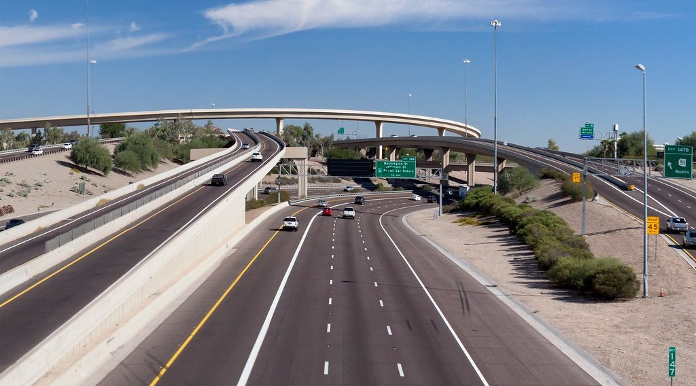
1. MOTORWAYS
Activity 1
A motorway interchange.
Notes:
Activity 1. Look carefully at this picture: a motorway interchange. Observe every detail before I ask the question.

Slide 19
1. MOTORWAYS
Activity 1: Question
What is a motorway?
Notes:
Here is the question for Activity 1: What is a motorway? Take one minute to think and write your answer in your rough notebook.

Slide 20
1. MOTORWAYS
Activity 1: Answer
A wide road with separate lanes and no crossroads, built for fast traffic.
Notes:
Let us check the answer together. A wide road with separate lanes and no crossroads, built for fast traffic.

Slide 21
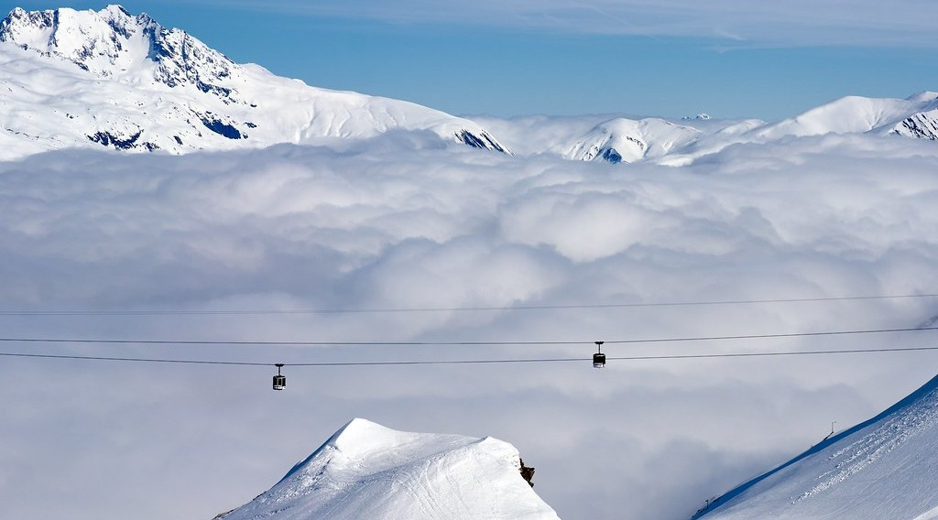
1. CABLEWAYS
Activity 2
Cable cars.
Notes:
Activity 2. Look carefully at this picture: cable cars. Observe every detail before I ask the question.

Slide 22
1. CABLEWAYS
Activity 2: Question
What is a cableway?
Notes:
Here is the question for Activity 2: What is a cableway? Take one minute to think and write your answer in your rough notebook.

Slide 23
1. CABLEWAYS
Activity 2: Answer
A system of cabins or buckets hanging on moving cables.
Notes:
Let us check the answer together. A system of cabins or buckets hanging on moving cables.

Slide 24

2. REASONS FOR CREATION
Activity 3
A traffic jam.
Notes:
Activity 3. Look carefully at this picture: a traffic jam. Observe every detail before I ask the question.

Slide 25
2. REASONS FOR CREATION
Activity 3: Question
Why are motorways built?
Notes:
Here is the question for Activity 3: Why are motorways built? Take one minute to think and write your answer in your rough notebook.

Slide 26
2. REASONS FOR CREATION
Activity 3: Answer
To reduce traffic jams and link big towns quickly.
Notes:
Let us check the answer together. To reduce traffic jams and link big towns quickly.

Slide 27
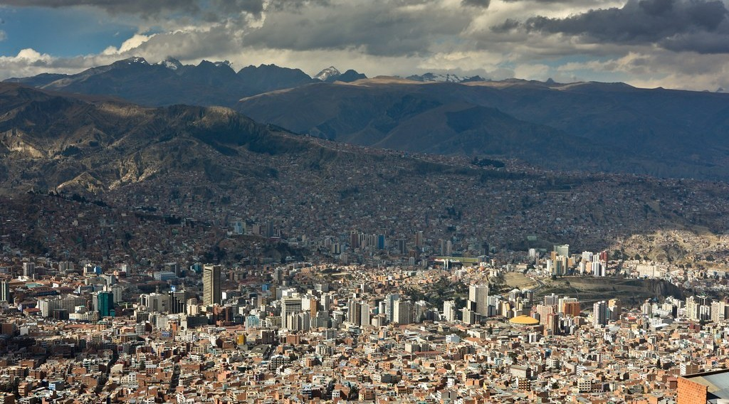
2. REASONS FOR CREATION
Activity 4
La Paz.
Notes:
Activity 4. Look carefully at this picture: la Paz. Observe every detail before I ask the question.

Slide 28
2. REASONS FOR CREATION
Activity 4: Question
Why are cableways built?
Notes:
Here is the question for Activity 4: Why are cableways built? Take one minute to think and write your answer in your rough notebook.

Slide 29
2. REASONS FOR CREATION
Activity 4: Answer
To cross steep mountains, valleys and crowded towns.
Notes:
Let us check the answer together. To cross steep mountains, valleys and crowded towns.

Slide 30

3. ADVANTAGES AND DISADVANTAGES
Activity 5
A transport network.
Notes:
Activity 5. Look carefully at this diagram: a transport network. Observe every detail before I ask the question.

Slide 31
3. ADVANTAGES AND DISADVANTAGES
Activity 5: Question
Give one advantage and one disadvantage of each.
Notes:
Here is the question for Activity 5: Give one advantage and one disadvantage of each. Take one minute to think and write your answer in your rough notebook.

Slide 32
3. ADVANTAGES AND DISADVANTAGES
Activity 5: Answer
Motorways are fast but costly; cableways cross mountains but carry small loads.
Notes:
Let us check the answer together. Motorways are fast but costly; cableways cross mountains but carry small loads.

Slide 33
BOARD SUMMARY
Board Summary
Topic: Managing Resources for Development through Economic Activities
Sub-topic: World Communication
Lesson 12: Specialised Forms of Transport: Motorways and Cableways
Notes:
Now we are going to copy the board summary. Write the title and the headings neatly in your notebooks. I will give you enough time for each slide, so do not rush.

Slide 34
BOARD SUMMARY
DEFINITIONS
The key terms of this lesson are defined as follows:
Motorway: It is a wide road with separate lanes and no crossroads for fast traffic.
Cableway: It is a system of cabins or buckets moved by cables over difficult land.
Notes:
Let us copy the definitions. The key terms of this lesson are defined as follows. On this slide we have Motorway and Cableway. Write each point on a new line, with the key term first, and explain it in your own words when we revise.

Slide 35
BOARD SUMMARY
1. Reasons for Their Creation
Specialised forms of transport are created for the following reasons:
Traffic jams: Motorways carry heavy traffic between big towns.
Difficult relief: Cableways cross steep mountains and deep valleys.
Notes:
Let us copy Reasons for Their Creation. Specialised forms of transport are created for the following reasons. On this slide we have Traffic jams and Difficult relief. Write each point on a new line, with the key term first, and explain it in your own words when we revise. When you finish, we go to the next slide.

Slide 36
BOARD SUMMARY
1. Reasons for Their Creation (continued)
Tourism and mining: Cableways carry skiers, tourists and ores in mountains.
Notes:
We continue with Reasons for Their Creation. On this slide we have Tourism and mining. Write each point on a new line, with the key term first, and explain it in your own words when we revise.

Slide 37
BOARD SUMMARY
2. Advantages and Disadvantages
Motorways and cableways have the following advantages and disadvantages:
Motorways: They are fast and safe but costly and take much land.
Cableways: They cross difficult relief but carry few people and small loads.
Notes:
Let us copy Advantages and Disadvantages. Motorways and cableways have the following advantages and disadvantages. On this slide we have Motorways and Cableways. Write each point on a new line, with the key term first, and explain it in your own words when we revise. When you finish, we go to the next slide.

Slide 38
BOARD SUMMARY
2. Advantages and Disadvantages (continued)
Environment: Motorways increase pollution while cableways cause little pollution.
Notes:
We continue with Advantages and Disadvantages. On this slide we have Environment. Write each point on a new line, with the key term first, and explain it in your own words when we revise.

Slide 39
FORMATIVE EVALUATION
Evaluation 1
Define a motorway.
Notes:
Now let us check what you have understood. Question 1: Define a motorway. Answer in your exercise book.

Slide 40
FORMATIVE EVALUATION
Expected Answer
A wide road with separate lanes and no crossroads.
Notes:
The expected answer is: a wide road with separate lanes and no crossroads. If you got it right, well done.

Slide 41
FORMATIVE EVALUATION
Evaluation 2
Why are cableways built?
Notes:
Now let us check what you have understood. Question 2: Why are cableways built? Answer in your exercise book.

Slide 42
FORMATIVE EVALUATION
Expected Answer
To cross steep mountains and valleys.
Notes:
The expected answer is: to cross steep mountains and valleys. If you got it right, well done.

Slide 43
REMEDIATION
Remediation
Fill in the blanks:
A road without crossroads for fast traffic is a ______.
Cabins moved by cables form a ______.
Cableways are useful in ______ areas.
Notes:
For those who need more practice, fill in the blanks in your exercise book. The answers are: number 1, motorway; number 2, cableway; number 3, mountainous.

Slide 44
HOMEWORK
Homework
Suggest where a motorway and a cableway could be useful in Cameroon.
Notes:
For your homework: Suggest where a motorway and a cableway could be useful in Cameroon. We shall correct it at the beginning of our next lesson.

Slide 45
NEXT LESSON
Next Lesson
Our next lesson will be on:
Lesson 13: Pipelines
Notes:
Our next lesson will be on Lesson 13: Pipelines. Thank you for your attention, and see you next time.

Slide 46
BILINGUAL GAME
Bilingual Game (Jeu Bilingue)
English | Français
Motorway | L'autoroute
Cableway | Le téléphérique
Lane | La voie
Crossroads | Le carrefour
Speed limit | La limitation de vitesse
Cabin | La cabine
Notes:
Let us play the bilingual game. I say a word in English, and you give me the French word. Then we do the reverse.

Slide 47
LOGBOOK
Official Logbook (1/2)
Module / Topic | Managing Resources for Development through Economic Activities
Lesson Title | Lesson 12: Specialised Forms of Transport: Motorways and Cableways
Expected Learning Outcomes | Define motorways and cableways. Explain the reasons for their creation. Give their advantages and disadvantages.
Competence | Learners are able to describe specialised forms of transport and assess them.
Notes:
I record this information in the official logbook of the class after the lesson.

Slide 48
LOGBOOK
Official Logbook (2/2)
Matter Taught | DEFINITIONS; Reasons for Their Creation; Advantages and Disadvantages.
Evaluation | Formative evaluation and remediation exercise.
Homework | Suggest where a motorway and a cableway could be useful in Cameroon.
Enrolment / Present / Absent | ____ / ____ / ____
Achievement | To be completed after the lesson.
Notes:
I complete the second page of the logbook: the matter taught, the evaluation, the homework and the attendance.

Slide 49
TEACHER'S NOTE
Teacher's Note
Timing: Homework correction, plan, objectives 8 min | Recall, situation, action 10 min | 5 activities 30 min | Board summary (copying) 30 min | Evaluation, remediation 10 min | Homework, next lesson 5 min | Logbook 7 min
Without the projector (Activity 1): describe.
Without the projector (Activity 2): describe.
Without the projector (Activity 3): discuss.
Without the projector (Activity 4): discuss.
Without the projector (Activity 5): compare.
Notes:
This slide is for me, the teacher: it gives the timing of the lesson and what to do if the projector is not available.

Slide 50
REFERENCES
References
Geography Syllabus, Forms I–V, MINESEC (2023) — Form 5, Module I: Management of Manufacturing and Tertiary Activities.
Photo, Activity 1: “'Mini Stack' Interchange of Interstate 10, Loop 202, and State Route 5” by squeaks2569, CC BY-SA 2.0, via Flickr (https://www.flickr.com/photos/38478466@N06/5180259860)
Photo, Activity 2: “Over the clouds” by radkuch.13, CC BY 2.0, via Flickr (https://www.flickr.com/photos/137294100@N08/51913188868)
Photo, Activity 3: “Nairobi Traffic Jam” by rogiro, CC BY-NC 2.0, via Flickr (https://www.flickr.com/photos/43132185@N00/48712135)
Photo, Activity 4: “La Paz” by cliff.hellis, CC BY-NC-ND 2.0, via Flickr (https://www.flickr.com/photos/30099537@N02/6348597083)
Diagrams and animations: drawn for this lesson (Geography Department).
Notes:
These are the references and picture credits used to prepare this lesson.

