Slide 1
FORM 5
GEOGRAPHY
Lesson 17
Volume of Trade
Notes:
Good morning, class, and welcome to our geography lesson. I am your geography teacher, Mr Kamdem. Today we are starting Lesson 17: Volume of Trade.

Slide 2
CLASS INFO
Class, Chapter and Duration
Class | Form 5
Chapter | Module I: Management of Manufacturing and Tertiary Activities
Duration | 2 periods (2 × 50 minutes)
Notes:
This lesson is for Form 5. It belongs to Module I: Management of Manufacturing and Tertiary Activities. We shall need 2 periods to cover it.

Slide 3
IDENTIFICATION
Lesson Identification
Topic | Managing Resources for Development through Economic Activities
Sub-topic | Global Trade
Lesson | Lesson 17: Volume of Trade
Notions / Concepts | Trade, internal trade, international trade, exports, imports, trade routes.
Syllabus focus | Meaning of trade; types of trade; major trade routes; global trade patterns; reasons for global trade patterns.
Competence | Learners are able to explain trade, locate the major trade routes and explain global trade patterns.
Notes:
Our topic is Managing Resources for Development through Economic Activities, and the sub-topic is Global Trade. The key notions we shall use today are: trade, internal trade, international trade, exports, imports, trade routes. At the end, you should be able to do this: learners are able to explain trade, locate the major trade routes and explain global trade patterns.

Slide 4

HOMEWORK CORRECTION
Correction of the Homework
Question (Practical Work 2: Communication on Maps):
Draw a sketch map of the communication network of a map extract.
Notes:
Before we start the new lesson, let us correct the homework I gave you at the end of Practical Work 2: Communication on Maps. The question was: Draw a sketch map of the communication network of a map extract. Take out your exercise books.

Slide 5
HOMEWORK CORRECTION
Correction: Possible Answer
A framed sketch with a title, key, scale and north arrow showing roads, railway, footpaths and telephone lines and the route centre.
Notes:
Here is a good answer. A framed sketch with a title, key, scale and north arrow showing roads, railway, footpaths and telephone lines and the route centre. Compare it with your own answer and correct your work in red.

Slide 6
LESSON PLAN
Lesson Plan
Correction of the homework
Objectives and recall
Real-life situation and action to take
Learning activities
Board summary
Evaluation, remediation and homework
Notes:
Here is the plan of our lesson today. First, we shall correct the homework. Then we shall look at the objectives and recall what you already know. After that, we shall study a situation from real life and the action to take, and do the learning activities. Finally, we shall copy the board summary, do the evaluation and the remediation, and I will give you the homework.

Slide 7
OBJECTIVES
Objectives
By the end of this lesson, you should be able to:
Define trade and give its types.
Locate the major world trade routes.
Describe and explain global trade patterns.
Notes:
By the end of this lesson, you should be able to do three things. Number 1: define trade and give its types. Number 2: locate the major world trade routes. Number 3: describe and explain global trade patterns.

Slide 8
PREVIOUS KNOWLEDGE
Previous Knowledge
Cameroon exports cocoa, coffee, timber and oil.
Ships carry most world trade.
AICs produce manufactured goods.
Notes:
Let us first remember what you already know. Cameroon exports cocoa, coffee, timber and oil. Ships carry most world trade. AICs produce manufactured goods. Keep this in mind, because we shall build on it today.

Slide 9
REAL-LIFE SITUATION
Situation in Real Life
Cameroon sells raw cocoa to Europe at a low price and buys cars and machines at high prices. Most world trade takes place between Europe, North America and East Asia.
Notes:
Listen carefully to this situation from real life. Cameroon sells raw cocoa to Europe at a low price and buys cars and machines at high prices. Most world trade takes place between Europe, North America and East Asia. Think about it, because I am going to ask you some questions.

Slide 10
REAL-LIFE SITUATION
Situation: Question 1
What is the problem in the situation?
Notes:
Question 1: What is the problem in the situation? Think for a moment, then raise your hand to answer.

Slide 11
REAL-LIFE SITUATION
Answer
We want to understand world trade patterns.
Notes:
Good. We want to understand world trade patterns.

Slide 12
REAL-LIFE SITUATION
Situation: Question 2
What does Cameroon export?
Notes:
Question 2: What does Cameroon export? Think for a moment, then raise your hand to answer.

Slide 13
REAL-LIFE SITUATION
Answer
Raw materials such as cocoa.
Notes:
Good. Raw materials such as cocoa.

Slide 14
REAL-LIFE SITUATION
Situation: Question 3
Which regions dominate world trade?
Notes:
Question 3: Which regions dominate world trade? Think for a moment, then raise your hand to answer.

Slide 15
REAL-LIFE SITUATION
Possible Answer
Europe, North America and East Asia.
Notes:
Good. Europe, North America and East Asia.

Slide 16
ACTION TO TAKE
Action to Take
Denounce unfair trade and support fair prices for producers.
Notes:
From this situation, the action we are working towards in this lesson is the following: denounce unfair trade and support fair prices for producers.

Slide 17
JUSTIFICATION
Justification of the Lesson
This lesson helps us to understand how countries exchange goods and why some gain more.
Notes:
Why is this lesson important for you? This lesson helps us to understand how countries exchange goods and why some gain more.

Slide 18

1. MEANING AND TYPES
Activity 1
A market.
Notes:
Activity 1. Look carefully at this picture: a market. Observe every detail before I ask the question.

Slide 19
1. MEANING AND TYPES
Activity 1: Question
What is trade?
Notes:
Here is the question for Activity 1: What is trade? Take one minute to think and write your answer in your rough notebook.

Slide 20
1. MEANING AND TYPES
Activity 1: Answer
The buying and selling or exchange of goods and services.
Notes:
Let us check the answer together. The buying and selling or exchange of goods and services.

Slide 21

1. MEANING AND TYPES
Activity 2
International trade.
Notes:
Activity 2. Look carefully at this picture: international trade. Observe every detail before I ask the question.

Slide 22
1. MEANING AND TYPES
Activity 2: Question
Distinguish internal and international trade.
Notes:
Here is the question for Activity 2: Distinguish internal and international trade. Take one minute to think and write your answer in your rough notebook.

Slide 23
1. MEANING AND TYPES
Activity 2: Answer
Internal trade is within a country; international trade is between countries.
Notes:
Let us check the answer together. Internal trade is within a country; international trade is between countries.

Slide 24
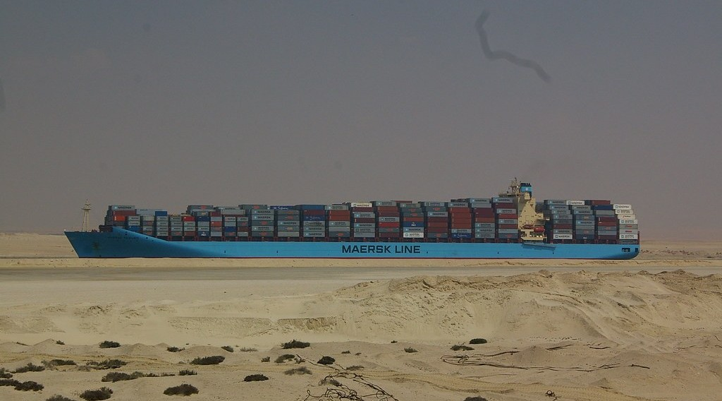
2. MAJOR TRADE ROUTES
Activity 3
The Suez Canal.
Notes:
Activity 3. Look carefully at this picture: the Suez Canal. Observe every detail before I ask the question.

Slide 25
2. MAJOR TRADE ROUTES
Activity 3: Question
Name two major world trade routes.
Notes:
Here is the question for Activity 3: Name two major world trade routes. Take one minute to think and write your answer in your rough notebook.

Slide 26
2. MAJOR TRADE ROUTES
Activity 3: Answer
The North Atlantic route and the Suez Canal route (also the Panama Canal and Cape routes).
Notes:
Let us check the answer together. The North Atlantic route and the Suez Canal route (also the Panama Canal and Cape routes).

Slide 27
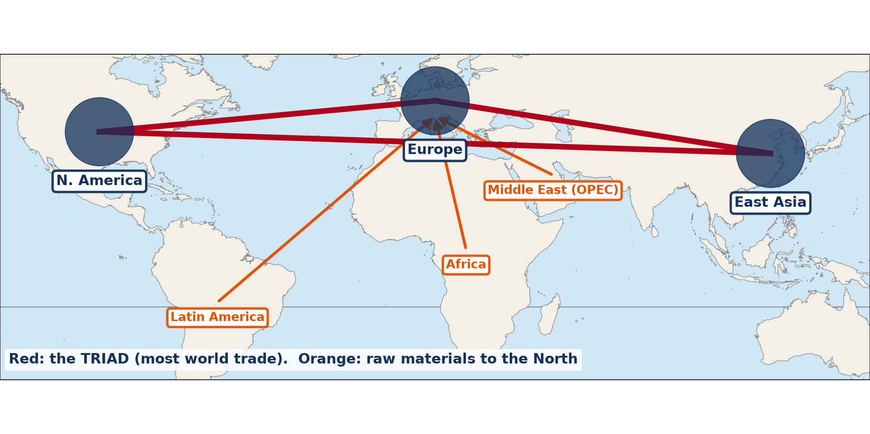
3. GLOBAL TRADE PATTERNS
Activity 4
The world economic triad.
Notes:
Activity 4. Look carefully at this diagram: the world economic triad. Observe every detail before I ask the question.

Slide 28
3. GLOBAL TRADE PATTERNS
Activity 4: Question
Describe the global pattern of trade.
Notes:
Here is the question for Activity 4: Describe the global pattern of trade. Take one minute to think and write your answer in your rough notebook.

Slide 29
3. GLOBAL TRADE PATTERNS
Activity 4: Answer
Most trade is between AICs and East Asia, while LICs export raw materials and import manufactured goods.
Notes:
Let us check the answer together. Most trade is between AICs and East Asia, while LICs export raw materials and import manufactured goods.

Slide 30
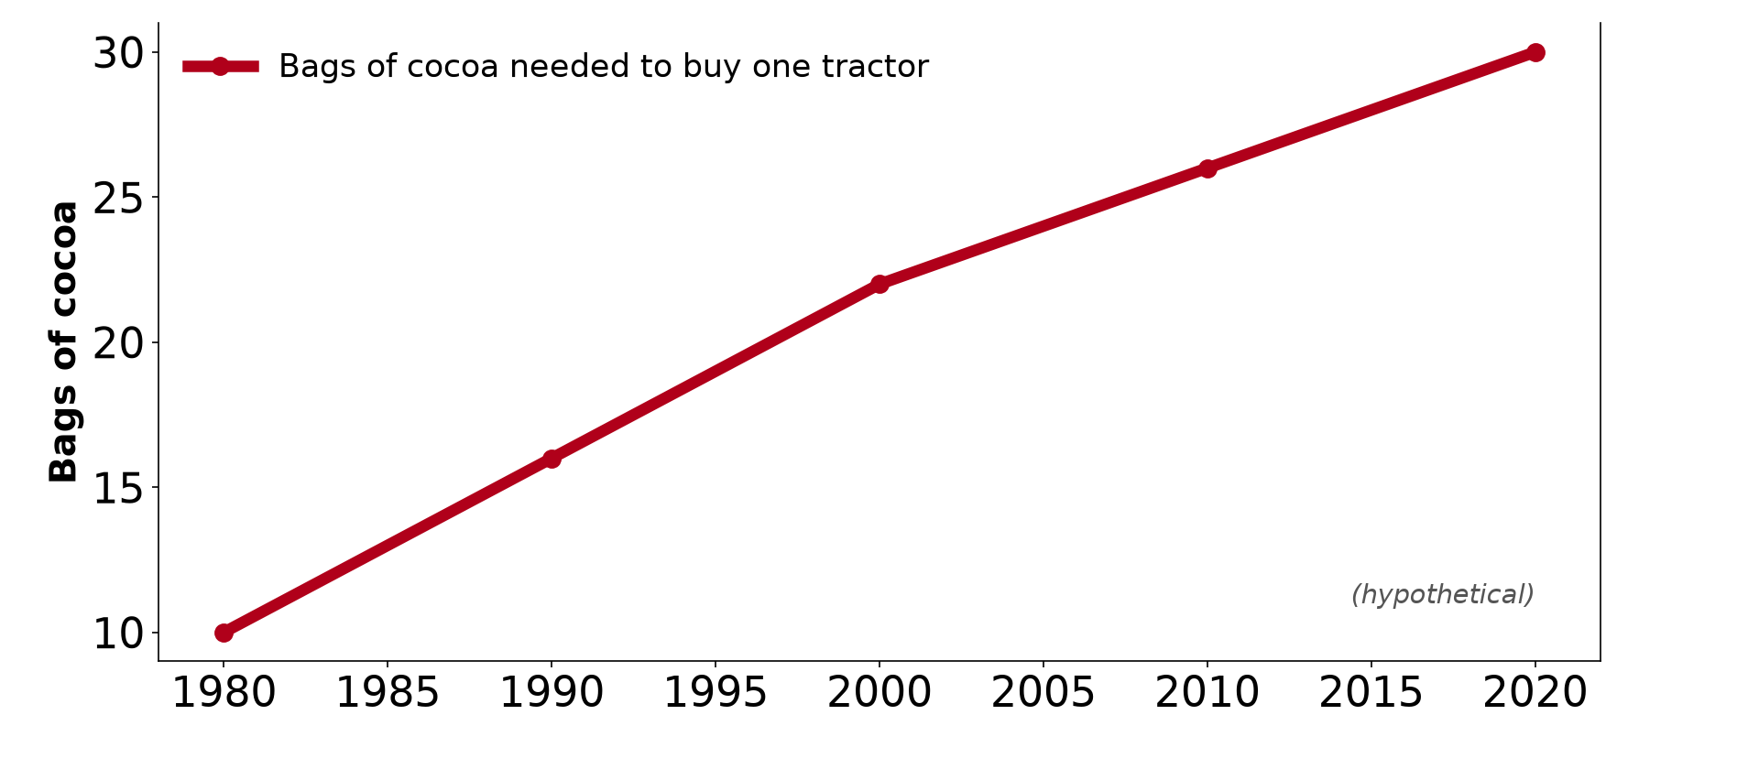
3. REASONS
Activity 5
Terms of trade.
Notes:
Activity 5. Look carefully at this diagram: terms of trade. Observe every detail before I ask the question.

Slide 31
3. REASONS
Activity 5: Question
Why do AICs dominate world trade?
Notes:
Here is the question for Activity 5: Why do AICs dominate world trade? Take one minute to think and write your answer in your rough notebook.

Slide 32
3. REASONS
Activity 5: Answer
They export valuable manufactured goods and control transport, finance and markets.
Notes:
Let us check the answer together. They export valuable manufactured goods and control transport, finance and markets.

Slide 33
BOARD SUMMARY
Board Summary
Topic: Managing Resources for Development through Economic Activities
Sub-topic: Global Trade
Lesson 17: Volume of Trade
Notes:
Now we are going to copy the board summary. Write the title and the headings neatly in your notebooks. I will give you enough time for each slide, so do not rush.

Slide 34
BOARD SUMMARY
DEFINITIONS
The key terms of this lesson are defined as follows:
Trade: It is the buying and selling or exchange of goods and services.
Exports and imports: Exports are goods sold abroad and imports are goods bought from abroad.
Notes:
Let us copy the definitions. The key terms of this lesson are defined as follows. On this slide we have Trade and Exports and imports. Write each point on a new line, with the key term first, and explain it in your own words when we revise.

Slide 35
BOARD SUMMARY
1. Types of Trade
The types of trade are the following:
Internal trade: It takes place within a country.
International trade: It takes place between countries.
Notes:
Let us copy Types of Trade. The types of trade are the following. On this slide we have Internal trade and International trade. Write each point on a new line, with the key term first, and explain it in your own words when we revise. When you finish, we go to the next slide.

Slide 36
BOARD SUMMARY
1. Types of Trade (continued)
Bilateral and multilateral trade: Bilateral trade is between two countries and multilateral trade is among many.
Notes:
We continue with Types of Trade. On this slide we have Bilateral and multilateral trade. Write each point on a new line, with the key term first, and explain it in your own words when we revise.

Slide 37
BOARD SUMMARY
2. Major Trade Routes and Global Patterns
A) Routes and Pattern
World trade follows the following routes and pattern:
North Atlantic route: It links Europe and North America and is the busiest route.
Suez and Panama routes: They link Europe, Asia and the Americas through canals.
Notes:
Let us copy Routes and Pattern. World trade follows the following routes and pattern. On this slide we have North Atlantic route and Suez and Panama routes. Write each point on a new line, with the key term first, and explain it in your own words when we revise. When you finish, we go to the next slide.

Slide 38
BOARD SUMMARY
2. Major Trade Routes and Global Patterns
A) Routes and Pattern (continued)
Pattern: Most trade is among AICs and East Asia, and LICs export raw materials.
Notes:
We continue with Routes and Pattern. On this slide we have Pattern. Write each point on a new line, with the key term first, and explain it in your own words when we revise.

Slide 39
BOARD SUMMARY
2. Major Trade Routes and Global Patterns
B) Reasons for the Dominance of AICs
AICs dominate world trade for the following reasons:
Valuable goods: They export manufactured goods and services.
Capital: They have money to invest.
Notes:
Let us copy Reasons for the Dominance of AICs. AICs dominate world trade for the following reasons. On this slide we have Valuable goods and Capital. Write each point on a new line, with the key term first, and explain it in your own words when we revise. When you finish, we go to the next slide.

Slide 40
BOARD SUMMARY
2. Major Trade Routes and Global Patterns
B) Reasons for the Dominance of AICs (continued)
Control of transport and markets: They own ships, banks and markets.
Notes:
We continue with Reasons for the Dominance of AICs. On this slide we have Control of transport and markets. Write each point on a new line, with the key term first, and explain it in your own words when we revise.

Slide 41
BOARD SUMMARY
2. Major Trade Routes and Global Patterns
Illustration: the world economic triad
Notes:
Now draw this illustration in your notebook: the world economic triad. Give it a title and label it clearly.

Slide 42
FORMATIVE EVALUATION
Evaluation 1
Define international trade.
Notes:
Now let us check what you have understood. Question 1: Define international trade. Answer in your exercise book.

Slide 43
FORMATIVE EVALUATION
Expected Answer
Trade between countries.
Notes:
The expected answer is: trade between countries. If you got it right, well done.

Slide 44
FORMATIVE EVALUATION
Evaluation 2
Give two reasons for the dominance of AICs in world trade.
Notes:
Now let us check what you have understood. Question 2: Give two reasons for the dominance of AICs in world trade. Answer in your exercise book.

Slide 45
FORMATIVE EVALUATION
Expected Answer
They export manufactured goods and control transport and finance.
Notes:
The expected answer is: they export manufactured goods and control transport and finance. If you got it right, well done.

Slide 46
REMEDIATION
Remediation
Fill in the blanks:
Goods sold abroad are ______.
Trade within a country is ______ trade.
The busiest trade route is the North ______ route.
Notes:
For those who need more practice, fill in the blanks in your exercise book. The answers are: number 1, exports; number 2, internal; number 3, Atlantic.

Slide 47
HOMEWORK
Homework
List three exports and three imports of Cameroon.
Notes:
For your homework: List three exports and three imports of Cameroon. We shall correct it at the beginning of our next lesson.

Slide 48
NEXT LESSON
Next Lesson
Our next lesson will be on:
Lesson 18: Trade Blocs
Notes:
Our next lesson will be on Lesson 18: Trade Blocs. Thank you for your attention, and see you next time.

Slide 49
BILINGUAL GAME
Bilingual Game (Jeu Bilingue)
English | Français
Trade | Le commerce
Export | L'exportation
Import | L'importation
Trade route | La route commerciale
Balance of trade | La balance commerciale
Fair trade | Le commerce équitable
Notes:
Let us play the bilingual game. I say a word in English, and you give me the French word. Then we do the reverse.

Slide 50
LOGBOOK
Official Logbook (1/2)
Module / Topic | Managing Resources for Development through Economic Activities
Lesson Title | Lesson 17: Volume of Trade
Expected Learning Outcomes | Define trade and give its types. Locate the major world trade routes. Describe and explain global trade patterns.
Competence | Learners are able to explain trade, locate the major trade routes and explain global trade patterns.
Notes:
I record this information in the official logbook of the class after the lesson.

Slide 51
LOGBOOK
Official Logbook (2/2)
Matter Taught | DEFINITIONS; Types of Trade; Routes and Pattern; Reasons for the Dominance of AICs.
Evaluation | Formative evaluation and remediation exercise.
Homework | List three exports and three imports of Cameroon.
Enrolment / Present / Absent | ____ / ____ / ____
Achievement | To be completed after the lesson.
Notes:
I complete the second page of the logbook: the matter taught, the evaluation, the homework and the attendance.

Slide 52
TEACHER'S NOTE
Teacher's Note
Timing: Homework correction, plan, objectives 8 min | Recall, situation, action 10 min | 5 activities 30 min | Board summary (copying) 30 min | Evaluation, remediation 10 min | Homework, next lesson 5 min | Logbook 7 min
Without the projector (Activity 1): give examples.
Without the projector (Activity 2): give examples.
Without the projector (Activity 3): use the atlas.
Without the projector (Activity 4): discuss.
Without the projector (Activity 5): discuss.
Notes:
This slide is for me, the teacher: it gives the timing of the lesson and what to do if the projector is not available.

Slide 53
REFERENCES
References
Geography Syllabus, Forms I–V, MINESEC (2023) — Form 5, Module I: Management of Manufacturing and Tertiary Activities.
Photo, Activity 1: “Sandga Market in Douala, Cameroon” by The Advocacy Project, CC BY-NC-SA 2.0, via Flickr (https://www.flickr.com/photos/42487558@N00/3636438732)
Photo, Activity 2: “Container Ships @ Port of Oakland” by jdnx, CC BY 2.0, via Flickr (https://www.flickr.com/photos/21442511@N08/3464243881)
Photo, Activity 3: “MV Maersk Taikung” by tim.md, CC BY-NC-ND 2.0, via Flickr (https://www.flickr.com/photos/50299151@N00/3252980648)
Diagrams and animations: drawn for this lesson (Geography Department).
Notes:
These are the references and picture credits used to prepare this lesson.

