Slide 1
FORM 5
GEOGRAPHY
Lesson 22
Economic Growth of Cameroon
Notes:
Good morning, class, and welcome to our geography lesson. I am your geography teacher, Mr Kamdem. Today we are starting Lesson 22: Economic Growth of Cameroon.

Slide 2
CLASS INFO
Class, Chapter and Duration
Class | Form 5
Chapter | Module I: Management of Manufacturing and Tertiary Activities
Duration | 2 periods (2 × 50 minutes)
Notes:
This lesson is for Form 5. It belongs to Module I: Management of Manufacturing and Tertiary Activities. We shall need 2 periods to cover it.

Slide 3
IDENTIFICATION
Lesson Identification
Topic | Managing Resources for Development through Economic Activities
Sub-topic | The Challenges to the Vision of Economic Emergence of Cameroon
Lesson | Lesson 22: Economic Growth of Cameroon
Notions / Concepts | Economic growth, GDP, GNP, emergence, Vision 2035.
Syllabus focus | Background on the levels of economic development; the reasons for the slow rate of economic growth; ways to uplift the economy to emergence.
Competence | Learners are able to explain the level of economic growth of Cameroon and propose ways to reach emergence.
Notes:
Our topic is Managing Resources for Development through Economic Activities, and the sub-topic is The Challenges to the Vision of Economic Emergence of Cameroon. The key notions we shall use today are: economic growth, GDP, GNP, emergence, Vision 2035. At the end, you should be able to do this: learners are able to explain the level of economic growth of Cameroon and propose ways to reach emergence.

Slide 4

HOMEWORK CORRECTION
Correction of the Homework
Question (Lesson 21: Development of Tourism in Cameroon):
Draw a sketch map of Cameroon showing six tourist attractions.
Notes:
Before we start the new lesson, let us correct the homework I gave you at the end of Lesson 21: Development of Tourism in Cameroon. The question was: Draw a sketch map of Cameroon showing six tourist attractions. Take out your exercise books.

Slide 5
HOMEWORK CORRECTION
Correction: Possible Answer
A framed sketch with Waza, Benue Park, Rhumsiki, Foumban, Mount Cameroon and Kribi (Lobé Falls), with a key and north arrow.
Notes:
Here is a good answer. A framed sketch with Waza, Benue Park, Rhumsiki, Foumban, Mount Cameroon and Kribi (Lobé Falls), with a key and north arrow. Compare it with your own answer and correct your work in red.

Slide 6
LESSON PLAN
Lesson Plan
Correction of the homework
Objectives and recall
Real-life situation and action to take
Learning activities
Board summary
Evaluation, remediation and homework
Notes:
Here is the plan of our lesson today. First, we shall correct the homework. Then we shall look at the objectives and recall what you already know. After that, we shall study a situation from real life and the action to take, and do the learning activities. Finally, we shall copy the board summary, do the evaluation and the remediation, and I will give you the homework.

Slide 7
OBJECTIVES
Objectives
By the end of this lesson, you should be able to:
Describe the level of economic development of Cameroon.
Explain the reasons for slow economic growth.
Notes:
Take your time to copy this part; we will continue together.

Slide 8
OBJECTIVES
Objectives (continued)
Propose ways to uplift the economy to emergence.
Notes:
By the end of this lesson, you should be able to do three things. Number 1: describe the level of economic development of Cameroon. Number 2: explain the reasons for slow economic growth. Number 3: propose ways to uplift the economy to emergence.

Slide 9
PREVIOUS KNOWLEDGE
Previous Knowledge
Cameroon exports raw materials.
GDP measures the wealth produced in a country.
Cameroon wants to be emergent by 2035.
Notes:
Let us first remember what you already know. Cameroon exports raw materials. GDP measures the wealth produced in a country. Cameroon wants to be emergent by 2035. Keep this in mind, because we shall build on it today.

Slide 10
REAL-LIFE SITUATION
Situation in Real Life
Cameroon plans to become an emerging country by 2035, but many young graduates are unemployed and the economy grows slowly.
Notes:
Listen carefully to this situation from real life. Cameroon plans to become an emerging country by 2035, but many young graduates are unemployed and the economy grows slowly. Think about it, because I am going to ask you some questions.

Slide 11
REAL-LIFE SITUATION
Situation: Question 1
What is the problem in the situation?
Notes:
Question 1: What is the problem in the situation? Think for a moment, then raise your hand to answer.

Slide 12
REAL-LIFE SITUATION
Answer
The economy of Cameroon grows slowly.
Notes:
Good. The economy of Cameroon grows slowly.

Slide 13
REAL-LIFE SITUATION
Situation: Question 2
What is the target year for emergence?
Notes:
Question 2: What is the target year for emergence? Think for a moment, then raise your hand to answer.

Slide 14
REAL-LIFE SITUATION
Answer
2035.
Notes:
Good. 2035.

Slide 15
REAL-LIFE SITUATION
Situation: Question 3
What problem do young graduates face?
Notes:
Question 3: What problem do young graduates face? Think for a moment, then raise your hand to answer.

Slide 16
REAL-LIFE SITUATION
Possible Answer
Unemployment.
Notes:
Good. Unemployment.

Slide 17
ACTION TO TAKE
Action to Take
Create village cooperatives and development associations and participate in human investment.
Notes:
From this situation, the action we are working towards in this lesson is the following: create village cooperatives and development associations and participate in human investment.

Slide 18
JUSTIFICATION
Justification of the Lesson
This lesson helps us to understand the challenges of our country and our role in its development.
Notes:
Why is this lesson important for you? This lesson helps us to understand the challenges of our country and our role in its development.

Slide 19
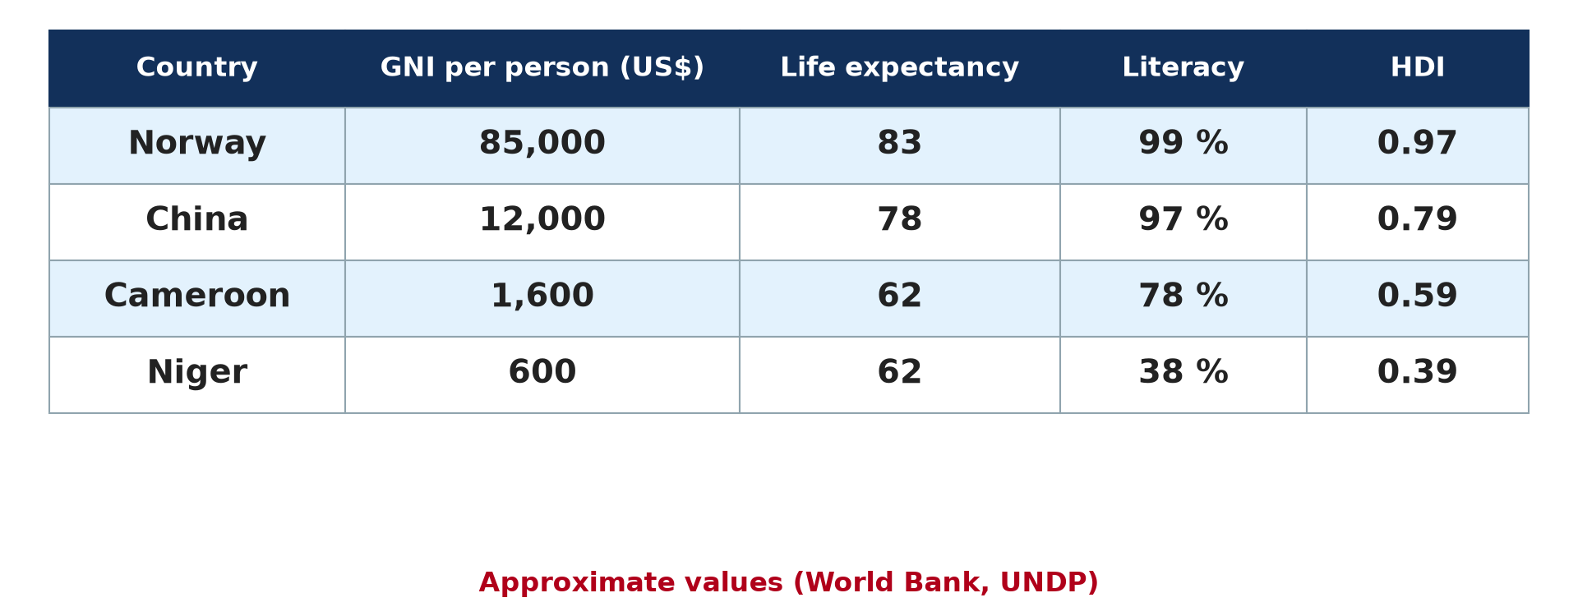
1. MEANING
Activity 1
Development indicators.
Notes:
Activity 1. Look carefully at this diagram: development indicators. Observe every detail before I ask the question.

Slide 20
1. MEANING
Activity 1: Question
Distinguish GDP and GNP.
Notes:
Here is the question for Activity 1: Distinguish GDP and GNP. Take one minute to think and write your answer in your rough notebook.

Slide 21
1. MEANING
Activity 1: Answer
GDP is the value produced inside a country in a year; GNP adds income from abroad.
Notes:
Let us check the answer together. GDP is the value produced inside a country in a year; GNP adds income from abroad.

Slide 22
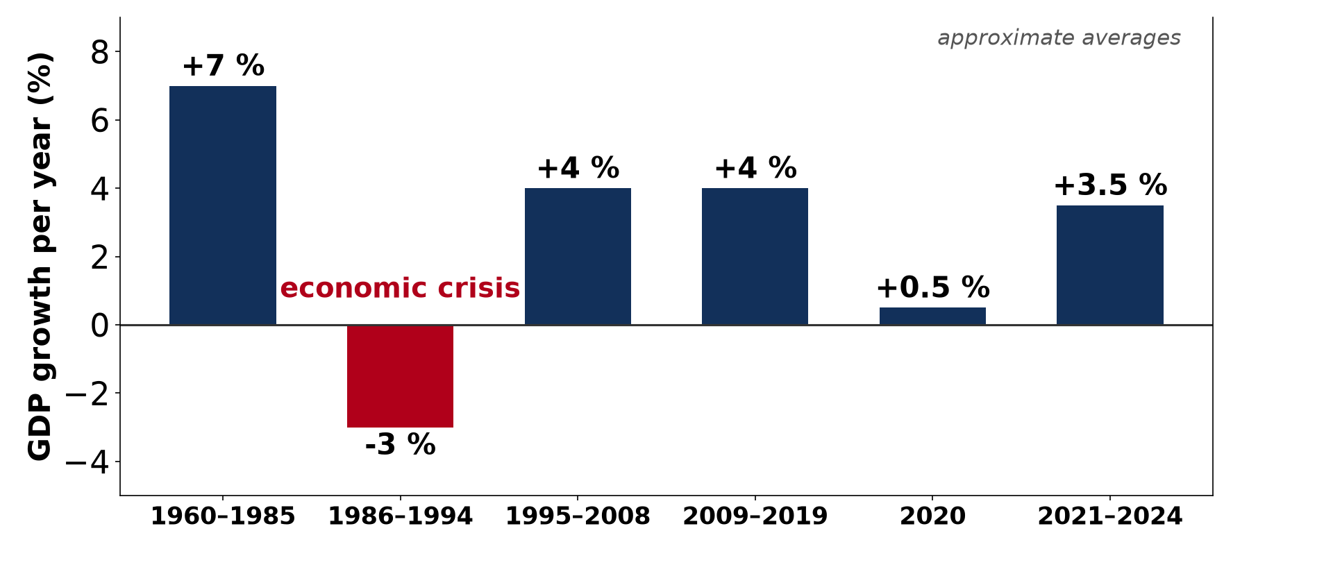
1. BACKGROUND
Activity 2
Economic growth of Cameroon (approximate).
Notes:
Activity 2. Look carefully at this diagram: economic growth of Cameroon (approximate). Observe every detail before I ask the question.

Slide 23
1. BACKGROUND
Activity 2: Question
Describe the evolution of the economy of Cameroon.
Notes:
Here is the question for Activity 2: Describe the evolution of the economy of Cameroon. Take one minute to think and write your answer in your rough notebook.

Slide 24
1. BACKGROUND
Activity 2: Answer
Fast growth until 1985, crisis from 1986 to 1994, then moderate growth.
Notes:
Let us check the answer together. Fast growth until 1985, crisis from 1986 to 1994, then moderate growth.

Slide 25
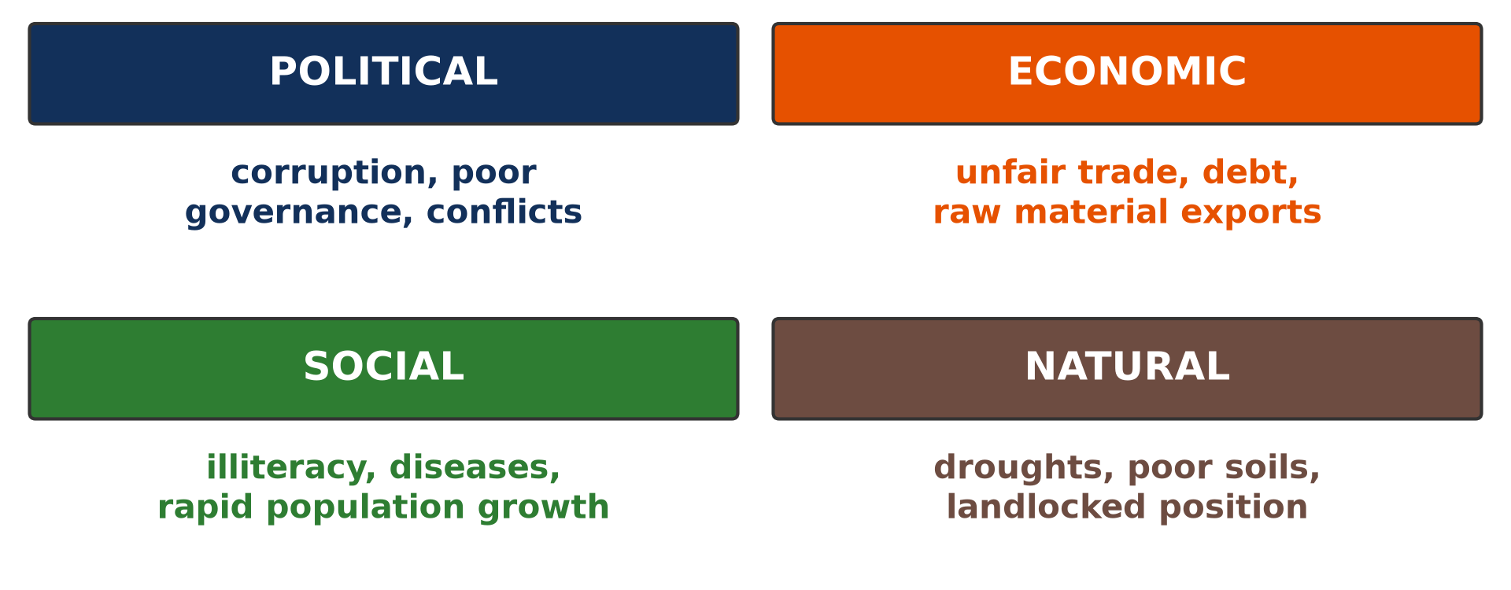
2. REASONS FOR SLOW GROWTH
Activity 3
Causes of underdevelopment.
Notes:
Activity 3. Look carefully at this diagram: causes of underdevelopment. Observe every detail before I ask the question.

Slide 26
2. REASONS FOR SLOW GROWTH
Activity 3: Question
Give three reasons for slow economic growth.
Notes:
Here is the question for Activity 3: Give three reasons for slow economic growth. Take one minute to think and write your answer in your rough notebook.

Slide 27
2. REASONS FOR SLOW GROWTH
Activity 3: Answer
Dependence on raw materials, corruption and poor infrastructure (also insecurity).
Notes:
Let us check the answer together. Dependence on raw materials, corruption and poor infrastructure (also insecurity).

Slide 28
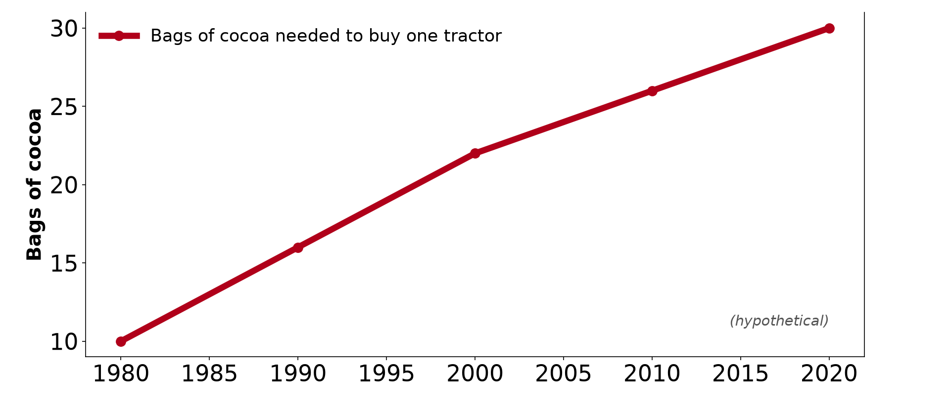
2. REASONS FOR SLOW GROWTH
Activity 4
Terms of trade.
Notes:
Activity 4. Look carefully at this diagram: terms of trade. Observe every detail before I ask the question.

Slide 29
2. REASONS FOR SLOW GROWTH
Activity 4: Question
How do falling export prices affect Cameroon?
Notes:
Here is the question for Activity 4: How do falling export prices affect Cameroon? Take one minute to think and write your answer in your rough notebook.

Slide 30
2. REASONS FOR SLOW GROWTH
Activity 4: Answer
Income falls, so the country earns less to invest.
Notes:
Let us check the answer together. Income falls, so the country earns less to invest.

Slide 31
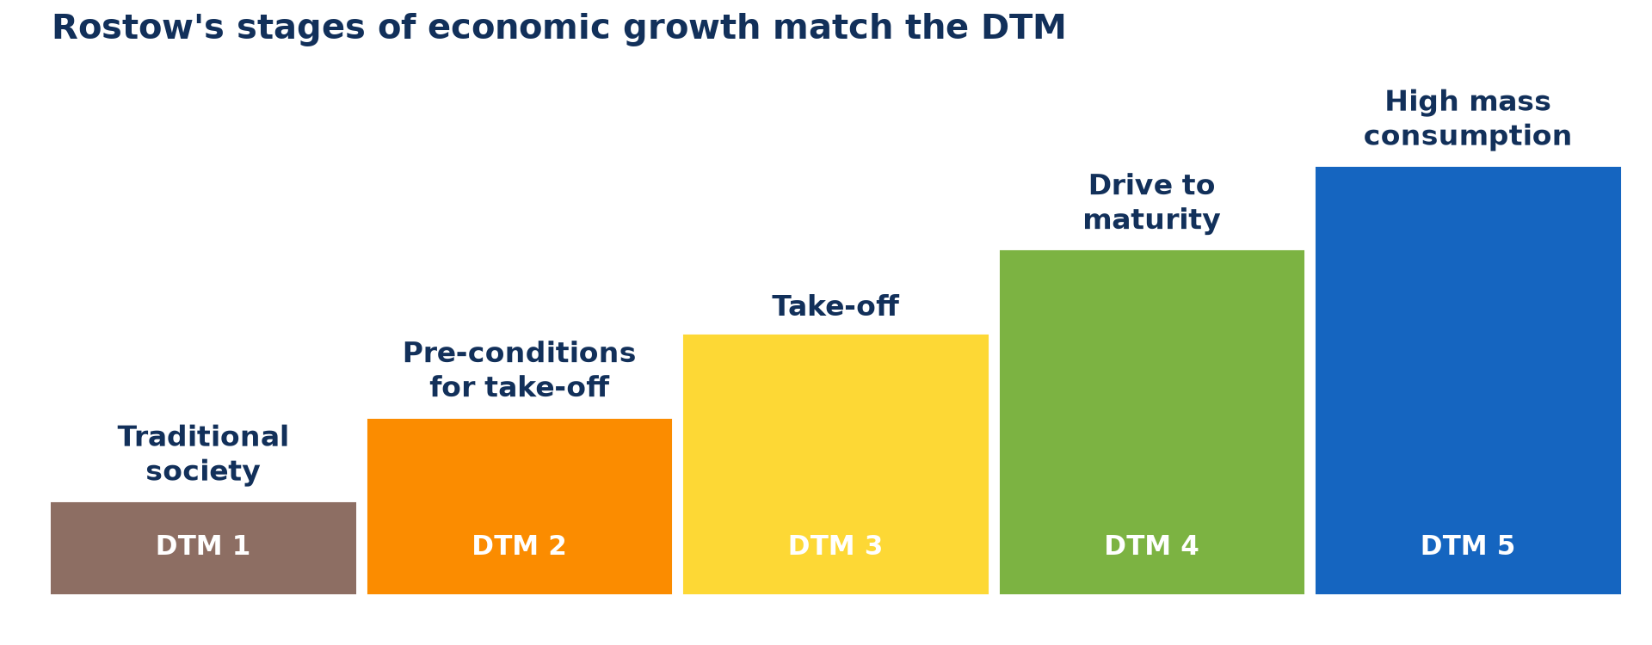
3. WAYS TO EMERGENCE
Activity 5
Stages of economic growth.
Notes:
Activity 5. Look carefully at this diagram: stages of economic growth. Observe every detail before I ask the question.

Slide 32
3. WAYS TO EMERGENCE
Activity 5: Question
Give three ways to uplift the economy.
Notes:
Here is the question for Activity 5: Give three ways to uplift the economy. Take one minute to think and write your answer in your rough notebook.

Slide 33
3. WAYS TO EMERGENCE
Activity 5: Answer
Process raw materials, build infrastructure and fight corruption (also train youths).
Notes:
Let us check the answer together. Process raw materials, build infrastructure and fight corruption (also train youths).

Slide 34
BOARD SUMMARY
Board Summary
Topic: Managing Resources for Development through Economic Activities
Sub-topic: The Challenges to the Vision of Economic Emergence of Cameroon
Lesson 22: Economic Growth of Cameroon
Notes:
Now we are going to copy the board summary. Write the title and the headings neatly in your notebooks. I will give you enough time for each slide, so do not rush.

Slide 35
BOARD SUMMARY
DEFINITIONS
The key terms of this lesson are defined as follows:
Economic growth: It is the increase in the value of goods and services produced by a country.
Notes:
Let us copy the definitions. The key terms of this lesson are defined as follows. On this slide we have Economic growth. Write each point on a new line, with the key term first, and explain it in your own words when we revise. When you finish, we go to the next slide.

Slide 36
BOARD SUMMARY
DEFINITIONS (continued)
Emergence: It is the stage where a developing country has strong and lasting growth and industrialisation.
Notes:
We continue with the definitions. On this slide we have Emergence. Write each point on a new line, with the key term first, and explain it in your own words when we revise.

Slide 37
BOARD SUMMARY
1. Background on the Levels of Economic Development
The economy of Cameroon evolved as follows:
1960 to 1985: Growth was fast thanks to agriculture and oil.
1986 to 1994: The economic crisis caused salary cuts and devaluation of the CFA franc.
Notes:
Let us copy Background on the Levels of Economic Development. The economy of Cameroon evolved as follows. On this slide we have 1960 to 1985 and 1986 to 1994. Write each point on a new line, with the key term first, and explain it in your own words when we revise. When you finish, we go to the next slide.

Slide 38
BOARD SUMMARY
1. Background on the Levels of Economic Development (continued)
Since 1995: Growth is moderate, and Vision 2035 aims at emergence.
Notes:
We continue with Background on the Levels of Economic Development. On this slide we have Since 1995. Write each point on a new line, with the key term first, and explain it in your own words when we revise.

Slide 39
BOARD SUMMARY
1. Background on the Levels of Economic Development
Illustration: economic growth of Cameroon
Notes:
Now draw this illustration in your notebook: economic growth of Cameroon. Give it a title and label it clearly.

Slide 40
BOARD SUMMARY
2. Reasons for the Slow Rate of Economic Growth
The economy grows slowly for the following reasons:
Raw material exports: Low and unstable prices reduce national income.
Poor infrastructure: Bad roads and power cuts raise production costs.
Notes:
Let us copy Reasons for the Slow Rate of Economic Growth. The economy grows slowly for the following reasons. On this slide we have Raw material exports and Poor infrastructure. Write each point on a new line, with the key term first, and explain it in your own words when we revise. When you finish, we go to the next slide.

Slide 41
BOARD SUMMARY
2. Reasons for the Slow Rate of Economic Growth (continued)
Governance: Corruption, embezzlement and administrative bottlenecks discourage investors.
Insecurity: Crises in some regions disturb economic activities.
Notes:
We continue with Reasons for the Slow Rate of Economic Growth. On this slide we have Governance and Insecurity. Write each point on a new line, with the key term first, and explain it in your own words when we revise.

Slide 42
BOARD SUMMARY
3. Ways to Uplift the Economy to Emergence
The economy can be uplifted in the following ways:
Industrialisation: Raw materials should be processed locally.
Infrastructure: Roads, ports, dams and electricity should be developed.
Notes:
Let us copy Ways to Uplift the Economy to Emergence. The economy can be uplifted in the following ways. On this slide we have Industrialisation and Infrastructure. Write each point on a new line, with the key term first, and explain it in your own words when we revise. When you finish, we go to the next slide.

Slide 43
BOARD SUMMARY
3. Ways to Uplift the Economy to Emergence (continued)
Good governance and human capital: Fighting corruption and training youths attract investment.
Notes:
We continue with Ways to Uplift the Economy to Emergence. On this slide we have Good governance and human capital. Write each point on a new line, with the key term first, and explain it in your own words when we revise.

Slide 44
FORMATIVE EVALUATION
Evaluation 1
What is economic growth?
Notes:
Now let us check what you have understood. Question 1: What is economic growth? Answer in your exercise book.

Slide 45
FORMATIVE EVALUATION
Expected Answer
The increase in the value of goods and services produced.
Notes:
The expected answer is: the increase in the value of goods and services produced. If you got it right, well done.

Slide 46
FORMATIVE EVALUATION
Evaluation 2
Give two reasons for slow growth and two solutions.
Notes:
Now let us check what you have understood. Question 2: Give two reasons for slow growth and two solutions. Answer in your exercise book.

Slide 47
FORMATIVE EVALUATION
Expected Answer
Corruption and poor infrastructure; fight corruption and build infrastructure.
Notes:
The expected answer is: corruption and poor infrastructure; fight corruption and build infrastructure. If you got it right, well done.

Slide 48
REMEDIATION
Remediation
Fill in the blanks:
The value produced inside a country in a year is the ______.
Cameroon aims at emergence by ______.
The economic crisis began in ______.
Notes:
For those who need more practice, fill in the blanks in your exercise book. The answers are: number 1, GDP; number 2, 2035; number 3, 1986 (the mid-1980s).

Slide 49
HOMEWORK
Homework
Suggest three actions young people can take to help Cameroon reach emergence.
Notes:
For your homework: Suggest three actions young people can take to help Cameroon reach emergence. We shall correct it at the beginning of our next lesson.

Slide 50
NEXT LESSON
Next Lesson
Our next lesson will be on:
Lesson 23: Land Reclamation
Notes:
Our next lesson will be on Lesson 23: Land Reclamation. Thank you for your attention, and see you next time.

Slide 51
BILINGUAL GAME
Bilingual Game (Jeu Bilingue)
English | Français
Economic growth | La croissance économique
Emergence | L'émergence
GDP | Le PIB
Crisis | La crise
Corruption | La corruption
Investment | L'investissement
Notes:
Let us play the bilingual game. I say a word in English, and you give me the French word. Then we do the reverse.

Slide 52
LOGBOOK
Official Logbook (1/2)
Module / Topic | Managing Resources for Development through Economic Activities
Lesson Title | Lesson 22: Economic Growth of Cameroon
Expected Learning Outcomes | Describe the level of economic development of Cameroon. Explain the reasons for slow economic growth. Propose ways to uplift the economy to emergence.
Competence | Learners are able to explain the level of economic growth of Cameroon and propose ways to reach emergence.
Notes:
I record this information in the official logbook of the class after the lesson.

Slide 53
LOGBOOK
Official Logbook (2/2)
Matter Taught | DEFINITIONS; Background on the Levels of Economic Development; Reasons for the Slow Rate of Economic Growth; Ways to Uplift the Economy to Emergence.
Evaluation | Formative evaluation and remediation exercise.
Homework | Suggest three actions young people can take to help Cameroon reach emergence.
Enrolment / Present / Absent | ____ / ____ / ____
Achievement | To be completed after the lesson.
Notes:
I complete the second page of the logbook: the matter taught, the evaluation, the homework and the attendance.

Slide 54
TEACHER'S NOTE
Teacher's Note
Timing: Homework correction, plan, objectives 8 min | Recall, situation, action 10 min | 5 activities 30 min | Board summary (copying) 30 min | Evaluation, remediation 10 min | Homework, next lesson 5 min | Logbook 7 min
Without the projector (Activity 1): define.
Without the projector (Activity 2): describe the graph.
Without the projector (Activity 3): discuss.
Without the projector (Activity 4): discuss.
Without the projector (Activity 5): list.
Notes:
This slide is for me, the teacher: it gives the timing of the lesson and what to do if the projector is not available.

Slide 55
REFERENCES
References
Geography Syllabus, Forms I–V, MINESEC (2023) — Form 5, Module I: Management of Manufacturing and Tertiary Activities.
Diagrams and animations: drawn for this lesson (Geography Department).
Notes:
These are the references and picture credits used to prepare this lesson.

