Slide 1
FORM 5
GEOGRAPHY
Lesson 29
Population Distribution
Notes:
Good morning, class, and welcome to our geography lesson. I am your geography teacher, Mr Kamdem. Today we are starting Lesson 29: Population Distribution.

Slide 2
CLASS INFO
Class, Chapter and Duration
Class | Form 5
Chapter | Module III: Management of Population Growth and Space Colonisation
Duration | 2 periods (2 × 50 minutes)
Notes:
This lesson is for Form 5. It belongs to Module III: Management of Population Growth and Space Colonisation. We shall need 2 periods to cover it.

Slide 3
IDENTIFICATION
Lesson Identification
Topic | The Dynamics of Population and Implications
Sub-topic | Population and Population Distribution
Lesson | Lesson 29: Population Distribution
Notions / Concepts | Population distribution, population density, dense, moderate, sparse.
Syllabus focus | Meaning of population distribution and population density; measures of population density.
Competence | Learners are able to define and calculate population density.
Notes:
Our topic is The Dynamics of Population and Implications, and the sub-topic is Population and Population Distribution. The key notions we shall use today are: population distribution, population density, dense, moderate, sparse. At the end, you should be able to do this: learners are able to define and calculate population density.

Slide 4

HOMEWORK CORRECTION
Correction of the Homework
Question (Further Study 3: Sources of Population Data):
Explain two reasons why census figures in Cameroon may be inaccurate.
Notes:
Before we start the new lesson, let us correct the homework I gave you at the end of Further Study 3: Sources of Population Data. The question was: Explain two reasons why census figures in Cameroon may be inaccurate. Take out your exercise books.

Slide 5
HOMEWORK CORRECTION
Correction: Possible Answer
Some people are absent, hide or are counted twice; insecurity and poor roads prevent agents from reaching some areas.
Notes:
Here is a good answer. Some people are absent, hide or are counted twice; insecurity and poor roads prevent agents from reaching some areas. Compare it with your own answer and correct your work in red.

Slide 6
LESSON PLAN
Lesson Plan
Correction of the homework
Objectives and recall
Real-life situation and action to take
Learning activities
Board summary
Evaluation, remediation and homework
Notes:
Here is the plan of our lesson today. First, we shall correct the homework. Then we shall look at the objectives and recall what you already know. After that, we shall study a situation from real life and the action to take, and do the learning activities. Finally, we shall copy the board summary, do the evaluation and the remediation, and I will give you the homework.

Slide 7
OBJECTIVES
Objectives
By the end of this lesson, you should be able to:
Define population distribution and density.
Distinguish dense, moderate and sparse areas.
Notes:
Take your time to copy this part; we will continue together.

Slide 8
OBJECTIVES
Objectives (continued)
Calculate the population density.
Notes:
By the end of this lesson, you should be able to do three things. Number 1: define population distribution and density. Number 2: distinguish dense, moderate and sparse areas. Number 3: calculate the population density.

Slide 9
PREVIOUS KNOWLEDGE
Previous Knowledge
Population is not evenly spread.
Cities are crowded.
The East of Cameroon has few people.
Notes:
Let us first remember what you already know. Population is not evenly spread. Cities are crowded. The East of Cameroon has few people. Keep this in mind, because we shall build on it today.

Slide 10
REAL-LIFE SITUATION
Situation in Real Life
The Littoral Region is small but very crowded, while the East Region is very large with few people. The teacher asks the class how to compare them.
Notes:
Listen carefully to this situation from real life. The Littoral Region is small but very crowded, while the East Region is very large with few people. The teacher asks the class how to compare them. Think about it, because I am going to ask you some questions.

Slide 11
REAL-LIFE SITUATION
Situation: Question 1
What is the problem in the situation?
Notes:
Question 1: What is the problem in the situation? Think for a moment, then raise your hand to answer.

Slide 12
REAL-LIFE SITUATION
Answer
We want to compare how crowded regions are.
Notes:
Good. We want to compare how crowded regions are.

Slide 13
REAL-LIFE SITUATION
Situation: Question 2
Which region is crowded?
Notes:
Question 2: Which region is crowded? Think for a moment, then raise your hand to answer.

Slide 14
REAL-LIFE SITUATION
Answer
The Littoral.
Notes:
Good. The Littoral.

Slide 15
REAL-LIFE SITUATION
Situation: Question 3
How can we compare them?
Notes:
Question 3: How can we compare them? Think for a moment, then raise your hand to answer.

Slide 16
REAL-LIFE SITUATION
Possible Answer
By calculating the population density.
Notes:
Good. By calculating the population density.

Slide 17
ACTION TO TAKE
Action to Take
Use density data to plan services such as schools and hospitals.
Notes:
From this situation, the action we are working towards in this lesson is the following: use density data to plan services such as schools and hospitals.

Slide 18
JUSTIFICATION
Justification of the Lesson
This lesson helps us to measure how people are spread on the land.
Notes:
Why is this lesson important for you? This lesson helps us to measure how people are spread on the land.

Slide 19
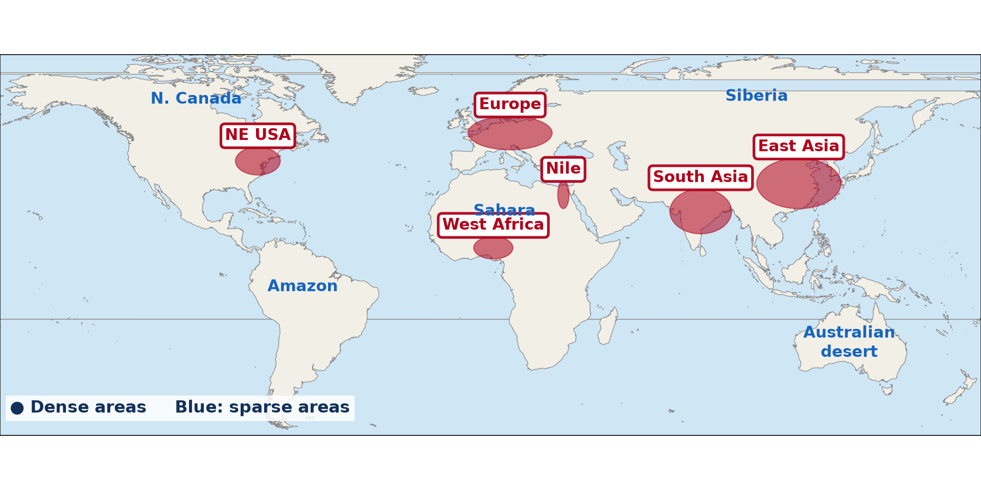
1. MEANING: DISTRIBUTION
Activity 1
World population distribution.
Notes:
Activity 1. Look carefully at this diagram: world population distribution. Observe every detail before I ask the question.

Slide 20
1. MEANING: DISTRIBUTION
Activity 1: Question
What is population distribution?
Notes:
Here is the question for Activity 1: What is population distribution? Take one minute to think and write your answer in your rough notebook.

Slide 21
1. MEANING: DISTRIBUTION
Activity 1: Answer
The way people are spread over an area.
Notes:
Let us check the answer together. The way people are spread over an area.

Slide 22
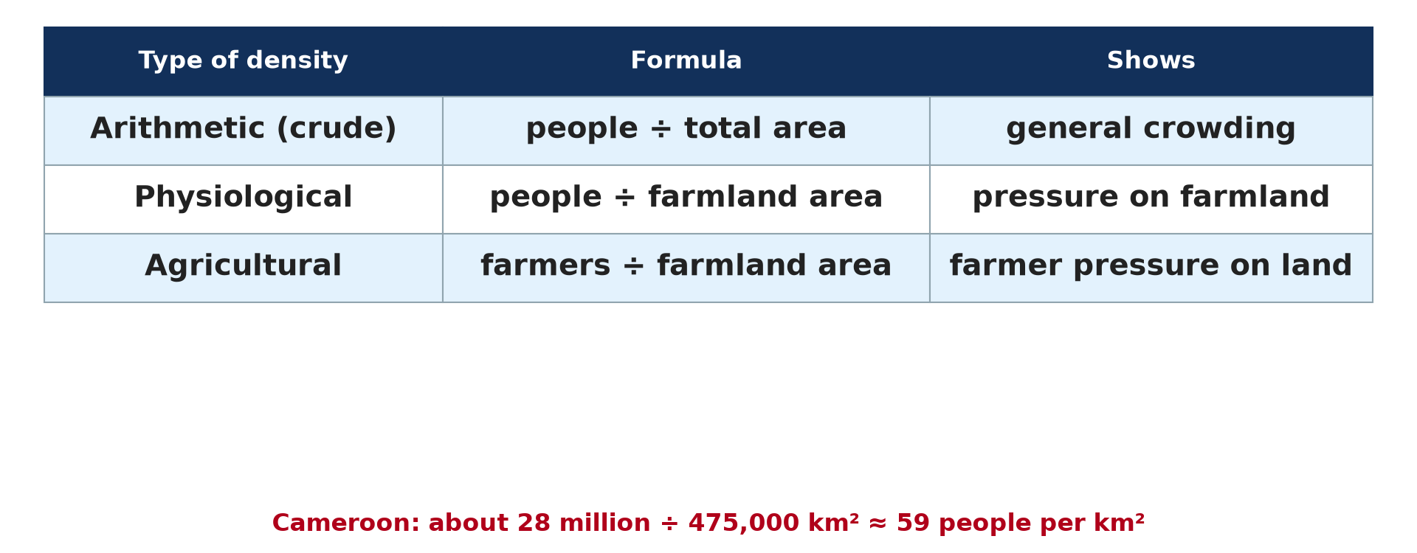
1. MEANING: DENSITY
Activity 2
Types of density.
Notes:
Activity 2. Look carefully at this diagram: types of density. Observe every detail before I ask the question.

Slide 23
1. MEANING: DENSITY
Activity 2: Question
What is population density?
Notes:
Here is the question for Activity 2: What is population density? Take one minute to think and write your answer in your rough notebook.

Slide 24
1. MEANING: DENSITY
Activity 2: Answer
The average number of people per square kilometre.
Notes:
Let us check the answer together. The average number of people per square kilometre.

Slide 25
2. MEASURES
Activity 3
Formula.
Notes:
Activity 3. Look carefully at this diagram: formula. Observe every detail before I ask the question.

Slide 26
2. MEASURES
Activity 3: Question
Calculate the density of an area of 500 km² with 25,000 people.
Notes:
Here is the question for Activity 3: Calculate the density of an area of 500 km² with 25,000 people. Take one minute to think and write your answer in your rough notebook.

Slide 27
2. MEASURES
Activity 3: Answer
25,000 ÷ 500 = 50 people per km².
Notes:
Let us check the answer together. 25,000 ÷ 500 = 50 people per km².

Slide 28

2. MEASURES
Activity 4
Density of Cameroon by region.
Notes:
Activity 4. Look carefully at this diagram: density of Cameroon by region. Observe every detail before I ask the question.

Slide 29
2. MEASURES
Activity 4: Question
Distinguish dense, moderate and sparse areas.
Notes:
Here is the question for Activity 4: Distinguish dense, moderate and sparse areas. Take one minute to think and write your answer in your rough notebook.

Slide 30
2. MEASURES
Activity 4: Answer
Dense: over 100 per km²; moderate: 20 to 100; sparse: under 20.
Notes:
Let us check the answer together. Dense: over 100 per km²; moderate: 20 to 100; sparse: under 20.

Slide 31
2. MEASURES
Activity 5
Other densities.
Notes:
Activity 5. Look carefully at this diagram: other densities. Observe every detail before I ask the question.

Slide 32
2. MEASURES
Activity 5: Question
What is physiological density?
Notes:
Here is the question for Activity 5: What is physiological density? Take one minute to think and write your answer in your rough notebook.

Slide 33
2. MEASURES
Activity 5: Answer
The number of people per square kilometre of farmland.
Notes:
Let us check the answer together. The number of people per square kilometre of farmland.

Slide 34
BOARD SUMMARY
Board Summary
Topic: The Dynamics of Population and Implications
Sub-topic: Population and Population Distribution
Lesson 29: Population Distribution
Notes:
Now we are going to copy the board summary. Write the title and the headings neatly in your notebooks. I will give you enough time for each slide, so do not rush.

Slide 35
BOARD SUMMARY
DEFINITIONS
The key terms of this lesson are defined as follows:
Population distribution: It is the way people are spread over an area.
Population density: It is the average number of people per square kilometre.
Notes:
Let us copy the definitions. The key terms of this lesson are defined as follows. On this slide we have Population distribution and Population density. Write each point on a new line, with the key term first, and explain it in your own words when we revise.

Slide 36
BOARD SUMMARY
1. Measures of Population Density
Population density is measured as follows:
Arithmetic density: It is the total population divided by the total area.
Physiological density: It is the population divided by the area of farmland.
Notes:
Let us copy Measures of Population Density. Population density is measured as follows. On this slide we have Arithmetic density and Physiological density. Write each point on a new line, with the key term first, and explain it in your own words when we revise. When you finish, we go to the next slide.

Slide 37
BOARD SUMMARY
1. Measures of Population Density (continued)
Agricultural density: It is the number of farmers divided by the area of farmland.
Notes:
We continue with Measures of Population Density. On this slide we have Agricultural density. Write each point on a new line, with the key term first, and explain it in your own words when we revise.

Slide 38
BOARD SUMMARY
1. Measures of Population Density
Illustration: types of population density
Notes:
Now draw this illustration in your notebook: types of population density. Give it a title and label it clearly.

Slide 39
BOARD SUMMARY
2. Levels of Density
Areas are classified by density as follows:
Dense areas: They have more than 100 people per km².
Moderate areas: They have 20 to 100 people per km².
Notes:
Let us copy Levels of Density. Areas are classified by density as follows. On this slide we have Dense areas and Moderate areas. Write each point on a new line, with the key term first, and explain it in your own words when we revise. When you finish, we go to the next slide.

Slide 40
BOARD SUMMARY
2. Levels of Density (continued)
Sparse areas: They have fewer than 20 people per km².
Notes:
We continue with Levels of Density. On this slide we have Sparse areas. Write each point on a new line, with the key term first, and explain it in your own words when we revise.

Slide 41
FORMATIVE EVALUATION
Evaluation 1
Define population density.
Notes:
Now let us check what you have understood. Question 1: Define population density. Answer in your exercise book.

Slide 42
FORMATIVE EVALUATION
Expected Answer
The average number of people per km².
Notes:
The expected answer is: the average number of people per km². If you got it right, well done.

Slide 43
FORMATIVE EVALUATION
Evaluation 2
Calculate the density of 60,000 people on 1,200 km².
Notes:
Now let us check what you have understood. Question 2: Calculate the density of 60,000 people on 1,200 km². Answer in your exercise book.

Slide 44
FORMATIVE EVALUATION
Expected Answer
60,000 ÷ 1,200 = 50 people per km².
Notes:
The expected answer is: 60,000 ÷ 1,200 = 50 people per km². If you got it right, well done.

Slide 45
REMEDIATION
Remediation
Fill in the blanks:
Density = population ÷ ______.
An area with under 20 people per km² is ______.
People per km² of farmland is ______ density.
Notes:
For those who need more practice, fill in the blanks in your exercise book. The answers are: number 1, area; number 2, sparse; number 3, physiological.

Slide 46
HOMEWORK
Homework
Calculate the density of Cameroon if it has 28 million people on 475,000 km².
Notes:
For your homework: Calculate the density of Cameroon if it has 28 million people on 475,000 km². We shall correct it at the beginning of our next lesson.

Slide 47
NEXT LESSON
Next Lesson
Our next lesson will be on:
Practical Work 3: Population Densities in Cameroon
Notes:
Our next lesson will be on Practical Work 3: Population Densities in Cameroon. Thank you for your attention, and see you next time.

Slide 48
BILINGUAL GAME
Bilingual Game (Jeu Bilingue)
English | Français
Distribution | La répartition
Density | La densité
Dense | Dense
Sparse | Clairsemé
Square kilometre | Le kilomètre carré
Farmland | Les terres agricoles
Notes:
Let us play the bilingual game. I say a word in English, and you give me the French word. Then we do the reverse.

Slide 49
LOGBOOK
Official Logbook (1/2)
Module / Topic | The Dynamics of Population and Implications
Lesson Title | Lesson 29: Population Distribution
Expected Learning Outcomes | Define population distribution and density. Distinguish dense, moderate and sparse areas. Calculate the population density.
Competence | Learners are able to define and calculate population density.
Notes:
I record this information in the official logbook of the class after the lesson.

Slide 50
LOGBOOK
Official Logbook (2/2)
Matter Taught | DEFINITIONS; Measures of Population Density; Levels of Density.
Evaluation | Formative evaluation and remediation exercise.
Homework | Calculate the density of Cameroon if it has 28 million people on 475,000 km².
Enrolment / Present / Absent | ____ / ____ / ____
Achievement | To be completed after the lesson.
Notes:
I complete the second page of the logbook: the matter taught, the evaluation, the homework and the attendance.

Slide 51
TEACHER'S NOTE
Teacher's Note
Timing: Homework correction, plan, objectives 8 min | Recall, situation, action 10 min | 5 activities 30 min | Board summary (copying) 30 min | Evaluation, remediation 10 min | Homework, next lesson 5 min | Logbook 7 min
Without the projector (Activity 1): describe.
Without the projector (Activity 2): define.
Without the projector (Activity 3): calculate.
Without the projector (Activity 4): classify.
Without the projector (Activity 5): define.
Notes:
This slide is for me, the teacher: it gives the timing of the lesson and what to do if the projector is not available.

Slide 52
REFERENCES
References
Geography Syllabus, Forms I–V, MINESEC (2023) — Form 5, Module III: Management of Population Growth and Space Colonisation.
Diagrams and animations: drawn for this lesson (Geography Department).
Notes:
These are the references and picture credits used to prepare this lesson.

