Slide 1
FORM 5
GEOGRAPHY
Lesson 41
Settlement
Notes:
Good morning, class, and welcome to our geography lesson. I am your geography teacher, Mr Kamdem. Today we are starting Lesson 41: Settlement.

Slide 2
CLASS INFO
Class, Chapter and Duration
Class | Form 5
Chapter | Module III: Management of Population Growth and Space Colonisation
Duration | 2 periods (2 × 50 minutes)
Notes:
This lesson is for Form 5. It belongs to Module III: Management of Population Growth and Space Colonisation. We shall need 2 periods to cover it.

Slide 3
IDENTIFICATION
Lesson Identification
Topic | The Development of Settlements and their Implications
Sub-topic | Rural Settlements, their Morphology and Implications on the Environment
Lesson | Lesson 41: Settlement
Notions / Concepts | Settlement, rural settlement, urban settlement.
Syllabus focus | Meaning; classification into types (rural and urban); differences between rural and urban settlements.
Competence | Learners are able to define settlement and distinguish rural and urban settlements.
Notes:
Our topic is The Development of Settlements and their Implications, and the sub-topic is Rural Settlements, their Morphology and Implications on the Environment. The key notions we shall use today are: settlement, rural settlement, urban settlement. At the end, you should be able to do this: learners are able to define settlement and distinguish rural and urban settlements.

Slide 4

HOMEWORK CORRECTION
Correction of the Homework
Question (Practical Work 4: Calculation of the Determinants of Population Growth (Indices)):
A town of 400,000 people has 14,000 births, 3,600 deaths, 5,000 immigrants and 1,000 emigrants in a year. Calculate all the indices.
Notes:
Before we start the new lesson, let us correct the homework I gave you at the end of Practical Work 4: Calculation of the Determinants of Population Growth (Indices). The question was: A town of 400,000 people has 14,000 births, 3,600 deaths, 5,000 immigrants and 1,000 emigrants in a year. Calculate all the indices. Take out your exercise books.

Slide 5
HOMEWORK CORRECTION
Correction: Possible Answer
BR = 35‰; DR = 9‰; NIR = 2.6 %; growth rate = (14,000 − 3,600 + 4,000) ÷ 400,000 × 100 = 3.6 %.
Notes:
Here is a good answer. BR = 35‰; DR = 9‰; NIR = 2.6 %; growth rate = (14,000 − 3,600 + 4,000) ÷ 400,000 × 100 = 3.6 %. Compare it with your own answer and correct your work in red.

Slide 6
LESSON PLAN
Lesson Plan
Correction of the homework
Objectives and recall
Real-life situation and action to take
Learning activities
Board summary
Evaluation, remediation and homework
Notes:
Here is the plan of our lesson today. First, we shall correct the homework. Then we shall look at the objectives and recall what you already know. After that, we shall study a situation from real life and the action to take, and do the learning activities. Finally, we shall copy the board summary, do the evaluation and the remediation, and I will give you the homework.

Slide 7
OBJECTIVES
Objectives
By the end of this lesson, you should be able to:
Define a settlement.
Classify settlements into rural and urban.
Give the differences between rural and urban settlements.
Notes:
By the end of this lesson, you should be able to do three things. Number 1: define a settlement. Number 2: classify settlements into rural and urban. Number 3: give the differences between rural and urban settlements.

Slide 8
PREVIOUS KNOWLEDGE
Previous Knowledge
People live in villages and towns.
Villagers are mostly farmers.
Towns have many services.
Notes:
Let us first remember what you already know. People live in villages and towns. Villagers are mostly farmers. Towns have many services. Keep this in mind, because we shall build on it today.

Slide 9
REAL-LIFE SITUATION
Situation in Real Life
A pupil from a village visits his uncle in Garoua. He notices tall buildings, many shops and traffic, unlike the farms and scattered houses of his village.
Notes:
Listen carefully to this situation from real life. A pupil from a village visits his uncle in Garoua. He notices tall buildings, many shops and traffic, unlike the farms and scattered houses of his village. Think about it, because I am going to ask you some questions.

Slide 10
REAL-LIFE SITUATION
Situation: Question 1
What is the problem in the situation?
Notes:
Question 1: What is the problem in the situation? Think for a moment, then raise your hand to answer.

Slide 11
REAL-LIFE SITUATION
Answer
We want to distinguish villages and towns.
Notes:
Good. We want to distinguish villages and towns.

Slide 12
REAL-LIFE SITUATION
Situation: Question 2
What does the pupil see in Garoua?
Notes:
Question 2: What does the pupil see in Garoua? Think for a moment, then raise your hand to answer.

Slide 13
REAL-LIFE SITUATION
Answer
Buildings, shops and traffic.
Notes:
Good. Buildings, shops and traffic.

Slide 14
REAL-LIFE SITUATION
Situation: Question 3
What does his village have?
Notes:
Question 3: What does his village have? Think for a moment, then raise your hand to answer.

Slide 15
REAL-LIFE SITUATION
Possible Answer
Farms and scattered houses.
Notes:
Good. Farms and scattered houses.

Slide 16
ACTION TO TAKE
Action to Take
Keep your settlement clean and well organised.
Notes:
From this situation, the action we are working towards in this lesson is the following: keep your settlement clean and well organised.

Slide 17
JUSTIFICATION
Justification of the Lesson
This lesson introduces the study of places where people live.
Notes:
Why is this lesson important for you? This lesson introduces the study of places where people live.

Slide 18

1. MEANING
Activity 1
A village.
Notes:
Activity 1. Look carefully at this picture: a village. Observe every detail before I ask the question.

Slide 19
1. MEANING
Activity 1: Question
What is a settlement?
Notes:
Here is the question for Activity 1: What is a settlement? Take one minute to think and write your answer in your rough notebook.

Slide 20
1. MEANING
Activity 1: Answer
A place where people live and carry out their activities.
Notes:
Let us check the answer together. A place where people live and carry out their activities.

Slide 21

2. CLASSIFICATION
Activity 2
Settlement hierarchy.
Notes:
Activity 2. Look carefully at this diagram: settlement hierarchy. Observe every detail before I ask the question.

Slide 22
2. CLASSIFICATION
Activity 2: Question
Name the two main types of settlements.
Notes:
Here is the question for Activity 2: Name the two main types of settlements. Take one minute to think and write your answer in your rough notebook.

Slide 23
2. CLASSIFICATION
Activity 2: Answer
Rural settlements and urban settlements.
Notes:
Let us check the answer together. Rural settlements and urban settlements.

Slide 24
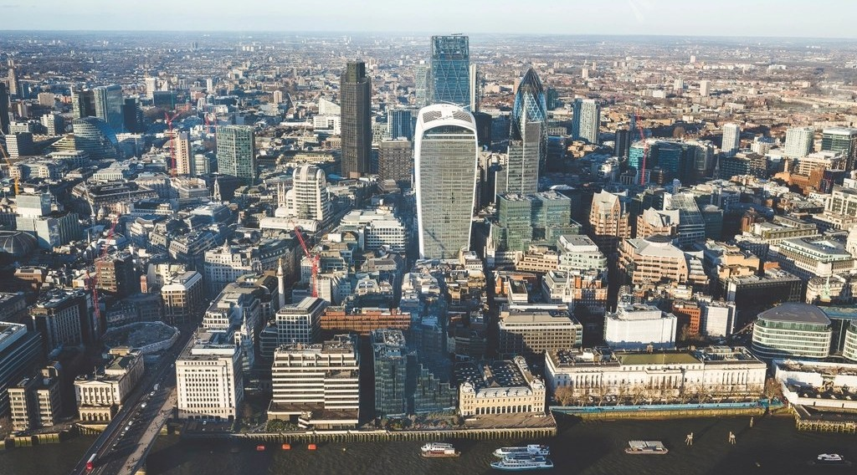
2. CLASSIFICATION
Activity 3
A city.
Notes:
Activity 3. Look carefully at this picture: a city. Observe every detail before I ask the question.

Slide 25
2. CLASSIFICATION
Activity 3: Question
Give two examples of each type in Cameroon.
Notes:
Here is the question for Activity 3: Give two examples of each type in Cameroon. Take one minute to think and write your answer in your rough notebook.

Slide 26
2. CLASSIFICATION
Activity 3: Answer
Rural: villages of the North; urban: Douala and Garoua.
Notes:
Let us check the answer together. Rural: villages of the North; urban: Douala and Garoua.

Slide 27
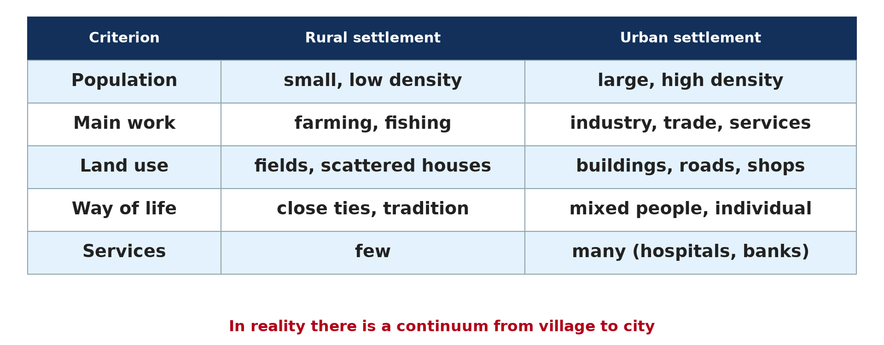
3. DIFFERENCES
Activity 4
Rural and urban settlements.
Notes:
Activity 4. Look carefully at this diagram: rural and urban settlements. Observe every detail before I ask the question.

Slide 28
3. DIFFERENCES
Activity 4: Question
Give two differences in activities and population.
Notes:
Here is the question for Activity 4: Give two differences in activities and population. Take one minute to think and write your answer in your rough notebook.

Slide 29
3. DIFFERENCES
Activity 4: Answer
Rural: farming and small population; urban: industry and services with a large population.
Notes:
Let us check the answer together. Rural: farming and small population; urban: industry and services with a large population.

Slide 30

3. DIFFERENCES
Activity 5
A rural chiefdom.
Notes:
Activity 5. Look carefully at this picture: a rural chiefdom. Observe every detail before I ask the question.

Slide 31
3. DIFFERENCES
Activity 5: Question
Give one difference in way of life.
Notes:
Here is the question for Activity 5: Give one difference in way of life. Take one minute to think and write your answer in your rough notebook.

Slide 32
3. DIFFERENCES
Activity 5: Answer
Rural life is traditional with close ties; urban life is modern and individual.
Notes:
Let us check the answer together. Rural life is traditional with close ties; urban life is modern and individual.

Slide 33
BOARD SUMMARY
Board Summary
Topic: The Development of Settlements and their Implications
Sub-topic: Rural Settlements, their Morphology and Implications on the Environment
Lesson 41: Settlement
Notes:
Now we are going to copy the board summary. Write the title and the headings neatly in your notebooks. I will give you enough time for each slide, so do not rush.

Slide 34
BOARD SUMMARY
DEFINITIONS
The key terms of this lesson are defined as follows:
Settlement: It is a place where people live and carry out their activities.
Notes:
Let us copy the definitions. The key terms of this lesson are defined as follows. On this slide we have Settlement. Write each point on a new line, with the key term first, and explain it in your own words when we revise.

Slide 35
BOARD SUMMARY
1. Types of Settlements
Settlements are classified into two types:
Rural settlements: They are isolated houses, hamlets and villages whose people mostly farm.
Urban settlements: They are towns and cities whose people work in industry and services.
Notes:
Let us copy Types of Settlements. Settlements are classified into two types. On this slide we have Rural settlements and Urban settlements. Write each point on a new line, with the key term first, and explain it in your own words when we revise.

Slide 36
BOARD SUMMARY
1. Types of Settlements
Illustration: settlement hierarchy
Notes:
Now draw this illustration in your notebook: settlement hierarchy. Give it a title and label it clearly.

Slide 37
BOARD SUMMARY
2. Differences between Rural and Urban Settlements
Rural and urban settlements differ as follows:
Population: Rural settlements are small and sparse, while urban ones are large and dense.
Notes:
Let us copy Differences between Rural and Urban Settlements. Rural and urban settlements differ as follows. On this slide we have Population. Write each point on a new line, with the key term first, and explain it in your own words when we revise. When you finish, we go to the next slide.

Slide 38
BOARD SUMMARY
2. Differences between Rural and Urban Settlements (continued)
Activities: Rural people farm, fish and herd, while urban people work in industry and services.
Services: Rural areas have few services, while towns have hospitals, banks and universities.
Notes:
We continue with Differences between Rural and Urban Settlements. On this slide we have Activities and Services. Write each point on a new line, with the key term first, and explain it in your own words when we revise. When you finish, we go to the next slide.

Slide 39
BOARD SUMMARY
2. Differences between Rural and Urban Settlements (continued)
Way of life: Rural life is traditional, while urban life is modern and individual.
Notes:
We continue with Differences between Rural and Urban Settlements. On this slide we have Way of life. Write each point on a new line, with the key term first, and explain it in your own words when we revise.

Slide 40
BOARD SUMMARY
2. Differences between Rural and Urban Settlements
Illustration: rural and urban settlements
Notes:
Now draw this illustration in your notebook: rural and urban settlements. Give it a title and label it clearly.

Slide 41
FORMATIVE EVALUATION
Evaluation 1
Define a settlement.
Notes:
Now let us check what you have understood. Question 1: Define a settlement. Answer in your exercise book.

Slide 42
FORMATIVE EVALUATION
Expected Answer
A place where people live and carry out their activities.
Notes:
The expected answer is: a place where people live and carry out their activities. If you got it right, well done.

Slide 43
FORMATIVE EVALUATION
Evaluation 2
Give two differences between rural and urban settlements.
Notes:
Now let us check what you have understood. Question 2: Give two differences between rural and urban settlements. Answer in your exercise book.

Slide 44
FORMATIVE EVALUATION
Expected Answer
Size of population and main activities.
Notes:
The expected answer is: size of population and main activities. If you got it right, well done.

Slide 45
REMEDIATION
Remediation
Fill in the blanks:
A village is a ______ settlement.
A town is an ______ settlement.
Most rural people are ______.
Notes:
For those who need more practice, fill in the blanks in your exercise book. The answers are: number 1, rural; number 2, urban; number 3, farmers.

Slide 46
HOMEWORK
Homework
Compare your village or quarter with a big town in five points.
Notes:
For your homework: Compare your village or quarter with a big town in five points. We shall correct it at the beginning of our next lesson.

Slide 47
NEXT LESSON
Next Lesson
Our next lesson will be on:
Lesson 42: Location of Settlements
Notes:
Our next lesson will be on Lesson 42: Location of Settlements. Thank you for your attention, and see you next time.

Slide 48
BILINGUAL GAME
Bilingual Game (Jeu Bilingue)
English | Français
Settlement | L'habitat / l'établissement humain
Rural | Rural
Urban | Urbain
Village | Le village
Town | La ville
Way of life | Le mode de vie
Notes:
Let us play the bilingual game. I say a word in English, and you give me the French word. Then we do the reverse.

Slide 49
LOGBOOK
Official Logbook (1/2)
Module / Topic | The Development of Settlements and their Implications
Lesson Title | Lesson 41: Settlement
Expected Learning Outcomes | Define a settlement. Classify settlements into rural and urban. Give the differences between rural and urban settlements.
Competence | Learners are able to define settlement and distinguish rural and urban settlements.
Notes:
I record this information in the official logbook of the class after the lesson.

Slide 50
LOGBOOK
Official Logbook (2/2)
Matter Taught | DEFINITIONS; Types of Settlements; Differences between Rural and Urban Settlements.
Evaluation | Formative evaluation and remediation exercise.
Homework | Compare your village or quarter with a big town in five points.
Enrolment / Present / Absent | ____ / ____ / ____
Achievement | To be completed after the lesson.
Notes:
I complete the second page of the logbook: the matter taught, the evaluation, the homework and the attendance.

Slide 51
TEACHER'S NOTE
Teacher's Note
Timing: Homework correction, plan, objectives 8 min | Recall, situation, action 10 min | 5 activities 30 min | Board summary (copying) 30 min | Evaluation, remediation 10 min | Homework, next lesson 5 min | Logbook 7 min
Without the projector (Activity 1): describe your settlement.
Without the projector (Activity 2): classify.
Without the projector (Activity 3): give examples.
Without the projector (Activity 4): compare.
Without the projector (Activity 5): compare.
Notes:
This slide is for me, the teacher: it gives the timing of the lesson and what to do if the projector is not available.

Slide 52
REFERENCES
References
Geography Syllabus, Forms I–V, MINESEC (2023) — Form 5, Module III: Management of Population Growth and Space Colonisation.
Photo, Activity 1: “Village built into the hillside” by 10b travelling / Carsten ten Brink, CC BY-NC-ND 2.0, via Flickr (https://www.flickr.com/photos/77334245@N00/5677301357)
Photo, Activity 3: “Aerial View City Skyline Skyscraper” by unknown, CC0 1.0, via rawpixel (https://www.rawpixel.com/image/5967710/aerial-view-city-skyline-skyscraper)
Photo, Activity 5: “Bandjoun's chefferie: I - the approach past the royal quarters” by 10b travelling / Carsten ten Brink, CC BY-NC-ND 2.0, via Flickr (https://www.flickr.com/photos/77334245@N00/7326237514)
Diagrams and animations: drawn for this lesson (Geography Department).
Notes:
These are the references and picture credits used to prepare this lesson.

