Slide 1
FORM 5
GEOGRAPHY
Lesson 50
Urban Fields or Spheres of Influence
Notes:
Good morning, class, and welcome to our geography lesson. I am your geography teacher, Mr Kamdem. Today we are starting Lesson 50: Urban Fields or Spheres of Influence.

Slide 2
CLASS INFO
Class, Chapter and Duration
Class | Form 5
Chapter | Module III: Management of Population Growth and Space Colonisation
Duration | 2 periods (2 × 50 minutes)
Notes:
This lesson is for Form 5. It belongs to Module III: Management of Population Growth and Space Colonisation. We shall need 2 periods to cover it.

Slide 3
IDENTIFICATION
Lesson Identification
Topic | The Development of Settlements and their Implications
Sub-topic | Urban Settlements and their Spheres of Influence
Lesson | Lesson 50: Urban Fields or Spheres of Influence
Notions / Concepts | Urban field, sphere of influence, hinterland.
Syllabus focus | Meaning; functional relationships within urban fields.
Competence | Learners are able to explain urban fields and the relationships between towns and their surroundings.
Notes:
Our topic is The Development of Settlements and their Implications, and the sub-topic is Urban Settlements and their Spheres of Influence. The key notions we shall use today are: urban field, sphere of influence, hinterland. At the end, you should be able to do this: learners are able to explain urban fields and the relationships between towns and their surroundings.

Slide 4

HOMEWORK CORRECTION
Correction of the Homework
Question (Lesson 49: Functions of Urban Settlements):
List the functions of Garoua and give evidence for each.
Notes:
Before we start the new lesson, let us correct the homework I gave you at the end of Lesson 49: Functions of Urban Settlements. The question was: List the functions of Garoua and give evidence for each. Take out your exercise books.

Slide 5
HOMEWORK CORRECTION
Correction: Possible Answer
Administrative (regional capital), commercial (markets, trade with Nigeria and Chad), industrial (CICAM, SODECOTON), transport (river port, airport), educational (schools).
Notes:
Here is a good answer. Administrative (regional capital), commercial (markets, trade with Nigeria and Chad), industrial (CICAM, SODECOTON), transport (river port, airport), educational (schools). Compare it with your own answer and correct your work in red.

Slide 6
LESSON PLAN
Lesson Plan
Correction of the homework
Objectives and recall
Real-life situation and action to take
Learning activities
Board summary
Evaluation, remediation and homework
Notes:
Here is the plan of our lesson today. First, we shall correct the homework. Then we shall look at the objectives and recall what you already know. After that, we shall study a situation from real life and the action to take, and do the learning activities. Finally, we shall copy the board summary, do the evaluation and the remediation, and I will give you the homework.

Slide 7
OBJECTIVES
Objectives
By the end of this lesson, you should be able to:
Define an urban field.
Explain the functional relationships within urban fields.
Show how urban fields are delimited.
Notes:
By the end of this lesson, you should be able to do three things. Number 1: define an urban field. Number 2: explain the functional relationships within urban fields. Number 3: show how urban fields are delimited.

Slide 8
PREVIOUS KNOWLEDGE
Previous Knowledge
Villagers go to town to buy and sell.
Towns have hospitals and schools.
Towns need food from villages.
Notes:
Let us first remember what you already know. Villagers go to town to buy and sell. Towns have hospitals and schools. Towns need food from villages. Keep this in mind, because we shall build on it today.

Slide 9
REAL-LIFE SITUATION
Situation in Real Life
Every week, villagers bring maize and onions to the Garoua market and buy clothes, medicines and phones. Some patients come from far away to the regional hospital.
Notes:
Listen carefully to this situation from real life. Every week, villagers bring maize and onions to the Garoua market and buy clothes, medicines and phones. Some patients come from far away to the regional hospital. Think about it, because I am going to ask you some questions.

Slide 10
REAL-LIFE SITUATION
Situation: Question 1
What is the problem in the situation?
Notes:
Question 1: What is the problem in the situation? Think for a moment, then raise your hand to answer.

Slide 11
REAL-LIFE SITUATION
Answer
Towns influence the surrounding area.
Notes:
Good. Towns influence the surrounding area.

Slide 12
REAL-LIFE SITUATION
Situation: Question 2
What do villagers bring to town?
Notes:
Question 2: What do villagers bring to town? Think for a moment, then raise your hand to answer.

Slide 13
REAL-LIFE SITUATION
Answer
Food crops.
Notes:
Good. Food crops.

Slide 14
REAL-LIFE SITUATION
Situation: Question 3
What do they get from town?
Notes:
Question 3: What do they get from town? Think for a moment, then raise your hand to answer.

Slide 15
REAL-LIFE SITUATION
Possible Answer
Goods and services.
Notes:
Good. Goods and services.

Slide 16
ACTION TO TAKE
Action to Take
Use and support local markets and services.
Notes:
From this situation, the action we are working towards in this lesson is the following: use and support local markets and services.

Slide 17
JUSTIFICATION
Justification of the Lesson
This lesson helps us to understand links between towns and their regions.
Notes:
Why is this lesson important for you? This lesson helps us to understand links between towns and their regions.

Slide 18
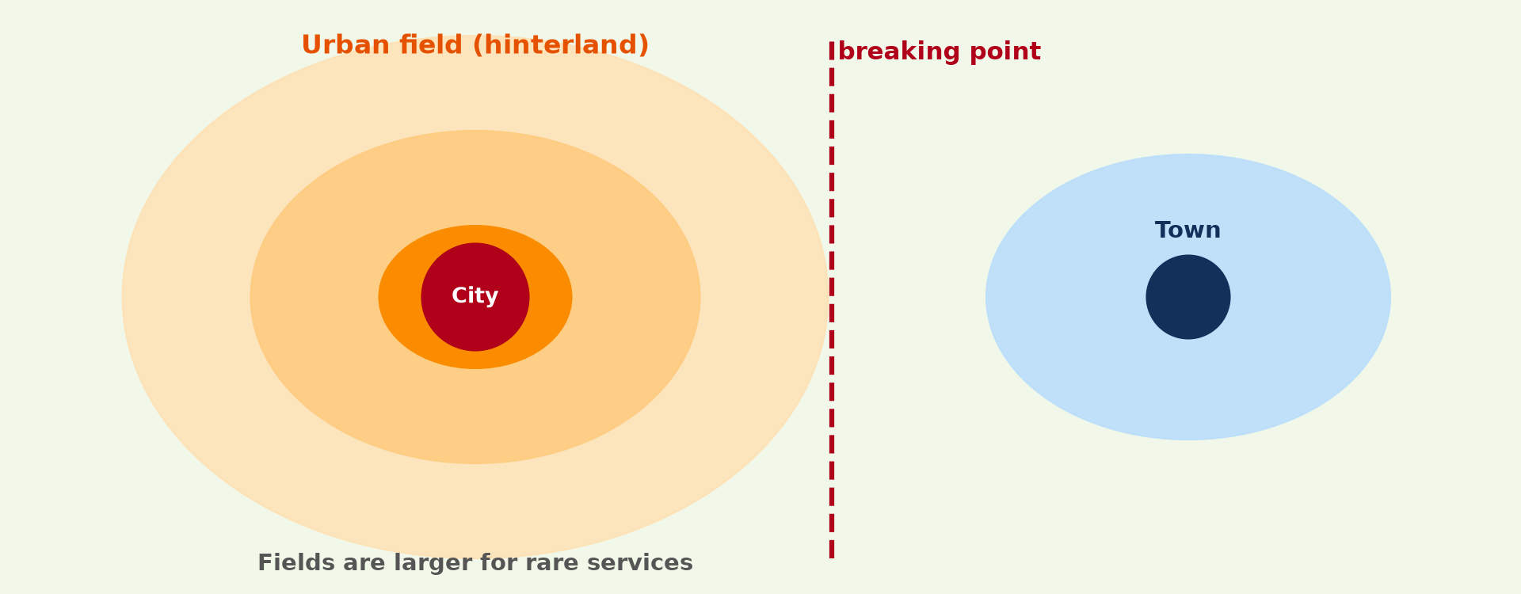
1. MEANING
Activity 1
Urban field.
Notes:
Activity 1. Look carefully at this diagram: urban field. Observe every detail before I ask the question.

Slide 19
1. MEANING
Activity 1: Question
What is an urban field?
Notes:
Here is the question for Activity 1: What is an urban field? Take one minute to think and write your answer in your rough notebook.

Slide 20
1. MEANING
Activity 1: Answer
The area around a town that it serves and influences.
Notes:
Let us check the answer together. The area around a town that it serves and influences.

Slide 21

2. RELATIONSHIPS: TOWN TO COUNTRY
Activity 2
A market.
Notes:
Activity 2. Look carefully at this picture: a market. Observe every detail before I ask the question.

Slide 22
2. RELATIONSHIPS: TOWN TO COUNTRY
Activity 2: Question
What does the town give to its field?
Notes:
Here is the question for Activity 2: What does the town give to its field? Take one minute to think and write your answer in your rough notebook.

Slide 23
2. RELATIONSHIPS: TOWN TO COUNTRY
Activity 2: Answer
Goods, services, jobs, news and administration.
Notes:
Let us check the answer together. Goods, services, jobs, news and administration.

Slide 24

2. RELATIONSHIPS: COUNTRY TO TOWN
Activity 3
A cattle market.
Notes:
Activity 3. Look carefully at this picture: a cattle market. Observe every detail before I ask the question.

Slide 25
2. RELATIONSHIPS: COUNTRY TO TOWN
Activity 3: Question
What does the field give to the town?
Notes:
Here is the question for Activity 3: What does the field give to the town? Take one minute to think and write your answer in your rough notebook.

Slide 26
2. RELATIONSHIPS: COUNTRY TO TOWN
Activity 3: Answer
Food, raw materials, workers and customers.
Notes:
Let us check the answer together. Food, raw materials, workers and customers.

Slide 27
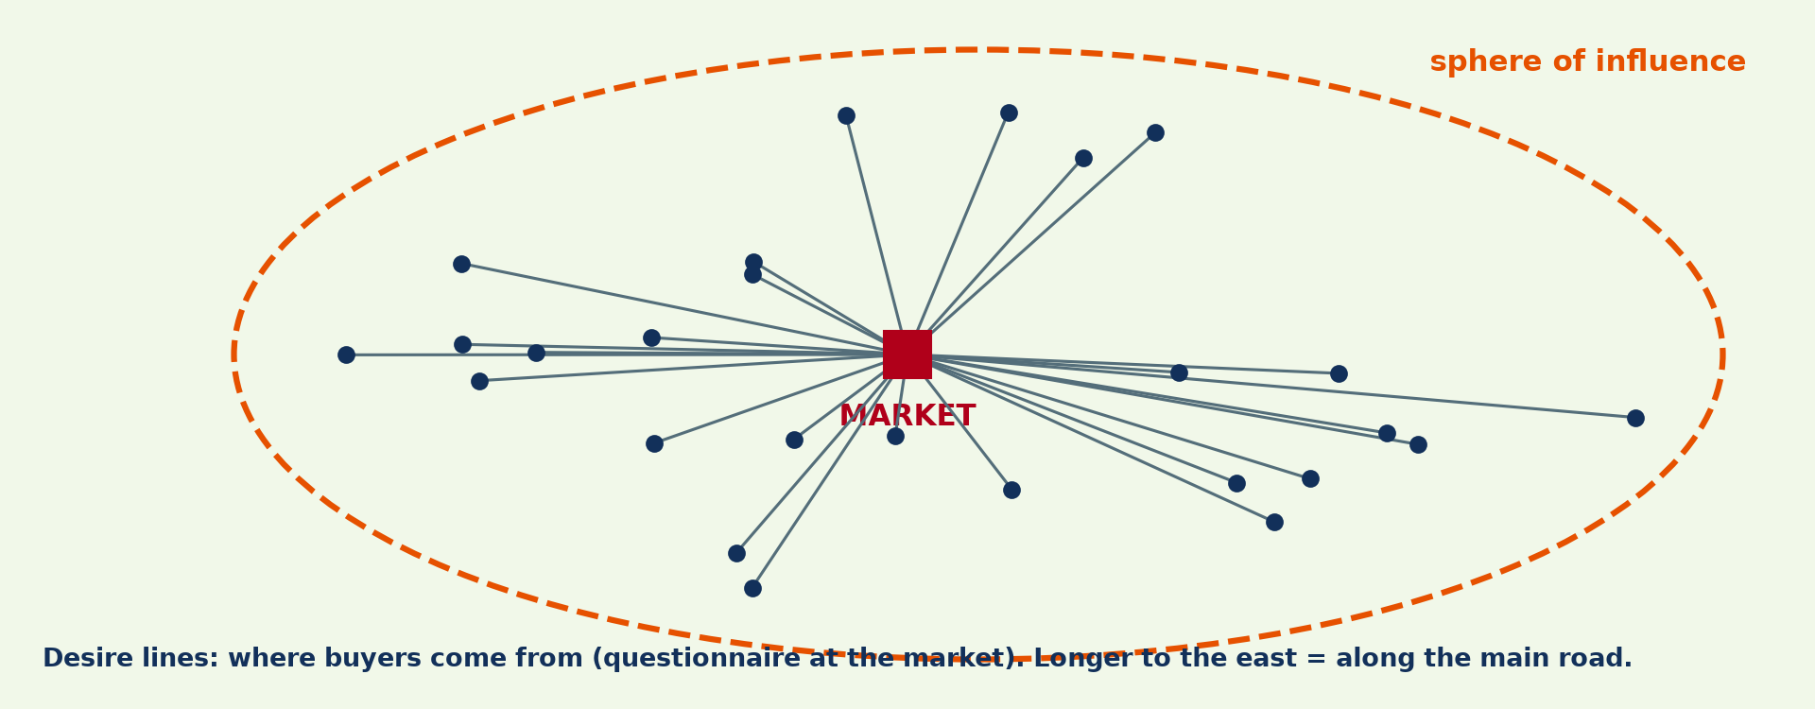
3. DELIMITATION
Activity 4
Sphere of influence from a survey.
Notes:
Activity 4. Look carefully at this diagram: sphere of influence from a survey. Observe every detail before I ask the question.

Slide 28
3. DELIMITATION
Activity 4: Question
How can we find the limit of an urban field?
Notes:
Here is the question for Activity 4: How can we find the limit of an urban field? Take one minute to think and write your answer in your rough notebook.

Slide 29
3. DELIMITATION
Activity 4: Answer
By mapping where customers, bus passengers or newspaper readers come from.
Notes:
Let us check the answer together. By mapping where customers, bus passengers or newspaper readers come from.

Slide 30

3. RANGE AND THRESHOLD
Activity 5
Range and threshold.
Notes:
Activity 5. Look carefully at this diagram: range and threshold. Observe every detail before I ask the question.

Slide 31
3. RANGE AND THRESHOLD
Activity 5: Question
Why is the field larger for a hospital than a bakery?
Notes:
Here is the question for Activity 5: Why is the field larger for a hospital than a bakery? Take one minute to think and write your answer in your rough notebook.

Slide 32
3. RANGE AND THRESHOLD
Activity 5: Answer
A hospital is a high-order service with a large range.
Notes:
Let us check the answer together. A hospital is a high-order service with a large range.

Slide 33
BOARD SUMMARY
Board Summary
Topic: The Development of Settlements and their Implications
Sub-topic: Urban Settlements and their Spheres of Influence
Lesson 50: Urban Fields or Spheres of Influence
Notes:
Now we are going to copy the board summary. Write the title and the headings neatly in your notebooks. I will give you enough time for each slide, so do not rush.

Slide 34
BOARD SUMMARY
DEFINITIONS
The key terms of this lesson are defined as follows:
Urban field: It is the area around a town that it serves and influences.
Notes:
Let us copy the definitions. The key terms of this lesson are defined as follows. On this slide we have Urban field. Write each point on a new line, with the key term first, and explain it in your own words when we revise.

Slide 35
BOARD SUMMARY
1. Functional Relationships within Urban Fields
A town and its field are linked as follows:
From town to field: The town supplies goods, services, jobs and administration.
From field to town: The field supplies food, raw materials, workers and customers.
Notes:
Let us copy Functional Relationships within Urban Fields. A town and its field are linked as follows. On this slide we have From town to field and From field to town. Write each point on a new line, with the key term first, and explain it in your own words when we revise. When you finish, we go to the next slide.

Slide 36
BOARD SUMMARY
1. Functional Relationships within Urban Fields (continued)
Transport links: Roads and buses make these exchanges possible.
Notes:
We continue with Functional Relationships within Urban Fields. On this slide we have Transport links. Write each point on a new line, with the key term first, and explain it in your own words when we revise.

Slide 37
BOARD SUMMARY
1. Functional Relationships within Urban Fields
Illustration: urban field
Notes:
Now draw this illustration in your notebook: urban field. Give it a title and label it clearly.

Slide 38
BOARD SUMMARY
2. Delimitation of Urban Fields
Urban fields are delimited as follows:
Surveys: We map where customers, patients and students come from.
Services: Bus routes, newspaper sales and school catchments show the field.
Notes:
Let us copy Delimitation of Urban Fields. Urban fields are delimited as follows. On this slide we have Surveys and Services. Write each point on a new line, with the key term first, and explain it in your own words when we revise. When you finish, we go to the next slide.

Slide 39
BOARD SUMMARY
2. Delimitation of Urban Fields (continued)
Size: Fields are larger for high-order services such as hospitals.
Notes:
We continue with Delimitation of Urban Fields. On this slide we have Size. Write each point on a new line, with the key term first, and explain it in your own words when we revise.

Slide 40
FORMATIVE EVALUATION
Evaluation 1
Define an urban field.
Notes:
Now let us check what you have understood. Question 1: Define an urban field. Answer in your exercise book.

Slide 41
FORMATIVE EVALUATION
Expected Answer
The area around a town that it serves.
Notes:
The expected answer is: the area around a town that it serves. If you got it right, well done.

Slide 42
FORMATIVE EVALUATION
Evaluation 2
Give two things a town gives to its field.
Notes:
Now let us check what you have understood. Question 2: Give two things a town gives to its field. Answer in your exercise book.

Slide 43
FORMATIVE EVALUATION
Expected Answer
Goods and services.
Notes:
The expected answer is: goods and services. If you got it right, well done.

Slide 44
REMEDIATION
Remediation
Fill in the blanks:
The area served by a town is its urban ______.
The field supplies ______ to the town.
A hospital has a large ______.
Notes:
For those who need more practice, fill in the blanks in your exercise book. The answers are: number 1, field; number 2, food; number 3, range.

Slide 45
HOMEWORK
Homework
Ask ten people at your market where they come from and draw the sphere of influence.
Notes:
For your homework: Ask ten people at your market where they come from and draw the sphere of influence. We shall correct it at the beginning of our next lesson.

Slide 46
NEXT LESSON
Next Lesson
Our next lesson will be on:
Lesson 51: Settlement Size-Functional Relationship
Notes:
Our next lesson will be on Lesson 51: Settlement Size-Functional Relationship. Thank you for your attention, and see you next time.

Slide 47
BILINGUAL GAME
Bilingual Game (Jeu Bilingue)
English | Français
Urban field | La zone d'influence urbaine
Hinterland | L'arrière-pays
Customer | Le client
Range | La portée
Threshold | Le seuil
Survey | L'enquête
Notes:
Let us play the bilingual game. I say a word in English, and you give me the French word. Then we do the reverse.

Slide 48
LOGBOOK
Official Logbook (1/2)
Module / Topic | The Development of Settlements and their Implications
Lesson Title | Lesson 50: Urban Fields or Spheres of Influence
Expected Learning Outcomes | Define an urban field. Explain the functional relationships within urban fields. Show how urban fields are delimited.
Competence | Learners are able to explain urban fields and the relationships between towns and their surroundings.
Notes:
I record this information in the official logbook of the class after the lesson.

Slide 49
LOGBOOK
Official Logbook (2/2)
Matter Taught | DEFINITIONS; Functional Relationships within Urban Fields; Delimitation of Urban Fields.
Evaluation | Formative evaluation and remediation exercise.
Homework | Ask ten people at your market where they come from and draw the sphere of influence.
Enrolment / Present / Absent | ____ / ____ / ____
Achievement | To be completed after the lesson.
Notes:
I complete the second page of the logbook: the matter taught, the evaluation, the homework and the attendance.

Slide 50
TEACHER'S NOTE
Teacher's Note
Timing: Homework correction, plan, objectives 8 min | Recall, situation, action 10 min | 5 activities 30 min | Board summary (copying) 30 min | Evaluation, remediation 10 min | Homework, next lesson 5 min | Logbook 7 min
Without the projector (Activity 1): define.
Without the projector (Activity 2): list.
Without the projector (Activity 3): list.
Without the projector (Activity 4): discuss.
Without the projector (Activity 5): discuss.
Notes:
This slide is for me, the teacher: it gives the timing of the lesson and what to do if the projector is not available.

Slide 51
REFERENCES
References
Geography Syllabus, Forms I–V, MINESEC (2023) — Form 5, Module III: Management of Population Growth and Space Colonisation.
Photo, Activity 2: “Sandga Market in Douala, Cameroon” by The Advocacy Project, CC BY-NC-SA 2.0, via Flickr (https://www.flickr.com/photos/42487558@N00/3636438732)
Photo, Activity 3: “Discussing the price” by 10b travelling / Carsten ten Brink, CC BY-NC-ND 2.0, via Flickr (https://www.flickr.com/photos/77334245@N00/7313656038)
Diagrams and animations: drawn for this lesson (Geography Department).
Notes:
These are the references and picture credits used to prepare this lesson.

