Slide 1
FORM 5
GEOGRAPHY
Lesson 7
Communication
Notes:
Good morning, class, and welcome to our geography lesson. I am your geography teacher, Mr Kamdem. Today we are starting Lesson 7: Communication.

Slide 2
CLASS INFO
Class, Chapter and Duration
Class | Form 5
Chapter | Module I: Management of Manufacturing and Tertiary Activities
Duration | 2 periods (2 × 50 minutes)
Notes:
This lesson is for Form 5. It belongs to Module I: Management of Manufacturing and Tertiary Activities. We shall need 2 periods to cover it.

Slide 3
IDENTIFICATION
Lesson Identification
Topic | Managing Resources for Development through Economic Activities
Sub-topic | World Communication
Lesson | Lesson 7: Communication
Notions / Concepts | Communication, transport, telecommunication, land, air and water transport.
Syllabus focus | Meaning of communication (transport and telecommunication); modes of transport.
Competence | Learners are able to define communication and classify the modes of transport.
Notes:
Our topic is Managing Resources for Development through Economic Activities, and the sub-topic is World Communication. The key notions we shall use today are: communication, transport, telecommunication, land, air and water transport. At the end, you should be able to do this: learners are able to define communication and classify the modes of transport.

Slide 4

HOMEWORK CORRECTION
Correction of the Homework
Question (Practical Work 1: Location of Economic Activities and Description of Land Use):
Draw a sketch map of the land uses of a map extract.
Notes:
Before we start the new lesson, let us correct the homework I gave you at the end of Practical Work 1: Location of Economic Activities and Description of Land Use. The question was: Draw a sketch map of the land uses of a map extract. Take out your exercise books.

Slide 5
HOMEWORK CORRECTION
Correction: Possible Answer
A framed sketch with a title, key, scale and north arrow showing zones such as plantations, forest reserve, settlements, the factory and the quarry.
Notes:
Here is a good answer. A framed sketch with a title, key, scale and north arrow showing zones such as plantations, forest reserve, settlements, the factory and the quarry. Compare it with your own answer and correct your work in red.

Slide 6
LESSON PLAN
Lesson Plan
Correction of the homework
Objectives and recall
Real-life situation and action to take
Learning activities
Board summary
Evaluation, remediation and homework
Notes:
Here is the plan of our lesson today. First, we shall correct the homework. Then we shall look at the objectives and recall what you already know. After that, we shall study a situation from real life and the action to take, and do the learning activities. Finally, we shall copy the board summary, do the evaluation and the remediation, and I will give you the homework.

Slide 7
OBJECTIVES
Objectives
By the end of this lesson, you should be able to:
Define communication, transport and telecommunication.
Identify the modes of transport.
Classify the modes of transport.
Notes:
By the end of this lesson, you should be able to do three things. Number 1: define communication, transport and telecommunication. Number 2: identify the modes of transport. Number 3: classify the modes of transport.

Slide 8
PREVIOUS KNOWLEDGE
Previous Knowledge
Trade moves goods from producers to consumers.
Cameroon has roads, railways, ports and airports.
People use phones to send messages.
Notes:
Let us first remember what you already know. Trade moves goods from producers to consumers. Cameroon has roads, railways, ports and airports. People use phones to send messages. Keep this in mind, because we shall build on it today.

Slide 9
REAL-LIFE SITUATION
Situation in Real Life
A trader in Garoua sends onions to Douala by lorry, calls his customer by phone and receives the money by mobile money. His son says all this is communication.
Notes:
Listen carefully to this situation from real life. A trader in Garoua sends onions to Douala by lorry, calls his customer by phone and receives the money by mobile money. His son says all this is communication. Think about it, because I am going to ask you some questions.

Slide 10
REAL-LIFE SITUATION
Situation: Question 1
What is the problem in the situation?
Notes:
Question 1: What is the problem in the situation? Think for a moment, then raise your hand to answer.

Slide 11
REAL-LIFE SITUATION
Answer
We want to know what communication is.
Notes:
Good. We want to know what communication is.

Slide 12
REAL-LIFE SITUATION
Situation: Question 2
How are the onions moved?
Notes:
Question 2: How are the onions moved? Think for a moment, then raise your hand to answer.

Slide 13
REAL-LIFE SITUATION
Answer
By lorry (road transport).
Notes:
Good. By lorry (road transport).

Slide 14
REAL-LIFE SITUATION
Situation: Question 3
How does the trader send messages?
Notes:
Question 3: How does the trader send messages? Think for a moment, then raise your hand to answer.

Slide 15
REAL-LIFE SITUATION
Possible Answer
By telephone (telecommunication).
Notes:
Good. By telephone (telecommunication).

Slide 16
ACTION TO TAKE
Action to Take
Use the transport and telecommunication means safely and responsibly.
Notes:
From this situation, the action we are working towards in this lesson is the following: use the transport and telecommunication means safely and responsibly.

Slide 17
JUSTIFICATION
Justification of the Lesson
This lesson helps us to understand how people, goods and information move.
Notes:
Why is this lesson important for you? This lesson helps us to understand how people, goods and information move.

Slide 18
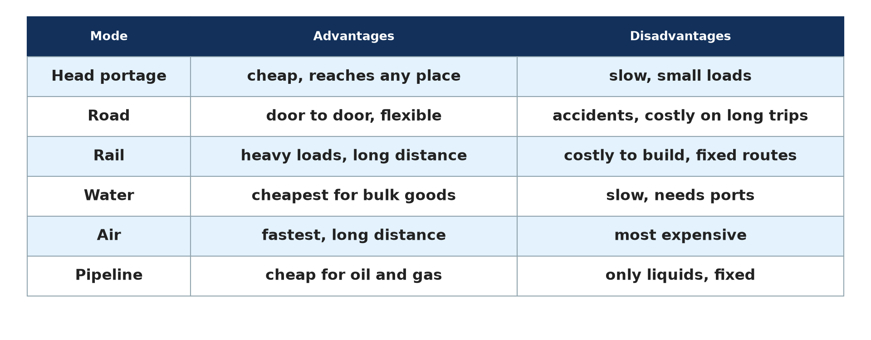
1. MEANING
Activity 1
Modes of transport.
Notes:
Activity 1. Look carefully at this diagram: modes of transport. Observe every detail before I ask the question.

Slide 19
1. MEANING
Activity 1: Question
What is communication?
Notes:
Here is the question for Activity 1: What is communication? Take one minute to think and write your answer in your rough notebook.

Slide 20
1. MEANING
Activity 1: Answer
The movement of people, goods and information from one place to another.
Notes:
Let us check the answer together. The movement of people, goods and information from one place to another.

Slide 21

1. MEANING: TRANSPORT
Activity 2
A lorry.
Notes:
Activity 2. Look carefully at this picture: a lorry. Observe every detail before I ask the question.

Slide 22
1. MEANING: TRANSPORT
Activity 2: Question
What is transport?
Notes:
Here is the question for Activity 2: What is transport? Take one minute to think and write your answer in your rough notebook.

Slide 23
1. MEANING: TRANSPORT
Activity 2: Answer
The movement of people and goods from one place to another.
Notes:
Let us check the answer together. The movement of people and goods from one place to another.

Slide 24

1. MEANING: TELECOMMUNICATION
Activity 3
A farmer using a phone.
Notes:
Activity 3. Look carefully at this picture: a farmer using a phone. Observe every detail before I ask the question.

Slide 25
1. MEANING: TELECOMMUNICATION
Activity 3: Question
What is telecommunication?
Notes:
Here is the question for Activity 3: What is telecommunication? Take one minute to think and write your answer in your rough notebook.

Slide 26
1. MEANING: TELECOMMUNICATION
Activity 3: Answer
The sending of information over a distance by telephone, radio, television or internet.
Notes:
Let us check the answer together. The sending of information over a distance by telephone, radio, television or internet.

Slide 27
2. MODES OF TRANSPORT
Activity 4
Land, water and air transport.
Notes:
Activity 4. Look carefully at this diagram: land, water and air transport. Observe every detail before I ask the question.

Slide 28
2. MODES OF TRANSPORT
Activity 4: Question
Name the three main modes of transport.
Notes:
Here is the question for Activity 4: Name the three main modes of transport. Take one minute to think and write your answer in your rough notebook.

Slide 29
2. MODES OF TRANSPORT
Activity 4: Answer
Land transport, water transport and air transport.
Notes:
Let us check the answer together. Land transport, water transport and air transport.

Slide 30
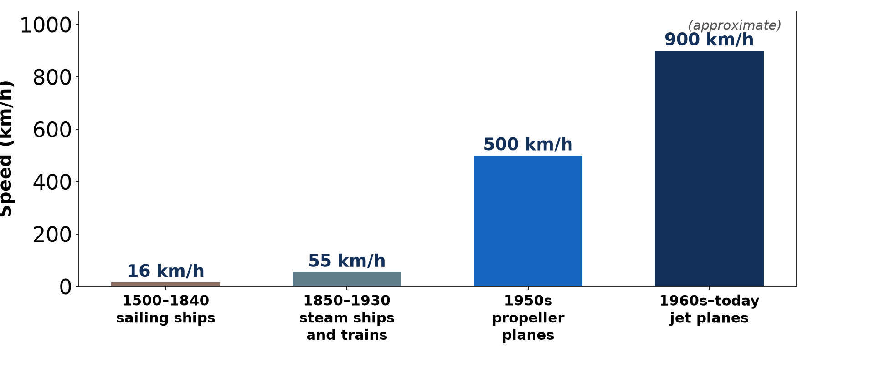
2. MODES OF TRANSPORT
Activity 5
The shrinking world.
Notes:
Activity 5. Look carefully at this diagram: the shrinking world. Observe every detail before I ask the question.

Slide 31
2. MODES OF TRANSPORT
Activity 5: Question
How has modern communication changed the world?
Notes:
Here is the question for Activity 5: How has modern communication changed the world? Take one minute to think and write your answer in your rough notebook.

Slide 32
2. MODES OF TRANSPORT
Activity 5: Answer
Places seem closer because travel and messages are faster.
Notes:
Let us check the answer together. Places seem closer because travel and messages are faster.

Slide 33
BOARD SUMMARY
Board Summary
Topic: Managing Resources for Development through Economic Activities
Sub-topic: World Communication
Lesson 7: Communication
Notes:
Now we are going to copy the board summary. Write the title and the headings neatly in your notebooks. I will give you enough time for each slide, so do not rush.

Slide 34
BOARD SUMMARY
DEFINITIONS
The key terms of this lesson are defined as follows:
Communication: It is the movement of people, goods and information from one place to another.
Transport: It is the movement of people and goods from one place to another.
Notes:
Let us copy the definitions. The key terms of this lesson are defined as follows. On this slide we have Communication and Transport. Write each point on a new line, with the key term first, and explain it in your own words when we revise. When you finish, we go to the next slide.

Slide 35
BOARD SUMMARY
DEFINITIONS (continued)
Telecommunication: It is the sending of information over a distance by electronic means.
Notes:
We continue with the definitions. On this slide we have Telecommunication. Write each point on a new line, with the key term first, and explain it in your own words when we revise.

Slide 36
BOARD SUMMARY
1. Modes of Transport
The modes of transport are the following:
Land transport: It includes roads, railways and pipelines.
Water transport: It includes sea, river and lake transport.
Notes:
Let us copy Modes of Transport. The modes of transport are the following. On this slide we have Land transport and Water transport. Write each point on a new line, with the key term first, and explain it in your own words when we revise. When you finish, we go to the next slide.

Slide 37
BOARD SUMMARY
1. Modes of Transport (continued)
Air transport: It uses aeroplanes and helicopters for fast travel.
Notes:
We continue with Modes of Transport. On this slide we have Air transport. Write each point on a new line, with the key term first, and explain it in your own words when we revise.

Slide 38
BOARD SUMMARY
1. Modes of Transport
Illustration: modes of transport
Notes:
Now draw this illustration in your notebook: modes of transport. Give it a title and label it clearly.

Slide 39
BOARD SUMMARY
2. Means of Telecommunication
The main means of telecommunication are the following:
Telephone: Fixed and mobile phones carry voice and text messages.
Radio and television: They broadcast information to many people at once.
Notes:
Let us copy Means of Telecommunication. The main means of telecommunication are the following. On this slide we have Telephone and Radio and television. Write each point on a new line, with the key term first, and explain it in your own words when we revise. When you finish, we go to the next slide.

Slide 40
BOARD SUMMARY
2. Means of Telecommunication (continued)
Internet: It links computers and phones all over the world.
Notes:
We continue with Means of Telecommunication. On this slide we have Internet. Write each point on a new line, with the key term first, and explain it in your own words when we revise.

Slide 41
FORMATIVE EVALUATION
Evaluation 1
Distinguish transport and telecommunication.
Notes:
Now let us check what you have understood. Question 1: Distinguish transport and telecommunication. Answer in your exercise book.

Slide 42
FORMATIVE EVALUATION
Expected Answer
Transport moves people and goods; telecommunication sends information.
Notes:
The expected answer is: transport moves people and goods; telecommunication sends information. If you got it right, well done.

Slide 43
FORMATIVE EVALUATION
Evaluation 2
Name the three modes of transport.
Notes:
Now let us check what you have understood. Question 2: Name the three modes of transport. Answer in your exercise book.

Slide 44
FORMATIVE EVALUATION
Expected Answer
Land, water and air.
Notes:
The expected answer is: land, water and air. If you got it right, well done.

Slide 45
REMEDIATION
Remediation
Fill in the blanks:
The movement of goods and people is ______.
Sending information by phone is ______.
Pipelines are a form of ______ transport.
Notes:
For those who need more practice, fill in the blanks in your exercise book. The answers are: number 1, transport; number 2, telecommunication; number 3, land.

Slide 46
HOMEWORK
Homework
List the means of transport and telecommunication used in your family.
Notes:
For your homework: List the means of transport and telecommunication used in your family. We shall correct it at the beginning of our next lesson.

Slide 47
NEXT LESSON
Next Lesson
Our next lesson will be on:
Lesson 8: Development of Road Transport
Notes:
Our next lesson will be on Lesson 8: Development of Road Transport. Thank you for your attention, and see you next time.

Slide 48
BILINGUAL GAME
Bilingual Game (Jeu Bilingue)
English | Français
Communication | La communication
Transport | Le transport
Telecommunication | La télécommunication
Road | La route
Railway | Le chemin de fer
Aeroplane | L'avion
Notes:
Let us play the bilingual game. I say a word in English, and you give me the French word. Then we do the reverse.

Slide 49
LOGBOOK
Official Logbook (1/2)
Module / Topic | Managing Resources for Development through Economic Activities
Lesson Title | Lesson 7: Communication
Expected Learning Outcomes | Define communication, transport and telecommunication. Identify the modes of transport. Classify the modes of transport.
Competence | Learners are able to define communication and classify the modes of transport.
Notes:
I record this information in the official logbook of the class after the lesson.

Slide 50
LOGBOOK
Official Logbook (2/2)
Matter Taught | DEFINITIONS; Modes of Transport; Means of Telecommunication.
Evaluation | Formative evaluation and remediation exercise.
Homework | List the means of transport and telecommunication used in your family.
Enrolment / Present / Absent | ____ / ____ / ____
Achievement | To be completed after the lesson.
Notes:
I complete the second page of the logbook: the matter taught, the evaluation, the homework and the attendance.

Slide 51
TEACHER'S NOTE
Teacher's Note
Timing: Homework correction, plan, objectives 8 min | Recall, situation, action 10 min | 5 activities 30 min | Board summary (copying) 30 min | Evaluation, remediation 10 min | Homework, next lesson 5 min | Logbook 7 min
Without the projector (Activity 1): list means of communication.
Without the projector (Activity 2): name means of transport.
Without the projector (Activity 3): name telecommunication means.
Without the projector (Activity 4): classify local means.
Without the projector (Activity 5): discuss.
Notes:
This slide is for me, the teacher: it gives the timing of the lesson and what to do if the projector is not available.

Slide 52
REFERENCES
References
Geography Syllabus, Forms I–V, MINESEC (2023) — Form 5, Module I: Management of Manufacturing and Tertiary Activities.
Photo, Activity 2: “Traveling by truck” by World Bank Photo Collection, CC BY-NC-ND 2.0, via Flickr (https://www.flickr.com/photos/10816734@N03/2628517227)
Photo, Activity 3: “Using mobile technology to give feedback about the crop trials” by Bioversity International, CC BY-NC-ND 2.0, via Flickr (https://www.flickr.com/photos/50383637@N07/15019002626)
Diagrams and animations: drawn for this lesson (Geography Department).
Notes:
These are the references and picture credits used to prepare this lesson.

