Slide 1
FORM 5
GEOGRAPHY
Lesson 15
Telecommunication (Internet Communication)
Notes:
Good morning, class, and welcome to our geography lesson. I am your geography teacher, Mr Kamdem. Today we are starting Lesson 15: Telecommunication (Internet Communication).

Slide 2
CLASS INFO
Class, Chapter and Duration
Class | Form 5
Chapter | Module I: Management of Manufacturing and Tertiary Activities
Duration | 2 periods (2 × 50 minutes)
Notes:
This lesson is for Form 5. It belongs to Module I: Management of Manufacturing and Tertiary Activities. We shall need 2 periods to cover it.

Slide 3
IDENTIFICATION
Lesson Identification
Topic | Managing Resources for Development through Economic Activities
Sub-topic | World Communication
Lesson | Lesson 15: Telecommunication (Internet Communication)
Notions / Concepts | Telecommunication networks, internet, mobile phones, satellites, optic fibre.
Syllabus focus | Types of telecommunication networks; the nature and uses; advantages and disadvantages; socio-economic impacts.
Competence | Learners are able to describe telecommunication networks and assess their socio-economic impact.
Notes:
Our topic is Managing Resources for Development through Economic Activities, and the sub-topic is World Communication. The key notions we shall use today are: telecommunication networks, internet, mobile phones, satellites, optic fibre. At the end, you should be able to do this: learners are able to describe telecommunication networks and assess their socio-economic impact.

Slide 4

HOMEWORK CORRECTION
Correction of the Homework
Question (Lesson 14: Globalisation):
List five foreign products used in your home and their countries of origin.
Notes:
Before we start the new lesson, let us correct the homework I gave you at the end of Lesson 14: Globalisation. The question was: List five foreign products used in your home and their countries of origin. Take out your exercise books.

Slide 5
HOMEWORK CORRECTION
Correction: Possible Answer
Example: phone (China), rice (Thailand), car (Japan), clothes (Turkey or China), medicine (France or India).
Notes:
Here is a good answer. Example: phone (China), rice (Thailand), car (Japan), clothes (Turkey or China), medicine (France or India). Compare it with your own answer and correct your work in red.

Slide 6
LESSON PLAN
Lesson Plan
Correction of the homework
Objectives and recall
Real-life situation and action to take
Learning activities
Board summary
Evaluation, remediation and homework
Notes:
Here is the plan of our lesson today. First, we shall correct the homework. Then we shall look at the objectives and recall what you already know. After that, we shall study a situation from real life and the action to take, and do the learning activities. Finally, we shall copy the board summary, do the evaluation and the remediation, and I will give you the homework.

Slide 7
OBJECTIVES
Objectives
By the end of this lesson, you should be able to:
Identify the types of telecommunication networks.
Describe the nature and uses of the internet.
Notes:
Take your time to copy this part; we will continue together.

Slide 8
OBJECTIVES
Objectives (continued)
Assess the advantages, disadvantages and impacts.
Notes:
By the end of this lesson, you should be able to do three things. Number 1: identify the types of telecommunication networks. Number 2: describe the nature and uses of the internet. Number 3: assess the advantages, disadvantages and impacts.

Slide 9
PREVIOUS KNOWLEDGE
Previous Knowledge
Telecommunication sends information over a distance.
Many people use mobile phones.
Mobile money is used in Cameroon.
Notes:
Let us first remember what you already know. Telecommunication sends information over a distance. Many people use mobile phones. Mobile money is used in Cameroon. Keep this in mind, because we shall build on it today.

Slide 10
REAL-LIFE SITUATION
Situation in Real Life
A farmer in the North checks the price of maize on his phone, sends money by mobile money and follows lessons on the radio. His son is victim of an internet scam.
Notes:
Listen carefully to this situation from real life. A farmer in the North checks the price of maize on his phone, sends money by mobile money and follows lessons on the radio. His son is victim of an internet scam. Think about it, because I am going to ask you some questions.

Slide 11
REAL-LIFE SITUATION
Situation: Question 1
What is the problem in the situation?
Notes:
Question 1: What is the problem in the situation? Think for a moment, then raise your hand to answer.

Slide 12
REAL-LIFE SITUATION
Answer
We want to know the uses and dangers of telecommunication.
Notes:
Good. We want to know the uses and dangers of telecommunication.

Slide 13
REAL-LIFE SITUATION
Situation: Question 2
Give two uses in the situation.
Notes:
Question 2: Give two uses in the situation. Think for a moment, then raise your hand to answer.

Slide 14
REAL-LIFE SITUATION
Answer
Checking prices and sending money.
Notes:
Good. Checking prices and sending money.

Slide 15
REAL-LIFE SITUATION
Situation: Question 3
What danger is mentioned?
Notes:
Question 3: What danger is mentioned? Think for a moment, then raise your hand to answer.

Slide 16
REAL-LIFE SITUATION
Possible Answer
Internet scams (cybercrime).
Notes:
Good. Internet scams (cybercrime).

Slide 17
ACTION TO TAKE
Action to Take
Protect your passwords and denounce cybercrime.
Notes:
From this situation, the action we are working towards in this lesson is the following: protect your passwords and denounce cybercrime.

Slide 18
JUSTIFICATION
Justification of the Lesson
This lesson helps us to use modern telecommunication wisely.
Notes:
Why is this lesson important for you? This lesson helps us to use modern telecommunication wisely.

Slide 19
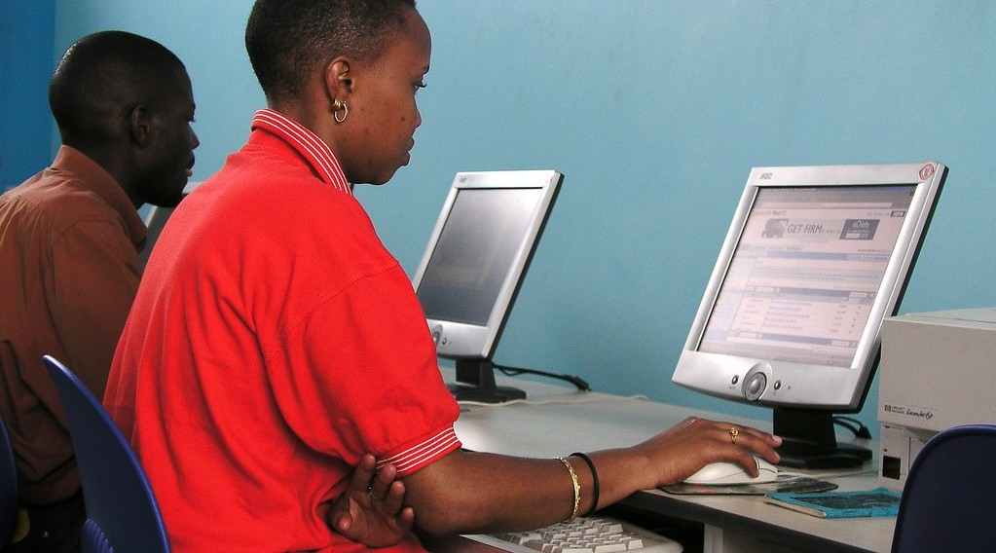
1. TYPES OF NETWORKS
Activity 1
Internet cables.
Notes:
Activity 1. Look carefully at this picture: internet cables. Observe every detail before I ask the question.

Slide 20
1. TYPES OF NETWORKS
Activity 1: Question
Name three types of telecommunication networks.
Notes:
Here is the question for Activity 1: Name three types of telecommunication networks. Take one minute to think and write your answer in your rough notebook.

Slide 21
1. TYPES OF NETWORKS
Activity 1: Answer
Fixed telephone lines, mobile phone networks and the internet (also satellites and radio).
Notes:
Let us check the answer together. Fixed telephone lines, mobile phone networks and the internet (also satellites and radio).

Slide 22
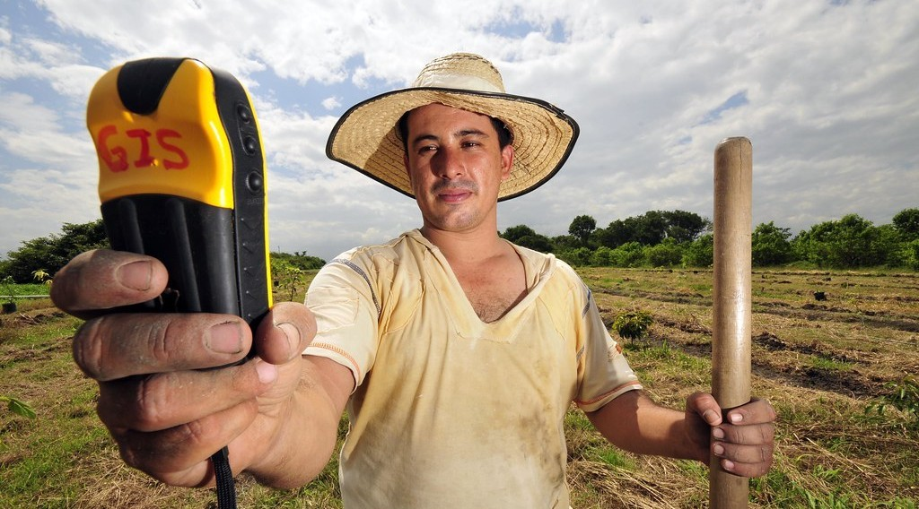
1. TYPES OF NETWORKS
Activity 2
Using GPS.
Notes:
Activity 2. Look carefully at this picture: using GPS. Observe every detail before I ask the question.

Slide 23
1. TYPES OF NETWORKS
Activity 2: Question
What carries telecommunication signals?
Notes:
Here is the question for Activity 2: What carries telecommunication signals? Take one minute to think and write your answer in your rough notebook.

Slide 24
1. TYPES OF NETWORKS
Activity 2: Answer
Optic fibre cables, radio waves, relay antennas and satellites.
Notes:
Let us check the answer together. Optic fibre cables, radio waves, relay antennas and satellites.

Slide 25
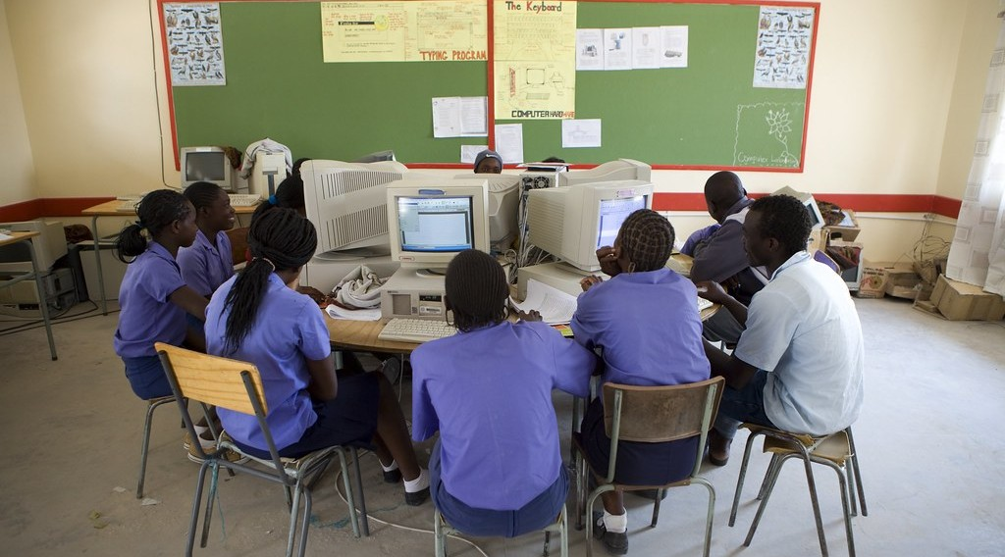
2. NATURE AND USES
Activity 3
A computer class.
Notes:
Activity 3. Look carefully at this picture: a computer class. Observe every detail before I ask the question.

Slide 26
2. NATURE AND USES
Activity 3: Question
Give three uses of the internet.
Notes:
Here is the question for Activity 3: Give three uses of the internet. Take one minute to think and write your answer in your rough notebook.

Slide 27
2. NATURE AND USES
Activity 3: Answer
Communication, education and trade (also banking and entertainment).
Notes:
Let us check the answer together. Communication, education and trade (also banking and entertainment).

Slide 28

3. ADVANTAGES AND IMPACTS
Activity 4
Mobile money.
Notes:
Activity 4. Look carefully at this picture: mobile money. Observe every detail before I ask the question.

Slide 29
3. ADVANTAGES AND IMPACTS
Activity 4: Question
Give two socio-economic impacts of telecommunication.
Notes:
Here is the question for Activity 4: Give two socio-economic impacts of telecommunication. Take one minute to think and write your answer in your rough notebook.

Slide 30
3. ADVANTAGES AND IMPACTS
Activity 4: Answer
It creates jobs and makes money transfer and trade easier.
Notes:
Let us check the answer together. It creates jobs and makes money transfer and trade easier.

Slide 31

3. DISADVANTAGES
Activity 5
A mobile phone.
Notes:
Activity 5. Look carefully at this picture: a mobile phone. Observe every detail before I ask the question.

Slide 32
3. DISADVANTAGES
Activity 5: Question
Give two disadvantages of telecommunication.
Notes:
Here is the question for Activity 5: Give two disadvantages of telecommunication. Take one minute to think and write your answer in your rough notebook.

Slide 33
3. DISADVANTAGES
Activity 5: Answer
Cybercrime and spread of false news (also high costs and addiction).
Notes:
Let us check the answer together. Cybercrime and spread of false news (also high costs and addiction).

Slide 34
BOARD SUMMARY
Board Summary
Topic: Managing Resources for Development through Economic Activities
Sub-topic: World Communication
Lesson 15: Telecommunication (Internet Communication)
Notes:
Now we are going to copy the board summary. Write the title and the headings neatly in your notebooks. I will give you enough time for each slide, so do not rush.

Slide 35
BOARD SUMMARY
1. Types of Telecommunication Networks
The main telecommunication networks are the following:
Fixed telephone: Lines and cables link homes and offices.
Mobile networks: Antennas carry calls, text messages and data to mobile phones.
Notes:
Let us copy Types of Telecommunication Networks. The main telecommunication networks are the following. On this slide we have Fixed telephone and Mobile networks. Write each point on a new line, with the key term first, and explain it in your own words when we revise. When you finish, we go to the next slide.

Slide 36
BOARD SUMMARY
1. Types of Telecommunication Networks (continued)
Internet: Optic fibre and satellites link computers all over the world.
Broadcasting: Radio and television send information to many people.
Notes:
We continue with Types of Telecommunication Networks. On this slide we have Internet and Broadcasting. Write each point on a new line, with the key term first, and explain it in your own words when we revise.

Slide 37
BOARD SUMMARY
2. Nature and Uses of the Internet
The internet is used as follows:
Communication: People send e-mails, messages and make video calls.
Education and information: Learners find lessons, books and news online.
Notes:
Let us copy Nature and Uses of the Internet. The internet is used as follows. On this slide we have Communication and Education and information. Write each point on a new line, with the key term first, and explain it in your own words when we revise. When you finish, we go to the next slide.

Slide 38
BOARD SUMMARY
2. Nature and Uses of the Internet (continued)
Trade and banking: People buy, sell and transfer money online.
Notes:
We continue with Nature and Uses of the Internet. On this slide we have Trade and banking. Write each point on a new line, with the key term first, and explain it in your own words when we revise.

Slide 39
BOARD SUMMARY
3. Advantages, Disadvantages and Socio-economic Impacts
Telecommunication has the following effects:
Advantages: It is fast, reduces distance and creates jobs.
Disadvantages: Cybercrime, viruses, false news and addiction are problems.
Notes:
Let us copy Advantages, Disadvantages and Socio-economic Impacts. Telecommunication has the following effects. On this slide we have Advantages and Disadvantages. Write each point on a new line, with the key term first, and explain it in your own words when we revise. When you finish, we go to the next slide.

Slide 40
BOARD SUMMARY
3. Advantages, Disadvantages and Socio-economic Impacts (continued)
Socio-economic impacts: Mobile money and online trade help small businesses.
Notes:
We continue with Advantages, Disadvantages and Socio-economic Impacts. On this slide we have Socio-economic impacts. Write each point on a new line, with the key term first, and explain it in your own words when we revise.

Slide 41
FORMATIVE EVALUATION
Evaluation 1
Name two telecommunication networks.
Notes:
Now let us check what you have understood. Question 1: Name two telecommunication networks. Answer in your exercise book.

Slide 42
FORMATIVE EVALUATION
Expected Answer
Mobile networks and the internet.
Notes:
The expected answer is: mobile networks and the internet. If you got it right, well done.

Slide 43
FORMATIVE EVALUATION
Evaluation 2
Give one advantage and one disadvantage of the internet.
Notes:
Now let us check what you have understood. Question 2: Give one advantage and one disadvantage of the internet. Answer in your exercise book.

Slide 44
FORMATIVE EVALUATION
Expected Answer
Fast communication; cybercrime.
Notes:
The expected answer is: fast communication; cybercrime. If you got it right, well done.

Slide 45
REMEDIATION
Remediation
Fill in the blanks:
Glass cables that carry data are optic ______.
Sending money by phone is mobile ______.
Crime committed on the internet is ______.
Notes:
For those who need more practice, fill in the blanks in your exercise book. The answers are: number 1, fibre; number 2, money; number 3, cybercrime.

Slide 46
HOMEWORK
Homework
Give three ways telecommunication helps farmers and traders in your area.
Notes:
For your homework: Give three ways telecommunication helps farmers and traders in your area. We shall correct it at the beginning of our next lesson.

Slide 47
NEXT LESSON
Next Lesson
Our next lesson will be on:
Lesson 16: Transport Development in Cameroon
Notes:
Our next lesson will be on Lesson 16: Transport Development in Cameroon. Thank you for your attention, and see you next time.

Slide 48
BILINGUAL GAME
Bilingual Game (Jeu Bilingue)
English | Français
Internet | L'internet
Optic fibre | La fibre optique
Satellite | Le satellite
Antenna | L'antenne
Cybercrime | La cybercriminalité
Mobile money | L'argent mobile
Notes:
Let us play the bilingual game. I say a word in English, and you give me the French word. Then we do the reverse.

Slide 49
LOGBOOK
Official Logbook (1/2)
Module / Topic | Managing Resources for Development through Economic Activities
Lesson Title | Lesson 15: Telecommunication (Internet Communication)
Expected Learning Outcomes | Identify the types of telecommunication networks. Describe the nature and uses of the internet. Assess the advantages, disadvantages and impacts.
Competence | Learners are able to describe telecommunication networks and assess their socio-economic impact.
Notes:
I record this information in the official logbook of the class after the lesson.

Slide 50
LOGBOOK
Official Logbook (2/2)
Matter Taught | Types of Telecommunication Networks; Nature and Uses of the Internet; Advantages, Disadvantages and Socio-economic Impacts.
Evaluation | Formative evaluation and remediation exercise.
Homework | Give three ways telecommunication helps farmers and traders in your area.
Enrolment / Present / Absent | ____ / ____ / ____
Achievement | To be completed after the lesson.
Notes:
I complete the second page of the logbook: the matter taught, the evaluation, the homework and the attendance.

Slide 51
TEACHER'S NOTE
Teacher's Note
Timing: Homework correction, plan, objectives 8 min | Recall, situation, action 10 min | 5 activities 30 min | Board summary (copying) 30 min | Evaluation, remediation 10 min | Homework, next lesson 5 min | Logbook 7 min
Without the projector (Activity 1): list.
Without the projector (Activity 2): discuss.
Without the projector (Activity 3): list.
Without the projector (Activity 4): discuss.
Without the projector (Activity 5): discuss.
Notes:
This slide is for me, the teacher: it gives the timing of the lesson and what to do if the projector is not available.

Slide 52
REFERENCES
References
Geography Syllabus, Forms I–V, MINESEC (2023) — Form 5, Module I: Management of Manufacturing and Tertiary Activities.
Photo, Activity 1: “Woman uses a computer in an internet cafe” by World Bank Photo Collection, CC BY-NC-ND 2.0, via Flickr (https://www.flickr.com/photos/10816734@N03/7556691396)
Photo, Activity 2: “DAPA GPS Fruit 5” by CIAT International Center for Tropical Agriculture, CC BY-SA 2.0, via Flickr (https://www.flickr.com/photos/38476503@N08/4821530518)
Photo, Activity 3: “The Oneputa Combined School goes from Grade 1 through to Grade 10” by World Bank Photo Collection, CC BY-NC-ND 2.0, via Flickr (https://www.flickr.com/photos/10816734@N03/5321464442)
Photo, Activity 4: “Scenes from Rwanda” by International Monetary Fund, CC BY-NC-ND 2.0, via Flickr (https://www.flickr.com/photos/38851430@N07/52660758172)
Photo, Activity 5: “Using mobile technology to give feedback about the crop trials” by Bioversity International, CC BY-NC-ND 2.0, via Flickr (https://www.flickr.com/photos/50383637@N07/15019002626)
Notes:
Take your time to copy this part; we will continue together.

Slide 53
REFERENCES
References (continued)
Diagrams and animations: drawn for this lesson (Geography Department).
Notes:
These are the references and picture credits used to prepare this lesson.

