Slide 1
FORM 5
GEOGRAPHY
Lesson 18
Trade Blocs
Notes:
Good morning, class, and welcome to our geography lesson. I am your geography teacher, Mr Kamdem. Today we are starting Lesson 18: Trade Blocs.

Slide 2
CLASS INFO
Class, Chapter and Duration
Class | Form 5
Chapter | Module I: Management of Manufacturing and Tertiary Activities
Duration | 2 periods (2 × 50 minutes)
Notes:
This lesson is for Form 5. It belongs to Module I: Management of Manufacturing and Tertiary Activities. We shall need 2 periods to cover it.

Slide 3
IDENTIFICATION
Lesson Identification
Topic | Managing Resources for Development through Economic Activities
Sub-topic | Cameroon and Trade
Lesson | Lesson 18: Trade Blocs
Notions / Concepts | Trade bloc, ECOWAS, CEMAC, European Union, ASEAN, LAFTA.
Syllabus focus | Definition and types; aims for creation; reasons for creation; advantages and disadvantages, with a case study in LICs.
Competence | Learners are able to explain trade blocs and assess their advantages and disadvantages.
Notes:
Our topic is Managing Resources for Development through Economic Activities, and the sub-topic is Cameroon and Trade. The key notions we shall use today are: trade bloc, ECOWAS, CEMAC, European Union, ASEAN, LAFTA. At the end, you should be able to do this: learners are able to explain trade blocs and assess their advantages and disadvantages.

Slide 4

HOMEWORK CORRECTION
Correction of the Homework
Question (Lesson 17: Volume of Trade):
List three exports and three imports of Cameroon.
Notes:
Before we start the new lesson, let us correct the homework I gave you at the end of Lesson 17: Volume of Trade. The question was: List three exports and three imports of Cameroon. Take out your exercise books.

Slide 5
HOMEWORK CORRECTION
Correction: Possible Answer
Exports: crude oil, cocoa, timber (also coffee, cotton, bananas); imports: cars, machines, rice (also fuel products, medicines, clothes).
Notes:
Here is a good answer. Exports: crude oil, cocoa, timber (also coffee, cotton, bananas); imports: cars, machines, rice (also fuel products, medicines, clothes). Compare it with your own answer and correct your work in red.

Slide 6
LESSON PLAN
Lesson Plan
Correction of the homework
Objectives and recall
Real-life situation and action to take
Learning activities
Board summary
Evaluation, remediation and homework
Notes:
Here is the plan of our lesson today. First, we shall correct the homework. Then we shall look at the objectives and recall what you already know. After that, we shall study a situation from real life and the action to take, and do the learning activities. Finally, we shall copy the board summary, do the evaluation and the remediation, and I will give you the homework.

Slide 7
OBJECTIVES
Objectives
By the end of this lesson, you should be able to:
Define a trade bloc and give its types.
Explain the aims and reasons for creating trade blocs.
Notes:
Take your time to copy this part; we will continue together.

Slide 8
OBJECTIVES
Objectives (continued)
Assess the advantages and disadvantages with a case study of CEMAC.
Notes:
By the end of this lesson, you should be able to do three things. Number 1: define a trade bloc and give its types. Number 2: explain the aims and reasons for creating trade blocs. Number 3: assess the advantages and disadvantages with a case study of CEMAC.

Slide 9
PREVIOUS KNOWLEDGE
Previous Knowledge
Countries trade with each other.
Cameroon uses the CFA franc.
The European Union has many members.
Notes:
Let us first remember what you already know. Countries trade with each other. Cameroon uses the CFA franc. The European Union has many members. Keep this in mind, because we shall build on it today.

Slide 10
REAL-LIFE SITUATION
Situation in Real Life
Cameroonian traders sell goods to Chad, Gabon and Congo with fewer customs duties because the countries belong to CEMAC. However, some traders still face many road checks.
Notes:
Listen carefully to this situation from real life. Cameroonian traders sell goods to Chad, Gabon and Congo with fewer customs duties because the countries belong to CEMAC. However, some traders still face many road checks. Think about it, because I am going to ask you some questions.

Slide 11
REAL-LIFE SITUATION
Situation: Question 1
What is the problem in the situation?
Notes:
Question 1: What is the problem in the situation? Think for a moment, then raise your hand to answer.

Slide 12
REAL-LIFE SITUATION
Answer
We want to understand trade blocs.
Notes:
Good. We want to understand trade blocs.

Slide 13
REAL-LIFE SITUATION
Situation: Question 2
Which bloc is mentioned?
Notes:
Question 2: Which bloc is mentioned? Think for a moment, then raise your hand to answer.

Slide 14
REAL-LIFE SITUATION
Answer
CEMAC.
Notes:
Good. CEMAC.

Slide 15
REAL-LIFE SITUATION
Situation: Question 3
What advantage do traders have?
Notes:
Question 3: What advantage do traders have? Think for a moment, then raise your hand to answer.

Slide 16
REAL-LIFE SITUATION
Possible Answer
Fewer customs duties.
Notes:
Good. Fewer customs duties.

Slide 17
ACTION TO TAKE
Action to Take
Support regional integration and denounce unfair trade practices.
Notes:
From this situation, the action we are working towards in this lesson is the following: support regional integration and denounce unfair trade practices.

Slide 18
JUSTIFICATION
Justification of the Lesson
This lesson helps us to understand regional cooperation in trade.
Notes:
Why is this lesson important for you? This lesson helps us to understand regional cooperation in trade.

Slide 19
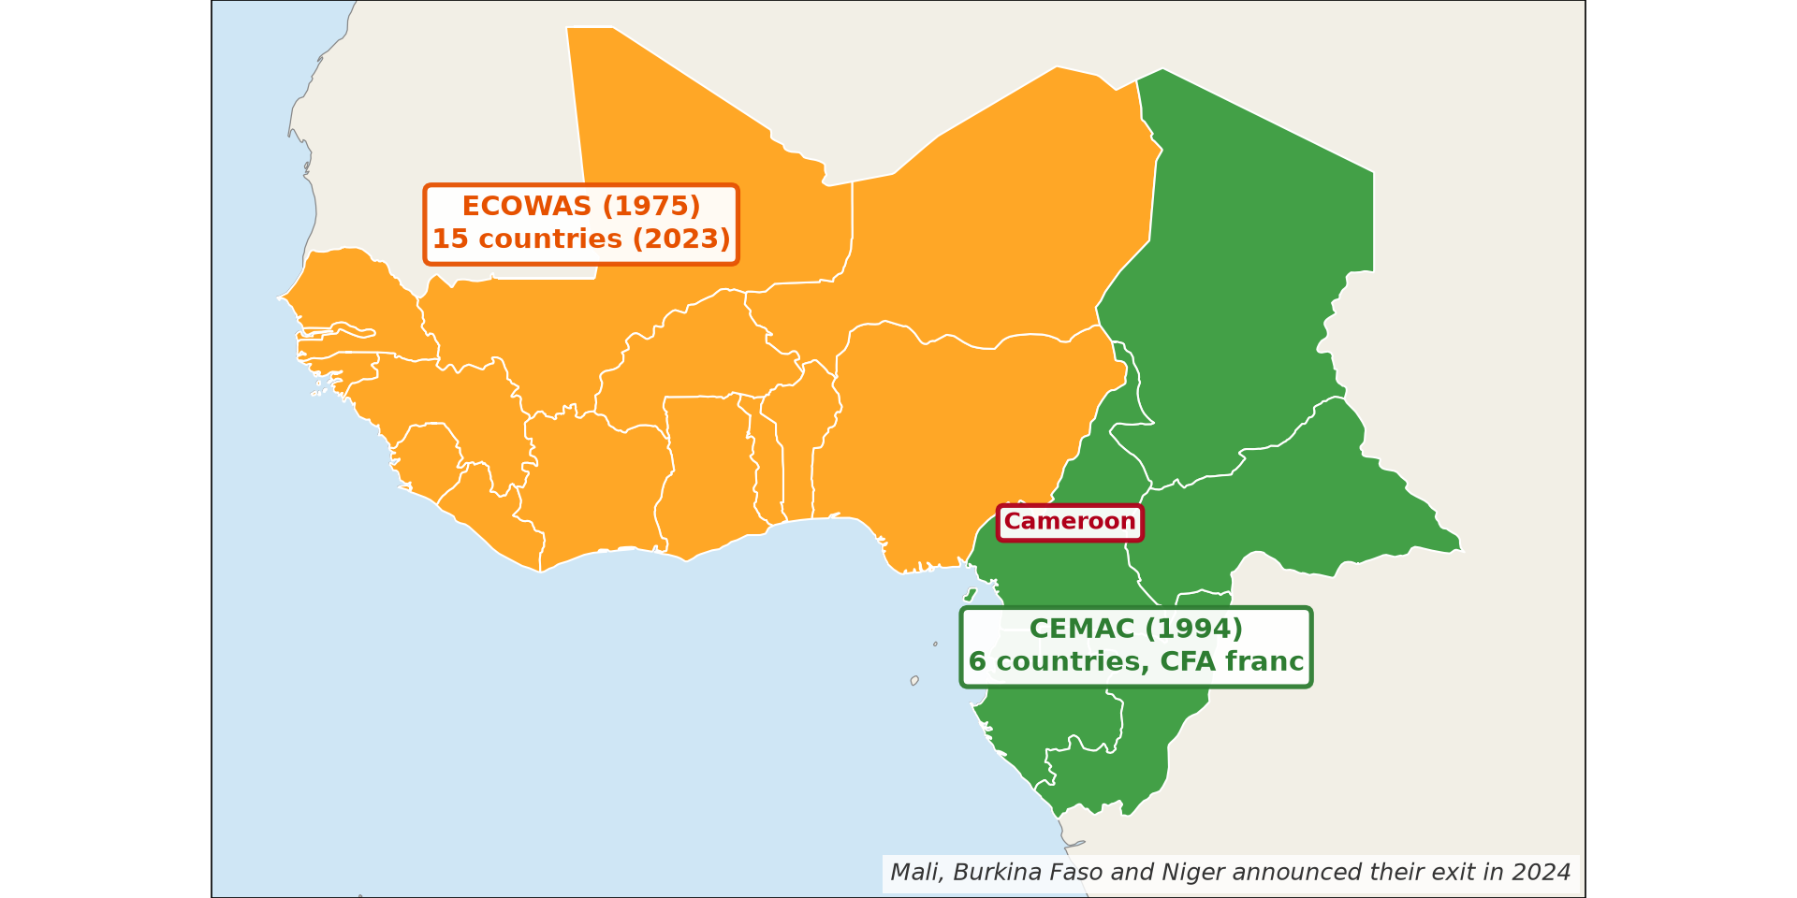
1. DEFINITION AND TYPES
Activity 1
Trade blocs in Africa.
Notes:
Activity 1. Look carefully at this diagram: trade blocs in Africa. Observe every detail before I ask the question.

Slide 20
1. DEFINITION AND TYPES
Activity 1: Question
What is a trade bloc?
Notes:
Here is the question for Activity 1: What is a trade bloc? Take one minute to think and write your answer in your rough notebook.

Slide 21
1. DEFINITION AND TYPES
Activity 1: Answer
A group of countries that agree to reduce trade barriers among themselves.
Notes:
Let us check the answer together. A group of countries that agree to reduce trade barriers among themselves.

Slide 22
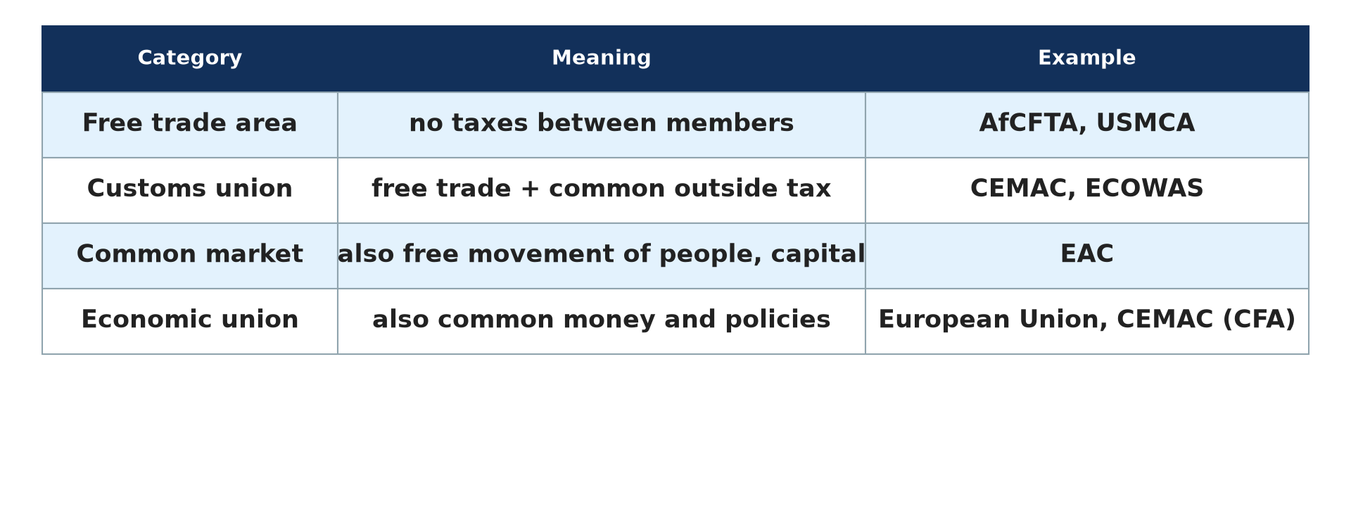
1. DEFINITION AND TYPES
Activity 2
Types of trade blocs.
Notes:
Activity 2. Look carefully at this diagram: types of trade blocs. Observe every detail before I ask the question.

Slide 23
1. DEFINITION AND TYPES
Activity 2: Question
Name three types of trade blocs.
Notes:
Here is the question for Activity 2: Name three types of trade blocs. Take one minute to think and write your answer in your rough notebook.

Slide 24
1. DEFINITION AND TYPES
Activity 2: Answer
Free trade area, customs union and common market (also economic union).
Notes:
Let us check the answer together. Free trade area, customs union and common market (also economic union).

Slide 25
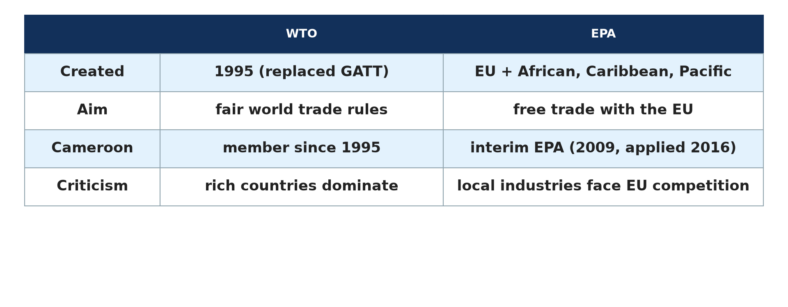
2. AIMS AND REASONS
Activity 3
Trade agreements.
Notes:
Activity 3. Look carefully at this diagram: trade agreements. Observe every detail before I ask the question.

Slide 26
2. AIMS AND REASONS
Activity 3: Question
Give two aims of trade blocs.
Notes:
Here is the question for Activity 3: Give two aims of trade blocs. Take one minute to think and write your answer in your rough notebook.

Slide 27
2. AIMS AND REASONS
Activity 3: Answer
To increase trade among members and to be stronger in world markets.
Notes:
Let us check the answer together. To increase trade among members and to be stronger in world markets.

Slide 28
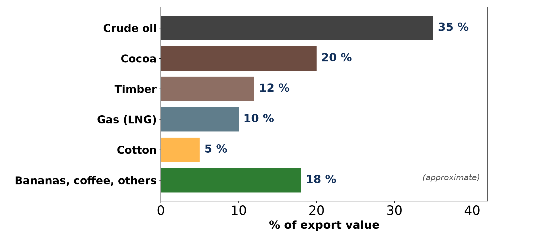
3. CASE STUDY: CEMAC
Activity 4
Trade of Cameroon.
Notes:
Activity 4. Look carefully at this diagram: trade of Cameroon. Observe every detail before I ask the question.

Slide 29
3. CASE STUDY: CEMAC
Activity 4: Question
Name the member states of CEMAC.
Notes:
Here is the question for Activity 4: Name the member states of CEMAC. Take one minute to think and write your answer in your rough notebook.

Slide 30
3. CASE STUDY: CEMAC
Activity 4: Answer
Cameroon, Chad, Gabon, Congo, the Central African Republic and Equatorial Guinea.
Notes:
Let us check the answer together. Cameroon, Chad, Gabon, Congo, the Central African Republic and Equatorial Guinea.

Slide 31
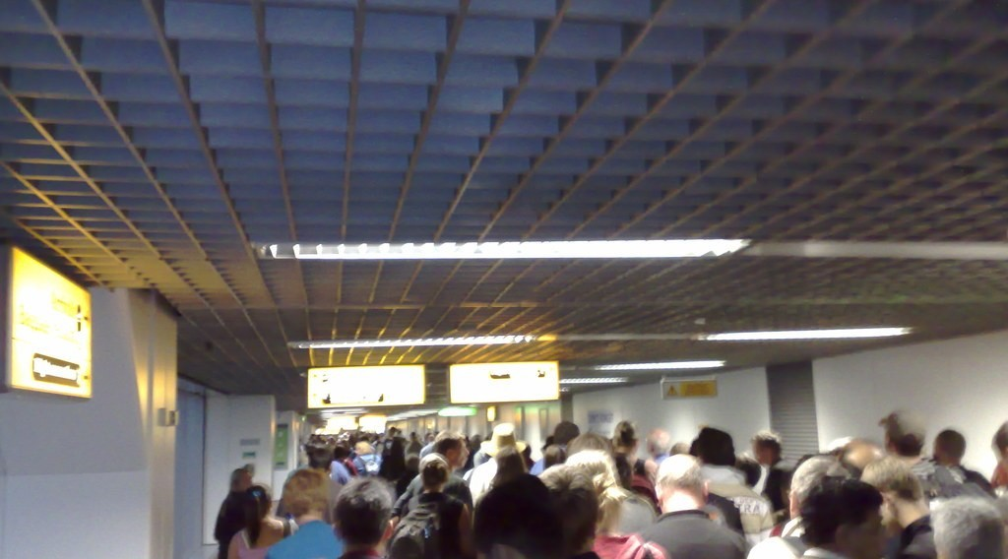
4. ADVANTAGES AND DISADVANTAGES
Activity 5
Free movement.
Notes:
Activity 5. Look carefully at this picture: free movement. Observe every detail before I ask the question.

Slide 32
4. ADVANTAGES AND DISADVANTAGES
Activity 5: Question
Give one advantage and one disadvantage of trade blocs.
Notes:
Here is the question for Activity 5: Give one advantage and one disadvantage of trade blocs. Take one minute to think and write your answer in your rough notebook.

Slide 33
4. ADVANTAGES AND DISADVANTAGES
Activity 5: Answer
Larger market; weak countries may lose customs revenue and local industries.
Notes:
Let us check the answer together. Larger market; weak countries may lose customs revenue and local industries.

Slide 34
BOARD SUMMARY
Board Summary
Topic: Managing Resources for Development through Economic Activities
Sub-topic: Cameroon and Trade
Lesson 18: Trade Blocs
Notes:
Now we are going to copy the board summary. Write the title and the headings neatly in your notebooks. I will give you enough time for each slide, so do not rush.

Slide 35
BOARD SUMMARY
DEFINITIONS
The key terms of this lesson are defined as follows:
Trade bloc: It is a group of countries that agree to reduce trade barriers among themselves.
Notes:
Let us copy the definitions. The key terms of this lesson are defined as follows. On this slide we have Trade bloc. Write each point on a new line, with the key term first, and explain it in your own words when we revise.

Slide 36
BOARD SUMMARY
1. Types, Aims and Reasons for Creation
Trade blocs are organised as follows:
Types: There are free trade areas, customs unions, common markets and economic unions.
Examples: CEMAC, ECOWAS, the European Union, ASEAN and LAFTA are trade blocs.
Notes:
Let us copy Types, Aims and Reasons for Creation. Trade blocs are organised as follows. On this slide we have Types and Examples. Write each point on a new line, with the key term first, and explain it in your own words when we revise. When you finish, we go to the next slide.

Slide 37
BOARD SUMMARY
1. Types, Aims and Reasons for Creation (continued)
Aims: They increase trade, attract investment and strengthen members in world markets.
Reasons: Small national markets and competition from big powers push countries to unite.
Notes:
We continue with Types, Aims and Reasons for Creation. On this slide we have Aims and Reasons. Write each point on a new line, with the key term first, and explain it in your own words when we revise.

Slide 38
BOARD SUMMARY
1. Types, Aims and Reasons for Creation
Illustration: trade blocs in Africa
Notes:
Now draw this illustration in your notebook: trade blocs in Africa. Give it a title and label it clearly.

Slide 39
BOARD SUMMARY
2. Case Study: CEMAC
CEMAC is an example of a trade bloc in LICs:
Members: Cameroon, Chad, Gabon, Congo, the Central African Republic and Equatorial Guinea are members.
Achievements: Members share the CFA franc and a common external tariff.
Notes:
Let us copy Case Study: CEMAC. CEMAC is an example of a trade bloc in LICs. On this slide we have Members and Achievements. Write each point on a new line, with the key term first, and explain it in your own words when we revise. When you finish, we go to the next slide.

Slide 40
BOARD SUMMARY
2. Case Study: CEMAC (continued)
Problems: Poor roads, road checks and similar exports limit trade among members.
Notes:
We continue with Case Study: CEMAC. On this slide we have Problems. Write each point on a new line, with the key term first, and explain it in your own words when we revise.

Slide 41
BOARD SUMMARY
3. Advantages and Disadvantages
Trade blocs have the following advantages and disadvantages:
Advantages: They give a larger market, more investment and free movement of people.
Disadvantages: Weak members may lose customs revenue and local industries.
Notes:
Let us copy Advantages and Disadvantages. Trade blocs have the following advantages and disadvantages. On this slide we have Advantages and Disadvantages. Write each point on a new line, with the key term first, and explain it in your own words when we revise.

Slide 42
FORMATIVE EVALUATION
Evaluation 1
Define a trade bloc.
Notes:
Now let us check what you have understood. Question 1: Define a trade bloc. Answer in your exercise book.

Slide 43
FORMATIVE EVALUATION
Expected Answer
A group of countries that reduce trade barriers among themselves.
Notes:
The expected answer is: a group of countries that reduce trade barriers among themselves. If you got it right, well done.

Slide 44
FORMATIVE EVALUATION
Evaluation 2
Name two trade blocs and one advantage.
Notes:
Now let us check what you have understood. Question 2: Name two trade blocs and one advantage. Answer in your exercise book.

Slide 45
FORMATIVE EVALUATION
Expected Answer
CEMAC and ECOWAS; a larger market.
Notes:
The expected answer is: cEMAC and ECOWAS; a larger market. If you got it right, well done.

Slide 46
REMEDIATION
Remediation
Fill in the blanks:
Cameroon belongs to the trade bloc ______.
The trade bloc of West Africa is ______.
The trade bloc of South-East Asia is ______.
Notes:
For those who need more practice, fill in the blanks in your exercise book. The answers are: number 1, CEMAC; number 2, ECOWAS; number 3, ASEAN.

Slide 47
HOMEWORK
Homework
Draw a sketch map of the CEMAC member states and name their capitals.
Notes:
For your homework: Draw a sketch map of the CEMAC member states and name their capitals. We shall correct it at the beginning of our next lesson.

Slide 48
NEXT LESSON
Next Lesson
Our next lesson will be on:
Lesson 19: Tourism
Notes:
Our next lesson will be on Lesson 19: Tourism. Thank you for your attention, and see you next time.

Slide 49
BILINGUAL GAME
Bilingual Game (Jeu Bilingue)
English | Français
Trade bloc | Le bloc commercial
Customs union | L'union douanière
Common market | Le marché commun
Customs duty | Le droit de douane
Member state | L'État membre
Integration | L'intégration
Notes:
Let us play the bilingual game. I say a word in English, and you give me the French word. Then we do the reverse.

Slide 50
LOGBOOK
Official Logbook (1/2)
Module / Topic | Managing Resources for Development through Economic Activities
Lesson Title | Lesson 18: Trade Blocs
Expected Learning Outcomes | Define a trade bloc and give its types. Explain the aims and reasons for creating trade blocs. Assess the advantages and disadvantages with a case study of CEMAC.
Competence | Learners are able to explain trade blocs and assess their advantages and disadvantages.
Notes:
I record this information in the official logbook of the class after the lesson.

Slide 51
LOGBOOK
Official Logbook (2/2)
Matter Taught | DEFINITIONS; Types, Aims and Reasons for Creation; Case Study: CEMAC; Advantages and Disadvantages.
Evaluation | Formative evaluation and remediation exercise.
Homework | Draw a sketch map of the CEMAC member states and name their capitals.
Enrolment / Present / Absent | ____ / ____ / ____
Achievement | To be completed after the lesson.
Notes:
I complete the second page of the logbook: the matter taught, the evaluation, the homework and the attendance.

Slide 52
TEACHER'S NOTE
Teacher's Note
Timing: Homework correction, plan, objectives 8 min | Recall, situation, action 10 min | 5 activities 30 min | Board summary (copying) 30 min | Evaluation, remediation 10 min | Homework, next lesson 5 min | Logbook 7 min
Without the projector (Activity 1): name blocs.
Without the projector (Activity 2): classify.
Without the projector (Activity 3): discuss.
Without the projector (Activity 4): use the map.
Without the projector (Activity 5): discuss.
Notes:
This slide is for me, the teacher: it gives the timing of the lesson and what to do if the projector is not available.

Slide 53
REFERENCES
References
Geography Syllabus, Forms I–V, MINESEC (2023) — Form 5, Module I: Management of Manufacturing and Tertiary Activities.
Photo, Activity 5: “London Heathrow T4 arrivals” by markhillary, CC BY 2.0, via Flickr (https://www.flickr.com/photos/56087830@N00/1568955656)
Diagrams and animations: drawn for this lesson (Geography Department).
Notes:
These are the references and picture credits used to prepare this lesson.

