Slide 1
FORM 5
GEOGRAPHY
Lesson 24
Multipurpose River Development Project (MRDP)
Notes:
Good morning, class, and welcome to our geography lesson. I am your geography teacher, Mr Kamdem. Today we are starting Lesson 24: Multipurpose River Development Project (MRDP).

Slide 2
CLASS INFO
Class, Chapter and Duration
Class | Form 5
Chapter | Module II: Preservation of the Natural Environment
Duration | 2 periods (2 × 50 minutes)
Notes:
This lesson is for Form 5. It belongs to Module II: Preservation of the Natural Environment. We shall need 2 periods to cover it.

Slide 3
IDENTIFICATION
Lesson Identification
Topic | Development Projects and Environmental Management
Sub-topic | Development Projects
Lesson | Lesson 24: Multipurpose River Development Project (MRDP)
Notions / Concepts | Dams, irrigation, navigation, hydro-electricity, flood control.
Syllabus focus | Meaning; reasons and objectives; achievements; problems and solutions, with a case study from an NIC.
Competence | Learners are able to explain the objectives, achievements and problems of a multipurpose river project.
Notes:
Our topic is Development Projects and Environmental Management, and the sub-topic is Development Projects. The key notions we shall use today are: dams, irrigation, navigation, hydro-electricity, flood control. At the end, you should be able to do this: learners are able to explain the objectives, achievements and problems of a multipurpose river project.

Slide 4

HOMEWORK CORRECTION
Correction of the Homework
Question (Lesson 23: Land Reclamation):
Propose three ways to reclaim degraded land in the North of Cameroon.
Notes:
Before we start the new lesson, let us correct the homework I gave you at the end of Lesson 23: Land Reclamation. The question was: Propose three ways to reclaim degraded land in the North of Cameroon. Take out your exercise books.

Slide 5
HOMEWORK CORRECTION
Correction: Possible Answer
Irrigation from the Benue or Logone, tree planting (Green Sahel), and zaï pits, stone lines and manure on eroded fields.
Notes:
Here is a good answer. Irrigation from the Benue or Logone, tree planting (Green Sahel), and zaï pits, stone lines and manure on eroded fields. Compare it with your own answer and correct your work in red.

Slide 6
LESSON PLAN
Lesson Plan
Correction of the homework
Objectives and recall
Real-life situation and action to take
Learning activities
Board summary
Evaluation, remediation and homework
Notes:
Here is the plan of our lesson today. First, we shall correct the homework. Then we shall look at the objectives and recall what you already know. After that, we shall study a situation from real life and the action to take, and do the learning activities. Finally, we shall copy the board summary, do the evaluation and the remediation, and I will give you the homework.

Slide 7
OBJECTIVES
Objectives
By the end of this lesson, you should be able to:
Define a multipurpose river development project.
Explain its objectives.
Notes:
Take your time to copy this part; we will continue together.

Slide 8
OBJECTIVES
Objectives (continued)
Assess its achievements and problems with the case of the Three Gorges Dam.
Notes:
By the end of this lesson, you should be able to do three things. Number 1: define a multipurpose river development project. Number 2: explain its objectives. Number 3: assess its achievements and problems with the case of the Three Gorges Dam.

Slide 9
PREVIOUS KNOWLEDGE
Previous Knowledge
Dams produce hydro-electricity.
Irrigation helps agriculture.
China is an NIC.
Notes:
Let us first remember what you already know. Dams produce hydro-electricity. Irrigation helps agriculture. China is an NIC. Keep this in mind, because we shall build on it today.

Slide 10
REAL-LIFE SITUATION
Situation in Real Life
China built the Three Gorges Dam on the Yangtze River to produce electricity, control floods and improve navigation. More than one million people were moved.
Notes:
Listen carefully to this situation from real life. China built the Three Gorges Dam on the Yangtze River to produce electricity, control floods and improve navigation. More than one million people were moved. Think about it, because I am going to ask you some questions.

Slide 11
REAL-LIFE SITUATION
Situation: Question 1
What is the problem in the situation?
Notes:
Question 1: What is the problem in the situation? Think for a moment, then raise your hand to answer.

Slide 12
REAL-LIFE SITUATION
Answer
We want to assess a big river project.
Notes:
Good. We want to assess a big river project.

Slide 13
REAL-LIFE SITUATION
Situation: Question 2
Give two aims of the dam.
Notes:
Question 2: Give two aims of the dam. Think for a moment, then raise your hand to answer.

Slide 14
REAL-LIFE SITUATION
Answer
Electricity and flood control (also navigation).
Notes:
Good. Electricity and flood control (also navigation).

Slide 15
REAL-LIFE SITUATION
Situation: Question 3
What negative effect is mentioned?
Notes:
Question 3: What negative effect is mentioned? Think for a moment, then raise your hand to answer.

Slide 16
REAL-LIFE SITUATION
Possible Answer
The displacement of more than one million people.
Notes:
Good. The displacement of more than one million people.

Slide 17
ACTION TO TAKE
Action to Take
Use water from dams carefully and protect river banks.
Notes:
From this situation, the action we are working towards in this lesson is the following: use water from dams carefully and protect river banks.

Slide 18
JUSTIFICATION
Justification of the Lesson
This lesson helps us to understand how rivers are developed for many uses.
Notes:
Why is this lesson important for you? This lesson helps us to understand how rivers are developed for many uses.

Slide 19
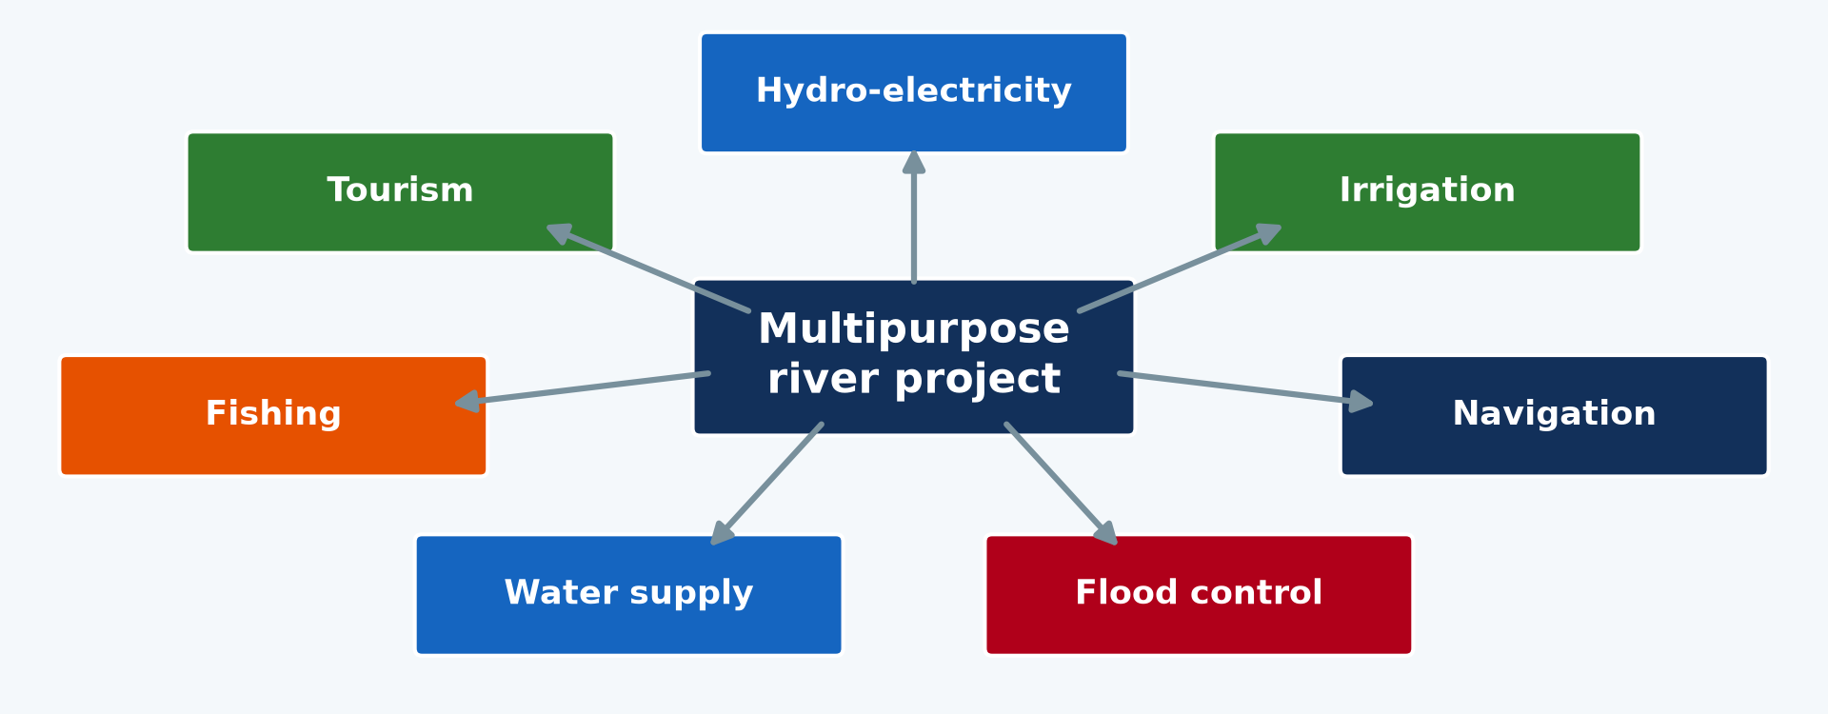
1. MEANING
Activity 1
Uses of a multipurpose river project.
Notes:
Activity 1. Look carefully at this diagram: uses of a multipurpose river project. Observe every detail before I ask the question.

Slide 20
1. MEANING
Activity 1: Question
What is a multipurpose river development project?
Notes:
Here is the question for Activity 1: What is a multipurpose river development project? Take one minute to think and write your answer in your rough notebook.

Slide 21
1. MEANING
Activity 1: Answer
The development of a river basin with dams for several uses at the same time.
Notes:
Let us check the answer together. The development of a river basin with dams for several uses at the same time.

Slide 22

2. REASONS AND OBJECTIVES
Activity 2
A dam spillway.
Notes:
Activity 2. Look carefully at this picture: a dam spillway. Observe every detail before I ask the question.

Slide 23
2. REASONS AND OBJECTIVES
Activity 2: Question
Give four objectives of an MRDP.
Notes:
Here is the question for Activity 2: Give four objectives of an MRDP. Take one minute to think and write your answer in your rough notebook.

Slide 24
2. REASONS AND OBJECTIVES
Activity 2: Answer
Hydro-electricity, irrigation, flood control and navigation (also water supply and fishing).
Notes:
Let us check the answer together. Hydro-electricity, irrigation, flood control and navigation (also water supply and fishing).

Slide 25
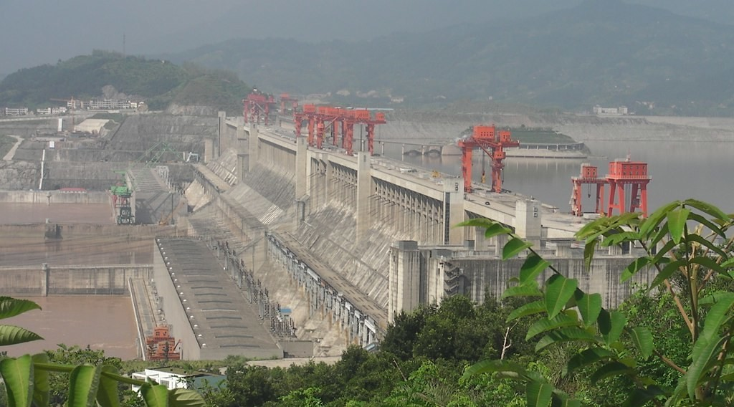
3. CASE STUDY: THREE GORGES DAM
Activity 3
The Three Gorges Dam, China.
Notes:
Activity 3. Look carefully at this picture: the Three Gorges Dam, China. Observe every detail before I ask the question.

Slide 26
3. CASE STUDY: THREE GORGES DAM
Activity 3: Question
Where is the Three Gorges Dam?
Notes:
Here is the question for Activity 3: Where is the Three Gorges Dam? Take one minute to think and write your answer in your rough notebook.

Slide 27
3. CASE STUDY: THREE GORGES DAM
Activity 3: Answer
On the Yangtze River in central China.
Notes:
Let us check the answer together. On the Yangtze River in central China.

Slide 28
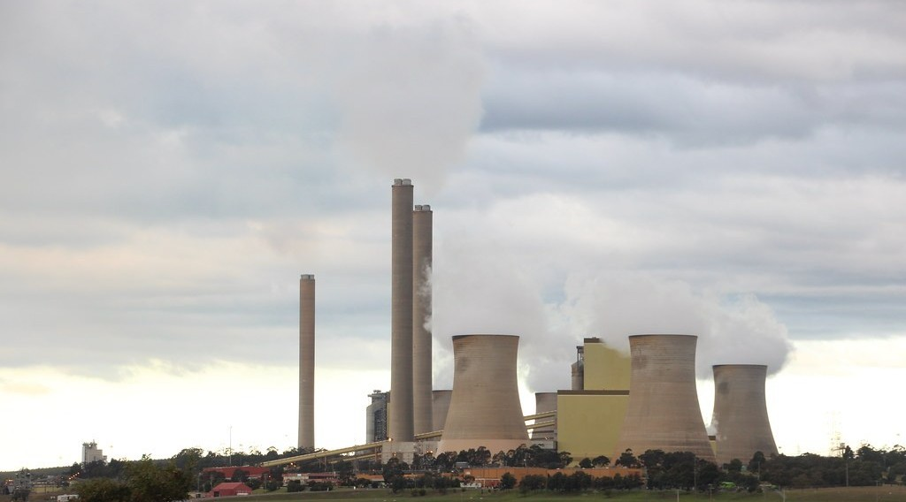
3. ACHIEVEMENTS
Activity 4
Power supply.
Notes:
Activity 4. Look carefully at this picture: power supply. Observe every detail before I ask the question.

Slide 29
3. ACHIEVEMENTS
Activity 4: Question
Give two achievements of the Three Gorges Dam.
Notes:
Here is the question for Activity 4: Give two achievements of the Three Gorges Dam. Take one minute to think and write your answer in your rough notebook.

Slide 30
3. ACHIEVEMENTS
Activity 4: Answer
It is the biggest power station in the world and it reduces floods downstream.
Notes:
Let us check the answer together. It is the biggest power station in the world and it reduces floods downstream.

Slide 31

4. PROBLEMS AND SOLUTIONS
Activity 5
Displaced people.
Notes:
Activity 5. Look carefully at this picture: displaced people. Observe every detail before I ask the question.

Slide 32
4. PROBLEMS AND SOLUTIONS
Activity 5: Question
Give two problems and one solution.
Notes:
Here is the question for Activity 5: Give two problems and one solution. Take one minute to think and write your answer in your rough notebook.

Slide 33
4. PROBLEMS AND SOLUTIONS
Activity 5: Answer
Displacement of people and silting; resettlement and reforestation of the basin.
Notes:
Let us check the answer together. Displacement of people and silting; resettlement and reforestation of the basin.

Slide 34
BOARD SUMMARY
Board Summary
Topic: Development Projects and Environmental Management
Sub-topic: Development Projects
Lesson 24: Multipurpose River Development Project (MRDP)
Notes:
Now we are going to copy the board summary. Write the title and the headings neatly in your notebooks. I will give you enough time for each slide, so do not rush.

Slide 35
BOARD SUMMARY
DEFINITIONS
The key terms of this lesson are defined as follows:
Multipurpose river development project: It is the development of a river basin with dams for several uses at the same time.
Notes:
Let us copy the definitions. The key terms of this lesson are defined as follows. On this slide we have Multipurpose river development project. Write each point on a new line, with the key term first, and explain it in your own words when we revise.

Slide 36
BOARD SUMMARY
1. Reasons and Objectives
MRDPs are built for the following objectives:
Energy: Dams produce hydro-electricity for homes and industries.
Agriculture and water supply: Reservoirs supply water for irrigation, towns and fishing.
Notes:
Let us copy Reasons and Objectives. MRDPs are built for the following objectives. On this slide we have Energy and Agriculture and water supply. Write each point on a new line, with the key term first, and explain it in your own words when we revise. When you finish, we go to the next slide.

Slide 37
BOARD SUMMARY
1. Reasons and Objectives (continued)
Flood control and navigation: Dams regulate the river flow and make navigation easier.
Notes:
We continue with Reasons and Objectives. On this slide we have Flood control and navigation. Write each point on a new line, with the key term first, and explain it in your own words when we revise.

Slide 38
BOARD SUMMARY
1. Reasons and Objectives
Illustration: uses of a multipurpose river project
Notes:
Now draw this illustration in your notebook: uses of a multipurpose river project. Give it a title and label it clearly.

Slide 39
BOARD SUMMARY
2. Case Study: The Three Gorges Dam in China
The Three Gorges project on the Yangtze River shows the following:
Achievements: It is the largest power station in the world and it controls floods.
More achievements: Large ships can now sail upstream to Chongqing.
Notes:
Let us copy Case Study: The Three Gorges Dam in China. The Three Gorges project on the Yangtze River shows the following. On this slide we have Achievements and More achievements. Write each point on a new line, with the key term first, and explain it in your own words when we revise. When you finish, we go to the next slide.

Slide 40
BOARD SUMMARY
2. Case Study: The Three Gorges Dam in China (continued)
Problems: More than one million people were moved and the reservoir is silting.
Solutions: Displaced people were resettled and trees are planted to reduce erosion.
Notes:
We continue with Case Study: The Three Gorges Dam in China. On this slide we have Problems and Solutions. Write each point on a new line, with the key term first, and explain it in your own words when we revise.

Slide 41
FORMATIVE EVALUATION
Evaluation 1
Define an MRDP.
Notes:
Now let us check what you have understood. Question 1: Define an MRDP. Answer in your exercise book.

Slide 42
FORMATIVE EVALUATION
Expected Answer
The development of a river basin with dams for several uses.
Notes:
The expected answer is: the development of a river basin with dams for several uses. If you got it right, well done.

Slide 43
FORMATIVE EVALUATION
Evaluation 2
Give two achievements and one problem of the Three Gorges Dam.
Notes:
Now let us check what you have understood. Question 2: Give two achievements and one problem of the Three Gorges Dam. Answer in your exercise book.

Slide 44
FORMATIVE EVALUATION
Expected Answer
Electricity and flood control; displacement of people.
Notes:
The expected answer is: electricity and flood control; displacement of people. If you got it right, well done.

Slide 45
REMEDIATION
Remediation
Fill in the blanks:
Electricity from falling water is ______.
The Three Gorges Dam is on the ______ River.
A lake behind a dam is a ______.
Notes:
For those who need more practice, fill in the blanks in your exercise book. The answers are: number 1, hydro-electricity; number 2, Yangtze; number 3, reservoir.

Slide 46
HOMEWORK
Homework
Draw a diagram showing the uses of a multipurpose dam.
Notes:
For your homework: Draw a diagram showing the uses of a multipurpose dam. We shall correct it at the beginning of our next lesson.

Slide 47
NEXT LESSON
Next Lesson
Our next lesson will be on:
Lesson 25: Multipurpose River Development Project in Cameroon
Notes:
Our next lesson will be on Lesson 25: Multipurpose River Development Project in Cameroon. Thank you for your attention, and see you next time.

Slide 48
BILINGUAL GAME
Bilingual Game (Jeu Bilingue)
English | Français
Dam | Le barrage
Reservoir | La retenue
Hydro-electricity | L'hydroélectricité
Navigation | La navigation
Flood control | La maîtrise des crues
Resettlement | La réinstallation
Notes:
Let us play the bilingual game. I say a word in English, and you give me the French word. Then we do the reverse.

Slide 49
LOGBOOK
Official Logbook (1/2)
Module / Topic | Development Projects and Environmental Management
Lesson Title | Lesson 24: Multipurpose River Development Project (MRDP)
Expected Learning Outcomes | Define a multipurpose river development project. Explain its objectives. Assess its achievements and problems with the case of the Three Gorges Dam.
Competence | Learners are able to explain the objectives, achievements and problems of a multipurpose river project.
Notes:
I record this information in the official logbook of the class after the lesson.

Slide 50
LOGBOOK
Official Logbook (2/2)
Matter Taught | DEFINITIONS; Reasons and Objectives; Case Study: The Three Gorges Dam in China.
Evaluation | Formative evaluation and remediation exercise.
Homework | Draw a diagram showing the uses of a multipurpose dam.
Enrolment / Present / Absent | ____ / ____ / ____
Achievement | To be completed after the lesson.
Notes:
I complete the second page of the logbook: the matter taught, the evaluation, the homework and the attendance.

Slide 51
TEACHER'S NOTE
Teacher's Note
Timing: Homework correction, plan, objectives 8 min | Recall, situation, action 10 min | 5 activities 30 min | Board summary (copying) 30 min | Evaluation, remediation 10 min | Homework, next lesson 5 min | Logbook 7 min
Without the projector (Activity 1): discuss.
Without the projector (Activity 2): list.
Without the projector (Activity 3): use the atlas.
Without the projector (Activity 4): discuss.
Without the projector (Activity 5): discuss.
Notes:
This slide is for me, the teacher: it gives the timing of the lesson and what to do if the projector is not available.

Slide 52
REFERENCES
References
Geography Syllabus, Forms I–V, MINESEC (2023) — Form 5, Module II: Preservation of the Natural Environment.
Photo, Activity 2: “Fontana Dam Spillway” by Frank Kehren, CC BY-NC-ND 2.0, via Flickr (https://www.flickr.com/photos/77759596@N00/9256852611)
Photo, Activity 3: “Three Gorges dam” by hughrocks, CC BY-SA 2.0, via Flickr (https://www.flickr.com/photos/97711233@N00/3892443712)
Photo, Activity 4: “Loy Yang coal power station” by John Englart (Takver), CC BY-SA 2.0, via Flickr (https://www.flickr.com/photos/81043308@N00/18269071871)
Photo, Activity 5: “Secretary-General Visits Refugee Camps in Chad” by United Nations Photo, CC BY-NC-ND 2.0, via Flickr (https://www.flickr.com/photos/35483578@N03/6140060599)
Diagrams and animations: drawn for this lesson (Geography Department).
Notes:
These are the references and picture credits used to prepare this lesson.

