Slide 1
FORM 5
GEOGRAPHY
Lesson 25
Multipurpose River Development Project in Cameroon
Notes:
Good morning, class, and welcome to our geography lesson. I am your geography teacher, Mr Kamdem. Today we are starting Lesson 25: Multipurpose River Development Project in Cameroon.

Slide 2
CLASS INFO
Class, Chapter and Duration
Class | Form 5
Chapter | Module II: Preservation of the Natural Environment
Duration | 2 periods (2 × 50 minutes)
Notes:
This lesson is for Form 5. It belongs to Module II: Preservation of the Natural Environment. We shall need 2 periods to cover it.

Slide 3
IDENTIFICATION
Lesson Identification
Topic | Development Projects and Environmental Management
Sub-topic | Development Projects in Cameroon
Lesson | Lesson 25: Multipurpose River Development Project in Cameroon
Notions / Concepts | Multipurpose river development, Lagdo dam, SEMRY, Lom Pangar.
Syllabus focus | Objectives; achievements; problems; attempted solutions.
Competence | Learners are able to assess a multipurpose river project in Cameroon.
Notes:
Our topic is Development Projects and Environmental Management, and the sub-topic is Development Projects in Cameroon. The key notions we shall use today are: multipurpose river development, Lagdo dam, SEMRY, Lom Pangar. At the end, you should be able to do this: learners are able to assess a multipurpose river project in Cameroon.

Slide 4

HOMEWORK CORRECTION
Correction of the Homework
Question (Lesson 24: Multipurpose River Development Project (MRDP)):
Draw a diagram showing the uses of a multipurpose dam.
Notes:
Before we start the new lesson, let us correct the homework I gave you at the end of Lesson 24: Multipurpose River Development Project (MRDP). The question was: Draw a diagram showing the uses of a multipurpose dam. Take out your exercise books.

Slide 5
HOMEWORK CORRECTION
Correction: Possible Answer
A central box (multipurpose dam) with arrows to hydro-electricity, irrigation, navigation, flood control, water supply, fishing and tourism.
Notes:
Here is a good answer. A central box (multipurpose dam) with arrows to hydro-electricity, irrigation, navigation, flood control, water supply, fishing and tourism. Compare it with your own answer and correct your work in red.

Slide 6
LESSON PLAN
Lesson Plan
Correction of the homework
Objectives and recall
Real-life situation and action to take
Learning activities
Board summary
Evaluation, remediation and homework
Notes:
Here is the plan of our lesson today. First, we shall correct the homework. Then we shall look at the objectives and recall what you already know. After that, we shall study a situation from real life and the action to take, and do the learning activities. Finally, we shall copy the board summary, do the evaluation and the remediation, and I will give you the homework.

Slide 7
OBJECTIVES
Objectives
By the end of this lesson, you should be able to:
Locate the Lagdo multipurpose project.
Explain its objectives and achievements.
Explain its problems and attempted solutions.
Notes:
By the end of this lesson, you should be able to do three things. Number 1: locate the Lagdo multipurpose project. Number 2: explain its objectives and achievements. Number 3: explain its problems and attempted solutions.

Slide 8
PREVIOUS KNOWLEDGE
Previous Knowledge
An MRDP has several uses.
The Benue flows through Garoua.
Lagdo is in the North Region.
Notes:
Let us first remember what you already know. An MRDP has several uses. The Benue flows through Garoua. Lagdo is in the North Region. Keep this in mind, because we shall build on it today.

Slide 9
REAL-LIFE SITUATION
Situation in Real Life
The Lagdo dam on the Benue supplies electricity to the North and water for irrigated farms and fishing. However, power cuts remain and the 2012 release of water flooded villages.
Notes:
Listen carefully to this situation from real life. The Lagdo dam on the Benue supplies electricity to the North and water for irrigated farms and fishing. However, power cuts remain and the 2012 release of water flooded villages. Think about it, because I am going to ask you some questions.

Slide 10
REAL-LIFE SITUATION
Situation: Question 1
What is the problem in the situation?
Notes:
Question 1: What is the problem in the situation? Think for a moment, then raise your hand to answer.

Slide 11
REAL-LIFE SITUATION
Answer
We want to assess the Lagdo project.
Notes:
Good. We want to assess the Lagdo project.

Slide 12
REAL-LIFE SITUATION
Situation: Question 2
On which river is the dam?
Notes:
Question 2: On which river is the dam? Think for a moment, then raise your hand to answer.

Slide 13
REAL-LIFE SITUATION
Answer
The Benue.
Notes:
Good. The Benue.

Slide 14
REAL-LIFE SITUATION
Situation: Question 3
Give one problem mentioned.
Notes:
Question 3: Give one problem mentioned. Think for a moment, then raise your hand to answer.

Slide 15
REAL-LIFE SITUATION
Possible Answer
Power cuts (also floods downstream).
Notes:
Good. Power cuts (also floods downstream).

Slide 16
ACTION TO TAKE
Action to Take
Protect the dam area and respect the rules of fishing in the lake.
Notes:
From this situation, the action we are working towards in this lesson is the following: protect the dam area and respect the rules of fishing in the lake.

Slide 17
JUSTIFICATION
Justification of the Lesson
This lesson helps us to understand a development project close to us.
Notes:
Why is this lesson important for you? This lesson helps us to understand a development project close to us.

Slide 18
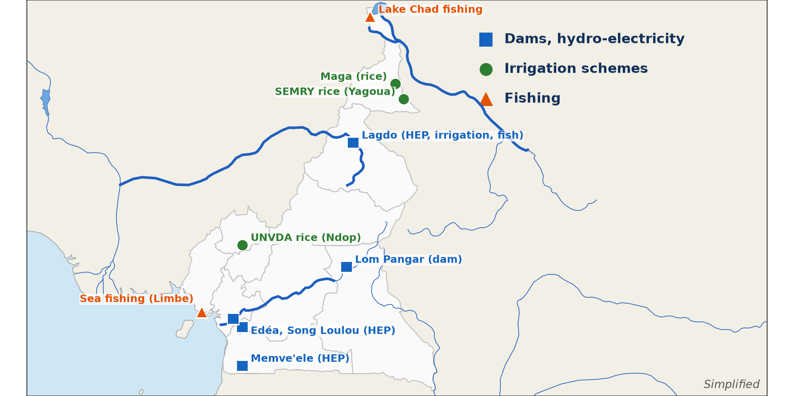
1. LOCATION
Activity 1
Dams and irrigation schemes of Cameroon.
Notes:
Activity 1. Look carefully at this diagram: dams and irrigation schemes of Cameroon. Observe every detail before I ask the question.

Slide 19
1. LOCATION
Activity 1: Question
Locate the Lagdo dam.
Notes:
Here is the question for Activity 1: Locate the Lagdo dam. Take one minute to think and write your answer in your rough notebook.

Slide 20
1. LOCATION
Activity 1: Answer
On the Benue River, about 50 km upstream of Garoua in the North Region.
Notes:
Let us check the answer together. On the Benue River, about 50 km upstream of Garoua in the North Region.

Slide 21
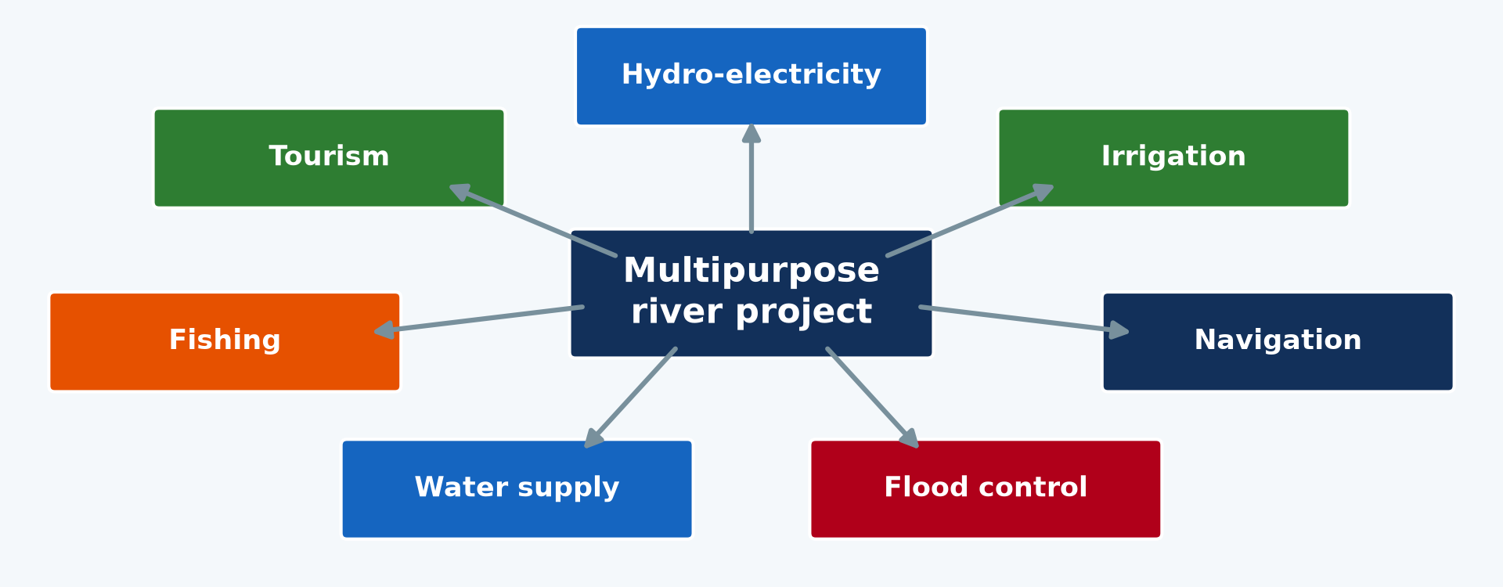
2. OBJECTIVES
Activity 2
Uses of an MRDP.
Notes:
Activity 2. Look carefully at this diagram: uses of an MRDP. Observe every detail before I ask the question.

Slide 22
2. OBJECTIVES
Activity 2: Question
Give three objectives of the Lagdo project.
Notes:
Here is the question for Activity 2: Give three objectives of the Lagdo project. Take one minute to think and write your answer in your rough notebook.

Slide 23
2. OBJECTIVES
Activity 2: Answer
Electricity for the North, irrigation and fishing (also flood control).
Notes:
Let us check the answer together. Electricity for the North, irrigation and fishing (also flood control).

Slide 24

3. ACHIEVEMENTS
Activity 3
Irrigated rice.
Notes:
Activity 3. Look carefully at this picture: irrigated rice. Observe every detail before I ask the question.

Slide 25
3. ACHIEVEMENTS
Activity 3: Question
Give two achievements of the Lagdo project.
Notes:
Here is the question for Activity 3: Give two achievements of the Lagdo project. Take one minute to think and write your answer in your rough notebook.

Slide 26
3. ACHIEVEMENTS
Activity 3: Answer
It supplies electricity to the northern regions and supports fishing and irrigated farming.
Notes:
Let us check the answer together. It supplies electricity to the northern regions and supports fishing and irrigated farming.

Slide 27

4. PROBLEMS
Activity 4
A flooded village.
Notes:
Activity 4. Look carefully at this picture: a flooded village. Observe every detail before I ask the question.

Slide 28
4. PROBLEMS
Activity 4: Question
Give three problems of the Lagdo project.
Notes:
Here is the question for Activity 4: Give three problems of the Lagdo project. Take one minute to think and write your answer in your rough notebook.

Slide 29
4. PROBLEMS
Activity 4: Answer
Low water in the dry season, silting and floods downstream when water is released.
Notes:
Let us check the answer together. Low water in the dry season, silting and floods downstream when water is released.

Slide 30

5. ATTEMPTED SOLUTIONS
Activity 5
Tree planting.
Notes:
Activity 5. Look carefully at this picture: tree planting. Observe every detail before I ask the question.

Slide 31
5. ATTEMPTED SOLUTIONS
Activity 5: Question
Give two attempted solutions.
Notes:
Here is the question for Activity 5: Give two attempted solutions. Take one minute to think and write your answer in your rough notebook.

Slide 32
5. ATTEMPTED SOLUTIONS
Activity 5: Answer
Tree planting in the basin and the interconnection of power grids (also warning before releases).
Notes:
Let us check the answer together. Tree planting in the basin and the interconnection of power grids (also warning before releases).

Slide 33
BOARD SUMMARY
Board Summary
Topic: Development Projects and Environmental Management
Sub-topic: Development Projects in Cameroon
Lesson 25: Multipurpose River Development Project in Cameroon
Notes:
Now we are going to copy the board summary. Write the title and the headings neatly in your notebooks. I will give you enough time for each slide, so do not rush.

Slide 34
BOARD SUMMARY
1. Objectives of the Lagdo Project
The Lagdo dam on the Benue was built for the following objectives:
Energy: It produces hydro-electricity for the northern regions.
Agriculture: It supplies water to irrigate rice and other crops.
Notes:
Let us copy Objectives of the Lagdo Project. The Lagdo dam on the Benue was built for the following objectives. On this slide we have Energy and Agriculture. Write each point on a new line, with the key term first, and explain it in your own words when we revise. When you finish, we go to the next slide.

Slide 35
BOARD SUMMARY
1. Objectives of the Lagdo Project (continued)
Fishing and flood control: The lake supports fishing and the dam regulates the Benue.
Notes:
We continue with Objectives of the Lagdo Project. On this slide we have Fishing and flood control. Write each point on a new line, with the key term first, and explain it in your own words when we revise.

Slide 36
BOARD SUMMARY
1. Objectives of the Lagdo Project
Illustration: dams and irrigation schemes of Cameroon
Notes:
Now draw this illustration in your notebook: dams and irrigation schemes of Cameroon. Give it a title and label it clearly.

Slide 37
BOARD SUMMARY
2. Achievements
The project achieved the following:
Electricity: Towns such as Garoua, Maroua and Ngaoundéré receive power.
Food production: Lake fishing and irrigated farms feed the region.
Notes:
Let us copy Achievements. The project achieved the following. On this slide we have Electricity and Food production. Write each point on a new line, with the key term first, and explain it in your own words when we revise. When you finish, we go to the next slide.

Slide 38
BOARD SUMMARY
2. Achievements (continued)
Other projects: Lom Pangar, Memve'ele and Song Loulou dams also serve Cameroon.
Notes:
We continue with Achievements. On this slide we have Other projects. Write each point on a new line, with the key term first, and explain it in your own words when we revise.

Slide 39
BOARD SUMMARY
3. Problems and Attempted Solutions
The project faces problems and attempted solutions as follows:
Problems: Low water in the dry season causes power cuts, and the lake is silting.
More problems: Water releases can flood villages downstream, as in 2012.
Notes:
Let us copy Problems and Attempted Solutions. The project faces problems and attempted solutions as follows. On this slide we have Problems and More problems. Write each point on a new line, with the key term first, and explain it in your own words when we revise. When you finish, we go to the next slide.

Slide 40
BOARD SUMMARY
3. Problems and Attempted Solutions (continued)
Attempted solutions: Tree planting, new dams, grid interconnection and flood warnings are used.
Notes:
We continue with Problems and Attempted Solutions. On this slide we have Attempted solutions. Write each point on a new line, with the key term first, and explain it in your own words when we revise.

Slide 41
FORMATIVE EVALUATION
Evaluation 1
Give two objectives of the Lagdo dam.
Notes:
Now let us check what you have understood. Question 1: Give two objectives of the Lagdo dam. Answer in your exercise book.

Slide 42
FORMATIVE EVALUATION
Expected Answer
Electricity and irrigation.
Notes:
The expected answer is: electricity and irrigation. If you got it right, well done.

Slide 43
FORMATIVE EVALUATION
Evaluation 2
Give one problem and one solution.
Notes:
Now let us check what you have understood. Question 2: Give one problem and one solution. Answer in your exercise book.

Slide 44
FORMATIVE EVALUATION
Expected Answer
Power cuts in the dry season; interconnection of power grids.
Notes:
The expected answer is: power cuts in the dry season; interconnection of power grids. If you got it right, well done.

Slide 45
REMEDIATION
Remediation
Fill in the blanks:
The Lagdo dam is on the ______ River.
The dam produces ______ for the North.
A dam on the Lom in the East is ______.
Notes:
For those who need more practice, fill in the blanks in your exercise book. The answers are: number 1, Benue; number 2, hydro-electricity; number 3, Lom Pangar.

Slide 46
HOMEWORK
Homework
Explain how the Lagdo dam affects the life of the people of Garoua.
Notes:
For your homework: Explain how the Lagdo dam affects the life of the people of Garoua. We shall correct it at the beginning of our next lesson.

Slide 47
NEXT LESSON
Next Lesson
Our next lesson will be on:
Lesson 26: Problems of Waste Management
Notes:
Our next lesson will be on Lesson 26: Problems of Waste Management. Thank you for your attention, and see you next time.

Slide 48
BILINGUAL GAME
Bilingual Game (Jeu Bilingue)
English | Français
Lake | Le lac
Silting | L'envasement
Power cut | La coupure de courant
Irrigated farm | La ferme irriguée
Downstream | En aval
Grid | Le réseau électrique
Notes:
Let us play the bilingual game. I say a word in English, and you give me the French word. Then we do the reverse.

Slide 49
LOGBOOK
Official Logbook (1/2)
Module / Topic | Development Projects and Environmental Management
Lesson Title | Lesson 25: Multipurpose River Development Project in Cameroon
Expected Learning Outcomes | Locate the Lagdo multipurpose project. Explain its objectives and achievements. Explain its problems and attempted solutions.
Competence | Learners are able to assess a multipurpose river project in Cameroon.
Notes:
I record this information in the official logbook of the class after the lesson.

Slide 50
LOGBOOK
Official Logbook (2/2)
Matter Taught | Objectives of the Lagdo Project; Achievements; Problems and Attempted Solutions.
Evaluation | Formative evaluation and remediation exercise.
Homework | Explain how the Lagdo dam affects the life of the people of Garoua.
Enrolment / Present / Absent | ____ / ____ / ____
Achievement | To be completed after the lesson.
Notes:
I complete the second page of the logbook: the matter taught, the evaluation, the homework and the attendance.

Slide 51
TEACHER'S NOTE
Teacher's Note
Timing: Homework correction, plan, objectives 8 min | Recall, situation, action 10 min | 5 activities 30 min | Board summary (copying) 30 min | Evaluation, remediation 10 min | Homework, next lesson 5 min | Logbook 7 min
Without the projector (Activity 1): use the map.
Without the projector (Activity 2): list.
Without the projector (Activity 3): discuss.
Without the projector (Activity 4): discuss.
Without the projector (Activity 5): list.
Notes:
This slide is for me, the teacher: it gives the timing of the lesson and what to do if the projector is not available.

Slide 52
REFERENCES
References
Geography Syllabus, Forms I–V, MINESEC (2023) — Form 5, Module II: Preservation of the Natural Environment.
Photo, Activity 3: “Irrigated rice fields in Sefula, Zambia. Photo by Kate Longley, 2013.” by WorldFish, CC BY-NC-ND 2.0, via Flickr (https://www.flickr.com/photos/61545321@N06/8608804590)
Photo, Activity 4: “Flood in Accra” by Stig Nygaard, CC BY 2.0, via Flickr (https://www.flickr.com/photos/10259776@N00/181742000)
Photo, Activity 5: “Haitian Students Breathe New Life into Depleted Pine Forest” by United Nations Photo, CC BY-NC-ND 2.0, via Flickr (https://www.flickr.com/photos/35483578@N03/5860275159)
Diagrams and animations: drawn for this lesson (Geography Department).
Notes:
These are the references and picture credits used to prepare this lesson.

