Slide 1
FORM 5
GEOGRAPHY
Lesson 30
Spatial Distribution of the World's Population
Notes:
Good morning, class, and welcome to our geography lesson. I am your geography teacher, Mr Kamdem. Today we are starting Lesson 30: Spatial Distribution of the World's Population.

Slide 2
CLASS INFO
Class, Chapter and Duration
Class | Form 5
Chapter | Module III: Management of Population Growth and Space Colonisation
Duration | 2 periods (2 × 50 minutes)
Notes:
This lesson is for Form 5. It belongs to Module III: Management of Population Growth and Space Colonisation. We shall need 2 periods to cover it.

Slide 3
IDENTIFICATION
Lesson Identification
Topic | The Dynamics of Population and Implications
Sub-topic | Population and Population Distribution
Lesson | Lesson 30: Spatial Distribution of the World's Population
Notions / Concepts | Dense, moderate, sparse, uneven distribution.
Syllabus focus | Uneven distribution (map); major areas of dense, moderate and sparse population.
Competence | Learners are able to locate and explain the dense and sparse areas of the world.
Notes:
Our topic is The Dynamics of Population and Implications, and the sub-topic is Population and Population Distribution. The key notions we shall use today are: dense, moderate, sparse, uneven distribution. At the end, you should be able to do this: learners are able to locate and explain the dense and sparse areas of the world.

Slide 4

HOMEWORK CORRECTION
Correction of the Homework
Question (Practical Work 3: Population Densities in Cameroon):
Draw the choropleth map of population densities of Cameroon using four classes.
Notes:
Before we start the new lesson, let us correct the homework I gave you at the end of Practical Work 3: Population Densities in Cameroon. The question was: Draw the choropleth map of population densities of Cameroon using four classes. Take out your exercise books.

Slide 5
HOMEWORK CORRECTION
Correction: Possible Answer
Classes: under 20, 20–50, 50–100, over 100 per km²; darkest for the Littoral, West, Far North and North-West; lightest for the East and South.
Notes:
Here is a good answer. Classes: under 20, 20–50, 50–100, over 100 per km²; darkest for the Littoral, West, Far North and North-West; lightest for the East and South. Compare it with your own answer and correct your work in red.

Slide 6
LESSON PLAN
Lesson Plan
Correction of the homework
Objectives and recall
Real-life situation and action to take
Learning activities
Board summary
Evaluation, remediation and homework
Notes:
Here is the plan of our lesson today. First, we shall correct the homework. Then we shall look at the objectives and recall what you already know. After that, we shall study a situation from real life and the action to take, and do the learning activities. Finally, we shall copy the board summary, do the evaluation and the remediation, and I will give you the homework.

Slide 7
OBJECTIVES
Objectives
By the end of this lesson, you should be able to:
Describe the uneven distribution of the world population.
Locate the major dense, moderate and sparse areas.
Notes:
Take your time to copy this part; we will continue together.

Slide 8
OBJECTIVES
Objectives (continued)
Explain the distribution.
Notes:
By the end of this lesson, you should be able to do three things. Number 1: describe the uneven distribution of the world population. Number 2: locate the major dense, moderate and sparse areas. Number 3: explain the distribution.

Slide 9
PREVIOUS KNOWLEDGE
Previous Knowledge
Population density is people per km².
Asia has many people.
Deserts have few people.
Notes:
Let us first remember what you already know. Population density is people per km². Asia has many people. Deserts have few people. Keep this in mind, because we shall build on it today.

Slide 10
REAL-LIFE SITUATION
Situation in Real Life
On a world map of population, some areas like South and East Asia are dark with people, while the Sahara and Siberia are almost empty.
Notes:
Listen carefully to this situation from real life. On a world map of population, some areas like South and East Asia are dark with people, while the Sahara and Siberia are almost empty. Think about it, because I am going to ask you some questions.

Slide 11
REAL-LIFE SITUATION
Situation: Question 1
What is the problem in the situation?
Notes:
Question 1: What is the problem in the situation? Think for a moment, then raise your hand to answer.

Slide 12
REAL-LIFE SITUATION
Answer
The world population is unevenly distributed.
Notes:
Good. The world population is unevenly distributed.

Slide 13
REAL-LIFE SITUATION
Situation: Question 2
Name a dense area.
Notes:
Question 2: Name a dense area. Think for a moment, then raise your hand to answer.

Slide 14
REAL-LIFE SITUATION
Answer
South or East Asia.
Notes:
Good. South or East Asia.

Slide 15
REAL-LIFE SITUATION
Situation: Question 3
Name a sparse area.
Notes:
Question 3: Name a sparse area. Think for a moment, then raise your hand to answer.

Slide 16
REAL-LIFE SITUATION
Possible Answer
The Sahara or Siberia.
Notes:
Good. The Sahara or Siberia.

Slide 17
ACTION TO TAKE
Action to Take
Create social amenities in areas of low density.
Notes:
From this situation, the action we are working towards in this lesson is the following: create social amenities in areas of low density.

Slide 18
JUSTIFICATION
Justification of the Lesson
This lesson helps us to understand where people live in the world and why.
Notes:
Why is this lesson important for you? This lesson helps us to understand where people live in the world and why.

Slide 19
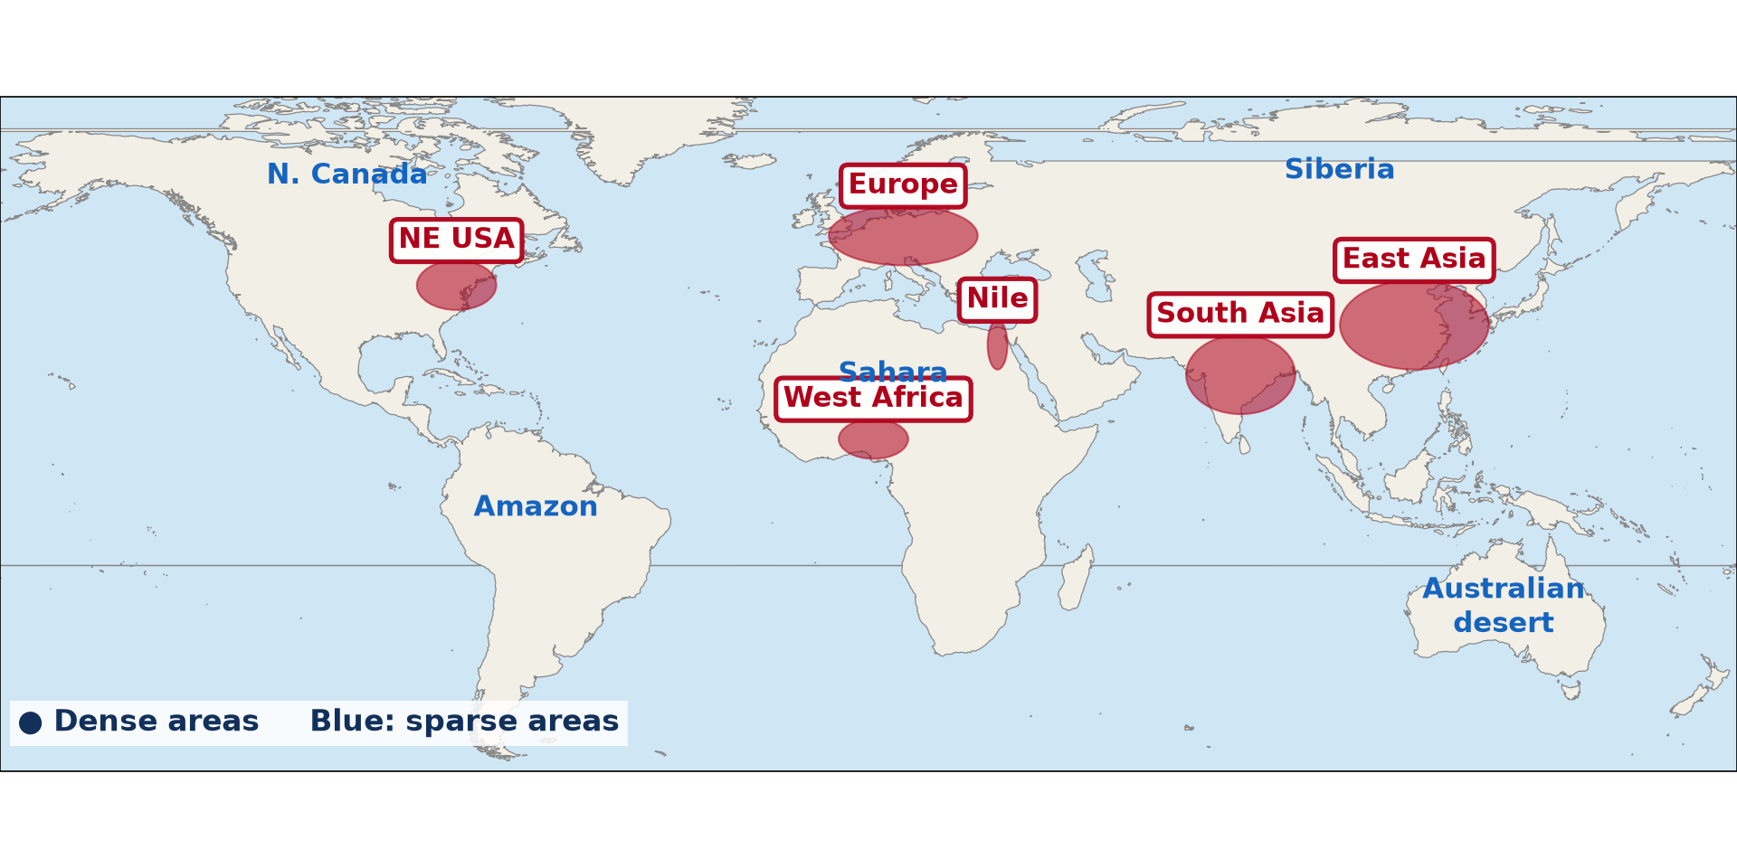
1. UNEVEN DISTRIBUTION
Activity 1
World population distribution.
Notes:
Activity 1. Look carefully at this diagram: world population distribution. Observe every detail before I ask the question.

Slide 20
1. UNEVEN DISTRIBUTION
Activity 1: Question
Describe the world distribution of population.
Notes:
Here is the question for Activity 1: Describe the world distribution of population. Take one minute to think and write your answer in your rough notebook.

Slide 21
1. UNEVEN DISTRIBUTION
Activity 1: Answer
It is uneven: most people live in a few regions, and large areas are almost empty.
Notes:
Let us check the answer together. It is uneven: most people live in a few regions, and large areas are almost empty.

Slide 22
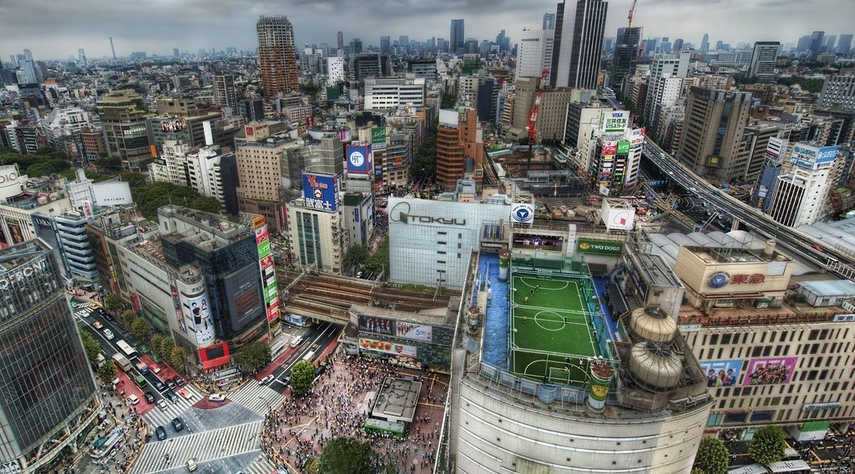
2. DENSE AREAS
Activity 2
Tokyo.
Notes:
Activity 2. Look carefully at this picture: tokyo. Observe every detail before I ask the question.

Slide 23
2. DENSE AREAS
Activity 2: Question
Name four dense areas of the world.
Notes:
Here is the question for Activity 2: Name four dense areas of the world. Take one minute to think and write your answer in your rough notebook.

Slide 24
2. DENSE AREAS
Activity 2: Answer
East Asia, South Asia, Western Europe and North-East USA (also West Africa and the Nile valley).
Notes:
Let us check the answer together. East Asia, South Asia, Western Europe and North-East USA (also West Africa and the Nile valley).

Slide 25
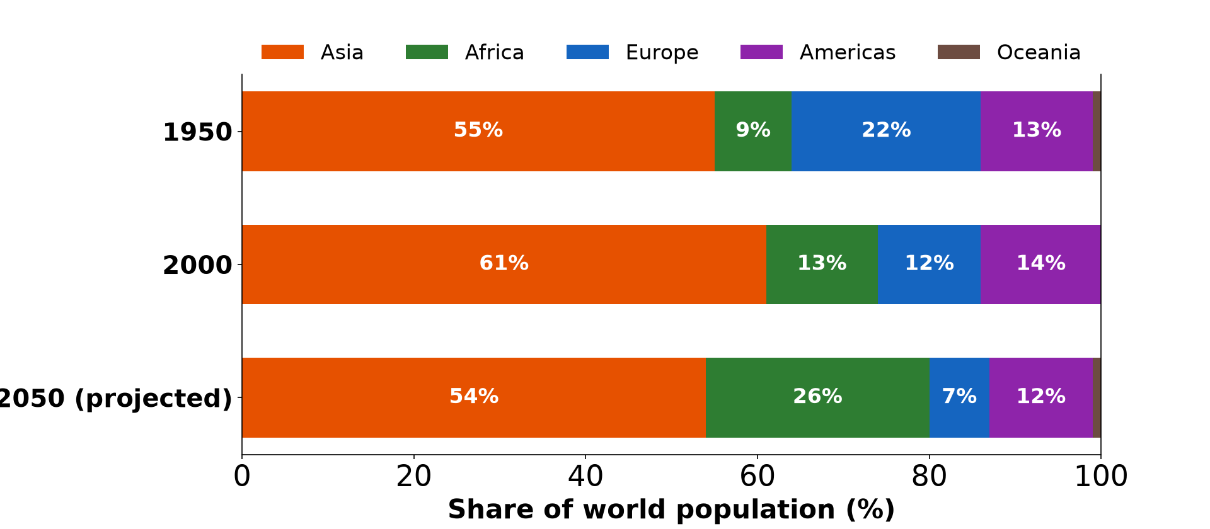
2. MODERATE AREAS
Activity 3
Share of world population.
Notes:
Activity 3. Look carefully at this diagram: share of world population. Observe every detail before I ask the question.

Slide 26
2. MODERATE AREAS
Activity 3: Question
Name two moderately populated areas.
Notes:
Here is the question for Activity 3: Name two moderately populated areas. Take one minute to think and write your answer in your rough notebook.

Slide 27
2. MODERATE AREAS
Activity 3: Answer
The savannas of Africa and the pampas of South America.
Notes:
Let us check the answer together. The savannas of Africa and the pampas of South America.

Slide 28

2. SPARSE AREAS
Activity 4
A sand desert.
Notes:
Activity 4. Look carefully at this picture: a sand desert. Observe every detail before I ask the question.

Slide 29
2. SPARSE AREAS
Activity 4: Question
Name three sparse areas.
Notes:
Here is the question for Activity 4: Name three sparse areas. Take one minute to think and write your answer in your rough notebook.

Slide 30
2. SPARSE AREAS
Activity 4: Answer
Hot deserts, cold polar lands and equatorial forests (also high mountains).
Notes:
Let us check the answer together. Hot deserts, cold polar lands and equatorial forests (also high mountains).

Slide 31
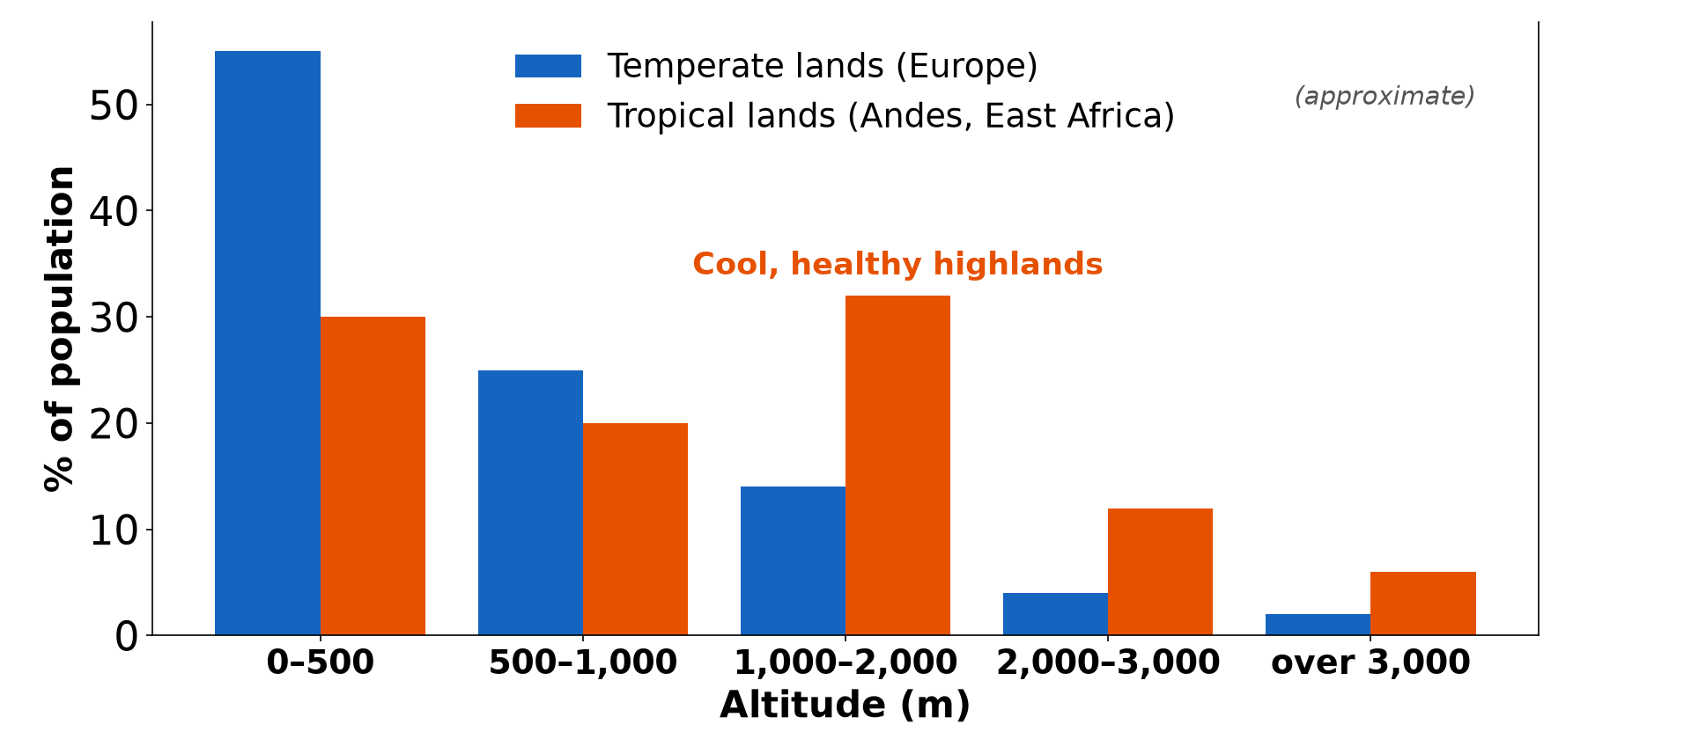
3. EXPLANATION
Activity 5
Population and altitude.
Notes:
Activity 5. Look carefully at this diagram: population and altitude. Observe every detail before I ask the question.

Slide 32
3. EXPLANATION
Activity 5: Question
Give two reasons for dense and sparse areas.
Notes:
Here is the question for Activity 5: Give two reasons for dense and sparse areas. Take one minute to think and write your answer in your rough notebook.

Slide 33
3. EXPLANATION
Activity 5: Answer
Fertile plains and moderate climates attract people; extreme climates and poor soils repel them.
Notes:
Let us check the answer together. Fertile plains and moderate climates attract people; extreme climates and poor soils repel them.

Slide 34
BOARD SUMMARY
Board Summary
Topic: The Dynamics of Population and Implications
Sub-topic: Population and Population Distribution
Lesson 30: Spatial Distribution of the World's Population
Notes:
Now we are going to copy the board summary. Write the title and the headings neatly in your notebooks. I will give you enough time for each slide, so do not rush.

Slide 35
BOARD SUMMARY
1. Uneven Distribution
The world population is distributed as follows:
Uneven pattern: Most people live on a small part of the land.
Hemispheres: About 90 percent of people live in the Northern Hemisphere.
Notes:
Let us copy Uneven Distribution. The world population is distributed as follows. On this slide we have Uneven pattern and Hemispheres. Write each point on a new line, with the key term first, and explain it in your own words when we revise.

Slide 36
BOARD SUMMARY
1. Uneven Distribution
Illustration: world population distribution
Notes:
Now draw this illustration in your notebook: world population distribution. Give it a title and label it clearly.

Slide 37
BOARD SUMMARY
2. Major Areas of Dense, Moderate and Sparse Population
The main population areas are the following:
Dense areas: East Asia, South Asia, Western Europe, North-East USA and West Africa are dense.
Moderate areas: Savannas, prairies and pampas have moderate densities.
Notes:
Let us copy Major Areas of Dense, Moderate and Sparse Population. The main population areas are the following. On this slide we have Dense areas and Moderate areas. Write each point on a new line, with the key term first, and explain it in your own words when we revise. When you finish, we go to the next slide.

Slide 38
BOARD SUMMARY
2. Major Areas of Dense, Moderate and Sparse Population (continued)
Sparse areas: Hot deserts, polar lands, equatorial forests and high mountains are sparse.
Reasons: Relief, climate, soils, water, resources and history explain the pattern.
Notes:
We continue with Major Areas of Dense, Moderate and Sparse Population. On this slide we have Sparse areas and Reasons. Write each point on a new line, with the key term first, and explain it in your own words when we revise.

Slide 39
FORMATIVE EVALUATION
Evaluation 1
Name two dense and two sparse areas of the world.
Notes:
Now let us check what you have understood. Question 1: Name two dense and two sparse areas of the world. Answer in your exercise book.

Slide 40
FORMATIVE EVALUATION
Expected Answer
East Asia and Western Europe; the Sahara and Siberia.
Notes:
The expected answer is: east Asia and Western Europe; the Sahara and Siberia. If you got it right, well done.

Slide 41
FORMATIVE EVALUATION
Evaluation 2
Give one reason for a sparse area.
Notes:
Now let us check what you have understood. Question 2: Give one reason for a sparse area. Answer in your exercise book.

Slide 42
FORMATIVE EVALUATION
Expected Answer
An extreme climate (hot or cold deserts).
Notes:
The expected answer is: an extreme climate (hot or cold deserts). If you got it right, well done.

Slide 43
REMEDIATION
Remediation
Fill in the blanks:
The most populated continent is ______.
The Sahara is a ______ area.
Most people live in the ______ Hemisphere.
Notes:
For those who need more practice, fill in the blanks in your exercise book. The answers are: number 1, Asia; number 2, sparse; number 3, Northern.

Slide 44
HOMEWORK
Homework
Draw a sketch map of the world showing three dense and three sparse areas.
Notes:
For your homework: Draw a sketch map of the world showing three dense and three sparse areas. We shall correct it at the beginning of our next lesson.

Slide 45
NEXT LESSON
Next Lesson
Our next lesson will be on:
Lesson 31: Age Composition of Population
Notes:
Our next lesson will be on Lesson 31: Age Composition of Population. Thank you for your attention, and see you next time.

Slide 46
BILINGUAL GAME
Bilingual Game (Jeu Bilingue)
English | Français
Uneven | Inégal
Hemisphere | L'hémisphère
Desert | Le désert
Plain | La plaine
Polar | Polaire
Settlement | Le peuplement
Notes:
Let us play the bilingual game. I say a word in English, and you give me the French word. Then we do the reverse.

Slide 47
LOGBOOK
Official Logbook (1/2)
Module / Topic | The Dynamics of Population and Implications
Lesson Title | Lesson 30: Spatial Distribution of the World's Population
Expected Learning Outcomes | Describe the uneven distribution of the world population. Locate the major dense, moderate and sparse areas. Explain the distribution.
Competence | Learners are able to locate and explain the dense and sparse areas of the world.
Notes:
I record this information in the official logbook of the class after the lesson.

Slide 48
LOGBOOK
Official Logbook (2/2)
Matter Taught | Uneven Distribution; Major Areas of Dense, Moderate and Sparse Population.
Evaluation | Formative evaluation and remediation exercise.
Homework | Draw a sketch map of the world showing three dense and three sparse areas.
Enrolment / Present / Absent | ____ / ____ / ____
Achievement | To be completed after the lesson.
Notes:
I complete the second page of the logbook: the matter taught, the evaluation, the homework and the attendance.

Slide 49
TEACHER'S NOTE
Teacher's Note
Timing: Homework correction, plan, objectives 8 min | Recall, situation, action 10 min | 5 activities 30 min | Board summary (copying) 30 min | Evaluation, remediation 10 min | Homework, next lesson 5 min | Logbook 7 min
Without the projector (Activity 1): use the atlas.
Without the projector (Activity 2): locate them.
Without the projector (Activity 3): locate them.
Without the projector (Activity 4): locate them.
Without the projector (Activity 5): discuss.
Notes:
This slide is for me, the teacher: it gives the timing of the lesson and what to do if the projector is not available.

Slide 50
REFERENCES
References
Geography Syllabus, Forms I–V, MINESEC (2023) — Form 5, Module III: Management of Population Growth and Space Colonisation.
Photo, Activity 2: “Tokyo from the Air” by Trey Ratcliff, CC BY-NC-SA 2.0, via Flickr (https://www.flickr.com/photos/95572727@N00/4140101118)
Photo, Activity 4: “Desert trekking in Merzouga” by Antonio Cinotti , CC BY-NC-ND 2.0, via Flickr (https://www.flickr.com/photos/46378751@N02/15331399979)
Diagrams and animations: drawn for this lesson (Geography Department).
Notes:
These are the references and picture credits used to prepare this lesson.

