Slide 1
FORM 5
GEOGRAPHY
Lesson 36
Migration
Notes:
Good morning, class, and welcome to our geography lesson. I am your geography teacher, Mr Kamdem. Today we are starting Lesson 36: Migration.

Slide 2
CLASS INFO
Class, Chapter and Duration
Class | Form 5
Chapter | Module III: Management of Population Growth and Space Colonisation
Duration | 2 periods (2 × 50 minutes)
Notes:
This lesson is for Form 5. It belongs to Module III: Management of Population Growth and Space Colonisation. We shall need 2 periods to cover it.

Slide 3
IDENTIFICATION
Lesson Identification
Topic | The Dynamics of Population and Implications
Sub-topic | Population Change in Space (Migration)
Lesson | Lesson 36: Migration
Notions / Concepts | Immigration, emigration, net migration, standards of living.
Syllabus focus | Meaning; types (internal and external); general causes; general consequences of migration at source and destination.
Competence | Learners are able to explain migration, its causes and consequences.
Notes:
Our topic is The Dynamics of Population and Implications, and the sub-topic is Population Change in Space (Migration). The key notions we shall use today are: immigration, emigration, net migration, standards of living. At the end, you should be able to do this: learners are able to explain migration, its causes and consequences.

Slide 4

HOMEWORK CORRECTION
Correction of the Homework
Question (Further Study 4: Control of Population Growth):
Should Cameroon adopt a one-child policy? Give two arguments for and two against.
Notes:
Before we start the new lesson, let us correct the homework I gave you at the end of Further Study 4: Control of Population Growth. The question was: Should Cameroon adopt a one-child policy? Give two arguments for and two against. Take out your exercise books.

Slide 5
HOMEWORK CORRECTION
Correction: Possible Answer
For: slower growth, fewer pressures on schools and jobs. Against: cultural values, future ageing, and education and health work better without force.
Notes:
Here is a good answer. For: slower growth, fewer pressures on schools and jobs. Against: cultural values, future ageing, and education and health work better without force. Compare it with your own answer and correct your work in red.

Slide 6
LESSON PLAN
Lesson Plan
Correction of the homework
Objectives and recall
Real-life situation and action to take
Learning activities
Board summary
Evaluation, remediation and homework
Notes:
Here is the plan of our lesson today. First, we shall correct the homework. Then we shall look at the objectives and recall what you already know. After that, we shall study a situation from real life and the action to take, and do the learning activities. Finally, we shall copy the board summary, do the evaluation and the remediation, and I will give you the homework.

Slide 7
OBJECTIVES
Objectives
By the end of this lesson, you should be able to:
Define migration and its types.
Explain the causes of migration.
Explain the consequences at source and destination.
Notes:
By the end of this lesson, you should be able to do three things. Number 1: define migration and its types. Number 2: explain the causes of migration. Number 3: explain the consequences at source and destination.

Slide 8
PREVIOUS KNOWLEDGE
Previous Knowledge
Many young people leave villages for towns.
Some Cameroonians go abroad.
Refugees flee wars.
Notes:
Let us first remember what you already know. Many young people leave villages for towns. Some Cameroonians go abroad. Refugees flee wars. Keep this in mind, because we shall build on it today.

Slide 9
REAL-LIFE SITUATION
Situation in Real Life
A young man leaves his village in the Far North for Douala to find work, while his cousin travels to Europe to study. Their village is left with old people.
Notes:
Listen carefully to this situation from real life. A young man leaves his village in the Far North for Douala to find work, while his cousin travels to Europe to study. Their village is left with old people. Think about it, because I am going to ask you some questions.

Slide 10
REAL-LIFE SITUATION
Situation: Question 1
What is the problem in the situation?
Notes:
Question 1: What is the problem in the situation? Think for a moment, then raise your hand to answer.

Slide 11
REAL-LIFE SITUATION
Answer
People are migrating.
Notes:
Good. People are migrating.

Slide 12
REAL-LIFE SITUATION
Situation: Question 2
Where does the young man go?
Notes:
Question 2: Where does the young man go? Think for a moment, then raise your hand to answer.

Slide 13
REAL-LIFE SITUATION
Answer
To Douala (internal migration).
Notes:
Good. To Douala (internal migration).

Slide 14
REAL-LIFE SITUATION
Situation: Question 3
What is the effect on the village?
Notes:
Question 3: What is the effect on the village? Think for a moment, then raise your hand to answer.

Slide 15
REAL-LIFE SITUATION
Possible Answer
Only old people remain.
Notes:
Good. Only old people remain.

Slide 16
ACTION TO TAKE
Action to Take
Create social amenities in rural areas to reduce rural exodus.
Notes:
From this situation, the action we are working towards in this lesson is the following: create social amenities in rural areas to reduce rural exodus.

Slide 17
JUSTIFICATION
Justification of the Lesson
This lesson helps us to understand the movement of people.
Notes:
Why is this lesson important for you? This lesson helps us to understand the movement of people.

Slide 18
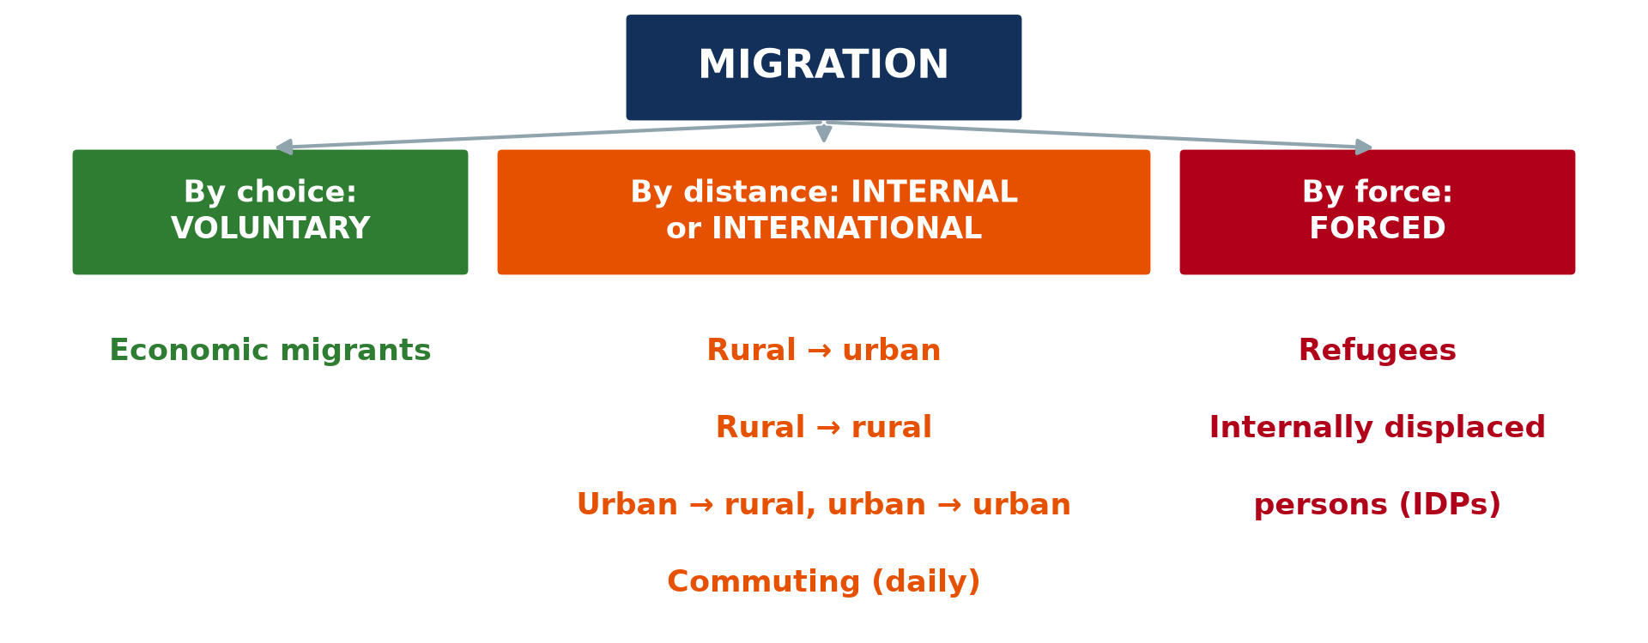
1. MEANING
Activity 1
Types of migration.
Notes:
Activity 1. Look carefully at this diagram: types of migration. Observe every detail before I ask the question.

Slide 19
1. MEANING
Activity 1: Question
What is migration?
Notes:
Here is the question for Activity 1: What is migration? Take one minute to think and write your answer in your rough notebook.

Slide 20
1. MEANING
Activity 1: Answer
The movement of people from one place to another to live.
Notes:
Let us check the answer together. The movement of people from one place to another to live.

Slide 21
2. TYPES
Activity 2
Types of migration.
Notes:
Activity 2. Look carefully at this diagram: types of migration. Observe every detail before I ask the question.

Slide 22
2. TYPES
Activity 2: Question
Distinguish internal and external migration.
Notes:
Here is the question for Activity 2: Distinguish internal and external migration. Take one minute to think and write your answer in your rough notebook.

Slide 23
2. TYPES
Activity 2: Answer
Internal migration is within a country; external migration crosses borders.
Notes:
Let us check the answer together. Internal migration is within a country; external migration crosses borders.

Slide 24
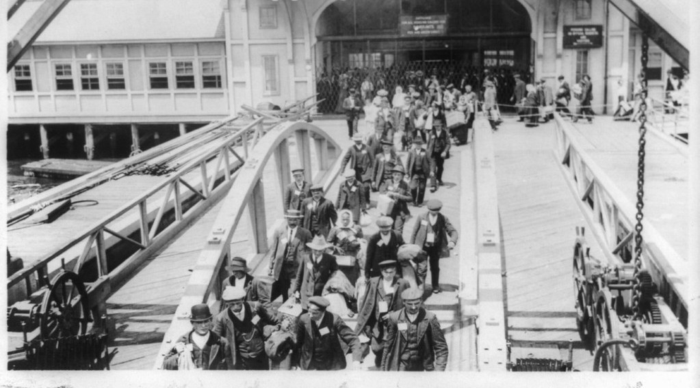
2. TERMS
Activity 3
Immigrants arriving.
Notes:
Activity 3. Look carefully at this picture: immigrants arriving. Observe every detail before I ask the question.

Slide 25
2. TERMS
Activity 3: Question
Distinguish immigration and emigration.
Notes:
Here is the question for Activity 3: Distinguish immigration and emigration. Take one minute to think and write your answer in your rough notebook.

Slide 26
2. TERMS
Activity 3: Answer
Immigration is entering a country; emigration is leaving it.
Notes:
Let us check the answer together. Immigration is entering a country; emigration is leaving it.

Slide 27

3. CAUSES
Activity 4
Refugees.
Notes:
Activity 4. Look carefully at this picture: refugees. Observe every detail before I ask the question.

Slide 28
3. CAUSES
Activity 4: Question
Give two push and two pull factors.
Notes:
Here is the question for Activity 4: Give two push and two pull factors. Take one minute to think and write your answer in your rough notebook.

Slide 29
3. CAUSES
Activity 4: Answer
Push: poverty and war; pull: jobs and better services.
Notes:
Let us check the answer together. Push: poverty and war; pull: jobs and better services.

Slide 30

4. CONSEQUENCES
Activity 5
A slum.
Notes:
Activity 5. Look carefully at this picture: a slum. Observe every detail before I ask the question.

Slide 31
4. CONSEQUENCES
Activity 5: Question
Give one consequence at the source and one at the destination.
Notes:
Here is the question for Activity 5: Give one consequence at the source and one at the destination. Take one minute to think and write your answer in your rough notebook.

Slide 32
4. CONSEQUENCES
Activity 5: Answer
Source: loss of young workers; destination: overcrowding and slums.
Notes:
Let us check the answer together. Source: loss of young workers; destination: overcrowding and slums.

Slide 33
BOARD SUMMARY
Board Summary
Topic: The Dynamics of Population and Implications
Sub-topic: Population Change in Space (Migration)
Lesson 36: Migration
Notes:
Now we are going to copy the board summary. Write the title and the headings neatly in your notebooks. I will give you enough time for each slide, so do not rush.

Slide 34
BOARD SUMMARY
DEFINITIONS
The key terms of this lesson are defined as follows:
Migration: It is the movement of people from one place to another to live.
Immigration and emigration: Immigration is entering a country and emigration is leaving it.
Notes:
Let us copy the definitions. The key terms of this lesson are defined as follows. On this slide we have Migration and Immigration and emigration. Write each point on a new line, with the key term first, and explain it in your own words when we revise. When you finish, we go to the next slide.

Slide 35
BOARD SUMMARY
DEFINITIONS (continued)
Net migration: It is the difference between immigrants and emigrants.
Notes:
We continue with the definitions. On this slide we have Net migration. Write each point on a new line, with the key term first, and explain it in your own words when we revise.

Slide 36
BOARD SUMMARY
1. Types and Causes of Migration
Migration has the following types and causes:
Internal migration: It takes place within a country, such as rural-urban migration.
External migration: It crosses international borders.
Notes:
Let us copy Types and Causes of Migration. Migration has the following types and causes. On this slide we have Internal migration and External migration. Write each point on a new line, with the key term first, and explain it in your own words when we revise. When you finish, we go to the next slide.

Slide 37
BOARD SUMMARY
1. Types and Causes of Migration (continued)
Push factors: Poverty, wars, disasters and lack of jobs push people away.
Pull factors: Jobs, schools, hospitals and security attract people.
Notes:
We continue with Types and Causes of Migration. On this slide we have Push factors and Pull factors. Write each point on a new line, with the key term first, and explain it in your own words when we revise.

Slide 38
BOARD SUMMARY
1. Types and Causes of Migration
Illustration: types of migration
Notes:
Now draw this illustration in your notebook: types of migration. Give it a title and label it clearly.

Slide 39
BOARD SUMMARY
2. Consequences of Migration
Migration has the following consequences:
At the source: Villages lose young workers but receive money sent by migrants.
At the destination: Towns gain workers but suffer overcrowding, slums and unemployment.
Notes:
Let us copy Consequences of Migration. Migration has the following consequences. On this slide we have At the source and At the destination. Write each point on a new line, with the key term first, and explain it in your own words when we revise. When you finish, we go to the next slide.

Slide 40
BOARD SUMMARY
2. Consequences of Migration (continued)
Brain drain: Skilled people leave poor countries for rich ones.
Notes:
We continue with Consequences of Migration. On this slide we have Brain drain. Write each point on a new line, with the key term first, and explain it in your own words when we revise.

Slide 41
FORMATIVE EVALUATION
Evaluation 1
Define migration.
Notes:
Now let us check what you have understood. Question 1: Define migration. Answer in your exercise book.

Slide 42
FORMATIVE EVALUATION
Expected Answer
The movement of people from one place to another to live.
Notes:
The expected answer is: the movement of people from one place to another to live. If you got it right, well done.

Slide 43
FORMATIVE EVALUATION
Evaluation 2
Give one push factor and one pull factor.
Notes:
Now let us check what you have understood. Question 2: Give one push factor and one pull factor. Answer in your exercise book.

Slide 44
FORMATIVE EVALUATION
Expected Answer
War; jobs.
Notes:
The expected answer is: war; jobs. If you got it right, well done.

Slide 45
REMEDIATION
Remediation
Fill in the blanks:
Leaving a country is ______.
Moving from villages to towns is ______ exodus.
The departure of skilled people is ______ drain.
Notes:
For those who need more practice, fill in the blanks in your exercise book. The answers are: number 1, emigration; number 2, rural; number 3, brain.

Slide 46
HOMEWORK
Homework
Interview a migrant in your area and write the causes of his or her migration.
Notes:
For your homework: Interview a migrant in your area and write the causes of his or her migration. We shall correct it at the beginning of our next lesson.

Slide 47
NEXT LESSON
Next Lesson
Our next lesson will be on:
Lesson 37: Notions on Optimum Population, Over-population and Under-population
Notes:
Our next lesson will be on Lesson 37: Notions on Optimum Population, Over-population and Under-population. Thank you for your attention, and see you next time.

Slide 48
BILINGUAL GAME
Bilingual Game (Jeu Bilingue)
English | Français
Migration | La migration
Immigration | L'immigration
Emigration | L'émigration
Refugee | Le réfugié
Rural exodus | L'exode rural
Brain drain | La fuite des cerveaux
Notes:
Let us play the bilingual game. I say a word in English, and you give me the French word. Then we do the reverse.

Slide 49
LOGBOOK
Official Logbook (1/2)
Module / Topic | The Dynamics of Population and Implications
Lesson Title | Lesson 36: Migration
Expected Learning Outcomes | Define migration and its types. Explain the causes of migration. Explain the consequences at source and destination.
Competence | Learners are able to explain migration, its causes and consequences.
Notes:
I record this information in the official logbook of the class after the lesson.

Slide 50
LOGBOOK
Official Logbook (2/2)
Matter Taught | DEFINITIONS; Types and Causes of Migration; Consequences of Migration.
Evaluation | Formative evaluation and remediation exercise.
Homework | Interview a migrant in your area and write the causes of his or her migration.
Enrolment / Present / Absent | ____ / ____ / ____
Achievement | To be completed after the lesson.
Notes:
I complete the second page of the logbook: the matter taught, the evaluation, the homework and the attendance.

Slide 51
TEACHER'S NOTE
Teacher's Note
Timing: Homework correction, plan, objectives 8 min | Recall, situation, action 10 min | 5 activities 30 min | Board summary (copying) 30 min | Evaluation, remediation 10 min | Homework, next lesson 5 min | Logbook 7 min
Without the projector (Activity 1): discuss.
Without the projector (Activity 2): give examples.
Without the projector (Activity 3): define.
Without the projector (Activity 4): list.
Without the projector (Activity 5): discuss.
Notes:
This slide is for me, the teacher: it gives the timing of the lesson and what to do if the projector is not available.

Slide 52
REFERENCES
References
Geography Syllabus, Forms I–V, MINESEC (2023) — Form 5, Module III: Management of Population Growth and Space Colonisation.
Photo, Activity 3: “No Known Restrictions: Ellis Island Immigrants by National Photo Co., ” by pingnews.com, Public domain 1.0, via Flickr (https://www.flickr.com/photos/39735679@N00/434439223)
Photo, Activity 4: “Secretary-General Visits Refugee Camps in Chad” by United Nations Photo, CC BY-NC-ND 2.0, via Flickr (https://www.flickr.com/photos/35483578@N03/6140060599)
Photo, Activity 5: “Mathare” by Book Aid International, CC BY-NC-ND 2.0, via Flickr (https://www.flickr.com/photos/45024905@N07/4135561707)
Diagrams and animations: drawn for this lesson (Geography Department).
Notes:
These are the references and picture credits used to prepare this lesson.

