Slide 1
FORM 5
GEOGRAPHY
Practical Work 5
Settlements on Maps
Notes:
Good morning, class, and welcome to our geography lesson. I am your geography teacher, Mr Kamdem. Today we are starting Practical Work 5: Settlements on Maps.

Slide 2
CLASS INFO
Class, Chapter and Duration
Class | Form 5
Chapter | Module III: Management of Population Growth and Space Colonisation
Duration | 2 periods (2 × 50 minutes)
Notes:
This lesson is for Form 5. It belongs to Module III: Management of Population Growth and Space Colonisation. We shall need 2 periods to cover it.

Slide 3
IDENTIFICATION
Lesson Identification
Topic | Initiation to Map Analysis
Sub-topic | Map Interpretation
Lesson | Practical Work 5: Settlements on Maps
Notions / Concepts | Settlement types, forms, patterns, site, situation, functions, sketch map.
Syllabus focus | Identification and description of types, forms, patterns and sizes of settlements; identification and description of the site and situation of main settlements; identify and justify the functions of settlements using map evidence; draw sketch maps showing site, situation and functions.
Competence | Learners are able to interpret settlements on a map and draw a sketch map.
Notes:
Our topic is Initiation to Map Analysis, and the sub-topic is Map Interpretation. The key notions we shall use today are: settlement types, forms, patterns, site, situation, functions, sketch map. At the end, you should be able to do this: learners are able to interpret settlements on a map and draw a sketch map.

Slide 4

HOMEWORK CORRECTION
Correction of the Homework
Question (Lesson 51: Settlement Size-Functional Relationship):
Compare the services of your village or quarter with those of your regional capital.
Notes:
Before we start the new lesson, let us correct the homework I gave you at the end of Lesson 51: Settlement Size-Functional Relationship. The question was: Compare the services of your village or quarter with those of your regional capital. Take out your exercise books.

Slide 5
HOMEWORK CORRECTION
Correction: Possible Answer
Village: kiosk, primary school, small market; regional capital: banks, hospital, secondary schools, big markets and administrative offices.
Notes:
Here is a good answer. Village: kiosk, primary school, small market; regional capital: banks, hospital, secondary schools, big markets and administrative offices. Compare it with your own answer and correct your work in red.

Slide 6
LESSON PLAN
Lesson Plan
Correction of the homework
Objectives and recall
Real-life situation and action to take
Learning activities
Board summary
Evaluation, remediation and homework
Notes:
Here is the plan of our lesson today. First, we shall correct the homework. Then we shall look at the objectives and recall what you already know. After that, we shall study a situation from real life and the action to take, and do the learning activities. Finally, we shall copy the board summary, do the evaluation and the remediation, and I will give you the homework.

Slide 7
OBJECTIVES
Objectives
By the end of this lesson, you should be able to:
Identify and describe types, forms, patterns and sizes of settlements on a map.
Describe site, situation and functions with map evidence.
Notes:
Take your time to copy this part; we will continue together.

Slide 8
OBJECTIVES
Objectives (continued)
Draw a sketch map of settlements.
Notes:
By the end of this lesson, you should be able to do three things. Number 1: identify and describe types, forms, patterns and sizes of settlements on a map. Number 2: describe site, situation and functions with map evidence. Number 3: draw a sketch map of settlements.

Slide 9
PREVIOUS KNOWLEDGE
Previous Knowledge
Settlements have forms and patterns.
Site and situation explain location.
Towns have functions.
Notes:
Let us first remember what you already know. Settlements have forms and patterns. Site and situation explain location. Towns have functions. Keep this in mind, because we shall build on it today.

Slide 10
REAL-LIFE SITUATION
Situation in Real Life
On a map extract, the class sees a town at a bridge, villages along a road and scattered huts in the hills. They must describe and explain these settlements.
Notes:
Listen carefully to this situation from real life. On a map extract, the class sees a town at a bridge, villages along a road and scattered huts in the hills. They must describe and explain these settlements. Think about it, because I am going to ask you some questions.

Slide 11
REAL-LIFE SITUATION
Situation: Question 1
What is the problem in the situation?
Notes:
Question 1: What is the problem in the situation? Think for a moment, then raise your hand to answer.

Slide 12
REAL-LIFE SITUATION
Answer
The class must interpret settlements on a map.
Notes:
Good. The class must interpret settlements on a map.

Slide 13
REAL-LIFE SITUATION
Situation: Question 2
Where is the town located?
Notes:
Question 2: Where is the town located? Think for a moment, then raise your hand to answer.

Slide 14
REAL-LIFE SITUATION
Answer
At a bridging point.
Notes:
Good. At a bridging point.

Slide 15
REAL-LIFE SITUATION
Situation: Question 3
What pattern do the huts in the hills show?
Notes:
Question 3: What pattern do the huts in the hills show? Think for a moment, then raise your hand to answer.

Slide 16
REAL-LIFE SITUATION
Possible Answer
Dispersed.
Notes:
Good. Dispersed.

Slide 17
ACTION TO TAKE
Action to Take
Always support your answers with map evidence and grid references.
Notes:
From this situation, the action we are working towards in this lesson is the following: always support your answers with map evidence and grid references.

Slide 18
JUSTIFICATION
Justification of the Lesson
This practical work helps us to read settlements on maps.
Notes:
Why is this lesson important for you? This practical work helps us to read settlements on maps.

Slide 19
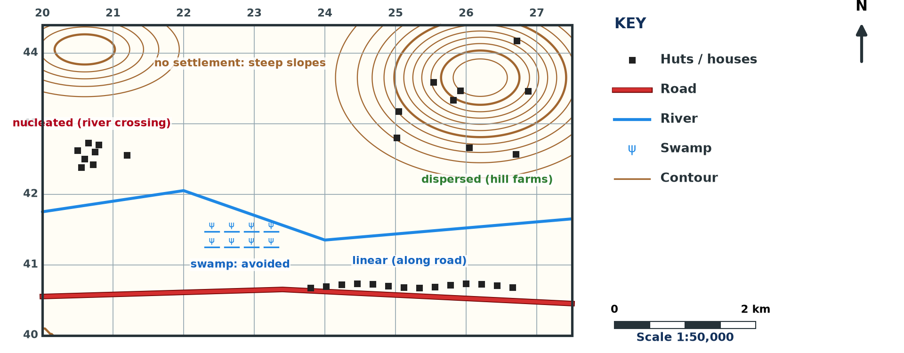
1. TYPES, FORMS AND PATTERNS
Activity 1
Settlements on a map (invented).
Notes:
Activity 1. Look carefully at this diagram: settlements on a map (invented). Observe every detail before I ask the question.

Slide 20
1. TYPES, FORMS AND PATTERNS
Activity 1: Question
Identify two settlement patterns on the extract.
Notes:
Here is the question for Activity 1: Identify two settlement patterns on the extract. Take one minute to think and write your answer in your rough notebook.

Slide 21
1. TYPES, FORMS AND PATTERNS
Activity 1: Answer
A linear pattern along the road and a dispersed pattern on the hills.
Notes:
Let us check the answer together. A linear pattern along the road and a dispersed pattern on the hills.

Slide 22
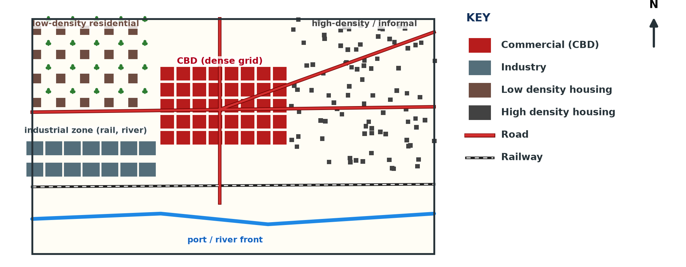
1. SIZES
Activity 2
A town on a map (invented).
Notes:
Activity 2. Look carefully at this diagram: a town on a map (invented). Observe every detail before I ask the question.

Slide 23
1. SIZES
Activity 2: Question
How do we recognise a town on a map?
Notes:
Here is the question for Activity 2: How do we recognise a town on a map? Take one minute to think and write your answer in your rough notebook.

Slide 24
1. SIZES
Activity 2: Answer
A large built-up area with many streets and services symbols.
Notes:
Let us check the answer together. A large built-up area with many streets and services symbols.

Slide 25
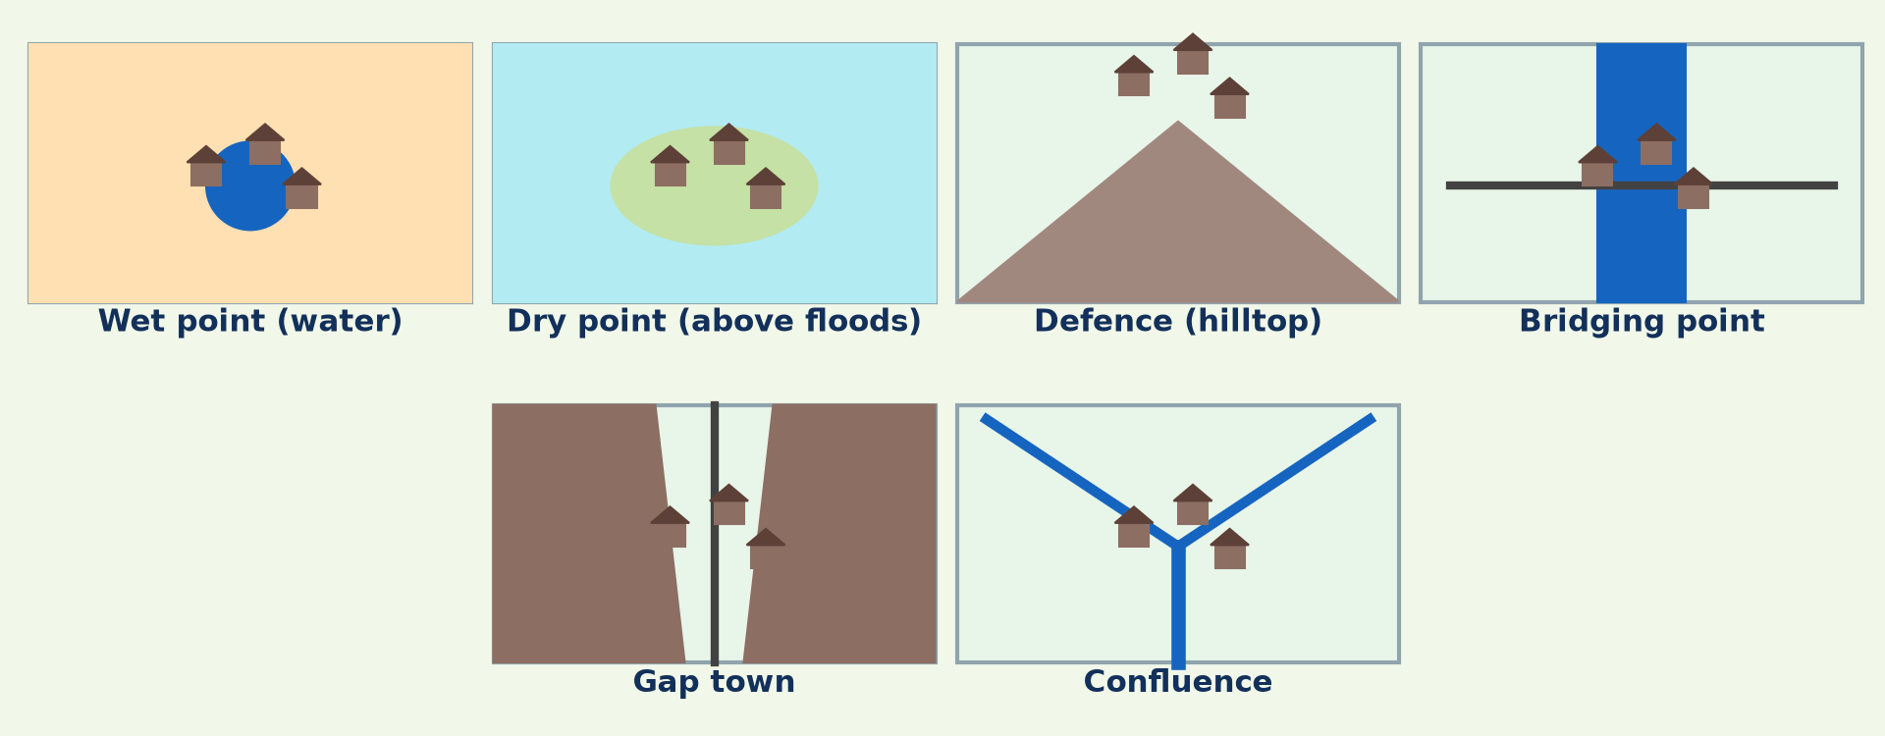
2. SITE AND SITUATION
Activity 3
Types of sites.
Notes:
Activity 3. Look carefully at this diagram: types of sites. Observe every detail before I ask the question.

Slide 26
2. SITE AND SITUATION
Activity 3: Question
Describe the site of the town on the extract.
Notes:
Here is the question for Activity 3: Describe the site of the town on the extract. Take one minute to think and write your answer in your rough notebook.

Slide 27
2. SITE AND SITUATION
Activity 3: Answer
On flat land at a bridging point of the river, above the flood plain.
Notes:
Let us check the answer together. On flat land at a bridging point of the river, above the flood plain.

Slide 28

3. FUNCTIONS
Activity 4
Conventional signs.
Notes:
Activity 4. Look carefully at this diagram: conventional signs. Observe every detail before I ask the question.

Slide 29
3. FUNCTIONS
Activity 4: Question
Give two functions of the town with map evidence.
Notes:
Here is the question for Activity 4: Give two functions of the town with map evidence. Take one minute to think and write your answer in your rough notebook.

Slide 30
3. FUNCTIONS
Activity 4: Answer
Administrative (post office, offices) and transport (railway station, road junction).
Notes:
Let us check the answer together. Administrative (post office, offices) and transport (railway station, road junction).

Slide 31

4. SKETCH MAP
Activity 5
Elements of a sketch map.
Notes:
Activity 5. Look carefully at this diagram: elements of a sketch map. Observe every detail before I ask the question.

Slide 32
4. SKETCH MAP
Activity 5: Question
What must a settlement sketch map show?
Notes:
Here is the question for Activity 5: What must a settlement sketch map show? Take one minute to think and write your answer in your rough notebook.

Slide 33
4. SKETCH MAP
Activity 5: Answer
The town and villages, rivers, main routes and relief, with a title, key and north arrow.
Notes:
Let us check the answer together. The town and villages, rivers, main routes and relief, with a title, key and north arrow.

Slide 34
BOARD SUMMARY
Board Summary
Topic: Initiation to Map Analysis
Sub-topic: Map Interpretation
Practical Work 5: Settlements on Maps
Notes:
Now we are going to copy the board summary. Write the title and the headings neatly in your notebooks. I will give you enough time for each slide, so do not rush.

Slide 35
BOARD SUMMARY
1. Types, Forms, Patterns and Sizes
Settlements on maps are described as follows:
Types and sizes: Isolated houses, villages and towns are identified by size and symbols.
Forms: Settlements may be linear, star-shaped, cruciform or compact.
Notes:
Let us copy Types, Forms, Patterns and Sizes. Settlements on maps are described as follows. On this slide we have Types and sizes and Forms. Write each point on a new line, with the key term first, and explain it in your own words when we revise. When you finish, we go to the next slide.

Slide 36
BOARD SUMMARY
1. Types, Forms, Patterns and Sizes (continued)
Patterns: Settlements may be nucleated, dispersed or linear.
Notes:
We continue with Types, Forms, Patterns and Sizes. On this slide we have Patterns. Write each point on a new line, with the key term first, and explain it in your own words when we revise.

Slide 37
BOARD SUMMARY
1. Types, Forms, Patterns and Sizes
Illustration: settlements on a map
Notes:
Now draw this illustration in your notebook: settlements on a map. Give it a title and label it clearly.

Slide 38
BOARD SUMMARY
2. Site, Situation and Functions
Site, situation and functions are interpreted as follows:
Site: We describe the relief, drainage and soils of the land the town is on.
Situation: We describe the routes, rivers and other settlements around it.
Notes:
Let us copy Site, Situation and Functions. Site, situation and functions are interpreted as follows. On this slide we have Site and Situation. Write each point on a new line, with the key term first, and explain it in your own words when we revise. When you finish, we go to the next slide.

Slide 39
BOARD SUMMARY
2. Site, Situation and Functions (continued)
Functions: Symbols such as schools, churches, stations and markets give evidence of functions.
Sketch map: We draw the main settlements, routes and rivers with a frame, title, key and north arrow.
Notes:
We continue with Site, Situation and Functions. On this slide we have Functions and Sketch map. Write each point on a new line, with the key term first, and explain it in your own words when we revise.

Slide 40
FORMATIVE EVALUATION
Evaluation 1
Give two patterns of settlements with map evidence.
Notes:
Now let us check what you have understood. Question 1: Give two patterns of settlements with map evidence. Answer in your exercise book.

Slide 41
FORMATIVE EVALUATION
Expected Answer
Linear along the road; dispersed on the hills.
Notes:
The expected answer is: linear along the road; dispersed on the hills. If you got it right, well done.

Slide 42
FORMATIVE EVALUATION
Evaluation 2
Give one function of a town and its evidence.
Notes:
Now let us check what you have understood. Question 2: Give one function of a town and its evidence. Answer in your exercise book.

Slide 43
FORMATIVE EVALUATION
Expected Answer
Transport: a railway station symbol.
Notes:
The expected answer is: transport: a railway station symbol. If you got it right, well done.

Slide 44
REMEDIATION
Remediation
Fill in the blanks:
A settlement at a river crossing is at a ______ point.
Scattered huts show a ______ pattern.
A railway station shows a ______ function.
Notes:
For those who need more practice, fill in the blanks in your exercise book. The answers are: number 1, bridging; number 2, dispersed; number 3, transport.

Slide 45
HOMEWORK
Homework
Draw a sketch map showing the site, situation and functions of the main town on a map extract.
Notes:
For your homework: Draw a sketch map showing the site, situation and functions of the main town on a map extract. We shall correct it at the beginning of our next lesson.

Slide 46
NEXT LESSON
Next Lesson
Our next lesson will be on:
Lesson 52: Settlements in Cameroon
Notes:
Our next lesson will be on Lesson 52: Settlements in Cameroon. Thank you for your attention, and see you next time.

Slide 47
BILINGUAL GAME
Bilingual Game (Jeu Bilingue)
English | Français
Map extract | L'extrait de carte
Built-up area | La zone bâtie
Grid reference | Les coordonnées
Evidence | La preuve
Sketch map | Le croquis
Symbol | Le symbole
Notes:
Let us play the bilingual game. I say a word in English, and you give me the French word. Then we do the reverse.

Slide 48
LOGBOOK
Official Logbook (1/2)
Module / Topic | Initiation to Map Analysis
Lesson Title | Practical Work 5: Settlements on Maps
Expected Learning Outcomes | Identify and describe types, forms, patterns and sizes of settlements on a map. Describe site, situation and functions with map evidence. Draw a sketch map of settlements.
Competence | Learners are able to interpret settlements on a map and draw a sketch map.
Notes:
I record this information in the official logbook of the class after the lesson.

Slide 49
LOGBOOK
Official Logbook (2/2)
Matter Taught | Types, Forms, Patterns and Sizes; Site, Situation and Functions.
Evaluation | Formative evaluation and remediation exercise.
Homework | Draw a sketch map showing the site, situation and functions of the main town on a map extract.
Enrolment / Present / Absent | ____ / ____ / ____
Achievement | To be completed after the lesson.
Notes:
I complete the second page of the logbook: the matter taught, the evaluation, the homework and the attendance.

Slide 50
TEACHER'S NOTE
Teacher's Note
Timing: Homework correction, plan, objectives 8 min | Recall, situation, action 10 min | 5 activities 30 min | Board summary (copying) 30 min | Evaluation, remediation 10 min | Homework, next lesson 5 min | Logbook 7 min
Without the projector (Activity 1): use a map.
Without the projector (Activity 2): describe.
Without the projector (Activity 3): describe.
Without the projector (Activity 4): use the key.
Without the projector (Activity 5): draw.
Notes:
This slide is for me, the teacher: it gives the timing of the lesson and what to do if the projector is not available.

Slide 51
REFERENCES
References
Geography Syllabus, Forms I–V, MINESEC (2023) — Form 5, Module III: Management of Population Growth and Space Colonisation.
Diagrams and animations: drawn for this lesson (Geography Department).
Notes:
These are the references and picture credits used to prepare this lesson.

