Slide 1
LOWER SIXTH ARTS
GEOGRAPHY
Lesson 1
The Meaning and Composition of the Atmosphere
Notes:
Good morning, class, and welcome to our geography lesson. I am your geography teacher, Mr Kamdem. Today we are starting Lesson 1: The Meaning and Composition of the Atmosphere.

Slide 2
CLASS INFO
Class, Chapter and Duration
Class | Lower Sixth Arts
Chapter | Module 1: Understanding and managing atmospheric and hydrological phenomena and hazards across the world in general and Cameroon in particular
Duration | 2 periods (2 × 50 minutes)
Notes:
This lesson is for Lower Sixth Arts. It belongs to Module 1: Understanding and managing atmospheric and hydrological phenomena and hazards across the world in general and Cameroon in particular. We shall need 2 periods to cover it.

Slide 3
IDENTIFICATION
Lesson Identification
Topic | The Atmosphere as a Centre of Weather and Climate
Sub-topic | The Atmosphere
Lesson | Lesson 1: The Meaning and Composition of the Atmosphere
Notions / Concepts | Atmosphere, constant gases, variable gases, water vapour, greenhouse gas, ozone, aerosols, condensation nuclei, Harmattan haze.
Syllabus focus | Meaning and importance of the atmosphere; gaseous components (constant and variable gases); aerosols (liquid and solid) and their role.
Competence | Learners are able to describe the composition of the atmosphere and explain local phenomena such as the Harmattan haze.
Notes:
Our topic is The Atmosphere as a Centre of Weather and Climate, and the sub-topic is The Atmosphere. The key notions we shall use today are: atmosphere, constant gases, variable gases, water vapour, greenhouse gas, ozone, aerosols, condensation nuclei, Harmattan haze. At the end, you should be able to do this: learners are able to describe the composition of the atmosphere and explain local phenomena such as the Harmattan haze.

Slide 4

LESSON PLAN
Lesson Plan
Objectives and recall
Real-life situation and action to take
Learning activities
Board summary
Evaluation, remediation and homework
Notes:
Here is the plan of our lesson today. First, we shall look at the objectives and recall what you already know. After that, we shall study a situation from real life and the action to take, and do the learning activities. Finally, we shall copy the board summary, do the evaluation and the remediation, and I will give you the homework.

Slide 5
OBJECTIVES
Objectives
By the end of this lesson, you should be able to:
Define the atmosphere and explain its importance.
Distinguish constant and variable gases with examples.
Notes:
Take your time to copy this part; we will continue together.

Slide 6
OBJECTIVES
Objectives (continued)
Describe liquid and solid aerosols and their sources.
Explain the role of aerosols in weather.
Notes:
By the end of this lesson, you should be able to do four things. Number 1: define the atmosphere and explain its importance. Number 2: distinguish constant and variable gases with examples. Number 3: describe liquid and solid aerosols and their sources. Number 4: explain the role of aerosols in weather.

Slide 7
PREVIOUS KNOWLEDGE
Previous Knowledge
The Harmattan is a dry, dusty wind from the Sahara.
Plants need carbon dioxide.
We breathe oxygen.
Notes:
Let us first remember what you already know. The Harmattan is a dry, dusty wind from the Sahara. Plants need carbon dioxide. We breathe oxygen. Keep this in mind, because we shall build on it today.

Slide 8
REAL-LIFE SITUATION
Situation in Real Life
On a January morning in Garoua, you go outside and notice that the sky is not clear blue but hazy and whitish.
The air is very dry and fine dust covers cars and leaves.
Yet everyone breathes normally.
Notes:
Take your time to copy this part; we will continue together.

Slide 9
REAL-LIFE SITUATION
Situation in Real Life (continued)
You ask: "What is the air made of, what makes the sky hazy, and why can we still breathe despite the dust?"
Notes:
Listen carefully to this situation from real life. On a January morning in Garoua, you go outside and notice that the sky is not clear blue but hazy and whitish. The air is very dry and fine dust covers cars and leaves. Yet everyone breathes normally. You ask: "What is the air made of, what makes the sky hazy, and why can we still breathe despite the dust?" Think about it, because I am going to ask you some questions.

Slide 10
REAL-LIFE SITUATION
Situation: Question 1
What is the problem in the situation?
Notes:
Question 1: What is the problem in the situation? Think for a moment, then raise your hand to answer.

Slide 11
REAL-LIFE SITUATION
Answer
The learner does not know the composition of the atmosphere.
Notes:
Good. The learner does not know the composition of the atmosphere.

Slide 12
REAL-LIFE SITUATION
Situation: Question 2
What makes the sky hazy in January?
Notes:
Question 2: What makes the sky hazy in January? Think for a moment, then raise your hand to answer.

Slide 13
REAL-LIFE SITUATION
Answer
Millions of dust particles (solid aerosols) carried by the Harmattan from the Sahara.
Notes:
Good. Millions of dust particles (solid aerosols) carried by the Harmattan from the Sahara.

Slide 14
REAL-LIFE SITUATION
Situation: Question 3
Why can we still breathe normally?
Notes:
Question 3: Why can we still breathe normally? Think for a moment, then raise your hand to answer.

Slide 15
REAL-LIFE SITUATION
Possible Answer
Oxygen is a constant gas: it stays at about 21 % even when dust and vapour change.
Notes:
Good. Oxygen is a constant gas: it stays at about 21 % even when dust and vapour change.

Slide 16
ACTION TO TAKE
Action to Take
Reduce smoke and dust pollution, and protect yourself during strong Harmattan haze.
Notes:
From this situation, the action we are working towards in this lesson is the following: reduce smoke and dust pollution, and protect yourself during strong Harmattan haze.

Slide 17
JUSTIFICATION
Justification of the Lesson
This lesson helps us to understand the air around us, the weather it produces and the pollution that threatens it.
Notes:
Why is this lesson important for you? This lesson helps us to understand the air around us, the weather it produces and the pollution that threatens it.

Slide 18
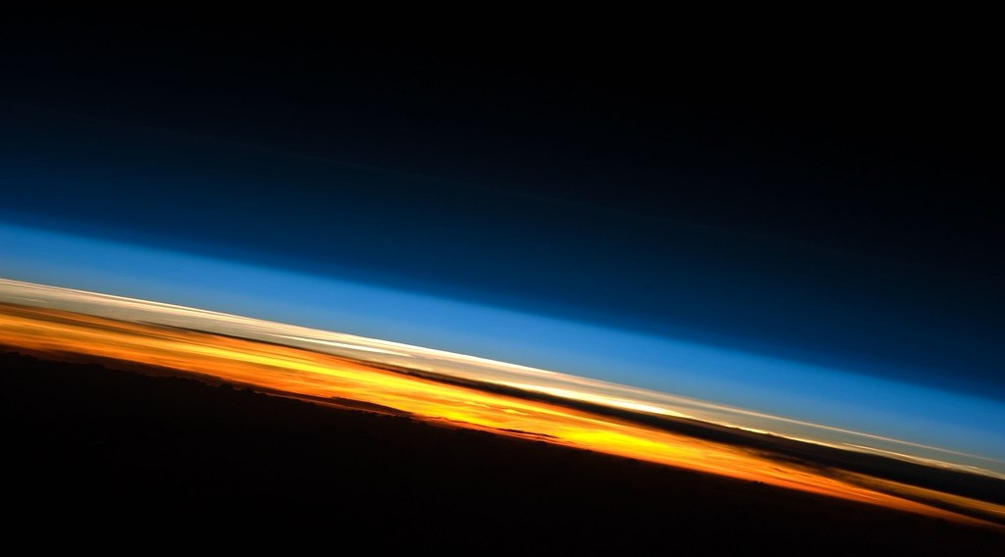
1. MEANING
Activity 1
The thin atmosphere seen from space.
Notes:
Activity 1. Look carefully at this picture: the thin atmosphere seen from space. Observe every detail before I ask the question.

Slide 19
1. MEANING
Activity 1: Question
What holds the atmosphere around the Earth?
Notes:
Here is the question for Activity 1: What holds the atmosphere around the Earth? Take one minute to think and write your answer in your rough notebook.

Slide 20
1. MEANING
Activity 1: Answer
The gravity of the Earth.
Notes:
Let us check the answer together. The gravity of the Earth.

Slide 21
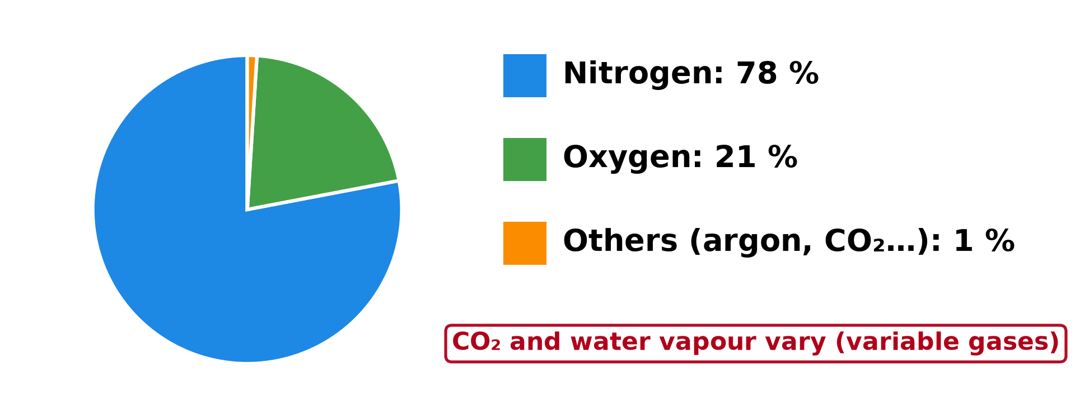
2. GASES
Activity 2
The gases of the air.
Notes:
Activity 2. Look carefully at this diagram: the gases of the air. Observe every detail before I ask the question.

Slide 22
2. GASES
Activity 2: Question
Which gas makes up about 78 % of the air?
Notes:
Here is the question for Activity 2: Which gas makes up about 78 % of the air? Take one minute to think and write your answer in your rough notebook.

Slide 23
2. GASES
Activity 2: Answer
Nitrogen.
Notes:
Let us check the answer together. Nitrogen.

Slide 24
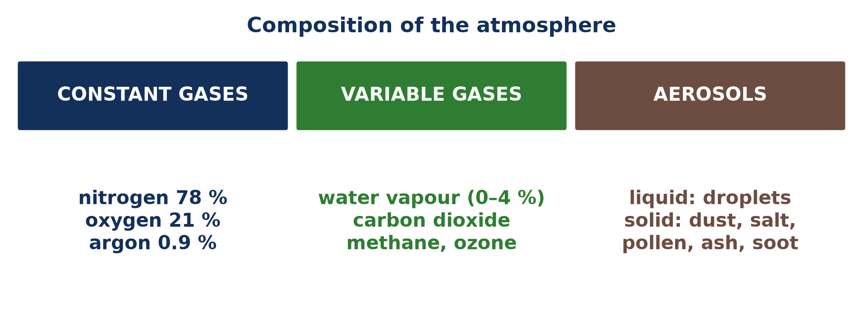
2. GASES
Activity 3
Constant gases, variable gases and aerosols.
Notes:
Activity 3. Look carefully at this picture: constant gases, variable gases and aerosols. Observe every detail before I ask the question.

Slide 25
2. GASES
Activity 3: Question
Why is water vapour called a variable gas?
Notes:
Here is the question for Activity 3: Why is water vapour called a variable gas? Take one minute to think and write your answer in your rough notebook.

Slide 26
2. GASES
Activity 3: Answer
Its amount changes from almost 0 % in deserts to about 4 % in the humid tropics.
Notes:
Let us check the answer together. Its amount changes from almost 0 % in deserts to about 4 % in the humid tropics.

Slide 27

3. AEROSOLS
Activity 4
Dust in the air.
Notes:
Activity 4. Look carefully at this picture: dust in the air. Observe every detail before I ask the question.

Slide 28
3. AEROSOLS
Activity 4: Question
Where does the Harmattan dust come from?
Notes:
Here is the question for Activity 4: Where does the Harmattan dust come from? Take one minute to think and write your answer in your rough notebook.

Slide 29
3. AEROSOLS
Activity 4: Answer
From the Sahara Desert.
Notes:
Let us check the answer together. From the Sahara Desert.

Slide 30

3. AEROSOLS
Activity 5
Fog.
Notes:
Activity 5. Look carefully at this picture: fog. Observe every detail before I ask the question.

Slide 31
3. AEROSOLS
Activity 5: Question
Why are aerosols important for clouds and fog?
Notes:
Here is the question for Activity 5: Why are aerosols important for clouds and fog? Take one minute to think and write your answer in your rough notebook.

Slide 32
3. AEROSOLS
Activity 5: Answer
Water vapour condenses on them: they act as condensation nuclei.
Notes:
Let us check the answer together. Water vapour condenses on them: they act as condensation nuclei.

Slide 33
BOARD SUMMARY
Board Summary
Topic: The Atmosphere as a Centre of Weather and Climate
Sub-topic: The Atmosphere
Lesson 1: The Meaning and Composition of the Atmosphere
Notes:
Now we are going to copy the board summary. Write the title and the headings neatly in your notebooks. I will give you enough time for each slide, so do not rush.

Slide 34
BOARD SUMMARY
DEFINITIONS
The key terms of this lesson are defined as follows:
Atmosphere: It is the thin layer of gases held around the Earth by gravity.
Constant gases: They are gases whose proportions in the air remain almost the same everywhere.
Notes:
Let us copy the definitions. The key terms of this lesson are defined as follows. On this slide we have Atmosphere and Constant gases. Write each point on a new line, with the key term first, and explain it in your own words when we revise. When you finish, we go to the next slide.

Slide 35
BOARD SUMMARY
DEFINITIONS (continued)
Variable gases: They are gases whose amounts change with place, time and season.
Aerosols: They are tiny solid or liquid particles suspended in the air.
Notes:
We continue with the definitions. On this slide we have Variable gases and Aerosols. Write each point on a new line, with the key term first, and explain it in your own words when we revise.

Slide 36
BOARD SUMMARY
1. Meaning of the Atmosphere
The atmosphere is explained as follows:
The atmosphere: The atmosphere is the envelope of gases, water and tiny particles that surrounds the Earth and is held to it by gravity. It rotates with the Earth and reaches about 1,000 km in height, but half of its mass lies below 5.5 km. It is in this layer of air that all weather and climate take place.
Illustration: the atmosphere seen from space
Notes:
Let us copy Meaning of the Atmosphere. The atmosphere is explained as follows. Copy the point on The atmosphere on the left, then draw the diagram on the right: the atmosphere seen from space. Give it a title and label it clearly.

Slide 37
BOARD SUMMARY
2. The Gaseous Components
A) Constant Gases
The constant gases of the atmosphere are the following:
Nitrogen (about 78 %): Nitrogen is the most abundant gas of the atmosphere and its proportion hardly changes. It dilutes oxygen, and bacteria in the soil fix it so that plants can use it to grow.
Illustration: the gases of the atmosphere
Notes:
Let us copy Constant Gases. The constant gases of the atmosphere are the following. Copy the point on Nitrogen (about 78 %) on the left, then draw the diagram on the right: the gases of the atmosphere. Give it a title and label it clearly.

Slide 38
BOARD SUMMARY
2. The Gaseous Components
A) Constant Gases
Oxygen (about 21 %): Oxygen is the second constant gas and is renewed by the photosynthesis of plants. It is needed by people and animals to breathe and by fire to burn.
Notes:
We continue with Constant Gases. Copy the point on Oxygen (about 21 %): write the key term first, then its explanation.

Slide 39
BOARD SUMMARY
2. The Gaseous Components
A) Constant Gases
Argon (about 0.9 %): Argon is an inert gas, which means that it does not react with other substances. Its amount stays the same everywhere, and it has almost no role in weather.
Notes:
We continue with Constant Gases. Copy the point on Argon (about 0.9 %): write the key term first, then its explanation.

Slide 40
BOARD SUMMARY
2. The Gaseous Components
B) Variable Gases
The variable gases of the atmosphere are the following:
Water vapour (0 to 4 %): Water vapour varies from almost nothing over deserts to about 4 % over hot oceans and forests. It forms clouds and rain and keeps the Earth warm by absorbing heat.
Illustration: constant and variable gases
Notes:
Let us copy Variable Gases. The variable gases of the atmosphere are the following. Copy the point on Water vapour (0 to 4 %) on the left, then draw the diagram on the right: constant and variable gases. Give it a title and label it clearly.

Slide 41
BOARD SUMMARY
2. The Gaseous Components
B) Variable Gases
Carbon dioxide (about 0.04 %): Carbon dioxide is released by breathing, burning and volcanoes and is used by plants for photosynthesis. Its amount is rising because of fuels and bush fires, which strengthens the greenhouse effect.
Notes:
We continue with Variable Gases. Copy the point on Carbon dioxide (about 0.04 %): write the key term first, then its explanation.

Slide 42
BOARD SUMMARY
2. The Gaseous Components
B) Variable Gases
Methane: Methane comes from swamps, rice fields, cattle and rotting waste. It exists in small amounts but traps heat much more strongly than carbon dioxide.
Notes:
We continue with Variable Gases. Copy the point on Methane: write the key term first, then its explanation.

Slide 43
BOARD SUMMARY
2. The Gaseous Components
B) Variable Gases
Ozone: Ozone is concentrated in the stratosphere, between about 15 and 35 km. It absorbs the harmful ultraviolet rays of the Sun and so protects life on Earth.
Notes:
We continue with Variable Gases. Copy the point on Ozone: write the key term first, then its explanation.

Slide 44
BOARD SUMMARY
3. Aerosols (Particulates)
A) Liquid Aerosols
The liquid aerosols of the atmosphere are the following:
Water droplets: Tiny droplets of water, formed by condensation, make up clouds, fog and mist. They reflect sunlight and, when they grow large enough, fall as drizzle or rain.
Illustration: fog
Notes:
Let us copy Liquid Aerosols. The liquid aerosols of the atmosphere are the following. Copy the point on Water droplets on the left, then draw the diagram on the right: fog. Give it a title and label it clearly.

Slide 45
BOARD SUMMARY
3. Aerosols (Particulates)
A) Liquid Aerosols
Acid droplets: Droplets of sulphuric and nitric acid form from gases given off by volcanoes, factories and vehicles. They make the sky hazy and fall as acid rain that damages plants and buildings.
Notes:
We continue with Liquid Aerosols. Copy the point on Acid droplets: write the key term first, then its explanation.

Slide 46
BOARD SUMMARY
3. Aerosols (Particulates)
B) Solid Aerosols
The solid aerosols of the atmosphere are the following:
Dust: Dust is lifted by winds from deserts and dry soils, as when the Harmattan brings Saharan dust to Garoua. It makes the sky hazy, reduces visibility and serves as nuclei on which droplets condense.
Illustration: a dust storm
Notes:
Let us copy Solid Aerosols. The solid aerosols of the atmosphere are the following. Copy the point on Dust on the left, then draw the diagram on the right: a dust storm. Give it a title and label it clearly.

Slide 47
BOARD SUMMARY
3. Aerosols (Particulates)
B) Solid Aerosols
Sea salt: Salt crystals are thrown into the air when waves break and sea spray evaporates. Because they attract water, they are among the best condensation nuclei over the oceans.
Notes:
We continue with Solid Aerosols. Copy the point on Sea salt: write the key term first, then its explanation.

Slide 48
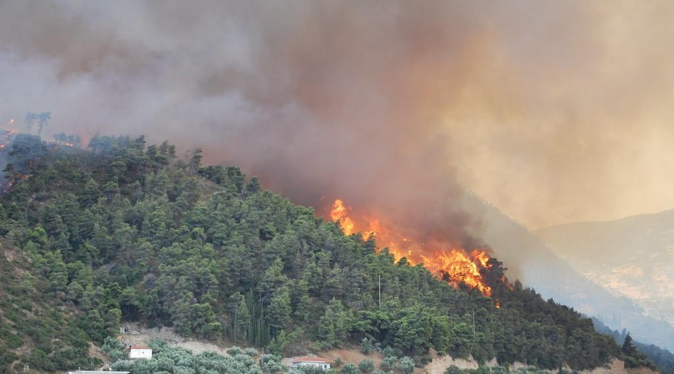
BOARD SUMMARY
3. Aerosols (Particulates)
B) Solid Aerosols
Smoke, soot and ash: They come from bush fires, factories, vehicles and volcanic eruptions. They absorb and scatter sunlight and can cool the Earth for months after a big eruption.
Illustration: smoke from a fire
Notes:
Copy the point on Smoke, soot and ash on the left, then draw the diagram on the right: smoke from a fire. Give it a title and label it clearly.

Slide 49
BOARD SUMMARY
3. Aerosols (Particulates)
B) Solid Aerosols
Pollen and spores: Plants and fungi release pollen grains and spores that are carried by the wind. They also act as condensation nuclei and cause allergies in some people.
Notes:
We continue with Solid Aerosols. Copy the point on Pollen and spores: write the key term first, then its explanation.

Slide 50
FORMATIVE EVALUATION
Evaluation 1
Distinguish a constant gas from a variable gas with one example each.
Notes:
Now let us check what you have understood. Question 1: Distinguish a constant gas from a variable gas with one example each. Answer in your exercise book.

Slide 51
FORMATIVE EVALUATION
Expected Answer
A constant gas keeps the same proportion everywhere (oxygen); a variable gas changes in amount (water vapour).
Notes:
The expected answer is: a constant gas keeps the same proportion everywhere (oxygen); a variable gas changes in amount (water vapour). If you got it right, well done.

Slide 52
FORMATIVE EVALUATION
Evaluation 2
Why are aerosols important in the formation of clouds?
Notes:
Now let us check what you have understood. Question 2: Why are aerosols important in the formation of clouds? Answer in your exercise book.

Slide 53
FORMATIVE EVALUATION
Expected Answer
Water vapour condenses on them; they act as condensation nuclei.
Notes:
The expected answer is: water vapour condenses on them; they act as condensation nuclei. If you got it right, well done.

Slide 54
REMEDIATION
Remediation
Fill in the blanks:
Nitrogen forms about ______ % of the air.
Ozone absorbs ______ radiation.
Harmattan dust is a ______ aerosol.
Notes:
For those who need more practice, fill in the blanks in your exercise book. The answers are: number 1, 78; number 2, ultraviolet; number 3, solid.

Slide 55
HOMEWORK
Homework
Name the four layers of the atmosphere.
Notes:
For your homework: Name the four layers of the atmosphere. We shall correct it at the beginning of our next lesson.

Slide 56
NEXT LESSON
Next Lesson
Our next lesson will be on:
Lesson 2: Structure of the Atmosphere
Notes:
Our next lesson will be on Lesson 2: Structure of the Atmosphere. Thank you for your attention, and see you next time.

Slide 57
BILINGUAL GAME
Bilingual Game (Jeu Bilingue)
English | Français
Atmosphere | L'atmosphère
Gas | Le gaz
Aerosol | L'aérosol
Dust | La poussière
Water vapour | La vapeur d'eau
Haze | La brume sèche
Notes:
Let us play the bilingual game. I say a word in English, and you give me the French word. Then we do the reverse.

Slide 58
LOGBOOK
Official Logbook (1/2)
Module / Topic | The Atmosphere as a Centre of Weather and Climate
Lesson Title | Lesson 1: The Meaning and Composition of the Atmosphere
Expected Learning Outcomes | Define the atmosphere and explain its importance. Distinguish constant and variable gases with examples. Describe liquid and solid aerosols and their sources. Explain the role of aerosols in weather.
Competence | Learners are able to describe the composition of the atmosphere and explain local phenomena such as the Harmattan haze.
Notes:
I record this information in the official logbook of the class after the lesson.

Slide 59
LOGBOOK
Official Logbook (2/2)
Matter Taught | DEFINITIONS; Meaning of the Atmosphere; Constant Gases; Variable Gases; Liquid Aerosols; Solid Aerosols.
Evaluation | Formative evaluation and remediation exercise.
Homework | Name the four layers of the atmosphere.
Enrolment / Present / Absent | ____ / ____ / ____
Achievement | To be completed after the lesson.
Notes:
I complete the second page of the logbook: the matter taught, the evaluation, the homework and the attendance.

Slide 60
TEACHER'S NOTE
Teacher's Note
Timing: Homework correction, plan, objectives 8 min | Recall, situation, action 10 min | 5 activities 30 min | Board summary (copying) 30 min | Evaluation, remediation 10 min | Homework, next lesson 5 min | Logbook 7 min
Without the projector (Activity 1): compare the atmosphere to a blanket.
Without the projector (Activity 2): draw the pie chart on the board.
Without the projector (Activity 3): compare January and August in Garoua.
Without the projector (Activity 4): look at dust on a car in January.
Without the projector (Activity 5): breathe on a cold glass.
Notes:
This slide is for me, the teacher: it gives the timing of the lesson and what to do if the projector is not available.

Slide 61
REFERENCES
References
Geography Syllabus for Sixth Forms (Lower and Upper Sixth), MINESEC, 2019 — Module 1 (Meteorology, Climatology & Hydrology).
Teacher's course notes: Mr KAMDEM E., Meteorology (LSA), GBHS Garoua, 2026.
Photo, Activity 1: “Sunset Over the Indian Ocean (NASA, International Space Station Scienc” by NASA's Marshall Space Flight Center, CC BY-NC 2.0, via nasa (https://www.flickr.com/photos/28634332@N05/8134997029)
Photo, Activity 4: “Sandstorm at Camp Bastion, Afghanistan” by Defence Images, CC BY-NC 2.0, via Flickr (https://www.flickr.com/photos/48399297@N04/10343833885)
Photo, Activity 5: “Mist” by Art by MarkAC, CC BY-SA 2.0, via Flickr (https://www.flickr.com/photos/60580775@N08/40783321332)
Photo, board summary (Smoke, soot and ash): “Forest Fires in Greece” by Lotus R, CC BY-SA 2.0, via Flickr (https://www.flickr.com/photos/66012345@N00/964251167)
Diagrams and animations: drawn for this lesson (Geography Department).
Notes:
These are the references and picture credits used to prepare this lesson.

